Slide 1
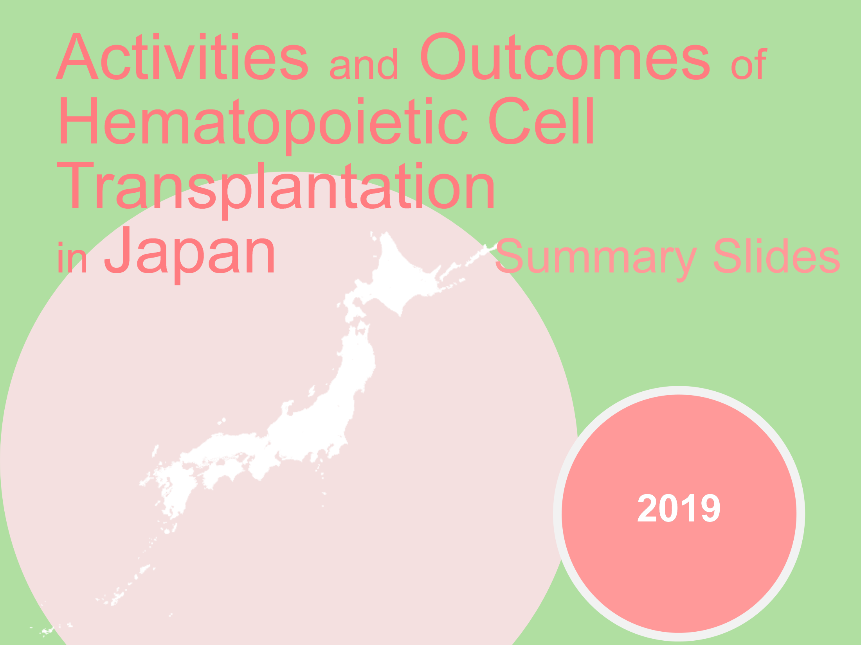
Title

Slide 2
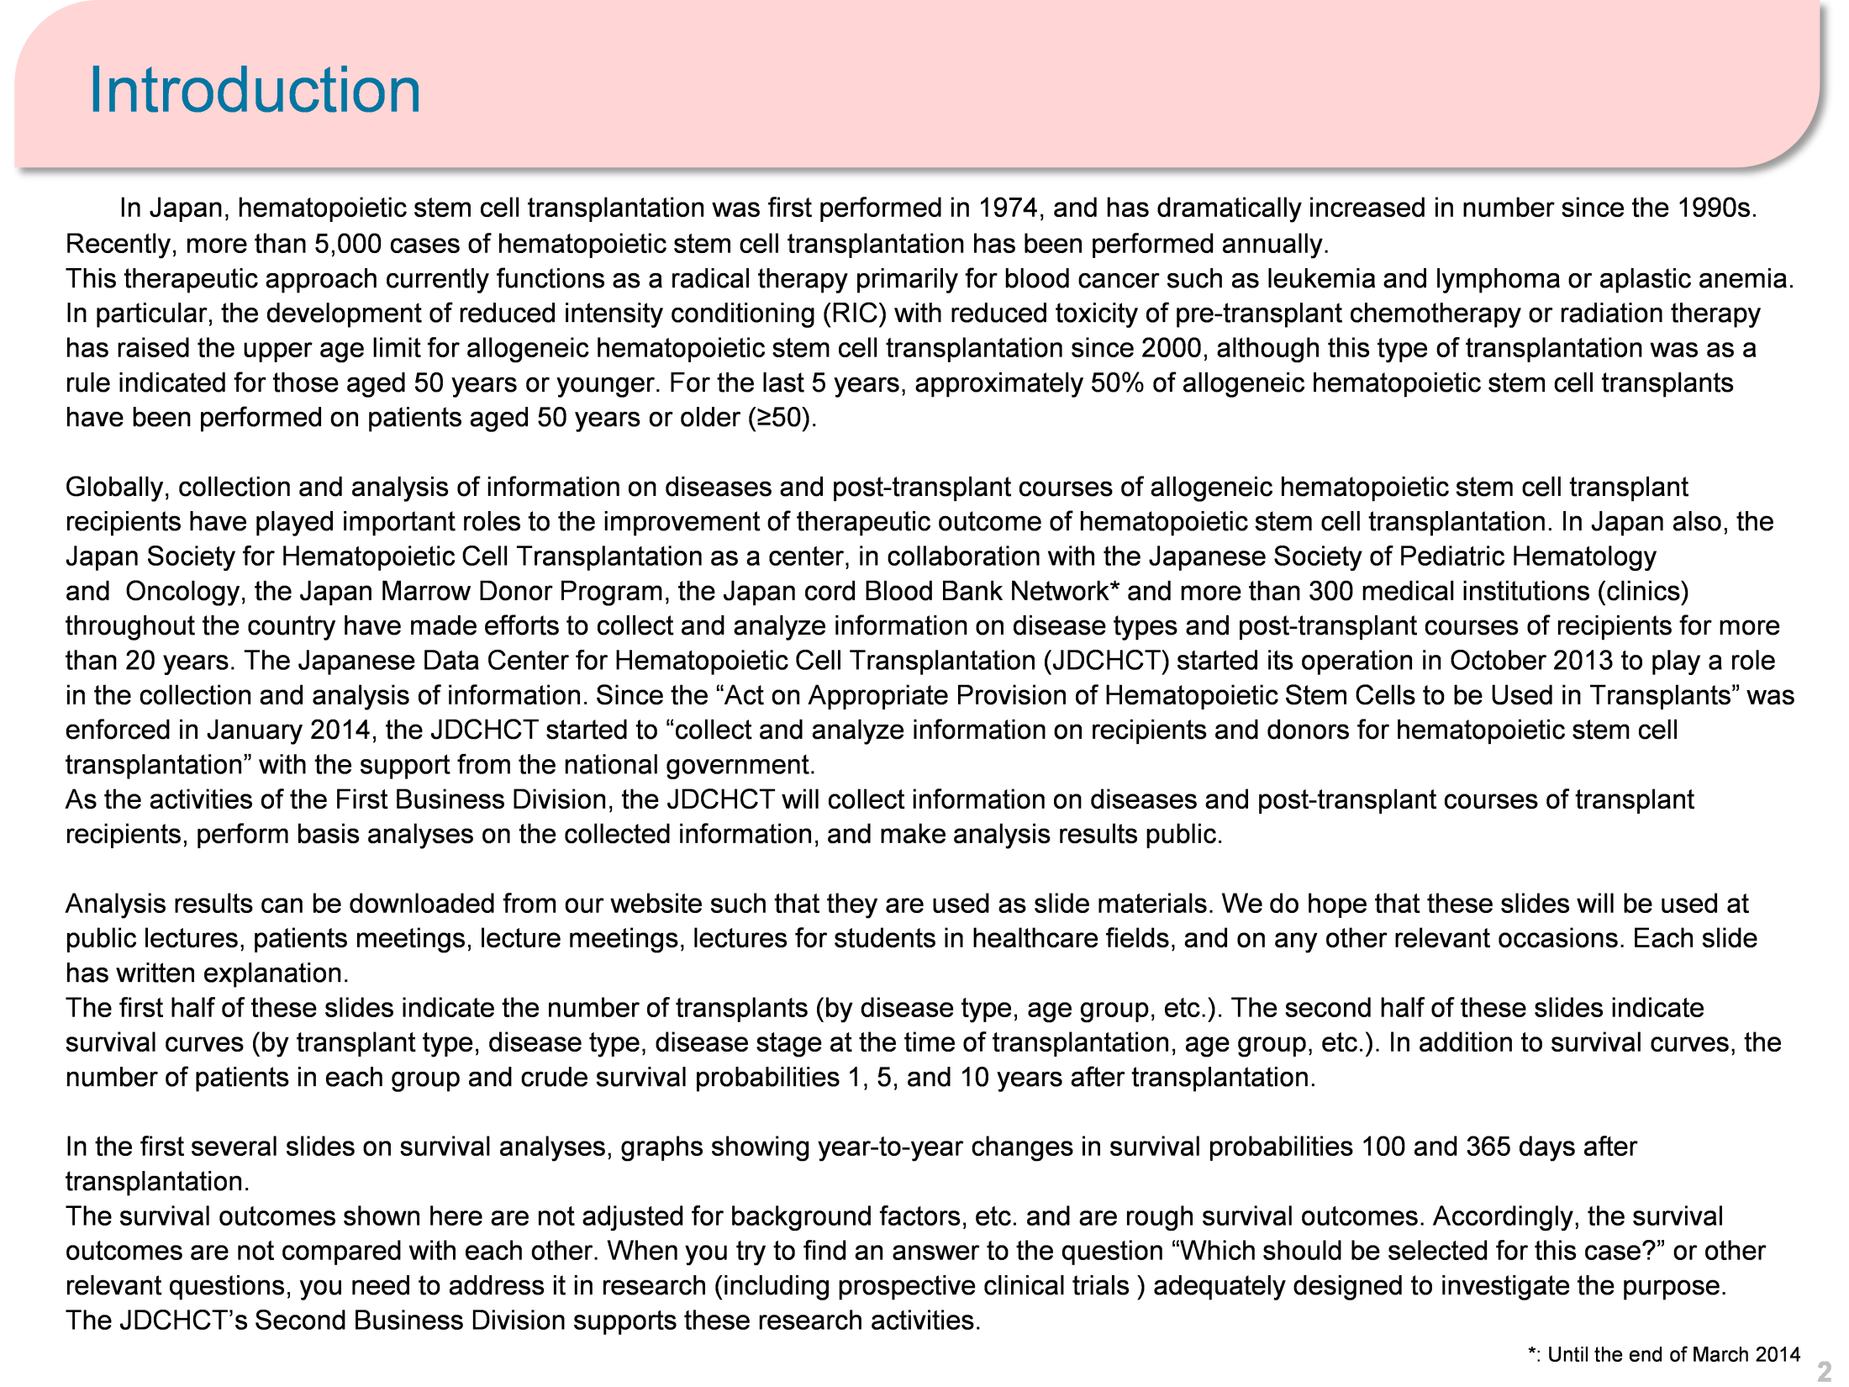
Introduction

Slide 3
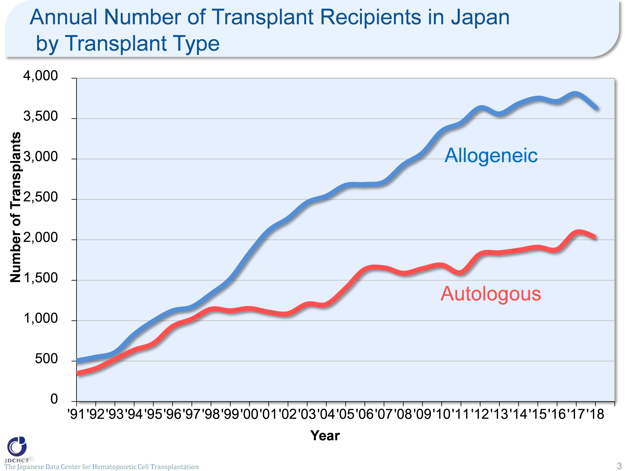

Annual Number of Transplant Recipients in the Japan by Transplant Type
The Japanese Data Center for Hematopoietic Cell Transplantation
3
Notes:
In Japan, registration for bone marrow transplantation from unrelated donors was started in 1993 and the first case of cord blood transplantation was performed in 1997. Since these times, transplantation from unrelated donors has spread and the total number of allogeneic transplant recipients has increased. Recently, the annual number of autologous and allogeneic transplants registration extends to round 5,500.

Slide 4
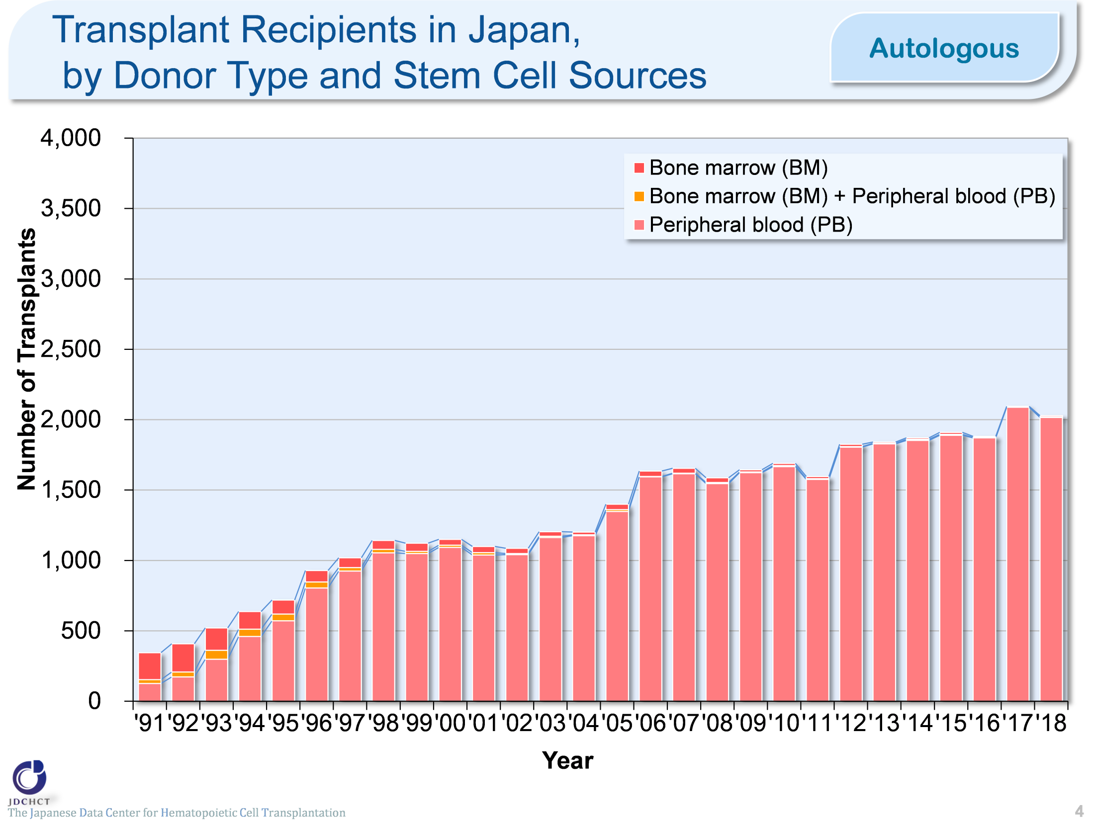
Transplant Recipients in the Japan, by Donor Type and Stem Cell Sources (Autologous)
The Japanese Data Center for Hematopoietic Cell Transplantation
Notes:
For autologous transplants, the annual number of cases registered has been approximately 1,800 for past several years, for which the stem cell source is peripheral blood in the vast majority of cases.

Slide 5
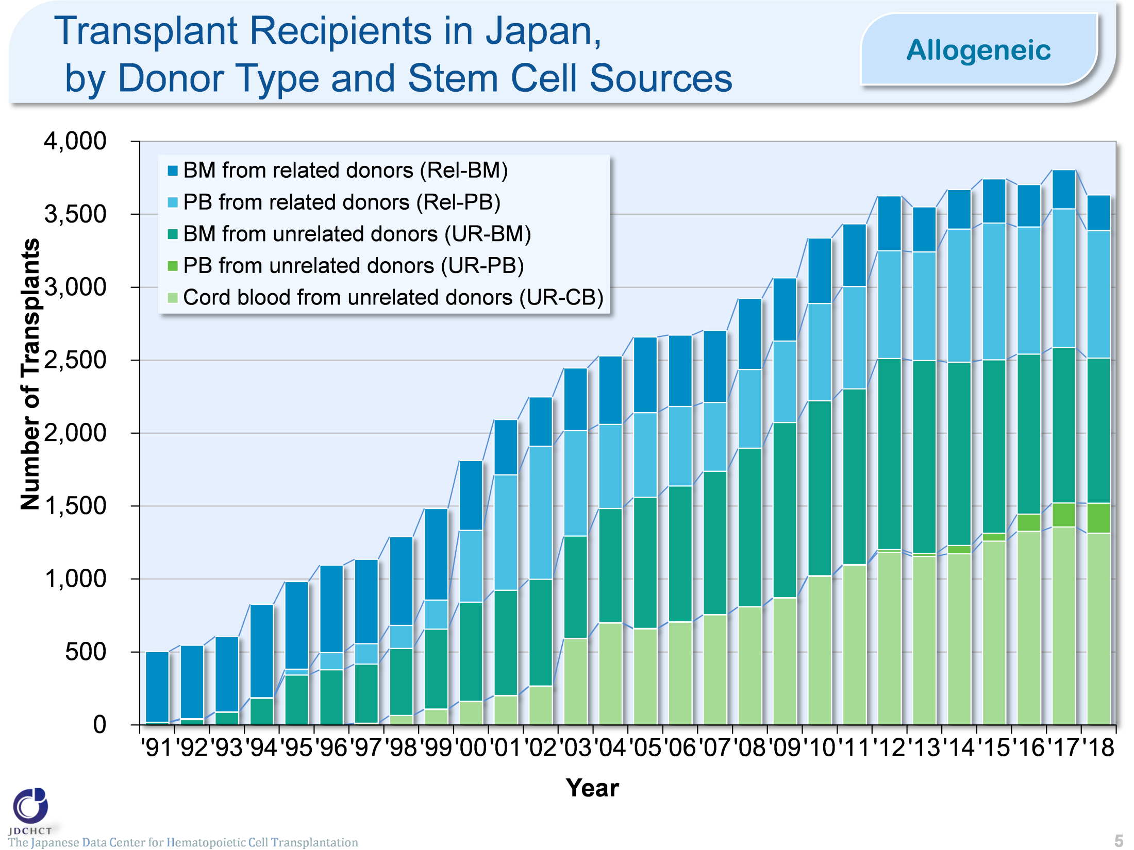
Transplant Recipients in the Japan, by Donor Type and Stem Cell Sources (Allogeneic)
The Japanese Data Center for Hematopoietic Cell Transplantation
Notes:
In Japan, since 1993 in which registration for bone marrow transplantation from unrelated donors was started and since 1997 in which the first case of cord blood transplantation was performed, transplantation from unrelated donors has spread and the total number of transplant recipients has increased. In particular, the increase in cord blood transplants is remarkable. Also, peripheral blood stem cell transplantation from unrelated donors was introduced since 2010, and the number of transplants has been gradually increased.

Slide 6
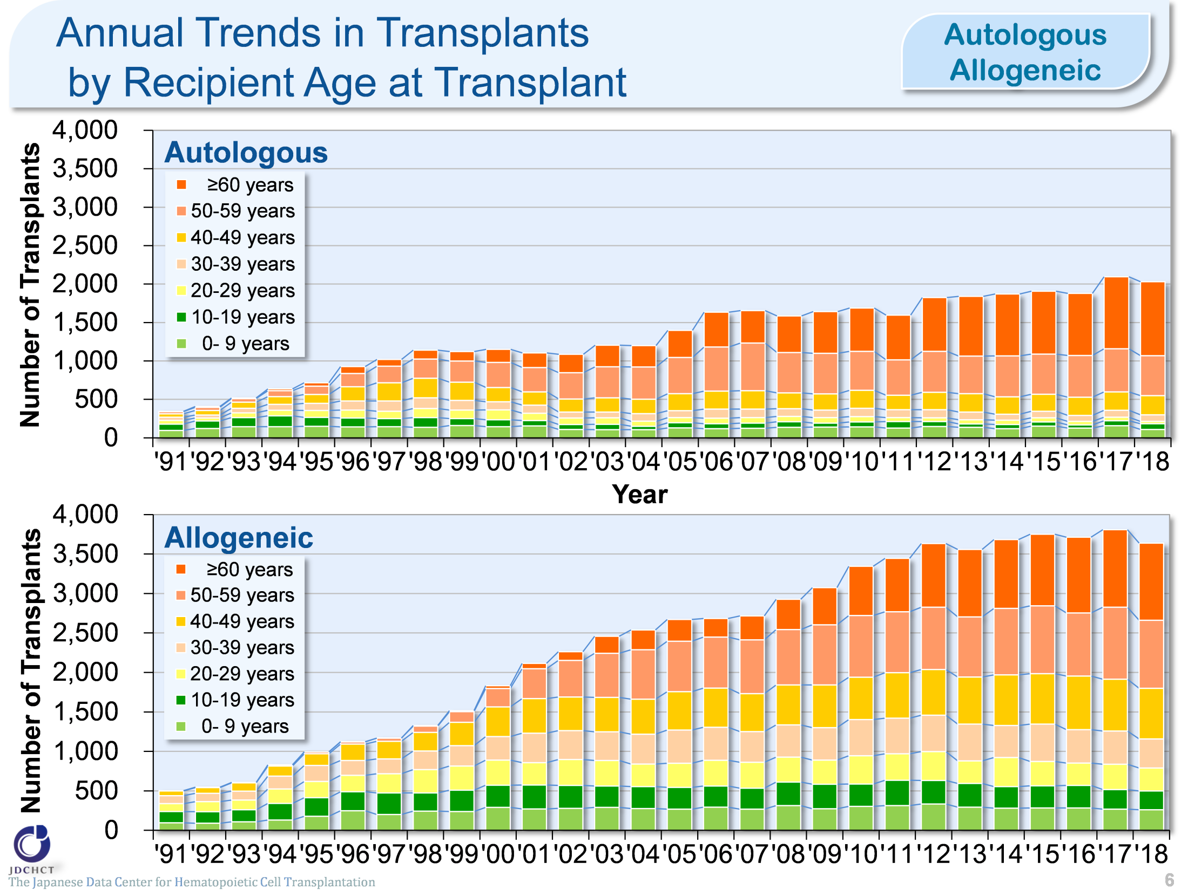
Annual Trends in Transplants by Recipient Age at Transplant (Autologous / Allogeneic)
The Japanese Data Center for Hematopoietic Cell Transplantation
6
Notes:
Due to the spread of transplants with reduced intensity conditioning (RIC), the age groups in which transplantation is indicated have expanded, and the number of transplants in older age groups has increased.

Slide 7
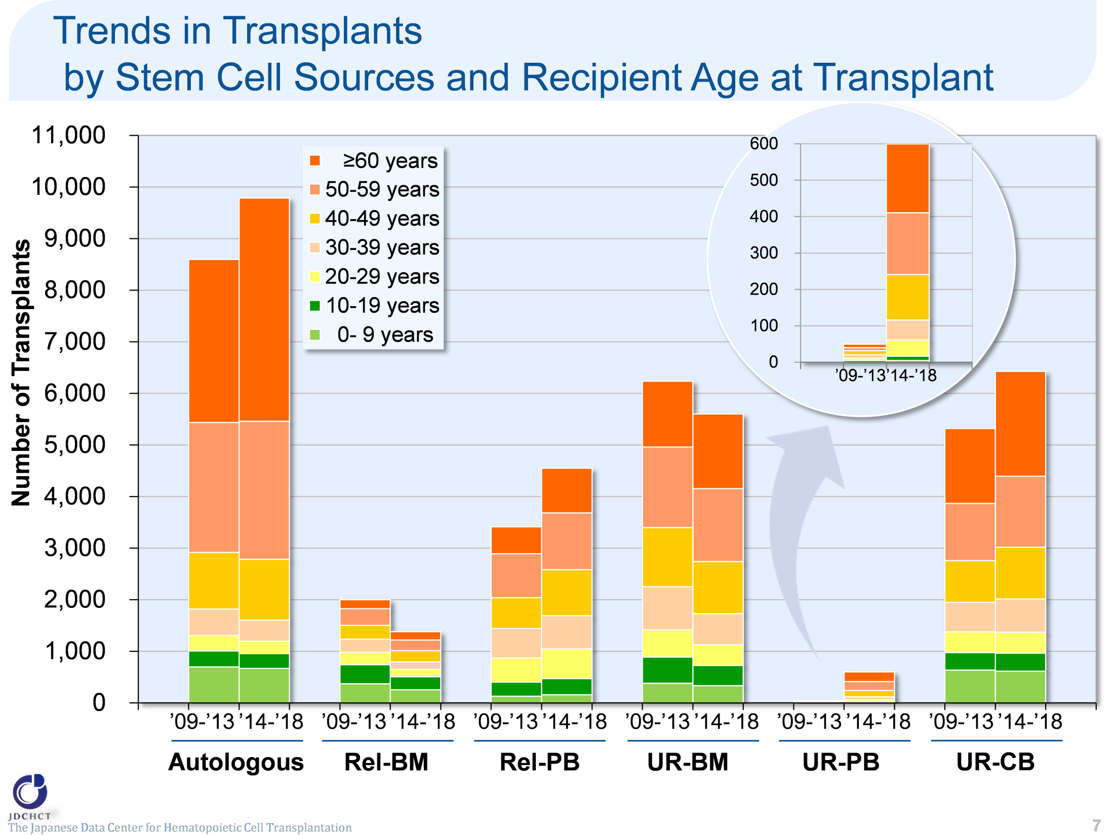
Trends in Transplants by Stem Cell Sources and Recipient Age at Transplant
The Japanese Data Center for Hematopoietic Cell Transplantation
7
Notes:
The spread of transplants with reduced intensity conditioning (RIC), has expanded the age groups in which transplantation is indicated.

Slide 8
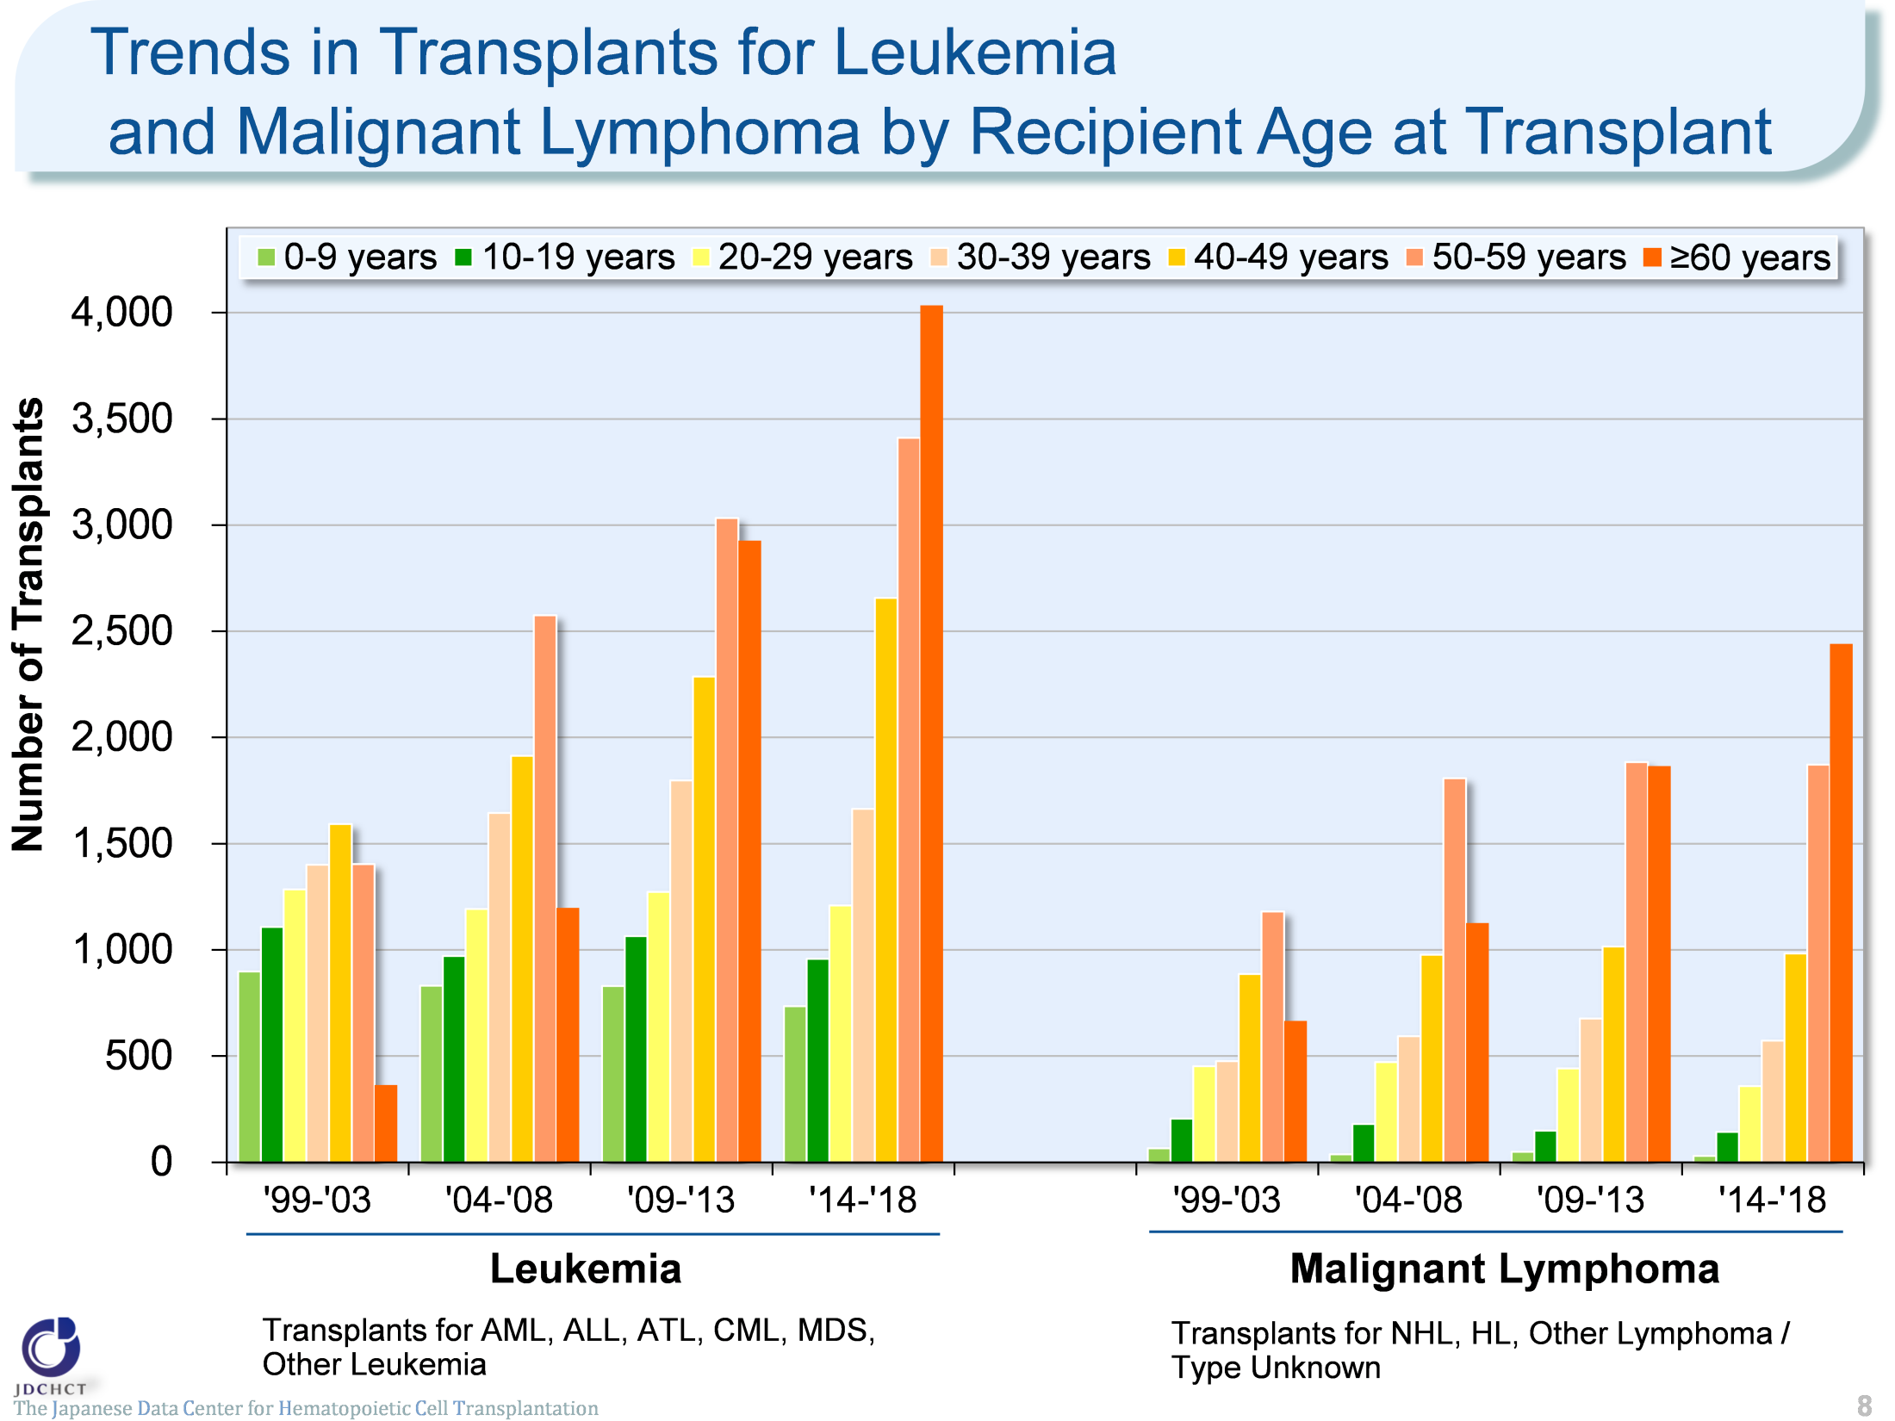
Trends in Transplants for Leukemia and Malignant Lymphoma by Recipient Age at Transplant
The Japanese Data Center for Hematopoietic Cell Transplantation
8
Notes:
The increase is specially remarkable in the elderly. In the period from 2014 to 2018, those aged 50 years or older accounted for 51% of the total cases of leukemia and 67% of the total cases of malignant lymphoma.

Slide 9
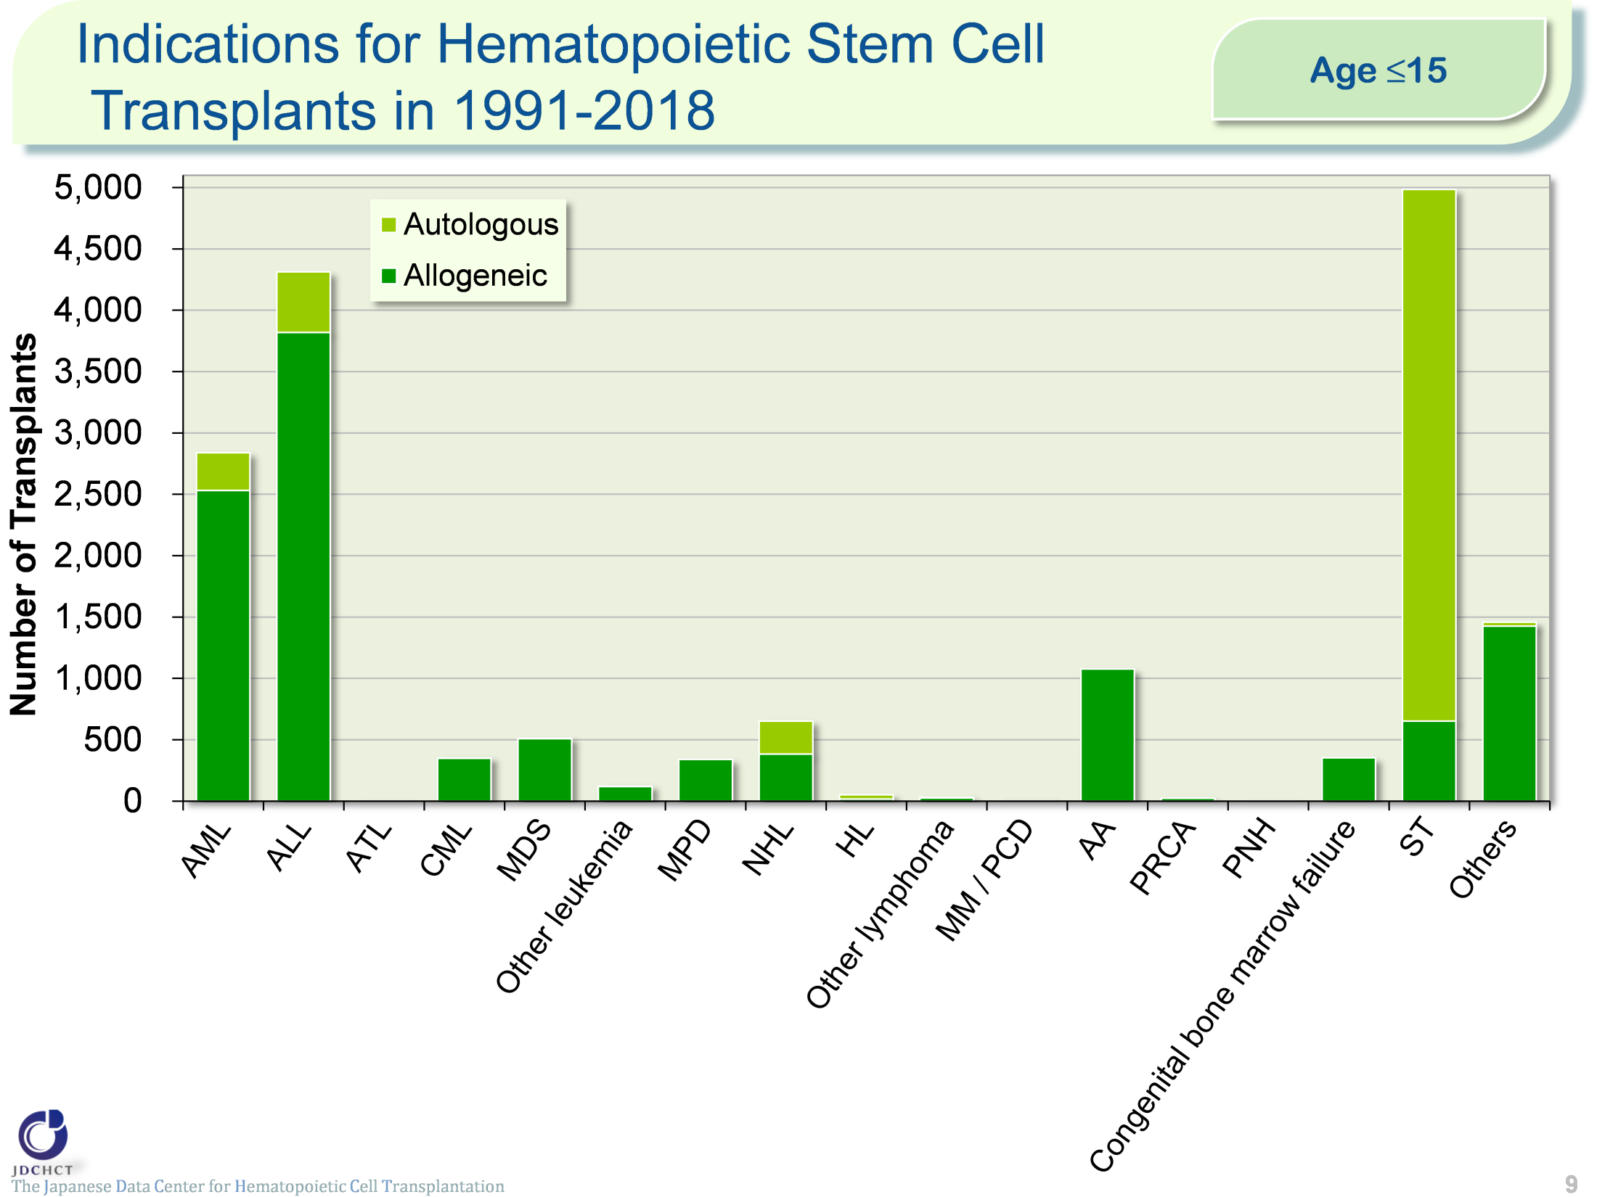
Indications for Hematopoietic Stem Cell
Transplants in 1991-2018 (Age≤15)
The Japanese Data Center for Hematopoietic Cell Transplantation
9
Notes:
In pediatric patients, allogeneic transplants are most frequently performed for acute leukemia (acute myeloid leukemia and acute lymphoid leukemia), which accounts for about 55% of the total cases of allogeneic transplantation. Following this, allogeneic transplants are also frequently performed for aplastic anemia. Although aplastic anemia is a rare disease, allogeneic transplantation is the first choice for serious and most serious cases.
Accordingly, aplastic anemia accounts for about 10% of the allogeneic transplants in pediatric patients.
For solid tumors in pediatric patients, autologous transplants are performed in order to rescue hematopoietic dysfunction due to high-dose chemotherapy and therefore, autologous transplantation accounts for 87% of the total number of transplants.

Slide 10
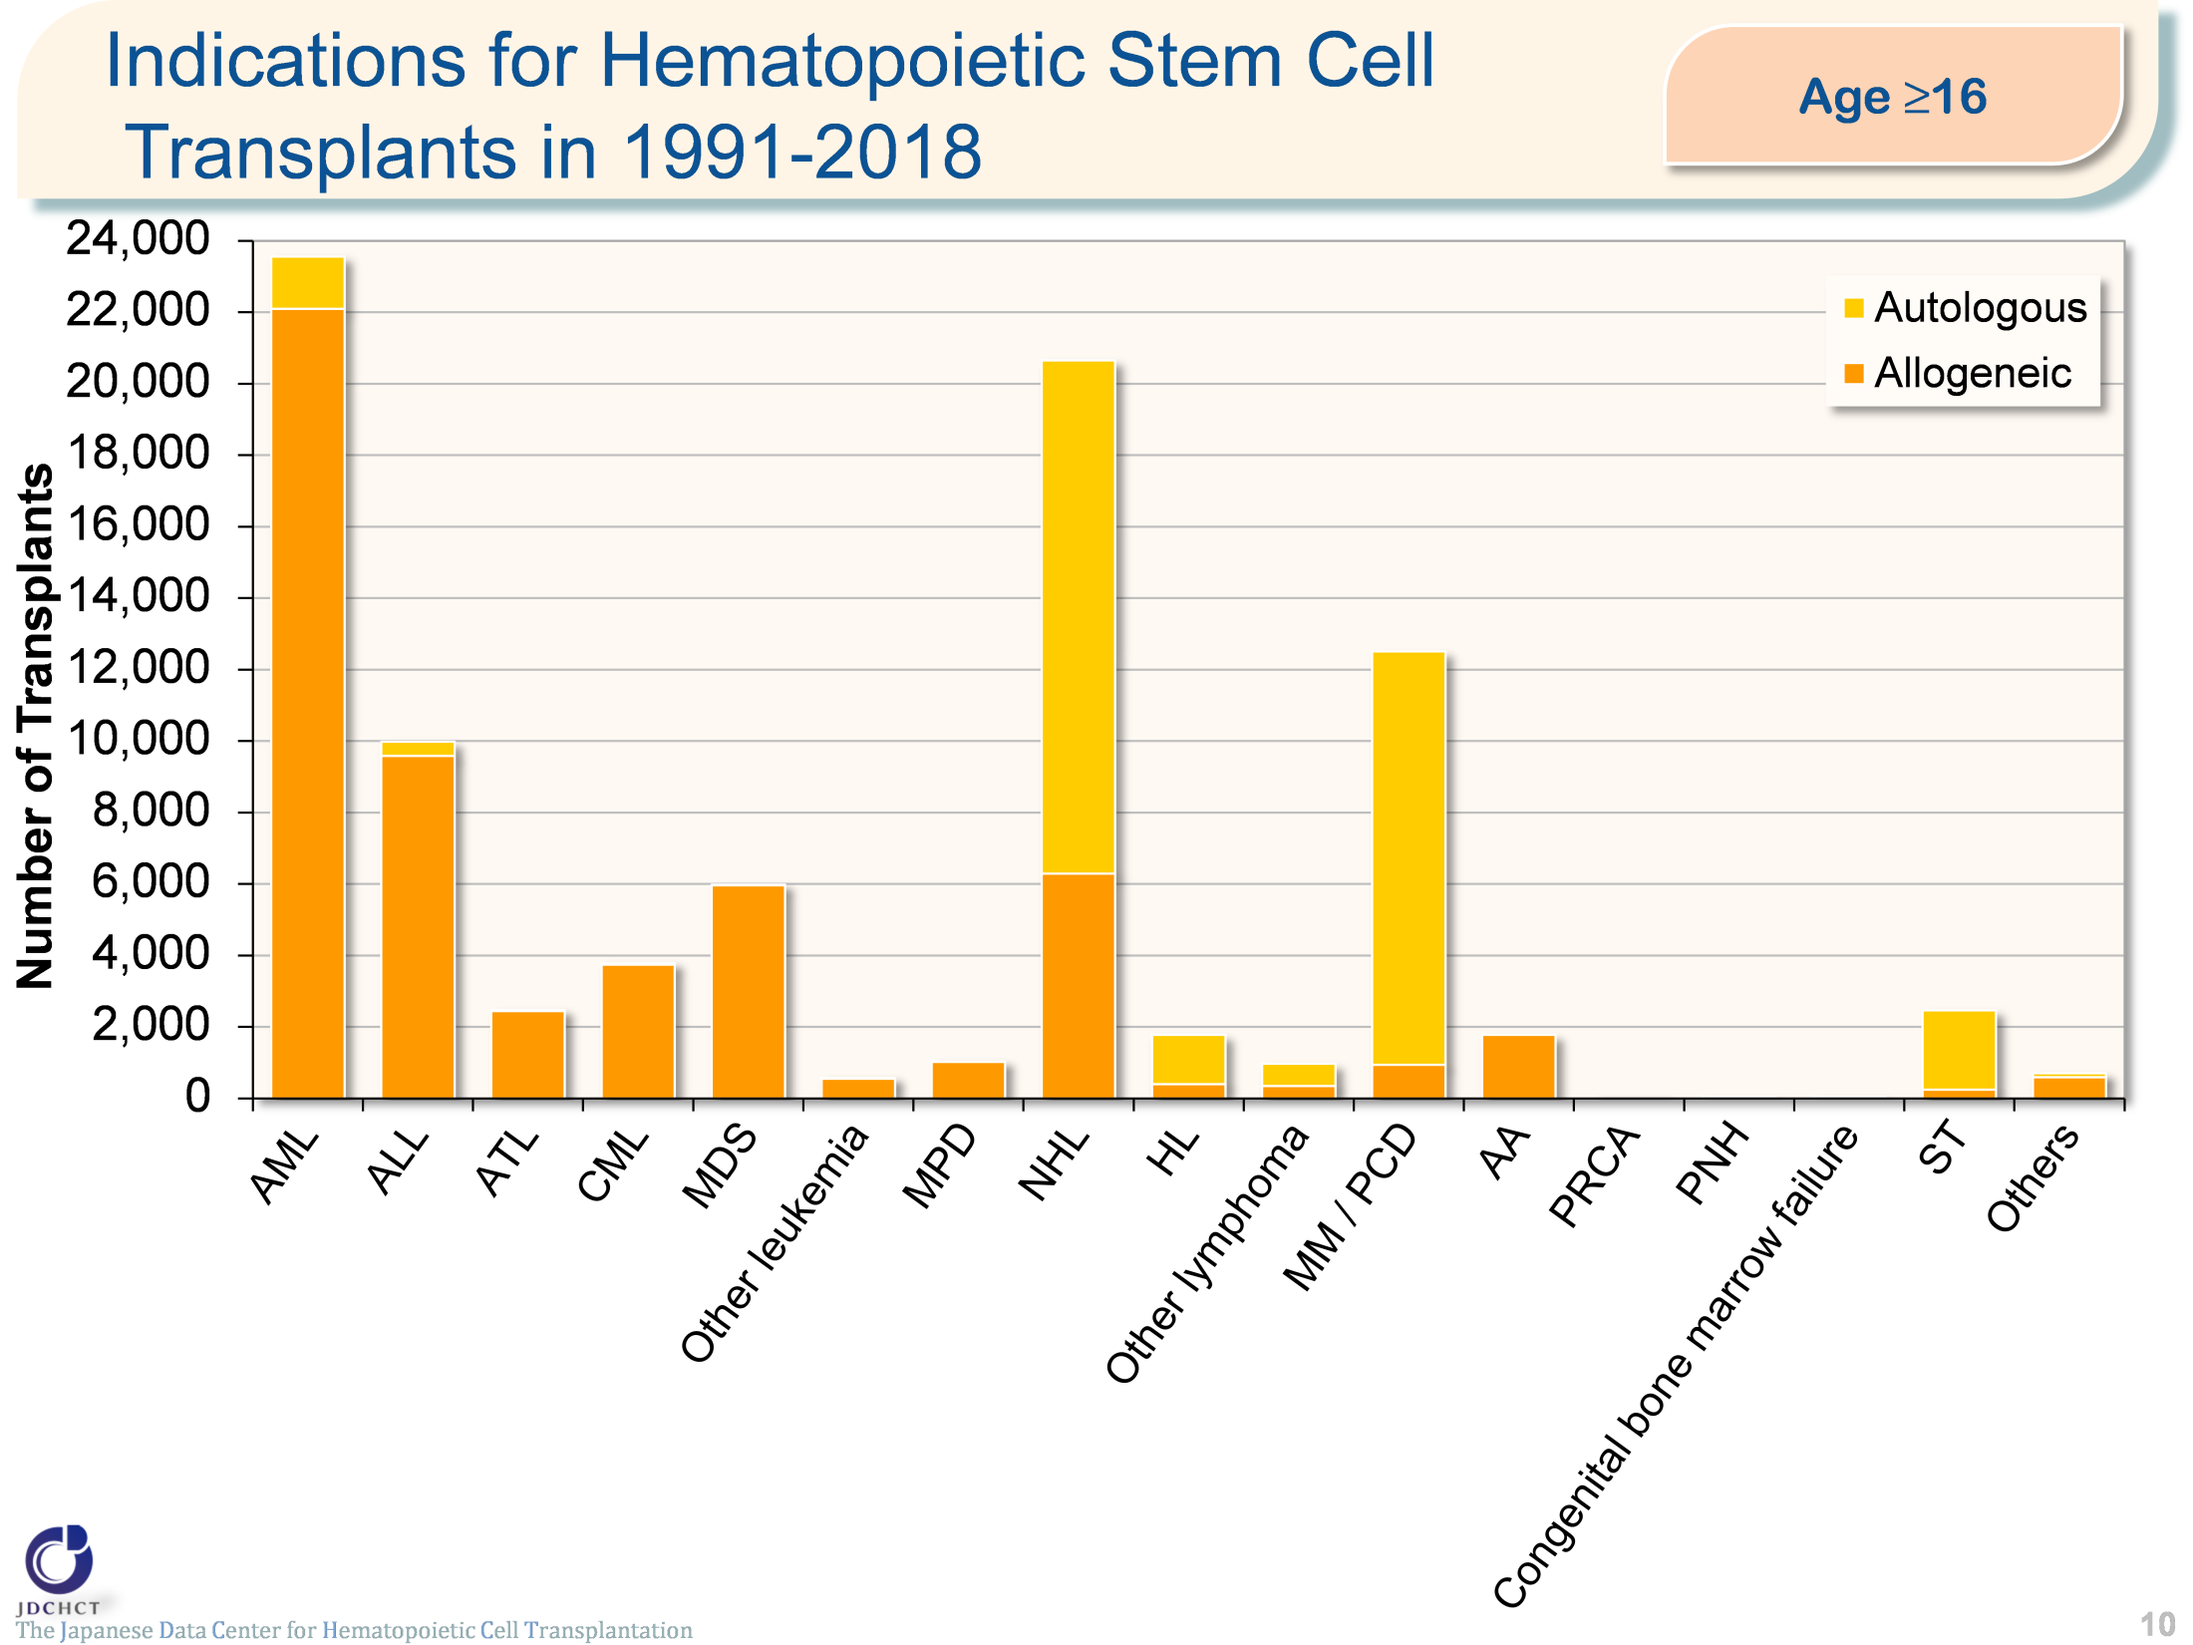
Indications for Hematopoietic Stem Cell
Transplants in 1991-2018 (Age≥16)
The Japanese Data Center for Hematopoietic Cell Transplantation
10
Notes:
In patients aged 16 years or older, allogeneic transplants are most frequently performed for acute leukemia (acute myeloid leukemia and acute lymphoid leukemia), which accounts for about 56% of the total cases of allogeneic transplants. Following this, allogeneic transplants are also frequently performed in non-Hodgkin lymphoma, myelodysplastic syndrome and chronic myeloid leukemia.
Multiple myeloma occurs more frequently in the elderly and the number of patients with multiple myeloma has shown a tendency to increase, as in malignant lymphoma. High-dose chemotherapy in combination with autologous transplantation is the established standard therapy for multiple myeloma in patients aged 65 years or younger, and autologous transplants account for about 96% of the first transplantation cases.

Slide 11
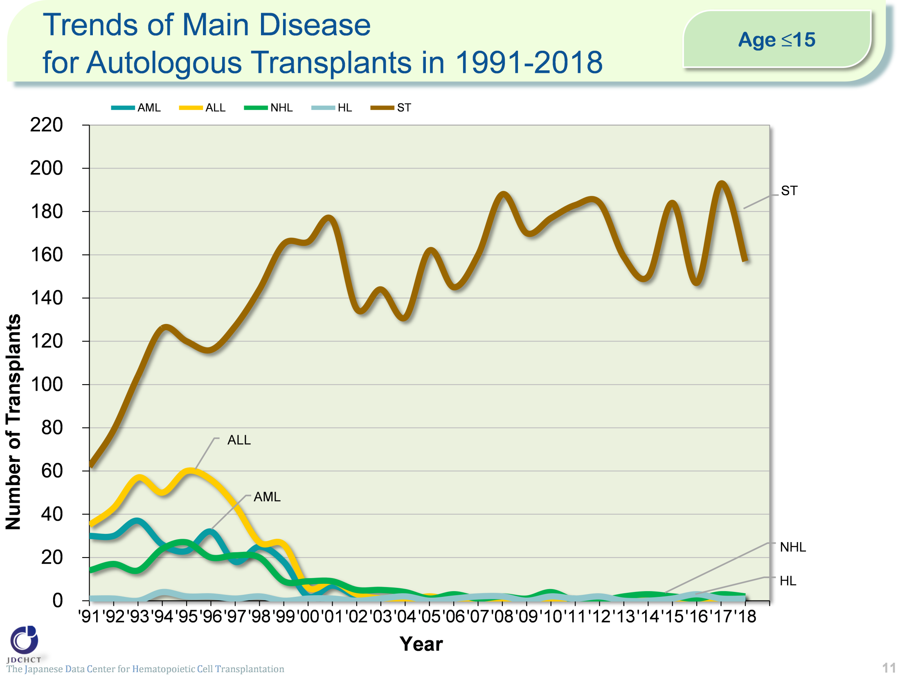
Trends of Main Disease for Autologous Transplants in 1991-2018 (Age≤15)
The Japanese Data Center for Hematopoietic Cell Transplantation
11
Notes:
For solid tumors in pediatric patients, autologous transplants are performed in order to rescue hematopoietic dysfunction due to high-dose chemotherapy and therefore, autologous transplantation is most performed and the number has been similar over the last decade.

Slide 12
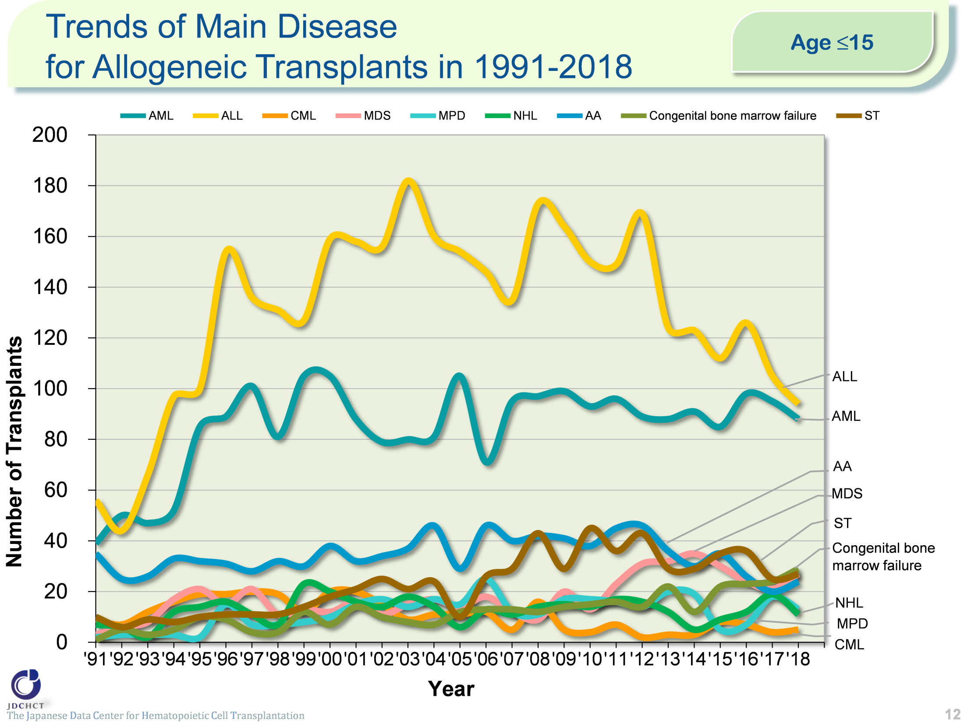
Trends of Main Disease for Allogeneic Transplants in 1991-2018 (Age≤15)
The Japanese Data Center for Hematopoietic Cell Transplantation
12
Notes:
For these disease in pediatric patients, the number of allogeneic transplants has been similar over the last decade.

Slide 13
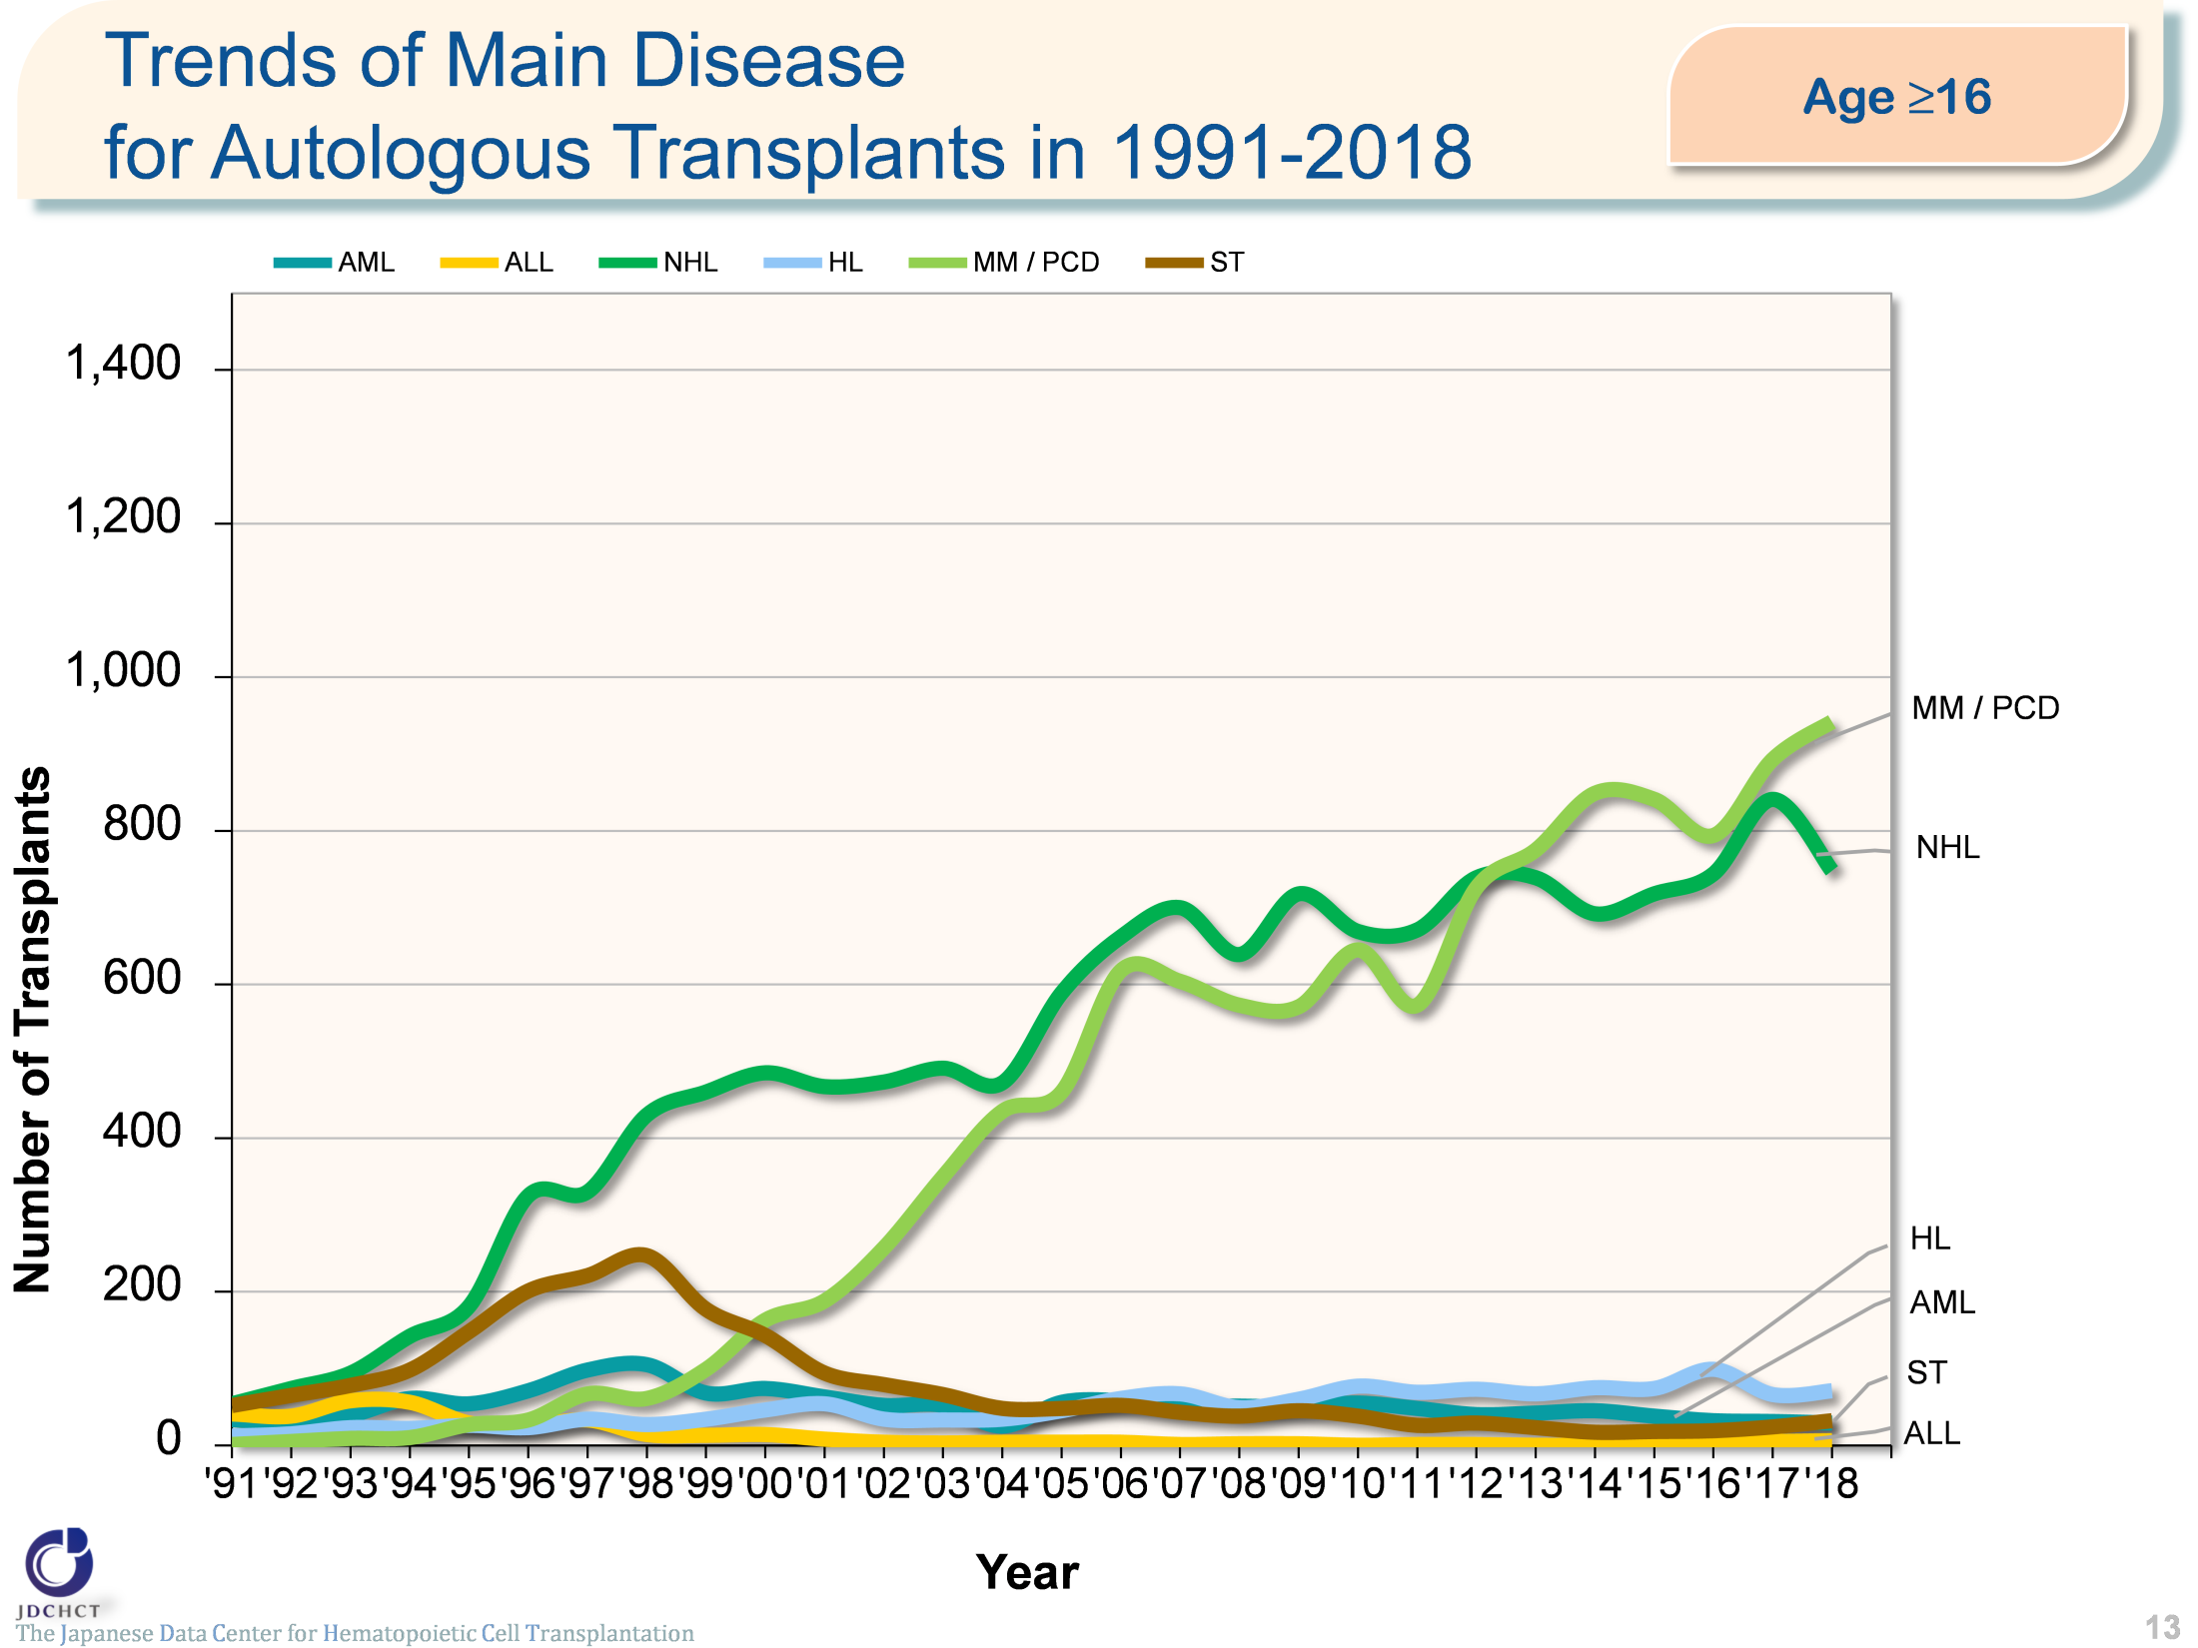
Trends of Main Disease for Autologous Transplants in 1991-2018 (Age≥16)
The Japanese Data Center for Hematopoietic Cell Transplantation
13
Notes:
Multiple myeloma occurs more frequently in the elderly and the number of patients with multiple myeloma has shown a tendency to increase, as in malignant lymphoma.

Slide 14
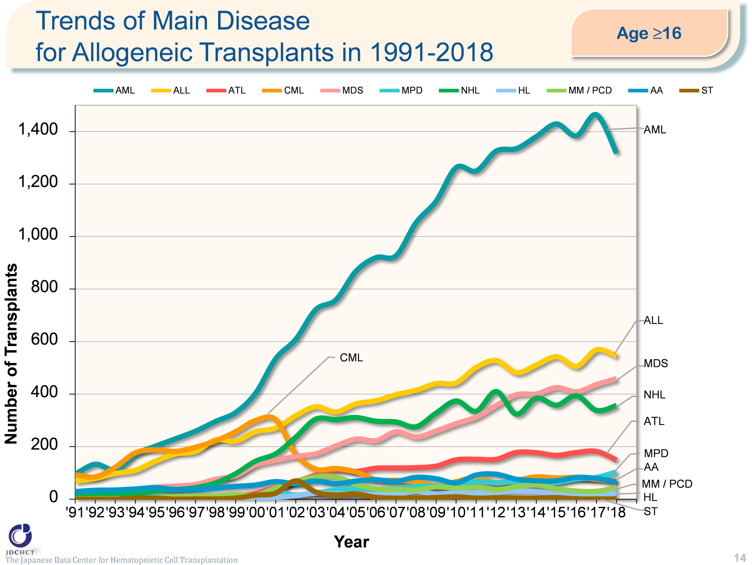
Trends of Main Disease for Allogeneic Transplants in 1991-2018 (Age≥16)
The Japanese Data Center for Hematopoietic Cell Transplantation
14
Notes:
In 2001, imatinib was officially approved in Japan as a molecular targeted therapy for chronic myeloid leukemia and subsequently, nilotinib and dasatinib were approved. Since then, transplantation for chronic myeloid leukemia has shown a tendency to decrease.
For malignant lymphoma, the number of patients with this disease has increased.
However, since rituximab, chemotherapy, and radiotherapy are effective in many cases, allogeneic transplantation is not commonly the first choice.

Slide 15
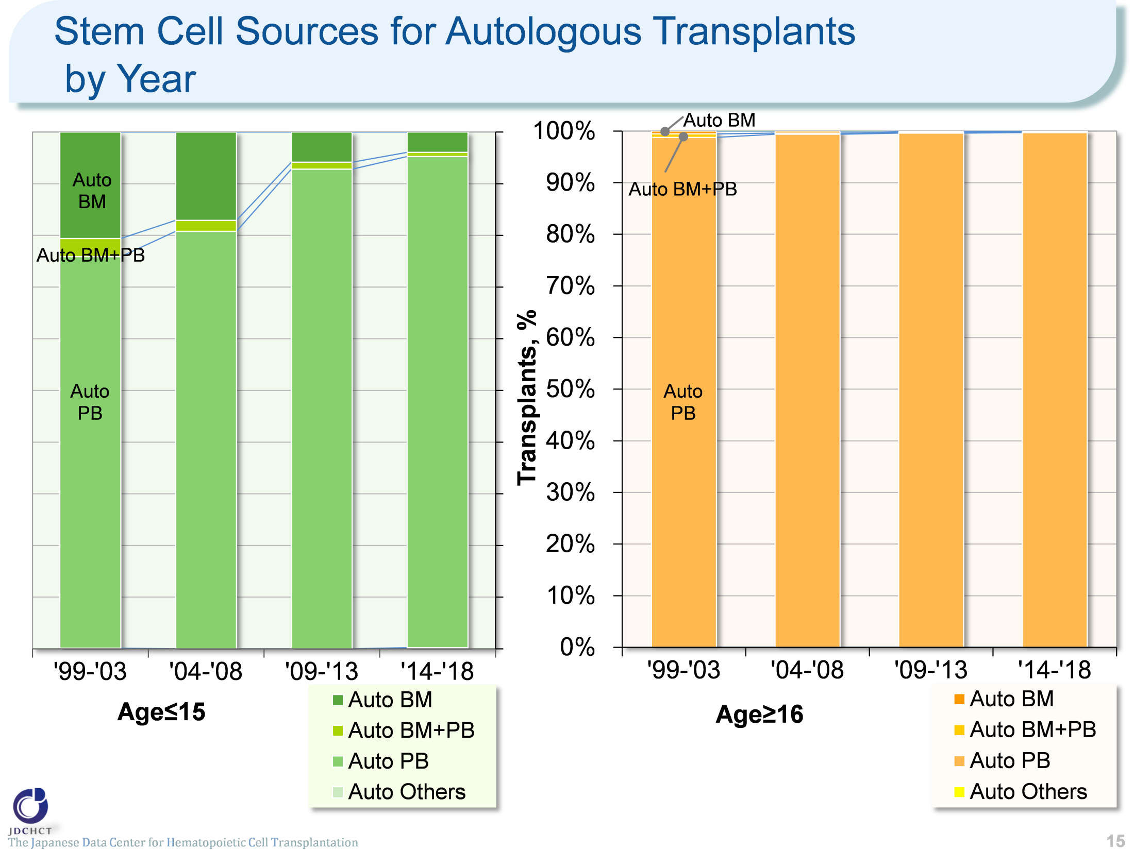
Stem Cell Sources for Autologous Transplants by Year
The Japanese Data Center for Hematopoietic Cell Transplantation
15
Notes:
In the period from 2014 to 2018, peripheral blood stem cell transplantation accounts for about 95% and 99% or more of the total cases of autologous transplants in patients aged 0 to 15 years and in those aged 16 years or older, respectively. The process of collecting peripheral blood stem cells poses less burden to patients than the harvesting procedure in bone marrow transplantation. Since 2000, the process of collecting peripheral blood stem cells for transplantation through the use of granulocyte-colony stimulating factor (G-CSF) has been covered by the national health insurance. For these reasons, the number of autologous peripheral blood stem cell transplantation has increased, whereas autologous bone marrow transplants have shown a tendency to decrease.

Slide 16
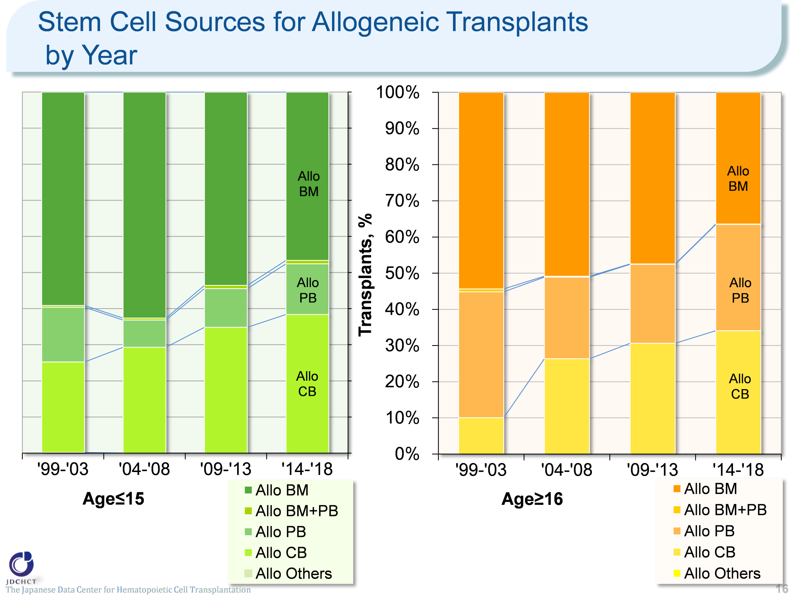
Stem Cell Sources for Allogeneic Transplants by Year
The Japanese Data Center for Hematopoietic Cell Transplantation
16
Notes:
The spread of cord blood transplantation has made the proportion of allogeneic bone marrow transplantation show a tendency to decrease.
In recent years, cord blood transplants account for about 30% of the total cases of allogeneic transplantation.

Slide 17
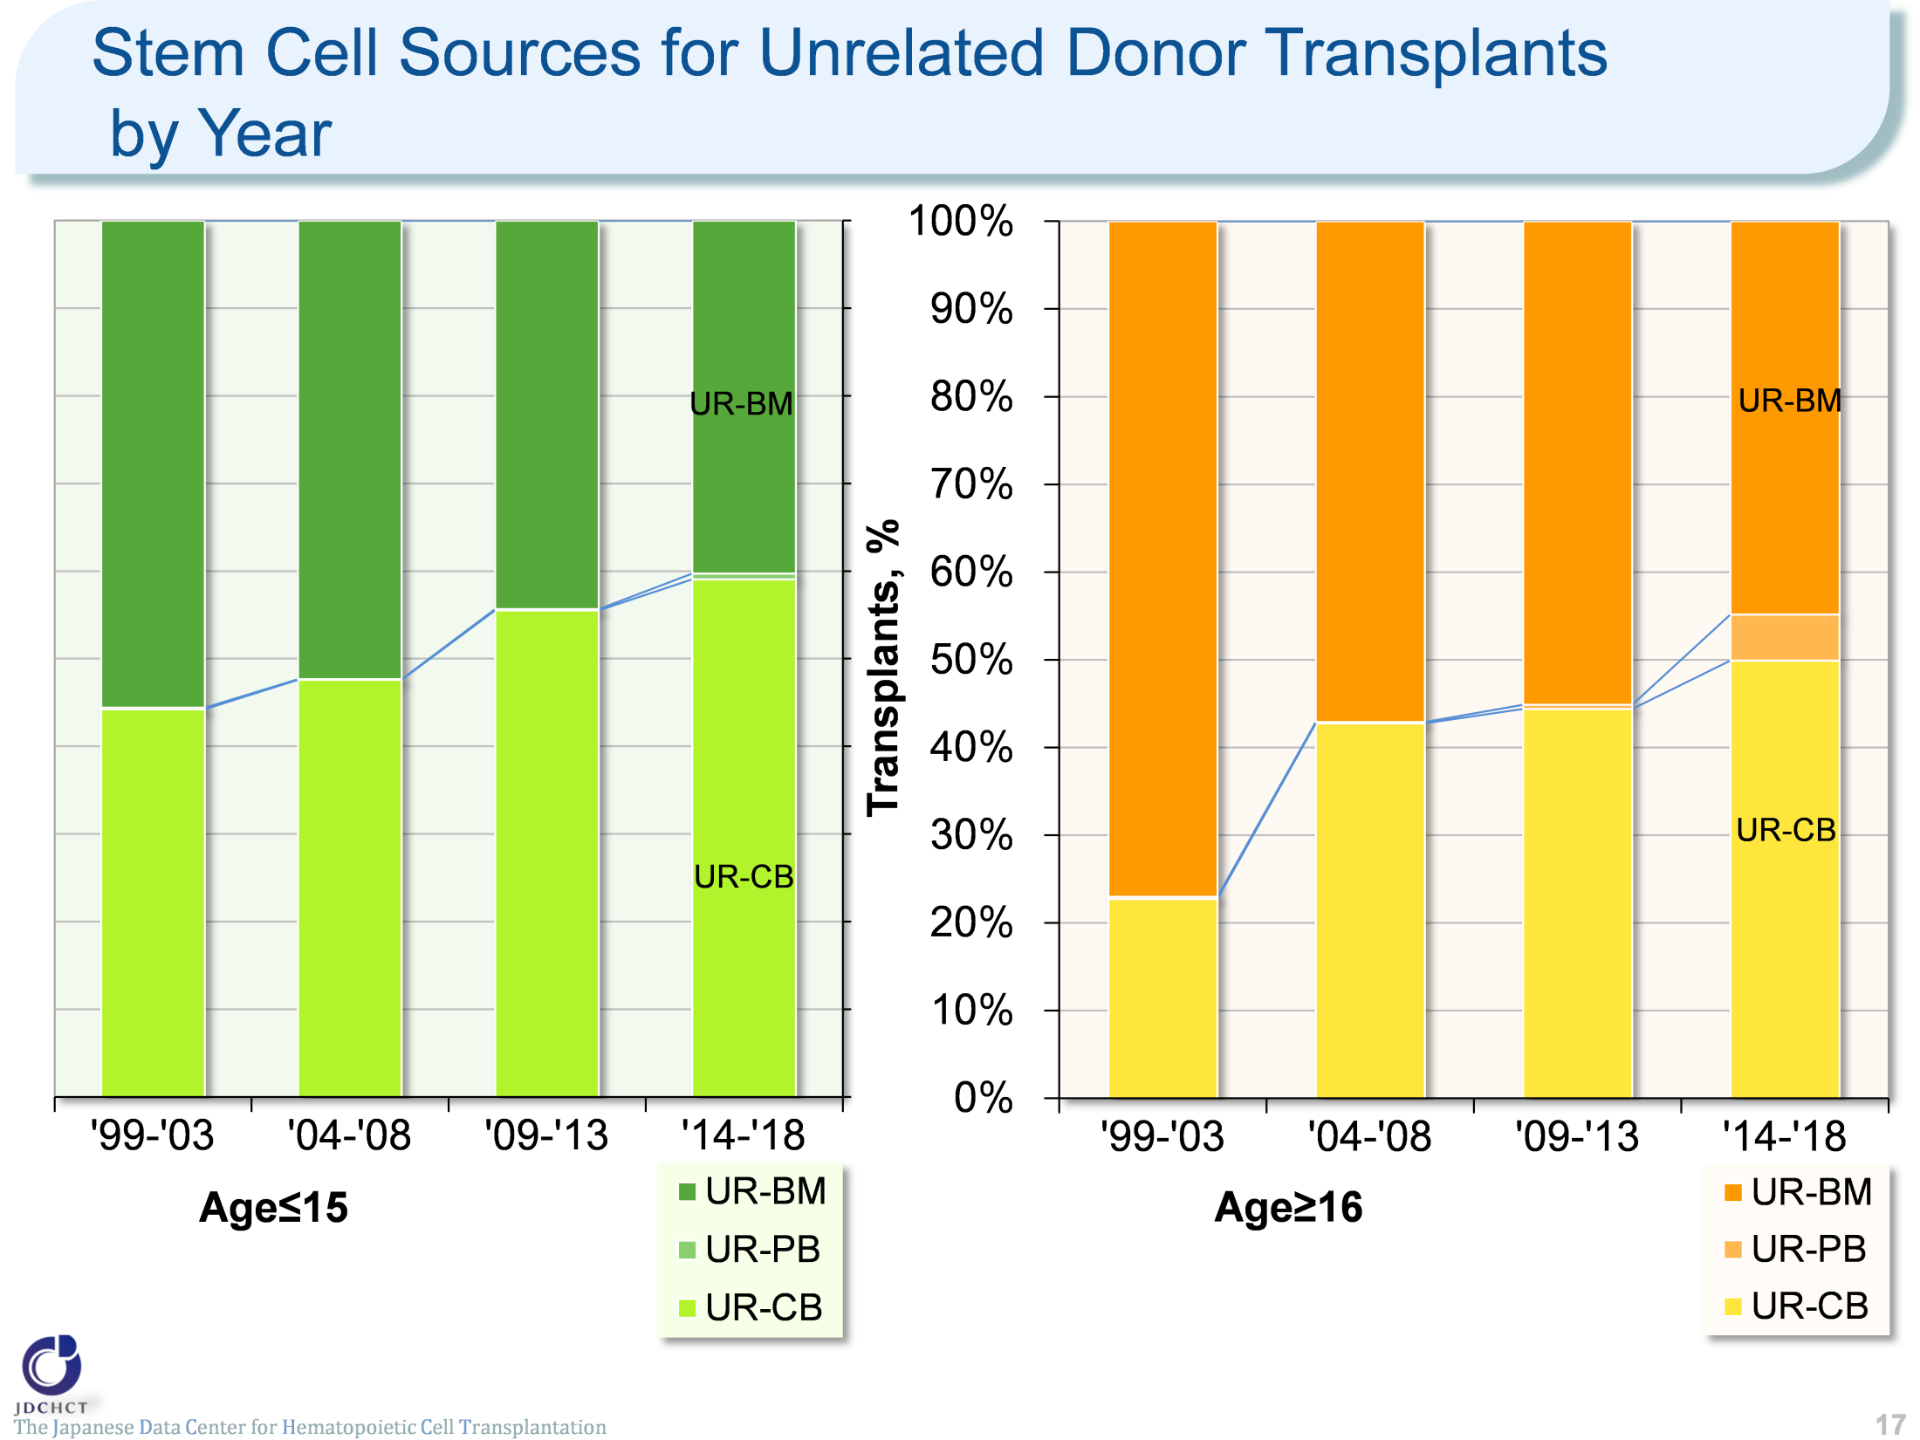
Stem Cell Sources for Unrelated Donor Transplants by Year
The Japanese Data Center for Hematopoietic Cell Transplantation
17
Notes:
In transplantation from unrelated donors, the increased number of cord blood transplants has recently resulted in the similar proportion between bone marrow transplants and cord blood transplants.

Slide 18
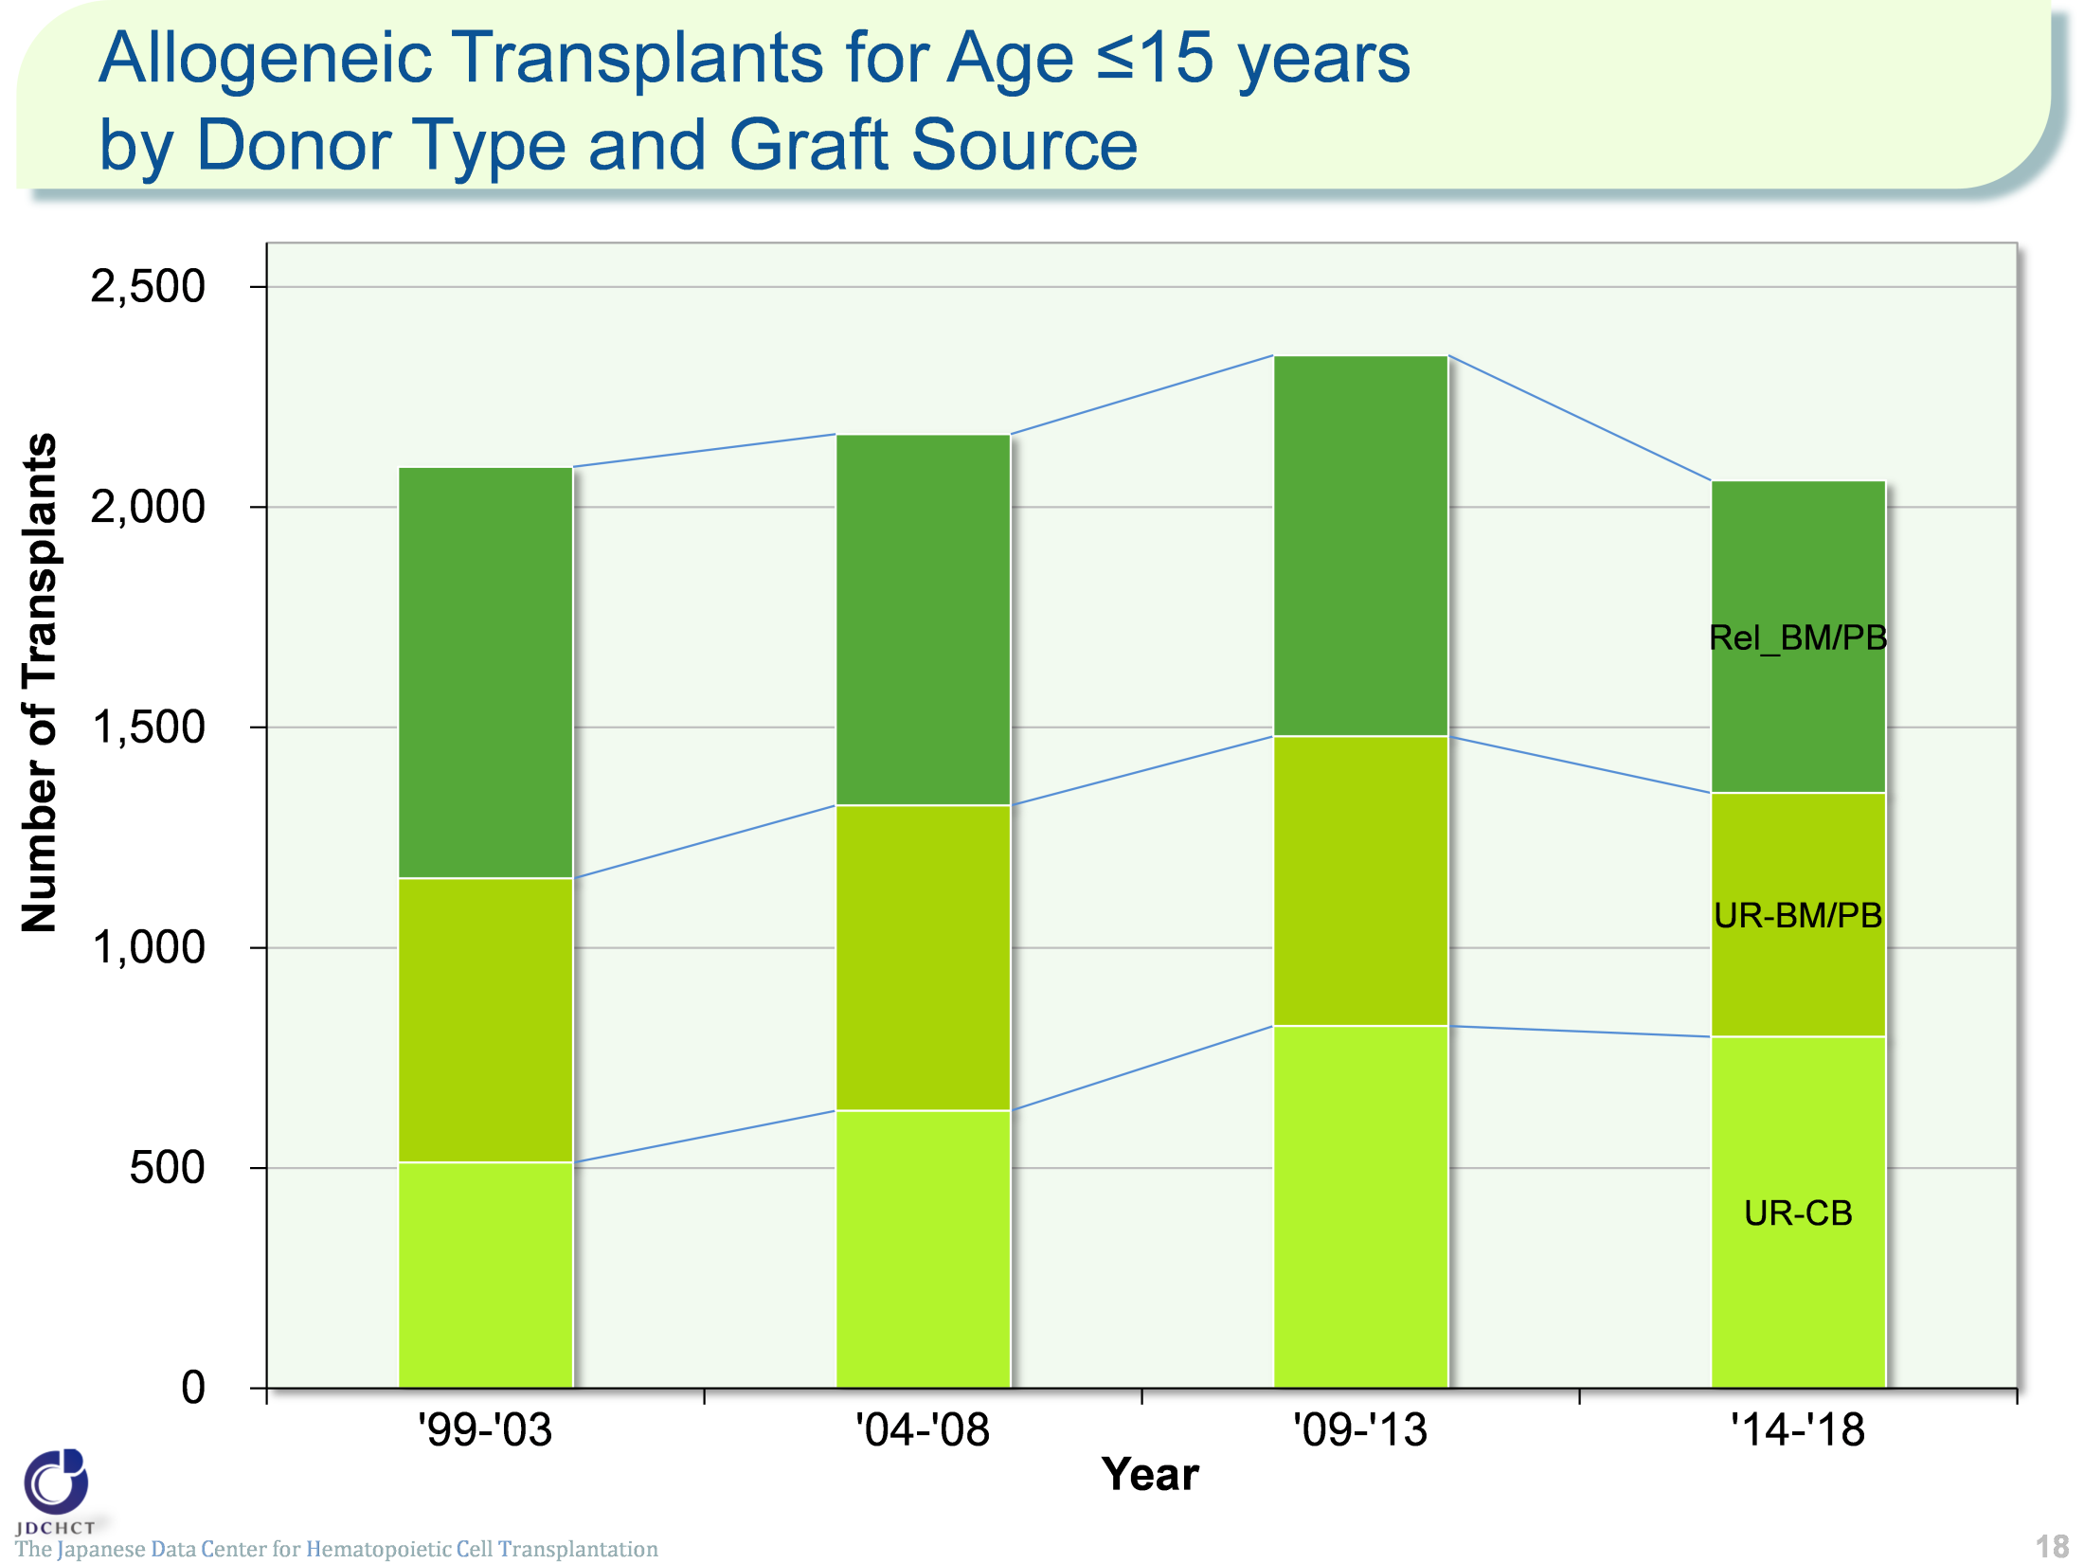
Allogeneic Transplants for Age ≤15 years by Donor Type and Graft Source
The Japanese Data Center for Hematopoietic Cell Transplantation
18
Notes:
Transplantation from unrelated donors has increased more markedly than transplantation from related donors. The ratio of transplantation from related donors to that from unrelated donors is 34% to 66%.

Slide 19
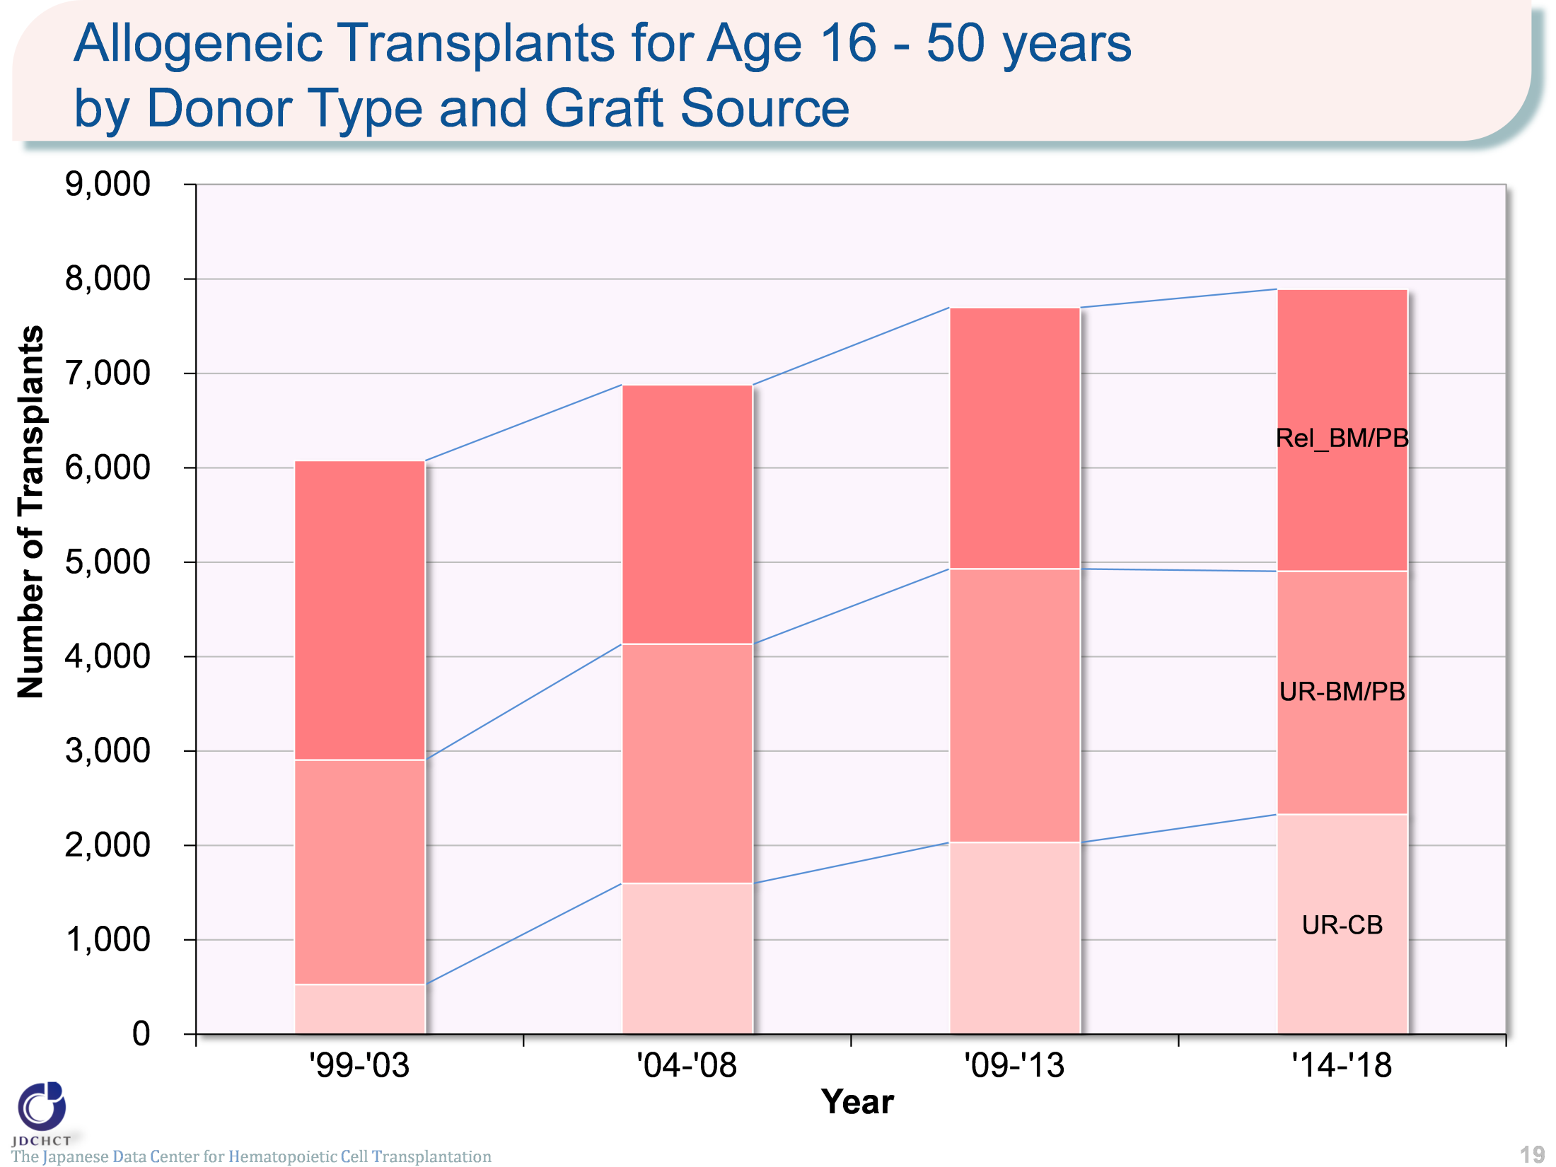
Allogeneic Transplants for Age 16-50 years by Donor Type and Graft Source
The Japanese Data Center for Hematopoietic Cell Transplantation
19
Notes:
Bone marrow transplantation from related donors and peripheral blood stem cell transplantation from related donors have leveled off, in particular, the number of cord blood transplants from unrelated donors have shown an increasing trend.

Slide 20
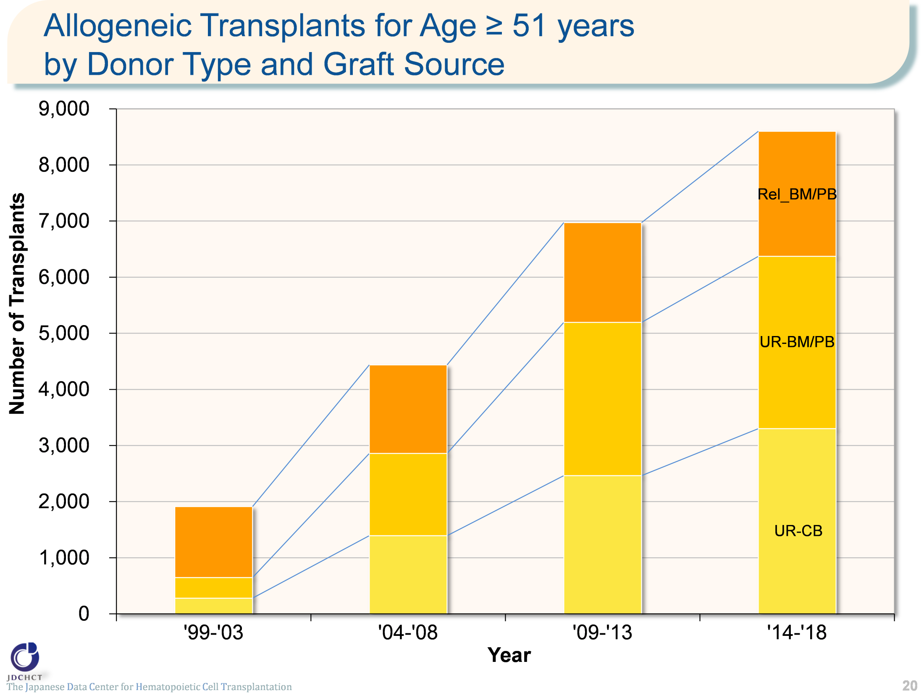
Allogeneic Transplants for Age ≥51 years by Donor Type and Graft Source
The Japanese Data Center for Hematopoietic Cell Transplantation
20
Notes:
Due to the spread of transplants with reduced intensity conditioning (RIC), in all types of allogeneic transplants, the number has remarkably increased in the elderly.

Slide 21
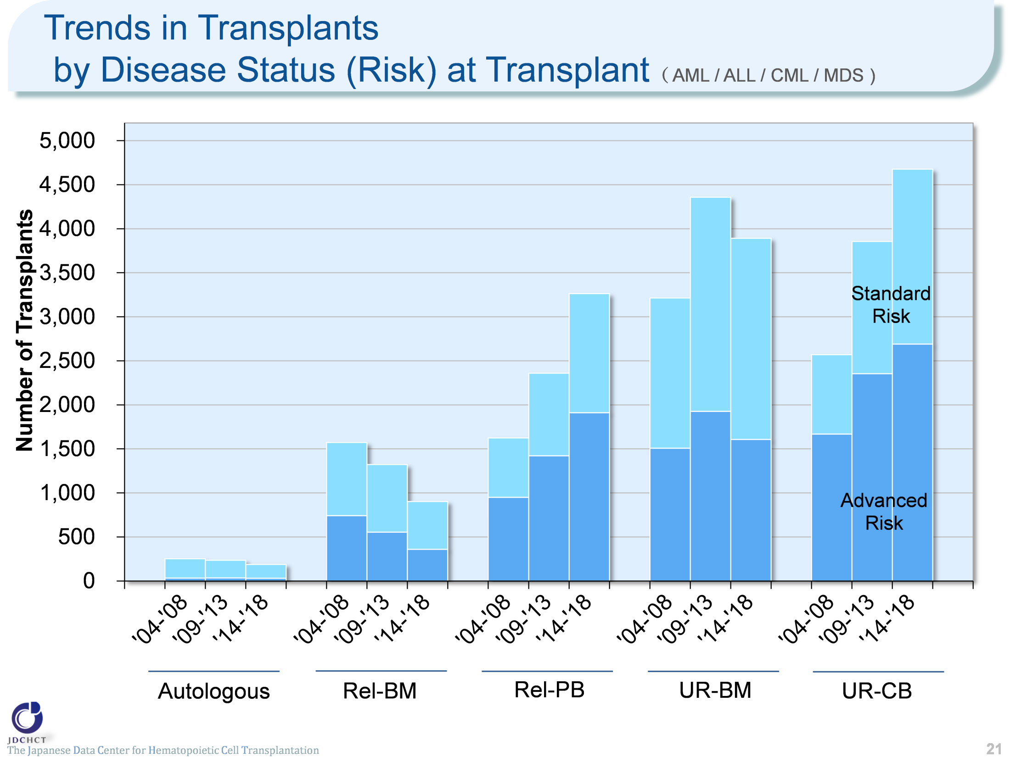
Trends in Transplants by Disease Status (Risk) at Transplant
（ AML / ALL / CML / MDS )
The Japanese Data Center for Hematopoietic Cell Transplantation
21
Notes:
Even in the advanced risk group of patients with leukemia for whom the disease condition is difficult to treat, transplants from unrelated donors (for bone marrow and cord blood) have increased in number.
―≪Disease risk status at transplantation≫―――――――――
■Standard Risk Group
・AML (first complete remission[1CR]／second complete remission[2CR])
・ALL (1CR)
・CML (first chronic phase[1CP])
・MDS (refractory anemia[RA] ／refractory anemia with ring sideroblasts[RARS])
■Advanced Risk Group
・all other conditions
――――――――――――――――――――――――――――――

Slide 22
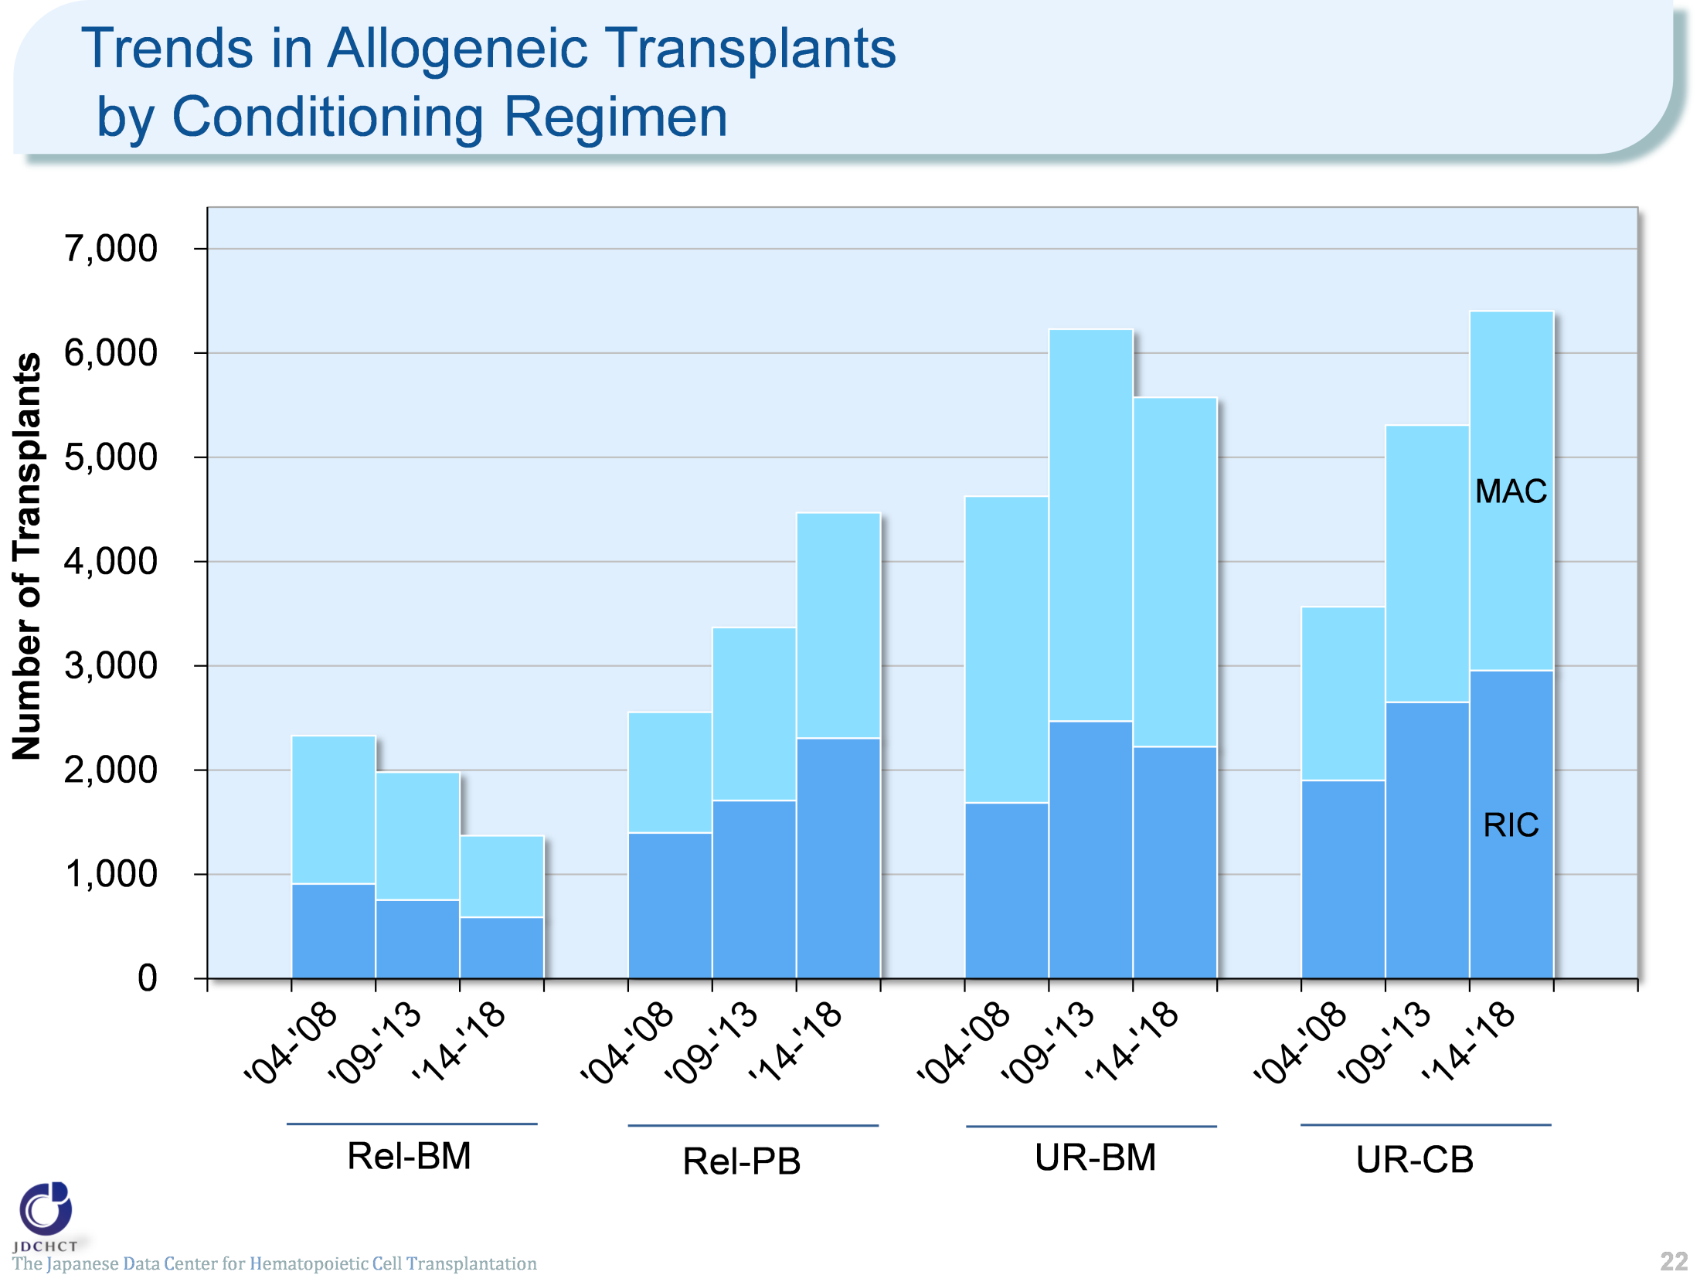
Trends in Allogeneic Transplants by Conditioning Regimen
The Japanese Data Center for Hematopoietic Cell Transplantation
22
Notes:
The spread of the reduced intensity conditioning (RIC) to reduce toxicity has expanded the scope of indication of transplantation to the elderly, which has greatly contributed to the increased number of overall transplants.
―≪Conditioning regimen≫――――――――
■Myeloablative conditioning (MAC)
Pre-transplantation therapy with the primary purpose of totally destroying cancer cells, together with normal blood cells, in the bone marrow by total body irradiation or high-dose chemotherapy
■Reduced-intensity conditioning (RIC)
Pre-transplantation therapy with the primary purpose of suppressing the patient’s immune system with drugs which do not have strong myelosuppressive effects
―――――――――――――――――――――

Slide 23
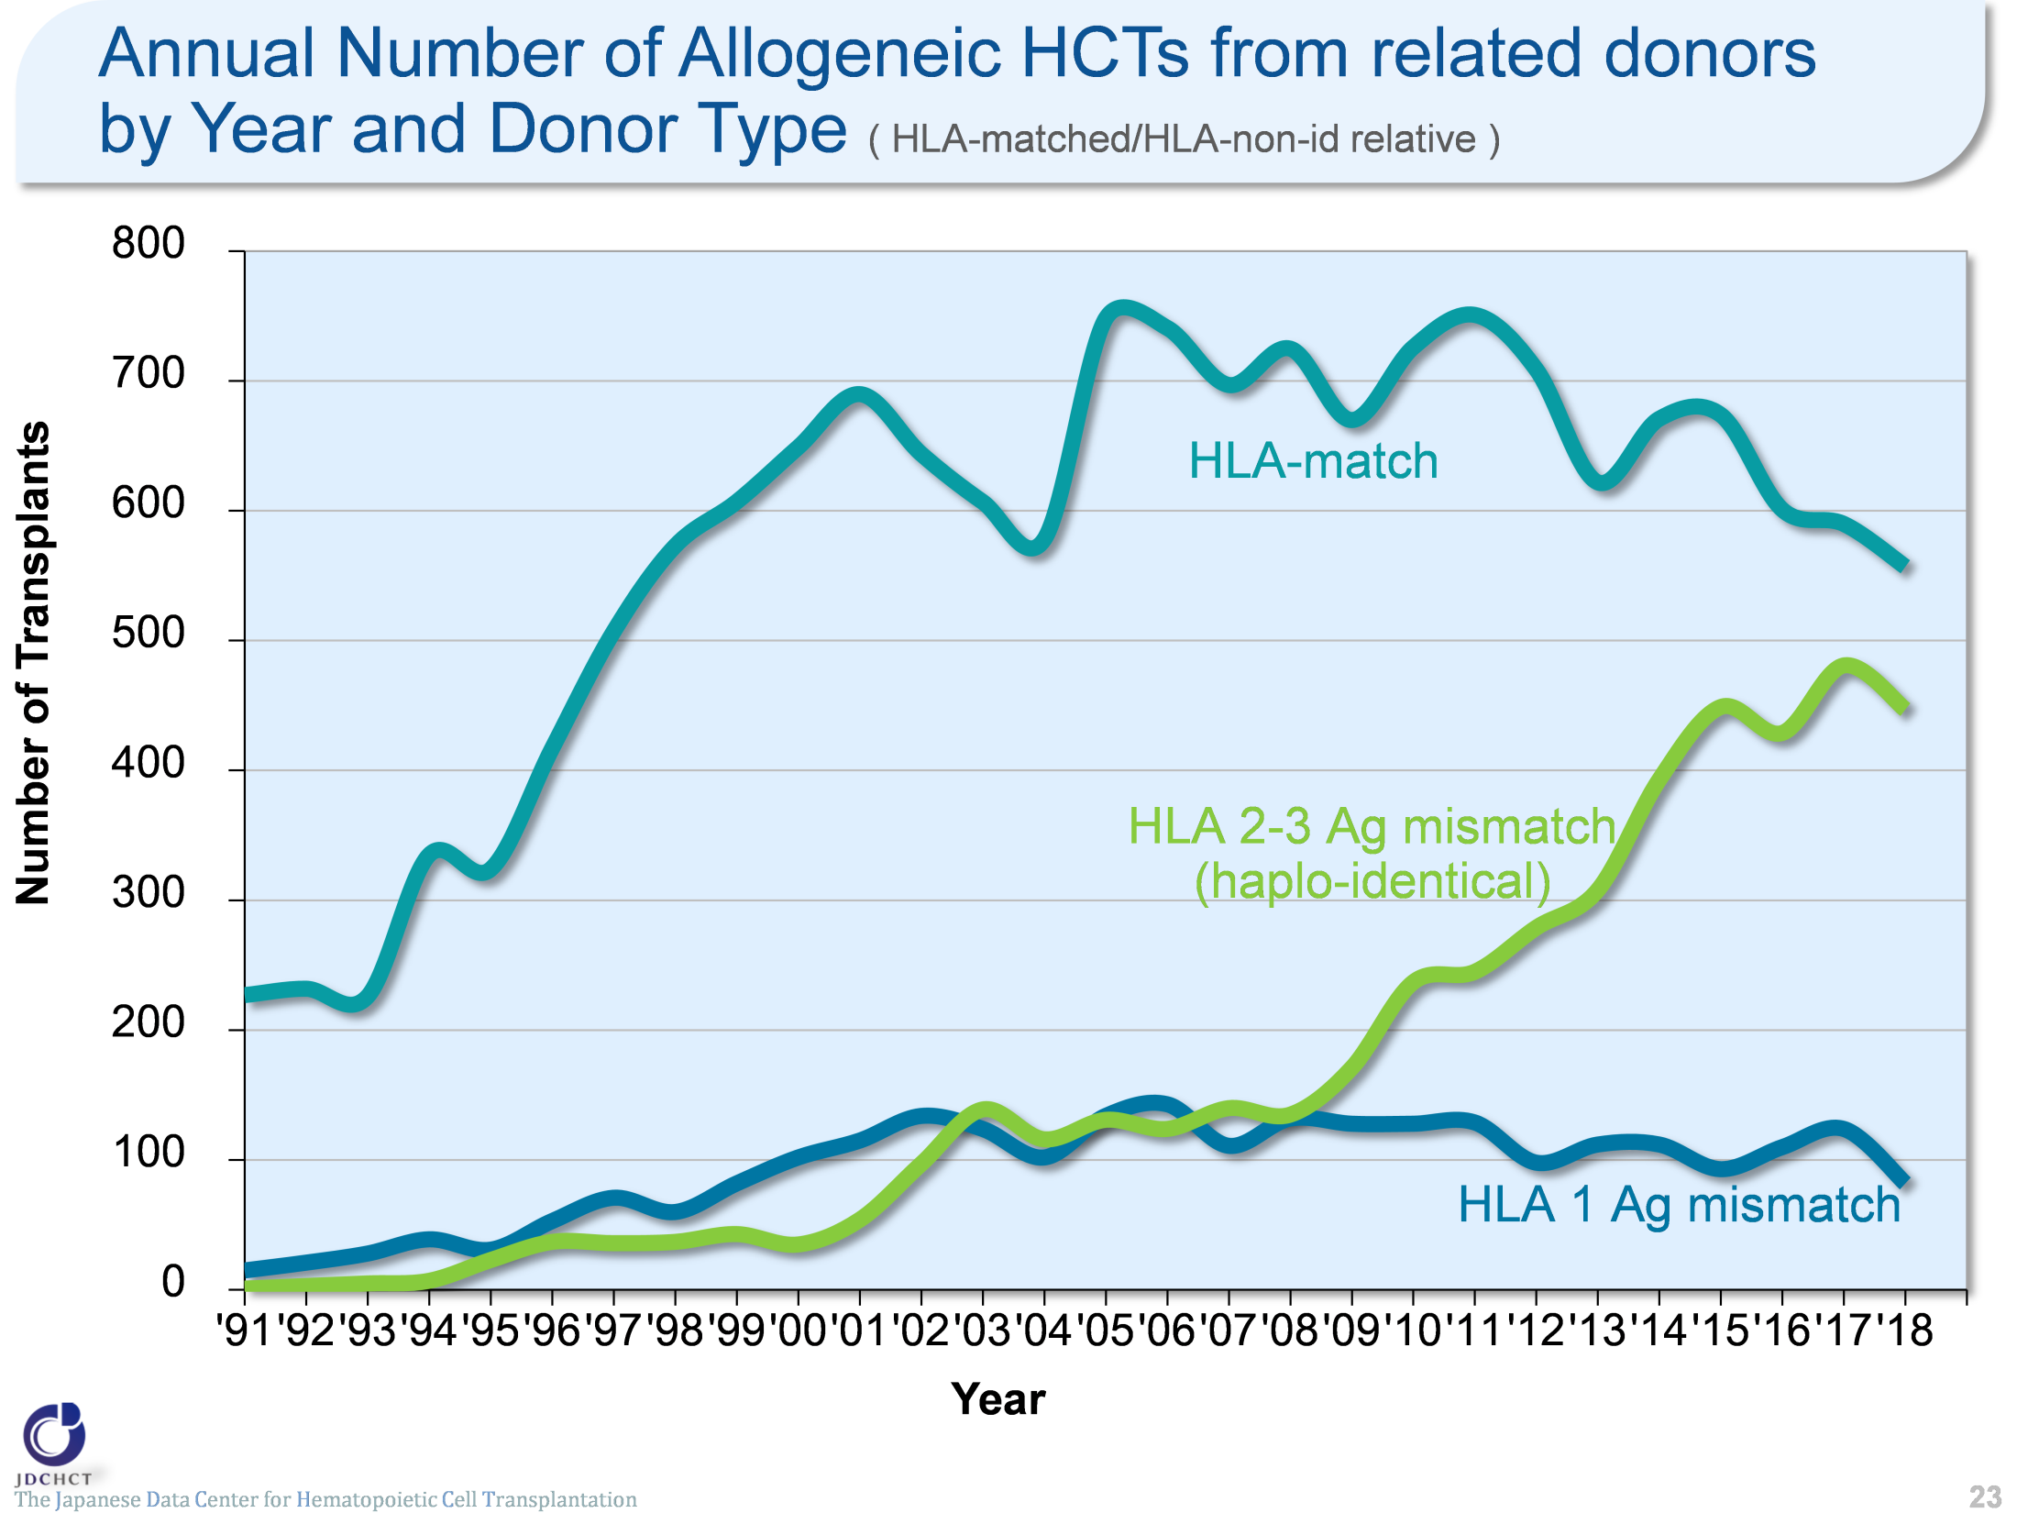
Annual Number of Allogeneic HCTs from related donors by Year and Donor Type
( HLA-matched/HLA-non-id relative )
The Japanese Data Center for Hematopoietic Cell Transplantation
23
Notes:
For transplantation from related donors, transplantation from a HLA-matched donor is most frequently performed. Since 2000, the annual number of transplant from HLA-matched related donors have leveled off. With the development of prevention method of GVHD, the number of haplo-identical transplantation increased remarkably since 2010.
※Subjects in this summary table include bone marrow transplantation, peripheral blood stem cell transplantation and bone marrow + peripheral blood stem cell transplantation from related donor.
※GVH-direction is considered for numbers of mismatched HLA loci.

Slide 24
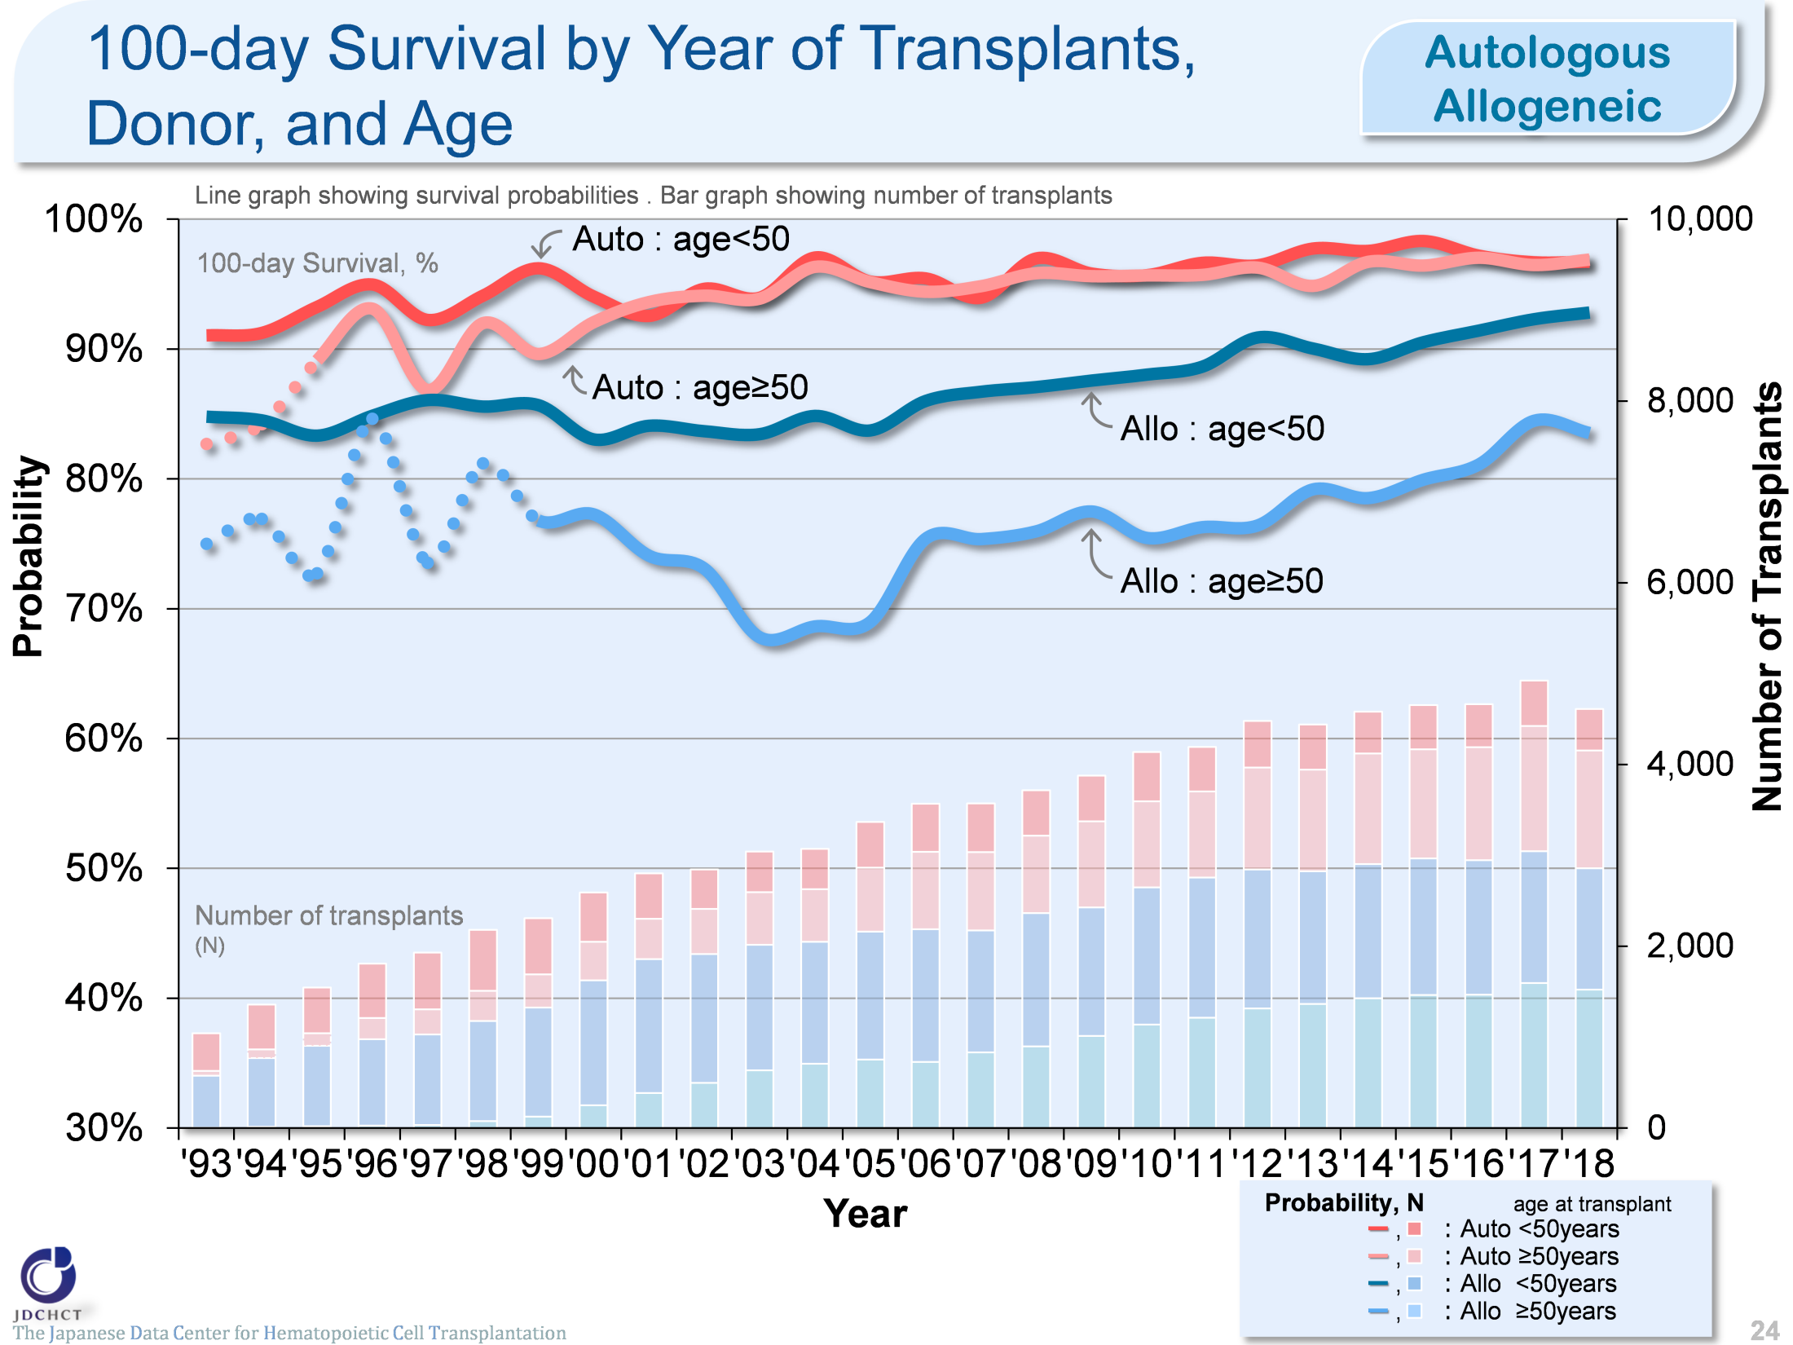
100-day Survival by Year of Transplants,
Donor, and Age
(Autologous / Allogeneic)
The Japanese Data Center for Hematopoietic Cell Transplantation
Notes:
The survival probabilities 100 days after allogeneic transplantation have shown slightly increasing trends over the last decade.
The survival probabilities 100 days after autologous transplantation are similar between those aged 49 years or younger (<50) and those aged 50 years or older (≥50).
※This table shows the results of analysis performed on patients who received first transplants.
※The dotted lines (…) indicate the survival probabilities calculated when the number of transplants was below 100.

Slide 25
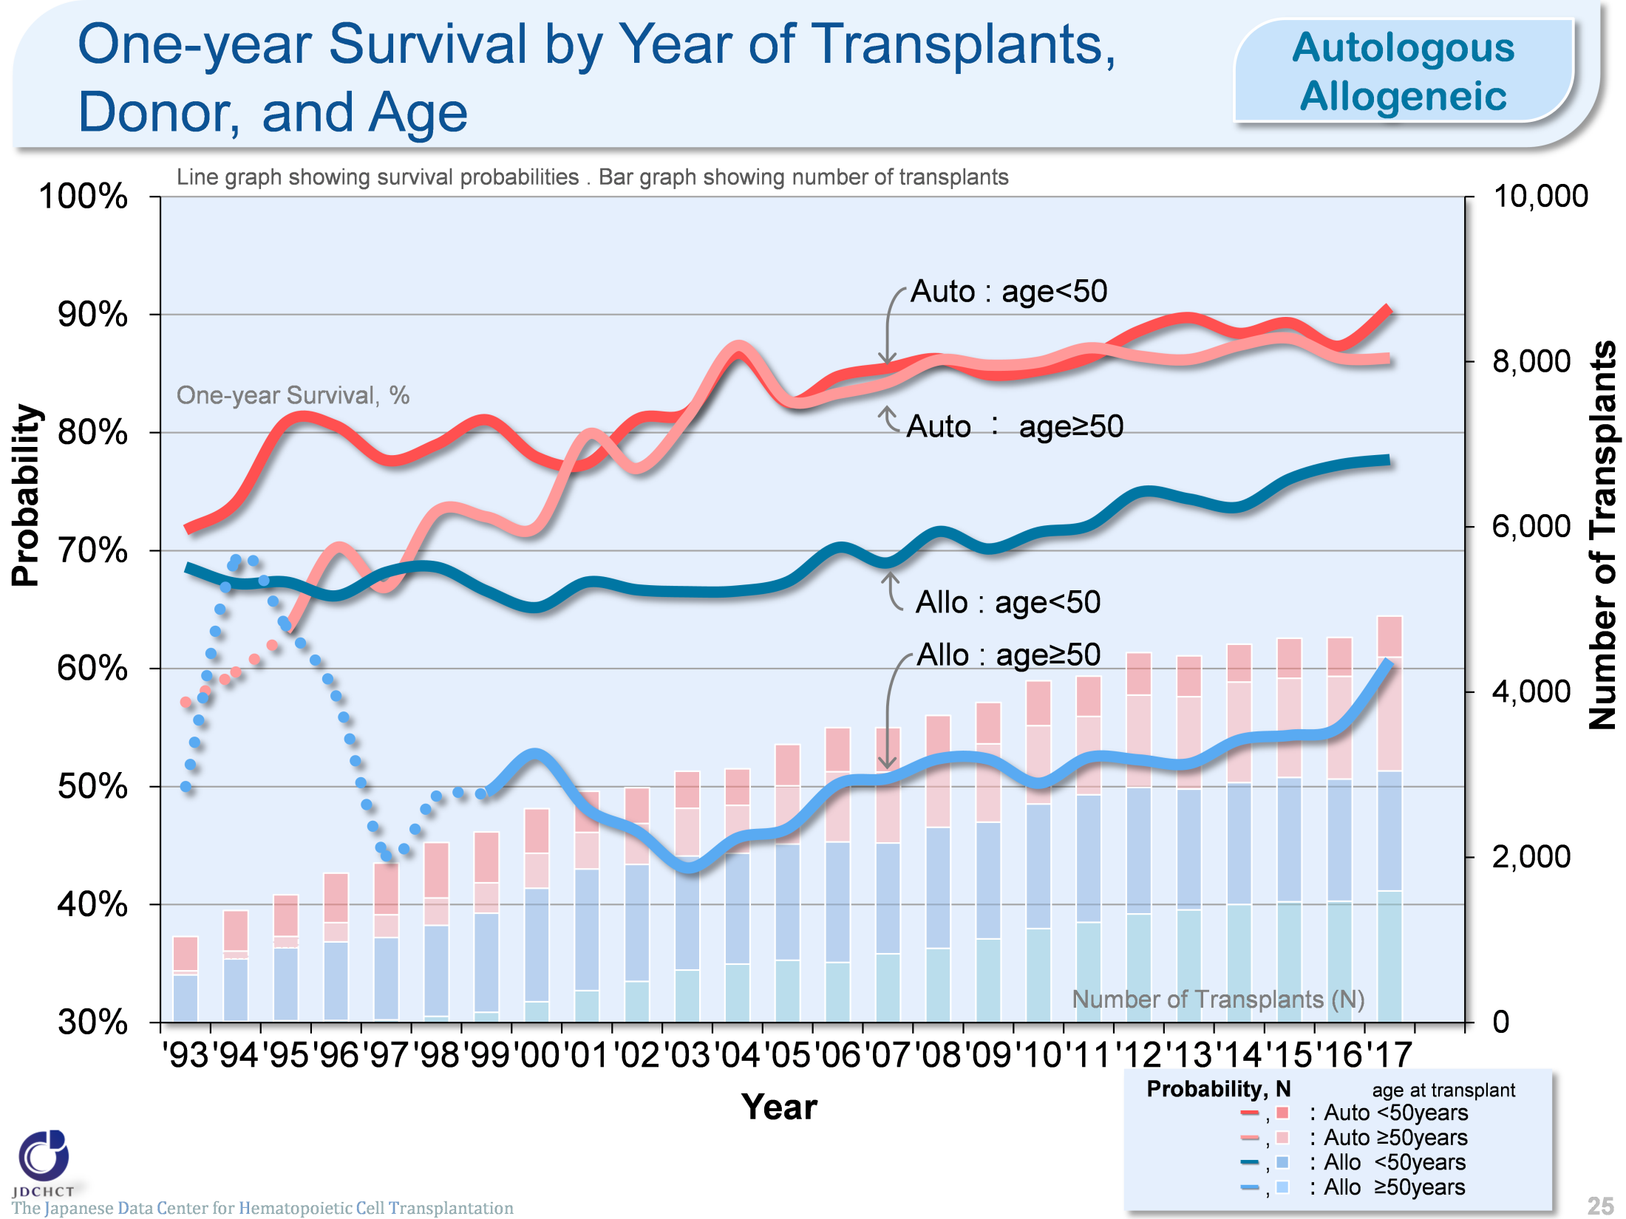
One-year Survival by Year of Transplants,
Donor, and Age
(Autologous / Allogeneic)
The Japanese Data Center for Hematopoietic Cell Transplantation
Notes:
The survival probabilities 365 days (1 year) after transplantation have shown increasing trends over the last decade in autologous transplant recipients and those aged 49 years or younger (<50) who received allogeneic transplants.
The survival probabilities 365 days after autologous transplantation are similar between those aged 49 years or younger (<50) and those aged 50 years or older (≥50).
※This table shows the results of analysis performed on patients who received first transplants.
※The dotted lines (…) indicate the survival probabilities calculated when the number of transplants was below 100.

Slide 26
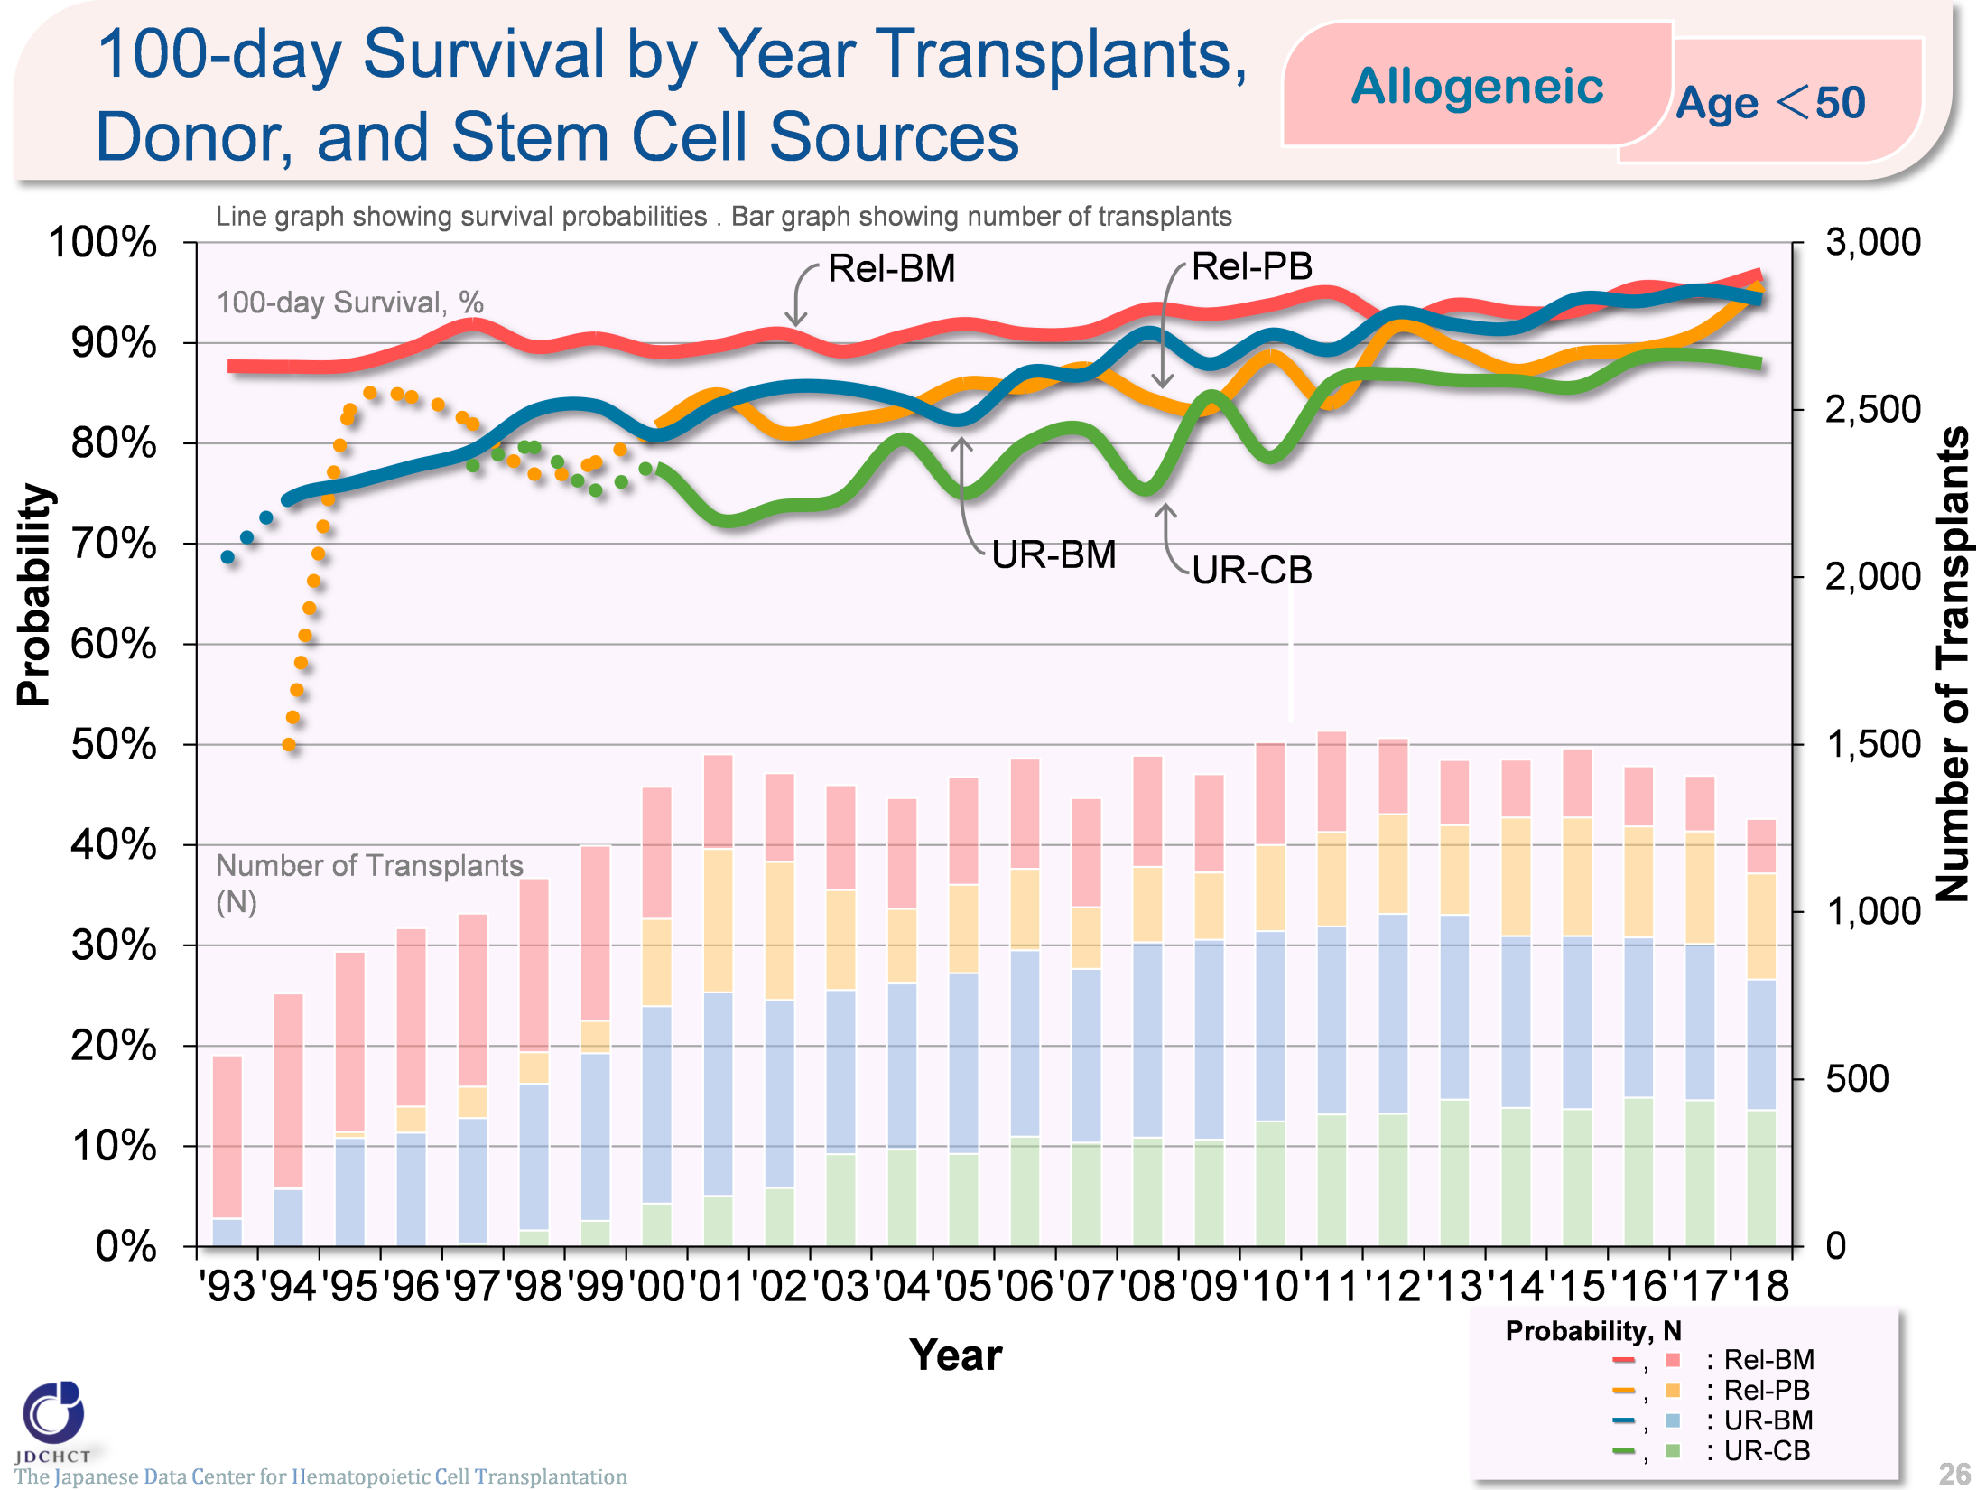
100-day Survival by Year of Allogeneic Transplants,
Donor, and Stem Cell Sources (Age<50)
The Japanese Data Center for Hematopoietic Cell Transplantation
Notes:
In those aged 49 years or younger (<50), the survival probabilities 100 days after transplantation have shown increasing trends over the last decade in both transplantation from related and unrelated donors.
Recently, the survival probabilities 100 days after bone marrow transplantation are similar between transplantation from related and unrelated donors.
※This table shows the results of analysis performed on patients who received first transplants.
※The dotted lines (…) indicate the survival probabilities calculated when the number of transplants was below 100.

Slide 27
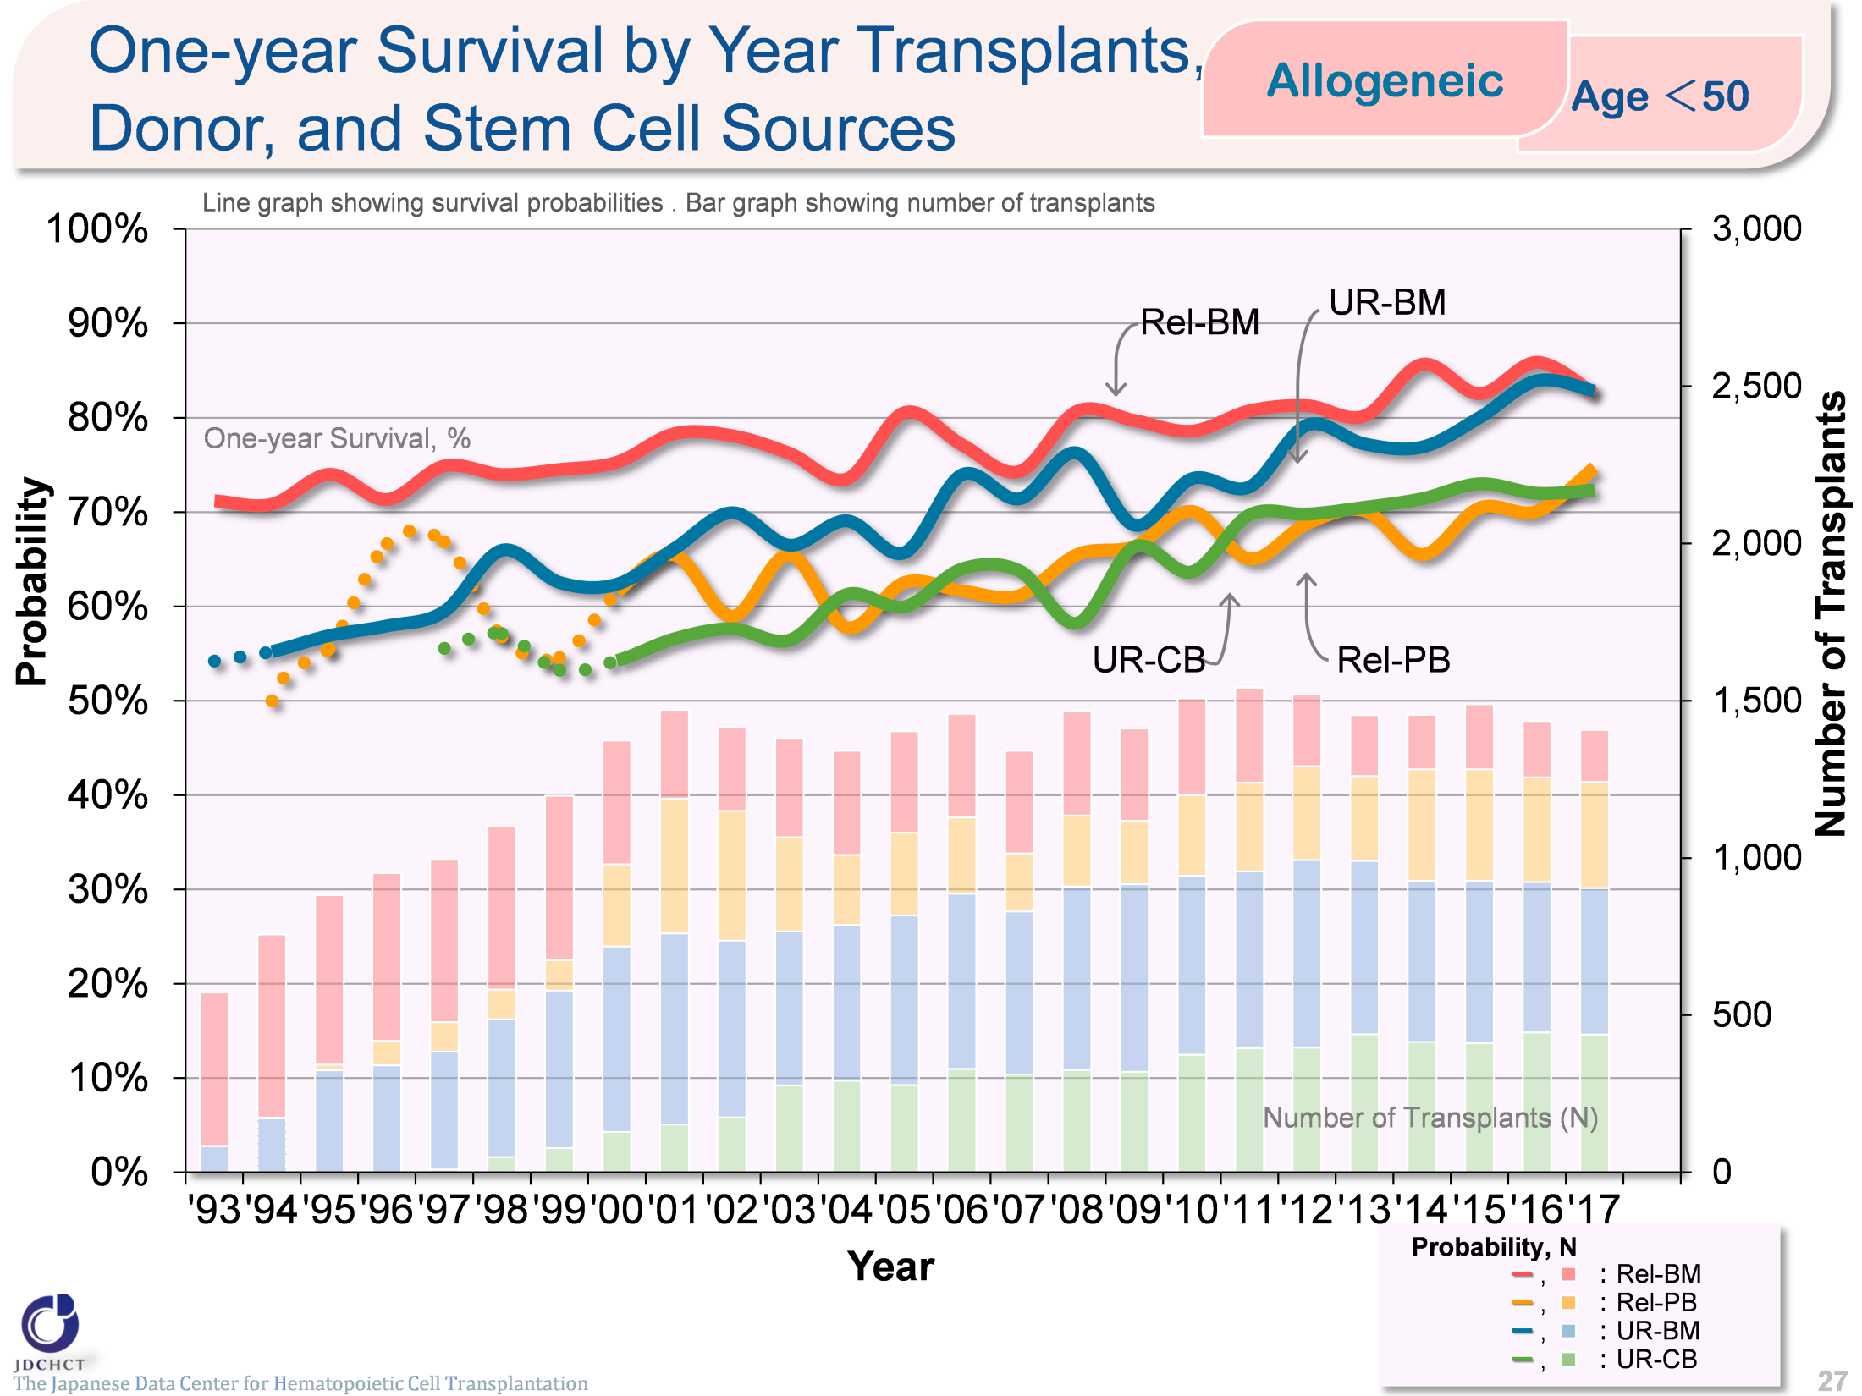
One-year Survival by Year of Allogeneic Transplants,
Donor, and Stem Cell Sources (Age<50)
The Japanese Data Center for Hematopoietic Cell Transplantation
Notes:
In those aged 49 years or younger (<50), the survival probabilities 365 days after transplantation have shown increasing trends over the last decade in both transplantation from related and unrelated donors.
※This table shows the results of analysis performed on patients who received first transplants.
※The dotted lines (…) indicate the survival probabilities calculated when the number of transplants was below 100.

Slide 28
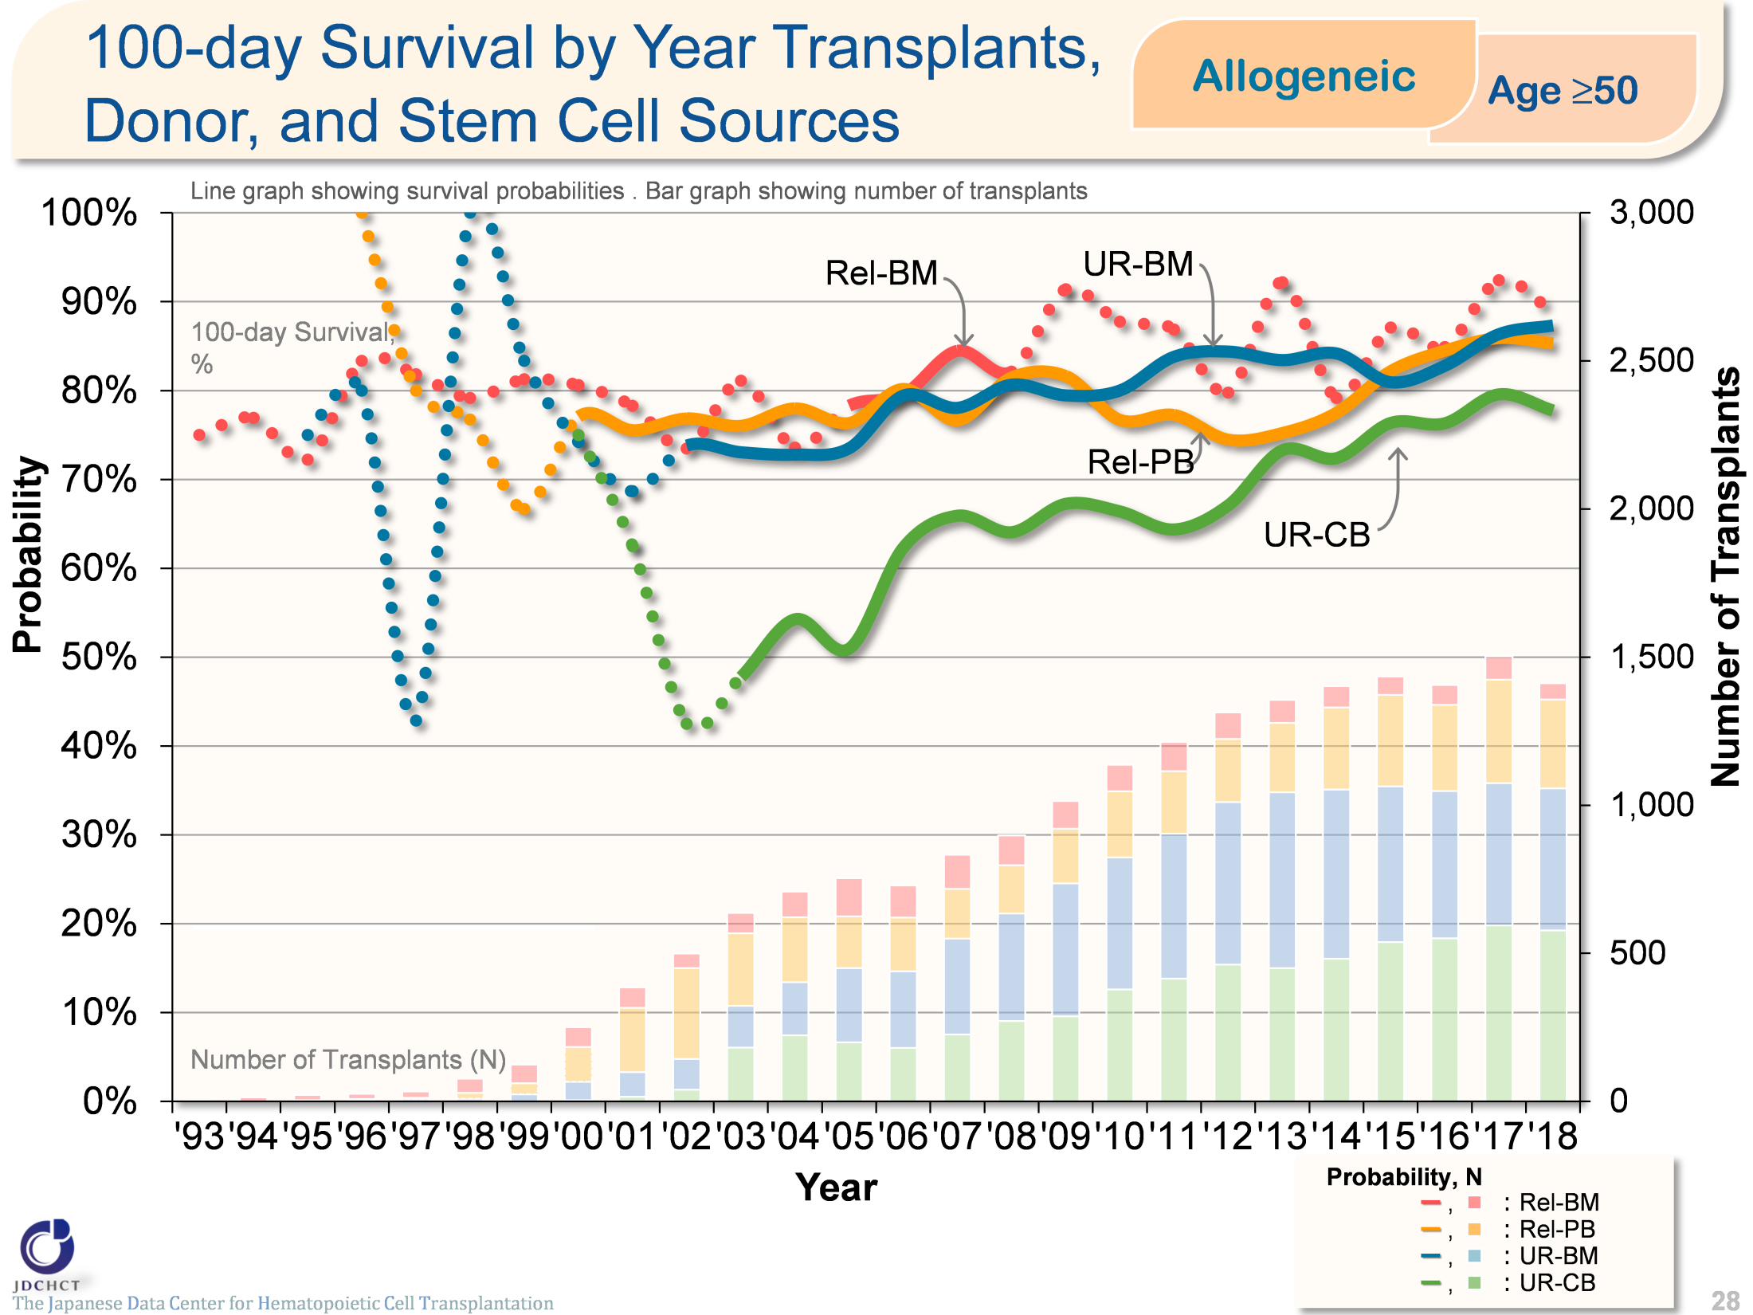
100-day Survival by Year of Allogeneic Transplants,
Donor, and Stem Cell Sources (Age≥50)
The Japanese Data Center for Hematopoietic Cell Transplantation
Notes:
In those aged 50 years or older (≥50), the survival probabilities 100 days after transplantation from unrelated donors have shown increasing trends over the last decade.
※This table shows the results of analysis performed on patients who received first transplants.
※The dotted lines (…) indicate the survival probabilities calculated when the number of transplants was below 100.

Slide 29
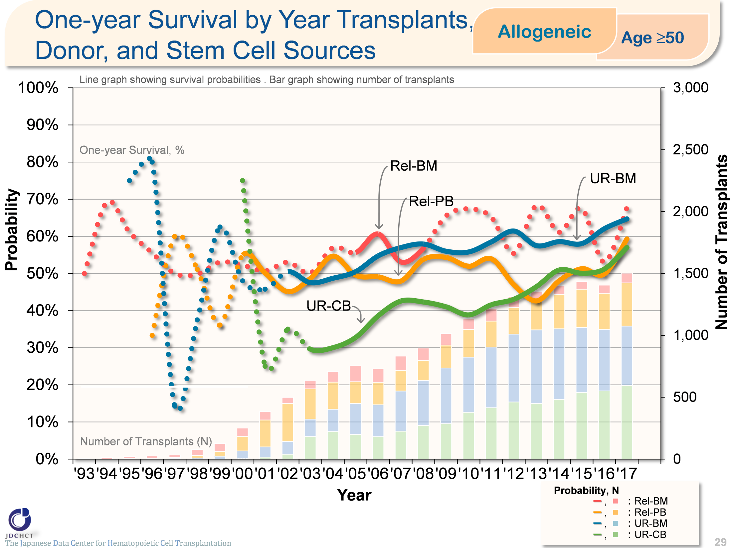
One-year Survival by Year of Allogeneic Transplants,
Donor, and Stem Cell Sources (Age≥50)
The Japanese Data Center for Hematopoietic Cell Transplantation
Notes:
In those aged 50 years or older (≥50), the survival probabilities 365 days after transplantation from unrelated donors have shown increasing trends over the last decade.
※This table shows the results of analysis performed on patients who received first transplants.
※The dotted lines (…) indicate the survival probabilities calculated when the number of transplants was below 100.

Slide 30
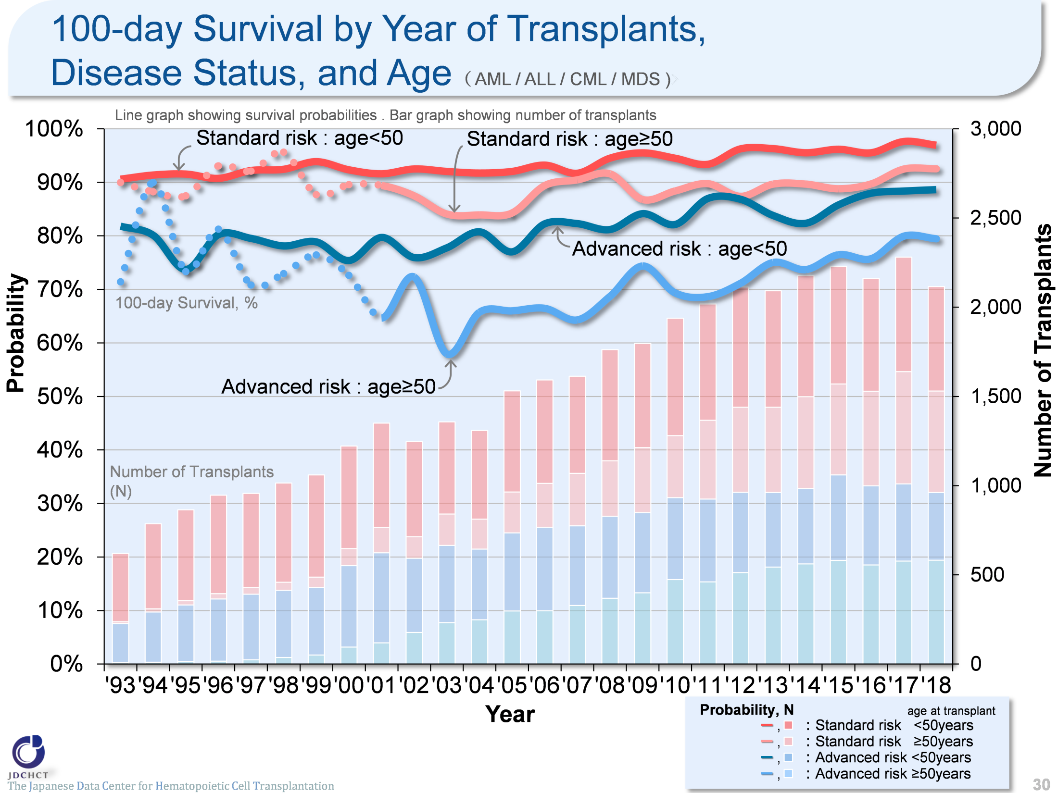
100-day Survival by Year of Transplants,
Disease Status, and Age
（ AML / ALL / CML / MDS )
The Japanese Data Center for Hematopoietic Cell Transplantation
Notes:
The survival probabilities 100 days after transplantation in the advanced risk group of patients with leukemia have shown increasing trends over the last 10 years in the subgroup of recipients aged 49 years or younger (<50). In the subgroup of recipients aged 50 years or older (≥50), the number of transplants increased and the outcome of transplantation improved, when compared with the situation 10 years ago.
※This table shows the results of analysis performed on patients who received first transplants.
※The dotted lines (…) indicate the survival probabilities calculated when the number of transplants was below 100.
―≪Disease risk status at transplantation≫―――――――――
■Standard Risk Group
・AML (1CR／2CR)
・ALL (1CR)
・CML (1CP)
・MDS (RA ／RARS)
■Advanced Risk Group
・all other conditions
―――――――――――――――――――――――――――――

Slide 31
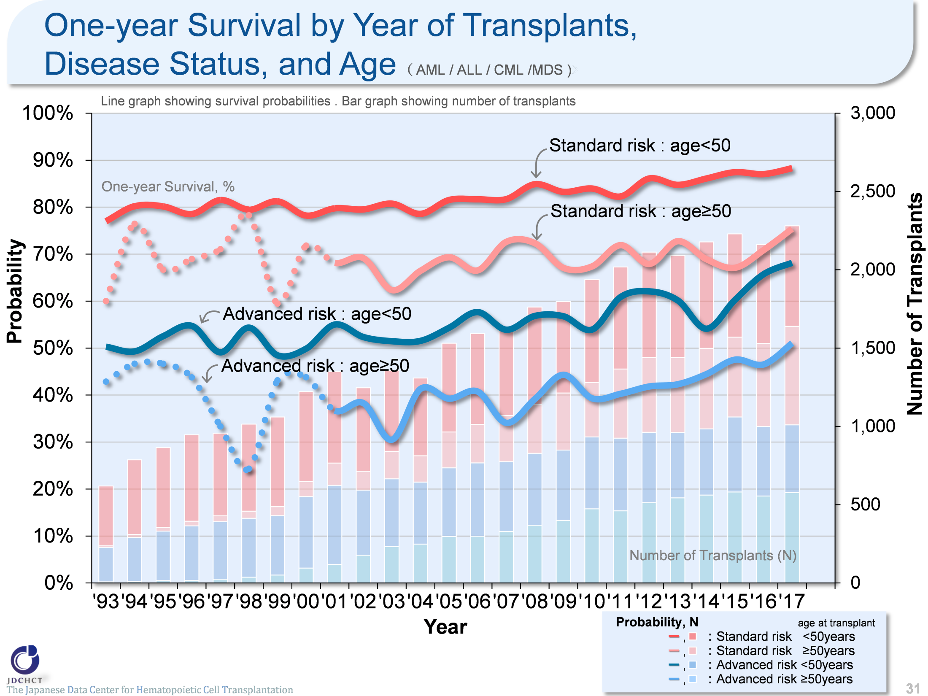
One-year Survival by Year of Transplants,
Disease Status, and Age
（ AML / ALL / CML /MDS )
The Japanese Data Center for Hematopoietic Cell Transplantation
Notes:
The survival probabilities 365 days after transplantation in patients with leukemia have shown slightly increasing trends or have leveled off over the last 10 years. Comparison of the younger patients and the older patients in each risk group has revealed that the outcome of transplantation is slightly better in the younger patient group.
※This table shows the results of analysis performed on patients who received first transplants.
※The dotted lines (…) indicate the survival probabilities calculated when the number of transplants was below 100.
―≪Disease risk status at transplantation≫―――――――――
■Standard Risk Group
・AML (1CR／2CR)
・ALL (1CR)
・CML (1CP)
・MDS (RA／RARS)
■Advanced Risk Group
・all other conditions
――――――――――――――――――――――――――――――

Slide 32
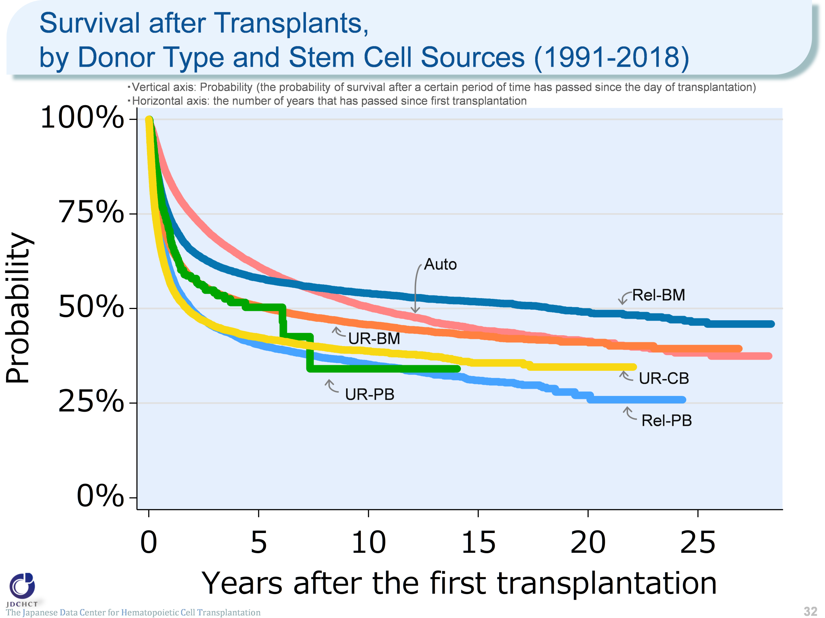
Survival after Transplants, by Donor Type and Stem Cell Sources (1991-2018)
The Japanese Data Center for Hematopoietic Cell Transplantation
32
Notes:
The survival probability in autologous transplants is 83.3% one year after transplantation, 61.1% five years after transplantation, and around 50% ten years after transplantation.
The survival probability in bone marrow transplants from related donors is 58.0% five years after transplantation and 54.0% ten years after transplantation. The survival probability in bone marrow transplants from unrelated donors is 50.6% five years after transplantation and 45.7% ten years after transplantation. In allogeneic transplants excluding peripheral blood stem cell transplants from unrelated donors which was introduced in 2010, the survival probabilities from the time of 5 years after transplantation onwards decline only modestly.
≪Probability of survival≫
Years after the first transplantation
N 1year 5years 10years
――――――――――――――――――――――――――――
Auto 32,653 83.3% 61.1% 50.4%
Rel-BM 11,500 73.5% 58.0% 54.0%
Rel-PB 10,381 59.5% 40.5% 35.3%
UR-BM 19,371 66.2% 50.6% 45.7%
UR-PB 559 68.5% 50.3% 34.1%
UR-CB 12,525 56.2% 42.4% 38.8%

Slide 33
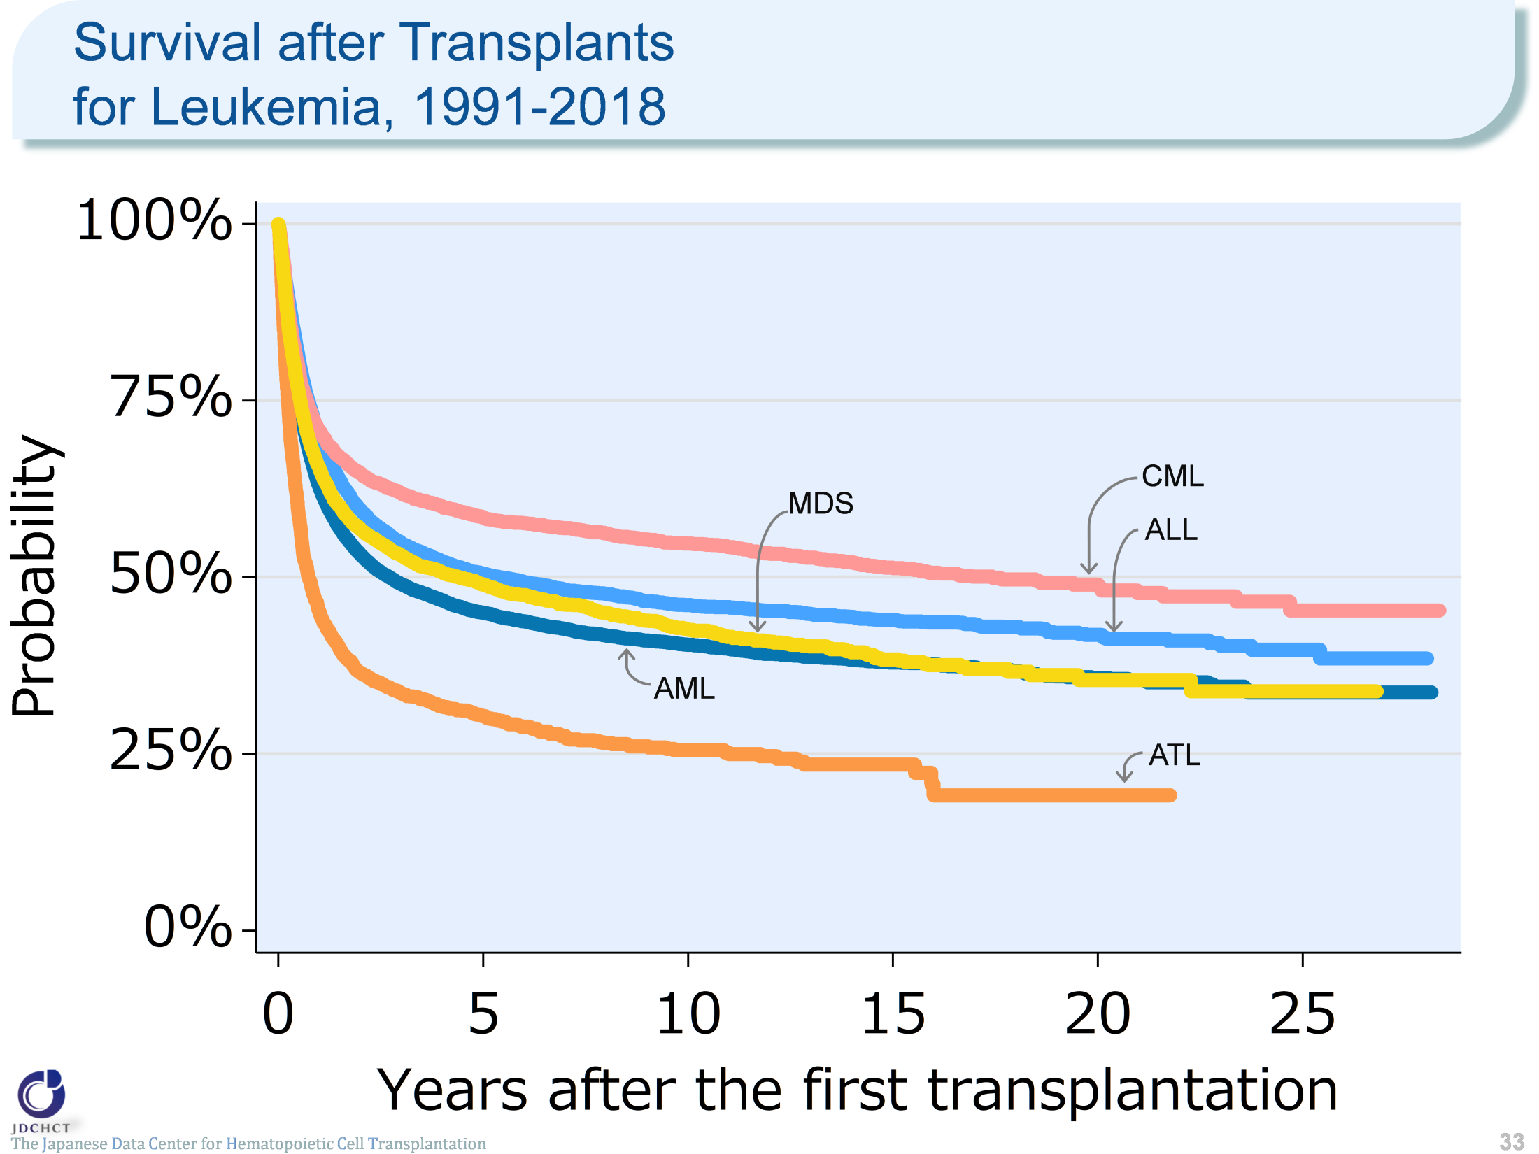
Survival after Transplants for Leukemia, 1991-2018
The Japanese Data Center for Hematopoietic Cell Transplantation
33
Notes:
In all types of acute leukemia, the survival probabilities are around 45% five years after transplantation and about 40% ten years after transplantation.
In chronic myelogenous leukemia, the spread of therapeutic drugs has reduced the number of transplants, and the survival probabilities both 5 and 10 years after transplantation are above 50%.
In adult T-cell leukemia, the survival probability is 45.1% one year after transplantation and 25.5 % ten years after transplantation, both of which are lower than the survival probabilities of the other types of leukemia.
≪Probability of survival≫
Years after the first transplantation
N 1year 5years 10years
――――――――――――――――――――――――――――
AML 21,521 62.8% 45.0% 40.5%
ALL 11,732 69.7% 50.5% 46.1%
ATL 2,342 45.1% 30.3% 25.5%
CML 3,577 70.7% 58.5% 54.8%
MDS 5,592 65.4% 48.9% 42.6%

Slide 34
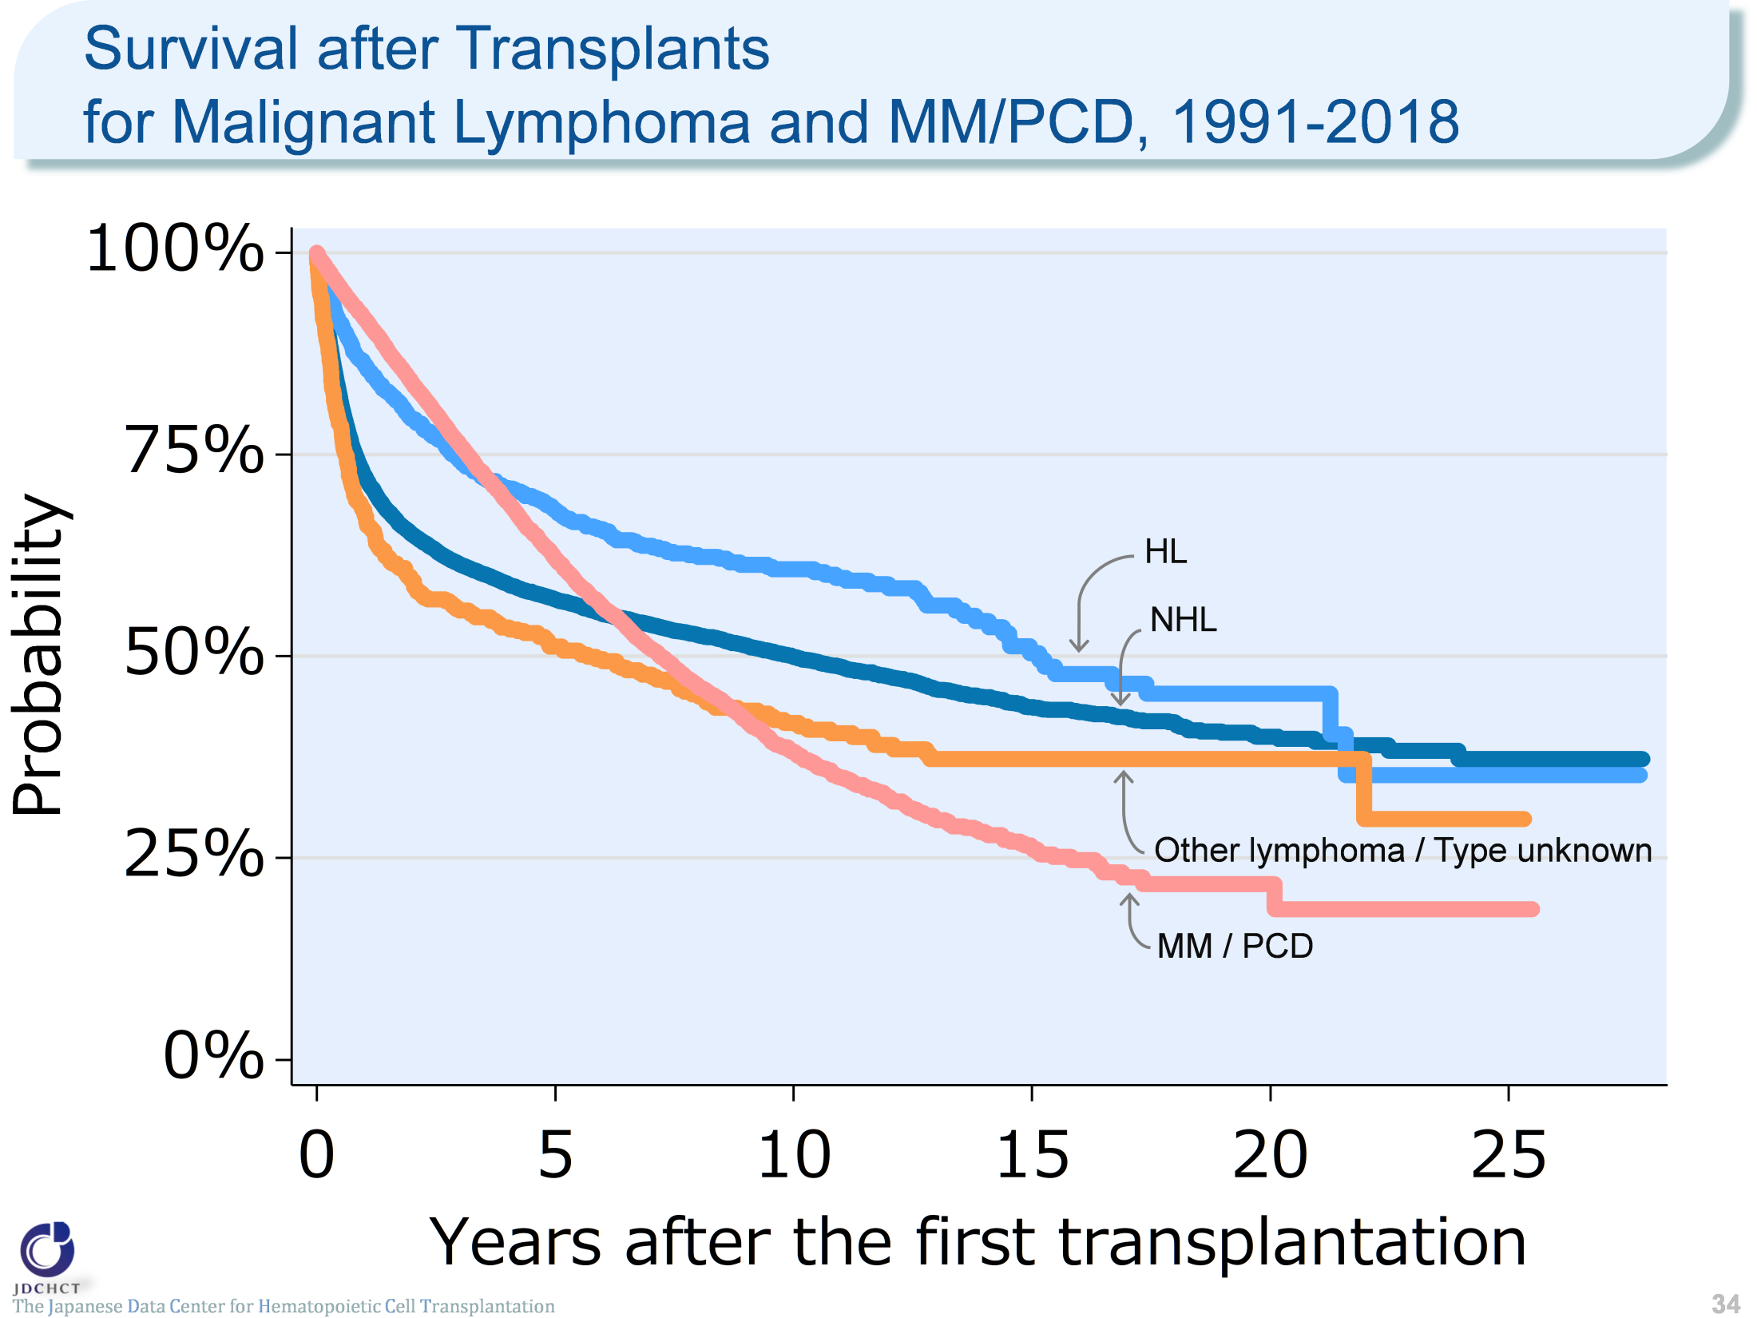
Survival after Transplants for Malignant Lymphoma and MM/PCD, 1991-2018
The Japanese Data Center for Hematopoietic Cell Transplantation
34
Notes:
In both non-Hodgkin lymphoma and Hodgkin lymphoma, the survival probabilities are around 60% five years after transplantation and around 50% ten years after transplantation. The survival probability one year after transplantation is slightly higher in Hodgkin lymphoma.
In approximately 97% of first transplants in plasma cell neoplasms including multiple myeloma, autologous transplants are performed. For the total autologous and allogeneic transplants, the survival probability one year after transplantation is as high as 91.8%, whereas the survival probability 10 years after transplantation is 38.2%.
≪Probability of survival≫
Years after the first transplantation
N 1year 5years 10years
――――――――――――――――――――――――――――――――――
NHL 18,672 72.4% 57.1% 49.9%
HL 1,495 86.2% 68.1% 60.8%
Other lymphoma 707 67.6% 51.2% 41.7%
/ type missing
MM/PCD 9,584 91.8% 62.1% 38.2%

Slide 35
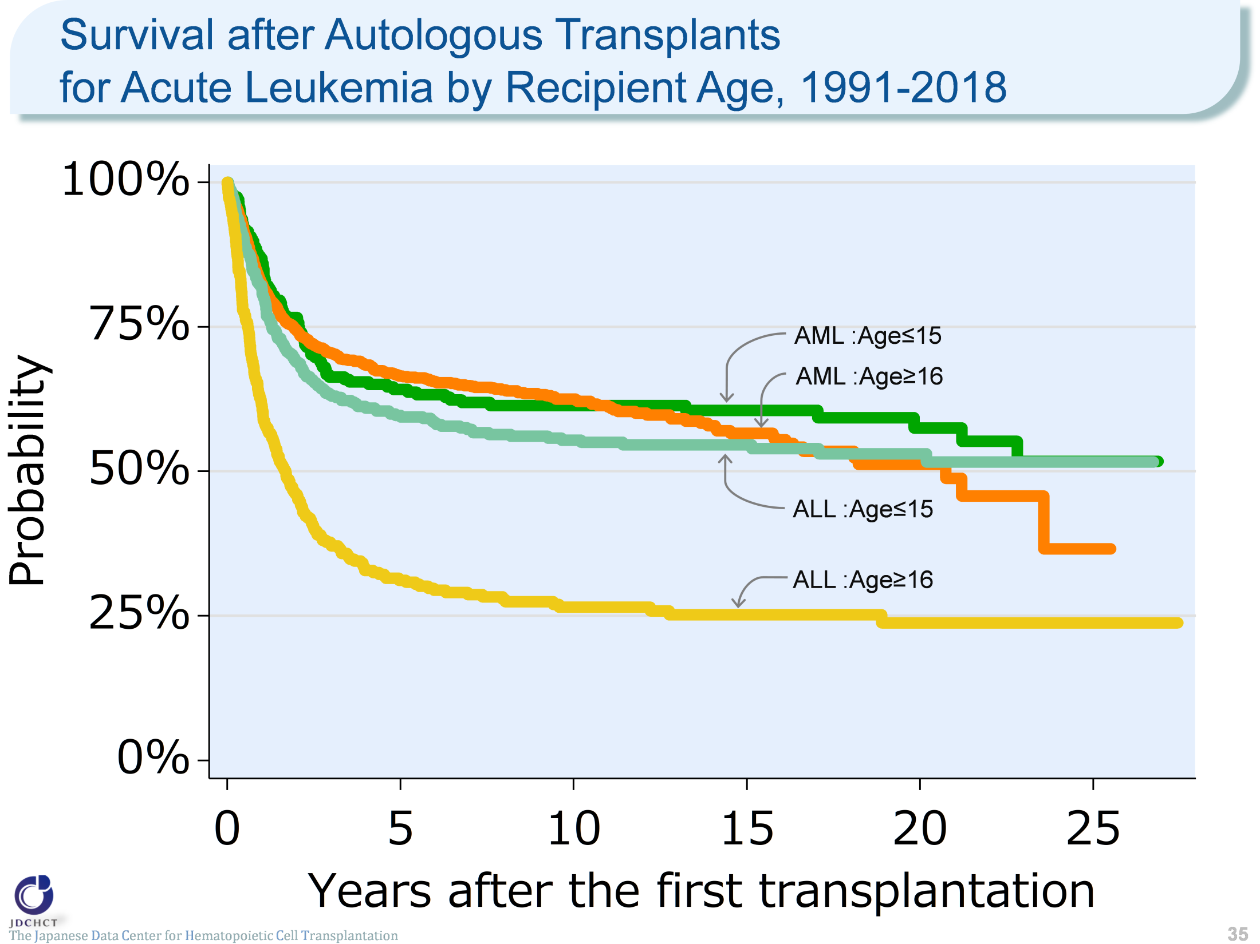
Survival after Autologous Transplants for Acute Leukemia by Recipient Age, 1991-2018
The Japanese Data Center for Hematopoietic Cell Transplantation
35
Notes:
In acute myeloid leukemia, the survival probabilities after autologous transplant are almost similar between recipients aged 0 to 15 years and those aged 16 years or older (≥16).
In acute lymphoblastic leukemia, the survival probability in those aged 16 years or older (≥16) is 31.2% and 26.5% five and ten years after autologous transplantation, respectively, indicating lower long-term survival probabilities in this age group than in pediatric patients.
≪Probability of survival≫
Years after the first transplantation
N 1year 5years 10years
――――――――――――――――――――――――――――――――――
AML Age≤15 235 86.8% 64.2% 61.4%
Age≥16 1,396 82.4% 66.5% 62.5%
ALL Age≤15 393 81.4% 59.7% 55.4%
Age≥16 341 61.2% 31.2% 26.5%

Slide 36
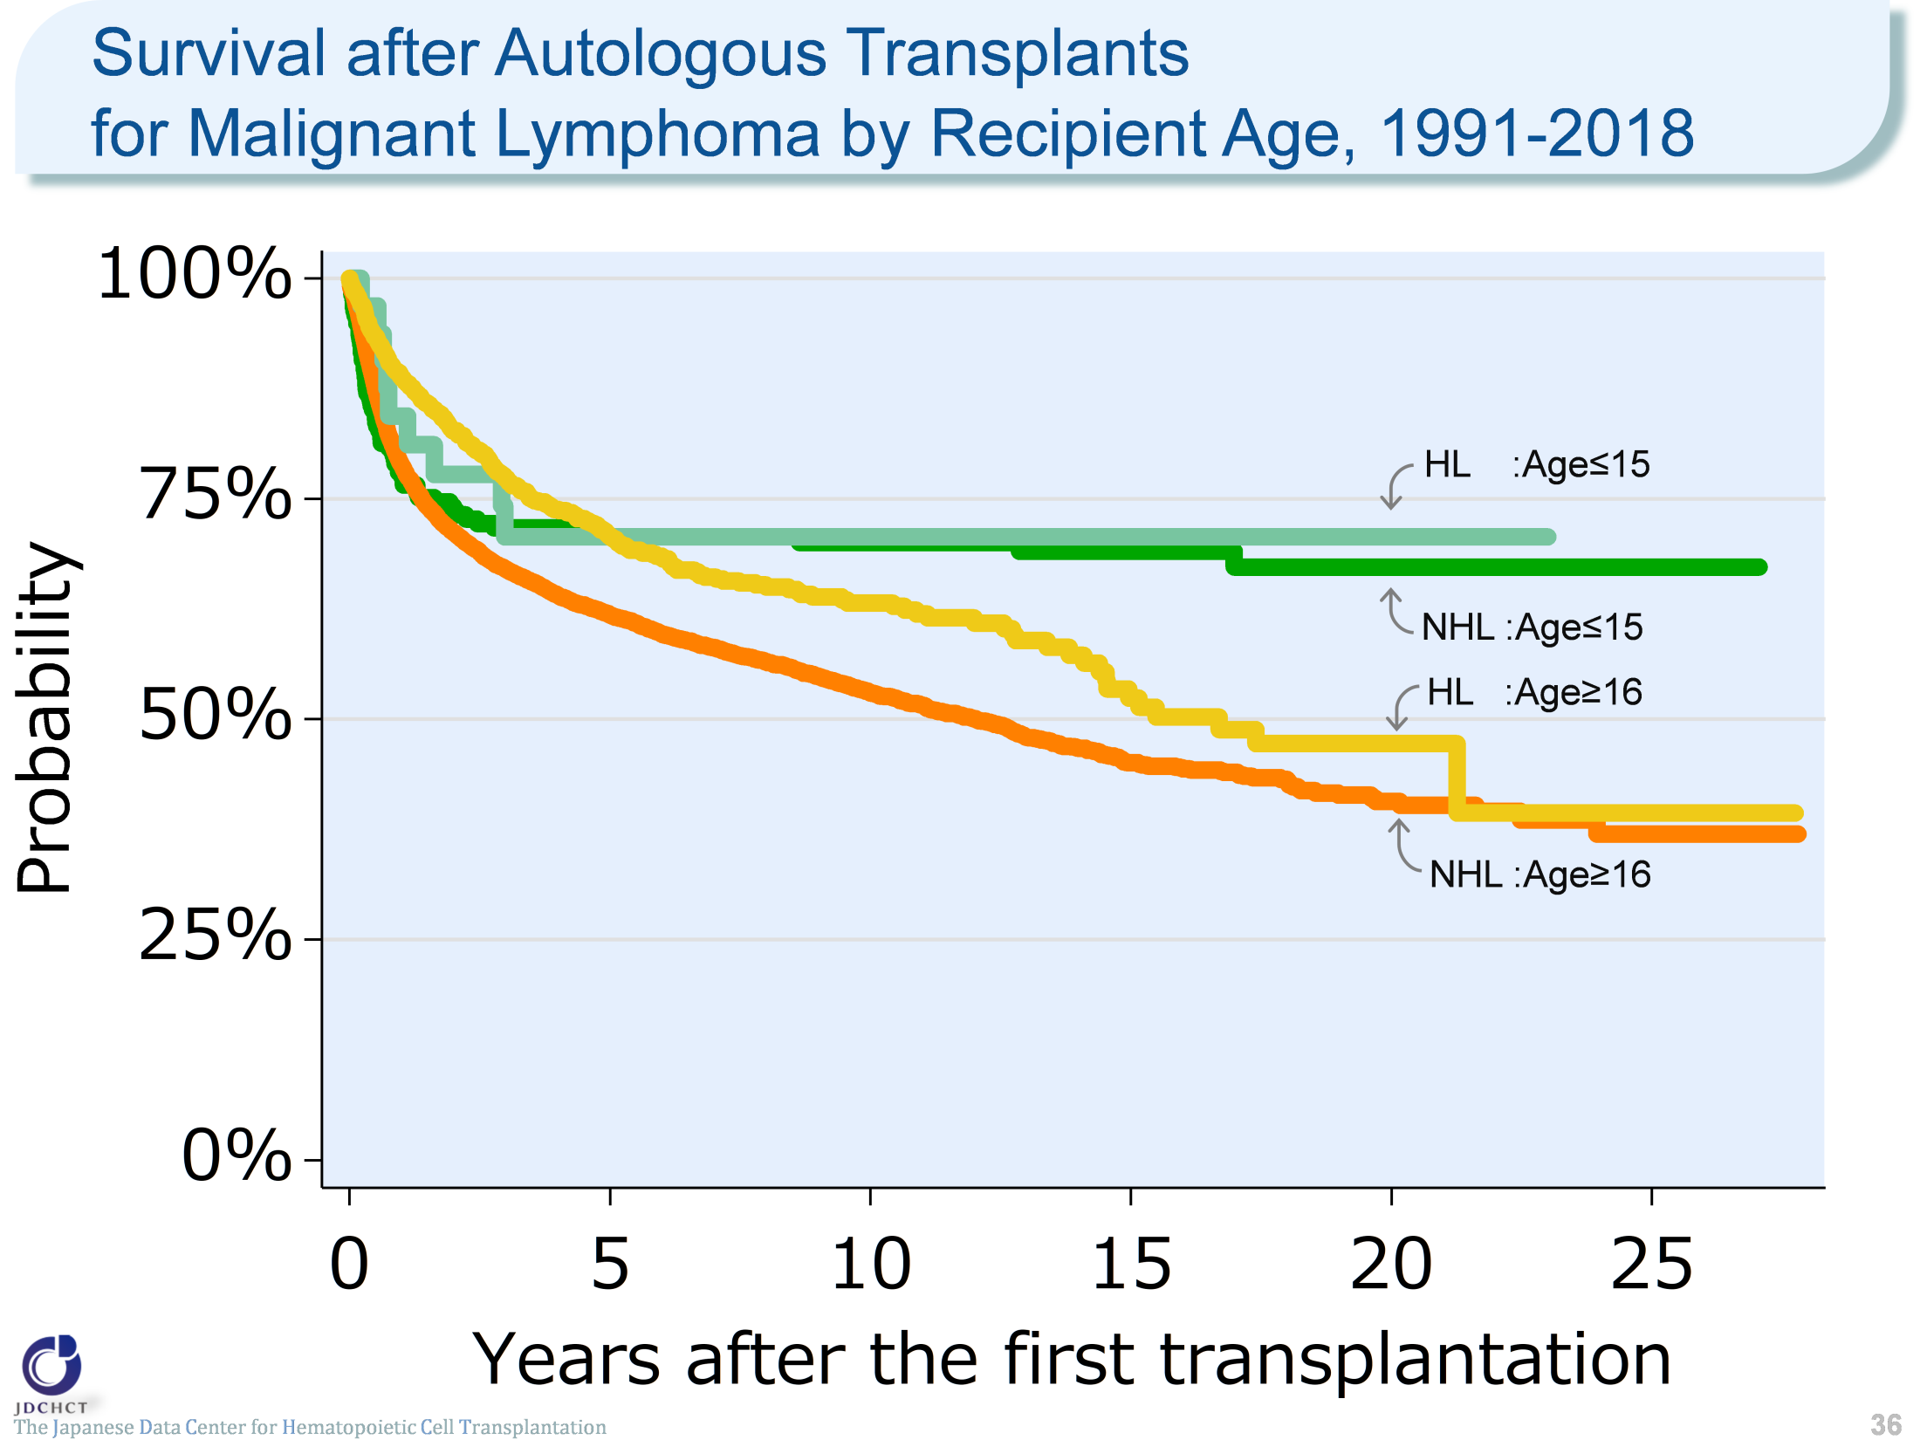
Survival after Autologous Transplants for Malignant Lymphoma by Recipient Age, 1991-2018
The Japanese Data Center for Hematopoietic Cell Transplantation
36
Notes:
In malignant lymphoma, non-Hodgkin lymphoma accounts for 89% of the total cases of first transplantation and Hodgkin lymphoma, less than 10%. These proportions are almost the same as those in the incidence rates of malignant lymphoma. The vast majority of transplants are autologous in recipients aged 16 years or older (≥16).
In both non-Hodgkin lymphoma and Hodgkin lymphoma, the survival probabilities 5 years after autologous transplantation are around 70% in recipients aged 0 to 15 years.
The survival probability in autologous transplant recipients aged 16 years or older (≥16) in Hodgkin lymphoma is as high as 88.8% one year after transplantation and is about 60% ten years after transplantation.
≪Probability of survival≫
Years after the first transplantation
N 1year 5years 10years
―――――――――――――――――――――――――――――――――
NHL Age≤15 215 78.0% 70.7% 70.0%
Age≥16 13,771 78.8% 61.9% 53.0%
HL Age≤15 33 84.4% 70.7% 70.7%
Age≥16 1,319 88.8% 70.7% 63.2%

Slide 37
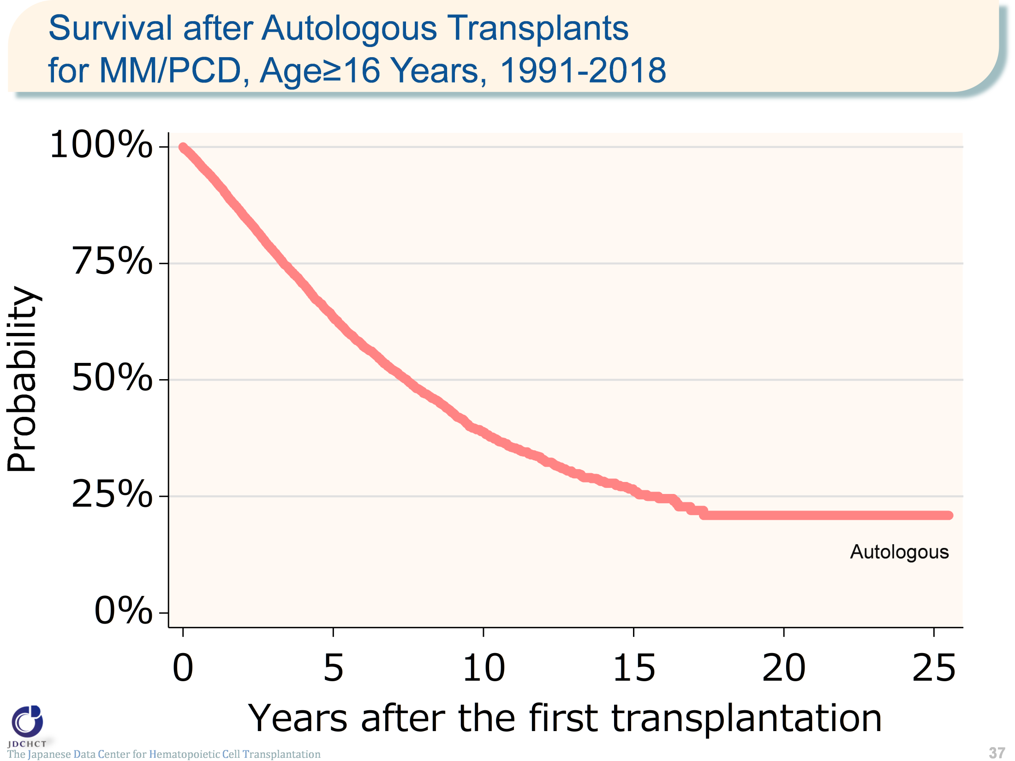
Survival after Autologous Transplants for MM/PCD, Age≥16 Years, 1991-2018
The Japanese Data Center for Hematopoietic Cell Transplantation
37
Notes:
Autologous transplants account for approximately 97% of the total cases of first transplantation for plasma cell neoplasms including multiple myeloma.
The survival probability is as high as 90% or more one year after transplantation, but decreases to 39% ten years after transplantation.
≪Probability of survival≫
Years after the first transplantation
N 1year 5years 10years
――――――――――――――――――――――――――――
Auto 9,274 93.2% 63.5% 38.8%

Slide 38
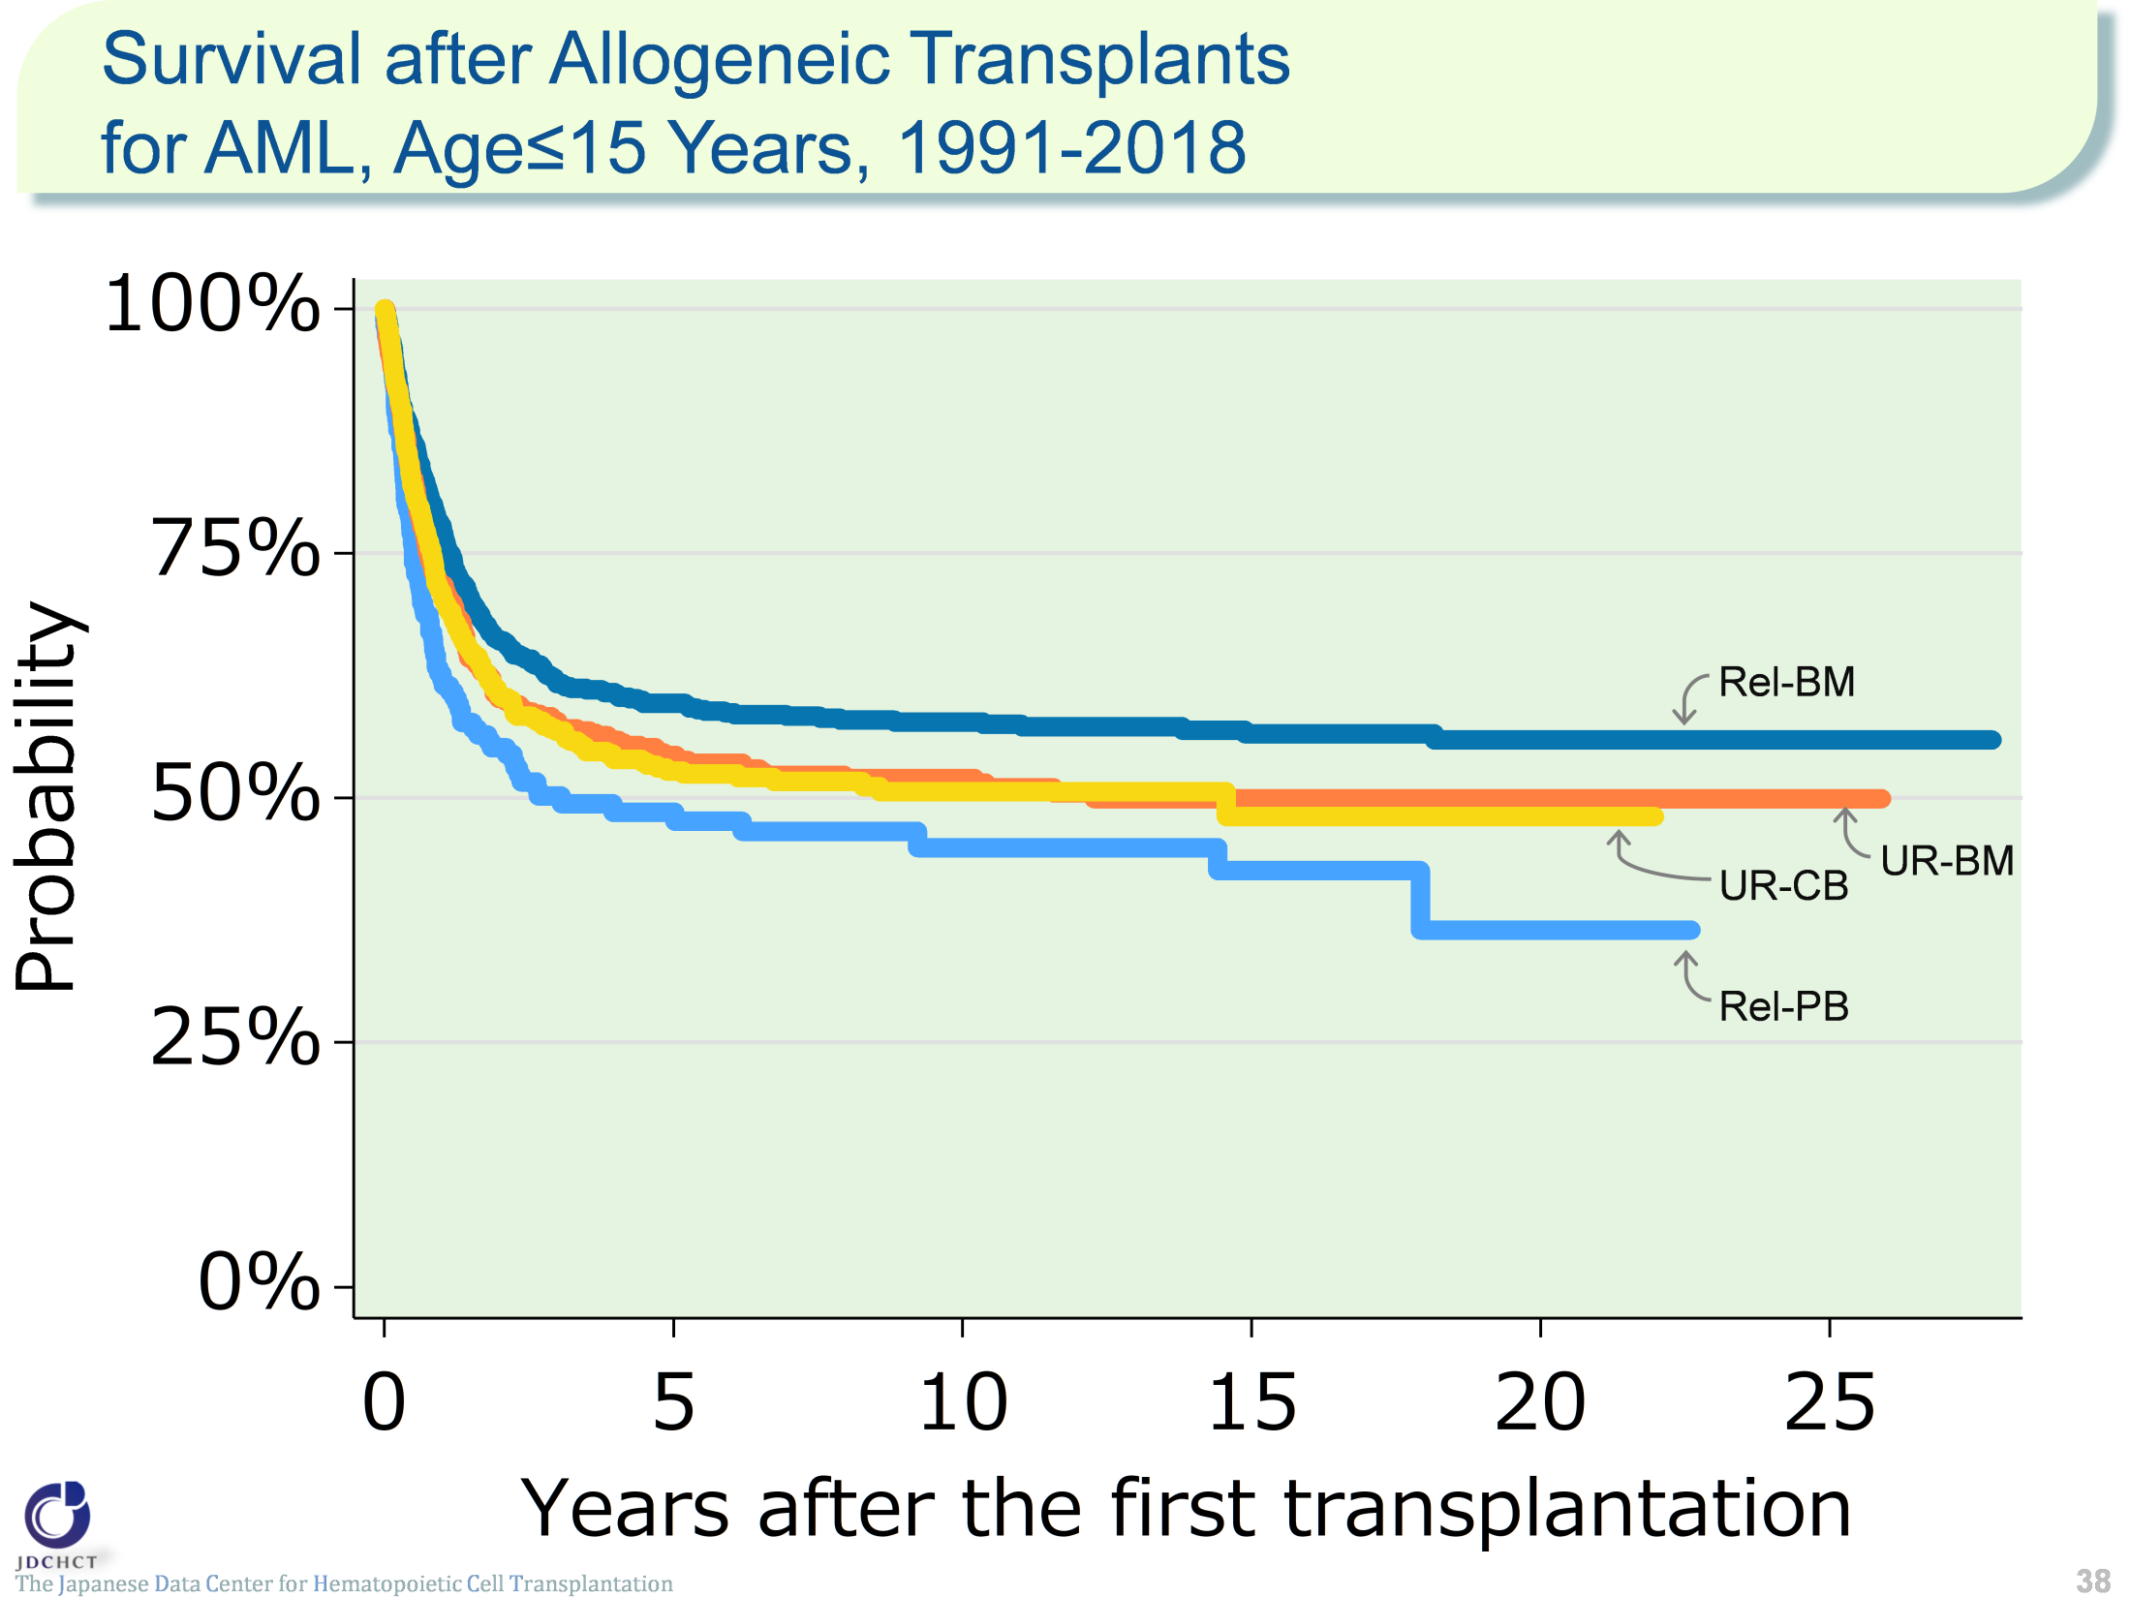
Survival after Allogeneic Transplants for AML, Age≤15 Years, 1991-2018
The Japanese Data Center for Hematopoietic Cell Transplantation
38
Notes:
For acute myeloid leukemia, allogeneic transplants account for approximately 90% of the total cases of transplantation, and bone marrow transplants from related donors are frequently performed in patients aged 15 years or younger (≤15). The survival probability 5 years after transplantation in registered patients who received first allogeneic transplants in the period between 1991 and 2018 is 59.7% for bone marrow transplants from related donors and about 50% for transplants from unrelated donors.
≪Probability of survival≫
Years after the first transplantation
N 1year 5years 10years
――――――――――――――――――――――――――――
Rel-BM 735 77.6% 59.7% 57.8%
Rel-PB 178 62.1% 48.6% 44.9%
UR-BM 464 71.7% 54.4% 52.0%
UR-CB 498 70.9% 52.8% 50.6%

Slide 39
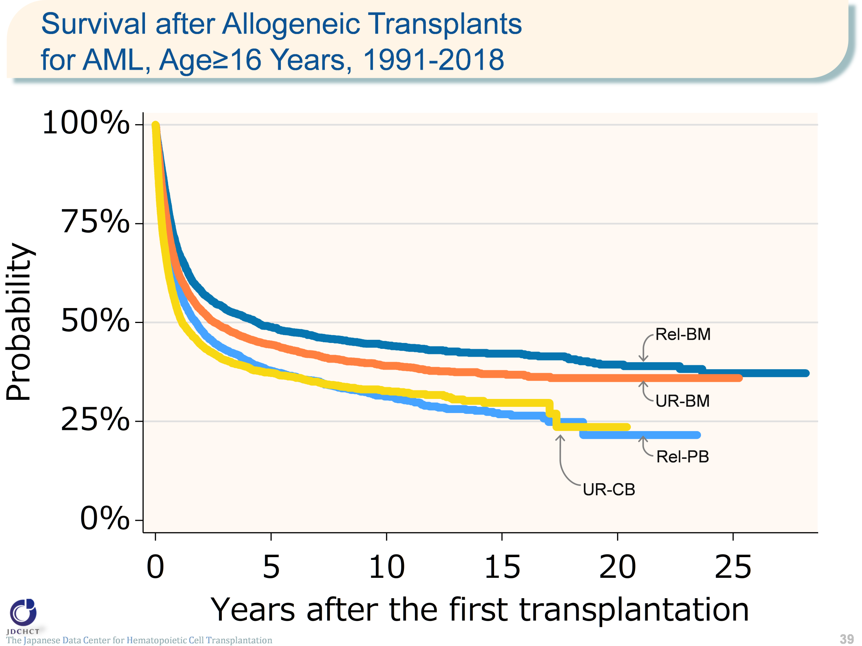
Survival after Allogeneic Transplants for AML, Age≥16 Years, 1991-2018
The Japanese Data Center for Hematopoietic Cell Transplantation
39
Notes:
For allogeneic transplants in patients with acute myeloid leukemia aged 16 years or older (≥16), bone marrow transplantation from unrelated donors is frequently performed. The survival probability 5 years after transplantation in registered patients who received first allogeneic transplants in the period between 1991 and 2018 ranges from 30% to 50% for both transplants from related and unrelated donors.
≪Probability of survival≫
Years after the first transplantation
N 1year 5years 10years
――――――――――――――――――――――――――――
Rel-BM 2,777 67.7% 48.9% 44.3%
Rel-PB 3,862 59.2% 37.8% 31.3%
UR-BM 6,211 62.4% 44.5% 39.1%
UR-CB 4,932 52.2% 37.3% 32.7%

Slide 40
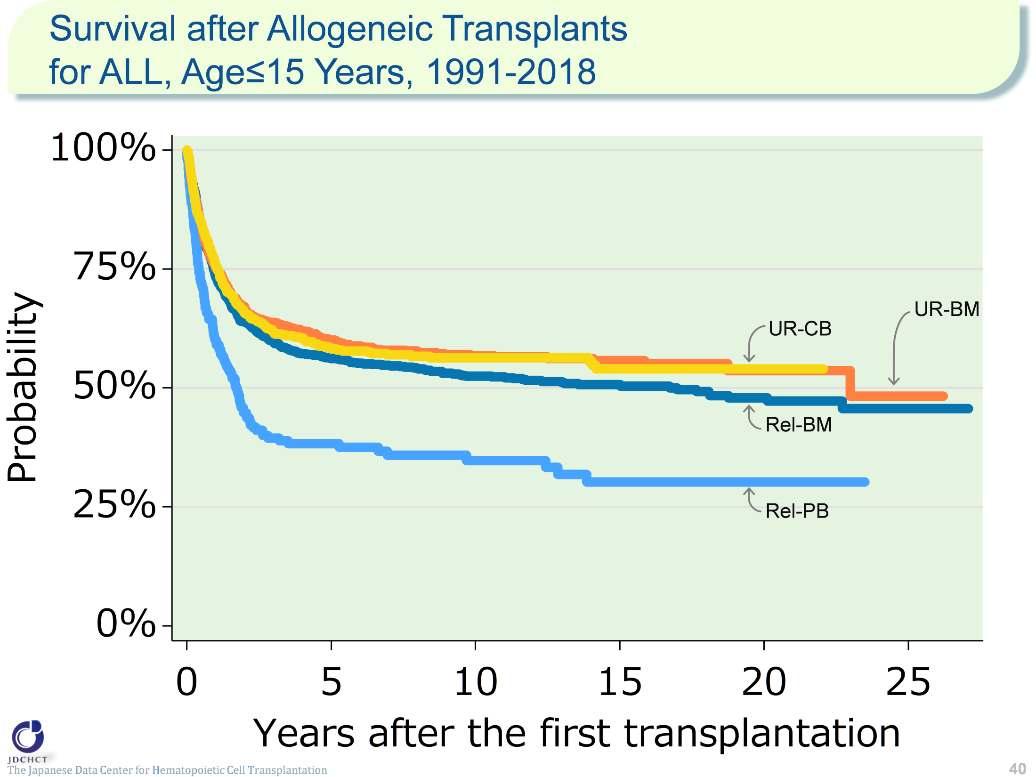
Survival after Allogeneic Transplants for ALL, Age≤15 Years, 1991-2018
The Japanese Data Center for Hematopoietic Cell Transplantation
40
Notes:
For acute lymphoblastic leukemia, allogeneic transplants account for approximately 90% of the total cases of transplantation, and bone marrow transplants from related donors are frequently performed in patients aged 15 years or younger (≤15). The survival probability 5 years after transplantation in registered patients who received first allogeneic transplants in the period between 1991 and 2018 is around 56% for bone marrow transplants from related donors and those from unrelated donors, and 38.3% for peripheral blood stem cell transplants from related donors. The decline in survival probabilities becomes moderate from the time of 5 years after transplantation onwards, and the survival probabilities 10 years after transplantation are more than 50% for both bone marrow transplants from related and unrelated donors.
≪Probability of survival≫
Years after the first transplantation
N 1year 5years 10years
――――――――――――――――――――――――――――
Rel-BM 1,102 73.4% 56.2% 52.5%
Rel-PB 218 60.1% 38.3% 34.7%
UR-BM 918 75.5% 60.1% 56.8%
UR-CB 774 75.8% 58.4% 56.3%

Slide 41
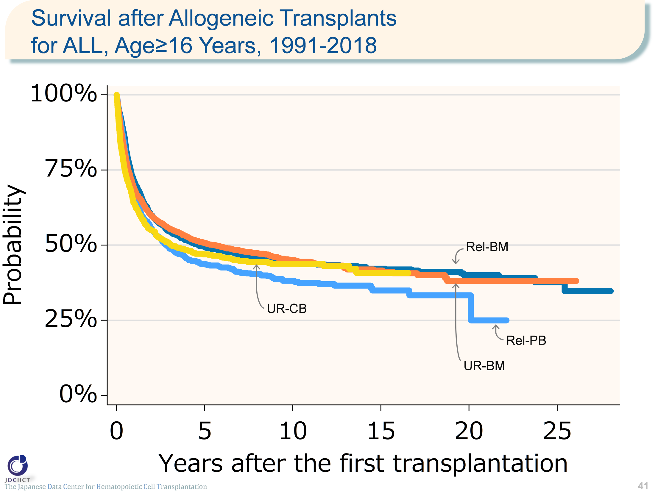
Survival after Allogeneic Transplants for ALL, Age≥16 Years, 1991-2018
The Japanese Data Center for Hematopoietic Cell Transplantation
41
Notes:
For allogeneic transplants in patients with acute lymphoblastic leukemia aged 16 years or older (≥16), bone marrow transplantation from unrelated donors is frequently performed. The survival probability 5 years after transplantation in registered patients who received first allogeneic transplants in the period between 1991 and 2018 is around 45% for both transplants from related and unrelated donors.
≪Probability of survival≫
Years after the first transplantation
N 1year 5years 10years
――――――――――――――――――――――――――――
Rel-BM 1,626 71.3% 49.4% 44.0%
Rel-PB 1,537 67.0% 43.6% 38.1%
UR-BM 3,186 68.7% 50.7% 45.0%
UR-CB 1,554 63.8% 46.9% 43.8%

Slide 42
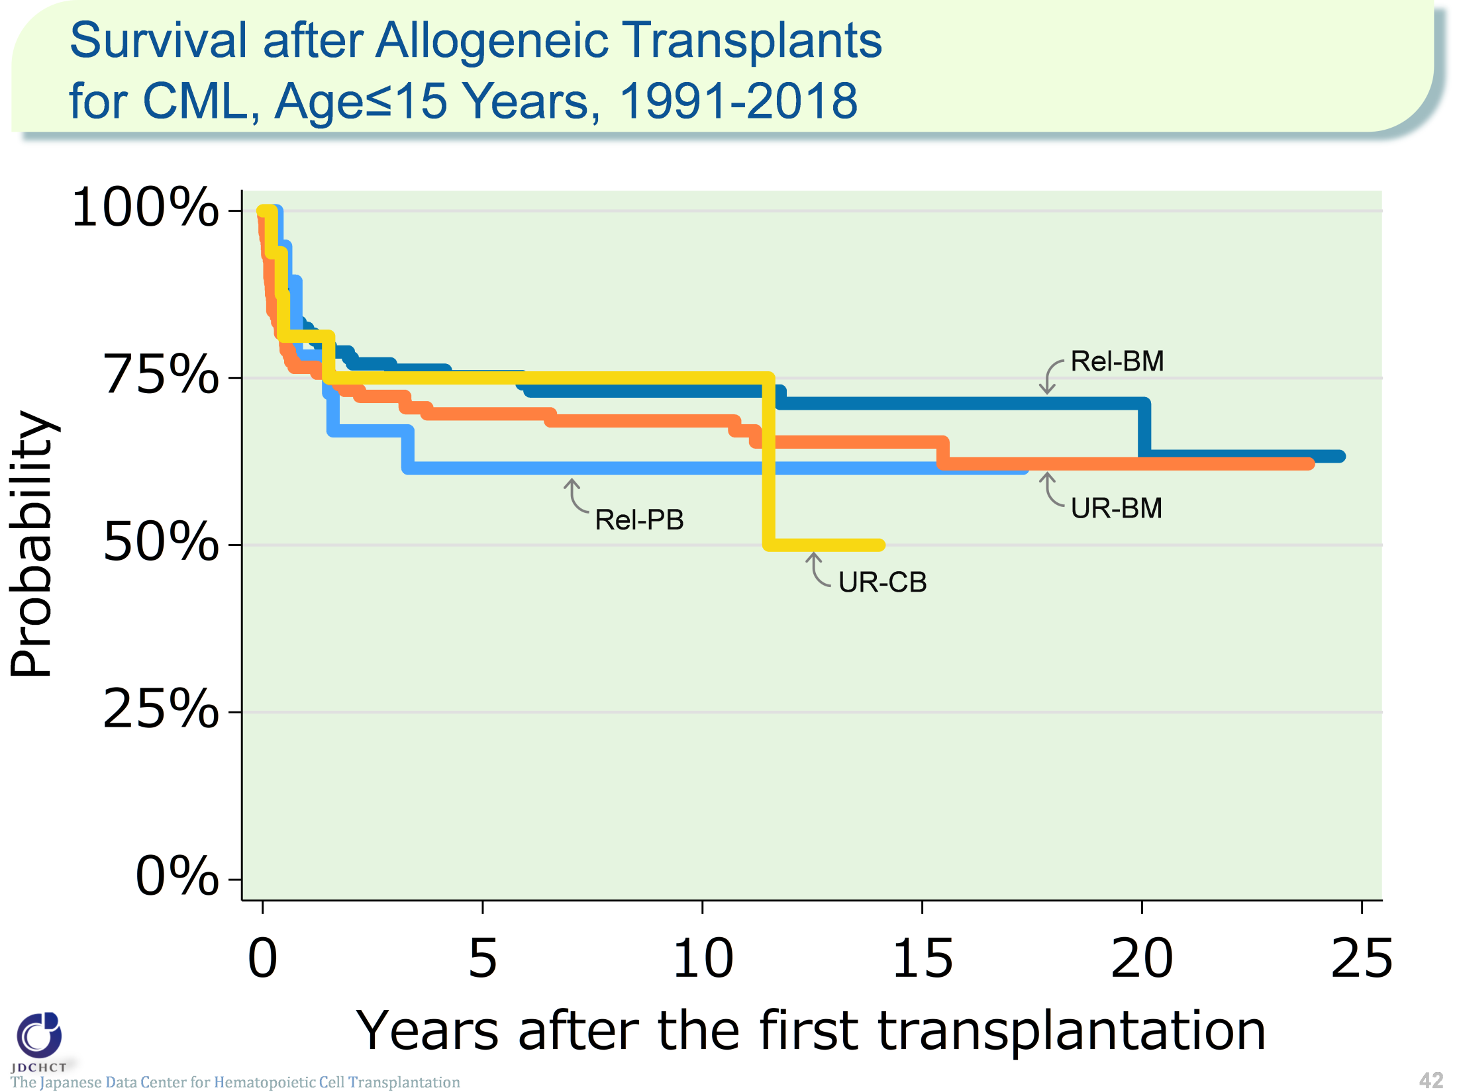
Survival after Allogeneic Transplants for CML, Age≤15 Years, 1991-2018
The Japanese Data Center for Hematopoietic Cell Transplantation
※Cases of cord blood transplantation (first transplantation) from unrelated donors in patients
with chronic myeloid leukemia aged 0 to 15 years are small in number and are not included in this analysis.
42
Notes:
The number of patients with chronic myeloid leukemia aged 15 years or younger (≤15) is small, for whom bone marrow transplants from related or unrelated donors are frequently performed. The survival probability 5 years after transplantation in registered patients who received first allogeneic transplants in the period between 1991 and 2018 is 75.2% for bone marrow transplants from related donors, and 69.6% for bone marrow transplants from unrelated donors. The decline in survival probabilities becomes moderate from the time of 5 years after transplantation onwards, and the survival probabilities 10 years after transplantation are more than 60% for both transplants from related and unrelated donors.
≪Probability of survival≫
Years after the first transplantation
N 1year 5years 10years
――――――――――――――――――――――――――――
Rel-BM 114 82.5% 75.2% 73.1%
Rel-PB 19 78.3% 61.5% 61.5%
UR-BM 120 76.6% 69.6% 68.6%
UR-CB 16 81.3% 75.0% 75.0%

Slide 43
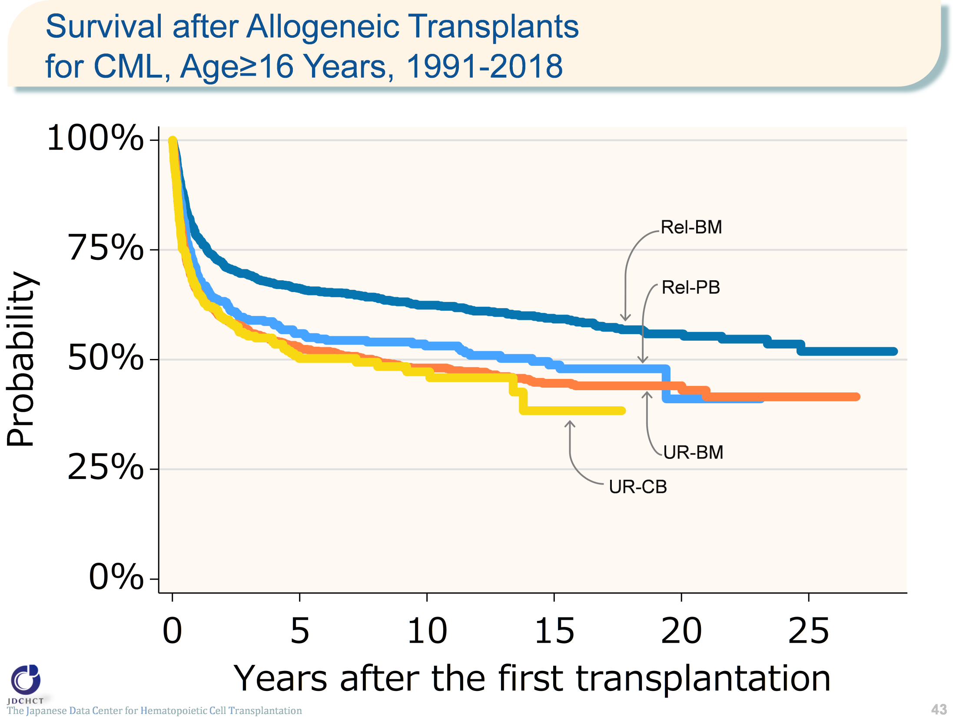
Survival after Allogeneic Transplants for CML, Age≥16 Years, 1991-2018
The Japanese Data Center for Hematopoietic Cell Transplantation
43
Notes:
For chronic myeloid leukemia, the vast majority of transplants in patients with the disease are allogeneic and bone marrow transplants from unrelated donors are frequently performed in those aged 16 years or older (≥16). The survival probability 5 years after transplantation in registered patients who received first allogeneic transplants in the period between 1991 and 2018 is 66.2% for bone marrow transplants from related donors, 56.0% for peripheral blood stem cell transplants from related donors, 52.8% for bone marrow transplants from unrelated donors, and 50.3% for cord blood transplants from unrelated donors. Ten years after transplantation, the survival probability is below 50% for transplants from unrelated donors.
≪Probability of survival≫
Years after the first transplantation
N 1year 5years 10years
――――――――――――――――――――――――――――
Rel-BM 1,095 77.9% 66.2% 62.4%
Rel-PB 496 69.0% 56.0% 53.1%
UR-BM 1,358 65.5% 52.8% 48.1%
UR-CB 308 65.0% 50.3% 47.2%

Slide 44
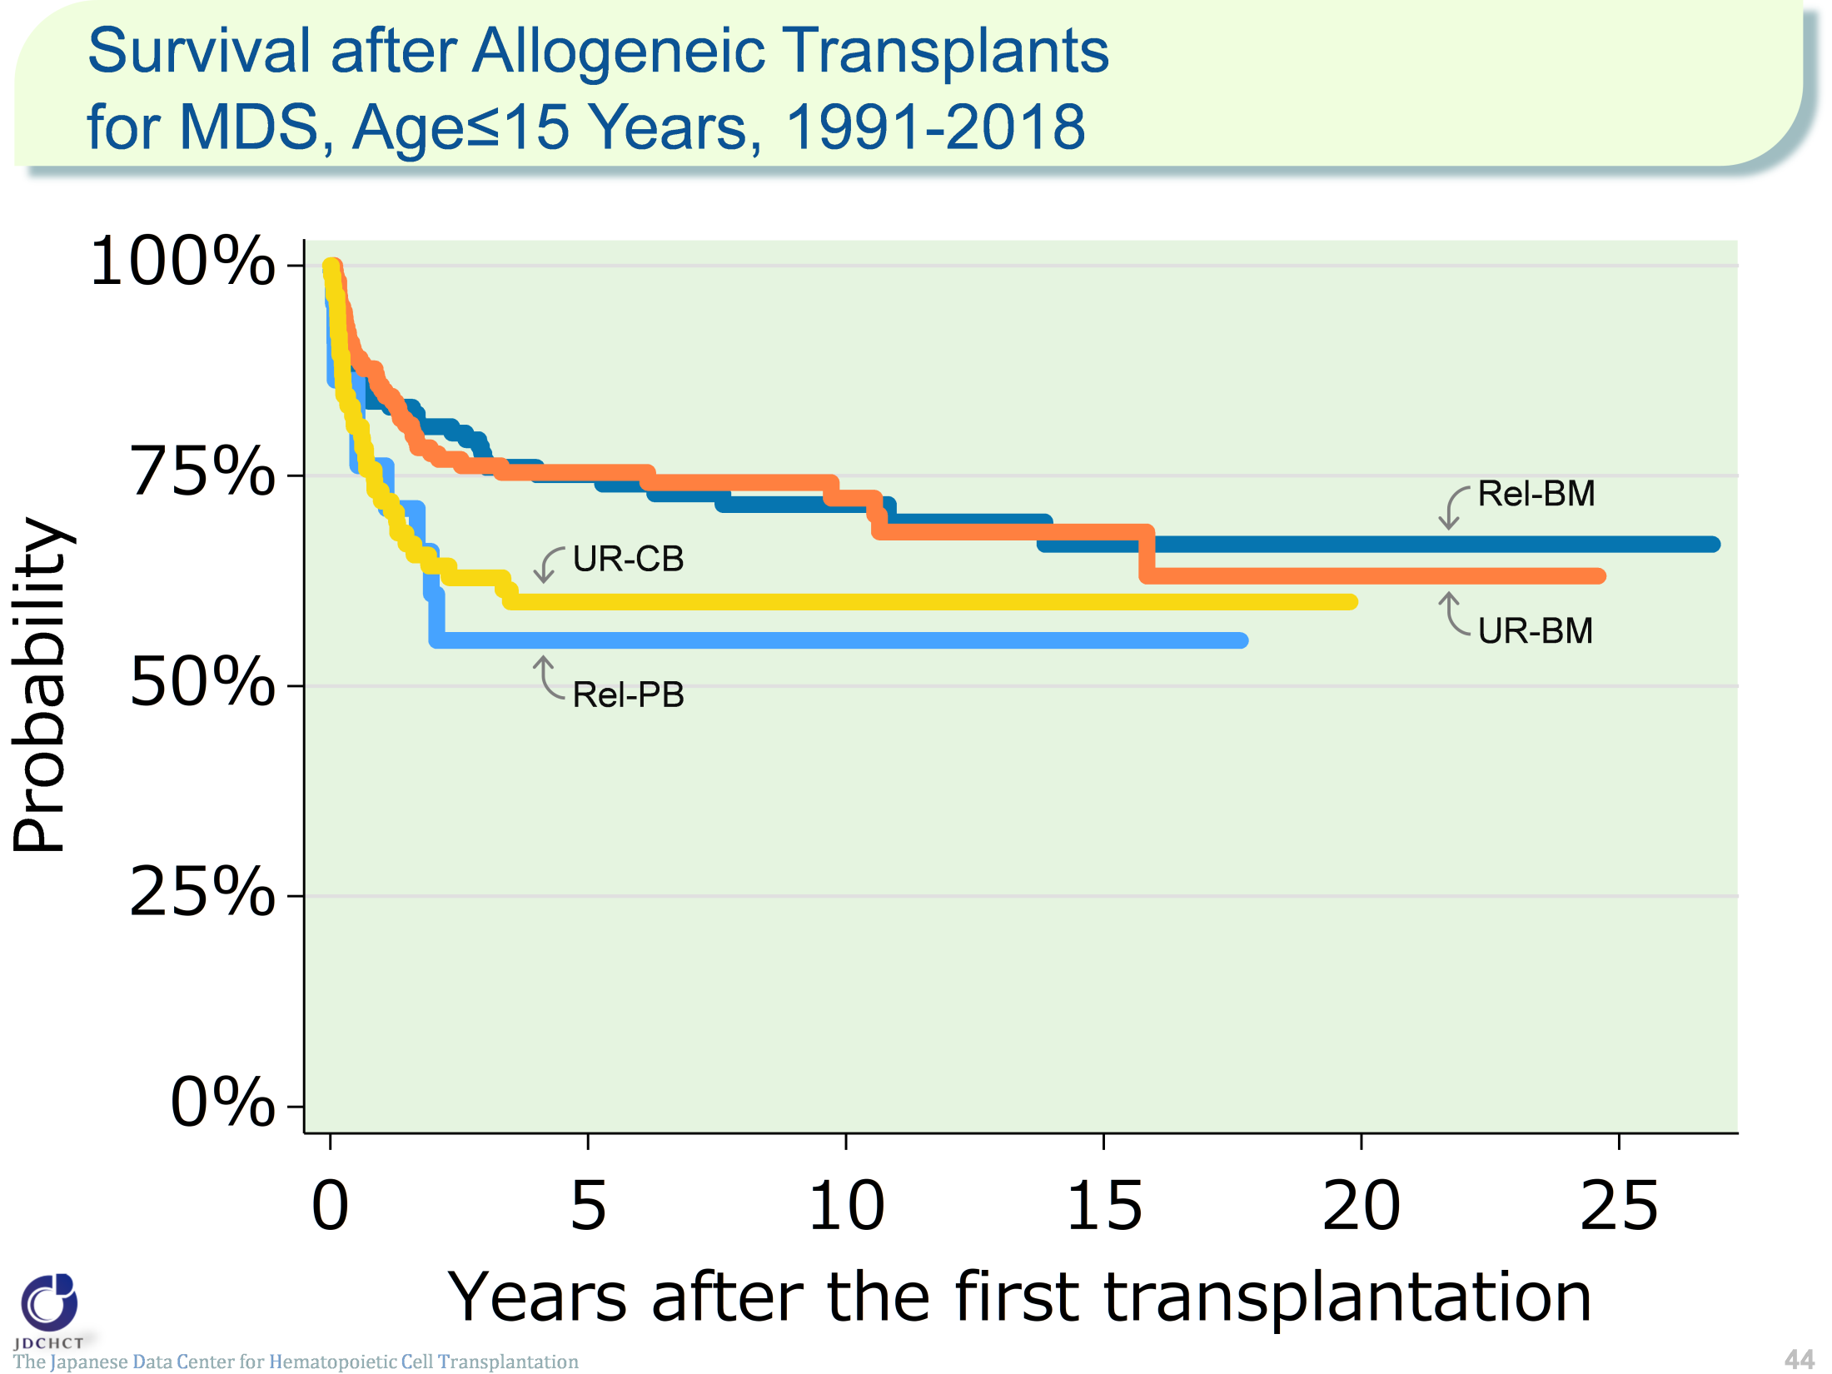
Survival after Allogeneic Transplants for MDS, Age≤15 Years, 1991-2018
The Japanese Data Center for Hematopoietic Cell Transplantation
44
Notes:
For myelodysplastic syndrome, the vast majority of transplants in patients with the syndrome are allogeneic and bone marrow transplants from related or unrelated donors are frequently performed in those aged 15 years or younger (≤15). The survival probability 5 years after transplantation in registered patients who received first allogeneic transplants in the period between 1991 and 2018 is 75.1% for bone marrow transplants from related donors, 55.4% for peripheral blood stem cell transplants from related donors, 75.4% for bone marrow transplants from unrelated donors, and 60.0% for cord blood transplants from unrelated donors. The decline in survival probabilities becomes moderate from the time of 5 years after transplantation onwards, and the survival probabilities are more than 50% for both transplants from related and unrelated donors.
≪Probability of survival≫
Years after the first transplantation
N 1year 5years 10years
――――――――――――――――――――――――――――
Rel-BM 143 83.9% 75.1% 71.6%
Rel-PB 22 76.2% 55.4% 55.4%
UR-BM 165 85.1% 75.4% 72.4%
UR-CB 85 72.0% 60.0% 60.0%

Slide 45
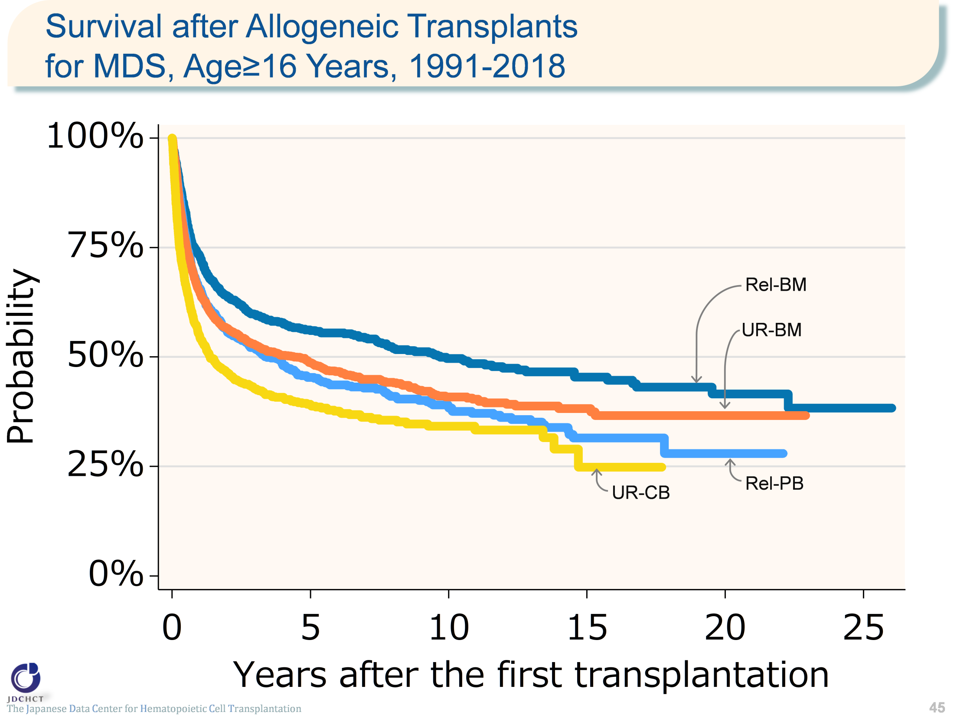
Survival after Allogeneic Transplants for MDS, Age≥16 Years, 1991-2018
The Japanese Data Center for Hematopoietic Cell Transplantation
45
Notes:
For allogeneic transplants in patients with myelodysplastic syndrome aged 16 years or older (≥16), bone marrow transplantation from unrelated donors is frequently performed. The survival probability 5 years after transplantation in registered patients who received first allogeneic transplants in the period between 1991 and 2018 is 56.0% for bone marrow transplants from related donors and below 50% for both peripheral blood stem cell transplants from related donors and transplants from unrelated donors.
≪Probability of survival≫
Years after the first transplantation
N 1year 5years 10years
――――――――――――――――――――――――――――
Rel-BM 760 73.0% 56.0% 49.7%
Rel-PB 957 65.6% 45.3% 38.7%
UR-BM 2,178 64.9% 48.7% 40.9%
UR-CB 1,153 54.6% 39.2% 34.2%

Slide 46
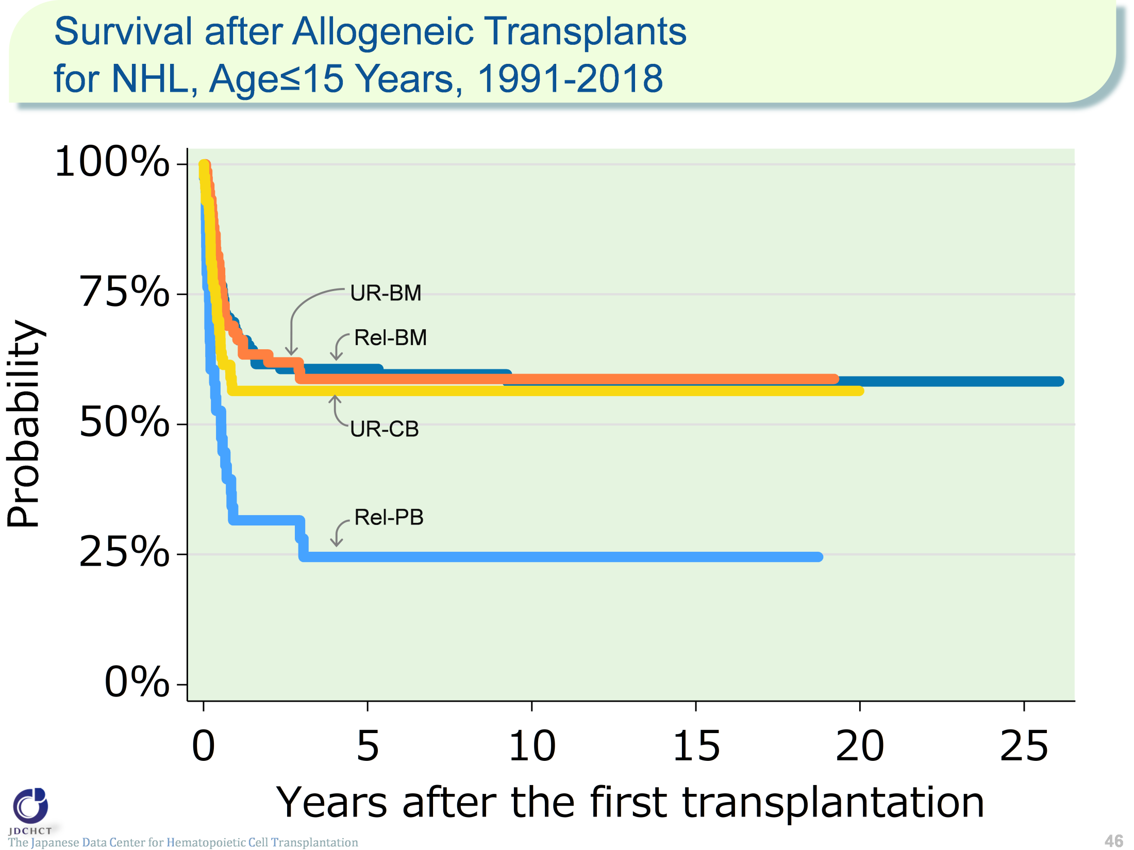
Survival after Allogeneic Transplants for NHL, Age≤15 Years, 1991-2018
The Japanese Data Center for Hematopoietic Cell Transplantation
46
Notes:
Approximately half the patients with non-Hodgkin lymphoma aged 15 years or younger (≤15) receive allogeneic transplants, for whom bone marrow transplantation from related donors is frequently performed. The survival probability 5 years after transplantation in registered patients who received first allogeneic transplants in the period between 1991 and 2018 is more than 50% for bone marrow transplants from related donors and for transplants from unrelated donors. From the time of 5 years after transplantation onward, the survival probability remains almost steady.
≪Probability of survival≫
Years after the first transplantation
N 1year 5years 10years
――――――――――――――――――――――――――――
Rel-BM 116 67.9% 60.7% 58.3%
Rel-PB 38 31.6% 24.6% 24.6%
UR-BM 75 67.6% 58.8% 58.8%
UR-CB 85 56.4% 56.4% 56.4%

Slide 47
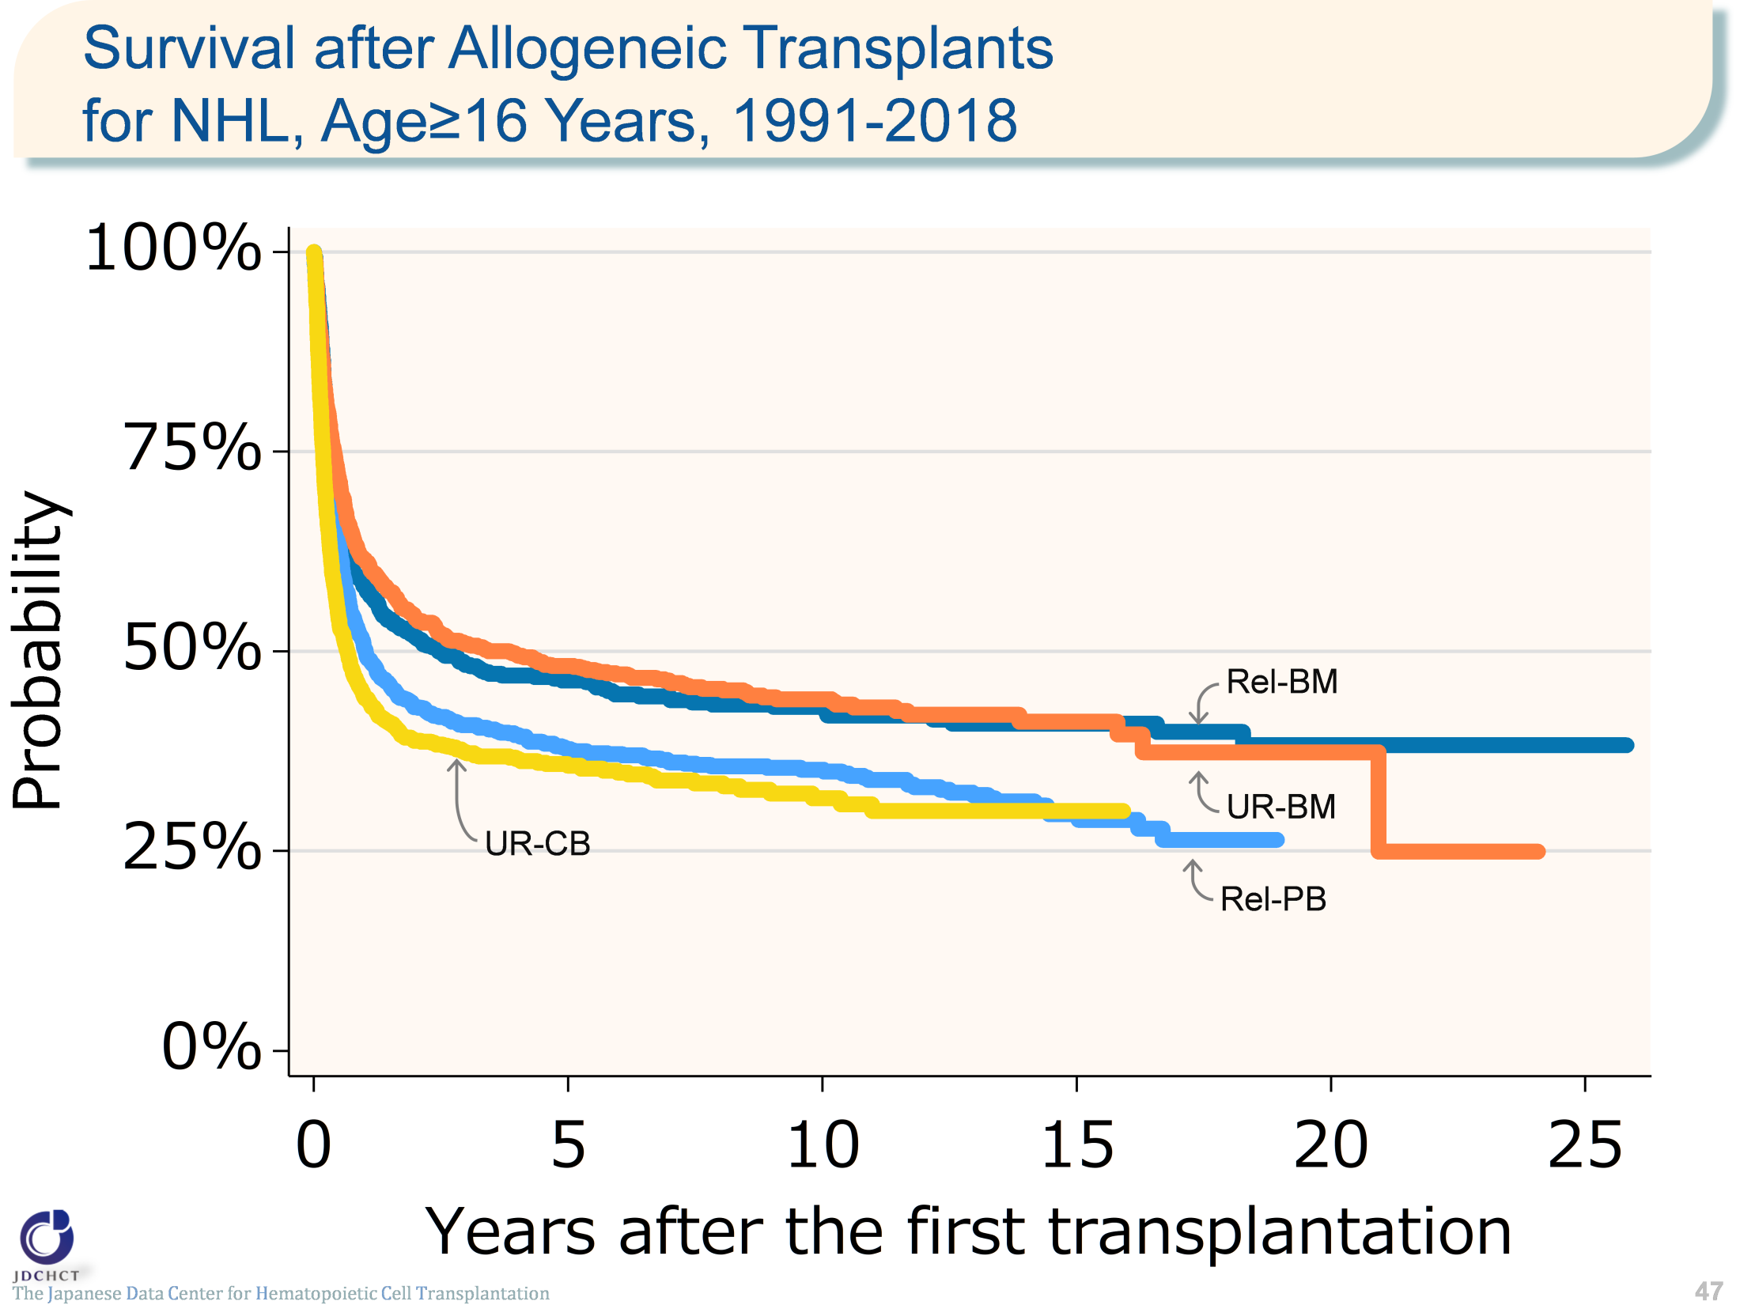
Survival after Allogeneic Transplants for NHL, Age≥16 Years, 1991-2018
The Japanese Data Center for Hematopoietic Cell Transplantation
47
Notes:
For allogeneic transplantation in patients with non-Hodgkin lymphoma aged 16 years or older (≥16), peripheral blood stem cell transplantation from related donors and bone marrow transplants from unrelated donors are frequently performed. The survival probability 5 years after transplantation in registered patients who received first allogeneic transplants in the period between 1991 and 2018 ranged from 30% to 50% for both transplants from related and unrelated donors.
≪Probability of survival≫
Years after the first transplantation
N 1year 5years 10years
――――――――――――――――――――――――――――
Rel-BM 594 58.2% 46.4% 43.0%
Rel-PB 1,355 50.2% 37.8% 35.2%
UR-BM 1,263 61.5% 48.2% 44.0%
UR-CB 1,107 44.3% 35.7% 31.6%

Slide 48
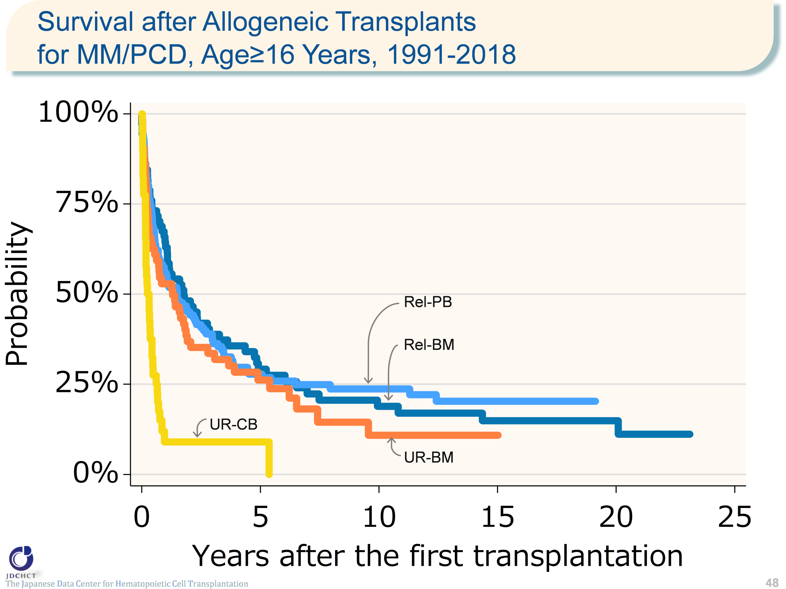
Survival after Allogeneic Transplants for MM/PCD, Age≥16 Years, 1991-2018
The Japanese Data Center for Hematopoietic Cell Transplantation
48
Notes:
Multiple myeloma occurs frequently in the elderly. Autologous transplants account for approximately 97% of the total cases of transplants in patients with multiple myeloma aged 16 years or older (≥16). For allogeneic transplants, peripheral blood stem cell transplantation from related donors is frequently performed. The survival probability 5 years after transplantation is below 30% for both transplants from related and unrelated donors, and subsequently, survival probabilities remarkably decline.
≪Probability of survival≫
Years after the first transplantation
N 1year 5years 10years
――――――――――――――――――――――――――――
Rel-BM 71 64.4% 29.2% 18.9%
Rel-PB 132 55.9% 27.8% 23.7%
UR-BM 64 52.9% 26.2% 10.9%
UR-CB 40 9.0% 9.0% ― .

Slide 49
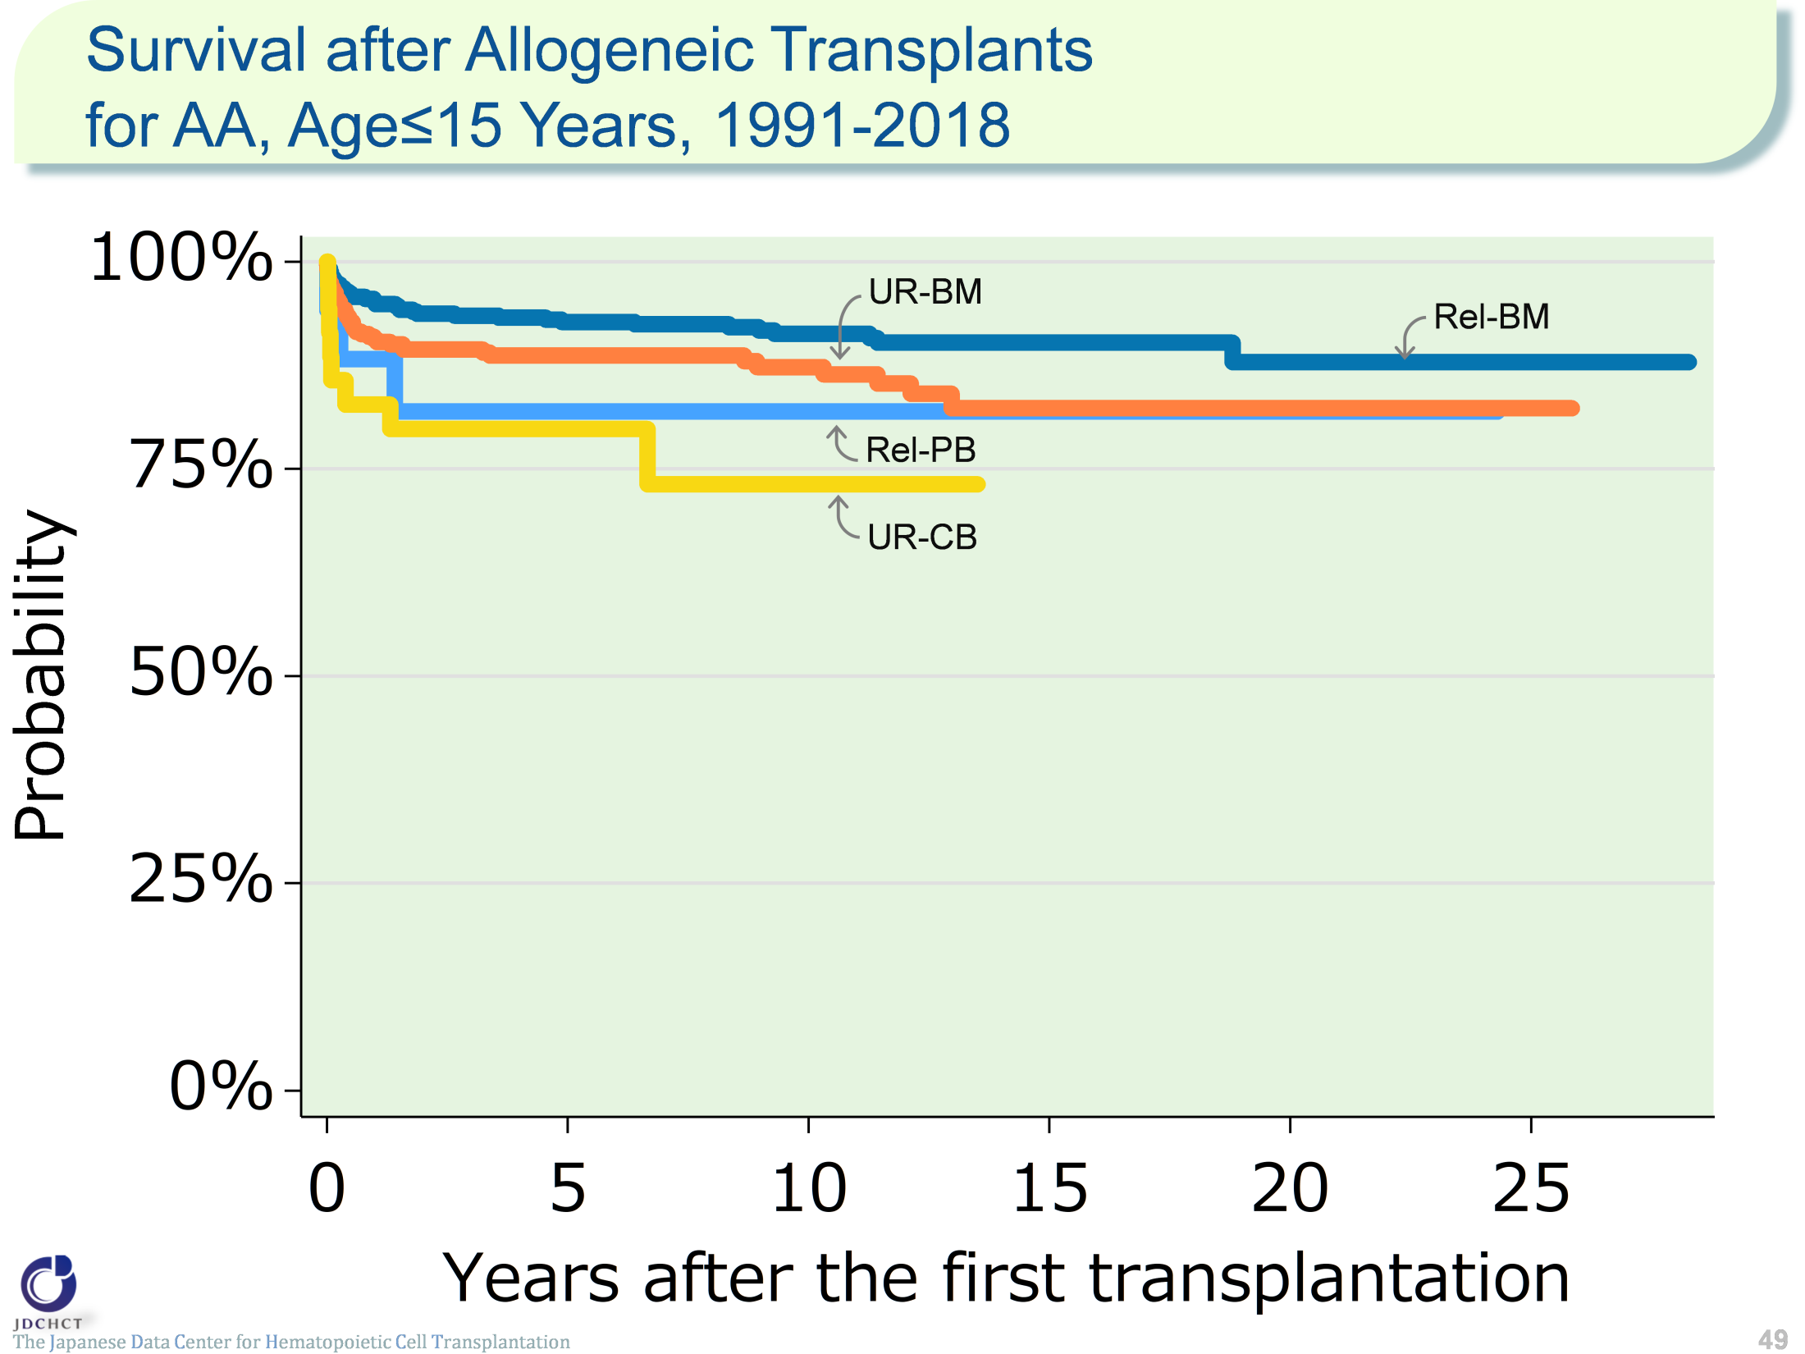
Survival after Allogeneic Transplants for AA, Age≤15 Years, 1991-2018
The Japanese Data Center for Hematopoietic Cell Transplantation
49
Notes:
For aplastic anemia, allogeneic transplants are performed and in patients aged 15 years or younger (≤15), bone marrow transplants from related donors are frequently performed. The survival probability 5 years after transplantation is 92.7% for bone marrow transplants from related donors, 81.9% for peripheral blood stem cell transplantation from related donors, 88.7% for bone marrow transplants from unrelated donors, and 79.8% for cord blood transplants from unrelated donors..
≪Probability of survival≫
Years after the first transplantation
N 1year 5years 10years
――――――――――――――――――――――――――――
Rel-BM 473 95.1% 92.7% 91.3%
Rel-PB 17 88.2% 81.9% 81.9%
UR-BM 348 90.6% 88.7% 87.3%
UR-CB 35 82.8% 79.8% 73.2%

Slide 50
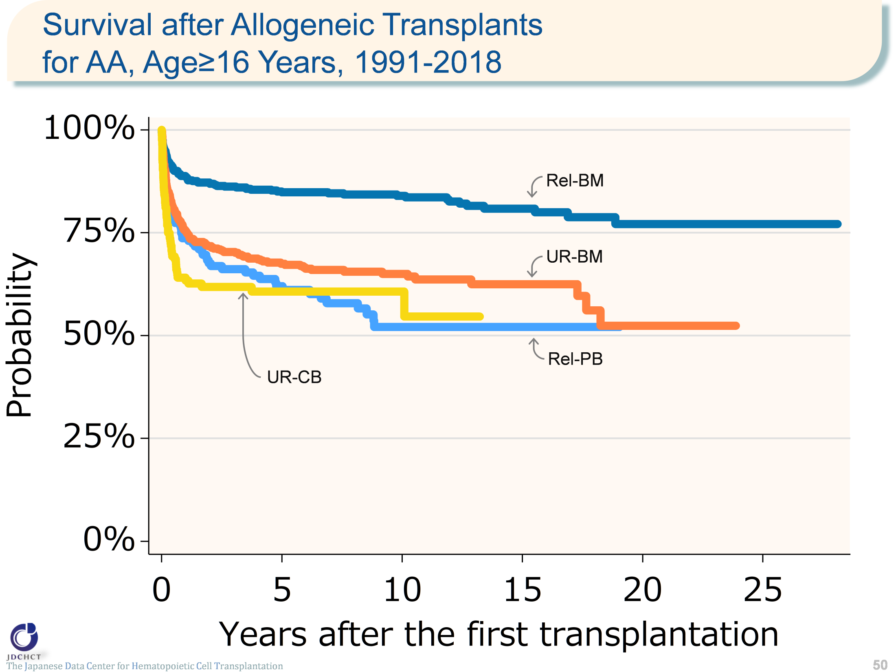
Survival after Allogeneic Transplants for AA, Age≥16 Years, 1991-2018
The Japanese Data Center for Hematopoietic Cell Transplantation
50
Notes:
For patients with aplastic anemia aged 16 years or older (≥16), approximately half the allogeneic transplants are bone marrow transplants from related donors. The survival probability 5 years after transplantation is more than 60% for both transplants from related and unrelated donors, and 84.8% for bone marrow transplants from related donors.
≪Probability of survival≫
Years after the first transplantation
N 1year 5years 10years
――――――――――――――――――――――――――――
Rel-BM 666 88.7% 84.8% 84.0%
Rel-PB 165 73.7% 62.0% 52.1%
UR-BM 571 75.4% 67.5% 65.0%
UR-CB 164 63.4% 60.7% 60.7%

