Slide 2
Introduction

Slide 3
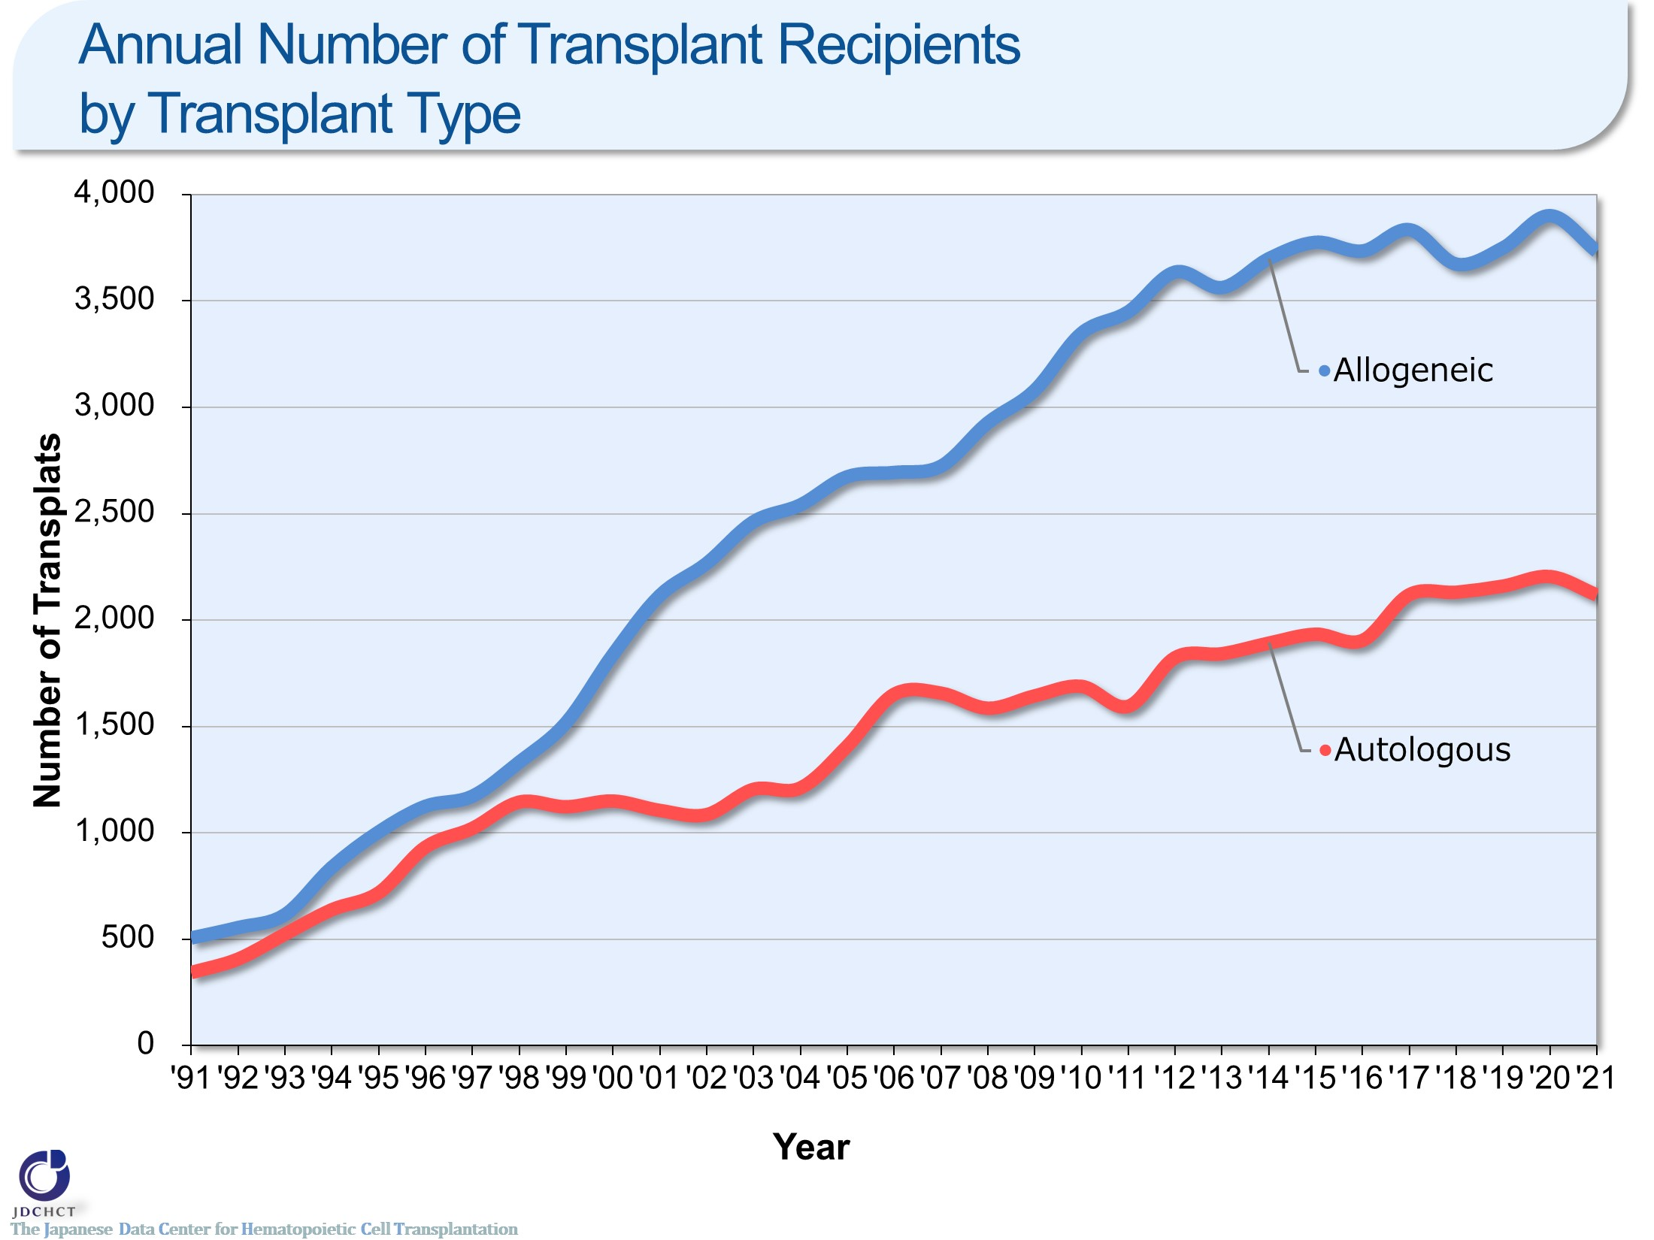
Annual Number of Transplant Recipients by Transplant Type
Notes:
In Japan, registration for bone marrow transplantation from unrelated donors was started in 1993 and the first case of cord blood transplantation was performed in 1997. Since these times, transplantation from unrelated donors has spread and the total number of allogeneic transplant recipients has increased. Recently, the annual number of autologous and allogeneic transplants registration exceeds 5,500.

Slide 4
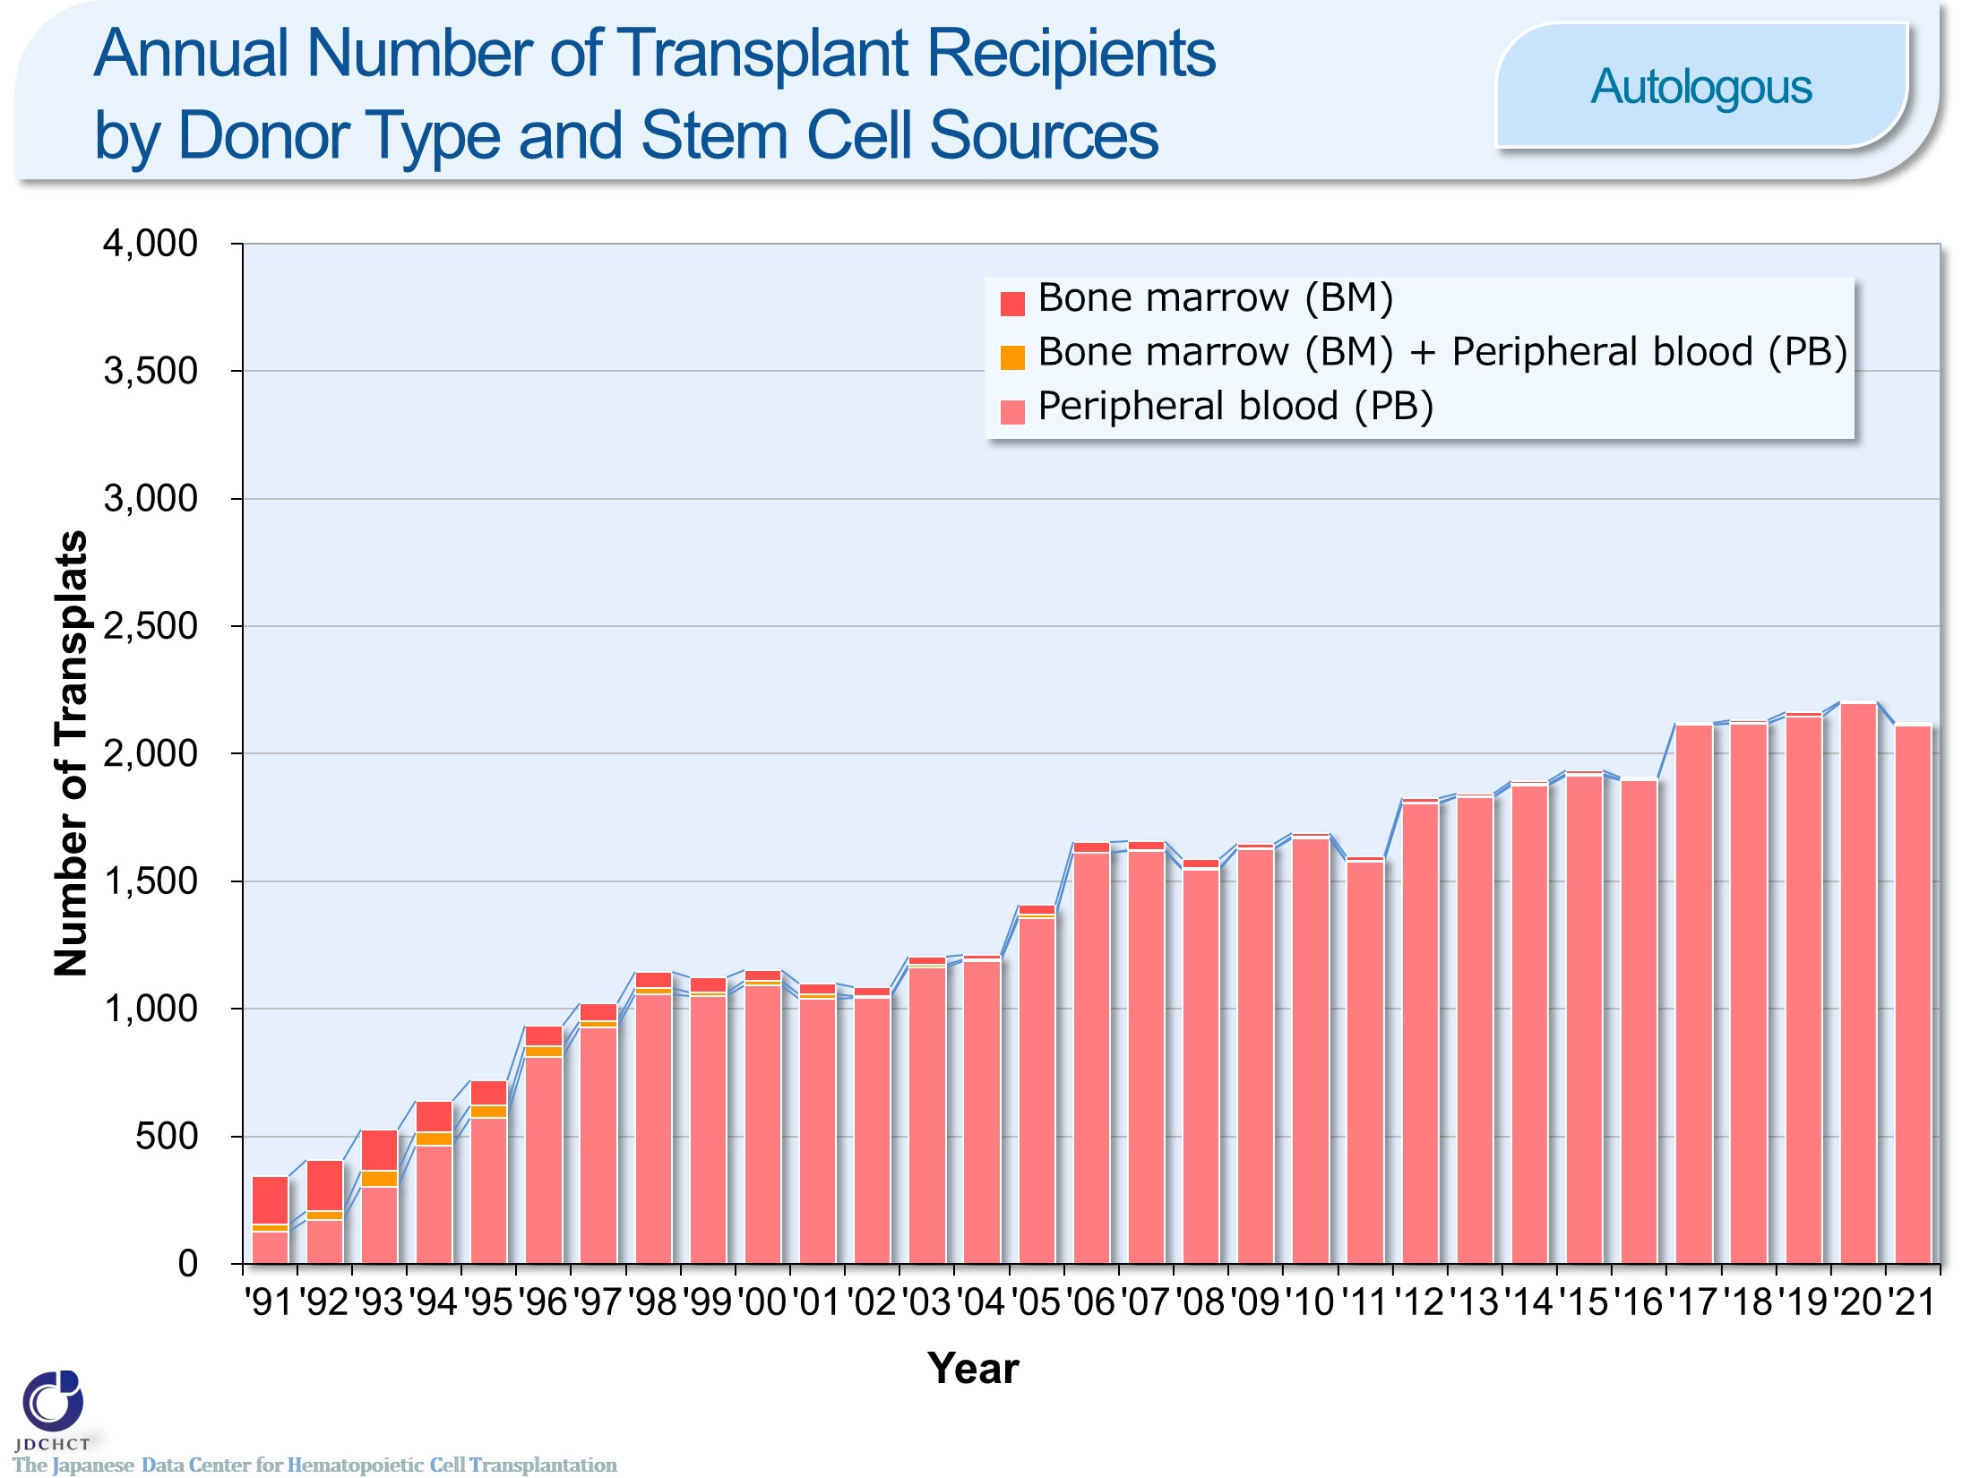
Annual Number of Transplant Recipients by Donor Type and Stem Cell Sources <Autologous>
Notes:
For autologous transplants, the annual number of cases registered has been approximately 2,000 for past several years, for which the stem cell source is peripheral blood in the vast majority of cases.

Slide 5
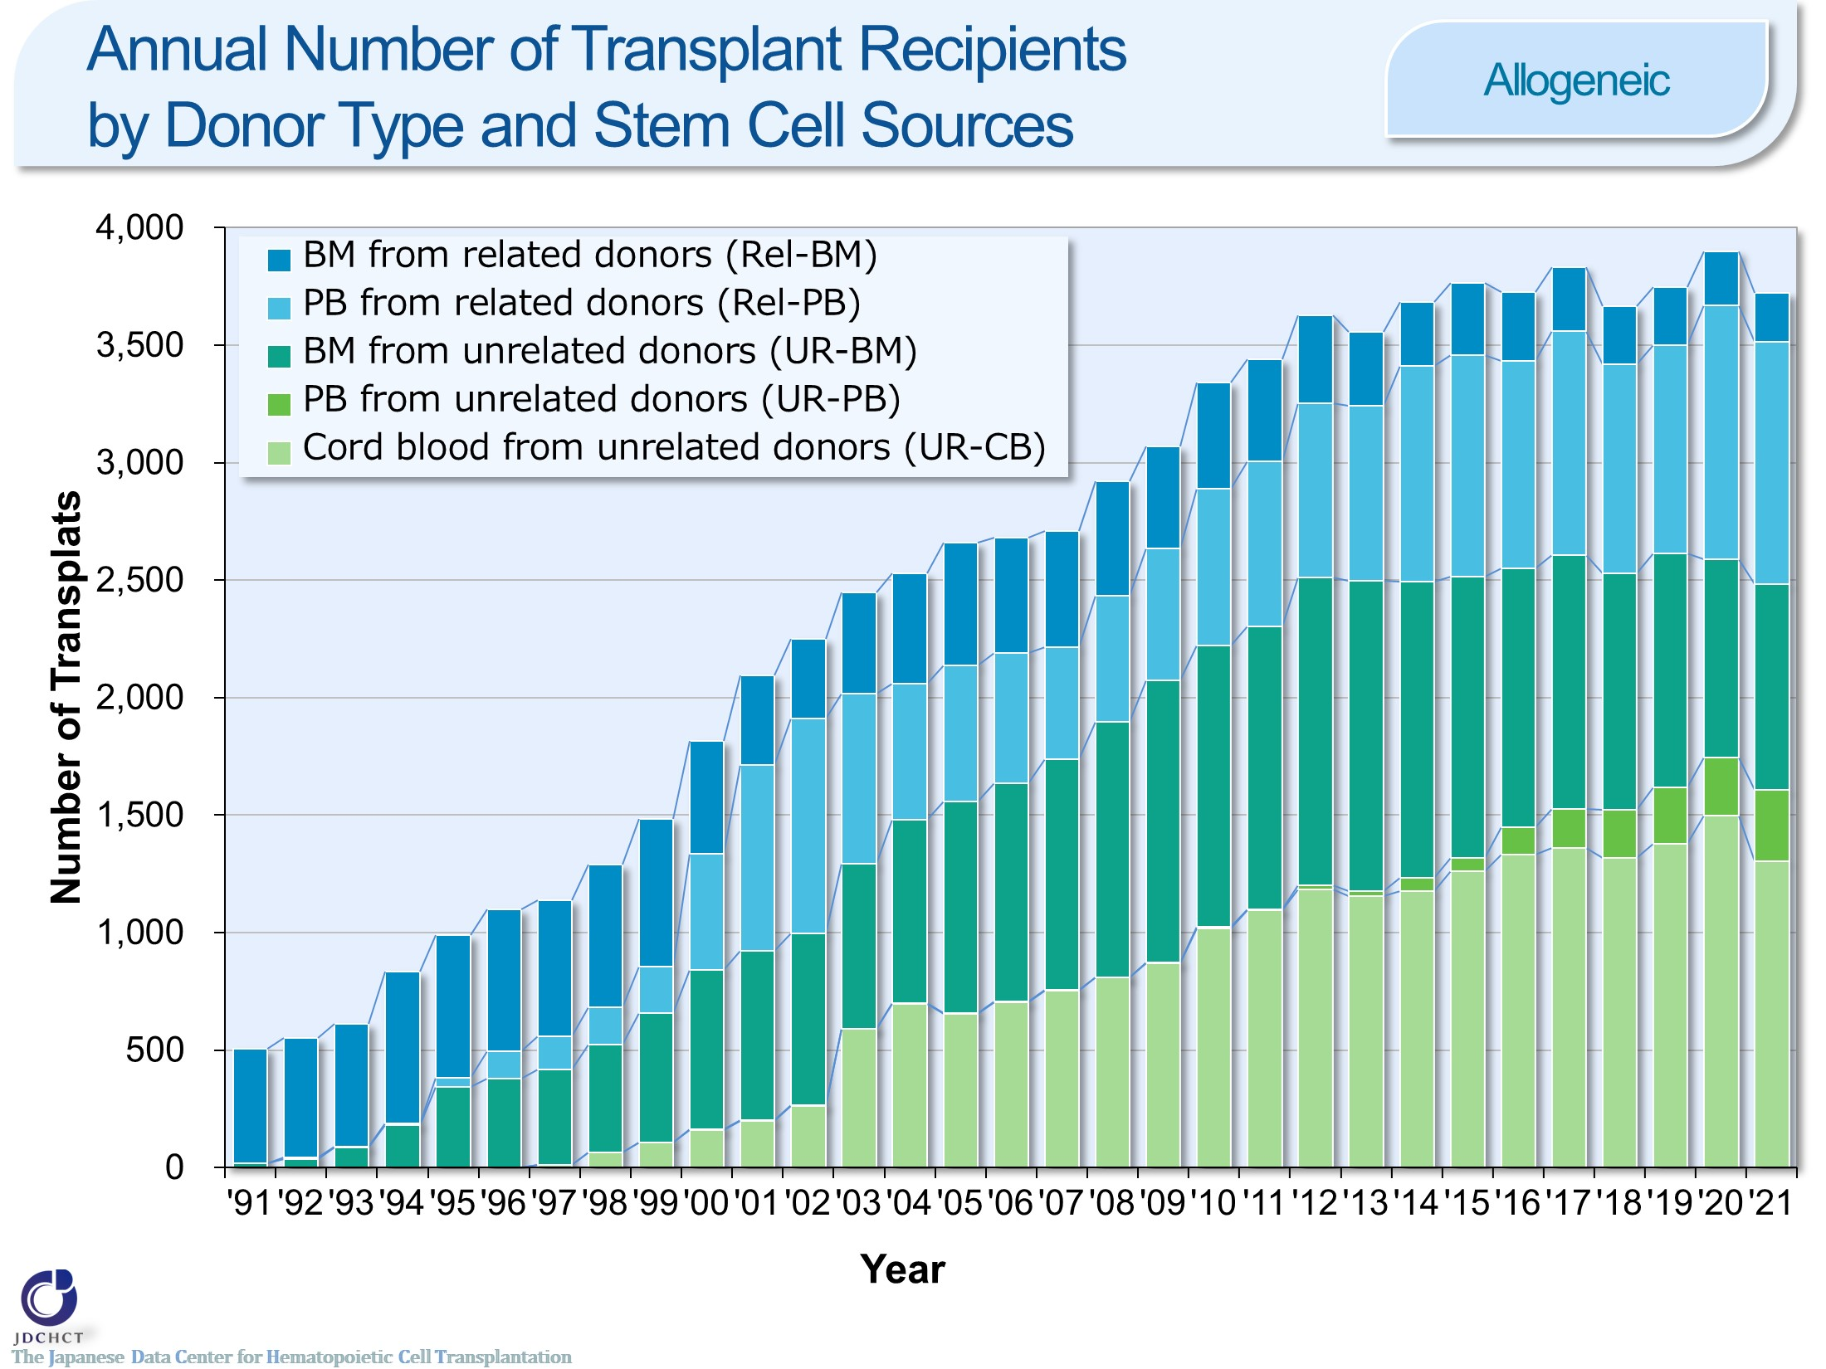
Annual Number of Transplant Recipients by Donor Type and Stem Cell Sources <Allogeneic>
Notes:
In Japan, since 1993 in which registration for bone marrow transplantation from unrelated donors was started and since 1997 in which the first case of cord blood transplantation was performed, transplantation from unrelated donors has spread and the total number of transplant recipients has increased. In particular, the increase in cord blood transplants is remarkable. Also, peripheral blood stem cell transplantation from unrelated donors was introduced since 2010, and the number of transplants has been gradually increased. The number of related peripheral blood stem cell transplantation has also increased as the number of haplo-identical transplantation increased remarkably since 2010.

Slide 6
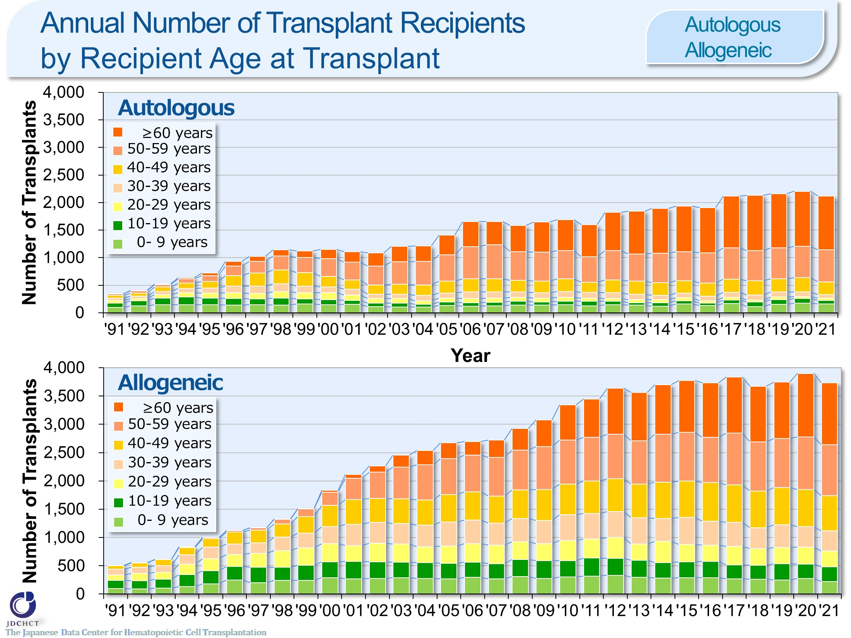
Annual Number of Transplant Recipients by Recipient Age at Transplant <Autologous/Allogeneic>
Notes:
Due to the spread of transplants with reduced intensity conditioning (RIC), the age groups in which transplantation is indicated have expanded, and the number of transplants in older age groups has increased.

Slide 7
Annual Number of Transplant Recipients by Recipient Age at Transplant <Rel-BM/Rel-PB>
Notes:
The number of peripheral blood stem cell transplantation from related donors in older age groups has increased.

Slide 8
Annual Number of Transplant Recipients by Recipient Age at Transplant <UR-BM/UR-PB>
Notes:
In both bone marrow transplantation and peripheral blood stem cell transplantation from unrelated donors, the proportion of transplants in older age groups has increased, and those aged 50 years or older accounted for more than 50％ of the each transplantation. The proportion of transplants in those aged 50 years or older is particularly high in peripheral blood stem cell transplantation.

Slide 9
Annual Number of Transplant Recipients by Recipient Age at Transplant <UR-CB>
Notes:
In cord blood transplantation from unrelated donors, the number of transplants in older age groups has increased, and those aged 50 years or older accounted for more than 50％.

Slide 10
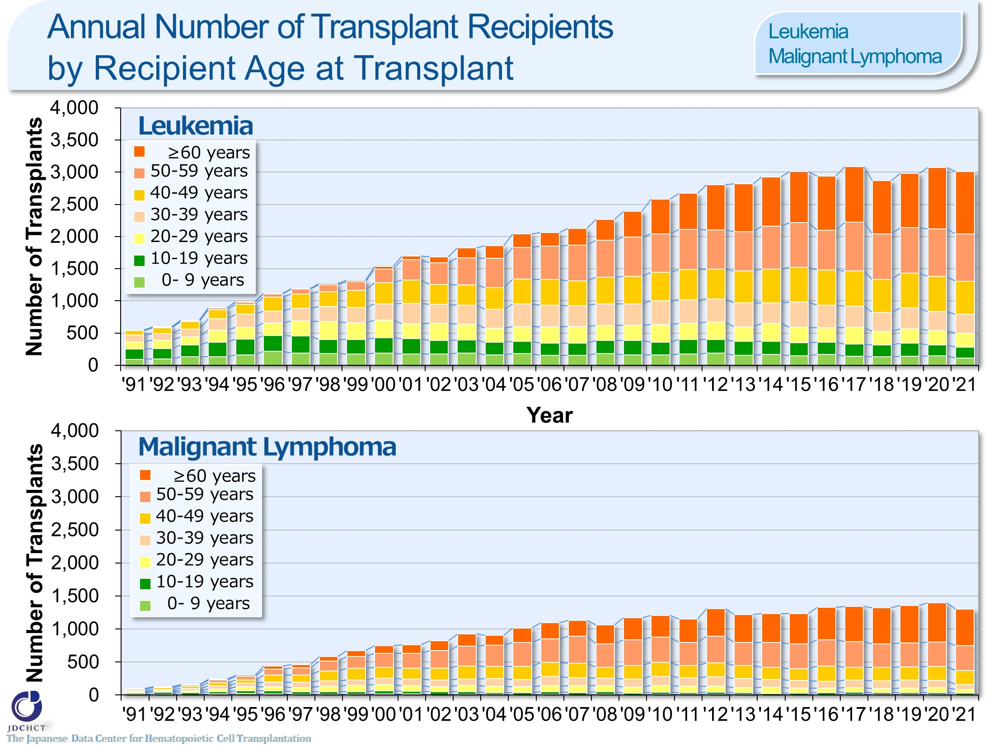
Annual Number of Transplant Recipients by Recipient Age at Transplant <Leukemia/Malignant Lymphoma>
Notes:
In leukemia and malignant lymphoma, the number of transplants (autologous transplantation and allogeneic transplantation) has increased in older age groups . Those aged 50 years or older accounted for about 50％ of the total cases of leukemia and about 70％ of the total cases of malignant lymphoma.

Slide 11
Indications for Hematopoietic Stem Cell Transplants by Transplant type <age 0-15>
Notes:
In pediatric patients, allogeneic transplants are most frequently performed for acute leukemia (acute myeloid leukemia and acute lymphoblastic leukemia), which accounts for about 54％ of the total cases of allogeneic transplantation. Following this, allogeneic transplants are also frequently performed for aplastic anemia. Although aplastic anemia is a rare disease, allogeneic transplantation is the first choice for serious and most serious cases when HLA-matched sibling donors are available. Accordingly, aplastic anemia accounts for about 9％ of the allogeneic transplants in pediatric patients.
For solid tumors in pediatric patients, autologous transplants are performed in order to rescue hematopoietic dysfunction due to high-dose chemotherapy and therefore, autologous transplantation around 80％ of the total number of transplants.

Slide 12
Indications for Hematopoietic Stem Cell Transplants by Transplant type <age ≥16>
Notes:
In patients aged 16 years or older, allogeneic transplants are most frequently performed for acute leukemia (acute myeloid leukemia and acute lymphoblastic leukemia), which accounts for 57％ of the total cases of allogeneic transplants. Following this, allogeneic transplants are also frequently performed in myelodysplastic syndrome and non-Hodgkin lymphoma.
Multiple myeloma occurs more frequently in the elderly and the number of patients with multiple myeloma has shown a tendency to increase, as in malignant lymphoma. High-dose chemotherapy in combination with autologous transplantation is the established standard therapy for multiple myeloma in patients under 65 years of age, and autologous transplants account for about 90％.

Slide 13
Annual Number of Transplant Recipients Trend of Main Disease <Autologous><age 0-15>
Notes:
For solid tumors in pediatric patients, autologous transplants are performed in order to rescue hematopoietic dysfunction due to high-dose chemotherapy and therefore, autologous transplantation is most performed, and the number has been similar over the last decade.

Slide 14
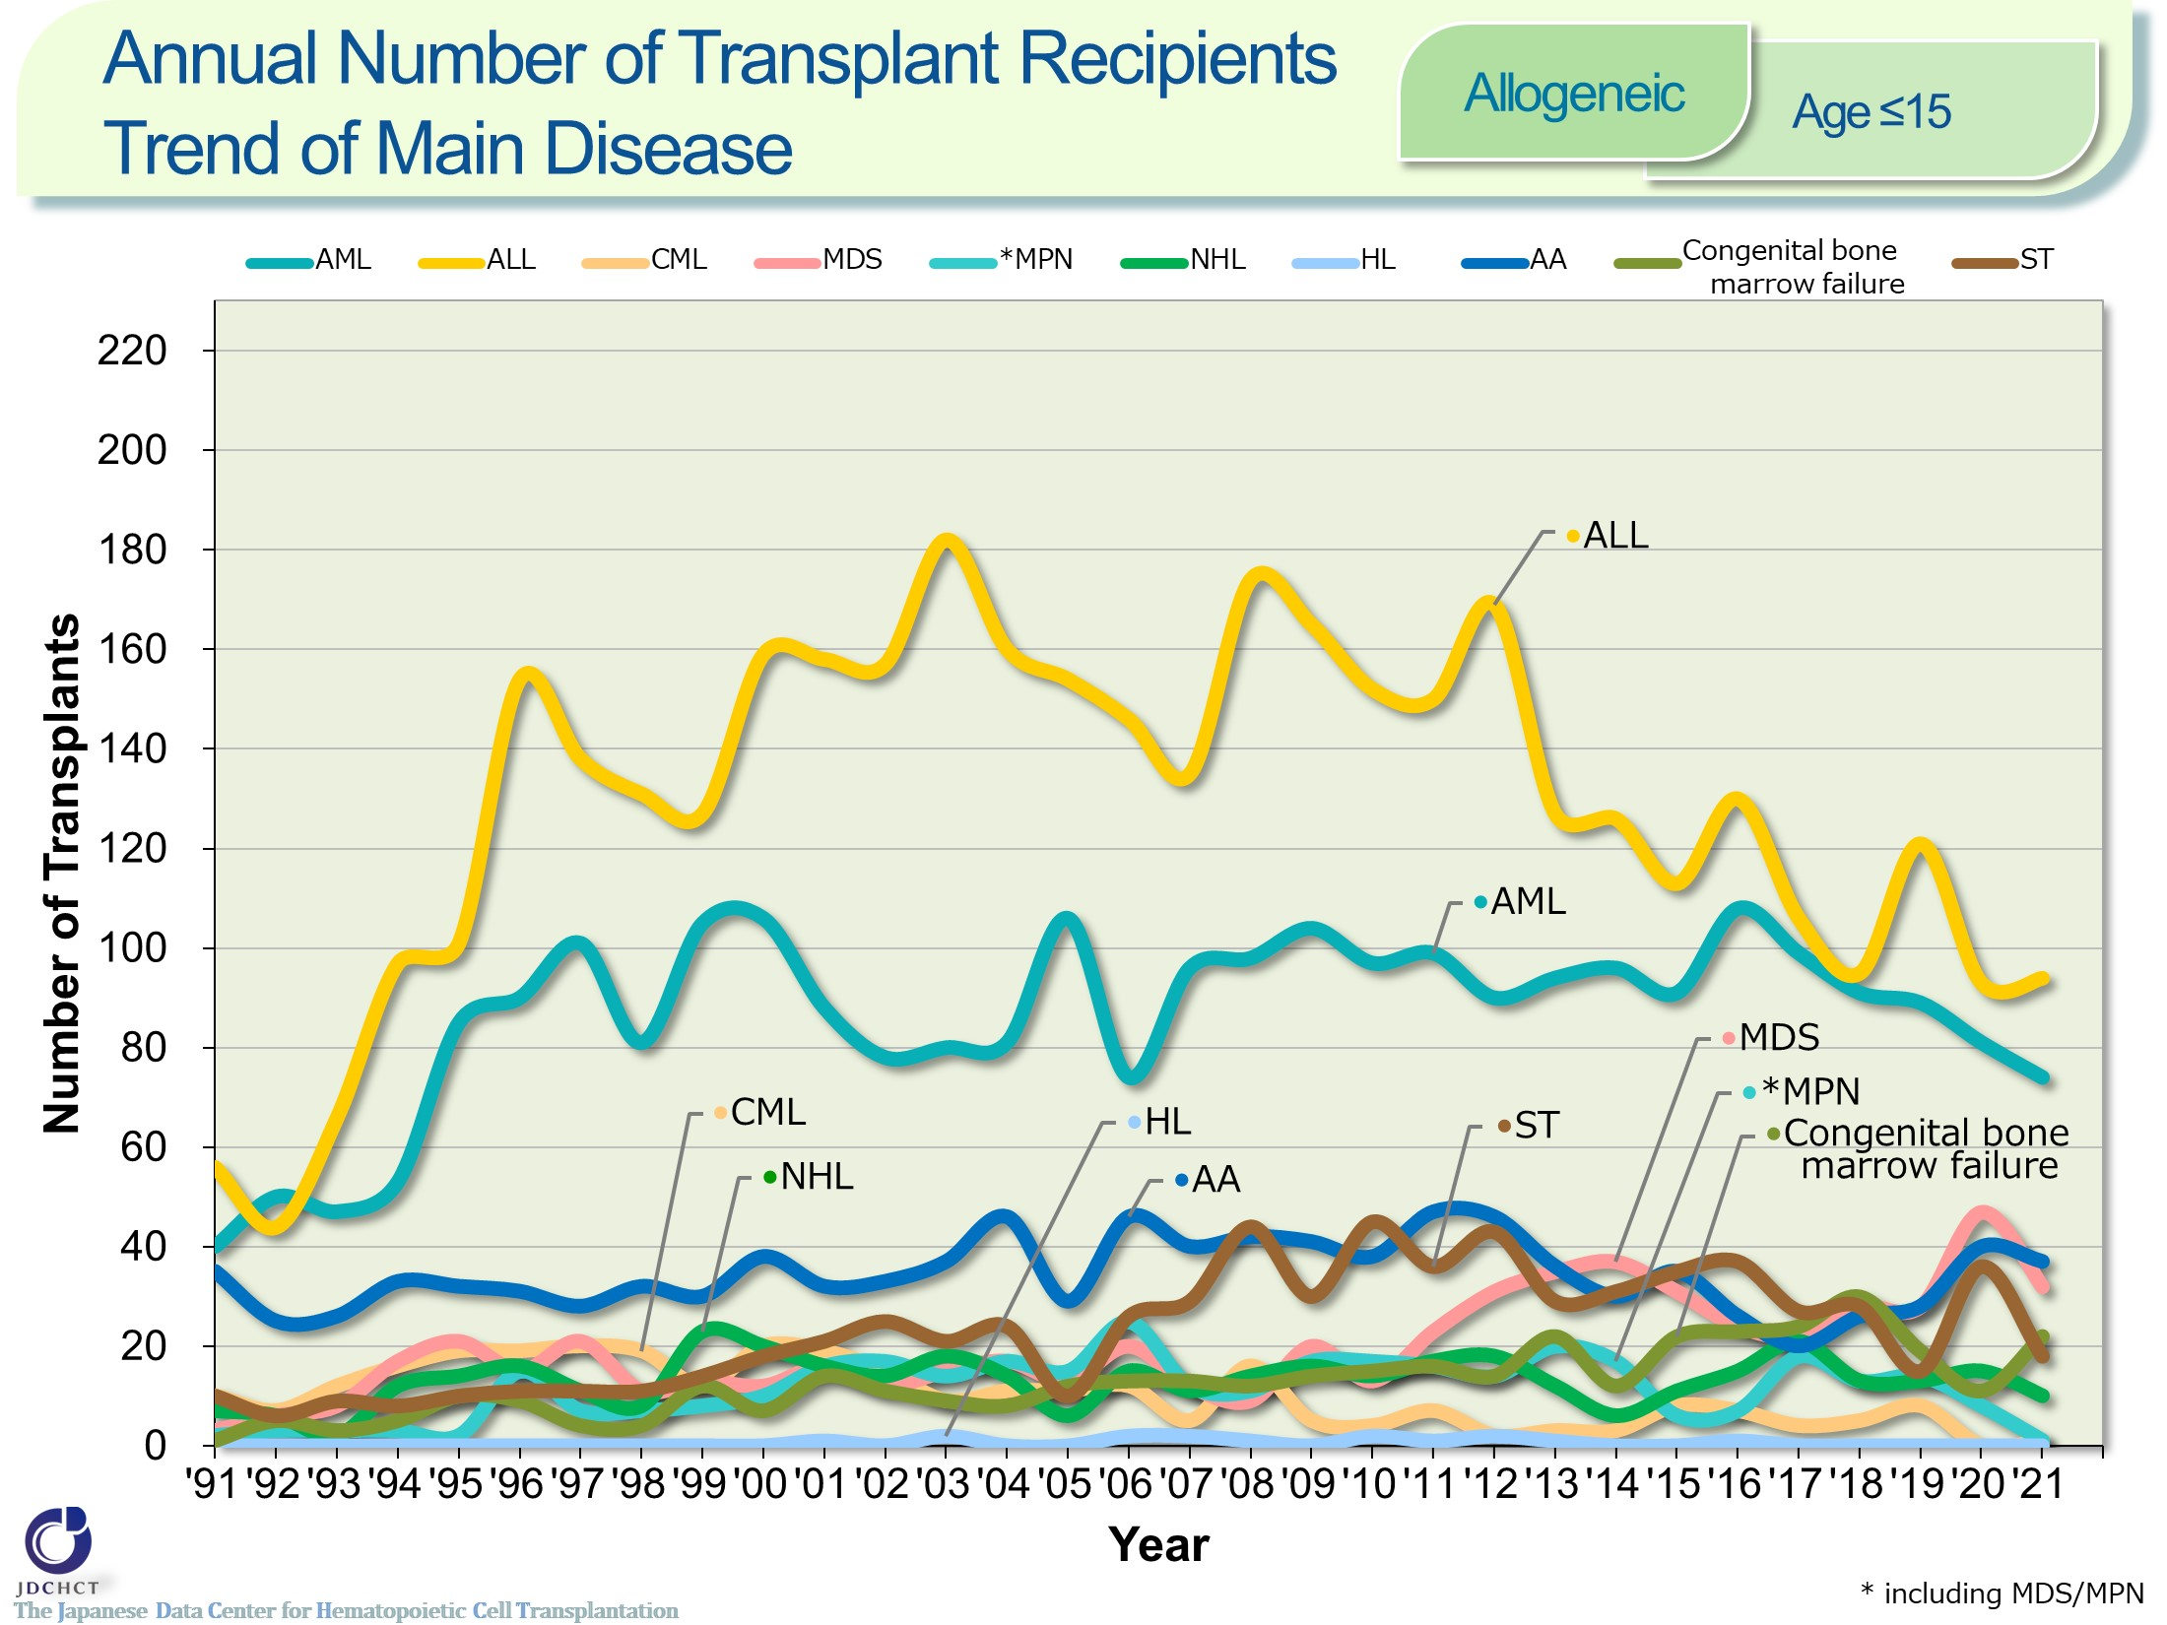
Annual Number of Transplant Recipients Trend of Main Disease <Allogeneic><age≤15>
Notes:
For these disease in pediatric patients, the number of allogeneic transplants has been similar over the last decade.

Slide 15
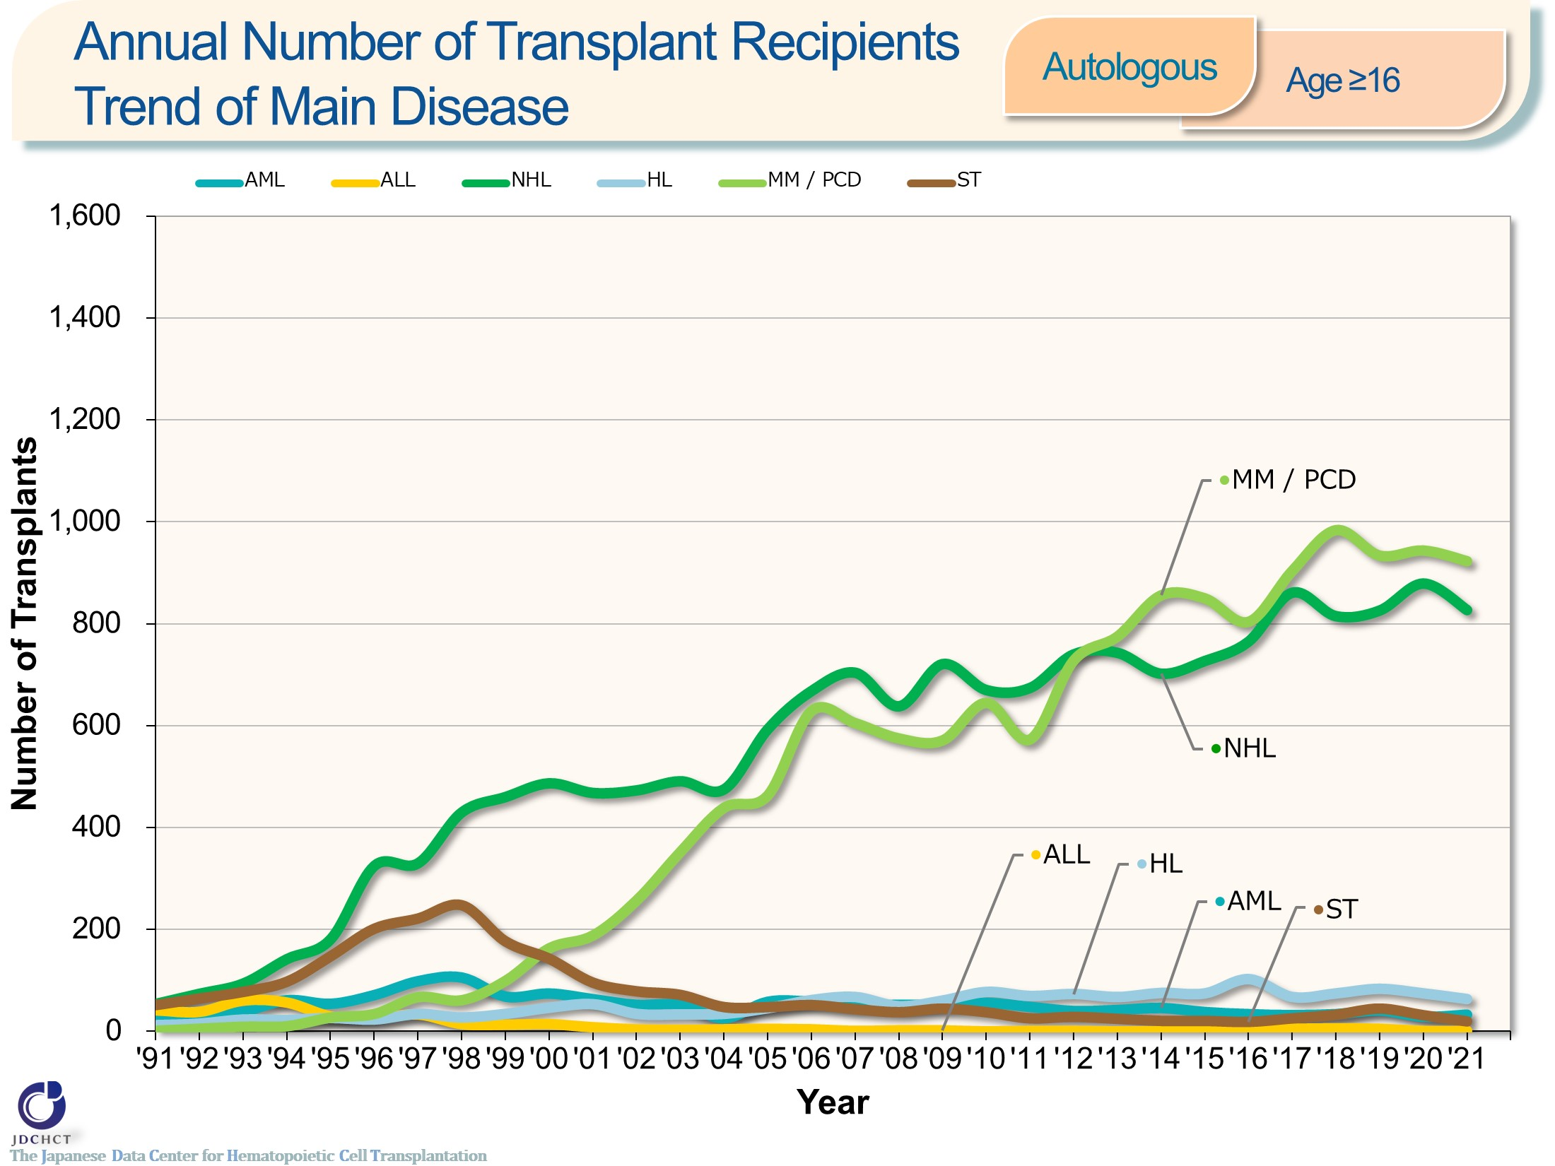
Annual Number of Transplant Recipients Trend of Main Disease <Autologous><age≥16>
Notes:
Multiple myeloma occurs more frequently in the elderly and the number of autologous transplants in adults with multiple myeloma has shown a tendency to increase, as in malignant lymphoma.

Slide 16
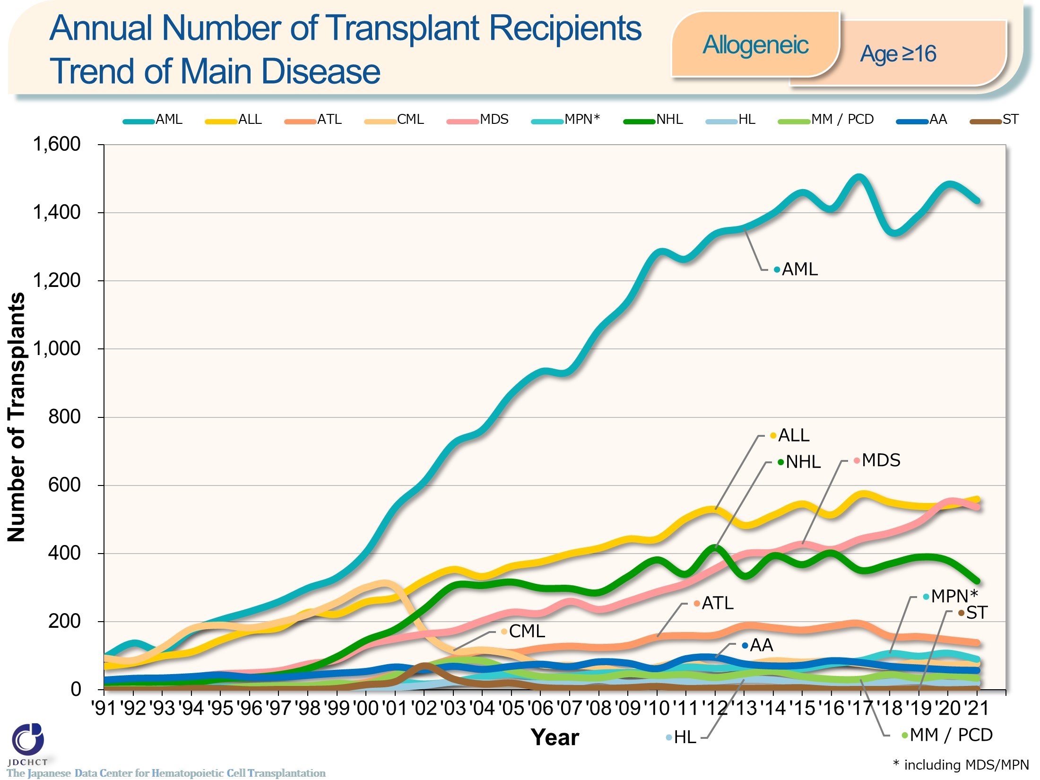
Annual Number of Transplant Recipients Trend of Main Disease <Allogeneic><age≥16>
Notes:
In patients aged 16 years or older, allogeneic transplants are most frequently performed for acute myeloid leukemia, followed by acute lymphoblastic leukemia and myelodysplastic syndrome.
In 2001, imatinib was officially approved in Japan as a molecular targeted therapy for chronic myeloid leukemia and subsequently, the second and third tyrosine kinase inhibitors (nilotinib, dasatinib, bosutinib and ponatinib) were approved. Since then, transplantation for chronic myeloid leukemia has shown a tendency to decrease.
For malignant lymphoma, the number of patients with this disease has increased. However, since rituximab, chemotherapy, and radiotherapy are effective in many cases, allogeneic transplantation is not commonly the first choice.

Slide 17
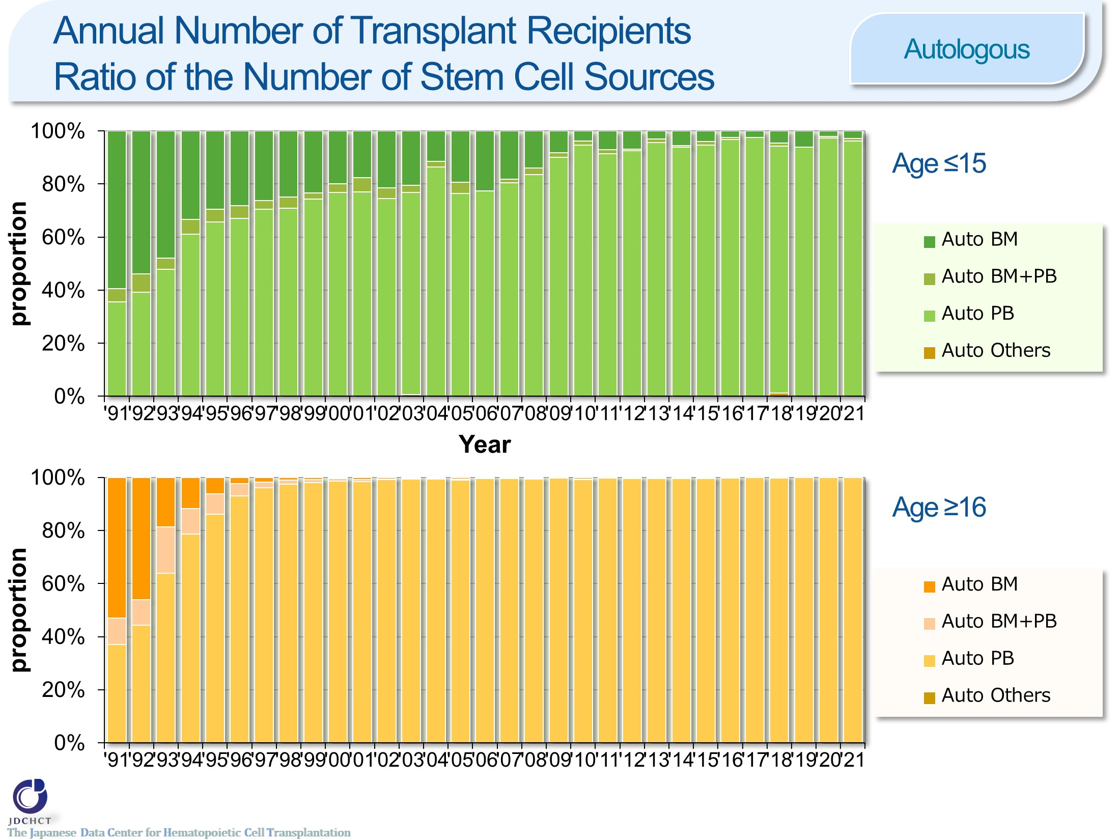
Annual Number of Transplant Recipients Ratio of the Number of Stem Cell Sources <Autologous>
Notes:
Recently, peripheral blood stem cell transplantations account for about 95％ and 99％ or more of the total cases of autologous transplants in patients aged 0 to 15 years and in those aged 16 years or older, respectively. The process of collecting peripheral blood stem cells poses less burden to patients than the harvesting procedure in bone marrow transplantation. Since 2000, the process of collecting peripheral blood stem cells for transplantation through the use of granulocyte-colony stimulating factor (G-CSF) has been covered by the national health insurance. For these reasons, the number of autologous peripheral blood stem cell transplantation has increased, whereas autologous bone marrow transplants have decreased.

Slide 18
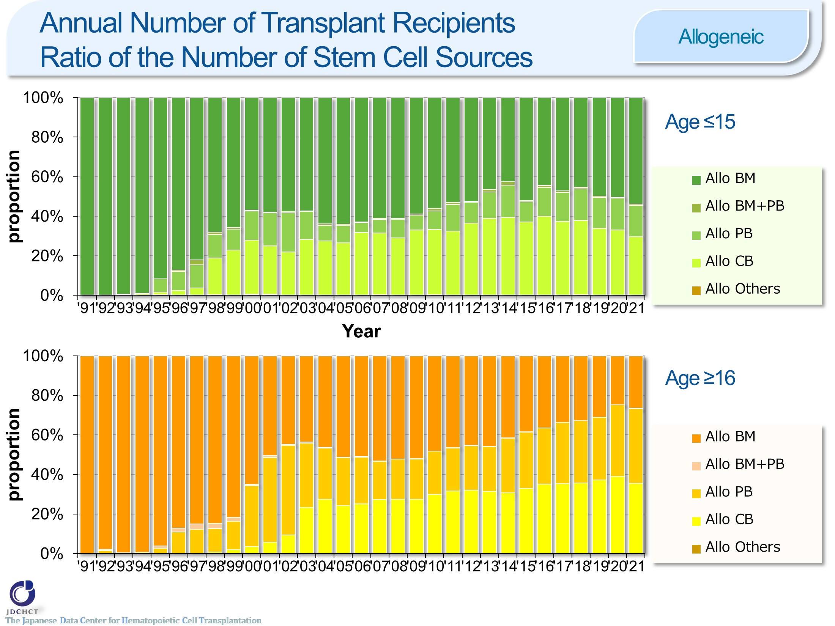
Annual Number of Transplant Recipients Ratio of the Number of Stem Cell Sources <Allogeneic>
Notes:
The spread of cord blood transplantation and peripheral blood stem cell transplantation has made the proportion of allogeneic bone marrow transplantation show a tendency to decrease. Bone marrow transplants account for about half of all allogeneic transplants in patients aged 0 to 15 years, while peripheral blood stem cell transplants outnumber bone marrow transplants in those aged 16 years or older. In recent years, cord blood transplants account for 30％ or more of the total cases of allogeneic transplantation in both age groups.

Slide 19
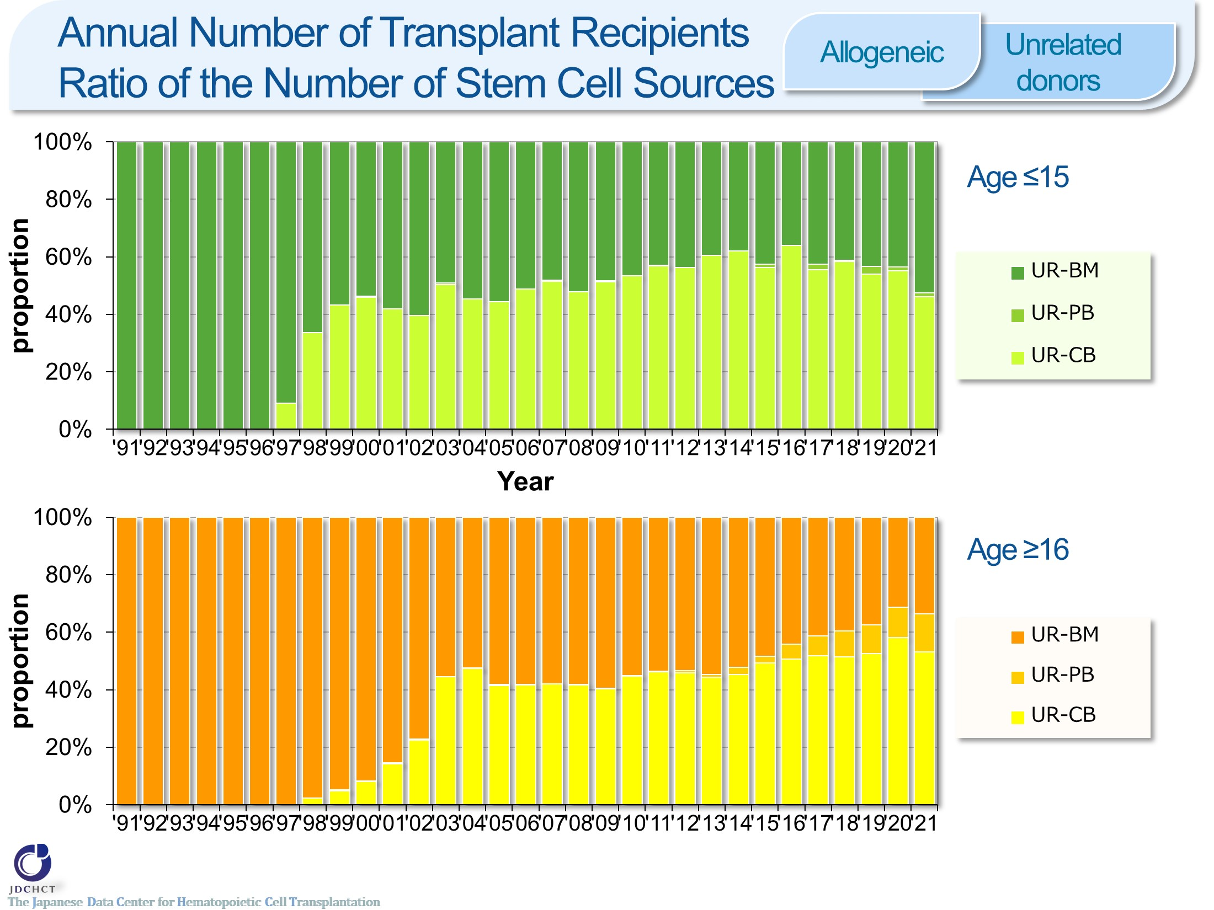
Annual Number of Transplant Recipients Ratio of the Number of Stem Cell Sources <Allogeneic><Unrelated donors>
Notes:
In transplantation from unrelated donors, the number of cord blood transplants has increased, accounts for about half in recent years.

Slide 20
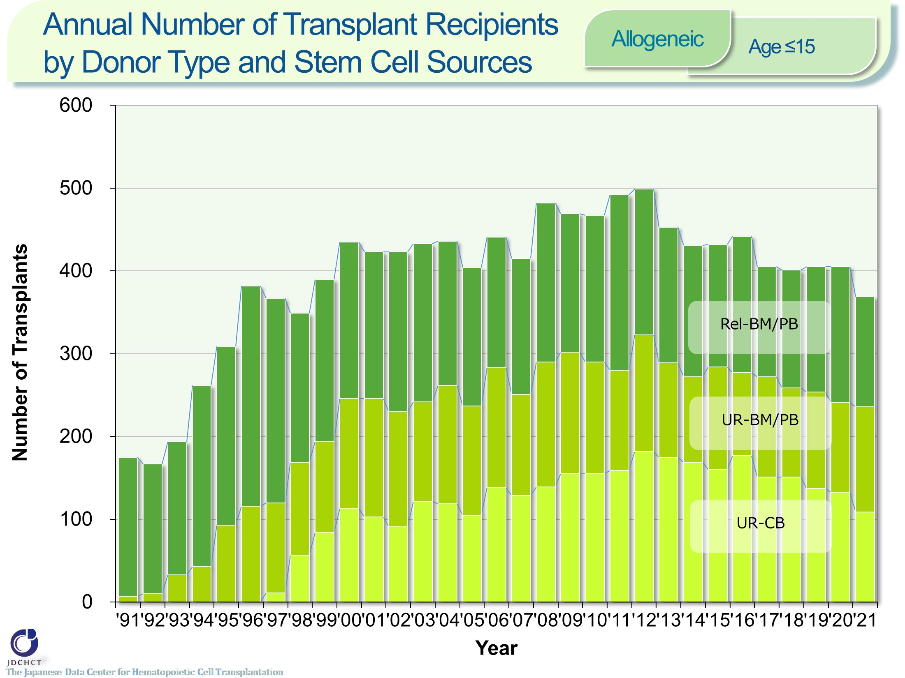
Annual Number of Transplant Recipients by Donor Type and Stem Cell Sources <Allogeneic> <age≤15>
Notes:
In patients aged 0 to 15 years, the increase rate of transplantation from unrelated donors was higher than transplantation from related donors.
Recently, the each transplantation have leveled off, the ratio of transplantation from unrelated donors are around 60％.

Slide 21
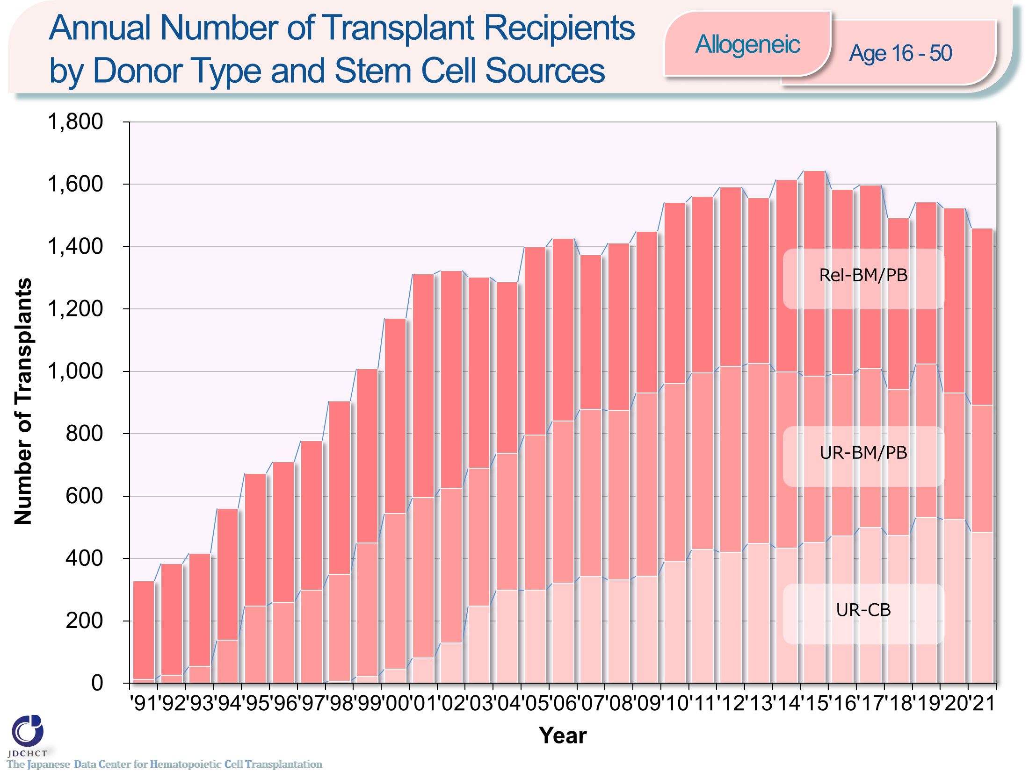
Annual Number of Transplant Recipients by Donor Type and Stem Cell Sources <Allogeneic> <age 16-50>
Notes:
In patients aged 16 to 50 years, both the number of bone marrow transplantation and peripheral blood stem cell transplantation from related donors have leveled off, the number of cord blood transplants from unrelated donors have shown an increasing trend in recent years.

Slide 22
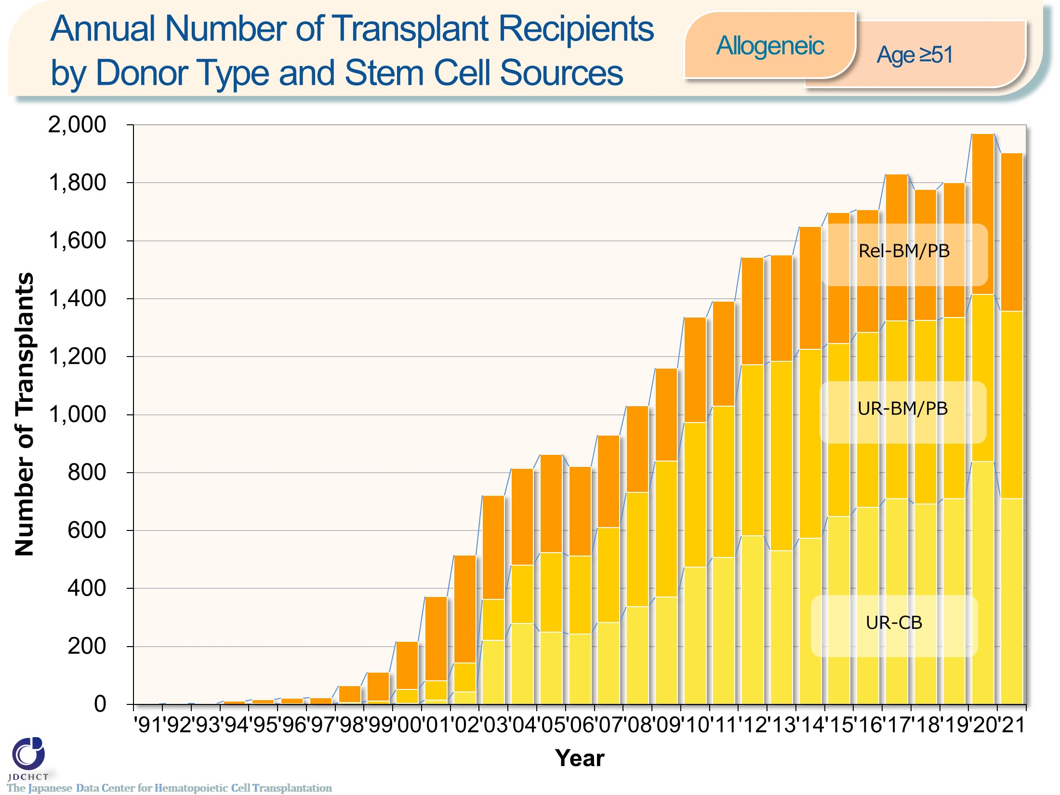
Annual Number of Transplant Recipients by Donor Type and Stem Cell Sources <Allogeneic> <age≥51>
Notes:
Due to the spread of transplants with reduced intensity conditioning (RIC), in all types of allogeneic transplants, the number of patients aged 51 years or older has remarkably increased.

Slide 23
Trend in the Number of Transplant Recipients Proportion of the Advanced Risk Group of Patients with Leukemia
Notes:
In the advanced risk group of patients with leukemia for whom the disease condition is difficult to treat, allogeneic transplantation is actively performed.
―≪Disease risk status at transplantation≫―
■Standard Risk Group
・AML (first complete remission[1CR]／second complete remission[2CR])
・ALL (1CR)
・CML (complete hematologic response(CHR)／first chronic phase[1CP])
・MDS (WHO 2017 classification： MDS with single lineage dysplasia／MDS-RS and single lineage dysplasia
／MDS-RS and multilineage dysplasia
／MDS with multilineage dysplasia
／MDS with isolated del(5q)
／MDS, unclassifiable
／Refractory cytopenia of childhood (provisional entity)
WHO old classification, FAB classification：refractory anemia[RA] ／refractory anemia with ring sideroblasts[RARS]／refractory
cytopenia with multilineage dysplasia[RCMD]／refractory cytopenia with multilineage dysplasia and ringed sideroblasts[RCMD-RS]／myelodysplastic syndrome associated
with isolated del（5q）chromosome abnormality[5q−syndrome])
■Advanced Risk Group
・all other conditions
―――――――――――――――――――――

Slide 24
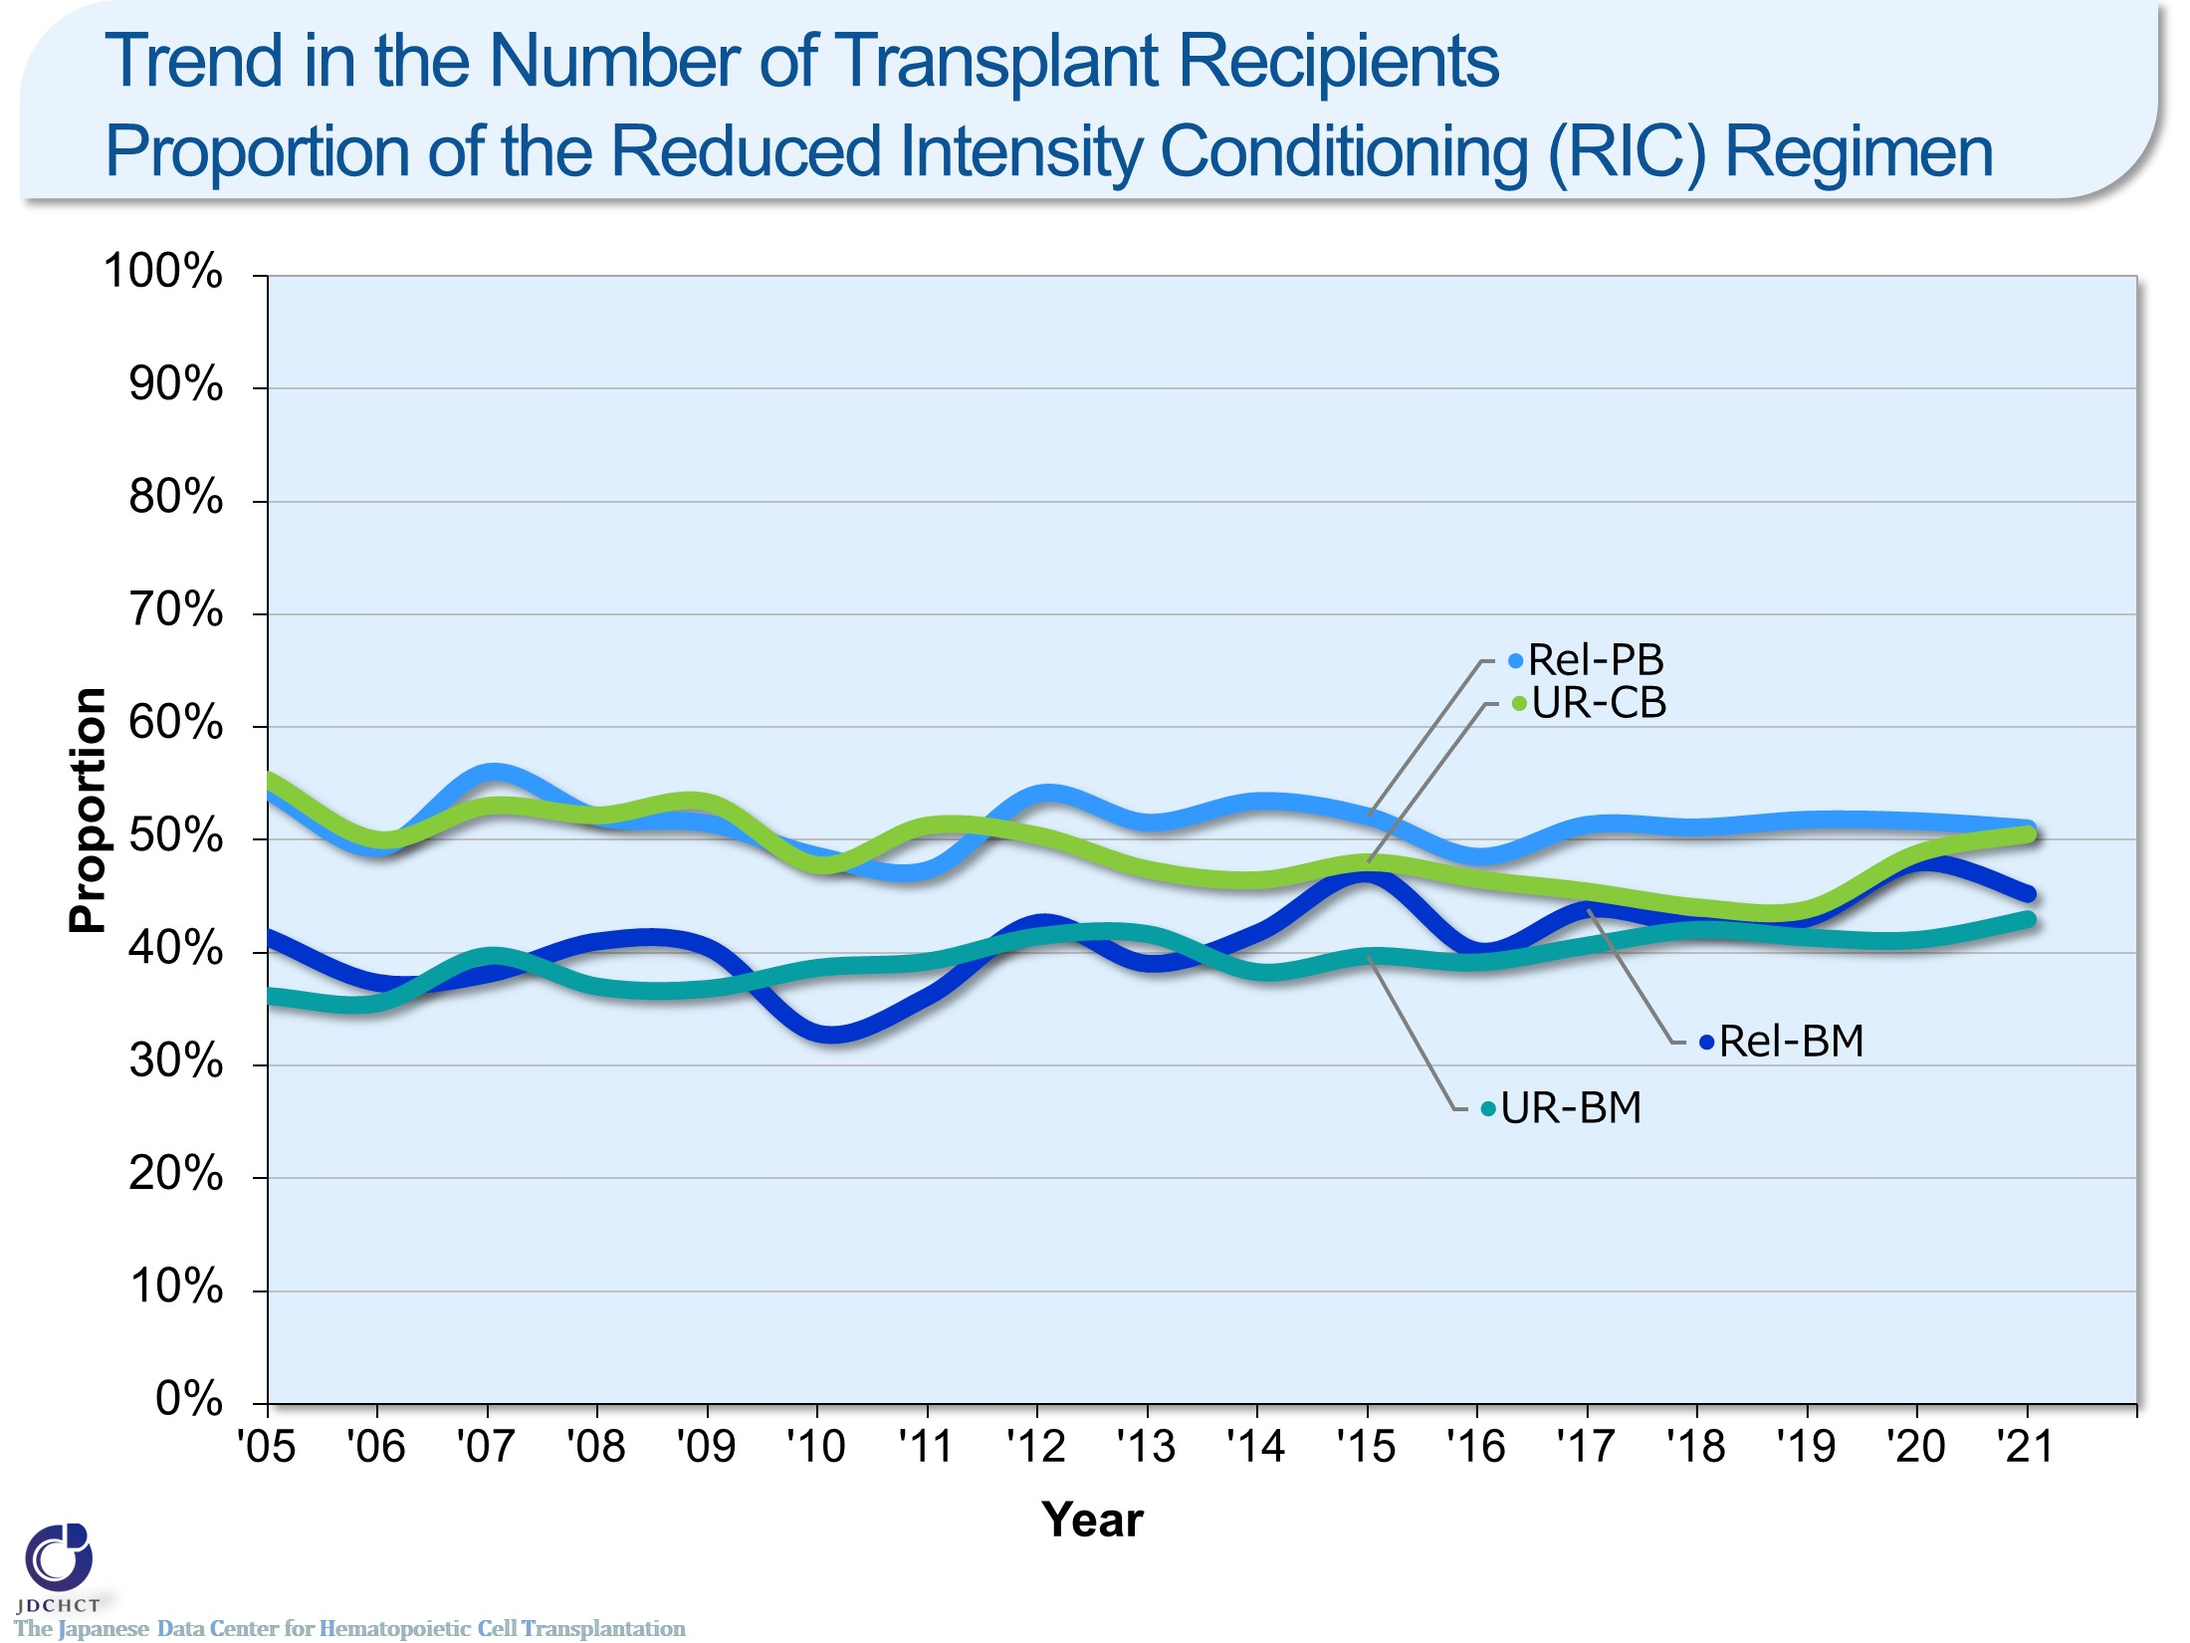
Trend in the Number of Transplant Recipients Proportion of the Reduced Intensity Conditioning (RIC) Regimen
Notes:
The spread of the reduced intensity conditioning (RIC) to reduce toxicity has expanded the scope of indication of transplantation to the older age groups.
In all types of allogeneic transplants, the reduced intensity conditioning (RIC) transplant has recently accounted for 40 to 50％.
―≪Conditioning regimen≫――――――
■Myeloablative conditioning (MAC)
Pre-transplantation therapy with the primary purpose of totally destroying cancer cells, together with normal blood cells, in the bone marrow by total body irradiation or high-dose chemotherapy
■Reduced-intensity conditioning (RIC)
Pre-transplantation therapy with the primary purpose of suppressing the patient’s immune system with drugs which do not have strong myelosuppressive effects
―――――――――――――――――――

Slide 25
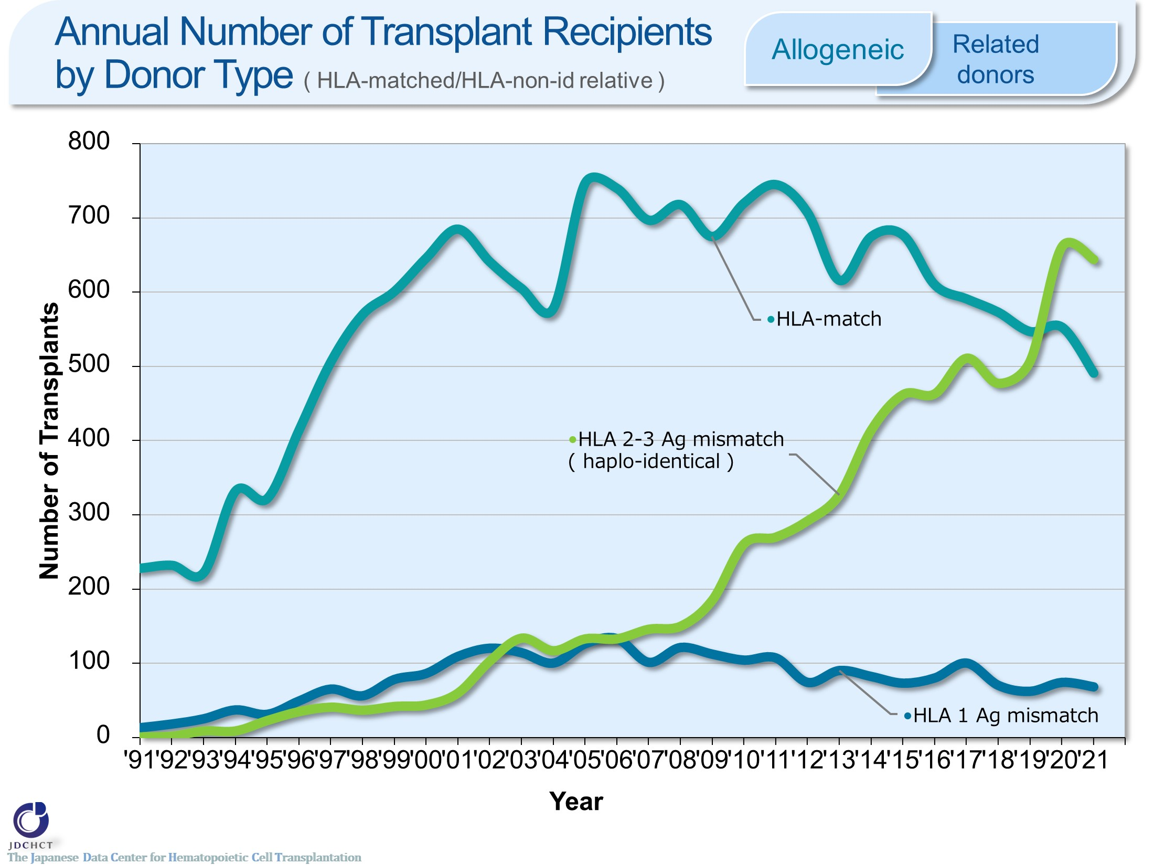
Annual Number of Transplant Recipients by Donor Type ( HLA-matched/HLA-non-id relative ) <Allogeneic><Related donors>
Notes:
With the development of GVHD prophylaxis, the number of haplo-identical transplantation increased remarkably since 2010. The annual number of haplo-identical transplants has recently exceeded the annual number of HLA-matched transplants.
※Subjects in this summary table include bone marrow transplantation, peripheral blood stem cell transplantation and bone marrow + peripheral blood stem cell transplantation from related donor.
※GVH-direction is considered for numbers of mismatched HLA loci.

Slide 26
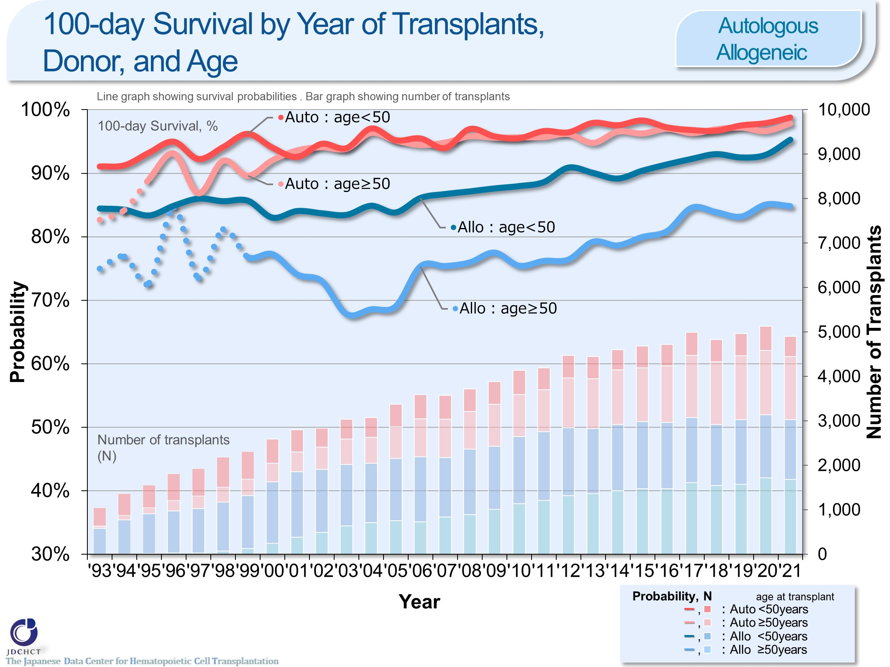
100-day Survival by Year of Transplants, Donor, and Age <Autologous/Allogeneic>
Notes:
The survival probabilities at 100 days after allogeneic transplantation have shown slightly improving trends over the last decade.
The survival probabilities at 100 days after autologous transplantation are similar between those aged 49 years or younger (<50) and those aged 50 years or older (≥50).
※This table shows the results of analysis performed on patients who received first transplants.
※The dotted lines (…) indicate the survival probabilities calculated when the number of transplants was below 100.

Slide 27
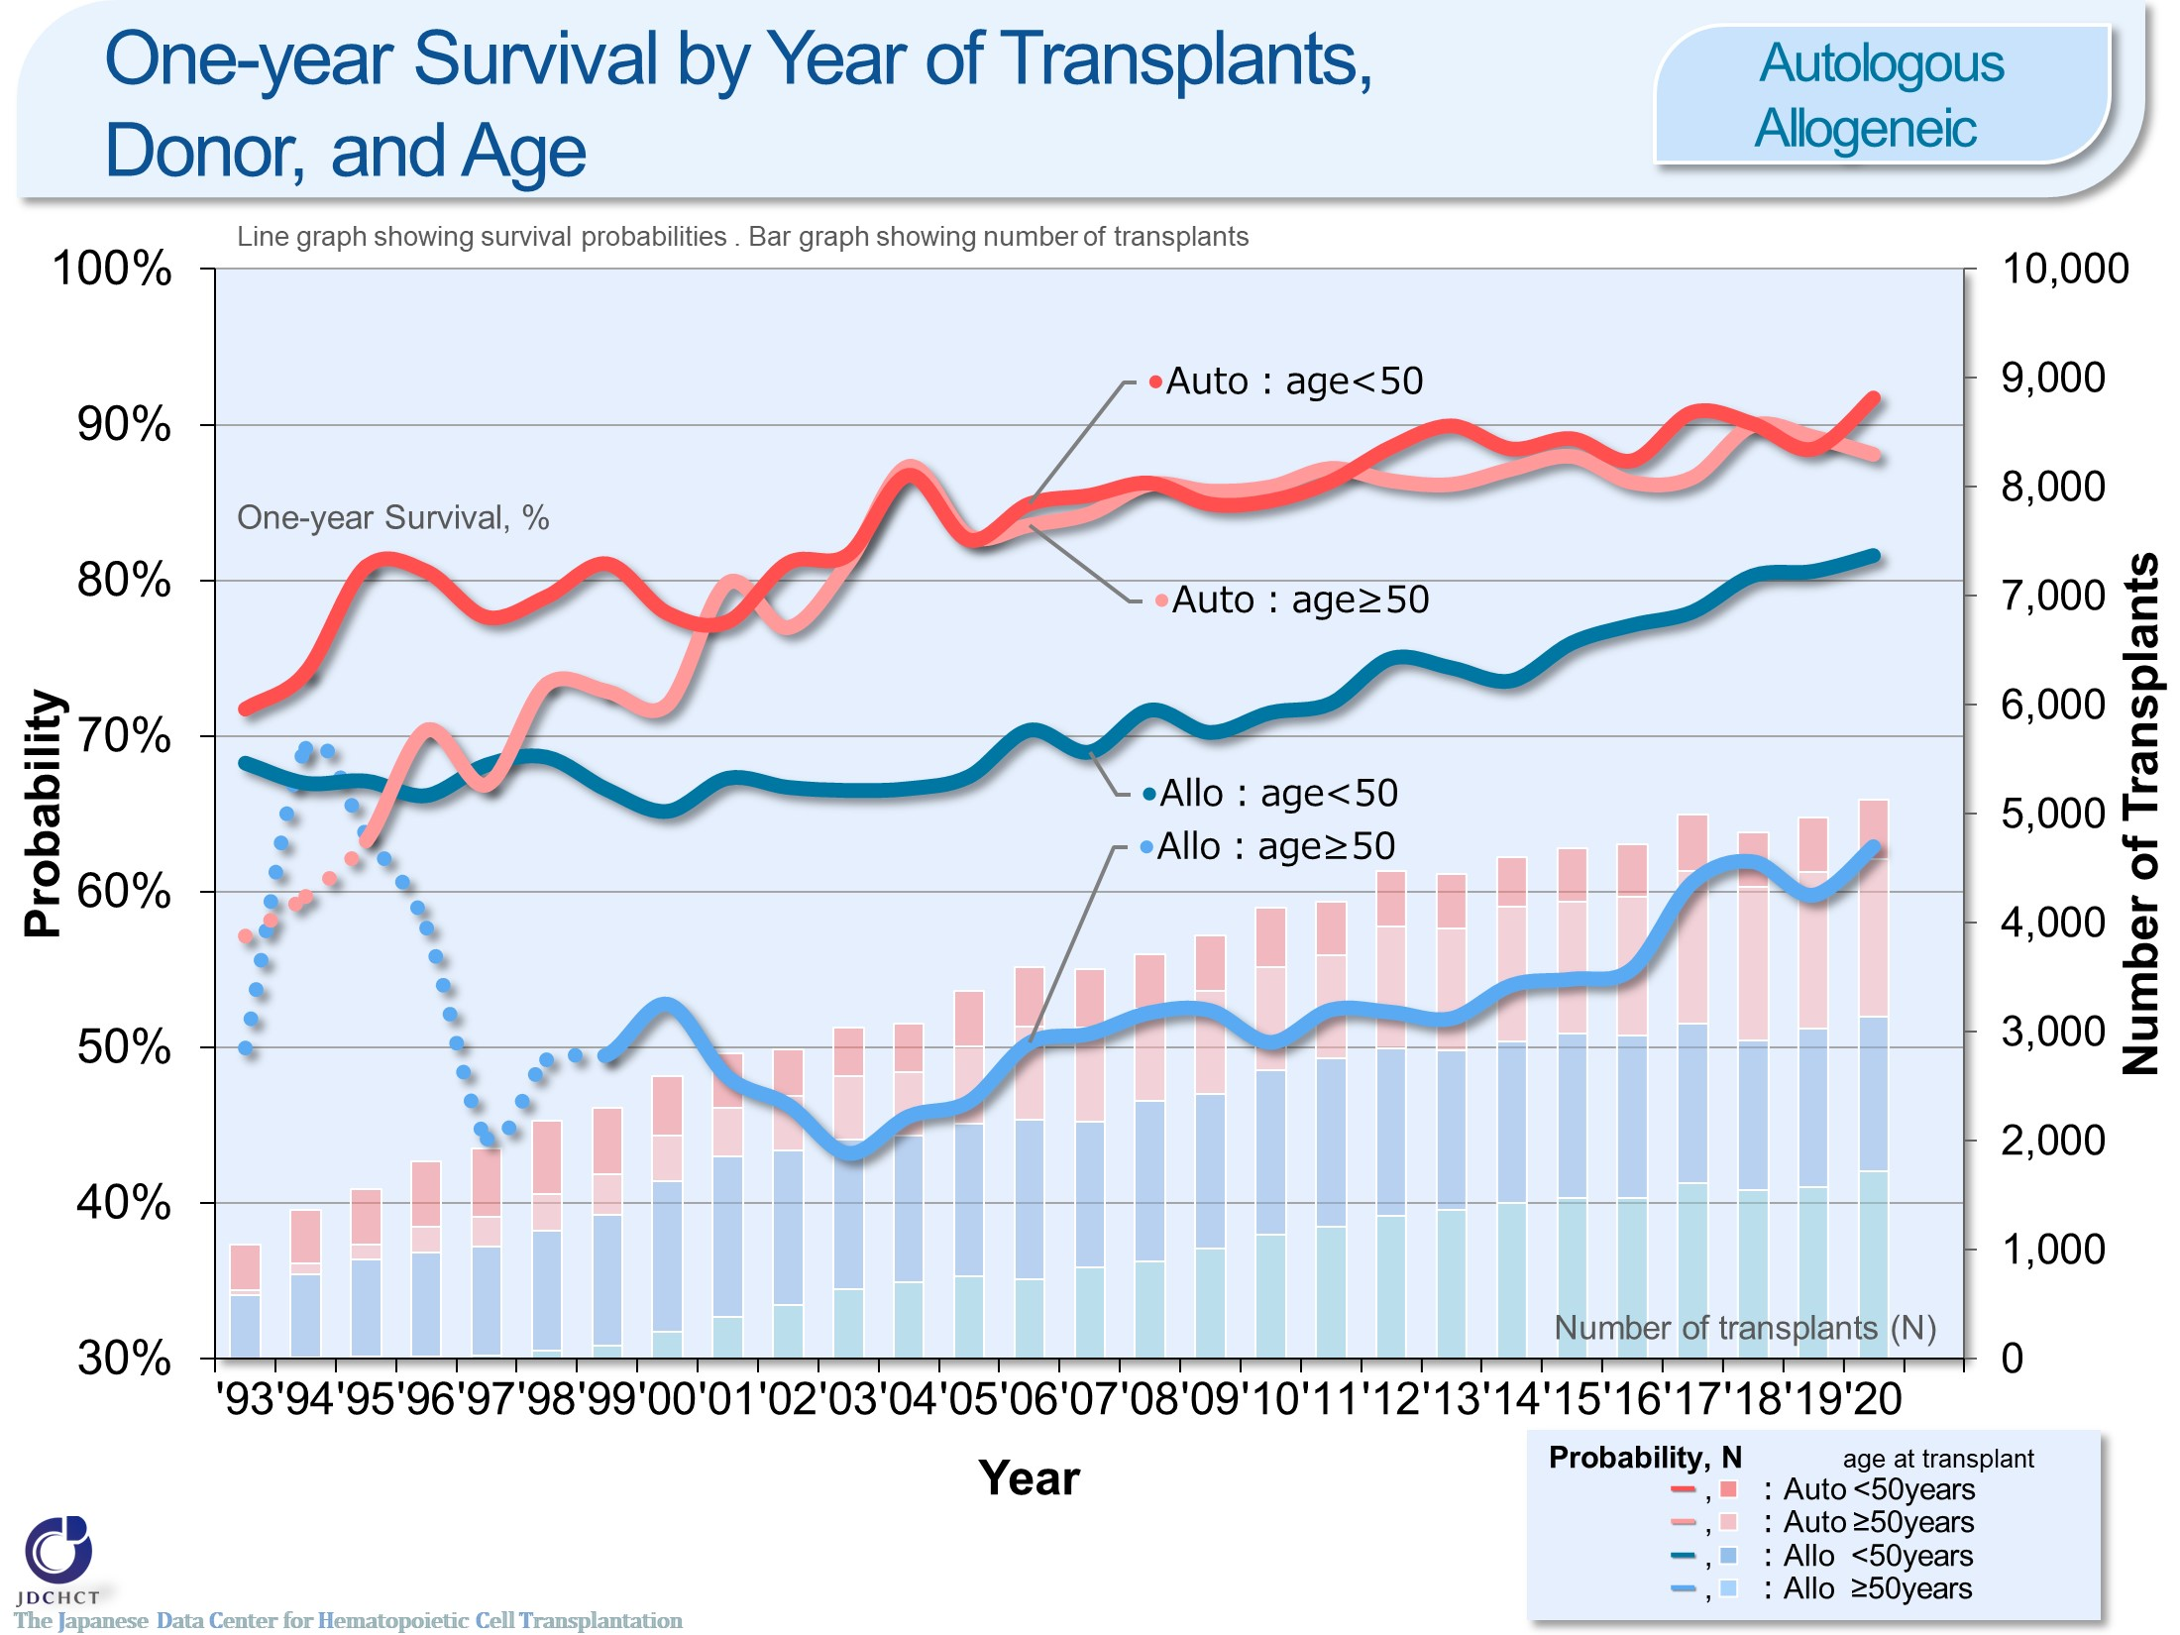
One-year Survival by Year of Transplants, Donor, and Age <Autologous/Allogeneic>
Notes:
The survival probabilities at 365 days (1 year) after transplantation have shown improving trends over the last decade who aged 49 years or younger (<50) and 50 years or older (≥50) in autologous and allogeneic transplants recipients.
The survival probabilities at 365 days after autologous transplantation are similar between those aged 49 years or younger (<50) and those aged 50 years or older (≥50).
※This table shows the results of analysis performed on patients who received first transplants.
※The dotted lines (…) indicate the survival probabilities calculated when the number of transplants was below 100.

Slide 28
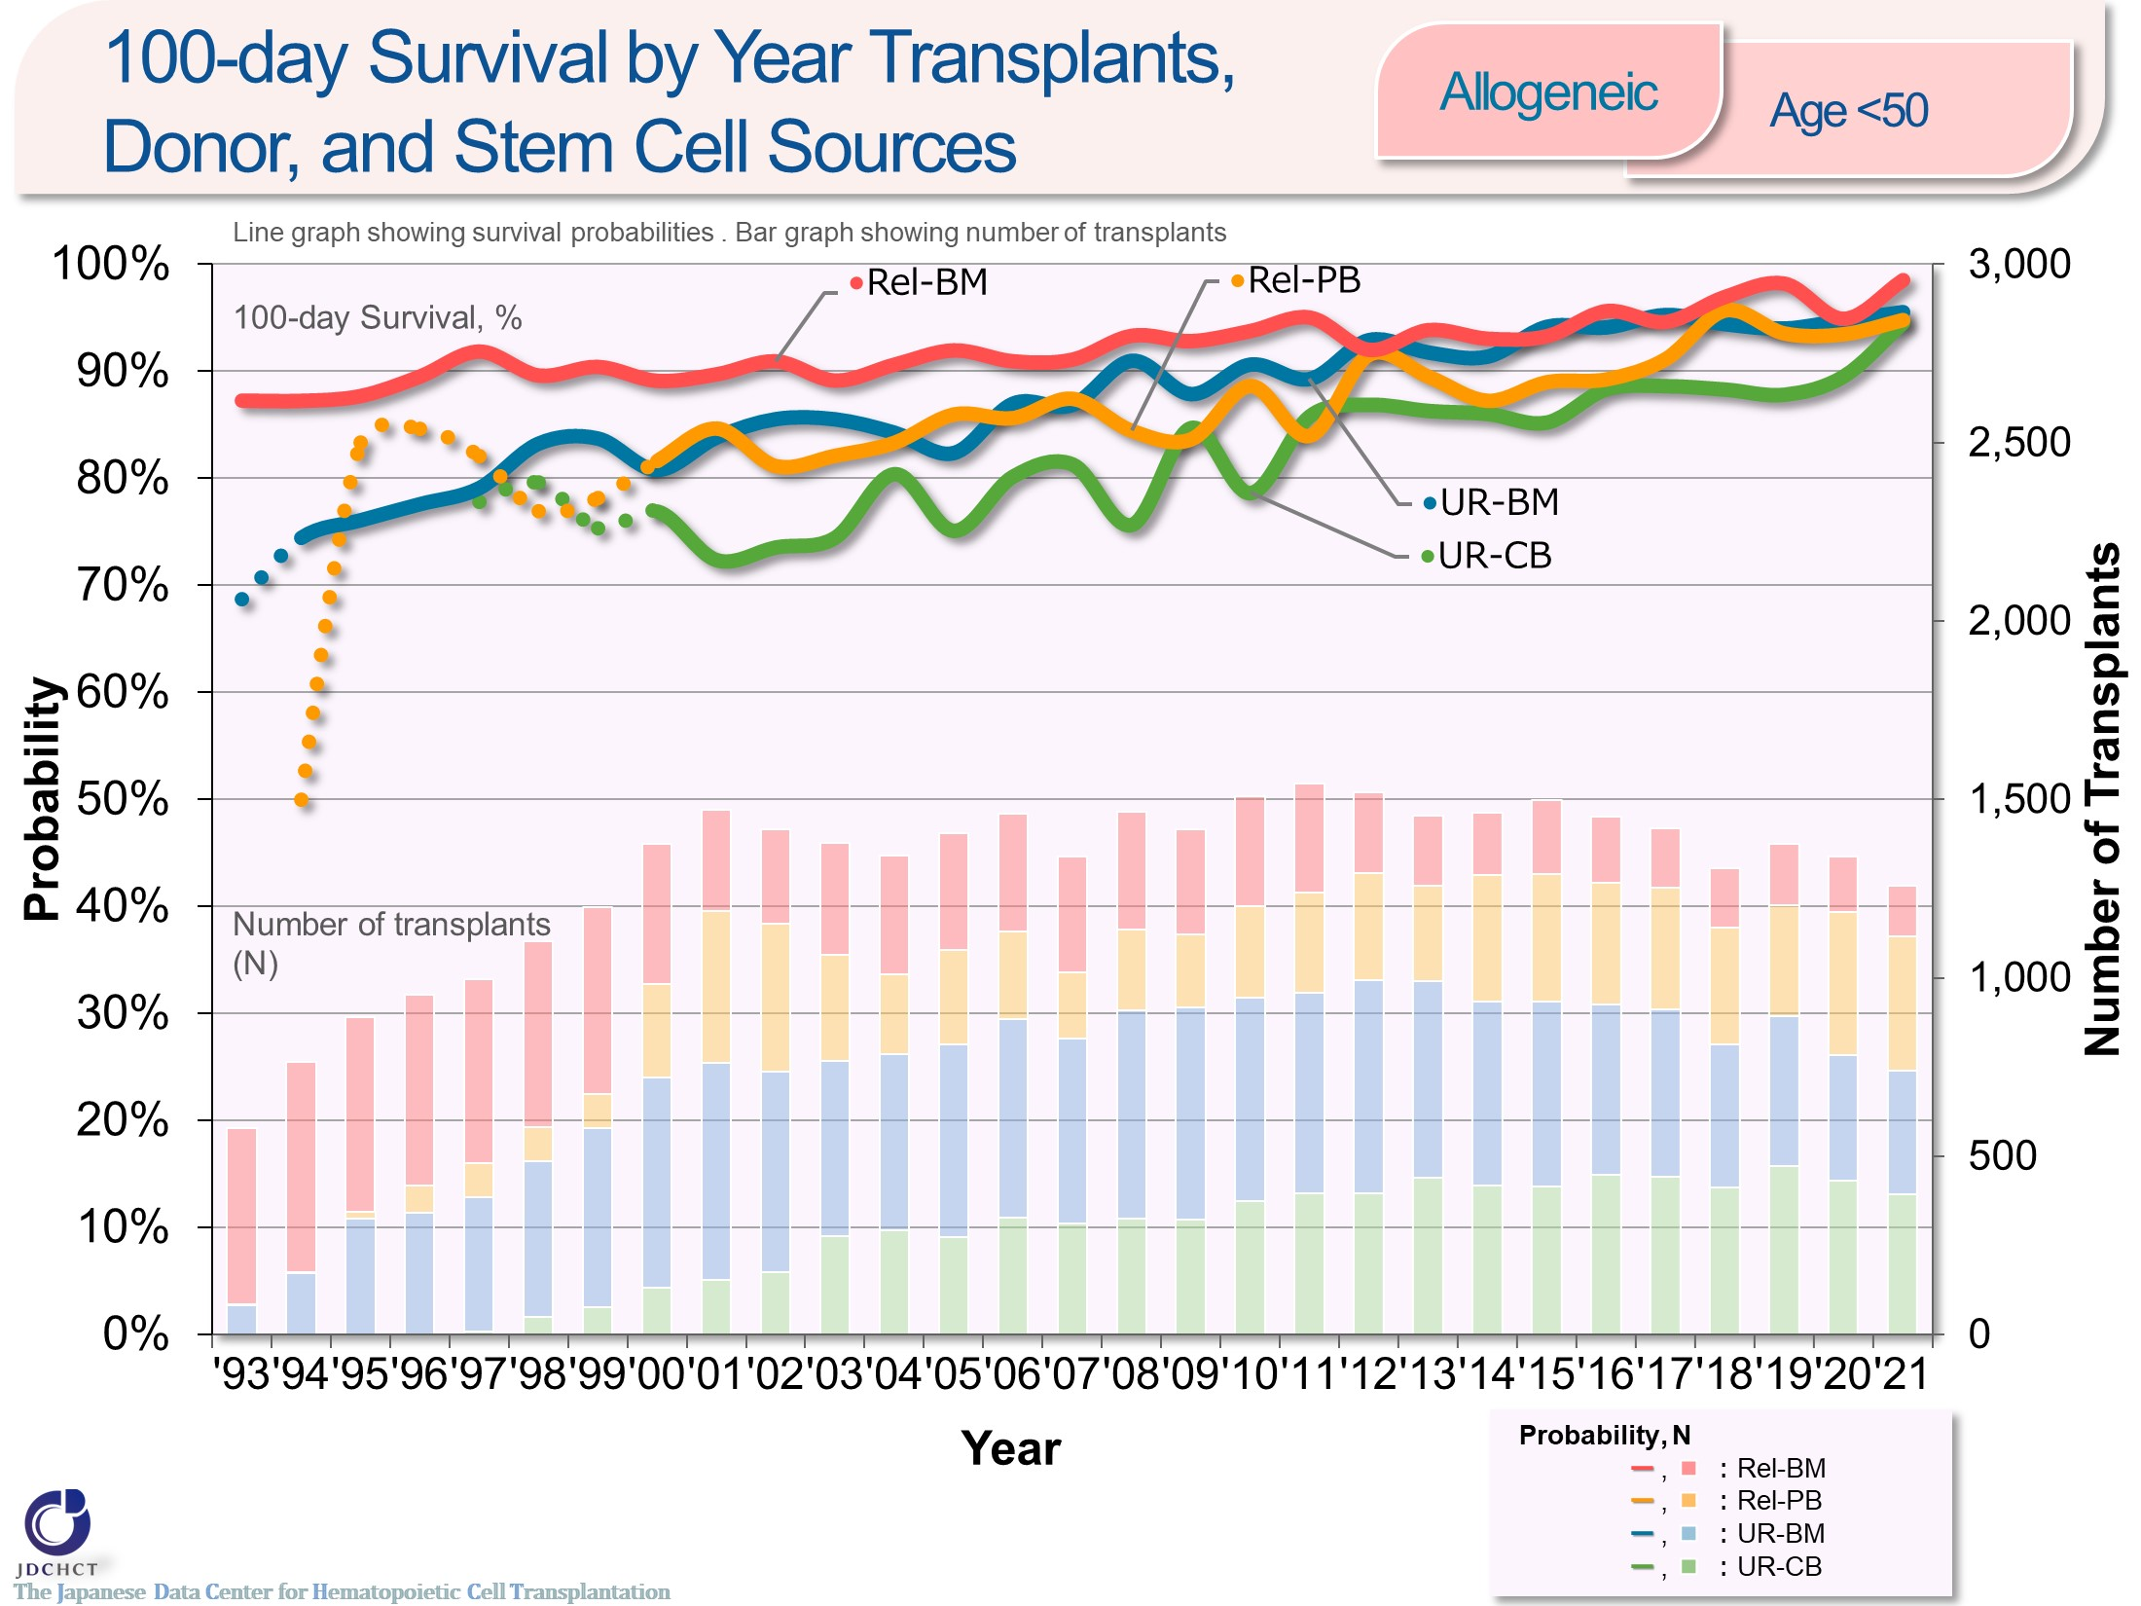
100-day Survival by Year Transplants, Donor, and Stem Cell Sources <Allogeneic><age<50>
Notes:
In those aged 49 years or younger (<50), the survival probabilities at 100 days after transplantation have shown improving trends over the last decade in both transplantation from related and unrelated donors.
Recently, the survival probabilities at 100 days after bone marrow transplantation are similar between transplantation from related and unrelated donors.
※This table shows the results of analysis performed on patients who received first transplants.
※The dotted lines (…) indicate the survival probabilities calculated when the number of transplants was below 100.

Slide 29
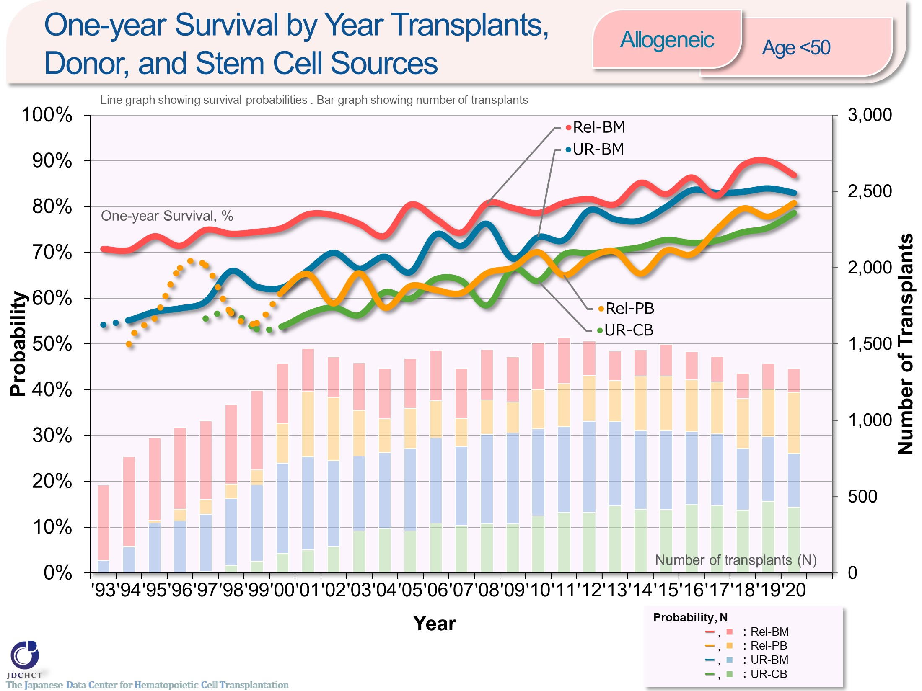
One-year Survival by Year Transplants, Donor, and Stem Cell Sources <Allogeneic><age<50>
Notes:
In those aged 49 years or younger (<50), the survival probabilities at 365 days after transplantation have shown improving trends over the last decade in both transplantation from related and unrelated donors.
※This table shows the results of analysis performed on patients who received first transplants.
※The dotted lines (…) indicate the survival probabilities calculated when the number of transplants was below 100.

Slide 30
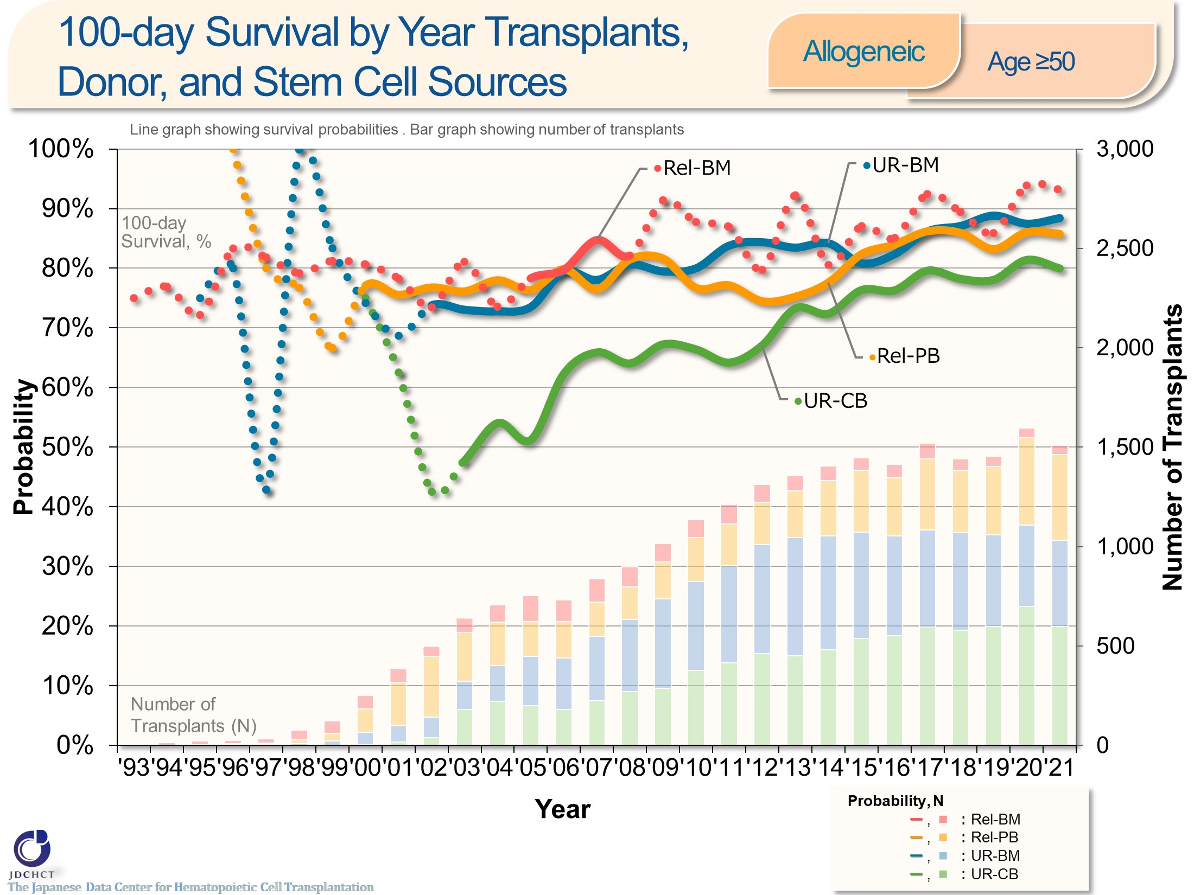
100-day Survival by Year Transplants, Donor, and Stem Cell Sources <Allogeneic><age≥50>
Notes:
In those aged 50 years or older (≥50), the survival probabilities at 100 days after transplantation from unrelated donors have shown improving trends over the last decade.
※This table shows the results of analysis performed on patients who received first transplants.
※The dotted lines (…) indicate the survival probabilities calculated when the number of transplants was below 100.

Slide 31
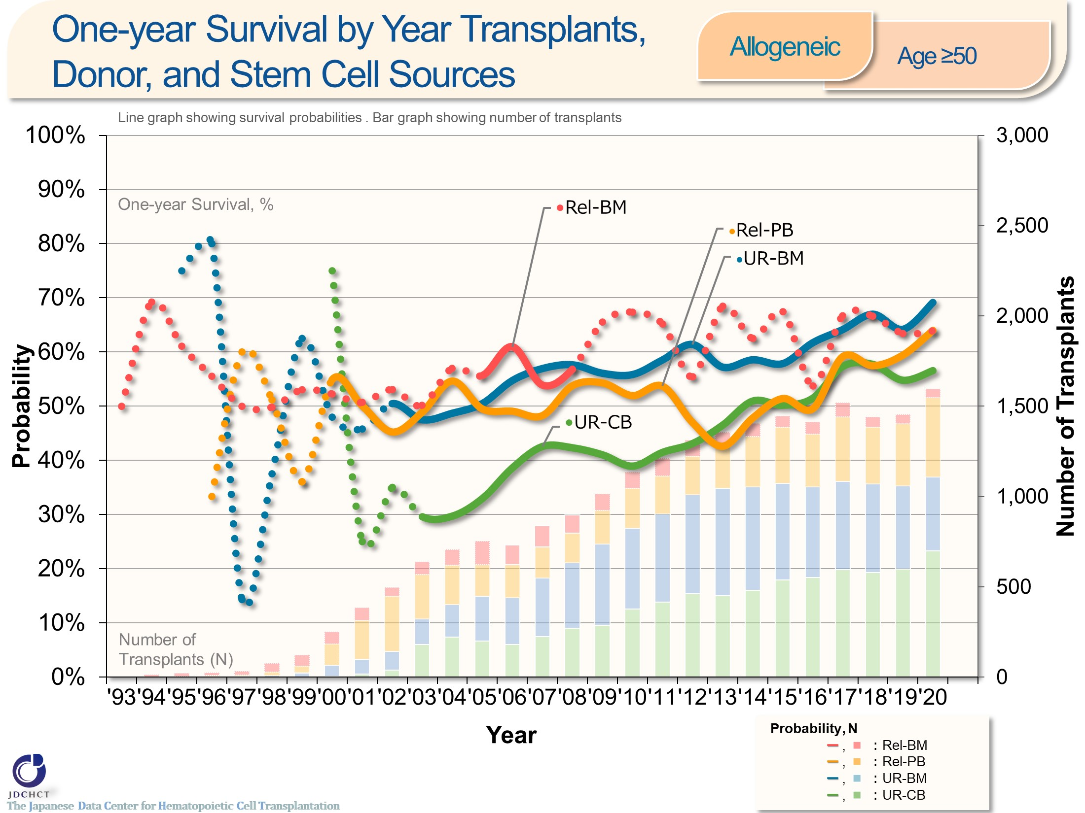
One-year Survival by Year Transplants, Donor, and Stem Cell Sources <Allogeneic><age≥50>
Notes:
In those aged 50 years or older (≥50), the survival probabilities at 365 days after transplantation from unrelated donors have shown improving trends over the last decade.
※This table shows the results of analysis performed on patients who received first transplants.
※The dotted lines (…) indicate the survival probabilities calculated when the number of transplants was below 100.

Slide 32
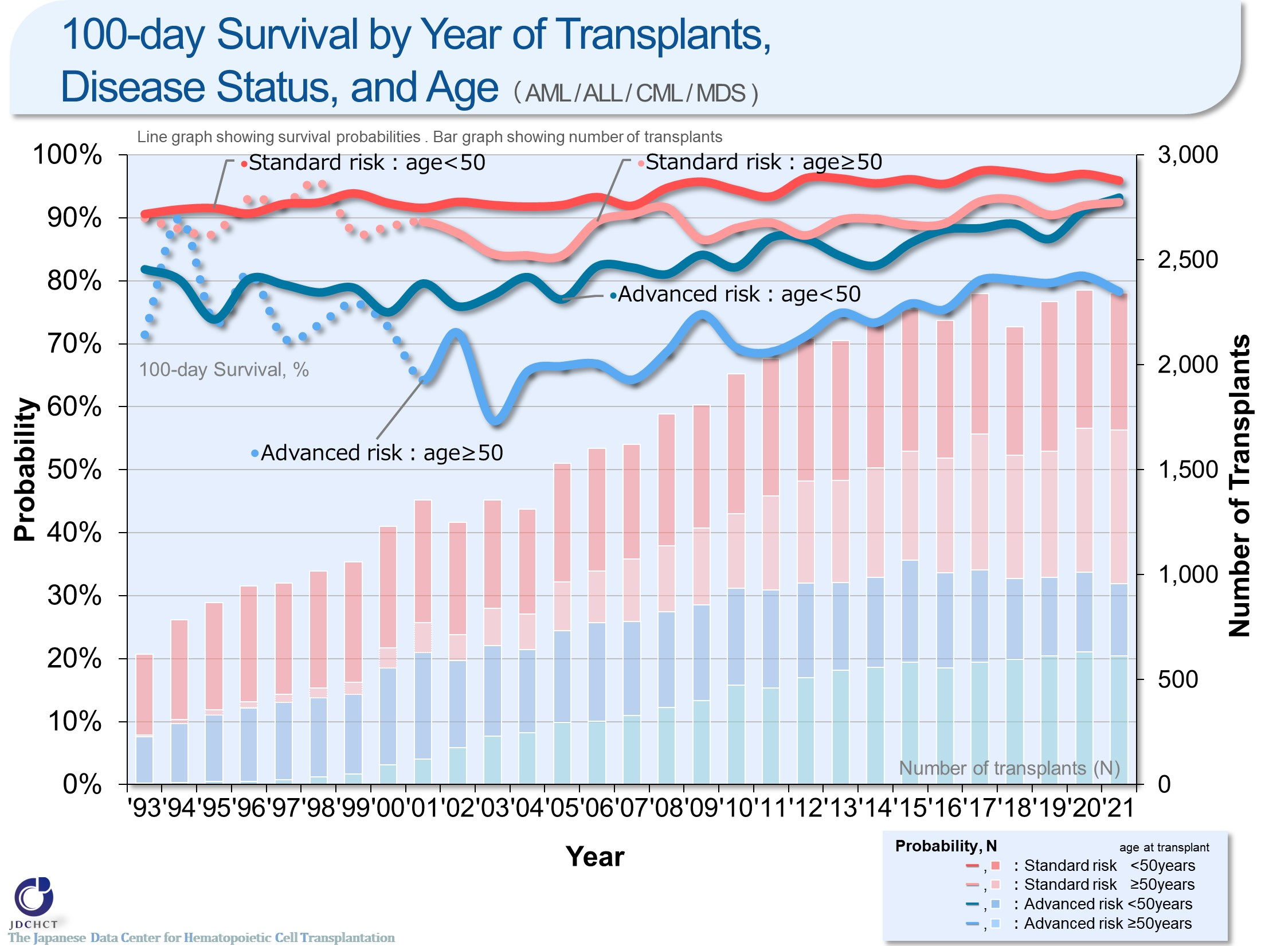
100-day Survival by Year of Transplants, Disease Status, and Age（ AML / ALL / CML / MDS )
Notes:
The survival probability at 100 days after transplantation in the advanced risk group of patients with leukemia have shown improving trends over the last 10 years in the subgroup of recipients aged 49 years or younger (<50). In the subgroup of recipients aged 50 years or older (≥50), the number of transplants increased and the outcome of transplantation improved, when compared with the situation 10 years ago.
※This table shows the results of analysis performed on patients who received first transplants.
※The dotted lines (…) indicate the survival probabilities calculated when the number of transplants was below 100.
―≪Disease risk status at transplantation≫―
■Standard Risk Group
・AML (first complete remission[1CR]／second complete remission[2CR])
・ALL (1CR)
・CML (complete hematologic response(CHR)／first chronic phase[1CP])
・MDS (WHO 2017 classification： MDS with single lineage dysplasia／MDS-RS and single lineage dysplasia
／MDS-RS and multilineage dysplasia
／MDS with multilineage dysplasia
／MDS with isolated del(5q)
／MDS, unclassifiable
／Refractory cytopenia of childhood (provisional entity)
WHO old classification, FAB classification：refractory anemia[RA] ／refractory anemia with ring sideroblasts[RARS]／refractory
cytopenia with multilineage dysplasia[RCMD]／refractory cytopenia with multilineage dysplasia and ringed sideroblasts[RCMD-RS]／myelodysplastic syndrome associated
with isolated del（5q）chromosome abnormality[5q−syndrome])
■Advanced Risk Group
・all other conditions
―――――――――――――――――――――

Slide 33
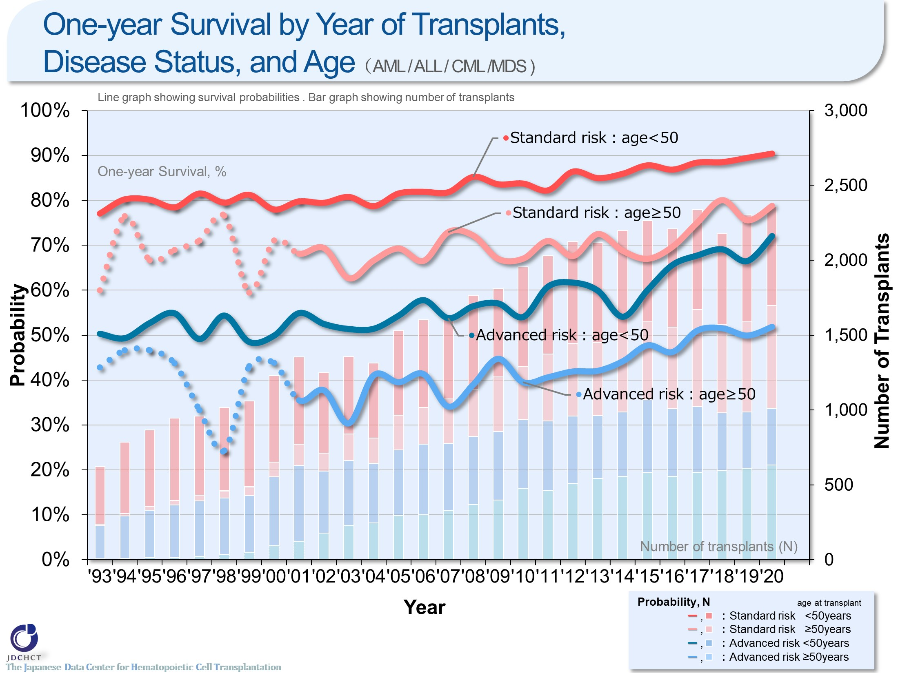
One-year Survival by Year of Transplants, Disease Status, and Age （ AML / ALL / CML /MDS )
Notes:
The survival probabilities at 365 days after transplantation in patients with leukemia have shown slightly improving trends in recent years.
Comparison of the younger patients and the older patients in each risk group has revealed that the outcome of transplantation is slightly better in the younger patient group.
※This table shows the results of analysis performed on patients who received first transplants.
※The dotted lines (…) indicate the survival probabilities calculated when the number of transplants was below 100.
―≪Disease risk status at transplantation≫―
■Standard Risk Group
・AML (first complete remission[1CR]／second complete remission[2CR])
・ALL (1CR)
・CML (complete hematologic response(CHR)／first chronic phase[1CP])
・MDS (WHO 2017 classification： MDS with single lineage dysplasia／MDS-RS and single lineage dysplasia
／MDS-RS and multilineage dysplasia
／MDS with multilineage dysplasia
／MDS with isolated del(5q)
／MDS, unclassifiable
／Refractory cytopenia of childhood (provisional entity)
WHO old classification, FAB classification：refractory anemia[RA] ／refractory anemia with ring sideroblasts[RARS]／refractory
cytopenia with multilineage dysplasia[RCMD]／refractory cytopenia with multilineage dysplasia and ringed sideroblasts[RCMD-RS]／myelodysplastic syndrome associated
with isolated del（5q）chromosome abnormality[5q−syndrome])
■Advanced Risk Group
・all other conditions
―――――――――――――――――――――

Slide 34
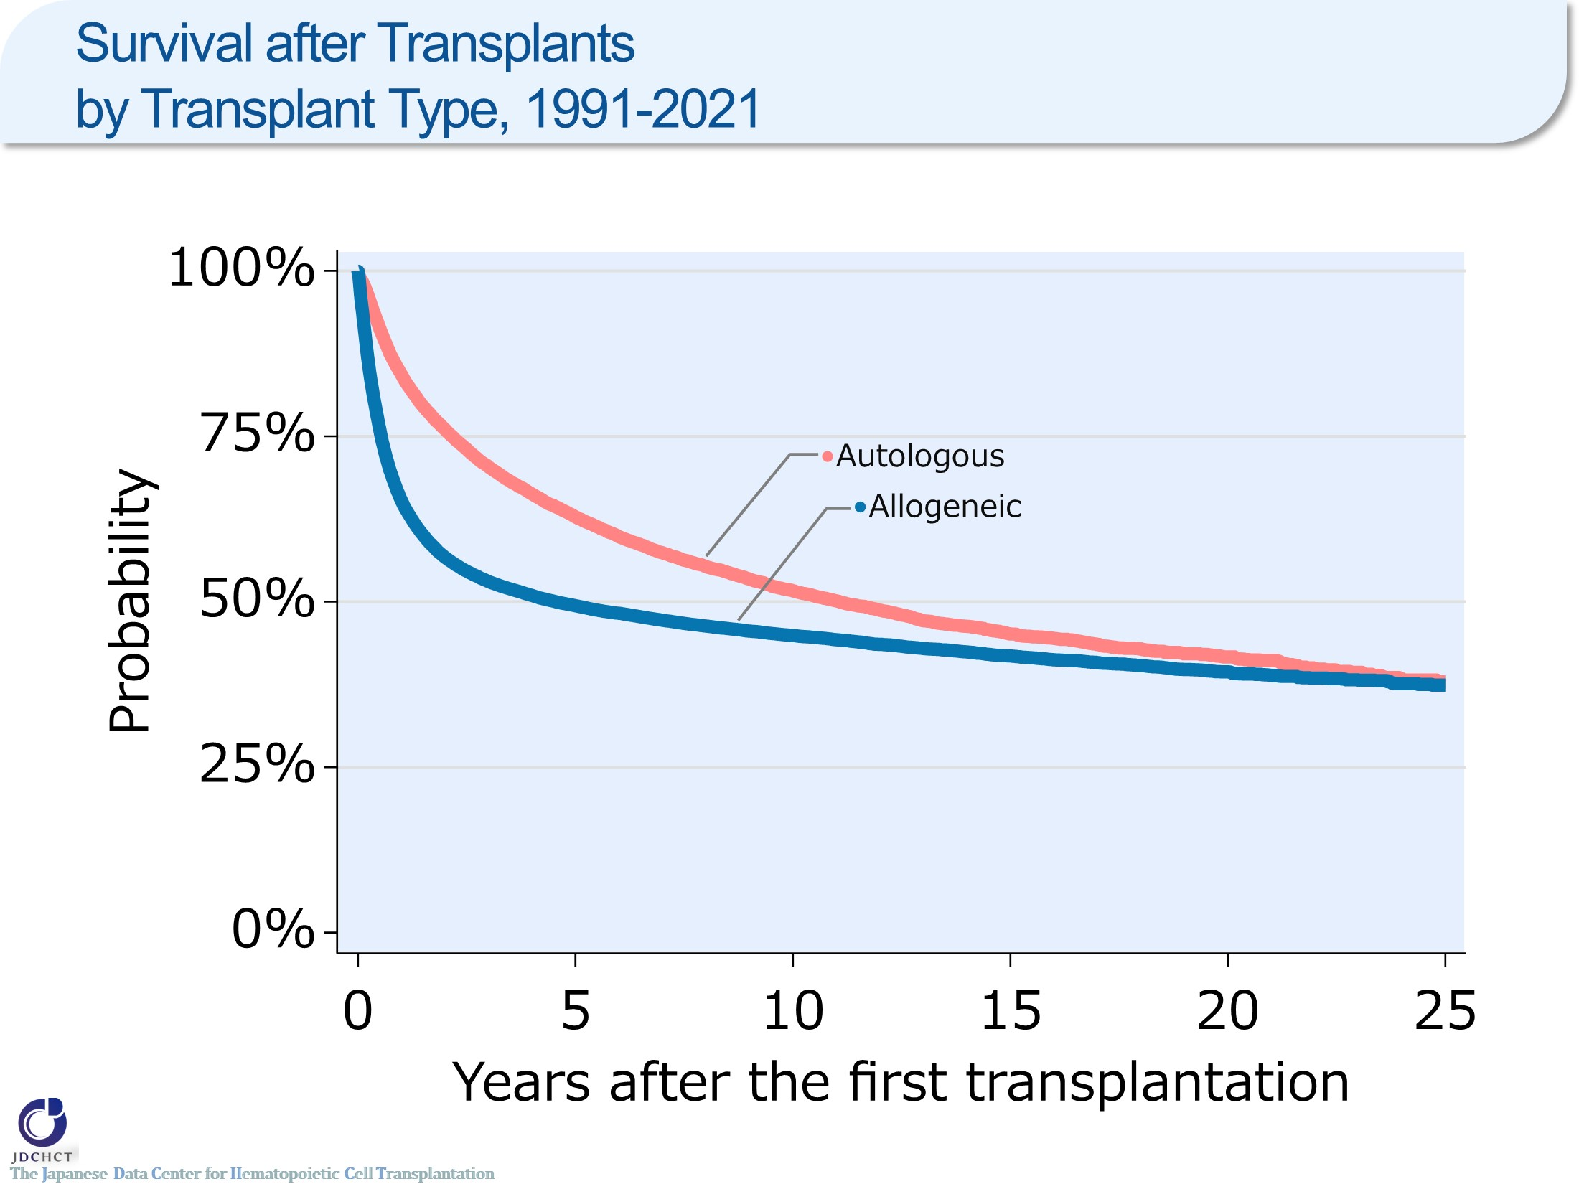
Survival after Transplants by Transplant Type, 1991-2021
Notes:
The survival probability in autologous transplants is 80％ or more at one year after transplantation, and 51.7％ at ten years after transplantation.
The survival probability in allogeneic transplants is 65.3％ at one year after transplantation, and 44.9％ at ten years after transplantation.

Slide 35
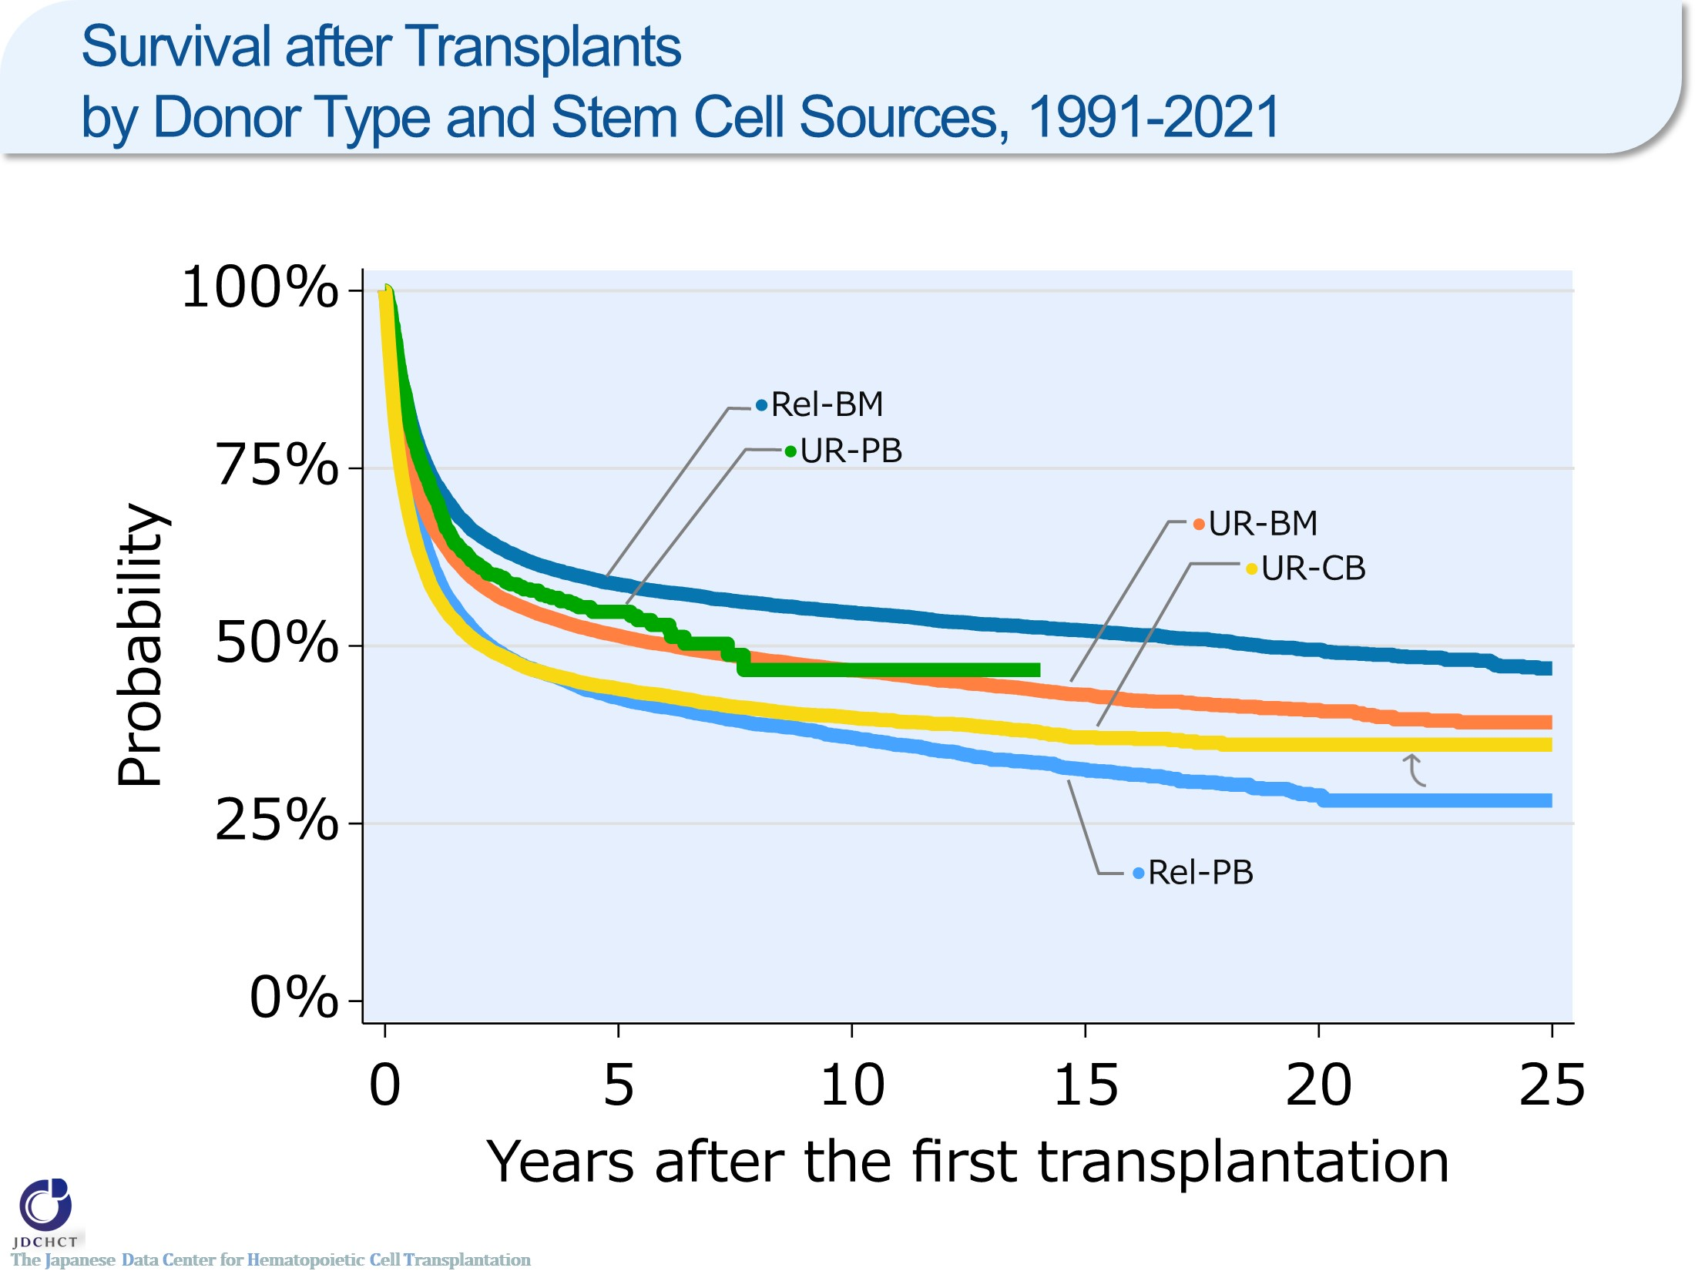
Survival after Transplants by Donor Type and Stem Cell Sources, 1991-2021
Notes:
The survival probability in bone marrow transplants from related donors is 58.7％ five years after transplantation and 54.7％ at ten years after transplantation. The survival probability in bone marrow transplants from unrelated donors is 51.4％ five years after transplantation and 46.6％ at ten years after transplantation.
In allogeneic transplants excluding peripheral blood stem cell transplants from unrelated donors which was introduced in 2010, the survival probabilities from the time of 5 years after transplantation onwards decline only modestly.

Slide 36
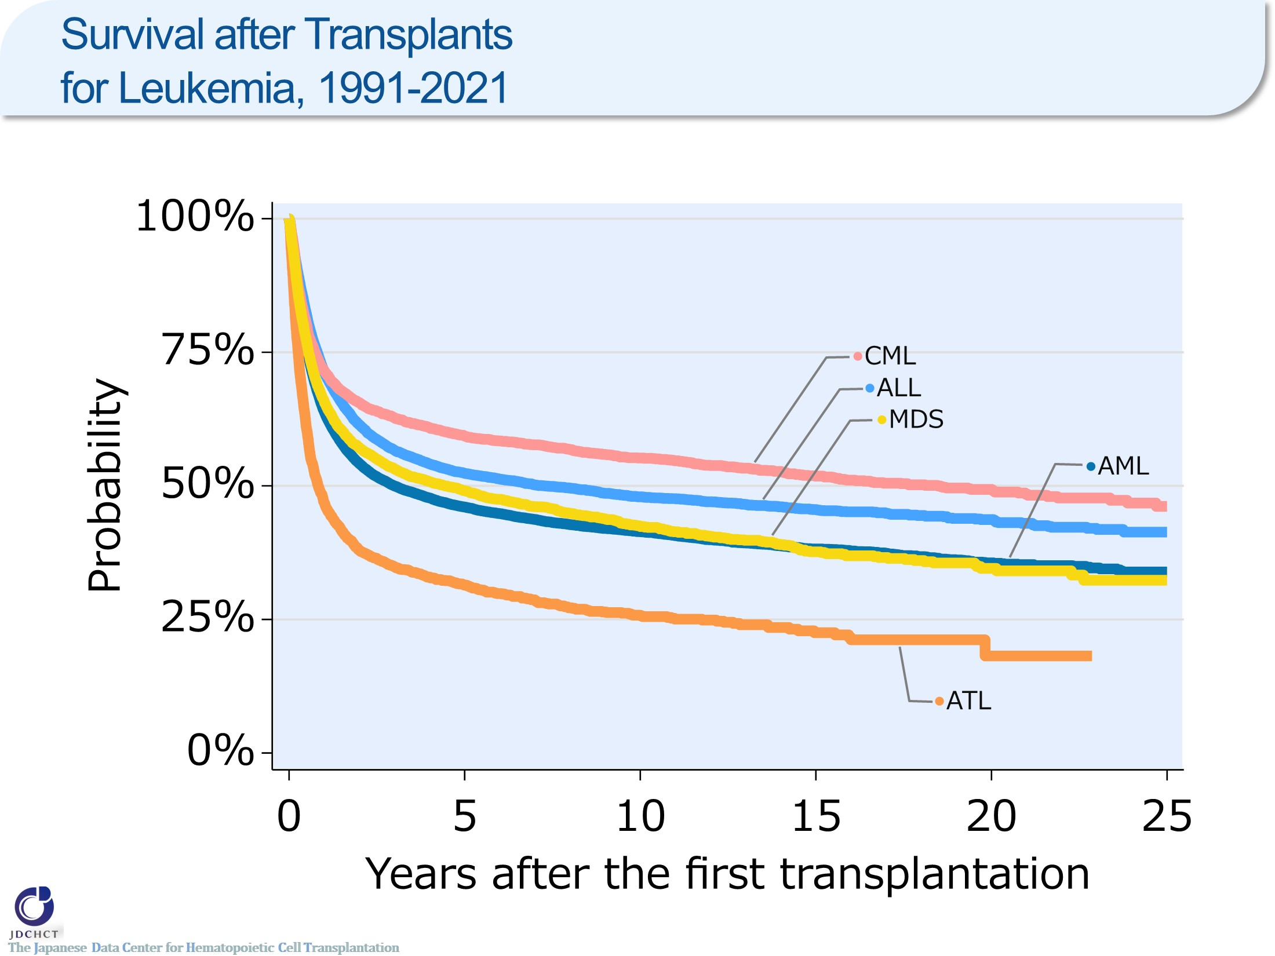
Survival after Transplants for Leukemia, 1991-2021
Notes:
In acute myeloid leukemia and acute lymphoblastic leukemia, the survival probabilities are 46.1％ and 52.4％ at five years after transplantation, and 41.4％ and 48.0％ at ten years after transplantation, respectively.
In chronic myelogenous leukemia, the spread of therapeutic drugs has reduced the number of transplants, and the survival probabilities both 5 and 10 years after transplantation are above 50％.
In adult T-cell leukemia, the survival probability is 46.9％ at one year after transplantation and 25.8％ at ten years after transplantation.

Slide 37
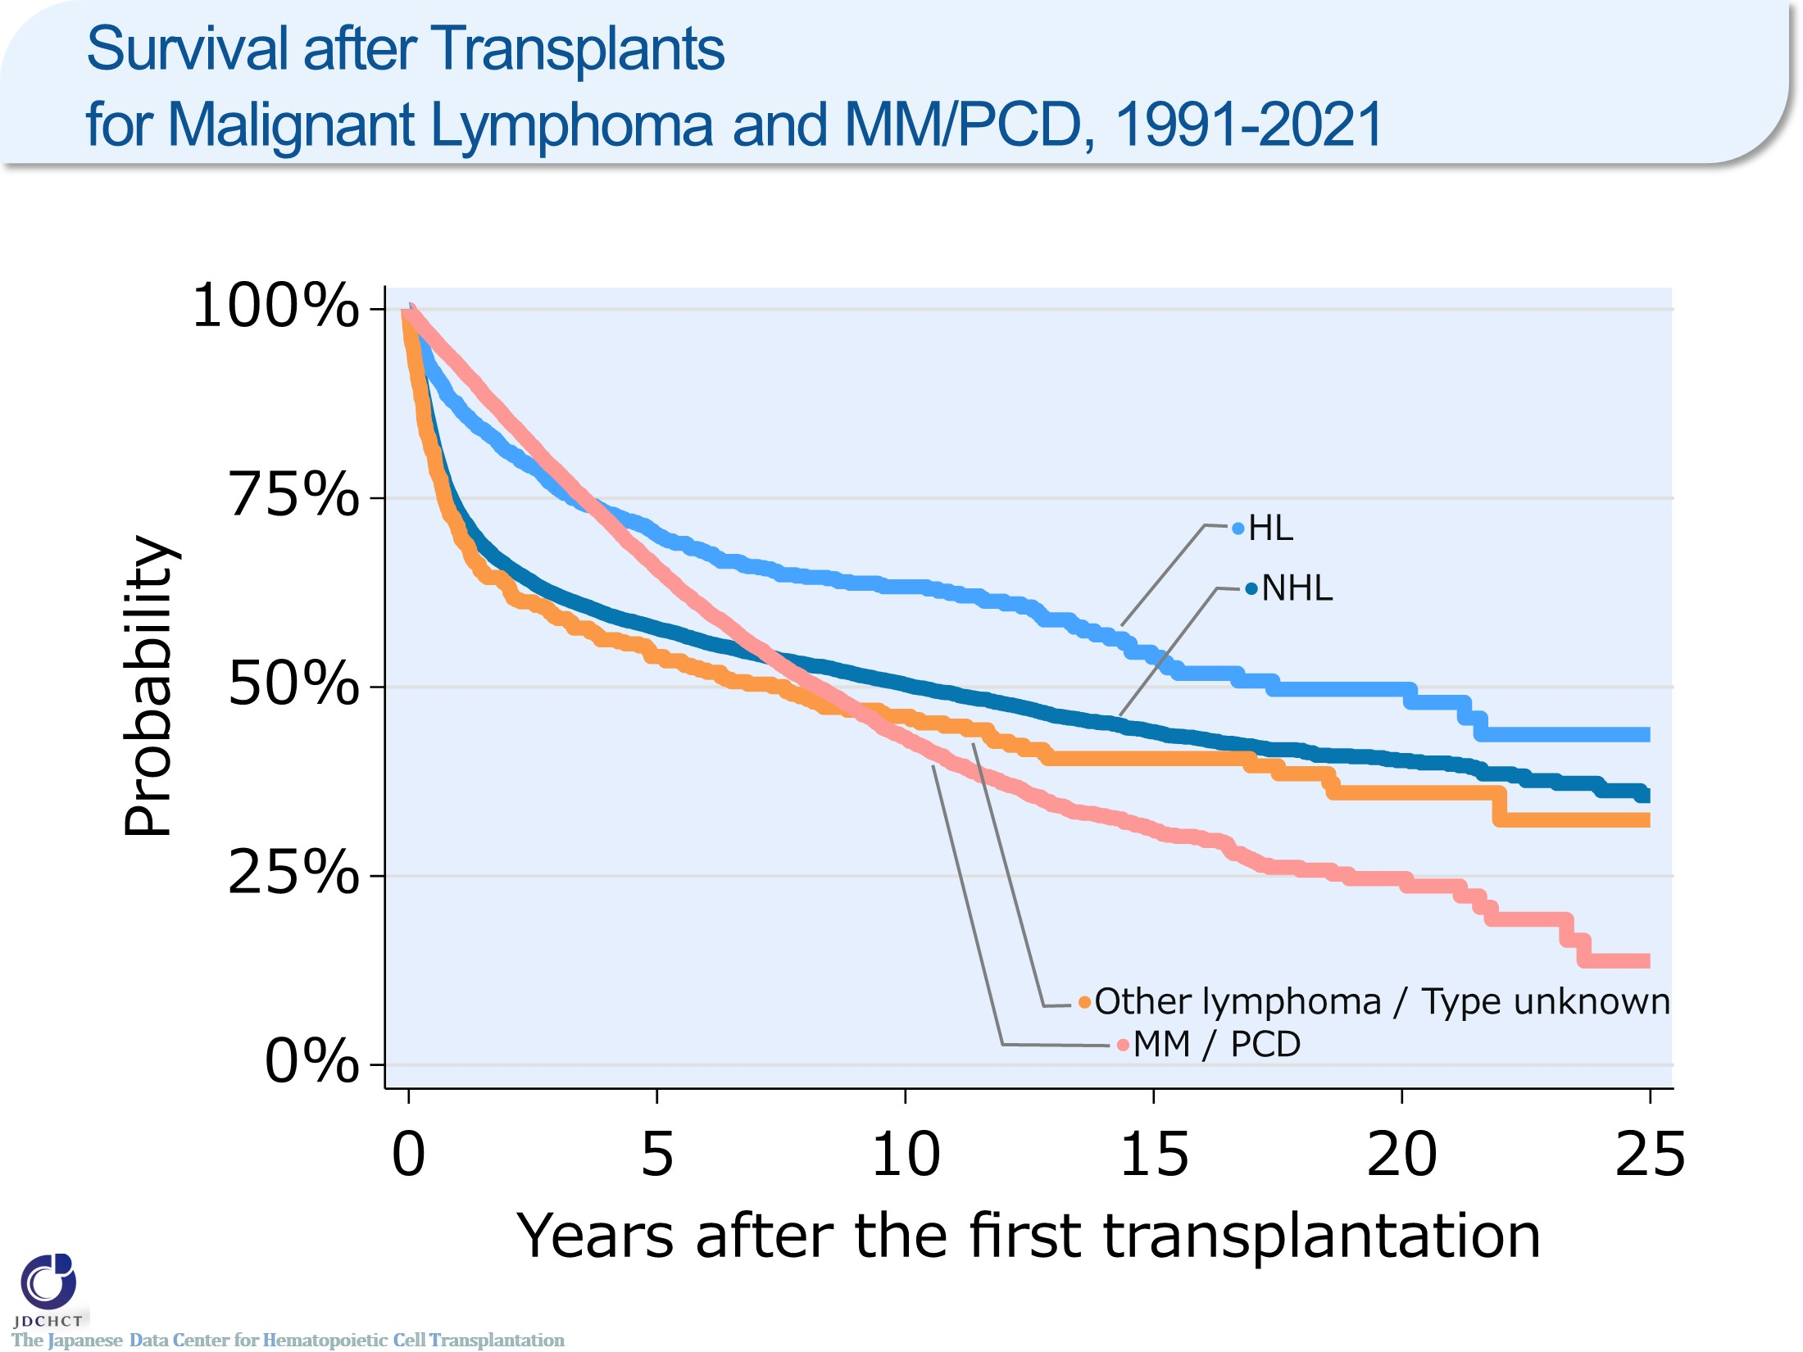
Survival after Transplants for Malignant Lymphoma and MM/PCD, 1991-2021
Notes:
In non-Hodgkin lymphoma and Hodgkin lymphoma, the survival probabilities are 57.8％ and 70.2％ at five years after transplantation and 50.3％ and 63.3％ at ten years after transplantation, respectively. The survival probability after transplantation is slightly higher in Hodgkin lymphoma.
In most of first transplants in plasma cell neoplasms including multiple myeloma, autologous transplants are performed. For the total autologous and allogeneic transplants, the survival probability at one year after transplantation is as high as 92.6％, whereas the survival probability at 10 years after transplantation is 43.3％.

Slide 38
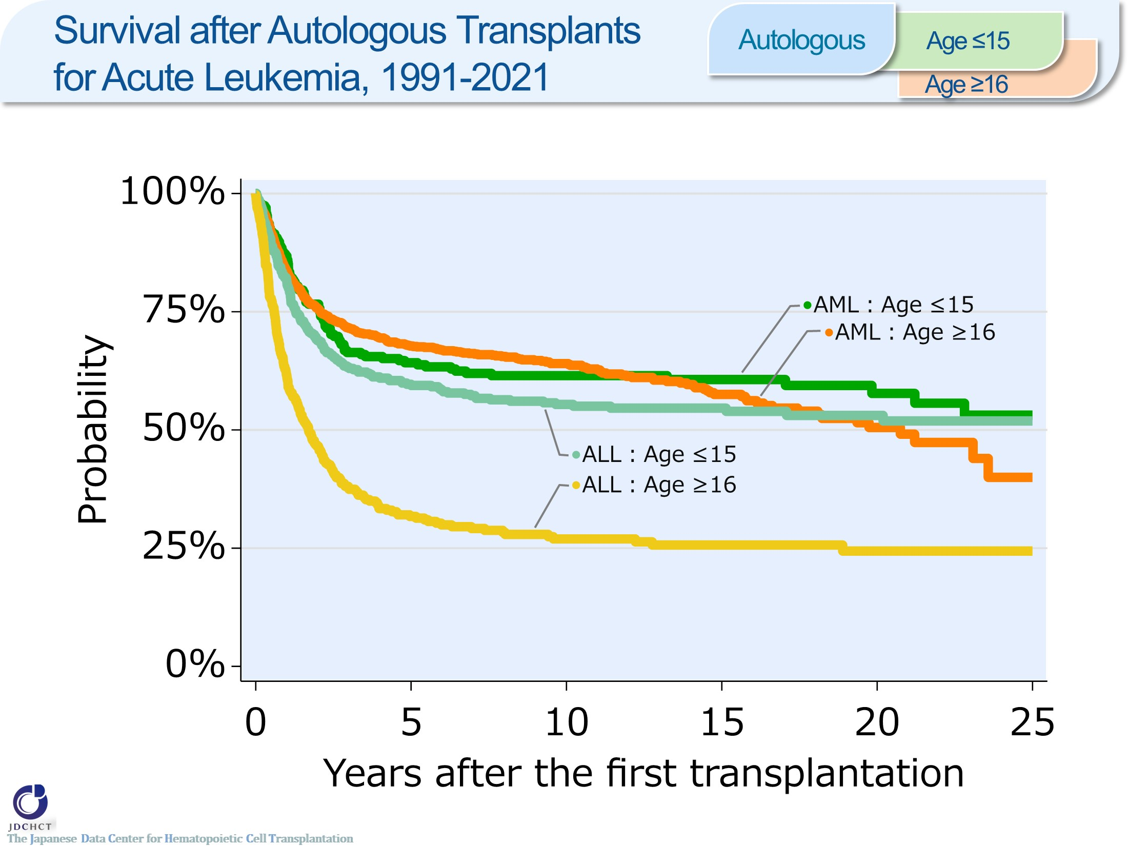
Survival after Autologous Transplants for Acute Leukemia, 1991-2021 <Autologous>
Notes:
In acute myeloid leukemia, the survival probabilities are around 65％ at five years after autologous transplant for both of recipients aged and 0 to 15 years and those aged 16 years or older (≥16).
In acute lymphoblastic leukemia, the survival probabilities at 5 years after transplantation are 59.7% and 31.7% in recipients aged 0 to 15 years and those aged 16 years or older (≥16).

Slide 39
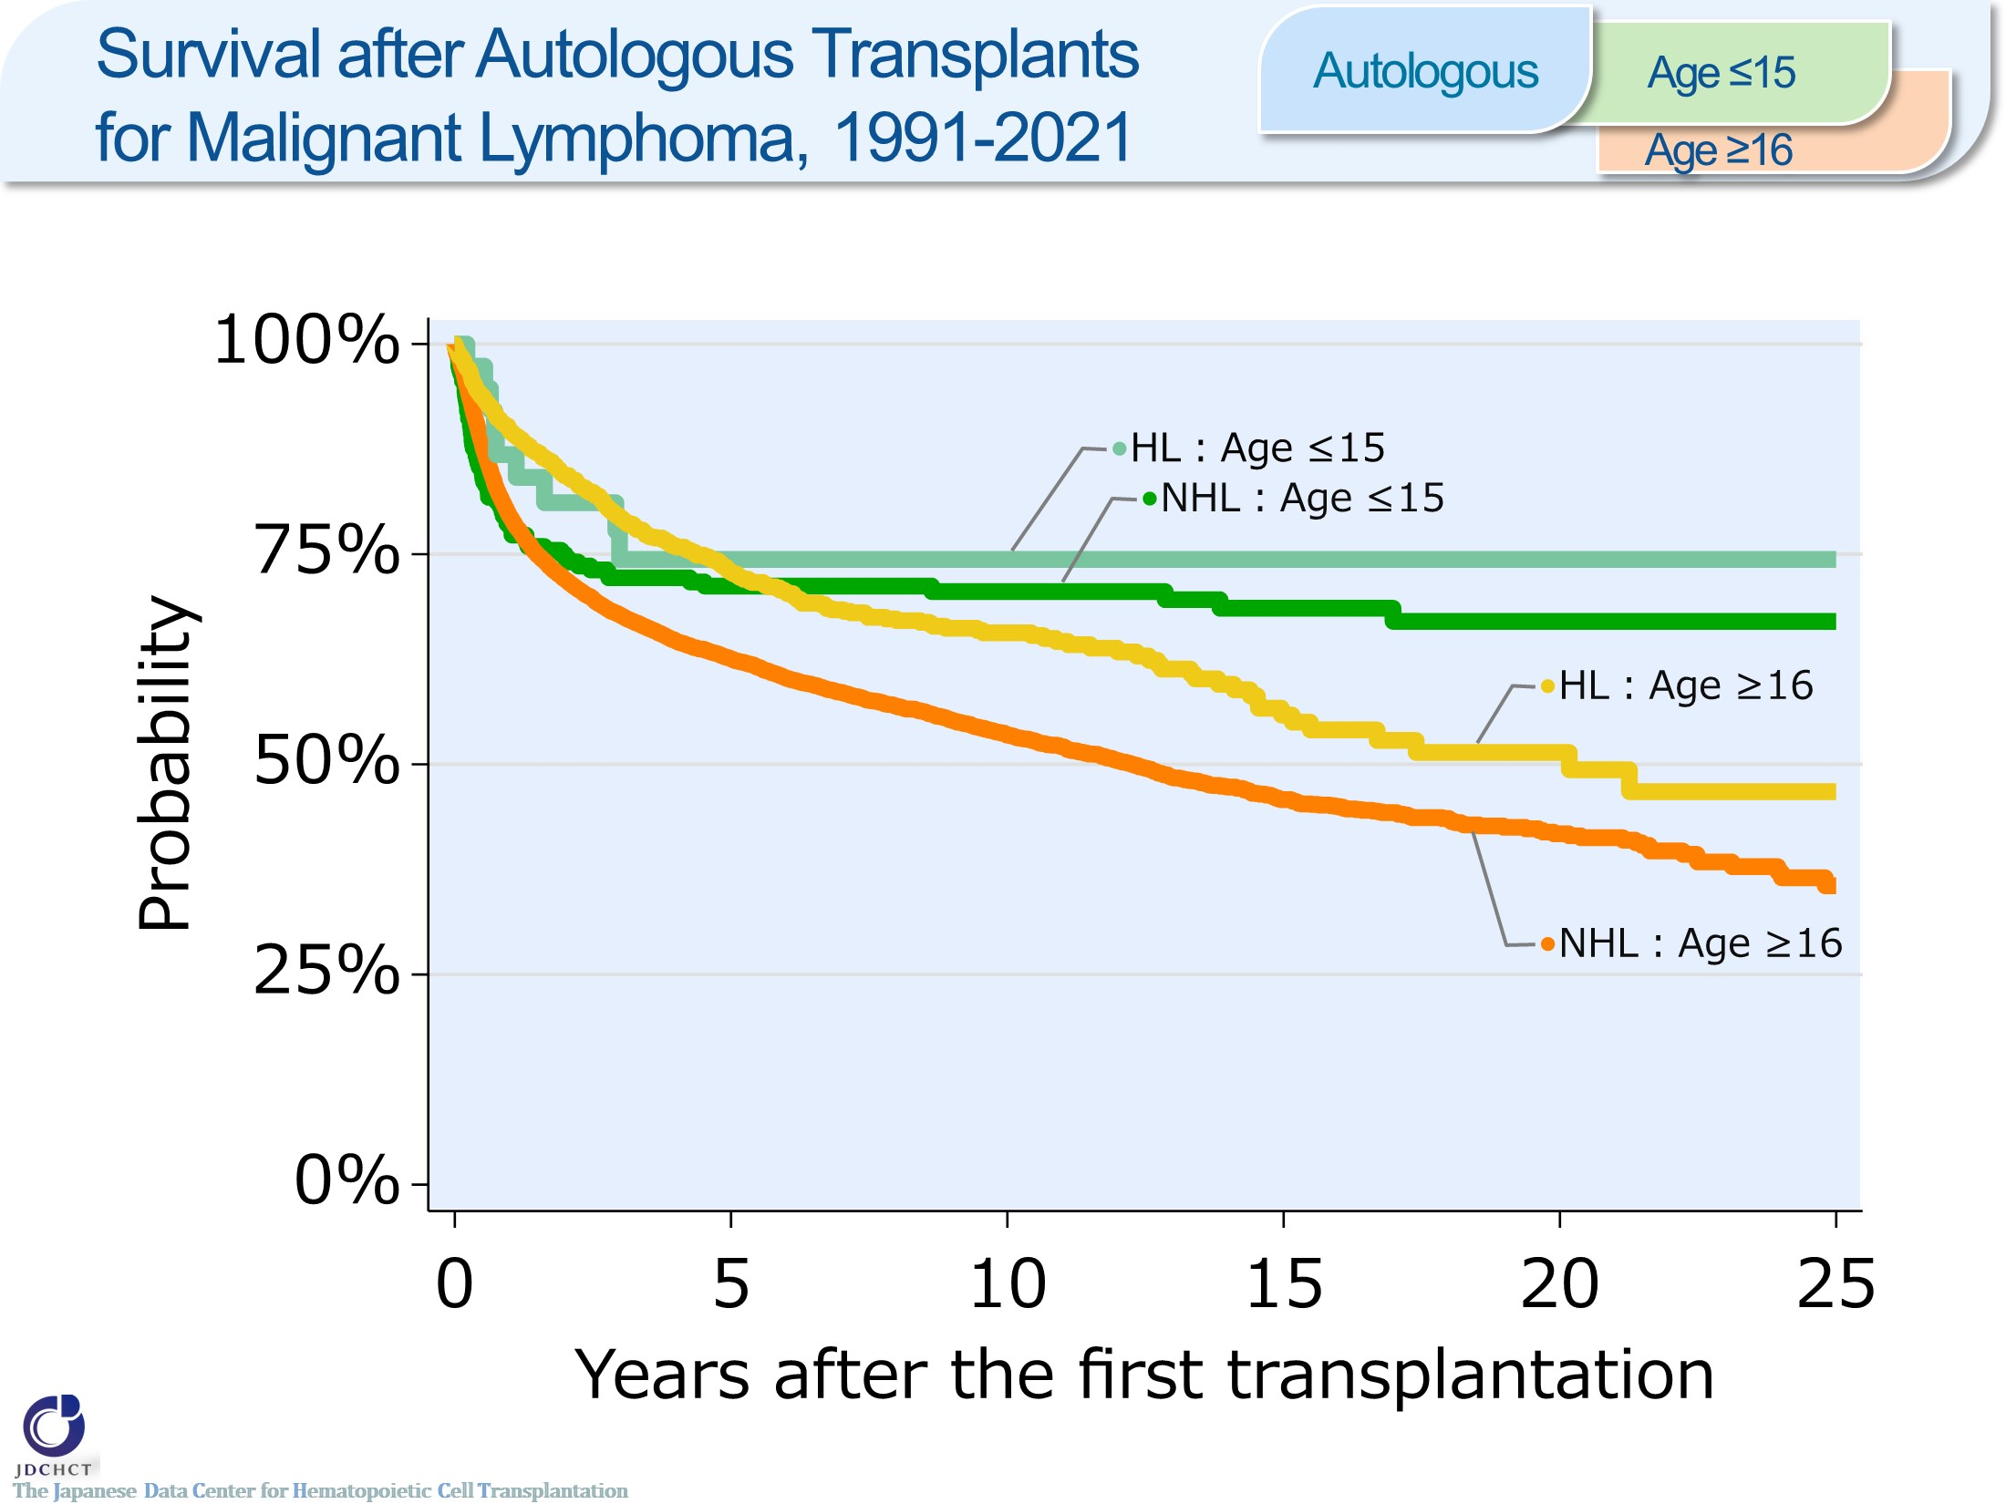
Survival after Autologous Transplants for Malignant Lymphoma, 1991-2021 <Autologous>
Notes:
In both non-Hodgkin lymphoma and Hodgkin lymphoma, the survival probabilities five years after autologous transplantation are around 70％ in recipients aged 0 to 15 years.
The survival probability in autologous transplant recipients aged 16 years or older (≥16) in non-Hodgkin lymphoma is 62.6% at five years after transplantation and 53.5% at ten years after transplantation.
The survival probability in autologous transplant recipients aged 16 years or older (≥16) in Hodgkin lymphoma is as high as 89.7％ at one year after transplantation, and is 65.7％ at ten years after transplantation.

Slide 40
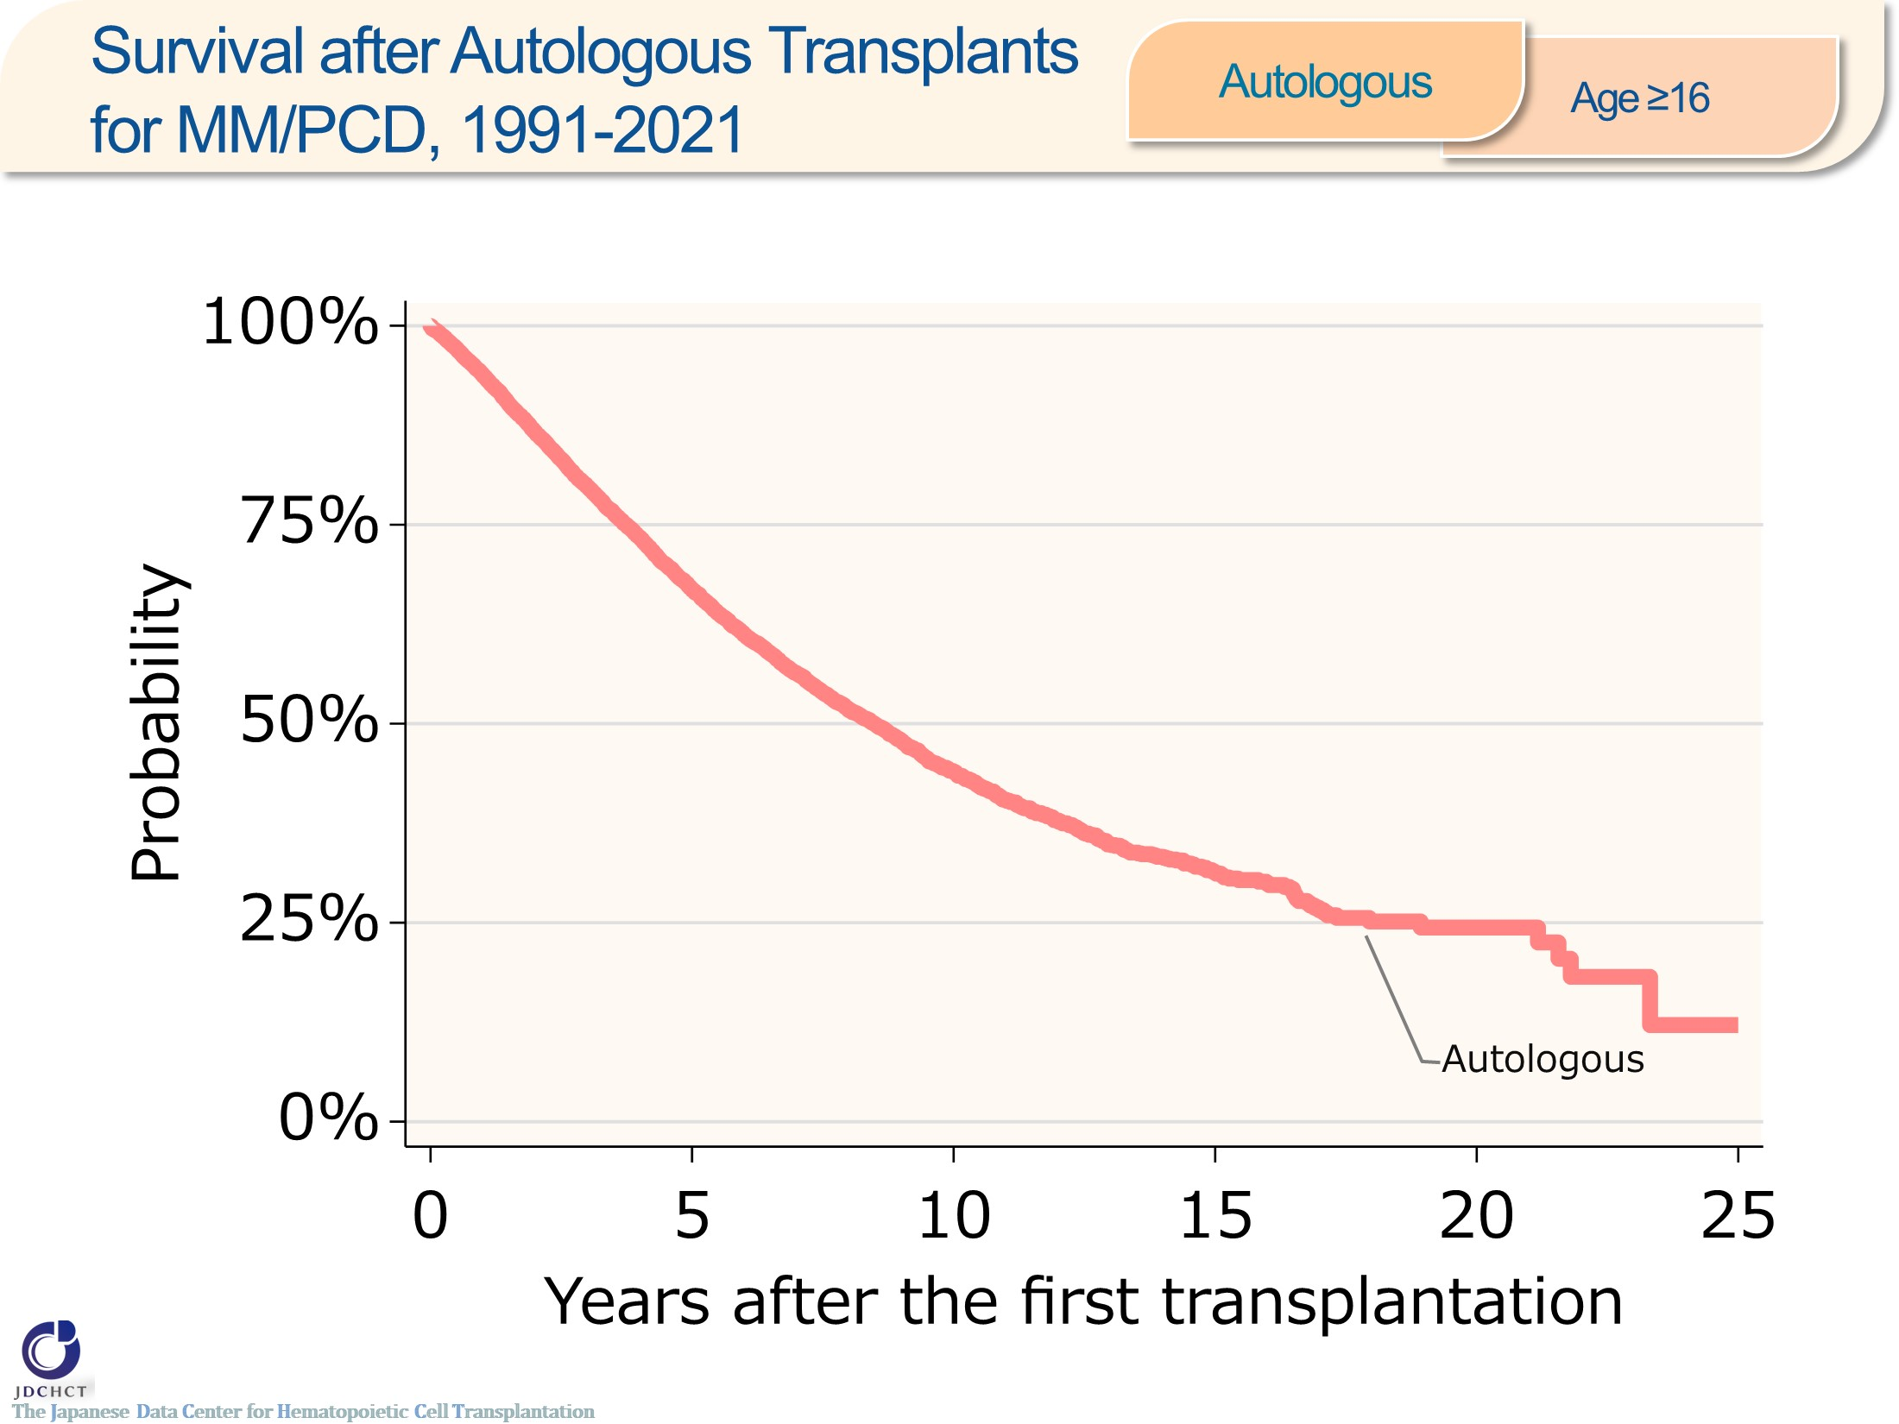
Survival after Autologous Transplants for MM/PCD, 1991-2021 <Autologous><age≥16>
Notes:
In plasma cell neoplasms including multiple myeloma, the survival probability at one year after autologous transplantation is as high as 93.8％ in recipients aged 16 years or older (≥16). The survival probability decreases to 44.0% at ten years after transplantation.

Slide 41
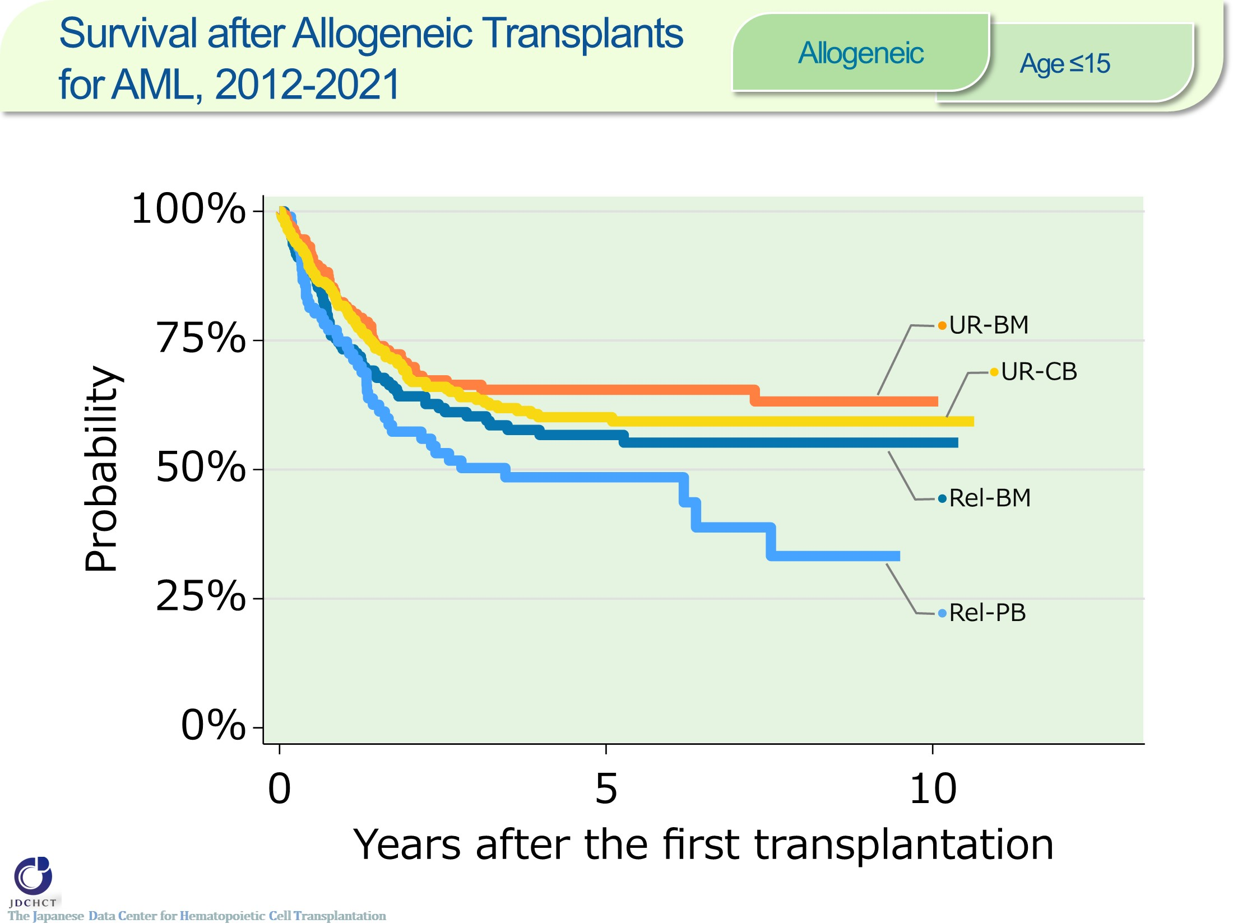
Survival after Allogeneic Transplants for AML, 2012-2021 <Allogeneic><age≤15>
Notes:
In acute myeloid leukemia, the number of allogeneic transplants registered is approximately 700 for the last 10 years for recipients aged 0 to 15 years. Cord blood transplantation from unrelated donors has accounted for around 40％ of the transplantation.
The survival probabilities at 5 years after transplantation in registered patients who received allogeneic transplants in the period between 2012 and 2021 are around 50% from related donors and about 60% from unrelated donors.

Slide 42
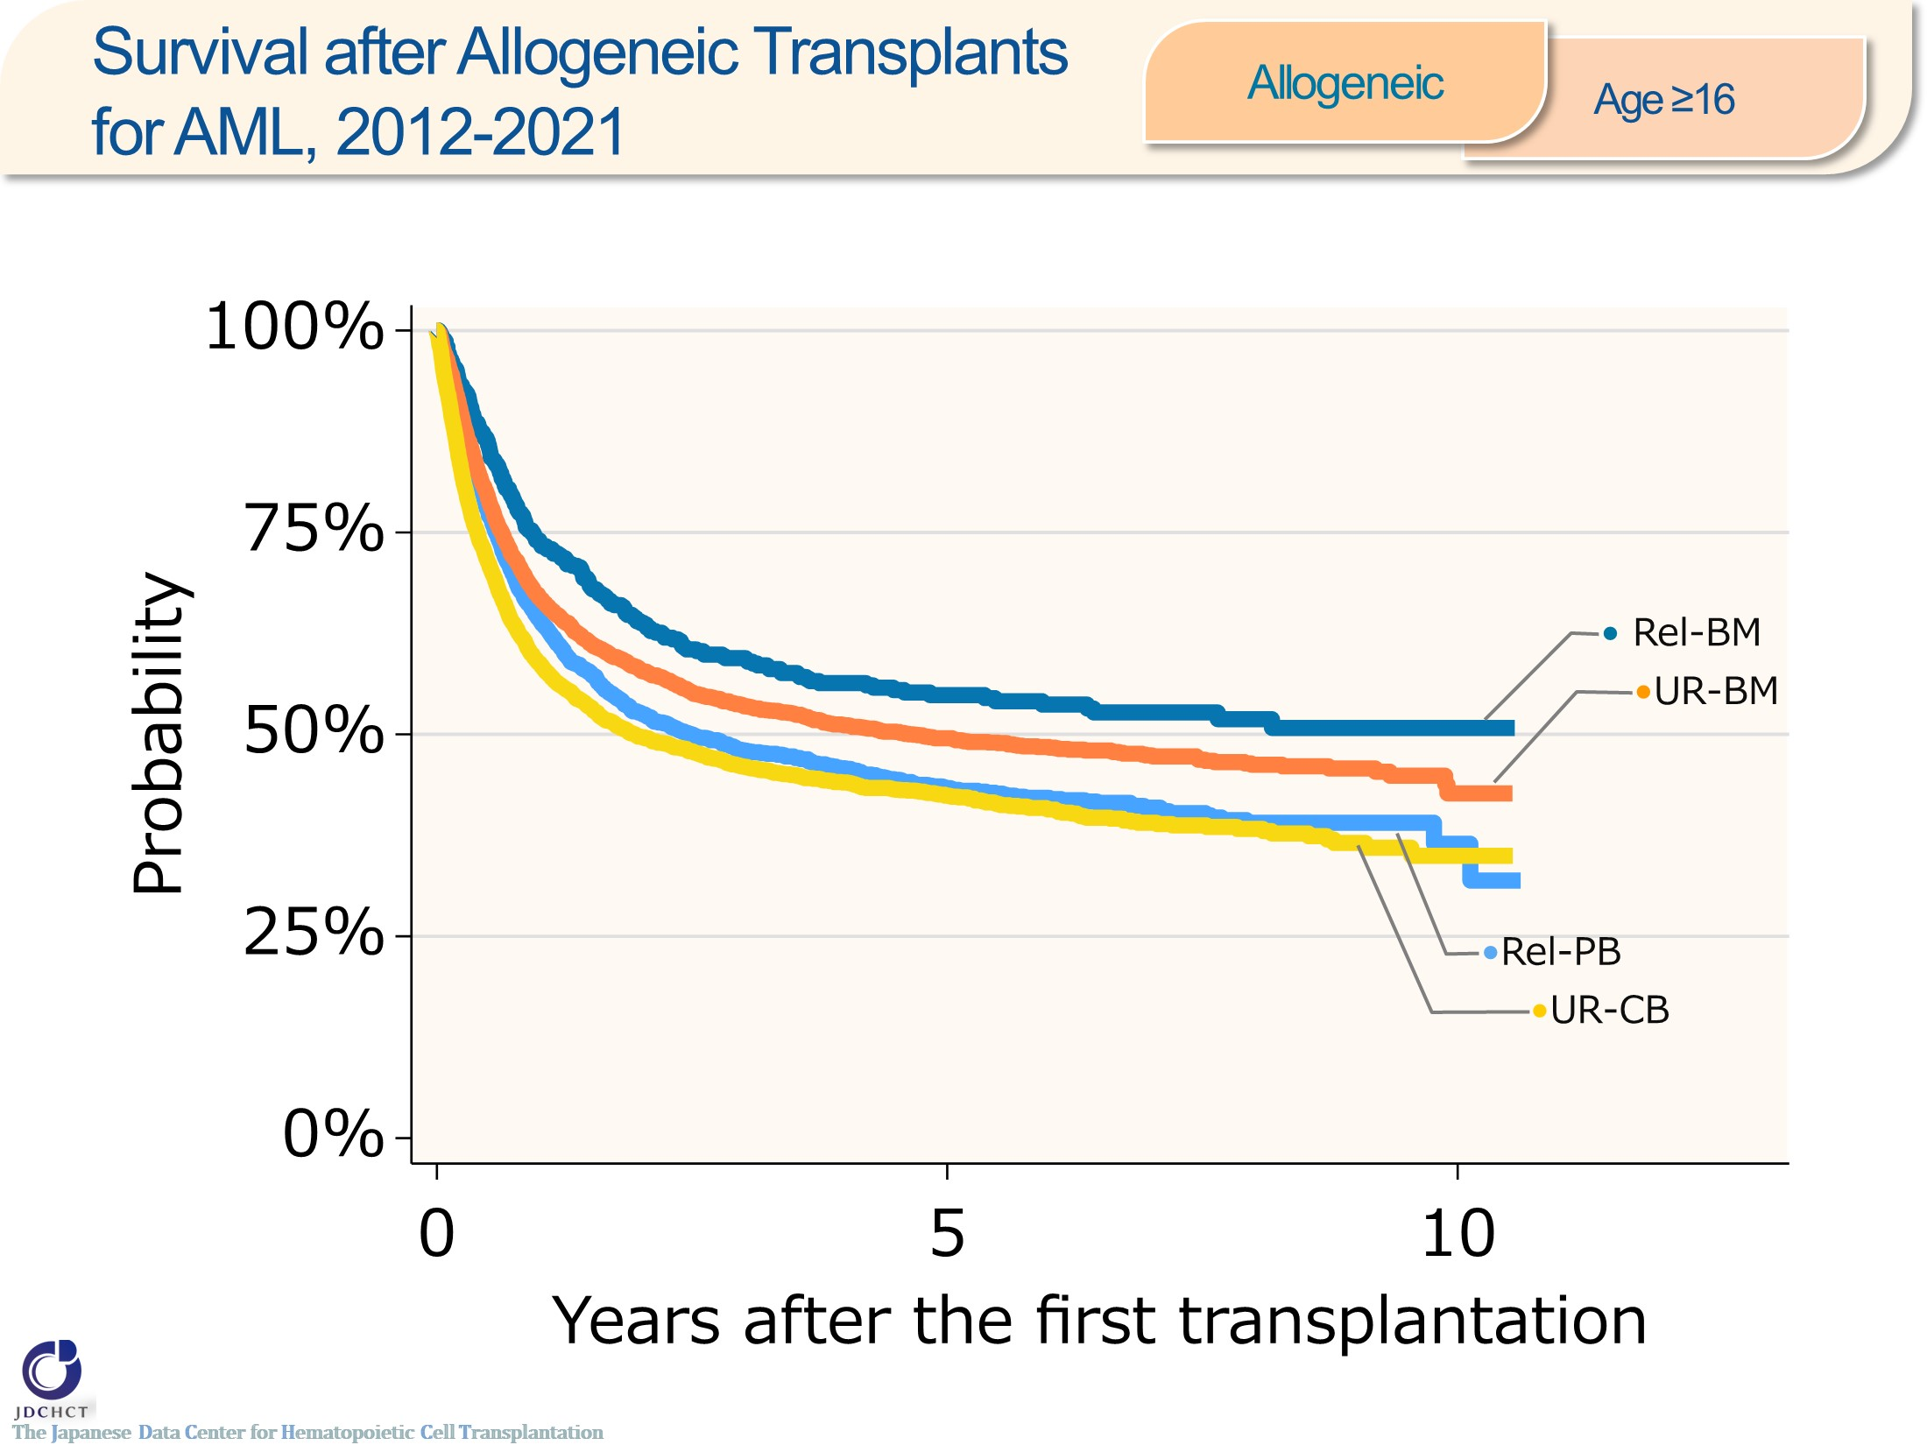
Survival after Allogeneic Transplants for AML, 2012-2021 <Allogeneic><age≥16>
Notes:
In acute myeloid leukemia, the number of allogeneic transplants registered is more than 10,000 for the last 10 years in recipients aged 16 years or older (≥16). Transplantation from unrelated donors is frequently performed.
The survival probabilities at 5 years after transplantation in registered patients who received allogeneic transplants in the period between 2012 and 2021 ranges from 40％ to 50％ for both transplants from related and unrelated donors.

Slide 43
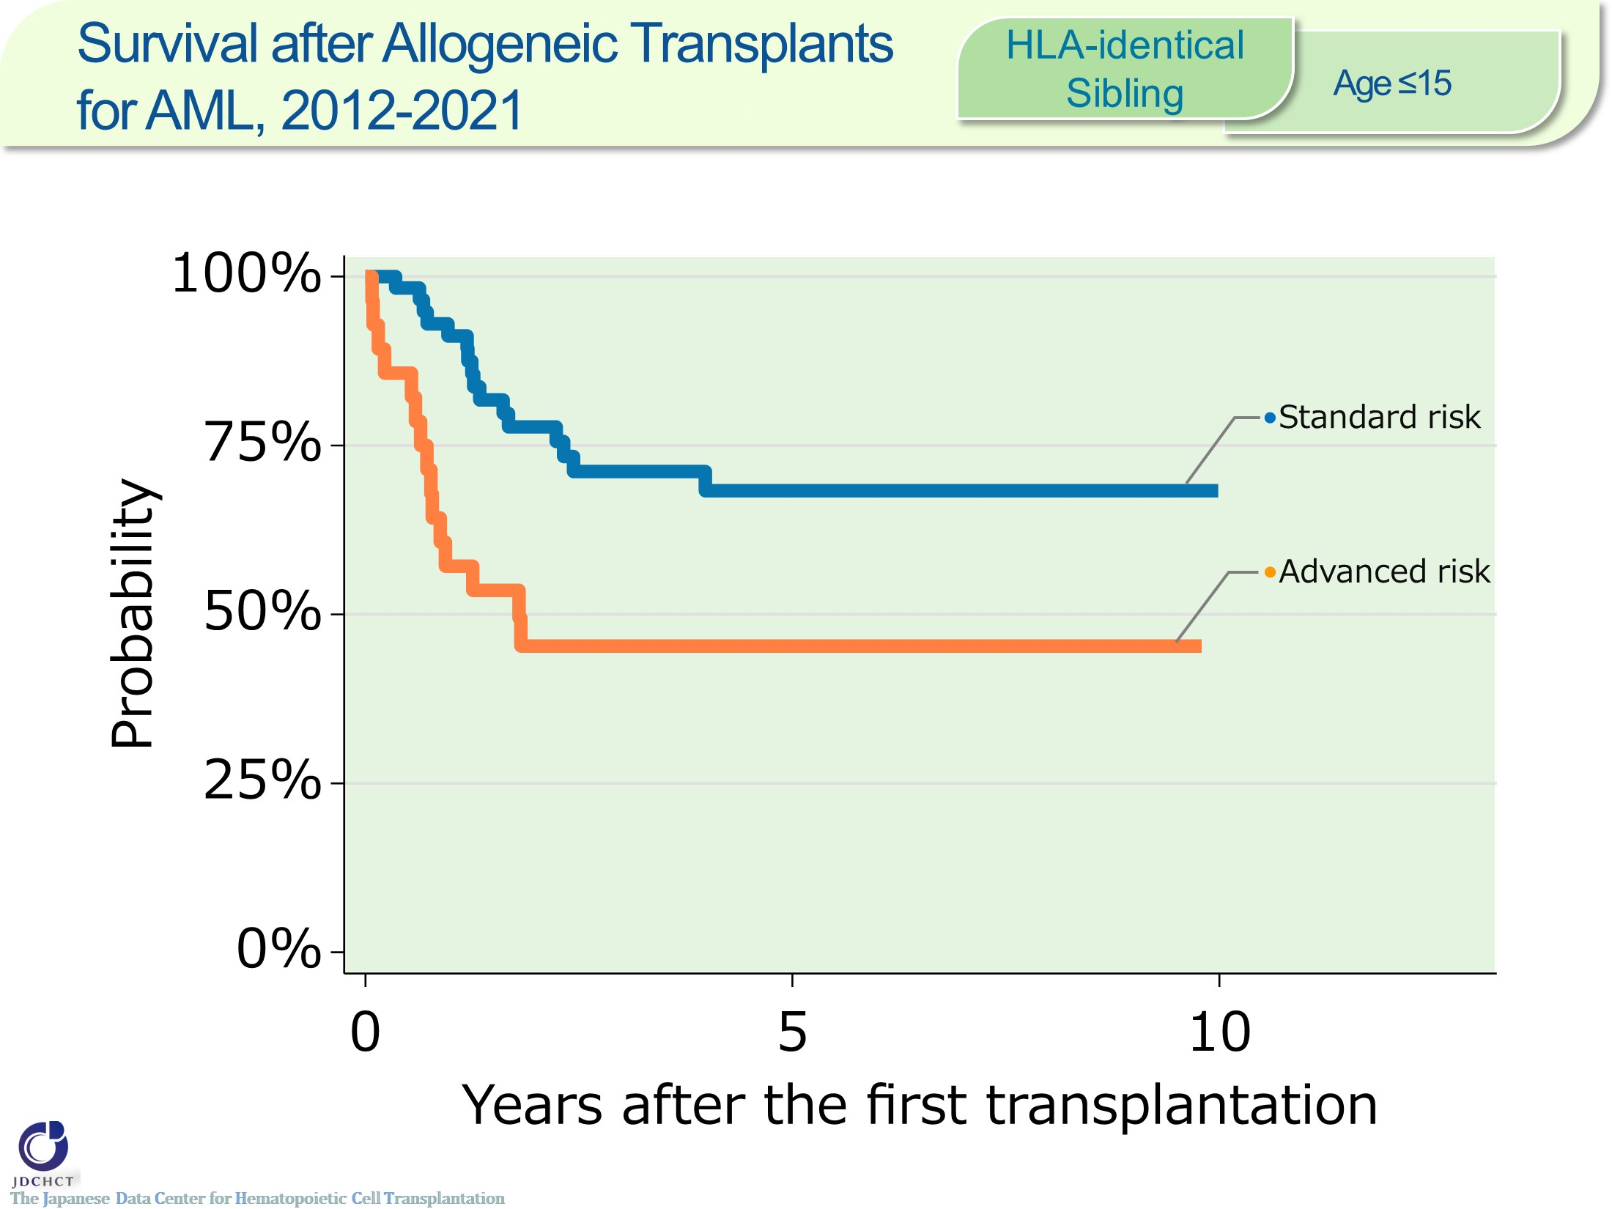
Survival after Allogeneic Transplants for AML, 2012-2021 <HLA-identical Sibling> <age≤15>
Notes:
In acute myeloid leukemia, the number of HLA-matched sibling donor transplants registered is below 100 for the last 10 years in recipients aged 0 to 15 years. The standard risk group is frequently performed.
The survival probabilities at 5 years after transplantation in registered patients who received HLA-matched sibling donor transplants in the period between 2012 and 2021 are 68.3％ in the standard risk group and 45.3％ in the advanced risk group of patients with leukemia.
―≪Disease risk status at transplantation≫―――
■Standard Risk Group : first complete remission [1CR]／second complete remission [2CR]
■Advanced Risk Group：third or more complete remission [≥3CR]／primary induction failure [PIF]／untreated／relapse
―――――――――――――――――――――――

Slide 44
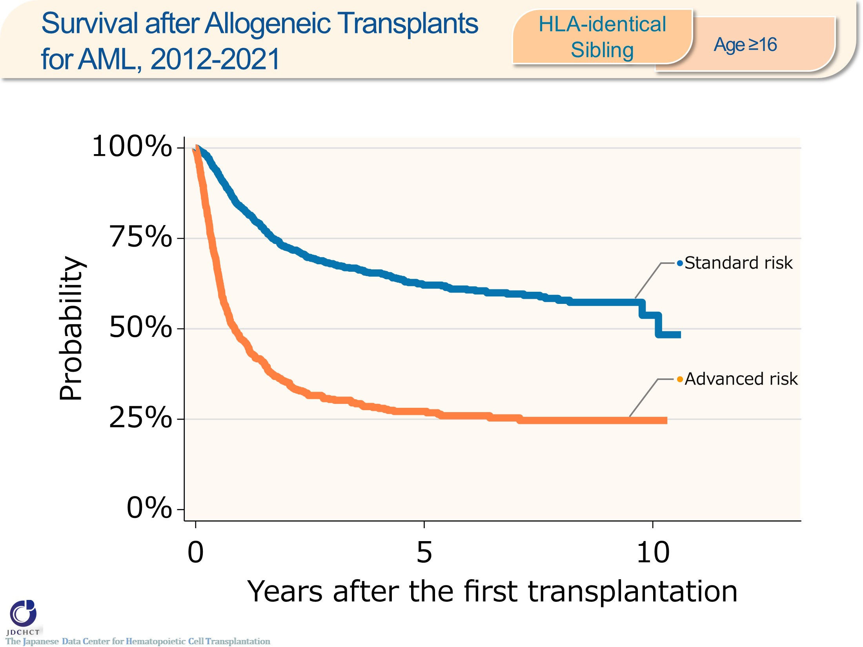
Survival after Allogeneic Transplants for AML, 2012-2021 <HLA-identical Sibling> <age≥16>
Notes:
In acute myeloid leukemia, the number of HLA-matched sibling donor transplants registered is approximately 1,900 for the last 10 years in recipients aged 16 years or older (≥16). The standard risk group is frequently performed.
The survival probabilities at 5 years after transplantation in registered patients who received HLA-matched sibling donor transplants in the period between 2012 and 2021 are 62.1％ in the standard risk group and 27.2％ in the advanced risk group of patients with leukemia.
―≪Disease risk status at transplantation≫―――
■Standard Risk Group : first complete remission [1CR]／second complete remission [2CR]
■Advanced Risk Group：third or more complete remission [≥3CR]／primary induction failure [PIF]／untreated／relapse
―――――――――――――――――――――――

Slide 45
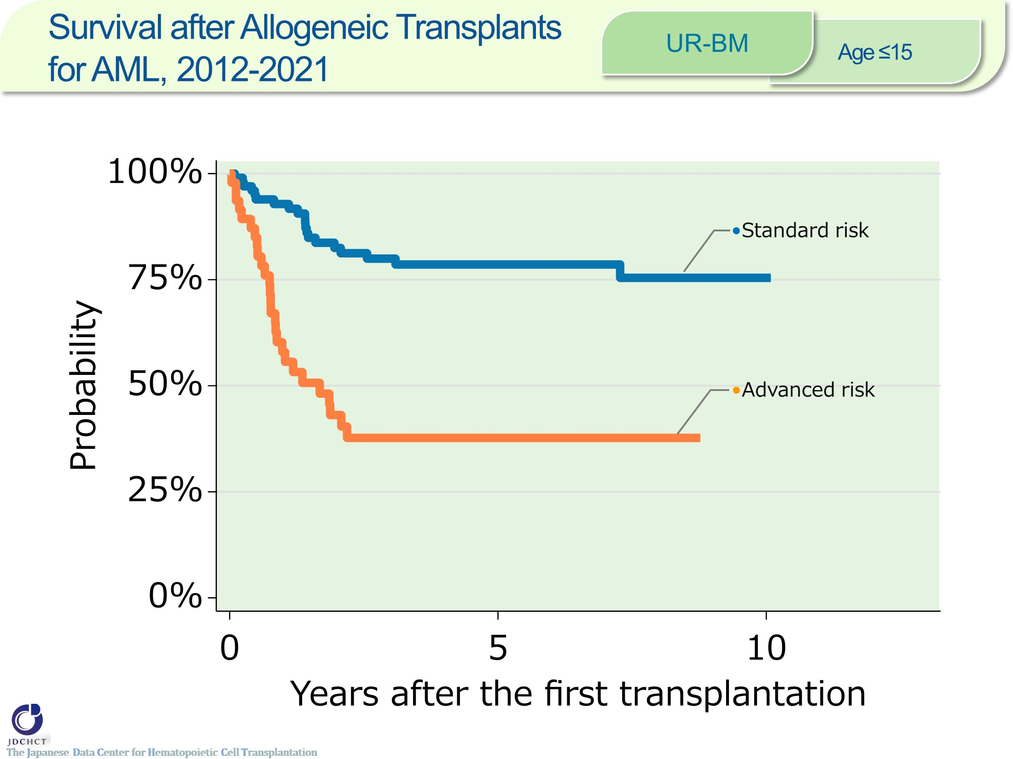
Survival after Allogeneic Transplants for AML, 2012-2021 <UR-BM><age≤15>
Notes:
In acute myeloid leukemia, the number of bone marrow transplants from unrelated donors registered is approximately 150 for the last 10 years in recipients aged 0 to 15 years. The standard risk group is frequently performed.
The survival probability at 5 years after transplantation in registered patients who received bone marrow transplants from unrelated donors in the period between 2012 and 2021 is 78.6％ in the standard risk group of patients with leukemia.
―≪Disease risk status at transplantation≫―――
■Standard Risk Group : first complete remission [1CR]／second complete remission [2CR]
■Advanced Risk Group：third or more complete remission [≥3CR]／primary induction failure [PIF]／untreated／relapse
―――――――――――――――――――――――

Slide 46
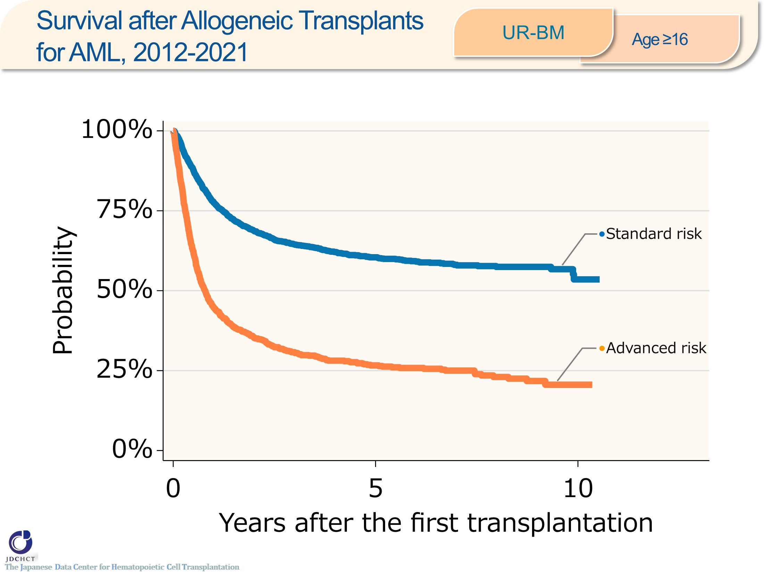
Survival after Allogeneic Transplants for AML, 2012-2021 <UR-BM><age≥16>
Notes:
In acute myeloid leukemia, the number of bone marrow transplants from unrelated donors registered is more than 3,000 for the last 10 years in recipients aged 16 years or older (≥16). The standard risk group has accounted for 68％ of the transplantation.
The survival probabilities at 5 years after transplantation in registered patients who received bone marrow transplants from unrelated donors in the period between 2012 and 2021 are 60.4％ in the standard risk group and 26.6％ in the advanced risk group of patients with leukemia.
―≪Disease risk status at transplantation≫―――
■Standard Risk Group : first complete remission [1CR]／second complete remission [2CR]
■Advanced Risk Group：third or more complete remission [≥3CR]／primary induction failure [PIF]／untreated／relapse
―――――――――――――――――――――――

Slide 47
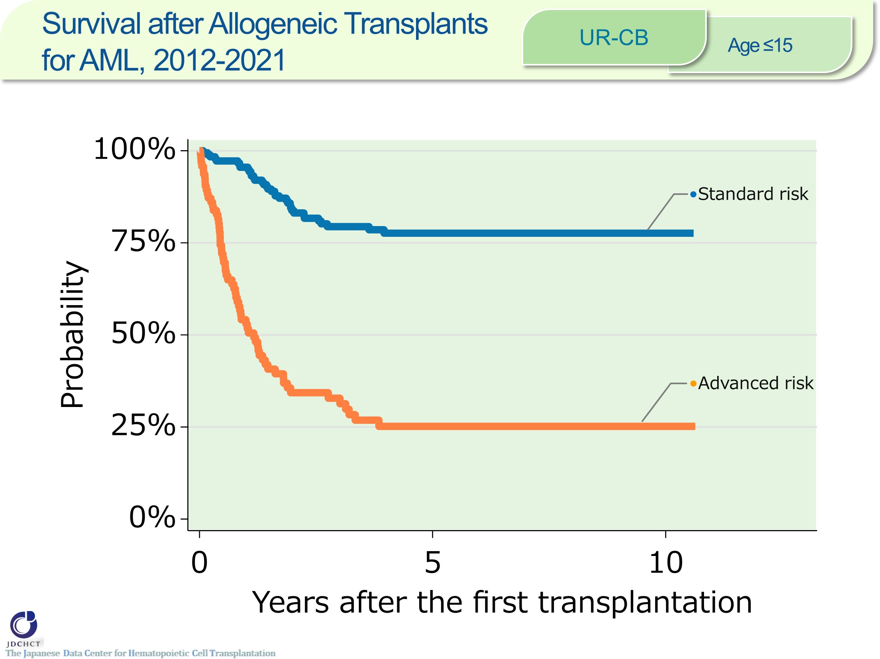
Survival after Allogeneic Transplants for AML, 2012-2021 <UR-CB><age≤15>
Notes:
In acute myeloid leukemia, the number of cord blood transplants from unrelated donors registered is approximately 300 for the last 10 years in recipients aged 0 to 15 years. The standard risk group is frequently performed.
The survival probabilities at 5 years after transplantation in registered patients who received cord blood transplants from unrelated donors in the period between 2012 and 2021 are 77.6％ in the standard risk group and 25.2％ in the advanced risk group of patients with leukemia.
―≪Disease risk status at transplantation≫―――
■Standard Risk Group : first complete remission [1CR]／second complete remission [2CR]
■Advanced Risk Group：third or more complete remission [≥3CR]／primary induction failure [PIF]／untreated／relapse
―――――――――――――――――――――――

Slide 48
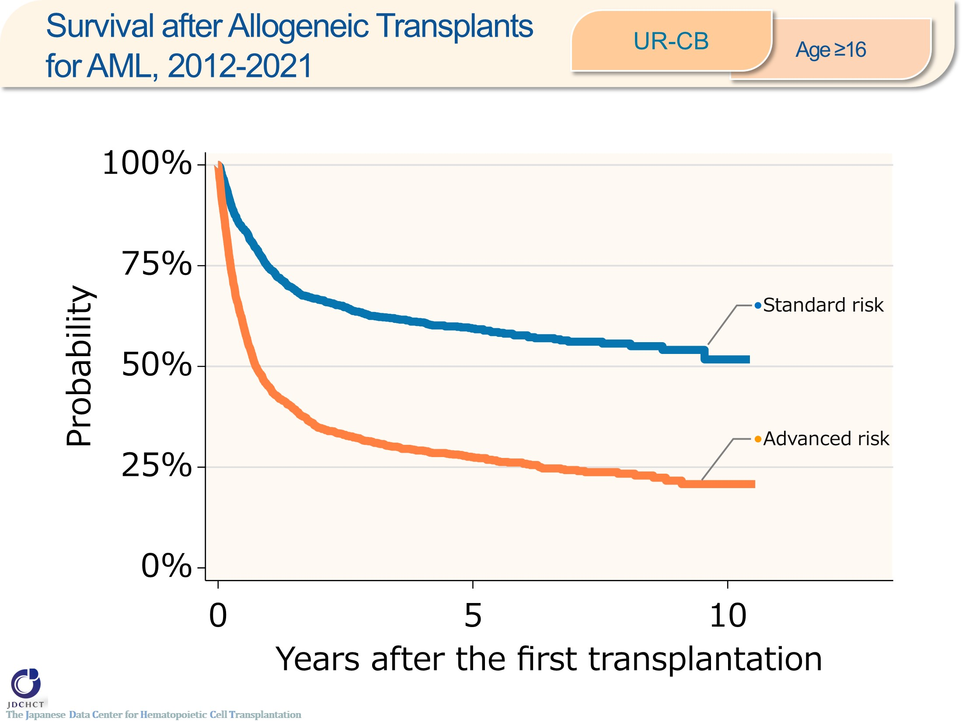
Survival after Allogeneic Transplants for AML, 2012-2021 <UR-CB><age≥16>
Notes:
In acute myeloid leukemia, the number of cord blood transplants from unrelated donors registered is approximately 4,000 for the last 10 years in recipients aged 16 years or older (≥16). The advanced risk group accounts for more than half.
The survival probabilities at 5 years after transplantation in registered patients who received cord blood transplants from unrelated donors in the period between 2012 and 2021 are 59.4％ in the standard risk group and 27.5％ in the advanced risk group of patients with leukemia.
―≪Disease risk status at transplantation≫―――
■Standard Risk Group : first complete remission [1CR]／second complete remission [2CR]
■Advanced Risk Group：third or more complete remission [≥3CR]／primary induction failure [PIF]／untreated／relapse
―――――――――――――――――――――――

Slide 49
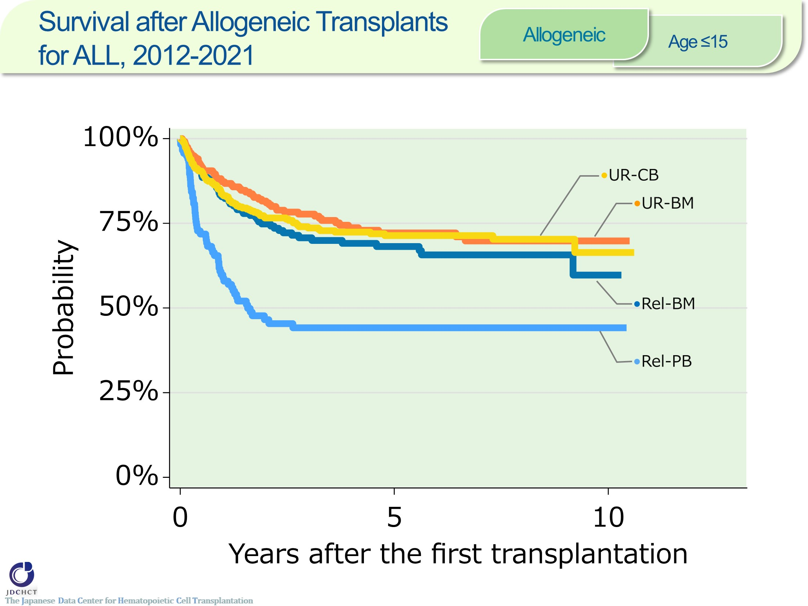
Survival after Allogeneic Transplants for ALL, 2012-2021 <Allogeneic><age≤15>
Notes:
In acute lymphoblastic leukemia, the number of allogeneic transplants registered is approximately 900 for the last 10 years in recipients aged 0 to 15 years. Cord blood transplantation from unrelated donors is frequently performed.
The survival probabilities at 5 years after transplantation in registered patients who received allogeneic transplants in the period between 2012 and 2021 are around 68 to 72% for bone marrow transplants from related donors and transplants from unrelated donors.

Slide 50
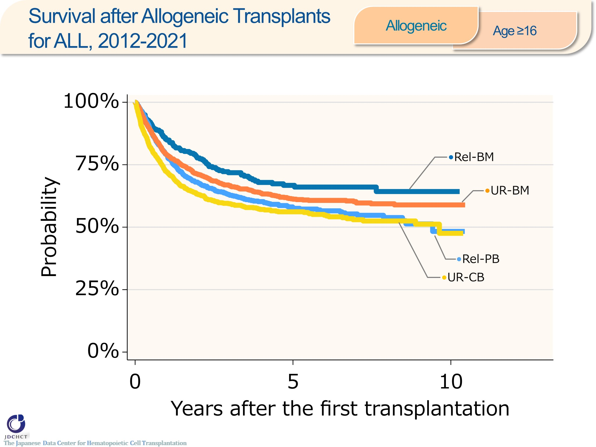
Survival after Allogeneic Transplants for ALL, 2012-2021 <Allogeneic><age≥16>
Notes:
In acute lymphoblastic leukemia, the number of allogeneic transplants registered is approximately 4,000 for the last 10 years in recipients aged 16 years or older (≥16). Bone marrow transplantation from unrelated donors is frequently performed.
The survival probabilities at 5 years after transplantation in registered patients who received allogeneic transplants in the period between 2012 and 2021 ranges from 56％ to 67％ for both transplants from related and unrelated donors.

Slide 51
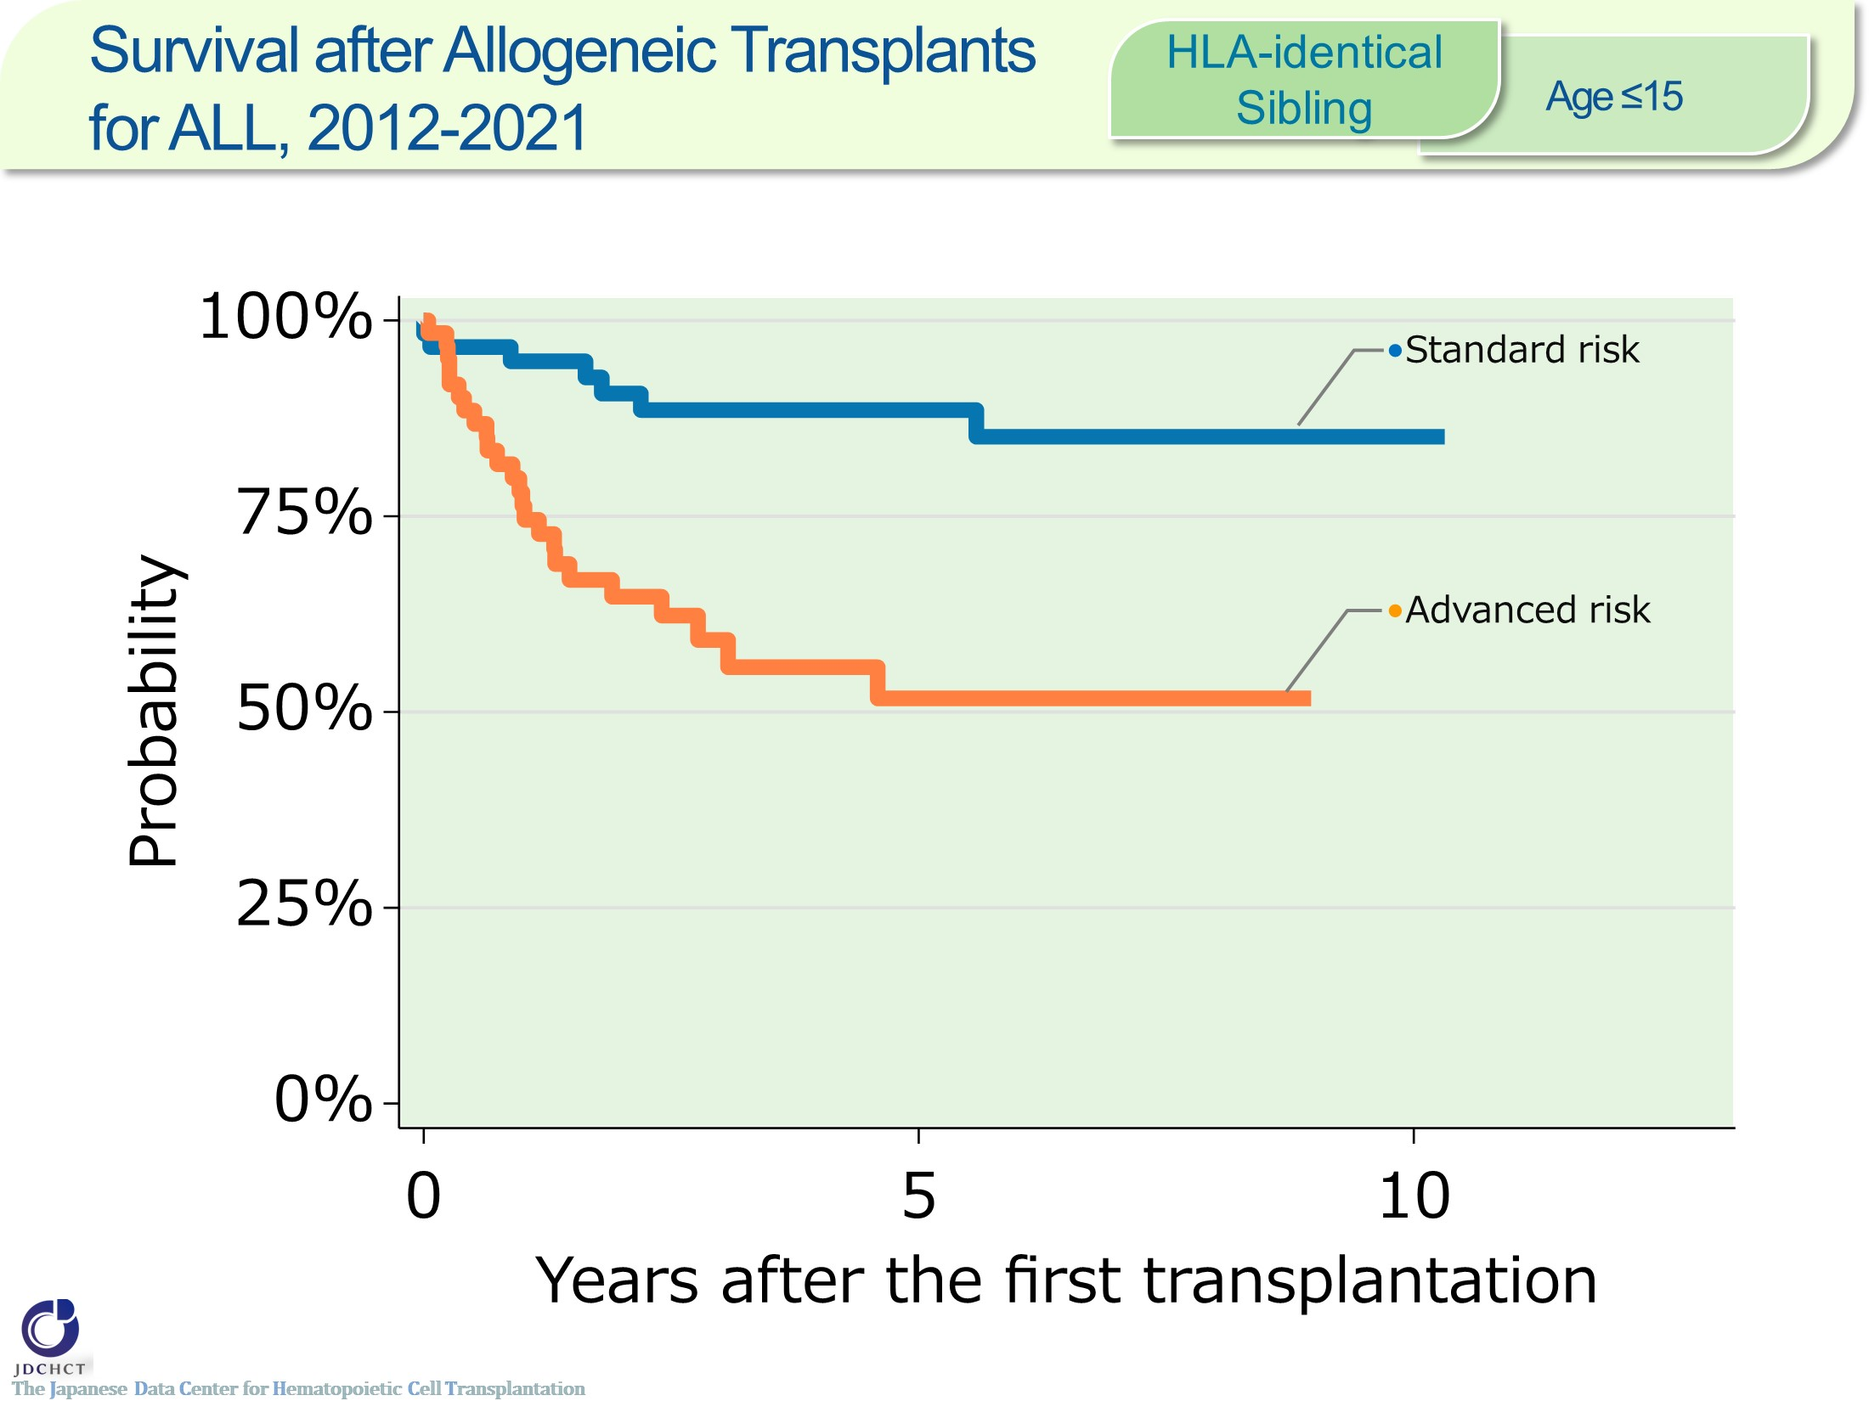
Survival after Allogeneic Transplants for ALL, 2012-2021 <HLA-identical Sibling> <age≤15>
Notes:
In acute lymphoblastic leukemia, the number of HLA-matched sibling donor transplants registered is approximately 120 for the last 10 years in recipients aged 0 to 15 years. The number of patients with standard risk or with advanced risk are similar.
The survival probabilities at 5 years after transplantation in registered patients who received HLA-matched sibling donor transplants in the period between 2012 and 2021 are as high as 88.6％ in the standard risk group and 51.7％ in the advanced risk group of patients with leukemia.
―≪Disease risk status at transplantation≫―――
■Standard Risk Group : first complete remission [1CR]
■Advanced Risk Group : second or more complete remission [≥2CR]／primary induction failure [PIF]／PIF, extramedullary involvement only ／untreated／relapse
――――――――――――――――――――――――

Slide 52
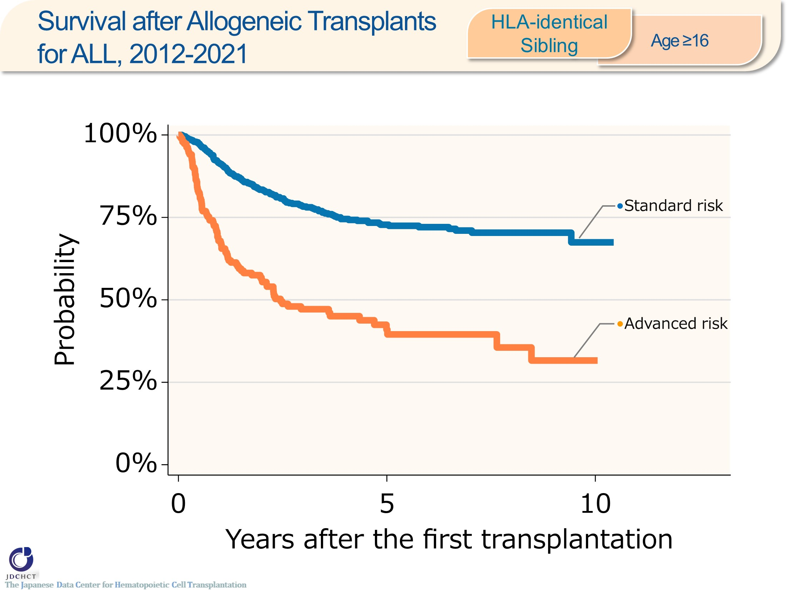
Survival after Allogeneic Transplants for ALL, 2012-2021 <HLA-identical Sibling> <age≥16>
Notes:
In acute lymphoblastic leukemia, the number of HLA-matched sibling donor transplants registered is approximately 900 for the last 10 years in recipients aged 16 years or older (≥16). The standard risk group has accounted for around 80％ of the transplantation.
The survival probabilities at 5 years after transplantation in registered patients who received HLA-matched sibling donor transplants in the period between 2012 and 2021 are 72.8％ in the standard risk group and 41.0％ in the advanced risk group of patients with leukemia.
―≪Disease risk status at transplantation≫―――
■Standard Risk Group : first complete remission [1CR]
■Advanced Risk Group : second or more complete remission [≥2CR]／primary induction failure [PIF]／PIF, extramedullary involvement only／untreated／relapse
――――――――――――――――――――――――

Slide 53
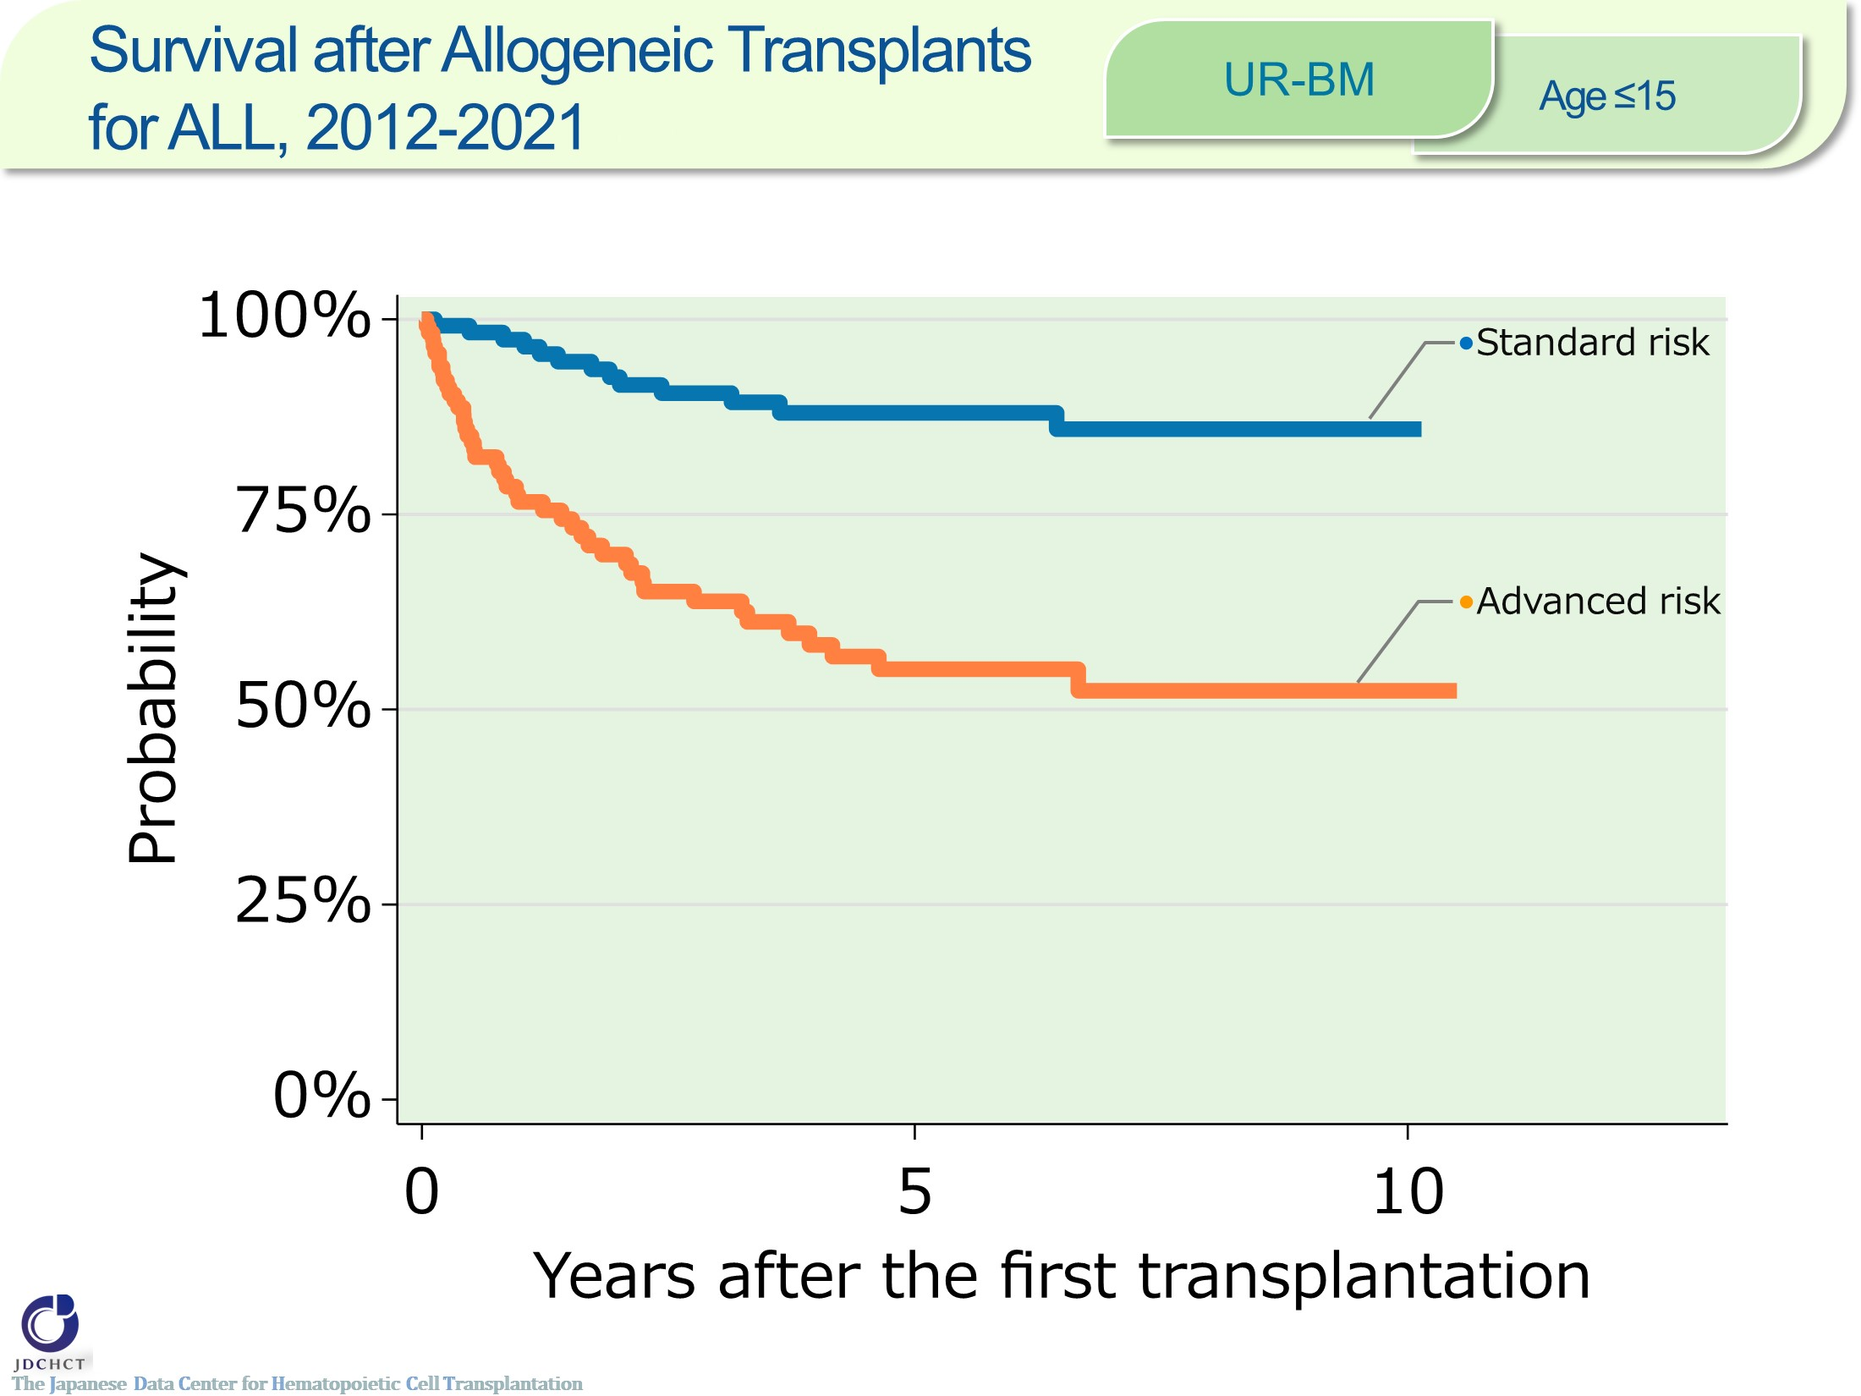
Survival after Allogeneic Transplants for ALL, 2012-2021 <UR-BM><age≤15>
Notes:
In acute lymphoblastic, the number of bone marrow transplants from unrelated donors registered is approximately 240 for the last 10 years in recipients aged 0 to 15 years. The number of patients with standard risk or with advanced risk are similar.
The survival probabilities at 5 years after transplantation in registered patients who received bone marrow transplants from unrelated donors in the period between 2012 and 2021 are 88.0％ in the standard risk group and 55.2％ in the advanced risk group of patients with leukemia.
―≪Disease risk status at transplantation≫―――
■Standard Risk Group : first complete remission [1CR]
■Advanced Risk Group : second or more complete remission [≥2CR]／primary induction failure [PIF]／PIF, extramedullary involvement only／untreated／relapse
――――――――――――――――――――――――

Slide 54
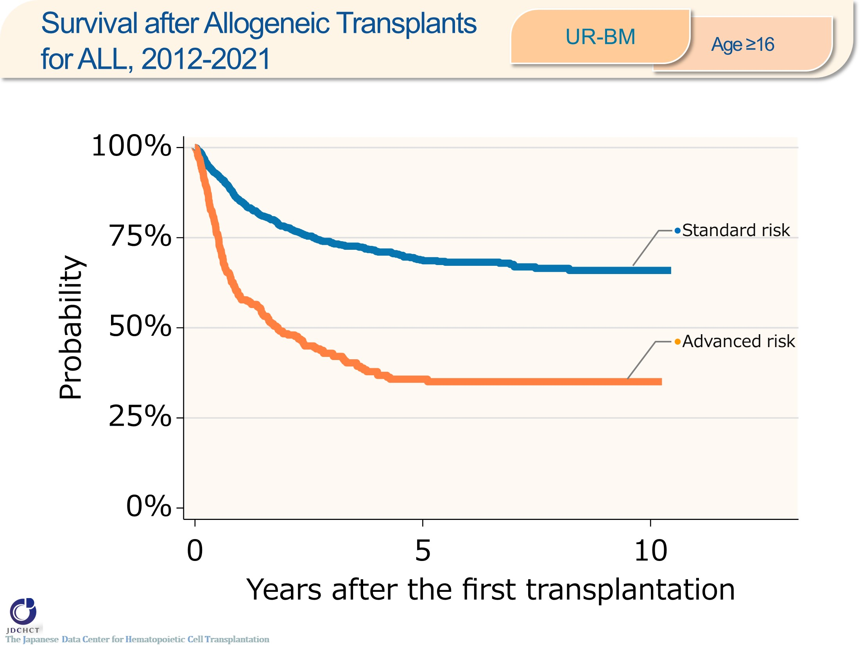
Survival after Allogeneic Transplants for ALL, 2012-2021 <UR-BM><age≥16>
Notes:
In acute lymphoblastic leukemia, the number of bone marrow transplants from unrelated donors registered is approximately 1,600 for the last 10 years in recipients aged 16 years or older (≥16). The standard risk group has accounted for around 75％ of the transplantation.
The survival probabilities at 5 years after transplantation in registered patients who received bone marrow transplants from unrelated donors in the period between 2012 and 2021 are 68.8％ in the standard risk group and 35.8％ in the advanced risk group of patients with leukemia.
―≪Disease risk status at transplantation≫―――
■Standard Risk Group : first complete remission [1CR]
■Advanced Risk Group : second or more complete remission [≥2CR]／primary induction failure [PIF]／PIF, extramedullary involvement only／untreated／relapse
――――――――――――――――――――――――

Slide 55
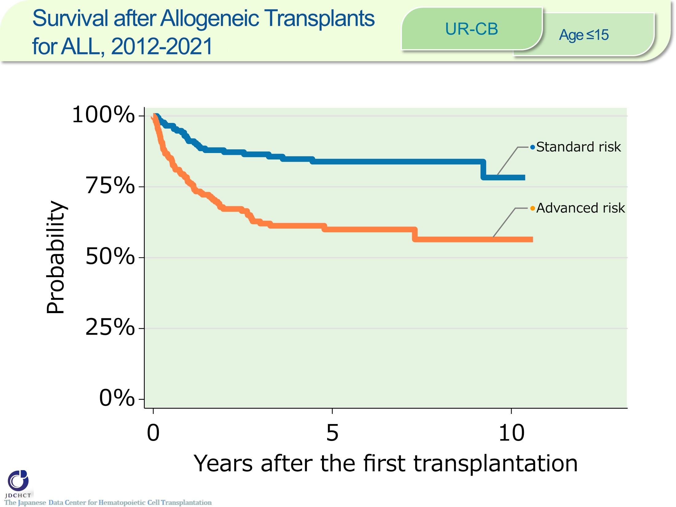
Survival after Allogeneic Transplants for ALL, 2012-2021 <UR-CB><age≤15>
Notes:
In acute lymphoblastic, the number of cord blood transplants from unrelated donors registered is approximately 400 for the last 10 years in recipients aged 0 to 15 years. The number of patients with standard risk or with advanced risk are similar.
The survival probabilities at 5 years after transplantation in registered patients who received cord blood transplants from unrelated donors in the period between 2012 and 2021 are 83.9％ in the standard risk group and 60.0％ in the advanced risk group of patients with leukemia.
―≪Disease risk status at transplantation≫―――
■Standard Risk Group : first complete remission [1CR]
■Advanced Risk Group : second or more complete remission [≥2CR]／primary induction failure [PIF]／PIF, extramedullary involvement only／untreated／relapse
――――――――――――――――――――――――

Slide 56
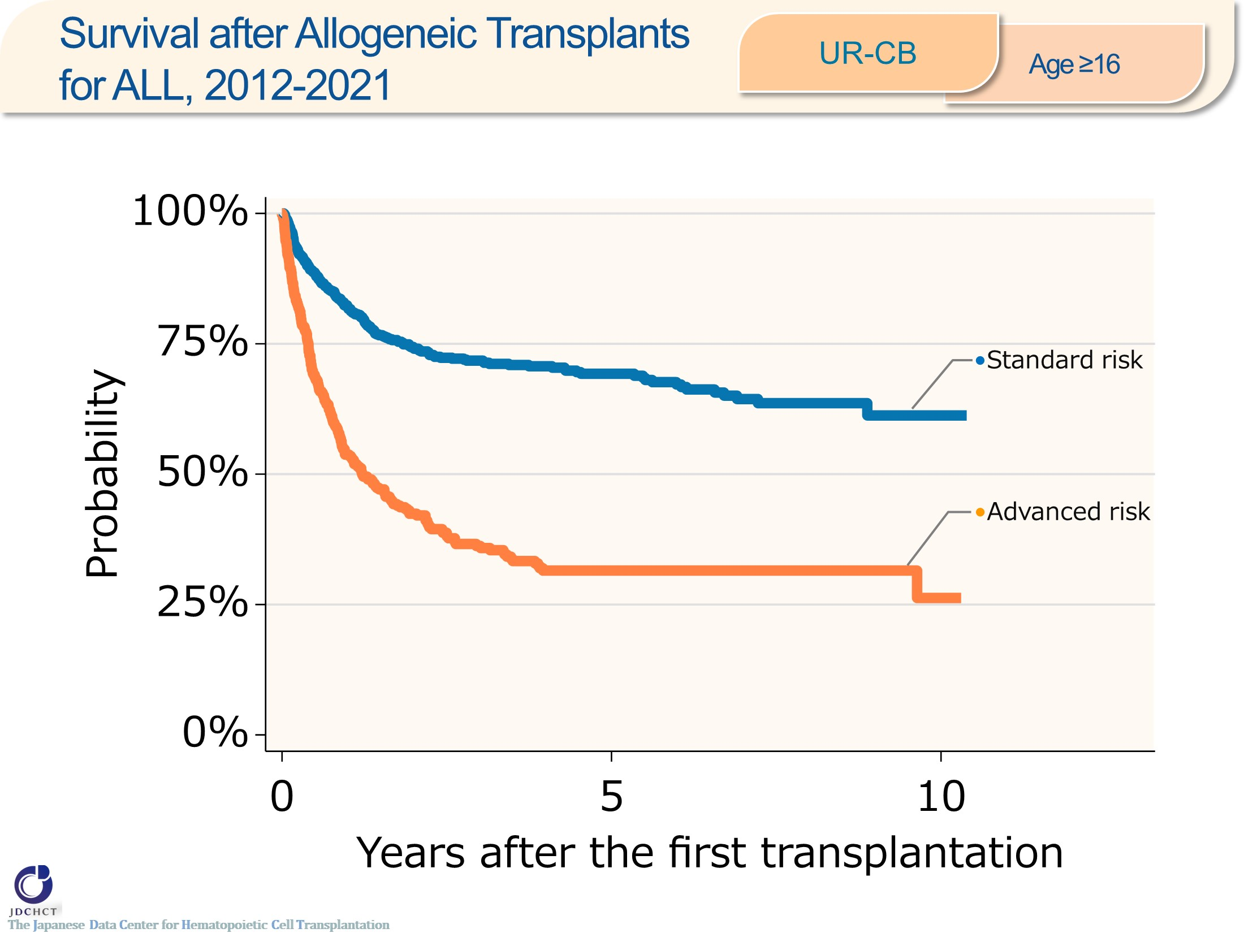
Survival after Allogeneic Transplants for ALL, 2012-2021 <UR-CB><age≥16>
Notes:
In acute lymphoblastic, the number of cord blood transplants from unrelated donors registered is approximately 1,200 for the last 10 years in recipients aged 16 years or older (≥16). The standard risk group has accounted for 65％ of the transplantation.
The survival probabilities at 5 years after transplantation in registered patients who received cord blood transplants from unrelated donors in the period between 2012 and 2021 are 69.3％ in the standard risk group and 31.5％ in the advanced risk group of patients with leukemia.
―≪Disease risk status at transplantation≫―――
■Standard Risk Group : first complete remission [1CR]
■Advanced Risk Group : second or more complete remission [≥2CR]／primary induction failure [PIF]／PIF, extramedullary involvement only／untreated／relapse
――――――――――――――――――――――――

Slide 57
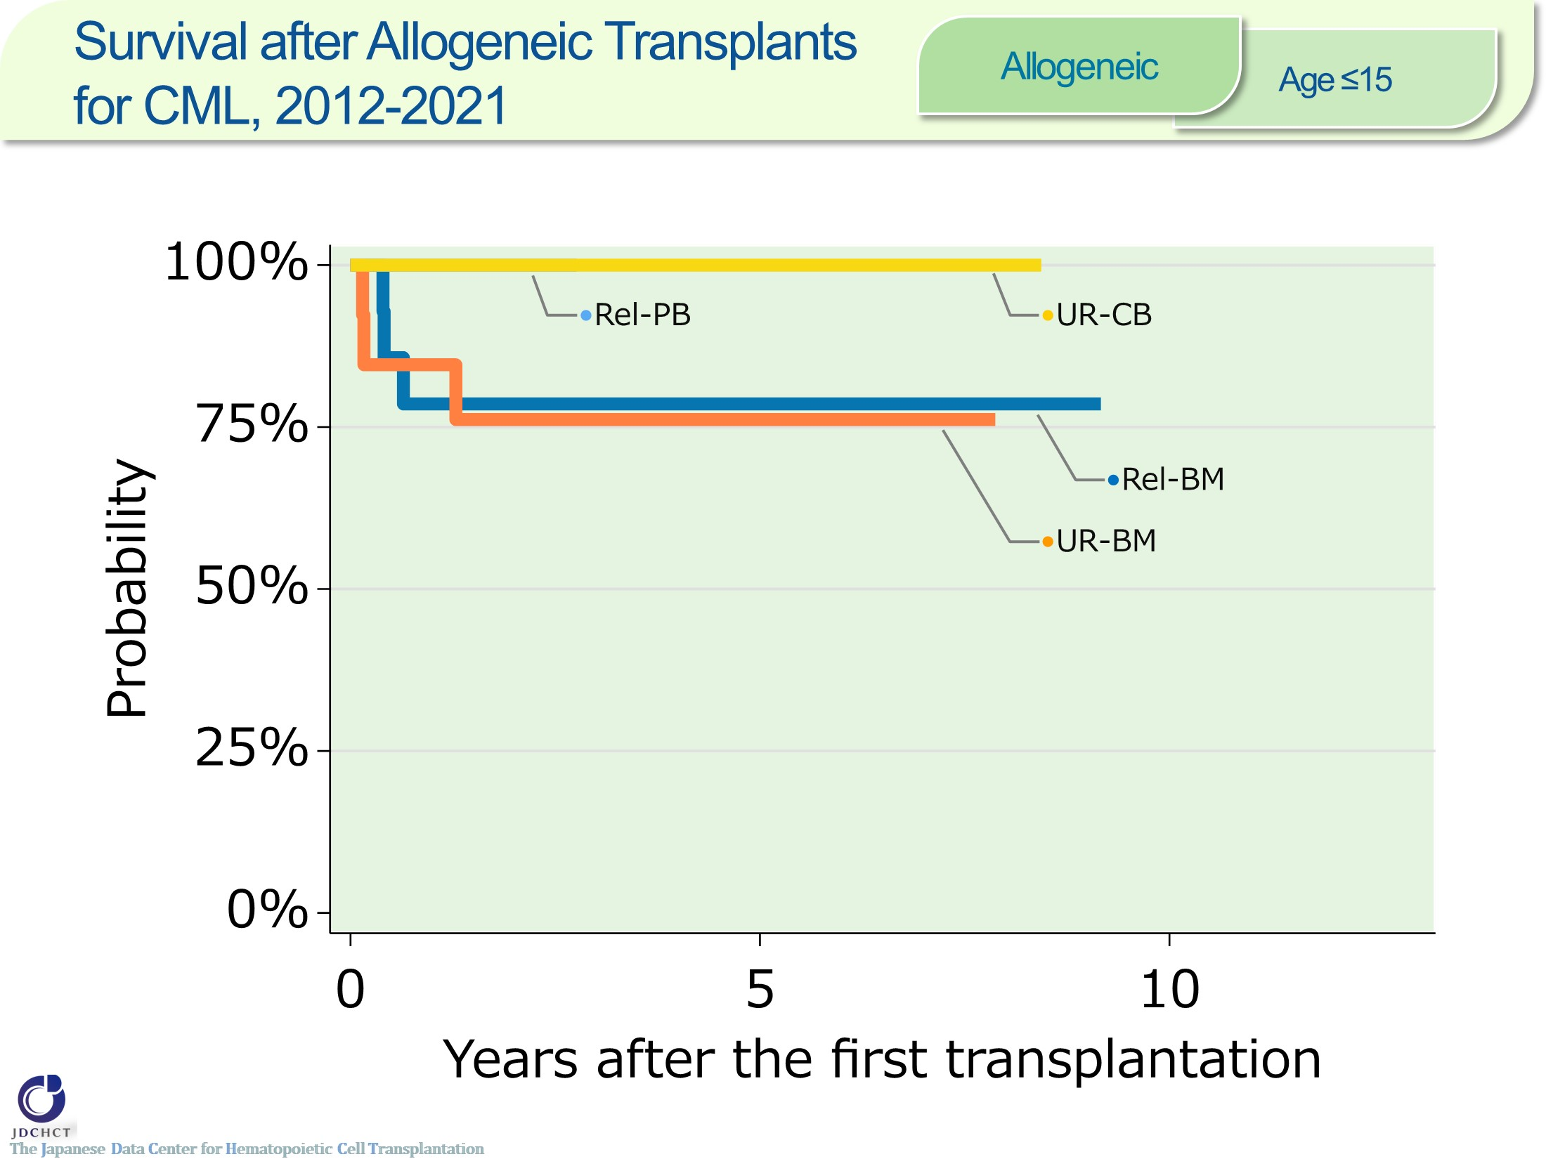
Survival after Allogeneic Transplants for CML, 2012-2021 <Allogeneic><age≤15>
Notes:
In chronic myelogenous leukemia, the number of allogeneic transplants registered is below 40 for the last 10 years in recipients aged 0 to 15 years.
The survival probabilities at 5 years after transplantation in registered patients who received allogeneic transplants in the period between 2012 and 2021 are 78.6％ for bone marrow transplants from related donors and 76.2％ for bone marrow transplants from unrelated donors.

Slide 58
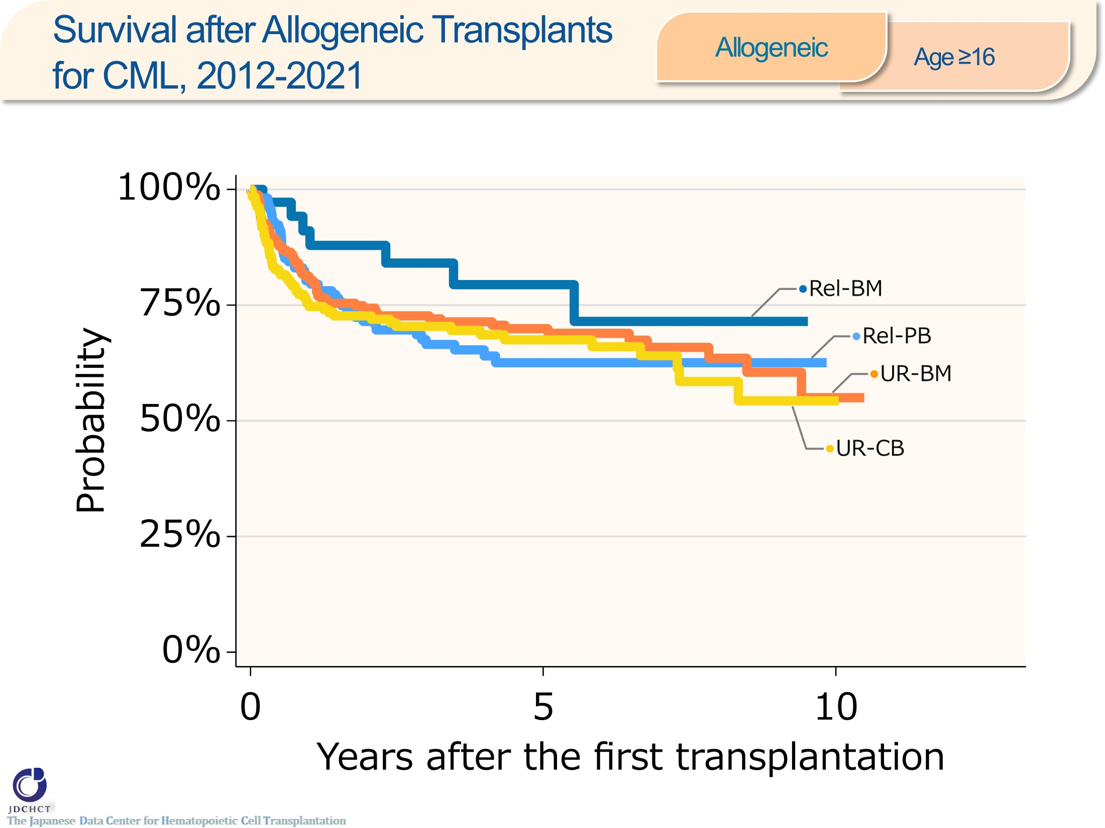
Survival after Allogeneic Transplants for CML, 2012-2021 <Allogeneic><age≥16>
Notes:
In chronic myelogenous leukemia, the number of allogeneic transplants registered is approximately 600 for the last 10 years in recipients aged 16 years or older (≥16). Bone marrow transplantation from unrelated donors is frequently performed.
The survival probabilities at 5 years after transplantation in registered patients who received allogeneic transplants in the period between 2012 and 2021 are 79.4% for bone marrow transplants from related donors, and ranges from 62％ to 70％ for peripheral blood stem cell transplants from related or transplants from unrelated donors.

Slide 59
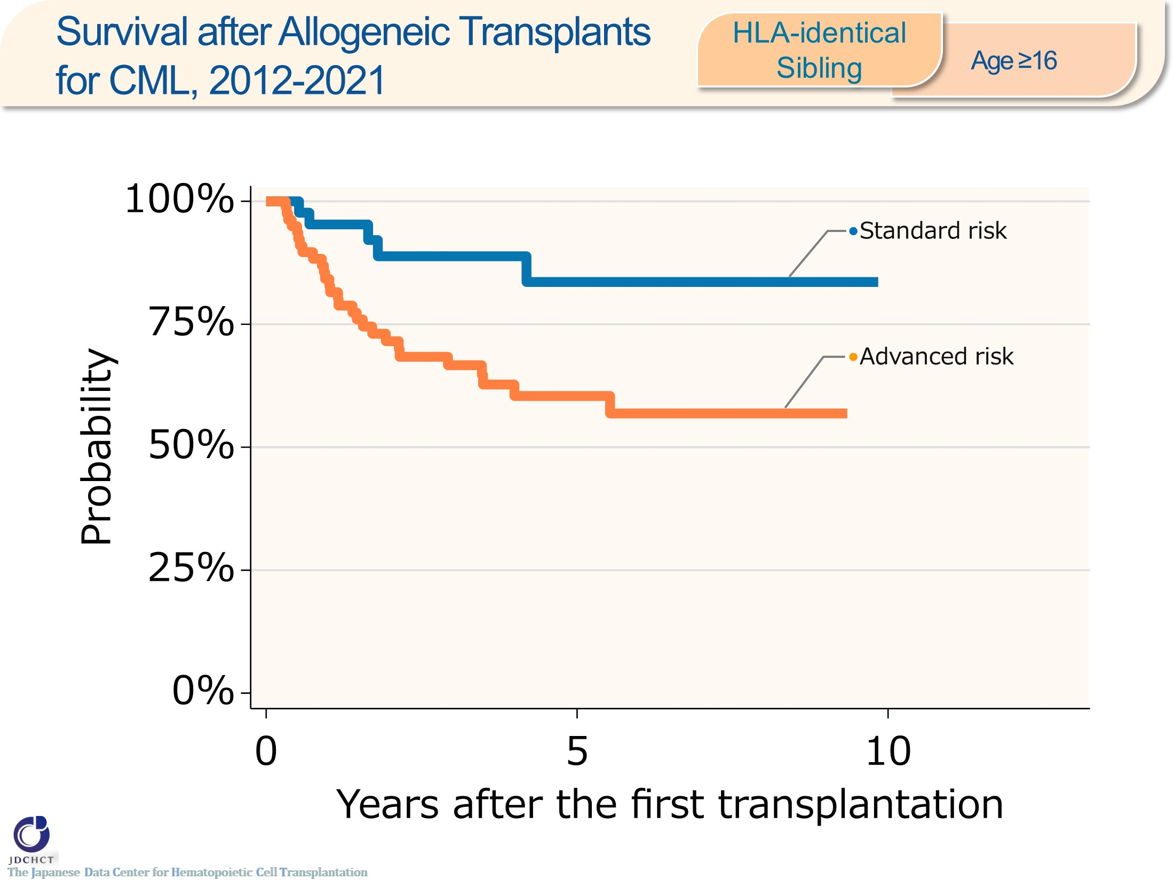
Survival after Allogeneic Transplants for CML, 2012-2021 <HLA-identical Sibling> <age≥16>
Notes:
In chronic myelogenous leukemia, the number of HLA-matched sibling donor transplants registered is approximately 130 for the last 10 years in recipients aged 16 years or older (≥16). The advanced risk group has accounted for 63％ of the transplantation.
The survival probabilities at 5 years after transplantation in registered patients who received HLA-matched sibling donor transplants in the period between 2012 and 2021 are 83.6％ in the standard risk group and 60.4％ in the advanced risk group of patients with leukemia.
―≪Disease risk status at transplantation≫―――
■Standard Risk Group : complete hematologic response(CHR)／first chronic phase[1CP]
■Advanced Risk Group : second or more chronic phase [≥2CP]／accelerated phase [AP]／blast crisis [BC]
―――――――――――――――――――――――

Slide 60
Survival after Allogeneic Transplants for CML, 2012-2021 <UR-BM><age≥16>
Notes:
In chronic myelogenous leukemia, the number of bone marrow transplants from unrelated donors registered is approximately 250 for the last 10 years in recipients aged 16 years or older (≥16). The advanced risk group has accounted for around 60％ of the transplantation.
The survival probabilities at 5 years after transplantation in registered patients who received bone marrow transplants from unrelated donors in the period between 2012 and 2021 are 80.0% in the standard risk group and 63.9% in the advanced risk group of patients with leukemia.
―≪Disease risk status at transplantation≫―――
■Standard Risk Group : complete hematologic response(CHR)／first chronic phase[1CP]
■Advanced Risk Group : second or more chronic phase [≥2CP]／accelerated phase [AP]／blast crisis [BC]
―――――――――――――――――――――――

Slide 61
Survival after Allogeneic Transplants for CML, 2012-2021 <UR-CB><age≥16>
Notes:
In chronic myelogenous leukemia, the number of cord blood transplants from unrelated donors registered is approximately 180 for the last 10 years in recipients aged 16 years or older (≥16). The advanced risk group has accounted for around 70％ of the transplantation.
The survival probabilities at 5 years after transplantation in registered patients who received cord blood transplants from unrelated donors in the period between 2012 and 2021 are 79.7％ in the standard risk group and 62.5％ in the advanced risk group of patients with leukemia.
―≪Disease risk status at transplantation≫―――
■Standard Risk Group : complete hematologic response(CHR)／first chronic phase[1CP]
■Advanced Risk Group : second or more chronic phase [≥2CP]／accelerated phase [AP]／blast crisis [BC]
―――――――――――――――――――――――

Slide 62
Survival after Allogeneic Transplants for MDS, 2012-2021 <Allogeneic><age≤15>
Notes:
In myelodysplastic syndromes, the number of allogeneic transplants registered is approximately 250 for the last 10 years for recipients aged 0 to 15 years. Bone marrow transplantation from unrelated donors is frequently performed.
The survival probabilities at 5 years after transplantation in registered patients who received allogeneic transplants in the period between 2012 and 2021 are 89.5% for bone marrow transplants from related donors, and 80.3% for bone marrow transplants from unrelated donors.

Slide 63
Survival after Allogeneic Transplants for MDS, 2012-2021 <Allogeneic><age≥16>
Notes:
In myelodysplastic syndromes, the number of allogeneic transplants registered is more than 3,000 for the last 10 years in recipients aged 16 years or older (≥16). Bone marrow transplantation from unrelated donors is frequently performed.
The survival probabilities at 5 years after transplantation in registered patients who received allogeneic transplants in the period between 2012 and 2021 ranges from 45 to 50%.

Slide 64
Survival after Allogeneic Transplants for MDS, 2012-2021 <HLA-identical Sibling> <age≤15>
Notes:
In myelodysplastic syndromes, the number of HLA-matched sibling donor transplants registered is approximately 50 for the last 10 years in recipients aged 0 to 15 years. The standard risk group is frequently performed.
The survival probabilities at 5 years after transplantation in registered patients who received HLA-matched sibling donor transplants in the period between 2012 and 2021 are 91.0％ in the standard risk group.
―≪Disease risk status at transplantation≫―――
■Standard Risk Group
WHO 2017 classification : MDS with single lineage dysplasia／MDS-RS and single lineage dysplasia／MDS-RS and multilineage dysplasia／MDS with multilineage dysplasia／MDS with isolated del(5q)／MDS, unclassifiable／Refractory cytopenia of childhood (provisional entity)
WHO old classification, FAB classification：RA／RARS／RCMD／RCMD-RS／5q-syndrome
■Advanced Risk Group
WHO 2017 classification : MDS with excess blasts-1 (MDS-EB-1)／MDS with excess blasts-2 (MDS-EB-2)
WHO old classification, FAB classification : RAEB／RAEBt／RAEB-1／RAEB-2
―――――――――――――――――――――――

Slide 65
Survival after Allogeneic Transplants for MDS, 2012-2021 <HLA-identical Sibling> <age≥16>
Notes:
In myelodysplastic syndromes, the number of HLA-matched sibling donor transplants registered is approximately 530 for the last 10 years in recipients aged 16 years or older (≥16). The advanced risk group has accounted for 63％ of the transplantation.
The survival probabilities at 5 years after transplantation in registered patients who received HLA-matched sibling donor transplants in the period between 2012 and 2021 are 64.8％ in the standard risk group and 46.5％ in the advanced risk group.
―≪Disease risk status at transplantation≫―――
■Standard Risk Group
WHO 2017 classification : MDS with single lineage dysplasia／MDS-RS and single lineage dysplasia／MDS-RS and multilineage dysplasia／MDS with multilineage dysplasia／MDS with isolated del(5q)／MDS, unclassifiable／Refractory cytopenia of childhood (provisional entity)
WHO old classification, FAB classification：RA／RARS／RCMD／RCMD-RS／5q-syndrome
■Advanced Risk Group
WHO 2017 classification : MDS with excess blasts-1 (MDS-EB-1)／MDS with excess blasts-2 (MDS-EB-2)
WHO old classification, FAB classification : RAEB／RAEBt／RAEB-1／RAEB-2
―――――――――――――――――――――――

Slide 66
Survival after Allogeneic Transplants for MDS, 2012-2021<UR-BM><age≤15>
Notes:
In myelodysplastic syndromes, the number of bone marrow transplants from unrelated donors registered is approximately 100 for the last 10 years in recipients aged 0 to 15 years.
The survival probabilities at 5 years after transplantation in registered patients who received bone marrow transplants from unrelated donors in the period between 2012 and 2021 are as high as 87.8％ in the standard risk group and 72.5％ in the advanced risk group.
―≪Disease risk status at transplantation≫―――
■Standard Risk Group
WHO 2017 classification : MDS with single lineage dysplasia／MDS-RS and single lineage dysplasia／MDS-RS and multilineage dysplasia／MDS with multilineage dysplasia／MDS with isolated del(5q)／MDS, unclassifiable／Refractory cytopenia of childhood (provisional entity)
WHO old classification, FAB classification：RA／RARS／RCMD／RCMD-RS／5q-syndrome
■Advanced Risk Group
WHO 2017 classification : MDS with excess blasts-1 (MDS-EB-1)／MDS with excess blasts-2 (MDS-EB-2)
WHO old classification, FAB classification : RAEB／RAEBt／RAEB-1／RAEB-2
―――――――――――――――――――――――

Slide 67
Survival after Allogeneic Transplants for MDS, 2012-2021 <UR-BM><age≥16>
Notes:
In myelodysplastic syndromes, the number of bone marrow transplants from unrelated donors registered is approximately 1,500 for the last 10 years in recipients aged 16 years or older (≥16). The advanced risk group has accounted for around 60％ of the transplantation.
The survival probabilities at 5 years after transplantation in registered patients who received bone marrow transplants from unrelated donors in the period between 2012 and 2021 are 52.8％ in the standard risk group and 43.1％ in the advanced risk group.
―≪Disease risk status at transplantation≫―――
■Standard Risk Group
WHO 2017 classification : MDS with single lineage dysplasia／MDS-RS and single lineage dysplasia／MDS-RS and multilineage dysplasia／MDS with multilineage dysplasia／MDS with isolated del(5q)／MDS, unclassifiable／Refractory cytopenia of childhood (provisional entity)
WHO old classification, FAB classification：RA／RARS／RCMD／RCMD-RS／5q-syndrome
■Advanced Risk Group
WHO 2017 classification : MDS with excess blasts-1 (MDS-EB-1)／MDS with excess blasts-2 (MDS-EB-2)
WHO old classification, FAB classification : RAEB／RAEBt／RAEB-1／RAEB-2
―――――――――――――――――――――――

Slide 68
Survival after Allogeneic Transplants for MDS, 2012-2021 <UR-CB><age≤15>
Notes:
In myelodysplastic syndromes, the number of cord blood transplants from unrelated donors registered is below 50 for the last 10 years in recipients aged 0 to 15 years.
The survival probabilities at 5 years after transplantation in registered patients who received cord blood transplants from unrelated donors in the period between 2012 and 2021 are 75.0％ in the standard risk group and 63.8％ in the advanced risk group.
―≪Disease risk status at transplantation≫―――
■Standard Risk Group
WHO 2017 classification : MDS with single lineage dysplasia／MDS-RS and single lineage dysplasia／MDS-RS and multilineage dysplasia／MDS with multilineage dysplasia／MDS with isolated del(5q)／MDS, unclassifiable／Refractory cytopenia of childhood (provisional entity)
WHO old classification, FAB classification：RA／RARS／RCMD／RCMD-RS／5q-syndrome
■Advanced Risk Group
WHO 2017 classification : MDS with excess blasts-1 (MDS-EB-1)／MDS with excess blasts-2 (MDS-EB-2)
WHO old classification, FAB classification : RAEB／RAEBt／RAEB-1／RAEB-2
―――――――――――――――――――――――

Slide 69
Survival after Allogeneic Transplants for MDS, 2012-2021 <UR-CB><age≥16>
Notes:
In myelodysplastic syndromes, the number of cord blood transplants from unrelated donors registered is 1,100 for the last 10 years in recipients aged 16 years or older (≥16). The advanced risk group has accounted for around 70％ of the transplantation.
The survival probabilities at 5 years after transplantation in registered patients who received cord blood transplants from unrelated donors in the period between 2012 and 2021 are 51.0％ in the standard risk group and 42.3％ in the advanced risk group.
―≪Disease risk status at transplantation≫―――
■Standard Risk Group
WHO 2017 classification : MDS with single lineage dysplasia／MDS-RS and single lineage dysplasia／MDS-RS and multilineage dysplasia／MDS with multilineage dysplasia／MDS with isolated del(5q)／MDS, unclassifiable／Refractory cytopenia of childhood (provisional entity)
WHO old classification, FAB classification：RA／RARS／RCMD／RCMD-RS／5q-syndrome
■Advanced Risk Group
WHO 2017 classification : MDS with excess blasts-1 (MDS-EB-1)／MDS with excess blasts-2 (MDS-EB-2)
WHO old classification, FAB classification : RAEB／RAEBt／RAEB-1／RAEB-2
―――――――――――――――――――――――

Slide 70
Survival after Allogeneic Transplants for NHL, 2012-2021 <Allogeneic><age≤15>
Notes:
In non-Hodgkin lymphoma, the number of allogeneic transplants registered is approximately 100 for the last 10 years for recipients aged 0 to 15 years. Cord blood transplantation from unrelated donors is frequently performed.
The survival probability at 5 years after transplantation in registered patients who received allogeneic transplants in the period between 2012 and 2021 is 73.2％ for cord blood transplants from unrelated donors.

Slide 71
Survival after Allogeneic Transplants for NHL, 2012-2021 <Allogeneic><age≥16>
Notes:
In non-Hodgkin lymphoma, the number of allogeneic transplants registered is more than 2,000 for the last 10 years in recipients aged 16 years or older (≥16). Cord blood transplantation from unrelated donors is frequently performed.
The survival probabilities at 5 years after transplantation in registered patients who received allogeneic transplants in the period between 2012 and 2021 are around 50% for bone marrow transplants from related or unrelated donors, and around 39% for peripheral blood stem cell transplants from related donors or cord blood transplants from unrelated donors.

Slide 72
Survival after Allogeneic Transplants for NHL, 2012-2021 <HLA-identical Sibling> <age≥16>
Notes:
In non-Hodgkin lymphoma, the number of HLA-matched sibling donor transplants registered is approximately 500 for the last 10 years in recipients aged 16 years or older (≥16). Those with untreated / PIF / relapse at transplantation has accounted for around 40％ of the transplantation.
The survival probabilities at 5 years after transplantation in registered patients who received HLA-matched sibling donor transplants in the period between 2012 and 2021 are around 75% for those with ≥2CR, 66.8% for those with 1CR, around 55% for those with PR, and 29.4% for those with untreated / PIF / relapse at transplantation.

Slide 73
Survival after Allogeneic Transplants for NHL, 2012-2021 <UR-BM><age≤15>
Notes:
In non-Hodgkin lymphoma, the number of bone marrow transplants from unrelated donors registered is approximately 30 for the last 10 years in recipients aged 0 to 15 years.
The survival probability at 5 years after transplantation in registered patients who received bone marrow transplants from unrelated donors in the period between 2012 and 2021 are 65.5％ for those with untreated / PIF / relapse at transplantation.

Slide 74
Survival after Allogeneic Transplants for NHL, 2012-2021 <UR-BM><age≥16>
Notes:
In non-Hodgkin lymphoma, the number of bone marrow transplants from unrelated donors registered is approximately 600 for the last 10 years in recipients aged 16 years or older (≥16). Untreated, PIF, or relapse at transplantation has accounted for around 40％ of the transplantation.
The survival probabilities at 5 years after transplantation in registered patients who received bone marrow transplants from unrelated donors in the period between 2012 and 2021 are 58 to 66％ for those with CR, around 50％ for those with PR, and 33.6% for those with untreated / PIF / relapse at transplantation.

Slide 75
Survival after Allogeneic Transplants for NHL, 2012-2021 <UR-CB><age≤15>
Notes:
In non-Hodgkin lymphoma, the number of cord blood transplants from unrelated donors registered is below 50 for the last 10 years in recipients aged 0 to 15 years.
The survival probabilities at 5 years after transplantation in registered patients who received cord blood transplants from unrelated donors in the period between 2012 and 2021 are 76.9% for those with 1CR and 57.4% for those with untreated / PIF / relapse at transplantation.

Slide 76
Survival after Allogeneic Transplants for NHL, 2012-2021 <UR-CB><age≥16>
Notes:
In non-Hodgkin lymphoma, the number of cord blood transplants from unrelated donors registered is approximately 900 for the last 10 years in recipients aged 16 years or older (≥16). Untreated, PIF, or relapse at transplantation accounted for 50％ of the transplantation.
The survival probabilities at 5 years after transplantation in registered patients who received cord blood transplants from unrelated donors in the period between 2012 and 2021 are 55.3% for those with 1CR, 51.4% for those with 1PR, and 27.9% for those with untreated / PIF / relapse at transplantation.

Slide 77
Survival after Autologous Transplants for MM / PCD, 2012-2021 <Autologous><age≥16>
Notes:
In multiple myeloma, the number of autologous transplants registration accounted 7,000 for the last 10 years in recipients aged 16 years or older (≥16).
The survival probability at 5 years after transplantation in registered patients who received autologous transplants in the period between 2012 and 2021 is 73.7%.

Slide 78
Survival after Allogeneic Transplants for MM / PCD, 2012-2021 <Allogeneic><age≥16>
Notes:
In multiple myeloma, the number of allogeneic transplants registered is approximately 70 for the last 10 years in recipients aged 16 years or older (≥16).
The survival probabilities at 5 years after transplantation in registered patients who received allogeneic transplants in the period between 2012 and 2021 are 43.9% for peripheral blood stem cell transplants from related donors and 28.6% for bone marrow transplants from unrelated donors.

Slide 79
Survival after Autologous Transplants for MM / PCD, 2012-2021 <Autologous><age≥16>
Notes:
In multiple myeloma, the number of autologous transplants registered is approximately 6,900 for the last 10 years in recipients aged 16 years or older (≥16). Those with VGPR or PR at transplantation has accounted for around 35％ of the transplantation.
The survival probabilities at 5 years after transplantation in registered patients who received autologous transplants in the period between 2012 and 2021 are 78.2% for those with CR/sCR, 74.4% for those with VGPR and 71.7% for those with PR at transplantation.

Slide 80
Survival after Allogeneic Transplants for MM / PCD, 2012-2021 <Allogeneic><age≥16>
Notes:
In multiple myeloma, the number of allogeneic transplants registered is around 70 for the last 10 years in recipients aged 16 years or older (≥16). Partial response at the time of transplant was most frequent among all disease status.
The survival probabilities at 5 years after transplantation in registered patients who received allogeneic transplants in the period between 2012 and 2021 is around 30% for those with VGPR and PR at transplantation.

Slide 81
Survival after Allogeneic Transplants for AA, 2012-2021 <Allogeneic><age≤15>
Notes:
In aplastic anemia, the number of allogeneic transplants registered is approximately 300 for the last 10 years for recipients aged 0 to 15 years. Bone marrow transplantation from related donors and unrelated donors are frequently performed.
The survival probabilities at 5 years after transplantation in registered patients who received allogeneic transplants in the period between 2012 and 2021 are as high as 90％ or more for bone marrow transplants from related donors and transplants unrelated donors.

Slide 82
Survival after Allogeneic Transplants for AA, 2012-2021 <Allogeneic><age≥16>
Notes:
In aplastic anemia, the number of allogeneic transplants registered is 660 for the last 10 years in recipients aged 16 years or older (≥16). Bone marrow transplantation from unrelated donors has accounted for around 40％ of the transplantation.
The survival probabilities at 5 years after transplantation in registered patients who received allogeneic transplants in the period between 2012 and 2021 are 64％ or more from related donors and unrelated donors, and 88.4% for bone marrow transplants from related donors.

Slide 83
Survival after Allogeneic Transplants for AA, 2012-2021 <Allogeneic><age≤15>
Notes:
In aplastic anemia, the number of HLA-matched sibling donor transplants, bone marrow transplants from unrelated donors and cord blood transplants from unrelated donors registered are approximately 260 for the last 10 years in recipients aged 0 to 15 years.
The survival probabilities at 5 years after transplantation in registered recipients in the period between 2012 and 2021 are 90％ or more.

Slide 84
Survival after Allogeneic Transplants for AA, 2012-2021 <Allogeneic><age≥16>
Notes:
In aplastic anemia, the number of HLA-matched sibling donor transplants, bone marrow transplants from unrelated donors and cord blood transplants from unrelated donors registered are approximately 600 for the last 10 years in recipients aged 16 years or older (≥16). Bone marrow transplantation from unrelated donors is frequently performed.
The survival probabilities at 5 years after transplantation in registered recipients in the period between 2012 and 2021 are 83.9％ for HLA-matched sibling donor transplants and 74.3％ for bone marrow transplants from unrelated donors.

