Slide 1
Cover

Slide 2
Introduction

Slide 3
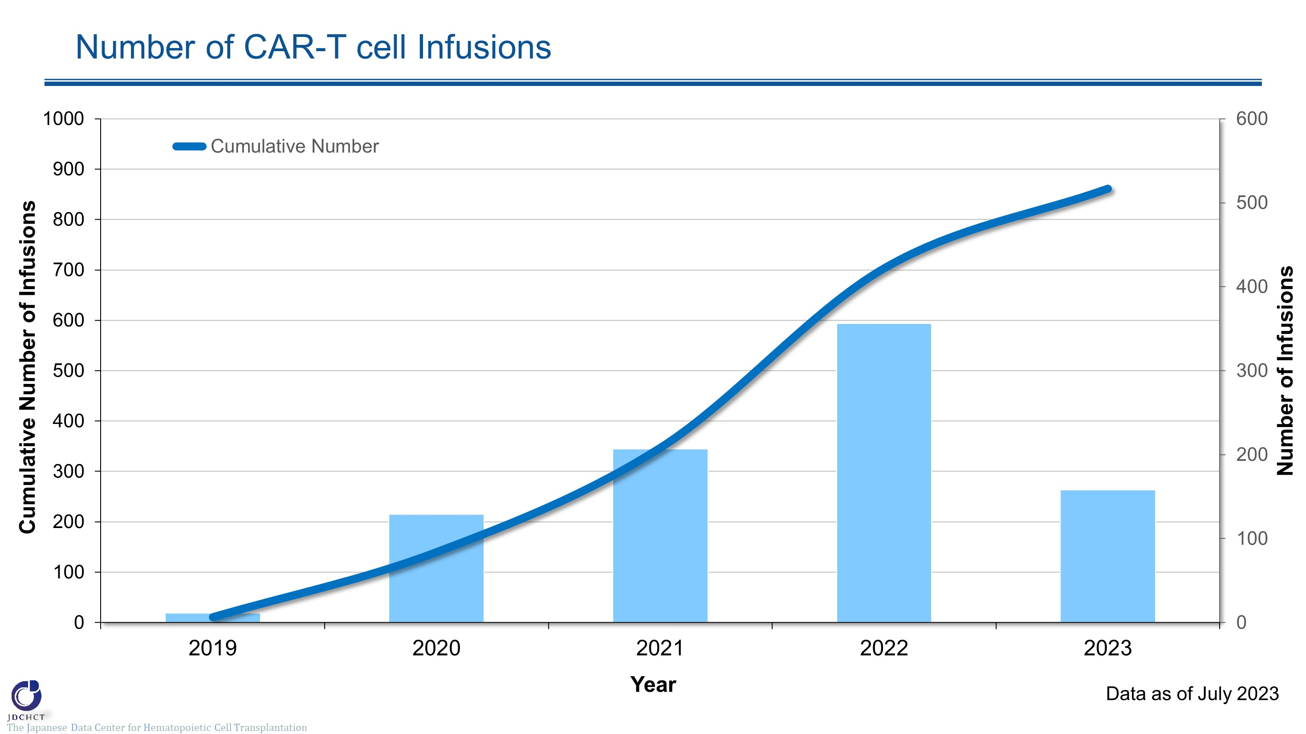
Number of CAR-T cell Infusions
Notes:
The cumulative number of CAR-T cell infusions from 2019 to 2023 was 861.
The number of CAR-T cell infusions has increased each year, with 356 infusions in 2022.

Slide 4
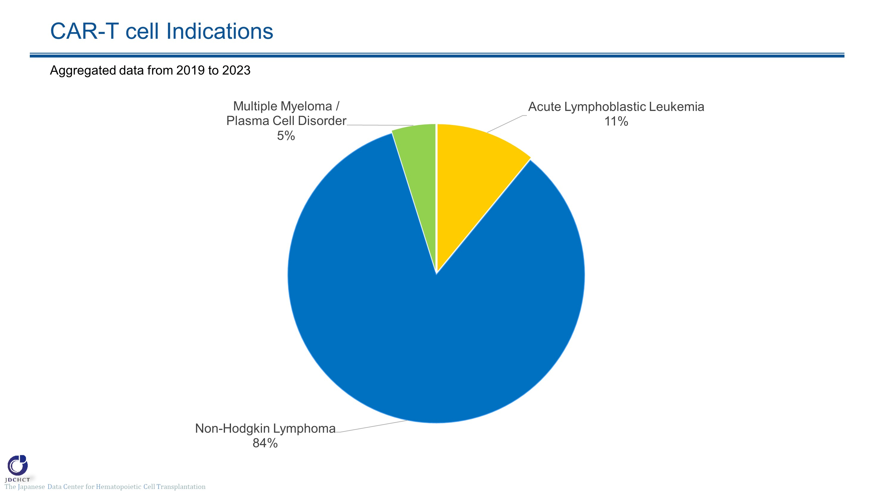
CAR-T cell Indications
Notes:
The most common indication for CAR-T cell therapy is non-Hodgkin lymphoma, accounting for 84% of all cases, followed by acute lymphoblastic leukemia (11%) and multiple myeloma / plasma cell disorder (5%).

Slide 5
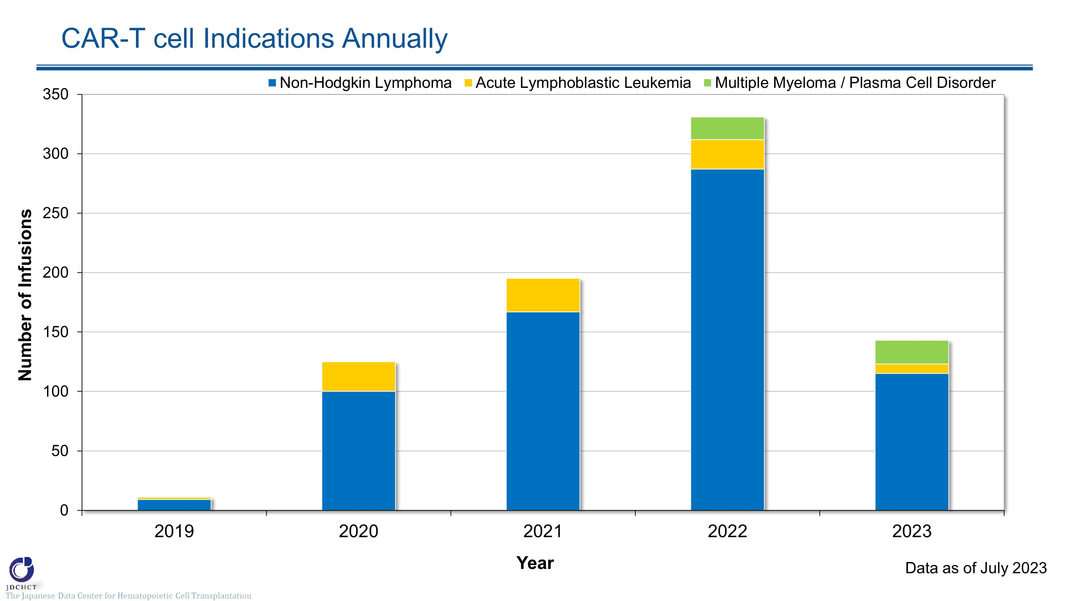
CAR-T cell Indications Annually
Notes:
The number of CAR-T cell infusions for non-Hodgkin lymphoma has increased, with 287 infusions in 2022.
Approximately 25 CAR-T cell infusions for acute lymphocytic leukemia have been registered annually.
CAR-T cell therapy has been used for the treatment of multiple myeloma / plasma cell disorder since 2022, aligning with the recent approval.

Slide 6
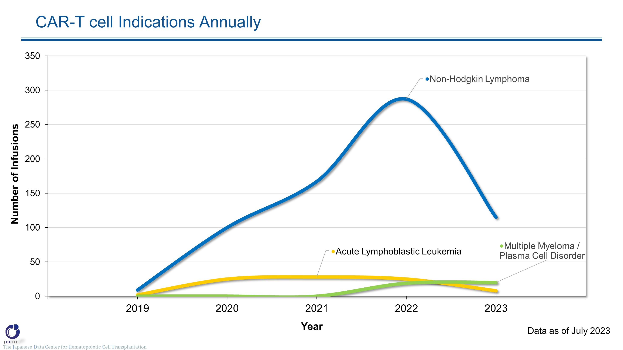
CAR-T cell Indications Annually
Notes:
The number of CAR-T cell infusions for non-Hodgkin lymphoma has increased, with 287 infusions in 2022.
Approximately 25 CAR-T cell infusions for acute lymphocytic leukemia have been registered annually.
CAR-T cell therapy has been used for the treatment of multiple myeloma / plasma cell disorder since 2022, aligning with the recent approval.

Slide 7
Distribution of CAR-T cell Recipients by Age
Notes:
The median age at the time of CAR-T cell infusion was 60 years (1-79 years). Those aged 65 years or older have recently accounted for one-third of all patients.

Slide 8
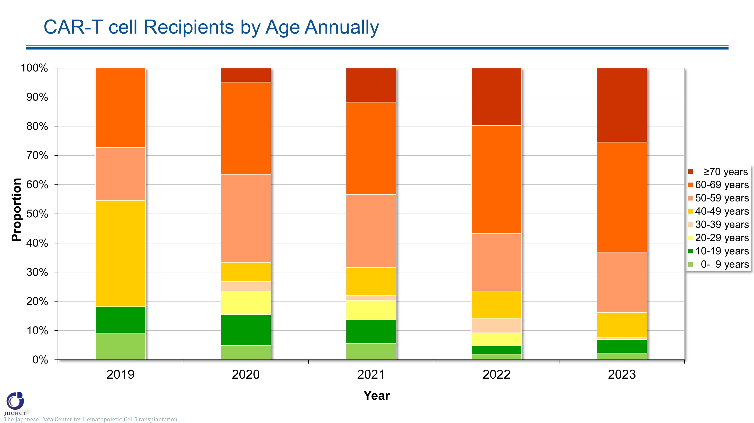
CAR-T cell Recipients by Age Annually
Notes:
The trend of the composition of CAR-T cell infusions by age group demonstrates that the proportion of older patients has increased year by year. Those aged 60 to 69 years accounted for 37% of all patients and those aged 70 years or older accounted for 20% of the total in 2022.

Slide 9
Distribution of CAR-T cell Recipients by In-specification / Out-of-specification
Notes:
It is possible that the final product of CAR-T cells may not meet specifications, termed out of specification (OOS). OOS products may be provided under corporate clinical trials to patients who have no other treatment options. OOS products accounted for 5% of the total CAR-T cell infusions. (Only post-launch products were included for the analysis.)

Slide 10
Prior HCT to CAR-T cell Infusions: Acute Lymphoblastic Leukemia
Notes:
This slide illustrates the proportion of patients with acute lymphoblastic leukemia with prior hematopoietic cell transplant. The percentage of patients who did not receive a hematopoietic cell transplant prior to CAR-T cell therapy is increasing, with 56% of patients with acute lymphoblastic leukemia in 2022.

Slide 11
Prior HCT to CAR-T cell Infusions: Non-Hodgkin Lymphoma
Notes:
This slide illustrates the proportion of patients with non-Hodgkin lymphoma with prior hematopoietic cell transplant. The percentage of patients who did not receive a hematopoietic cell transplant prior to CAR-T cell therapy is increasing, with 70% of patients with non-Hodgkin lymphoma in 2022.

