Slide 1
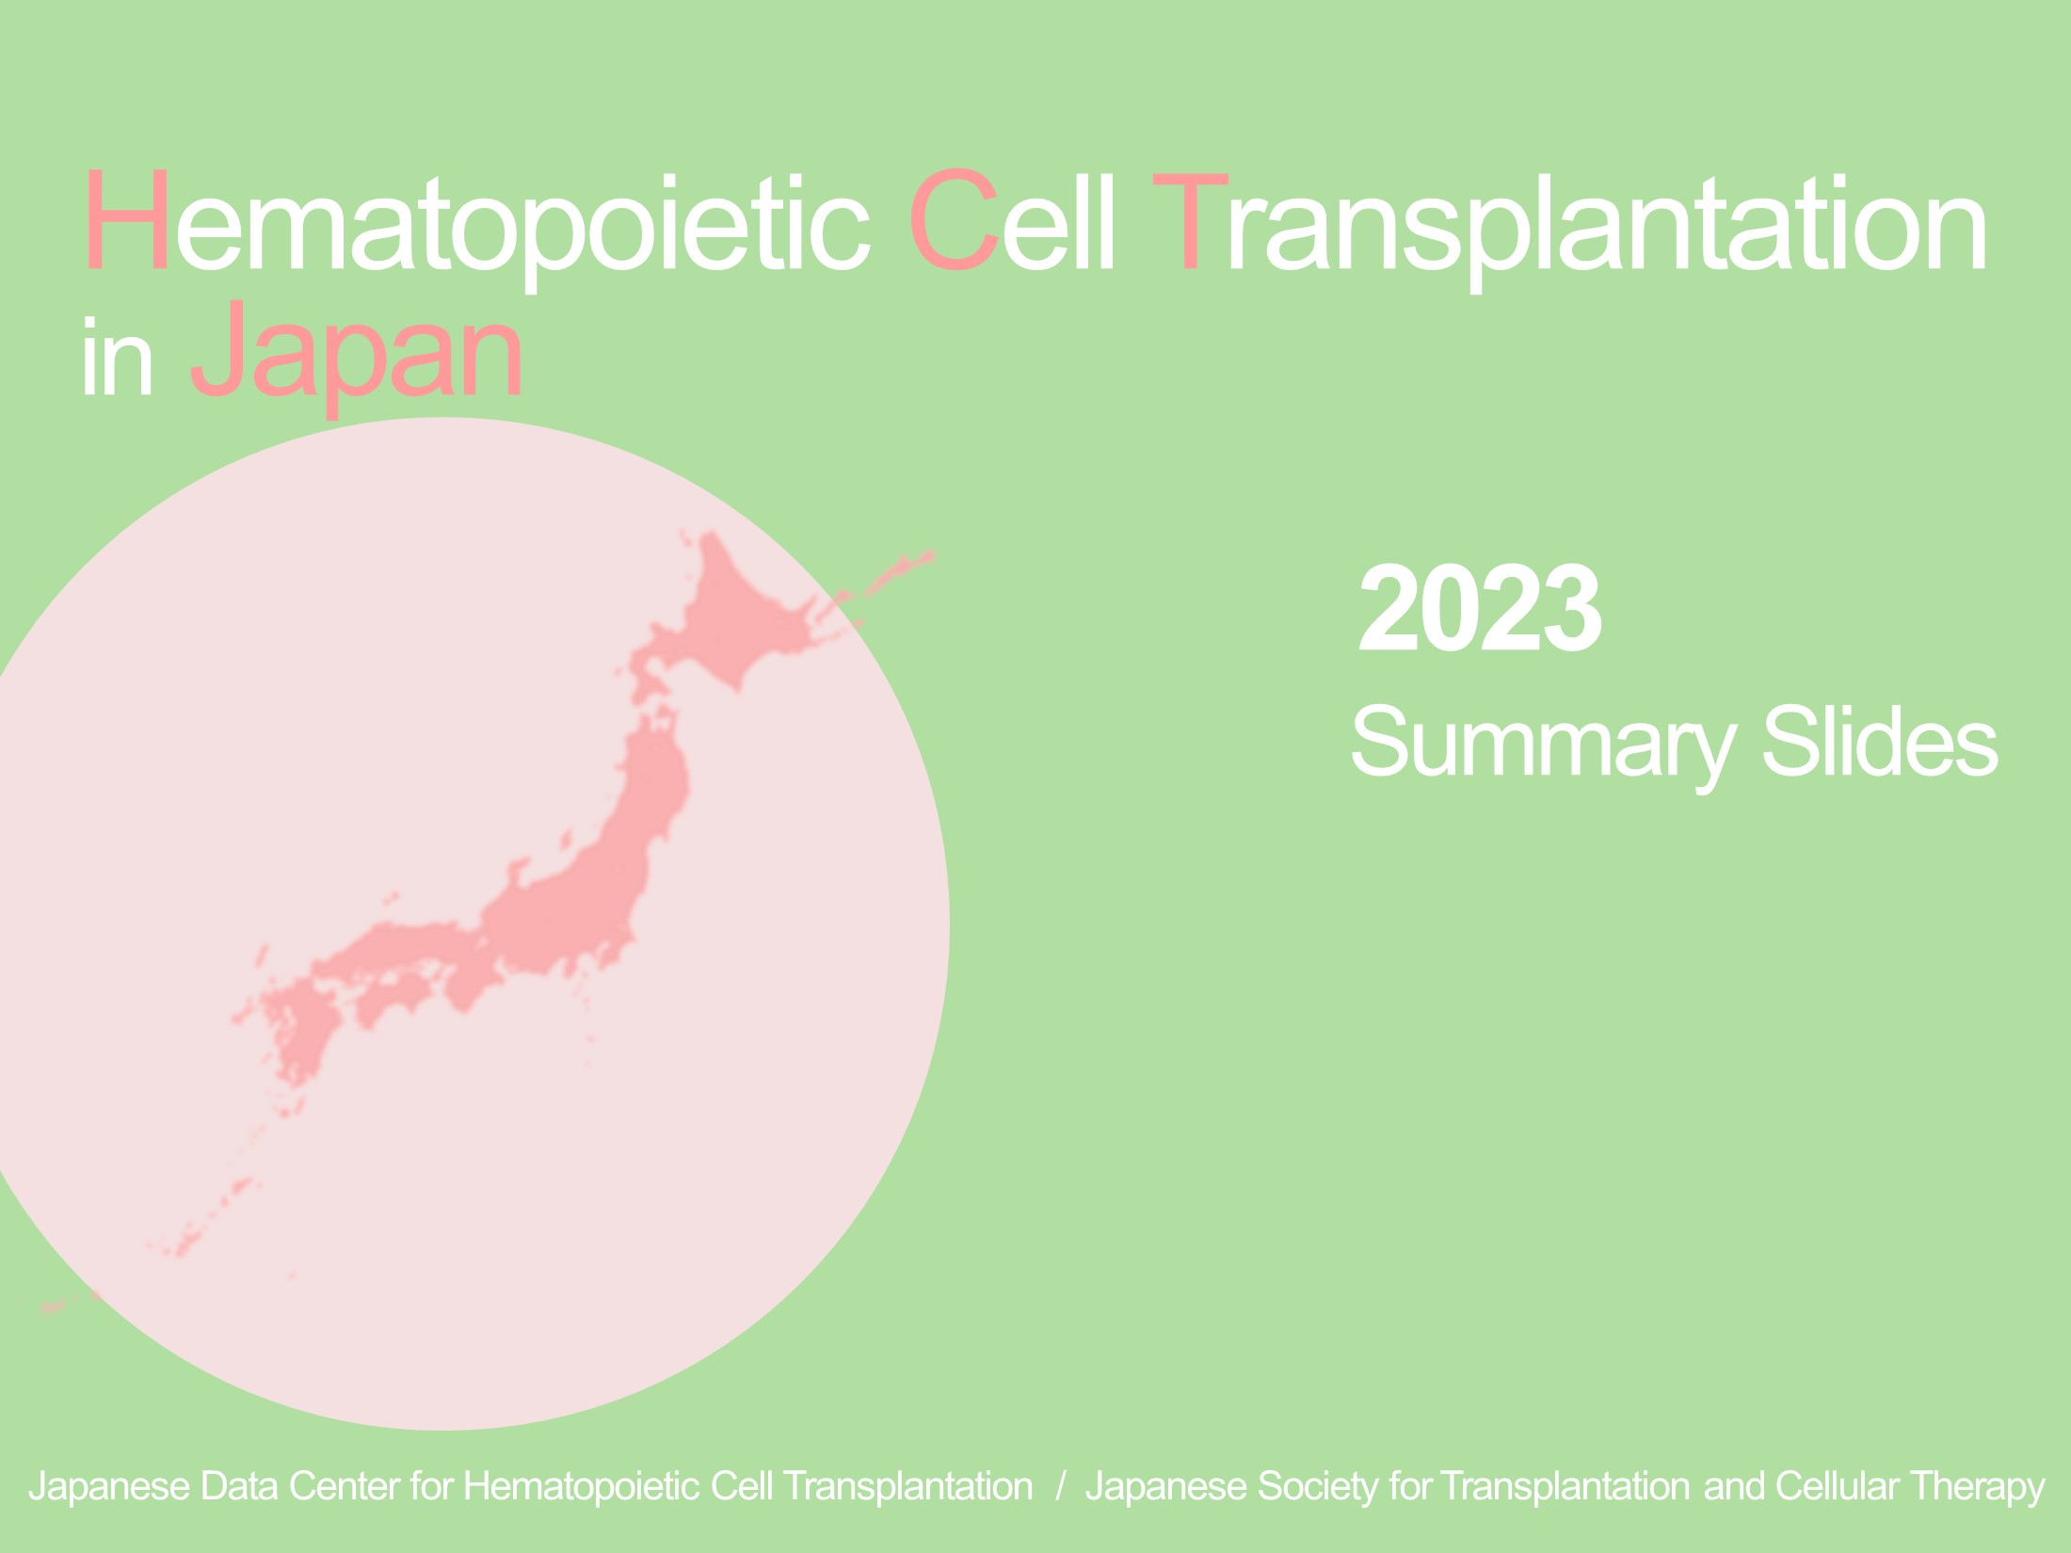
Hematopoietic Cell Transplantation in Japan 2023 Summary Slides

Slide 2
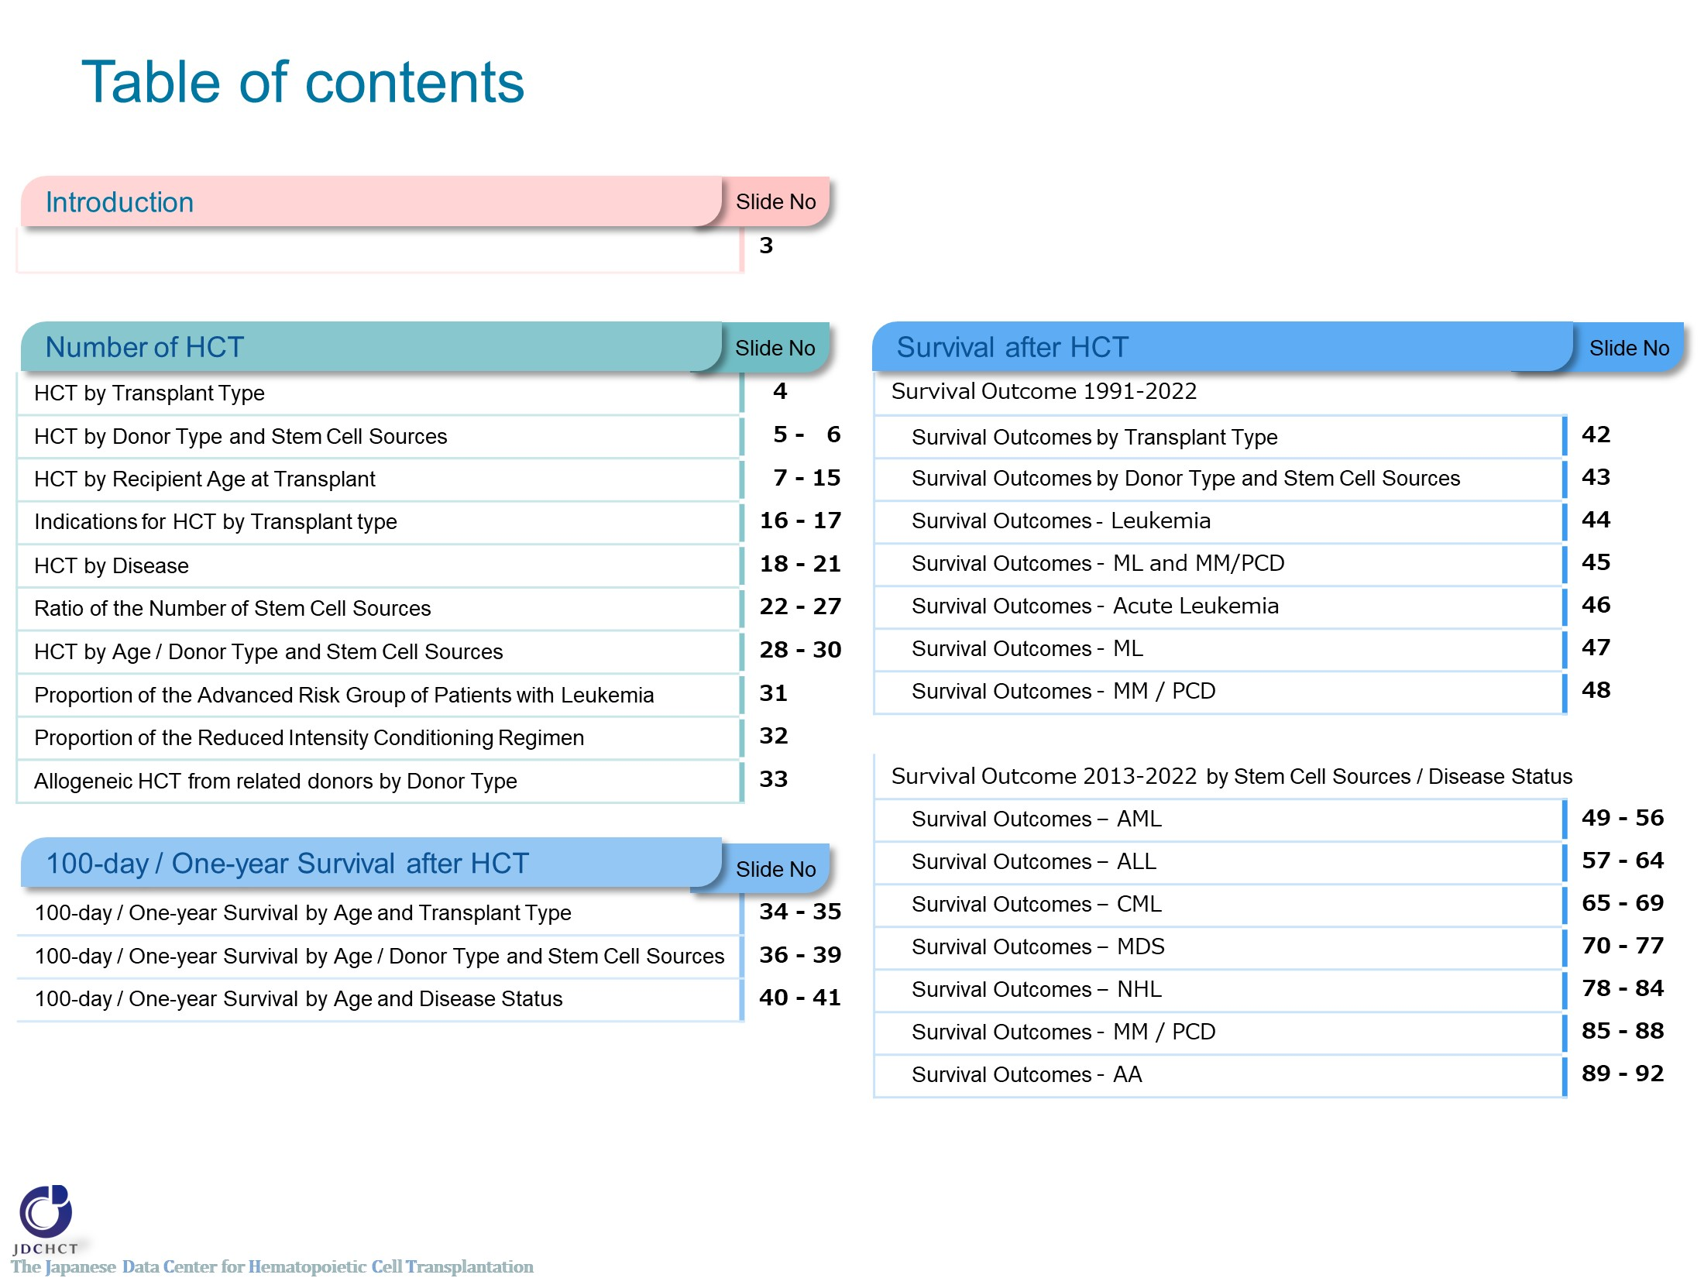
Table of contents

Slide 3
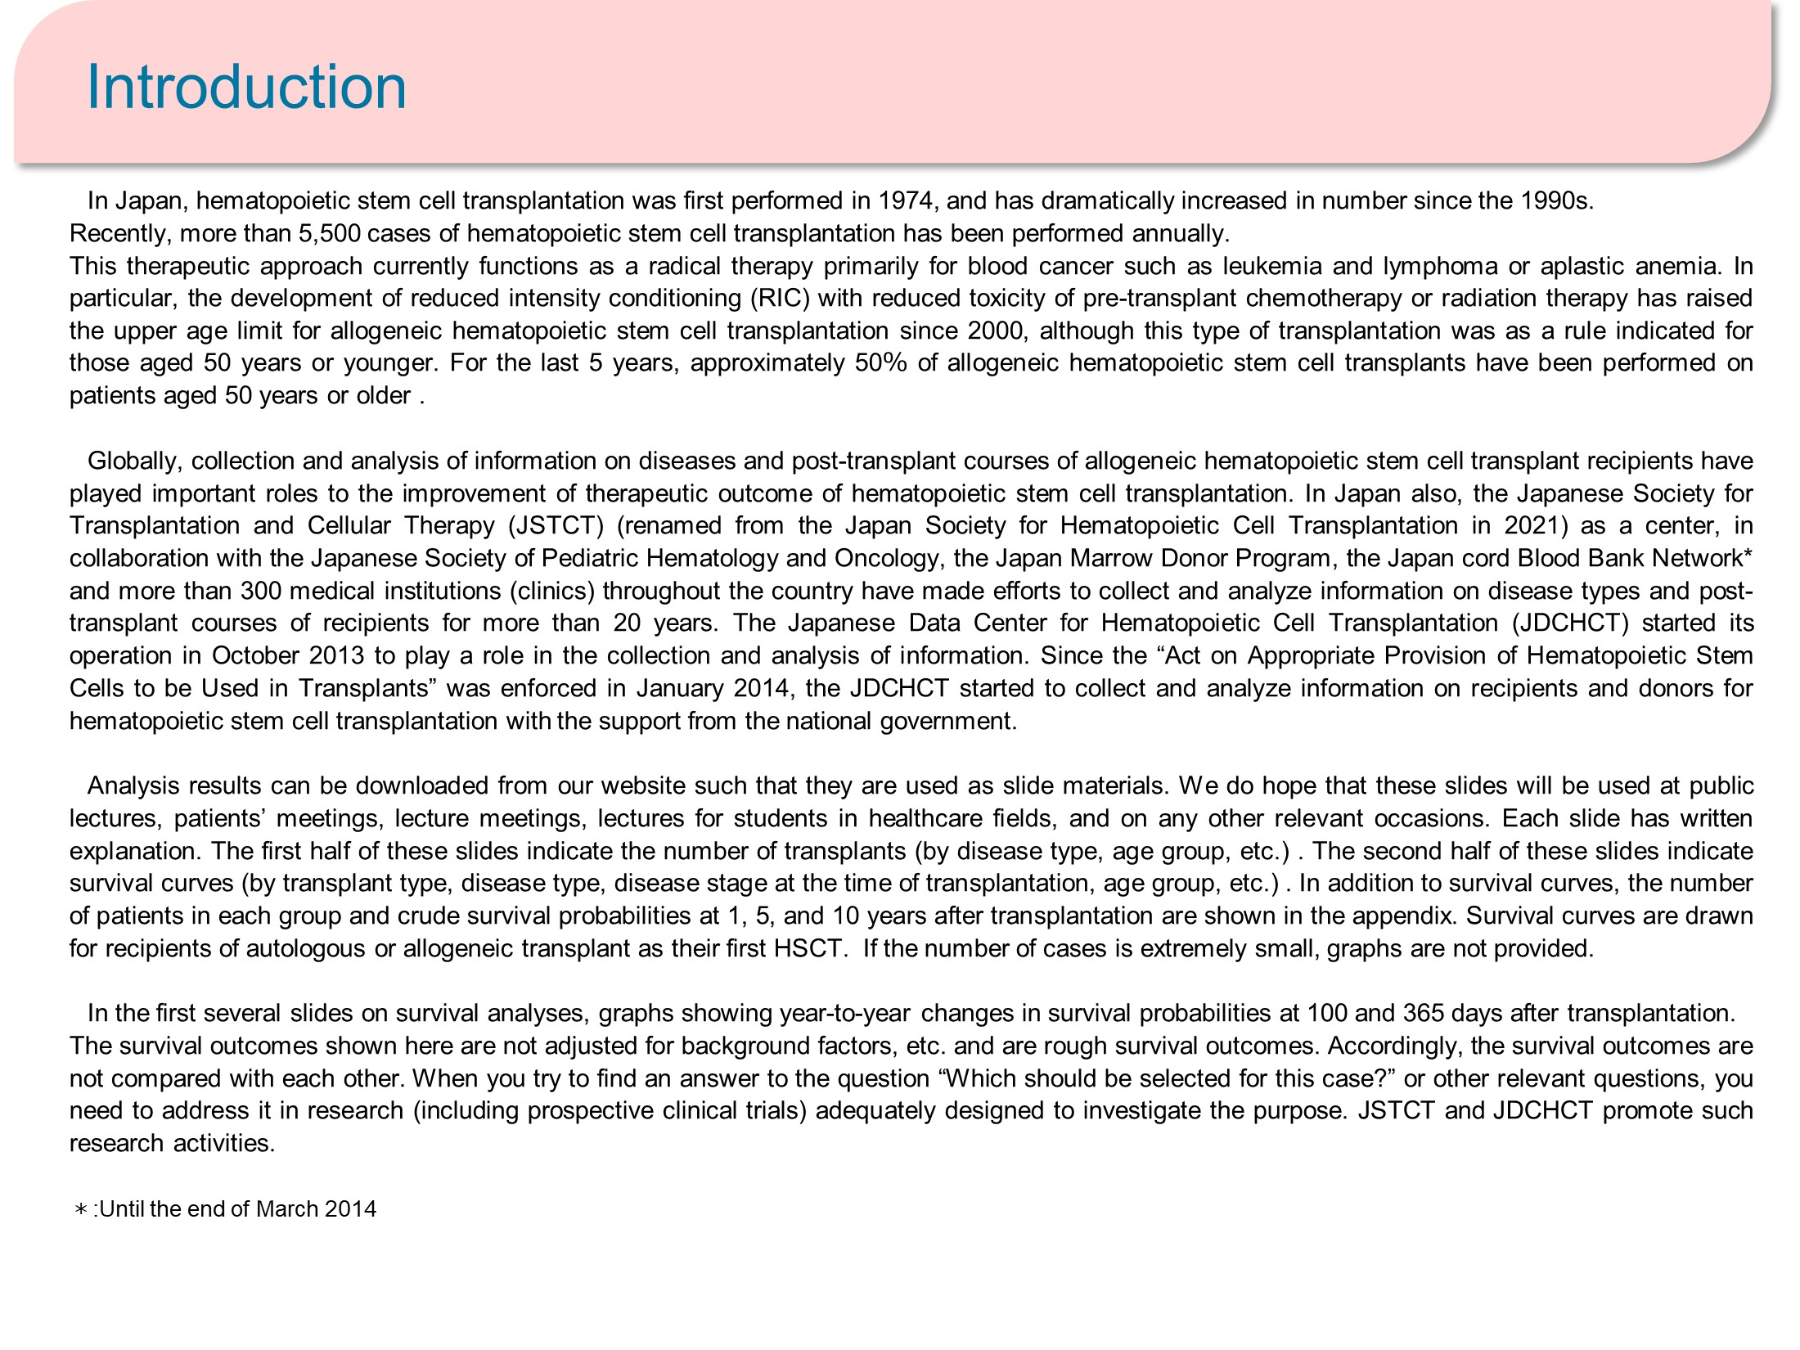
Introduction

Slide 4
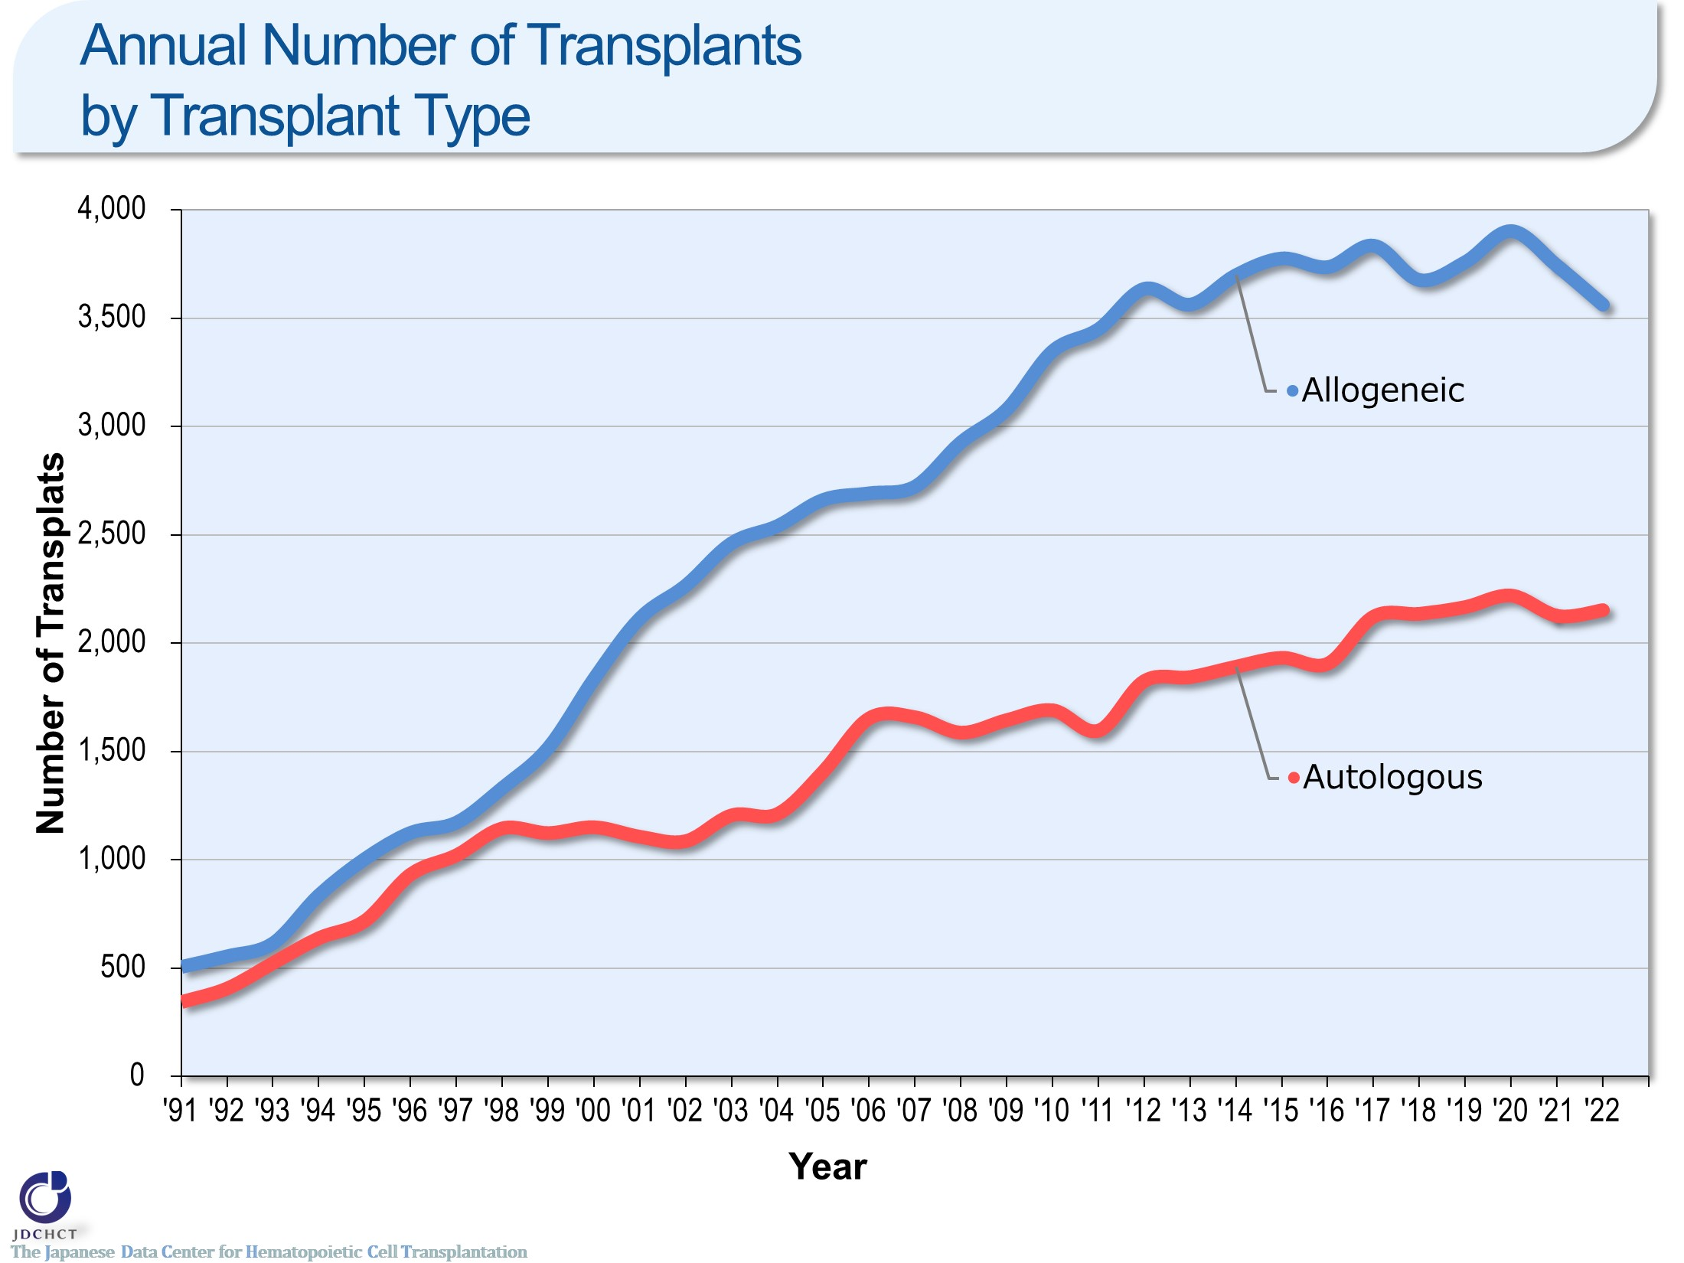
Annual Number of Transplants by Transplant Type
Notes:
In Japan, registration for bone marrow transplantation from unrelated donors was started in 1993 and the first case of cord blood transplantation was performed in 1997. Since these times, transplantation from unrelated donors has spread and the total number of allogeneic transplant recipients has increased. Recently, the annual number of autologous and allogeneic transplants registration exceeds 5,500.

Slide 5
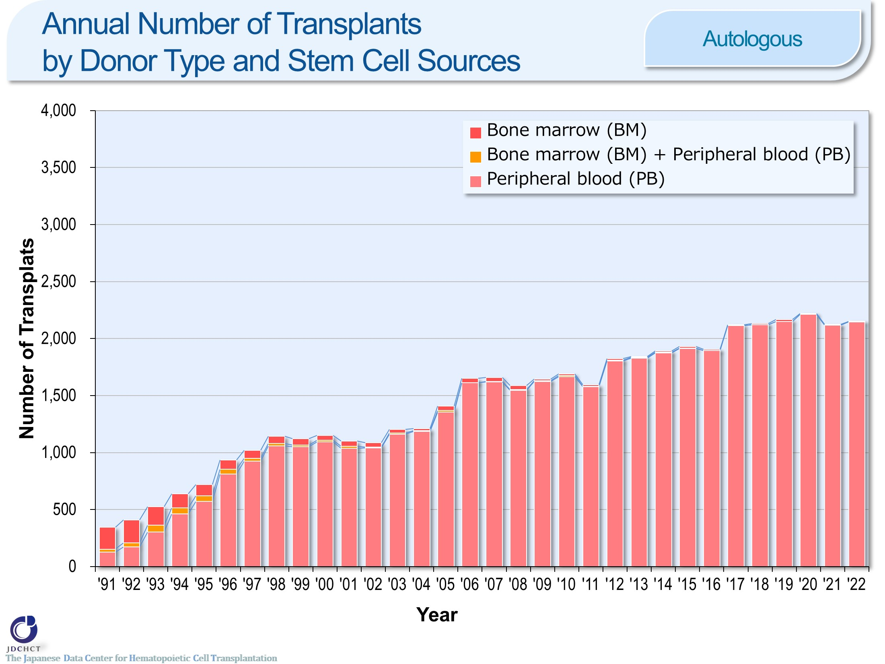
Annual Number of Transplants by Donor Type and Stem Cell Sources <Autologous>
Notes:
For autologous transplants, the annual number of cases registered has been approximately 2,000 for past several years. Recently, peripheral blood stem cell transplantations account for 99％ or more of the total cases of autologous transplants.

Slide 6
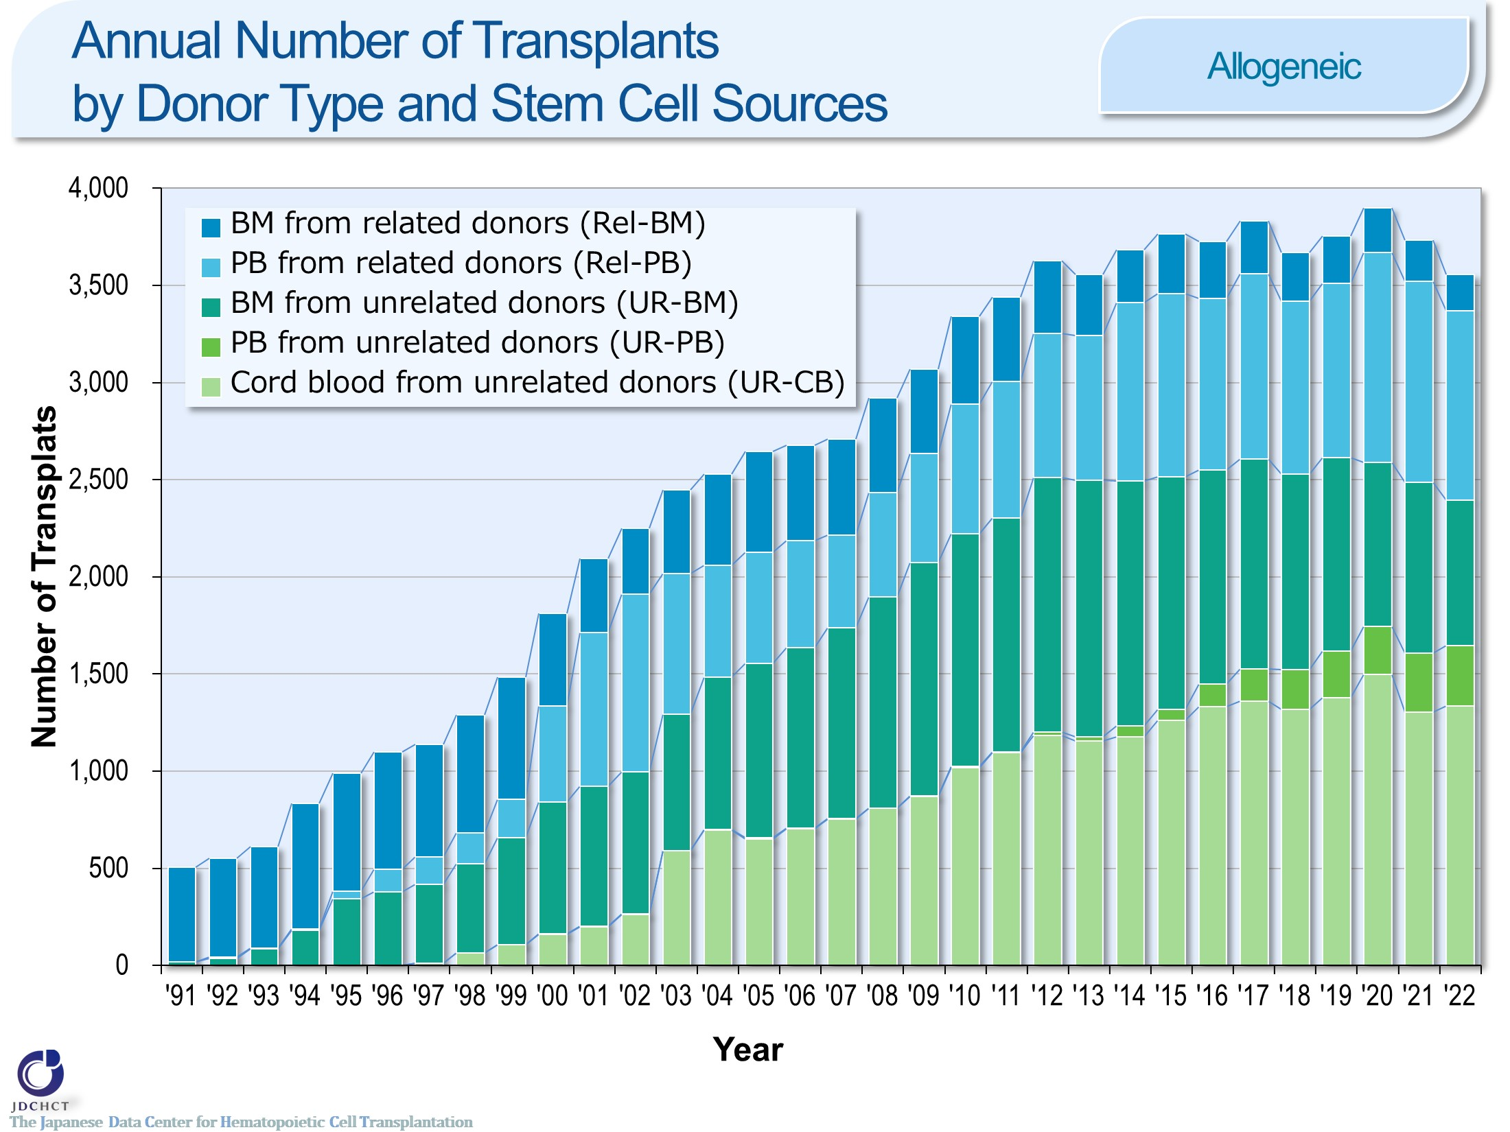
Annual Number of Transplants by Donor Type and Stem Cell Sources <Allogeneic>
Notes:
In Japan, since 1993 in which registration for bone marrow transplantation from unrelated donors was started and since 1997 in which the first case of cord blood transplantation was performed, transplantation from unrelated donors has spread and the total number of transplant recipients has increased. In particular, the increase in cord blood transplants is remarkable. Also, peripheral blood stem cell transplantation from unrelated donors was introduced since 2010, and the number of transplants has been gradually increased. The number of related peripheral blood stem cell transplantation has also increased as the number of haplo-identical transplantation increased remarkably since 2010.

Slide 7
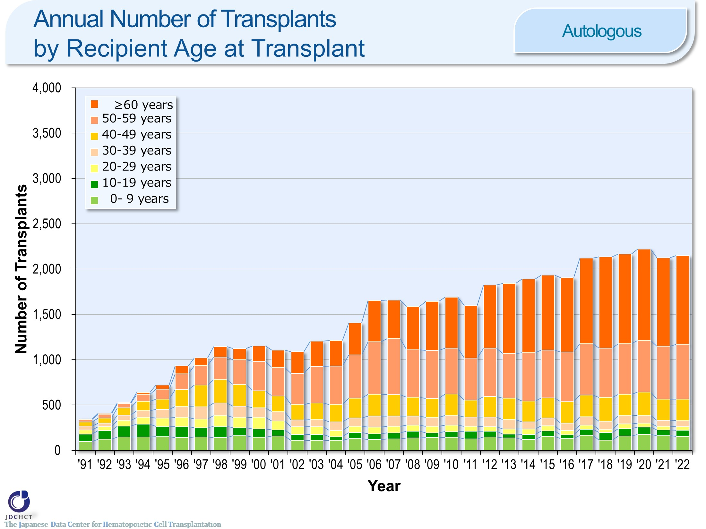
Annual Number of Transplants by Recipient Age at Transplant <Autologous>
Notes:
Due to the spread of transplants with reduced intensity conditioning (RIC) , the age groups in which transplantation is indicated have expanded, and the number of transplants in older age groups has increased. Those aged 50 years or older have recently accounted for more than 70% of the total cases of autologous transplants.

Slide 8
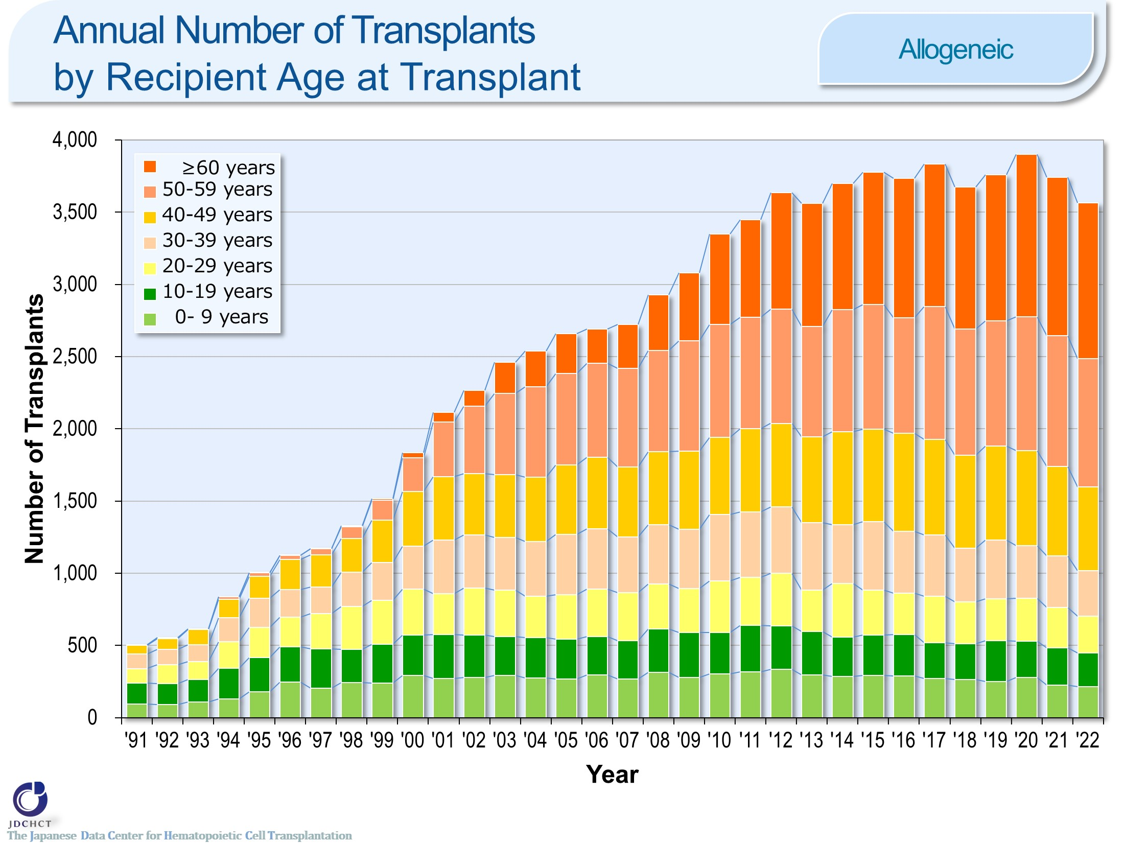
Annual Number of Transplants by Recipient Age at Transplant <Allogeneic>
Notes:
Due to the spread of transplants with reduced intensity conditioning (RIC) , the age groups in which transplantation is indicated have expanded, and the number of transplants in older age groups has increased. Those aged 50 years or older have recently accounted for more than 50％ of allogeneic transplants.

Slide 9
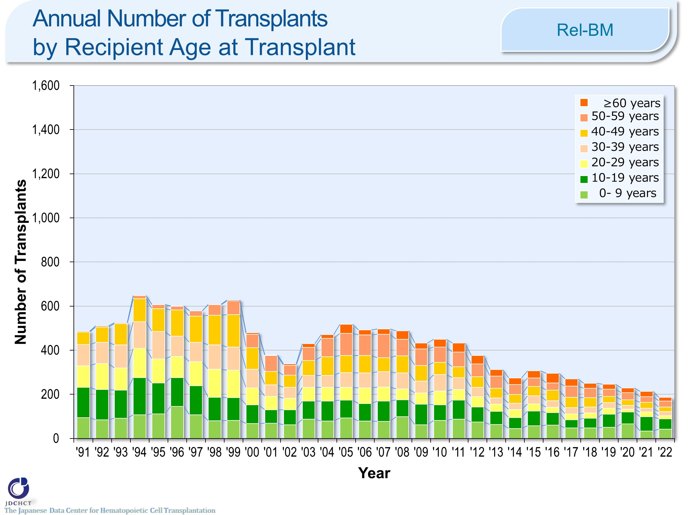
Annual Number of Transplants by Recipient Age at Transplant <Rel-BM>
Notes:
The number of bone marrow transplantation from related donors in all age groups is on a decreasing trend.

Slide 10
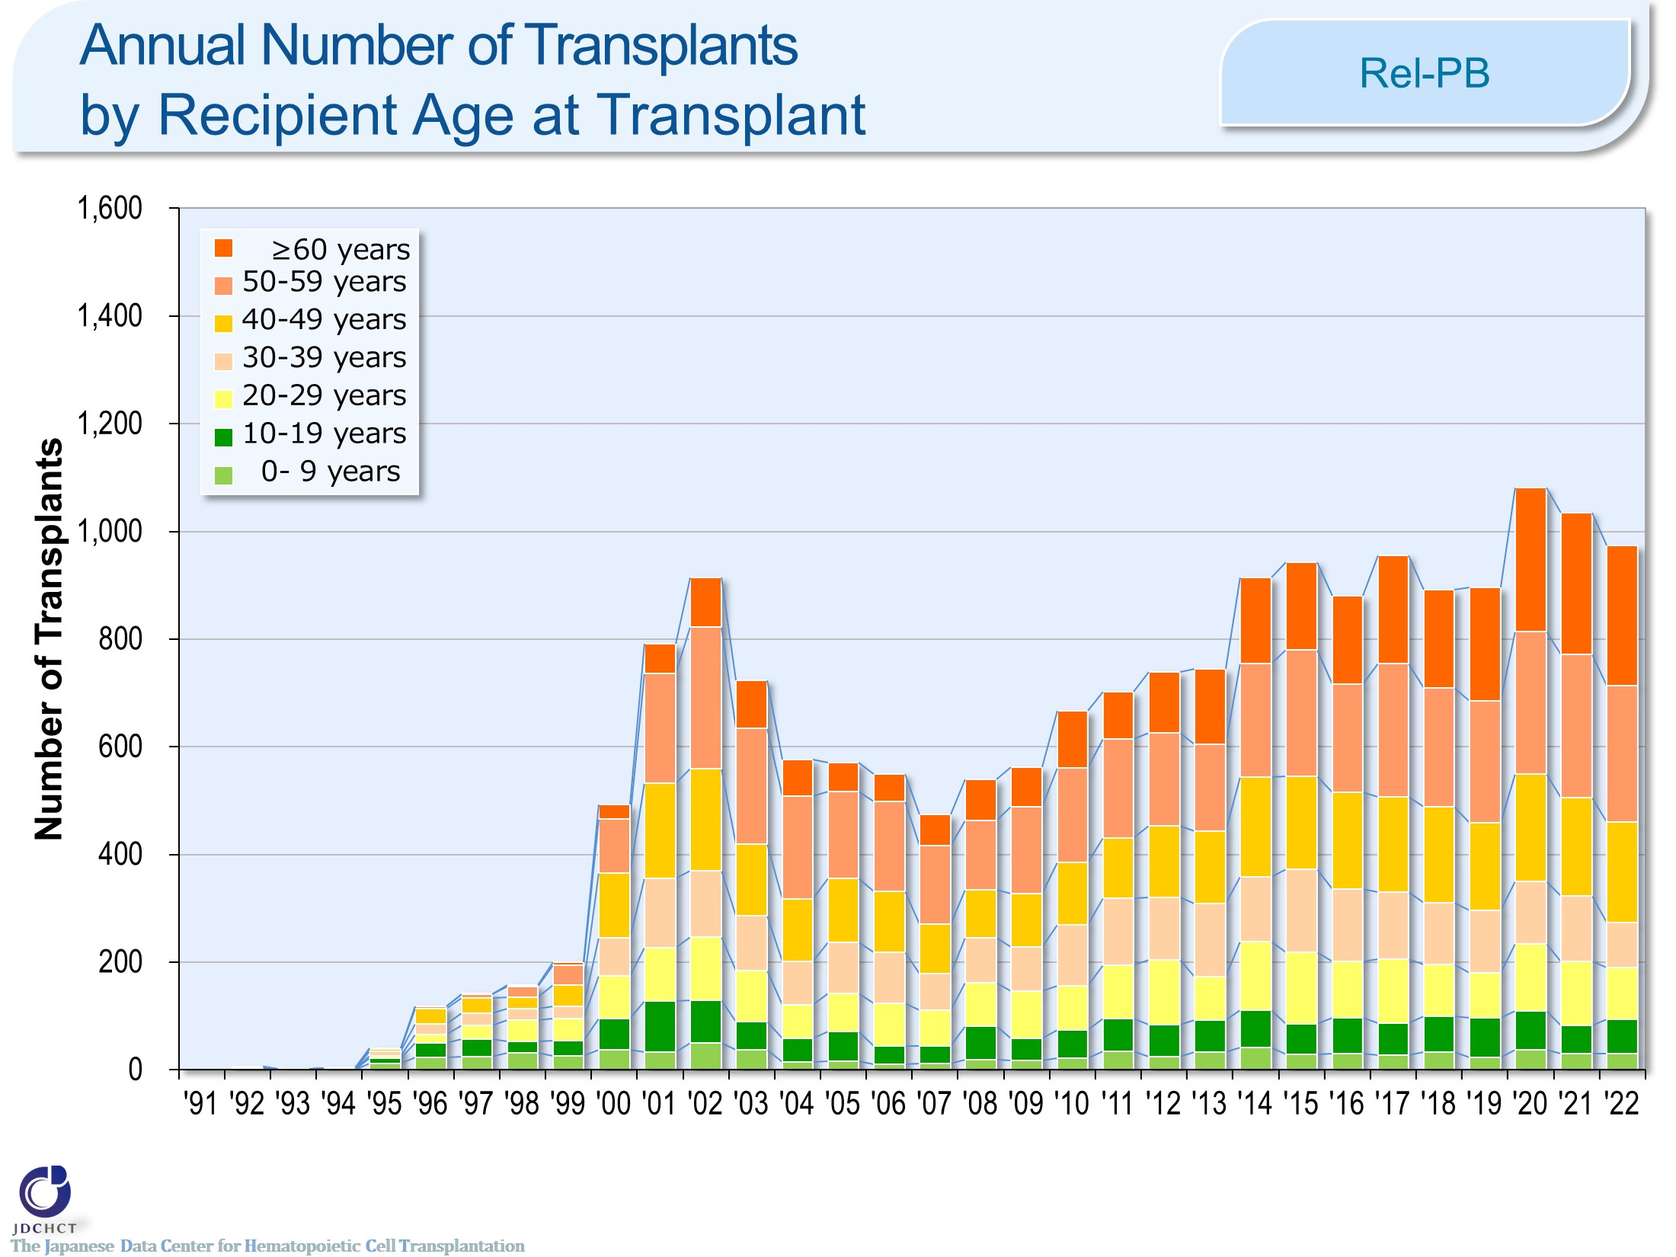
Annual Number of Transplants by Recipient Age at Transplant <Rel-PB>
Notes:
The number of peripheral blood stem cell transplantation from related donors in older age groups has increased.

Slide 11
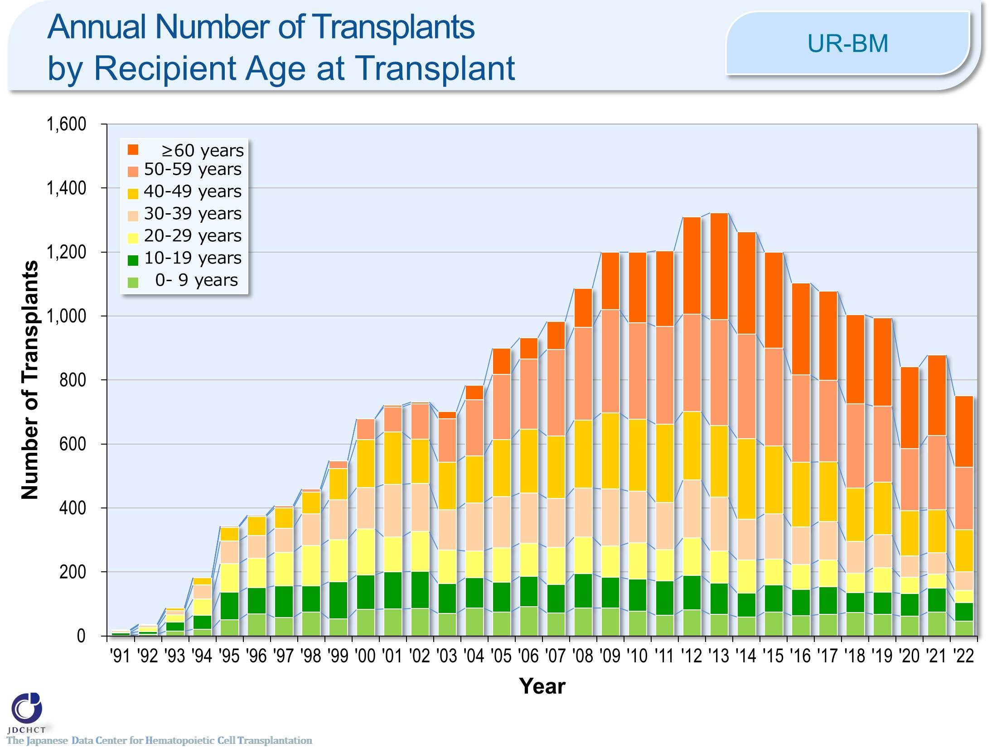
Annual Number of Transplants by Recipient Age at Transplant <UR-BM>
Notes:
In bone marrow transplantation from unrelated donors, the proportion of transplants in older age groups has increased, and those aged 50 years or older accounted for more than 50％.

Slide 12
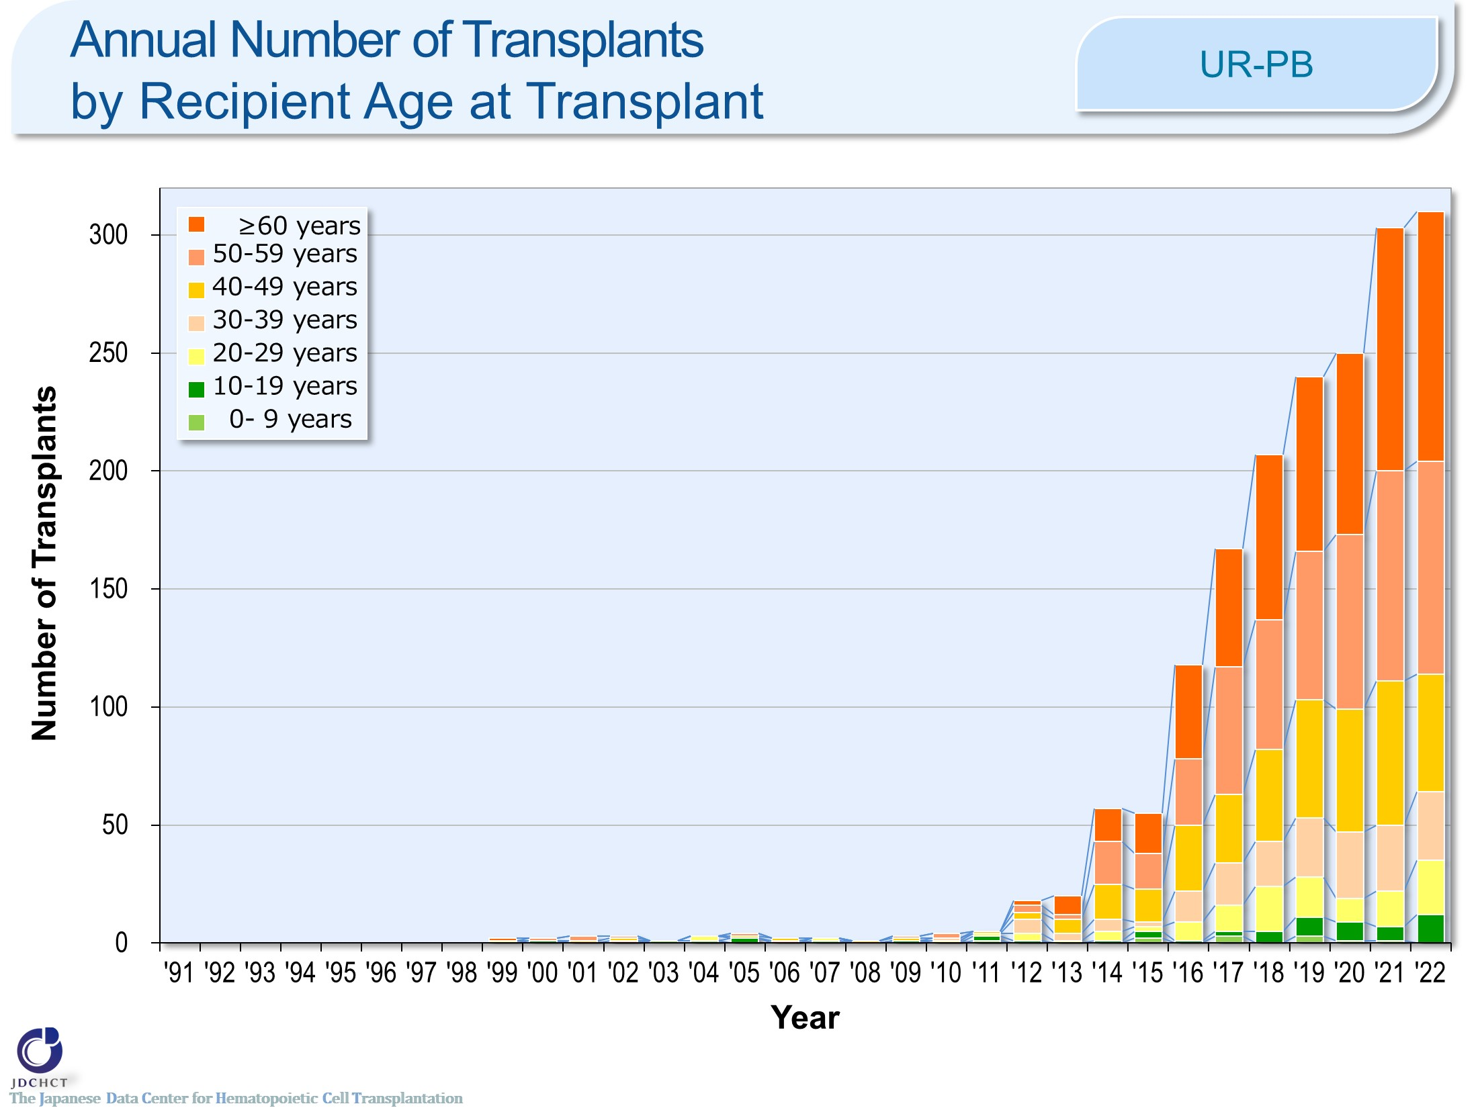
Annual Number of Transplants by Recipient Age at Transplant <UR-PB>
Notes:
In peripheral blood stem cell transplantation from unrelated donors, the proportion of transplants in older age groups has increased, and those aged 50 years or older accounted for more than 50％. The proportion of transplants in those aged 50 years or older is particularly high in peripheral blood stem cell transplantation.

Slide 13
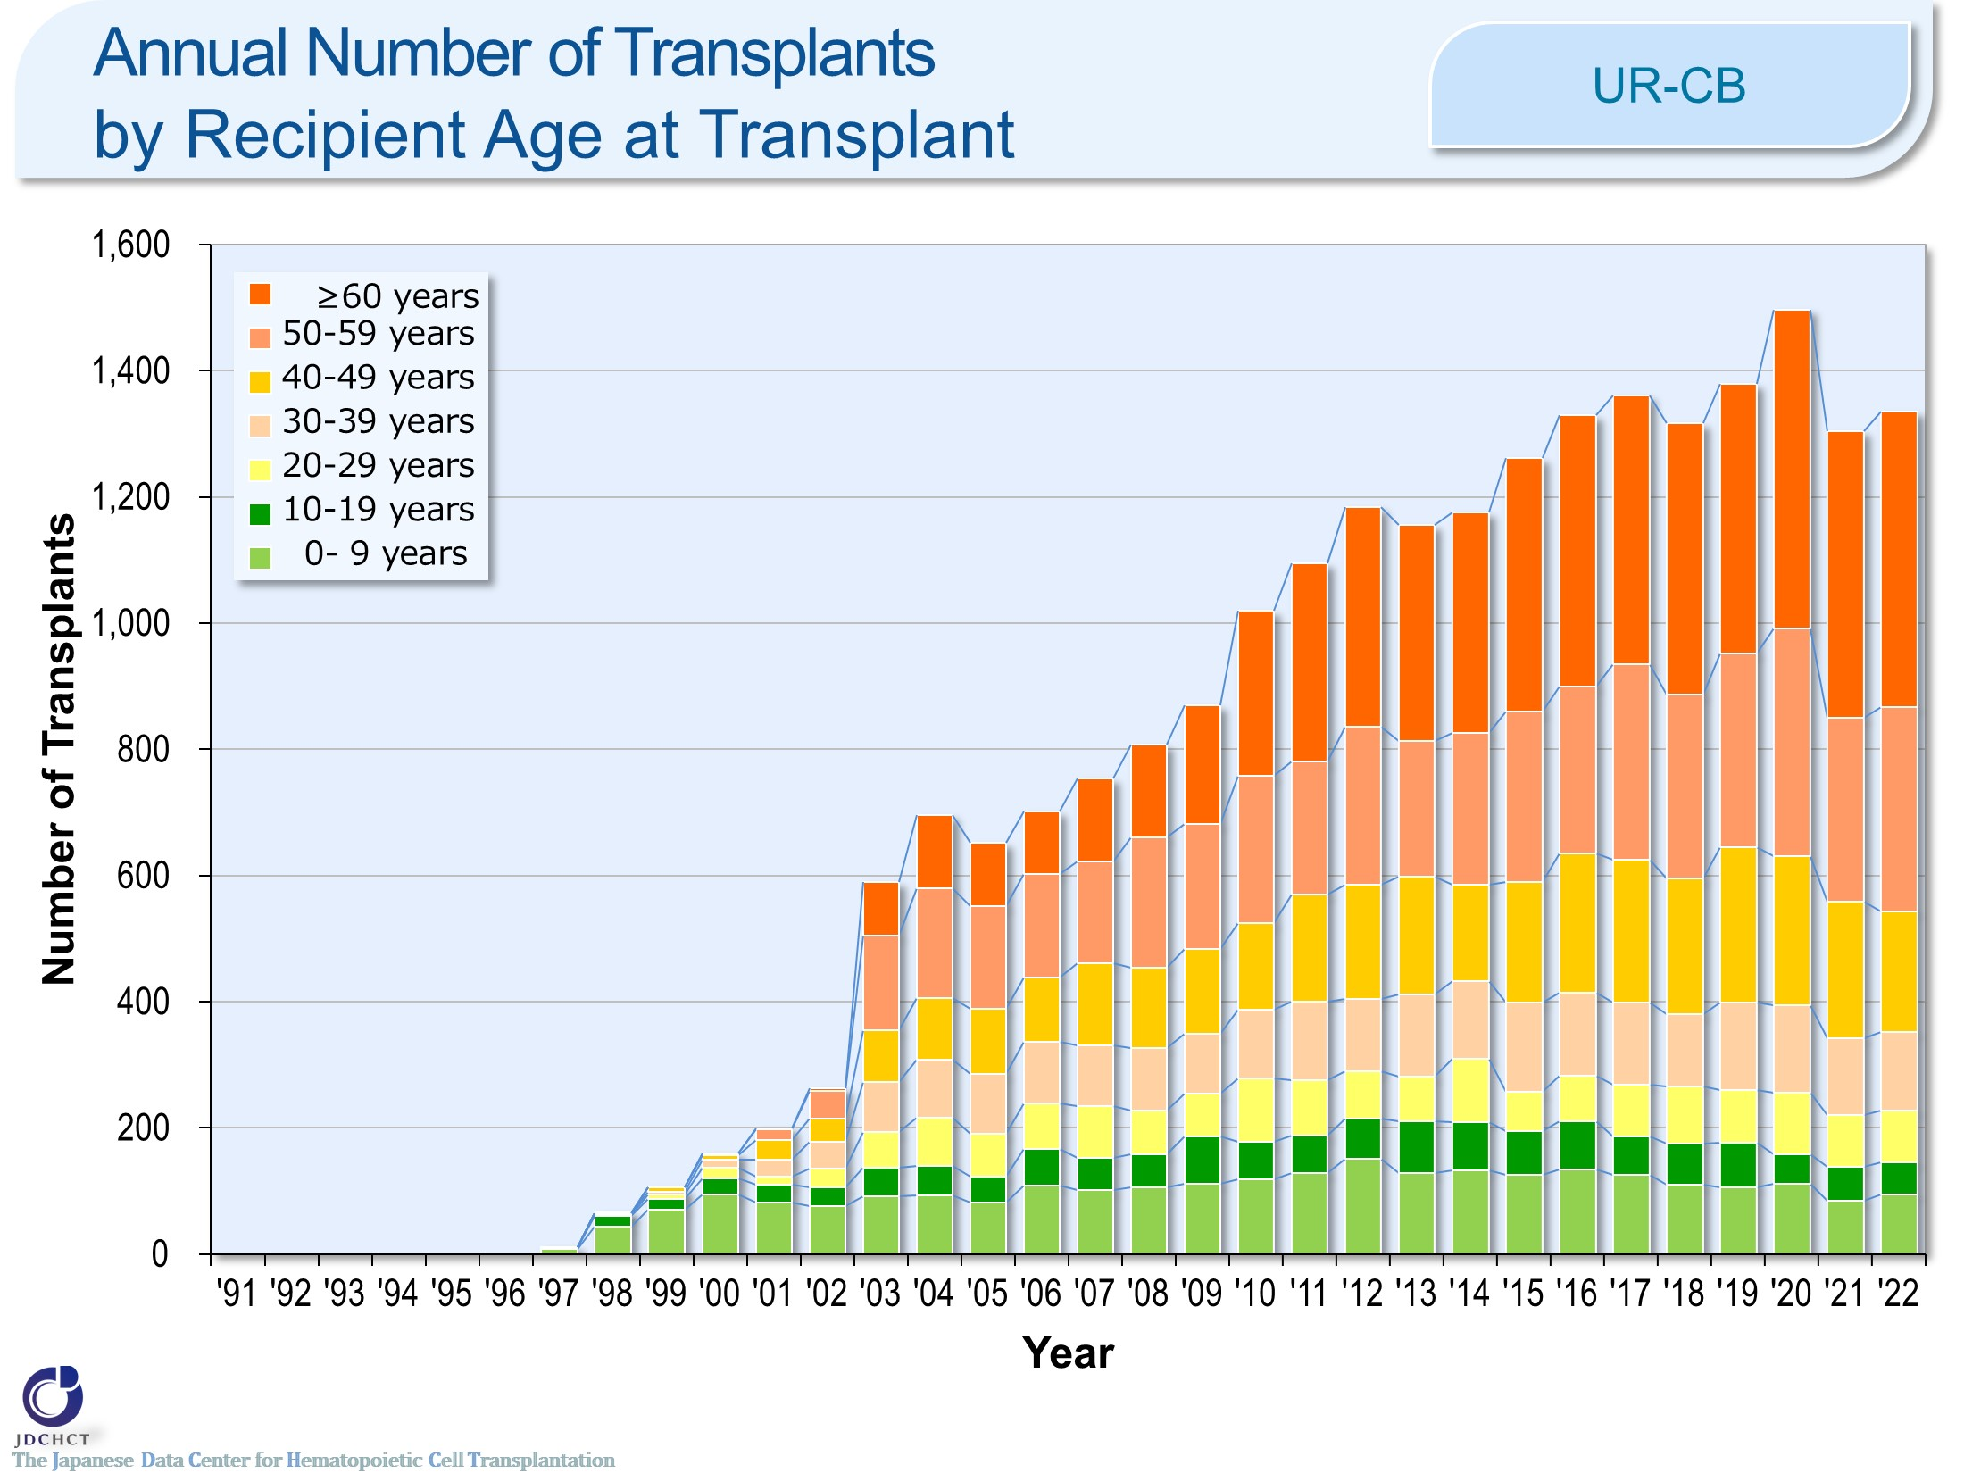
Annual Number of Transplants by Recipient Age at Transplant <UR-CB>
Notes:
In cord blood transplantation from unrelated donors, the number of transplants in older age groups has increased, and those aged 50 years or older accounted for more than 50％.

Slide 14
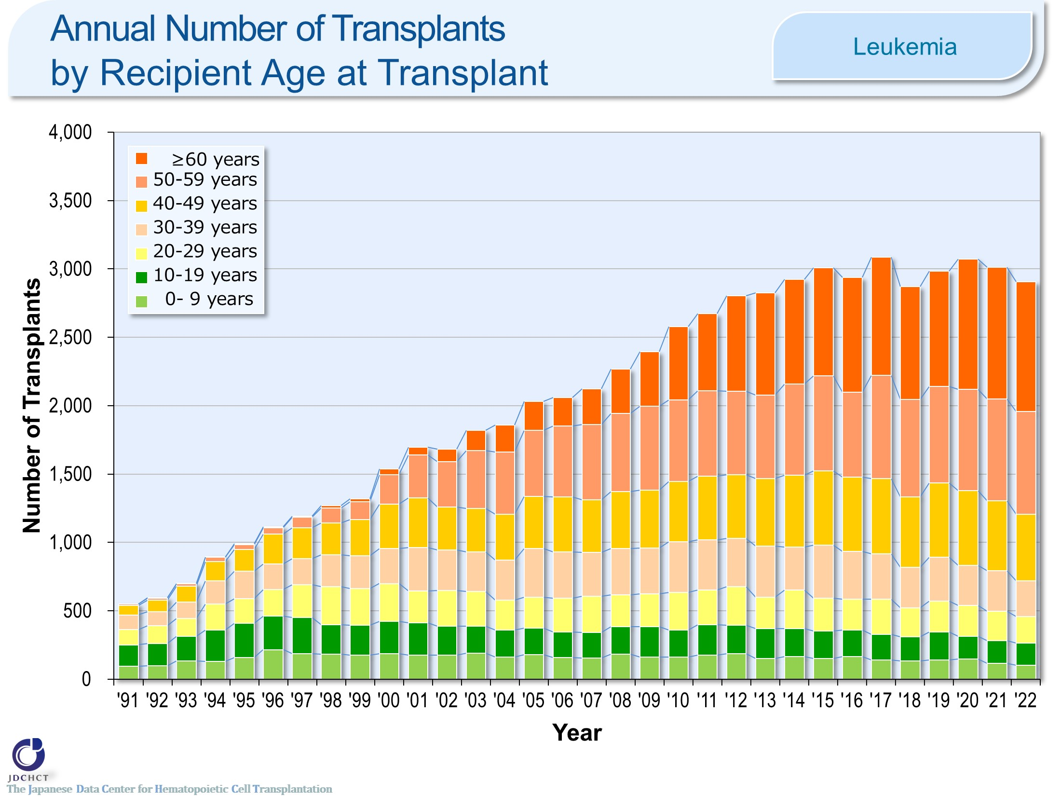
Annual Number of Transplants by Recipient Age at Transplant <Leukemia>
Notes:
In leukemia, the number of transplants (autologous transplantation and allogeneic transplantation) has increased in older age groups. Those aged 50 years or older accounted for about 60％ of the total cases of leukemia.

Slide 15
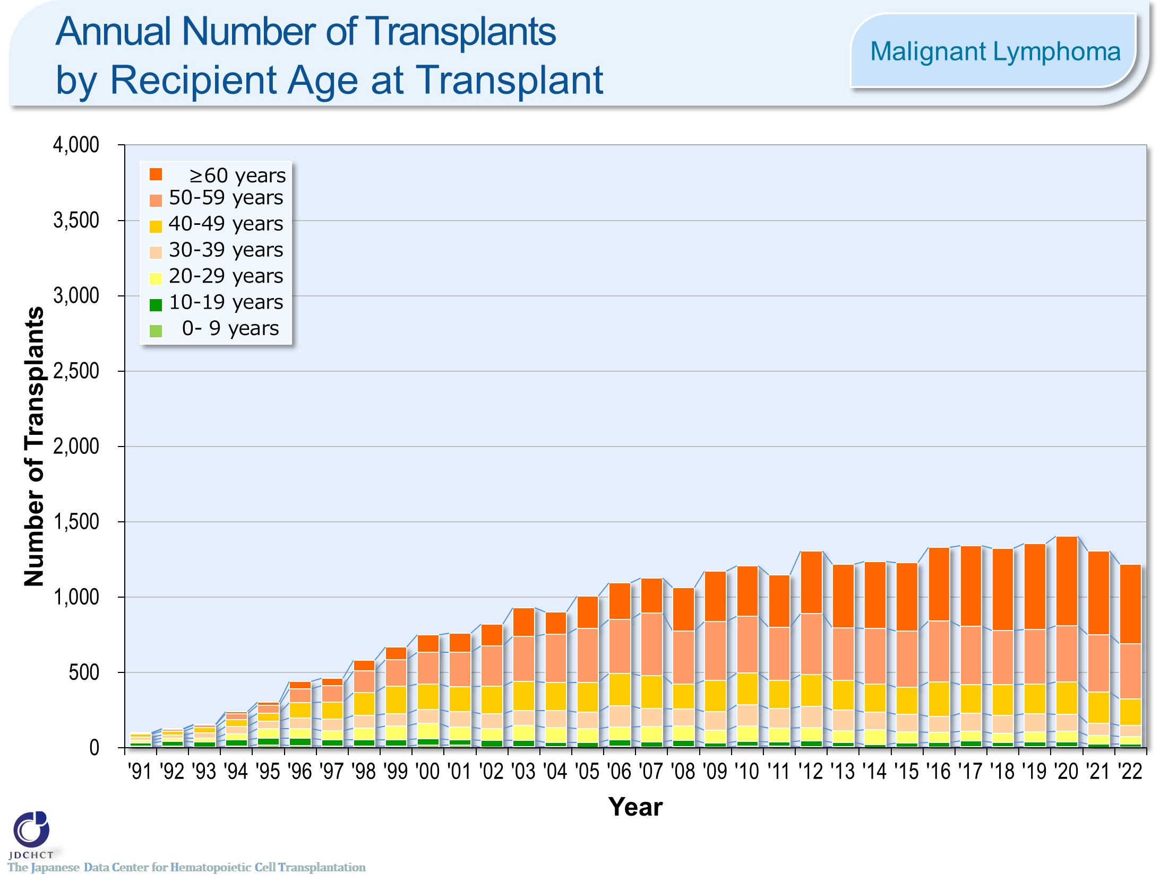
Annual Number of Transplants by Recipient Age at Transplant <Malignant Lymphoma>
Notes:
In malignant lymphoma, the number of transplants (autologous transplantation and allogeneic transplantation) has increased in older age groups. Those aged 50 years or older accounted for about 70％ of the total cases of malignant lymphoma.

Slide 16
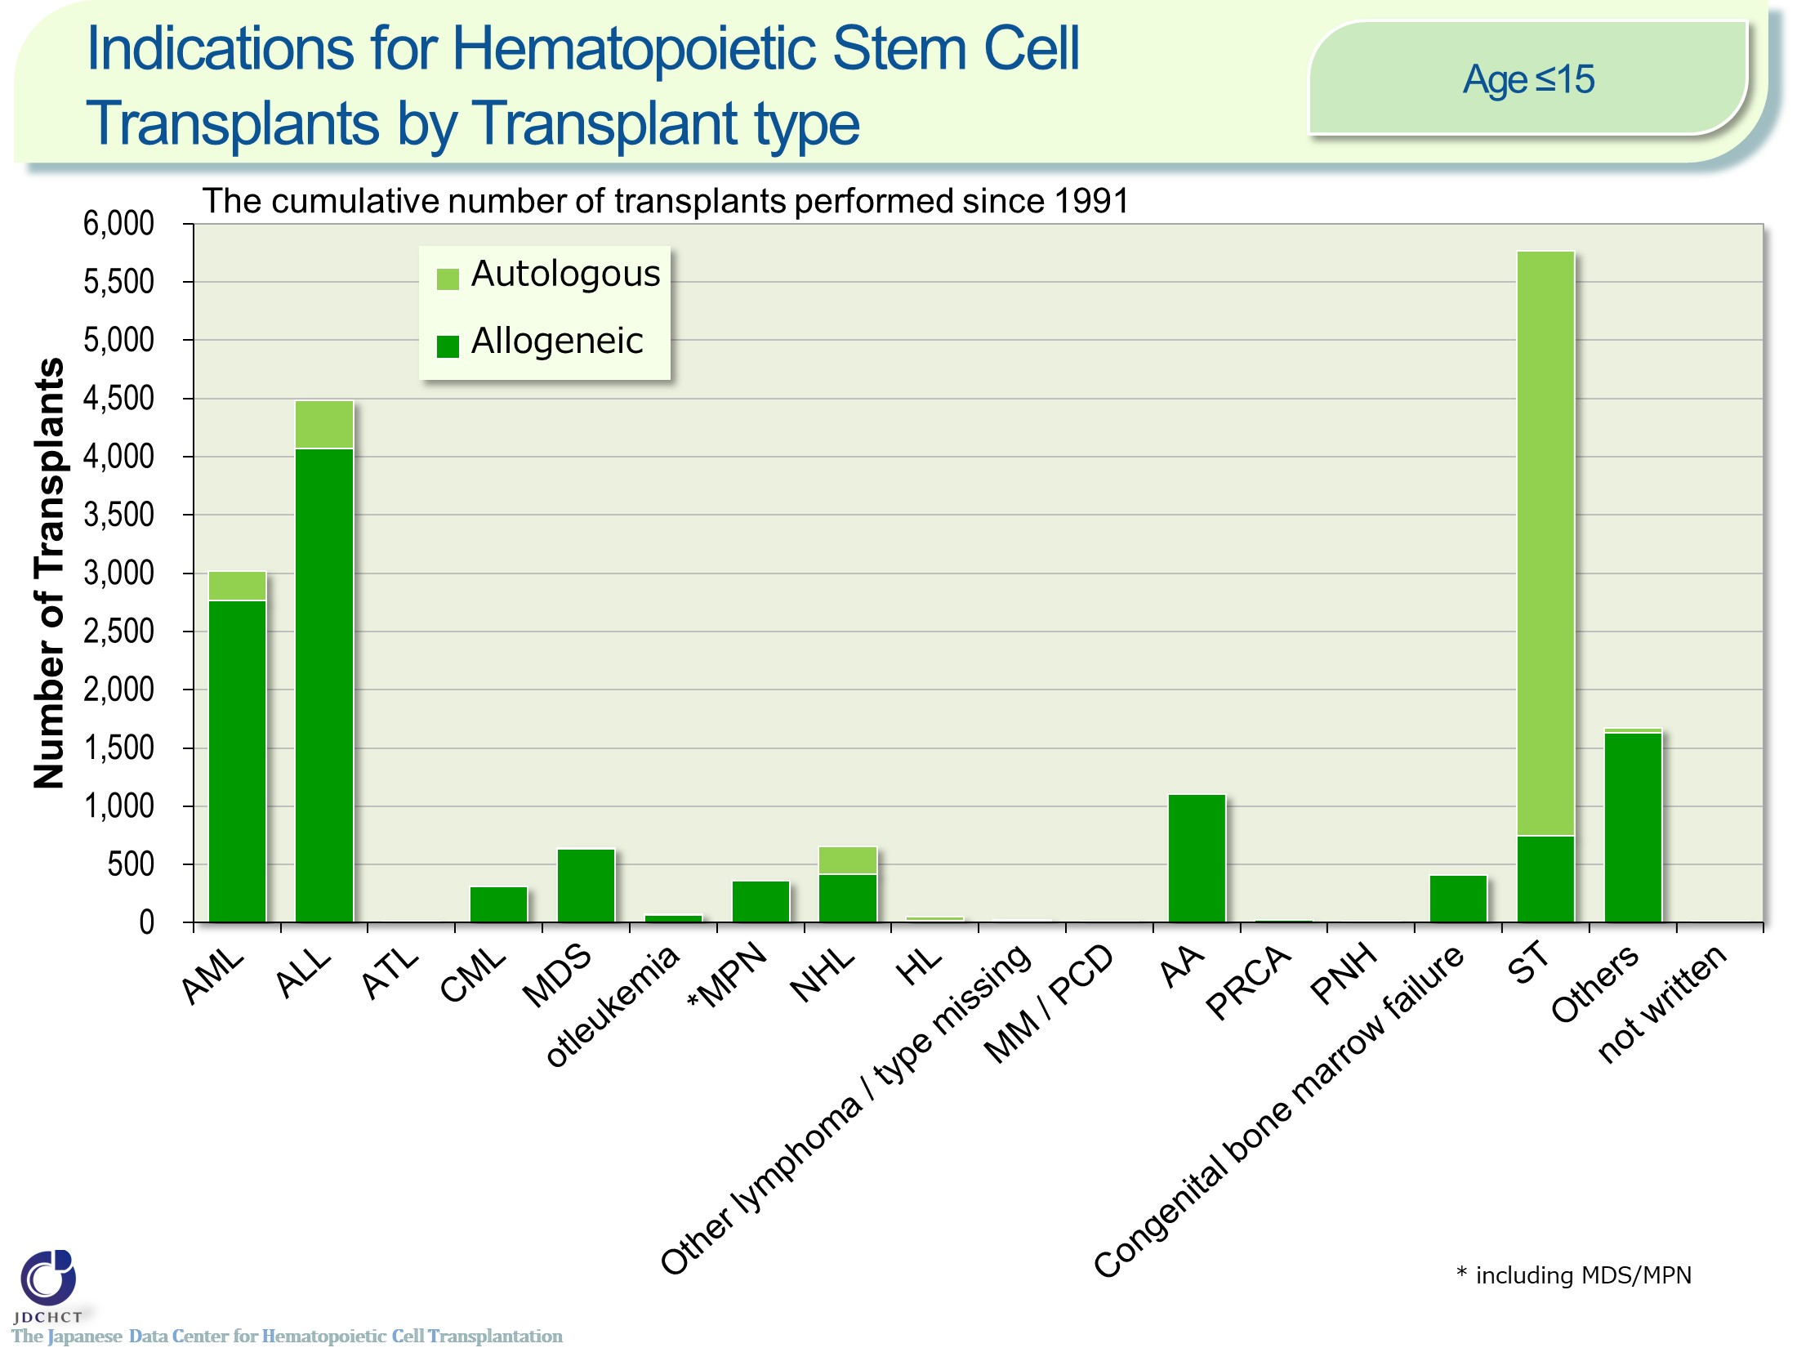
Indications for Hematopoietic Stem Cell
Transplants by Transplant type <age 0-15>
Notes:
In pediatric patients, allogeneic transplants are most frequently performed for acute leukemia (acute myeloid leukemia and acute lymphoblastic leukemia) , which accounts for about 54％ of the total cases of allogeneic transplantation. Following this, allogeneic transplants are also frequently performed for aplastic anemia. Although aplastic anemia is a rare disease, allogeneic transplantation is the first choice for serious and most serious cases when HLA-matched sibling donors are available. Accordingly, aplastic anemia accounts for about 9％ of the allogeneic transplants in pediatric patients.
For solid tumors in pediatric patients, autologous transplants are performed in order to rescue hematopoietic dysfunction due to high-dose chemotherapy, accounting for about 80% of all autologous transplant cases.

Slide 17
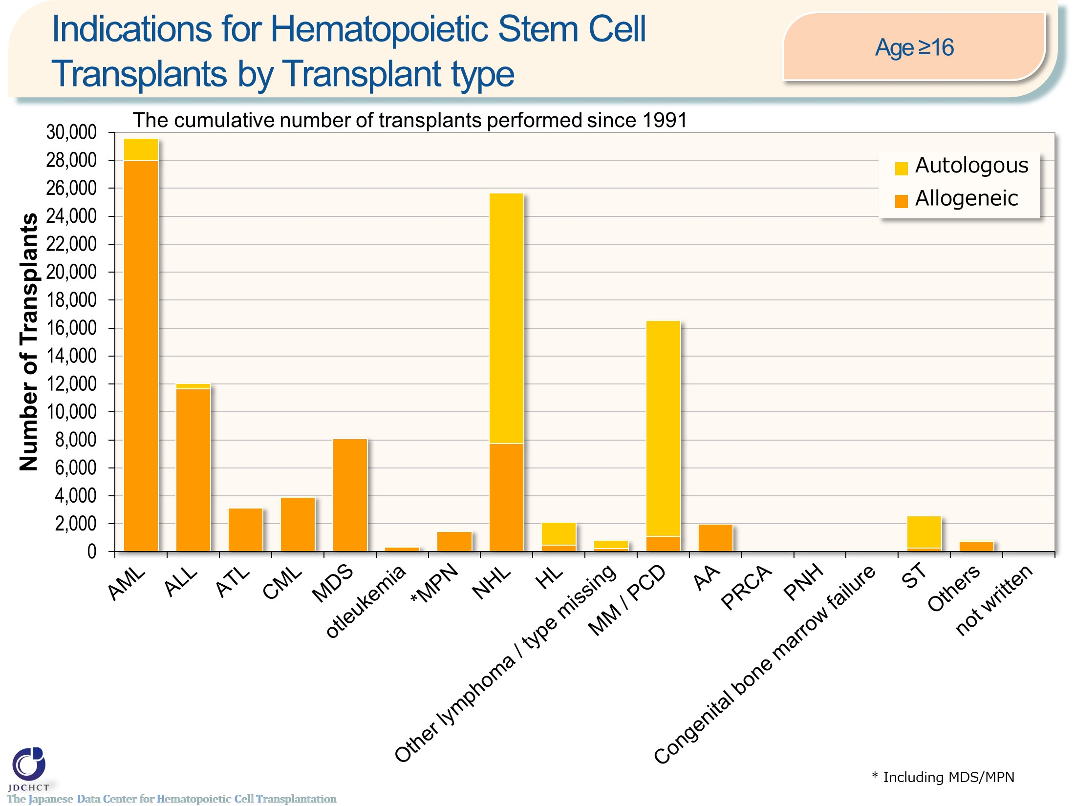
Indications for Hematopoietic Stem Cell
Transplants by Transplant type <age ≥16>
Notes:
In patients aged 16 years or older, allogeneic transplants are most frequently performed for acute leukemia (acute myeloid leukemia and acute lymphoblastic leukemia) , which accounts for 57％ of the total cases of allogeneic transplants. Following this, allogeneic transplants are also frequently performed in myelodysplastic syndrome and non-Hodgkin lymphoma.
Multiple myeloma occurs more frequently in the elderly and the number of patients with multiple myeloma has shown a tendency to increase, as in malignant lymphoma. High-dose chemotherapy in combination with autologous transplantation is the established standard therapy for multiple myeloma in patients under 65 years of age, and autologous transplants account for about 90％.

Slide 18
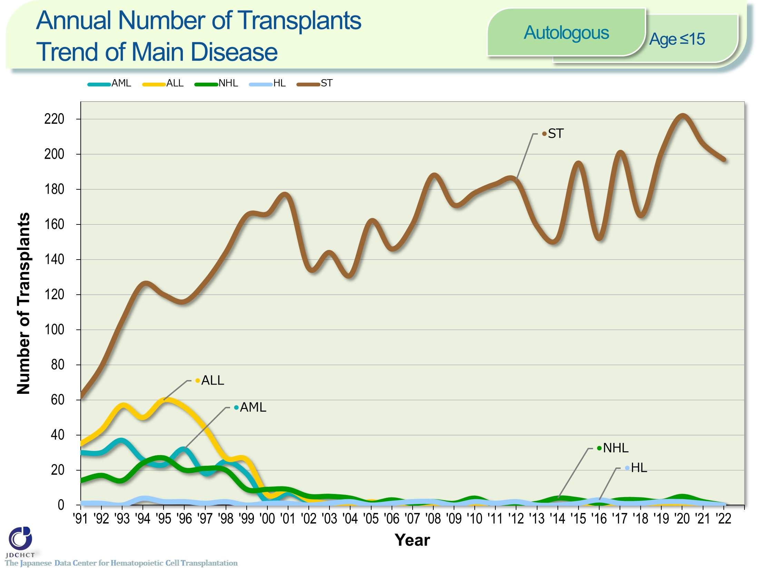
Annual Number of Transplants
Trend of Main Disease <Autologous><age 0-15>
Notes:
For solid tumors in pediatric patients, autologous transplants are performed in order to rescue hematopoietic dysfunction due to high-dose chemotherapy and therefore, autologous transplantation is most performed, and the number has been similar over the last decade.

Slide 19
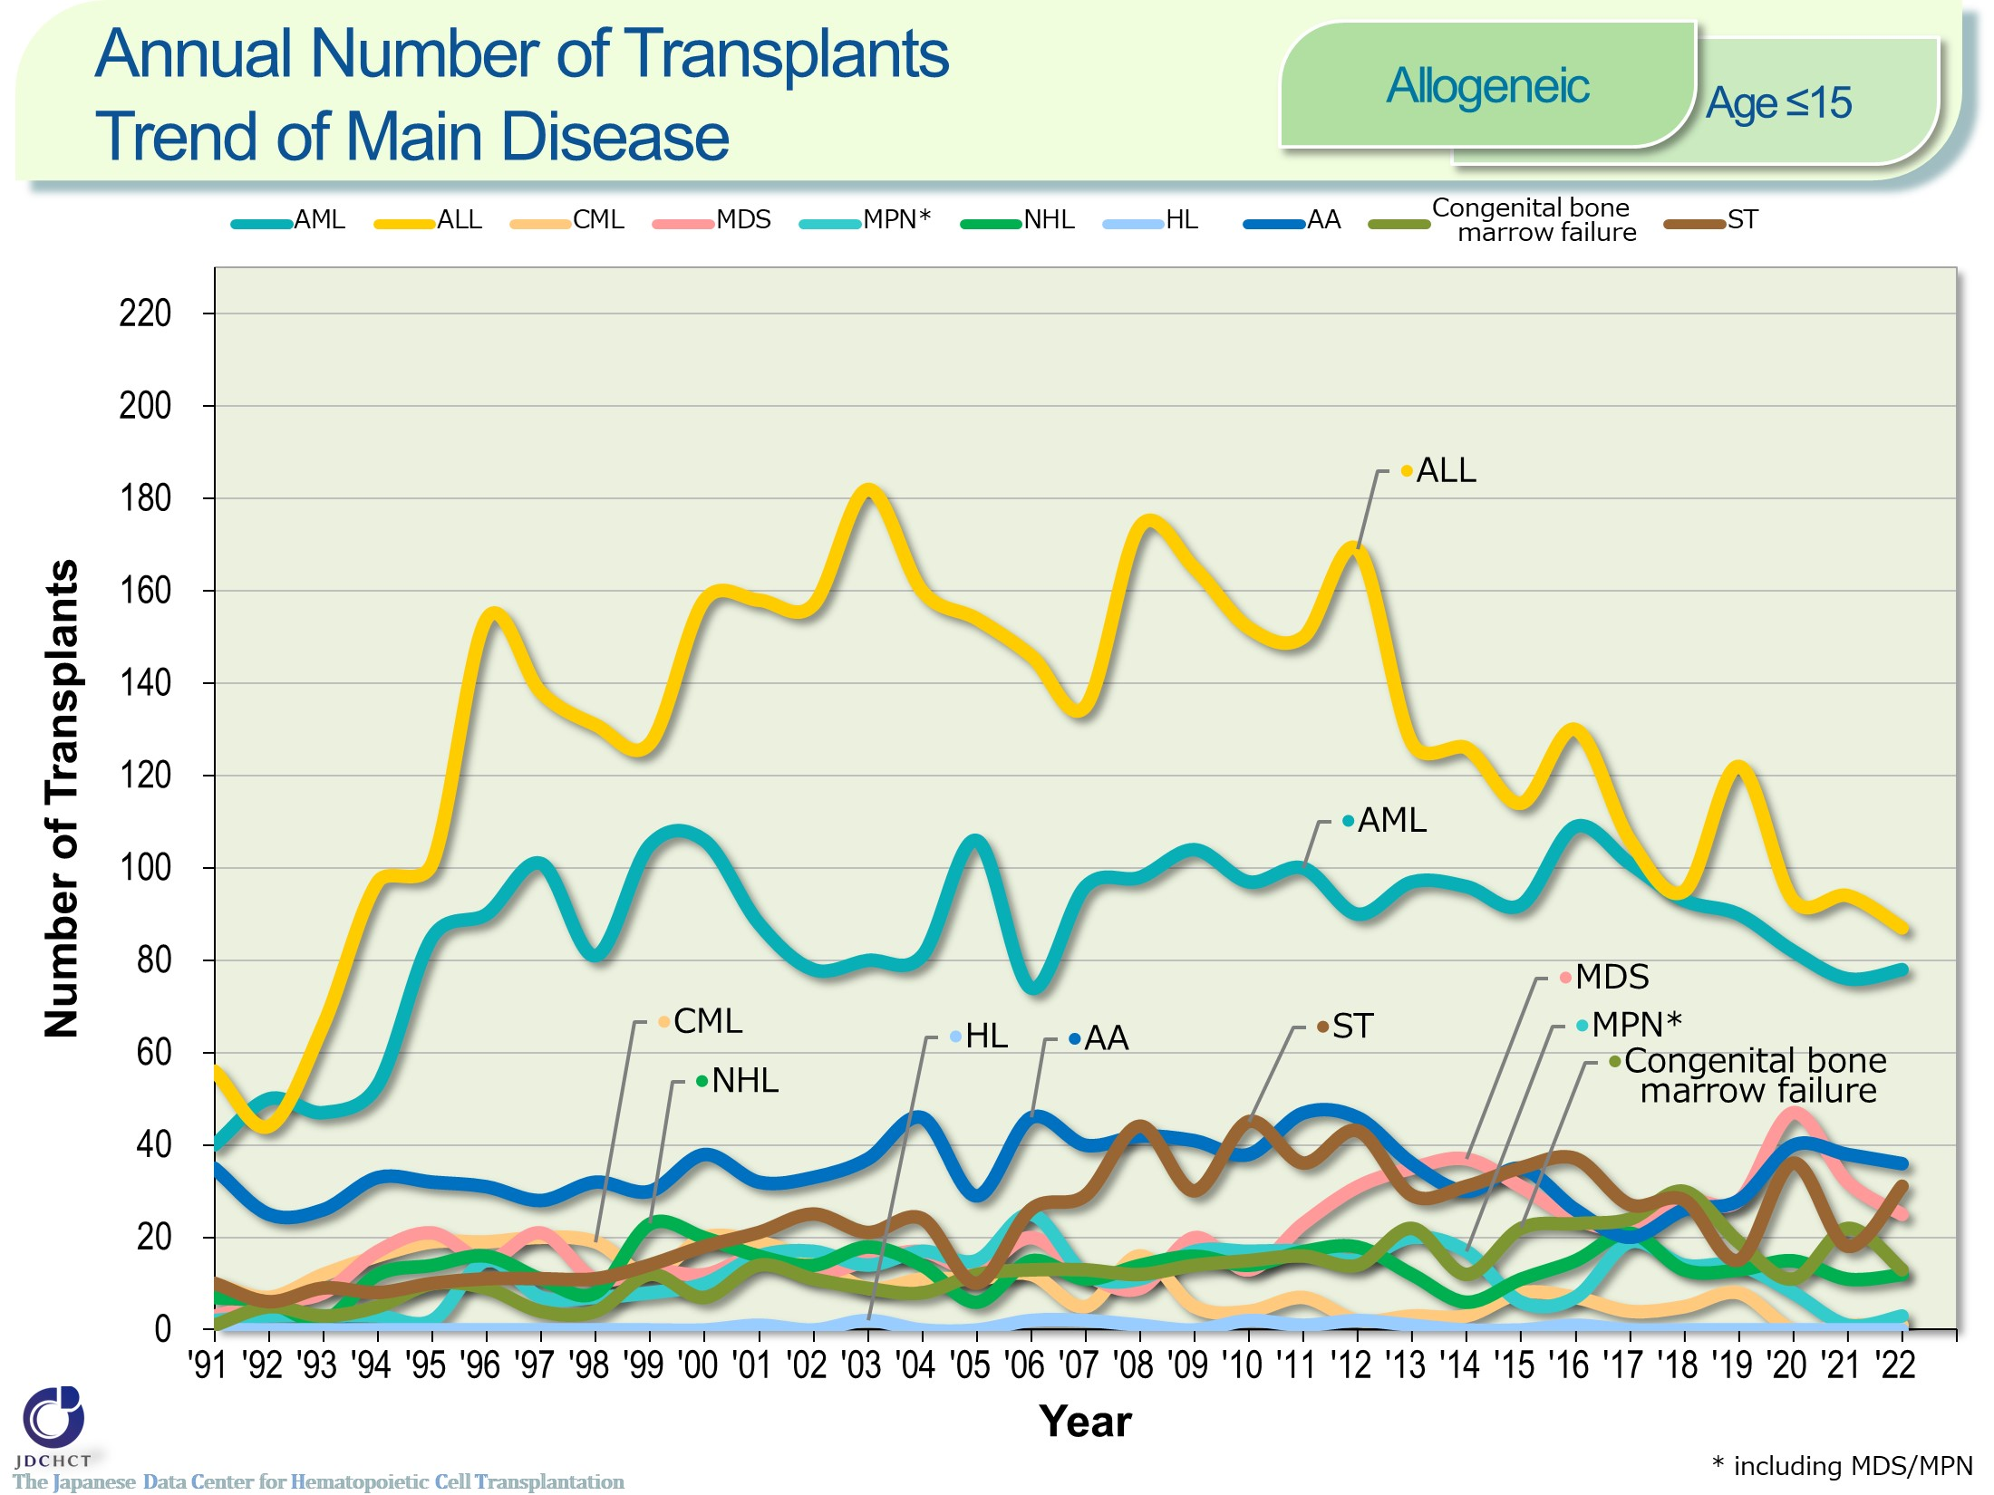
Annual Number of Transplants
Trend of Main Disease <Allogeneic><age≤15>
Notes:
In pediatric patients, allogeneic transplants are frequently performed for acute lymphoblastic leukemia and acute myeloid leukemia.

Slide 20
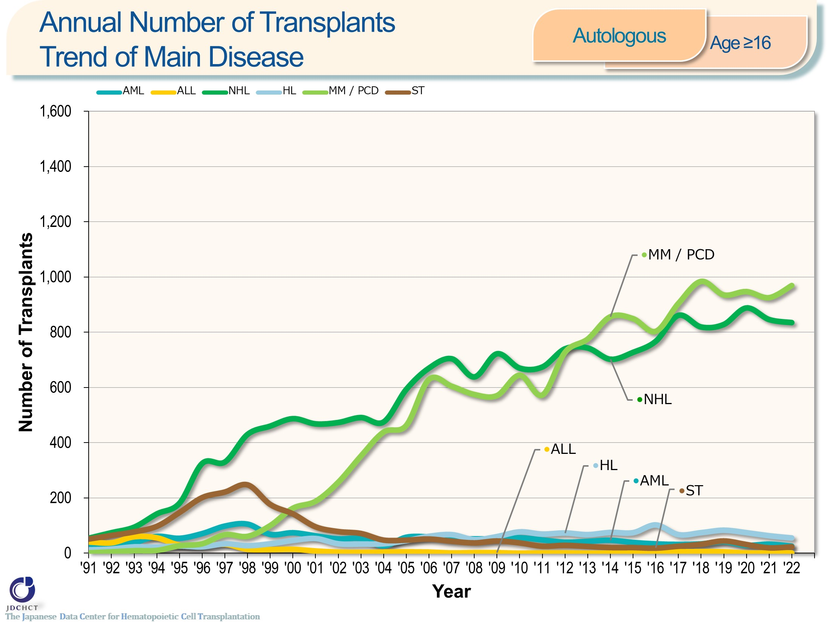
Annual Number of Transplants
Trend of Main Disease <Autologous><age≥16>
Notes:
Multiple myeloma occurs more frequently in the elderly and the number of autologous transplants in adults with multiple myeloma has shown a tendency to increase, as in malignant lymphoma.

Slide 21
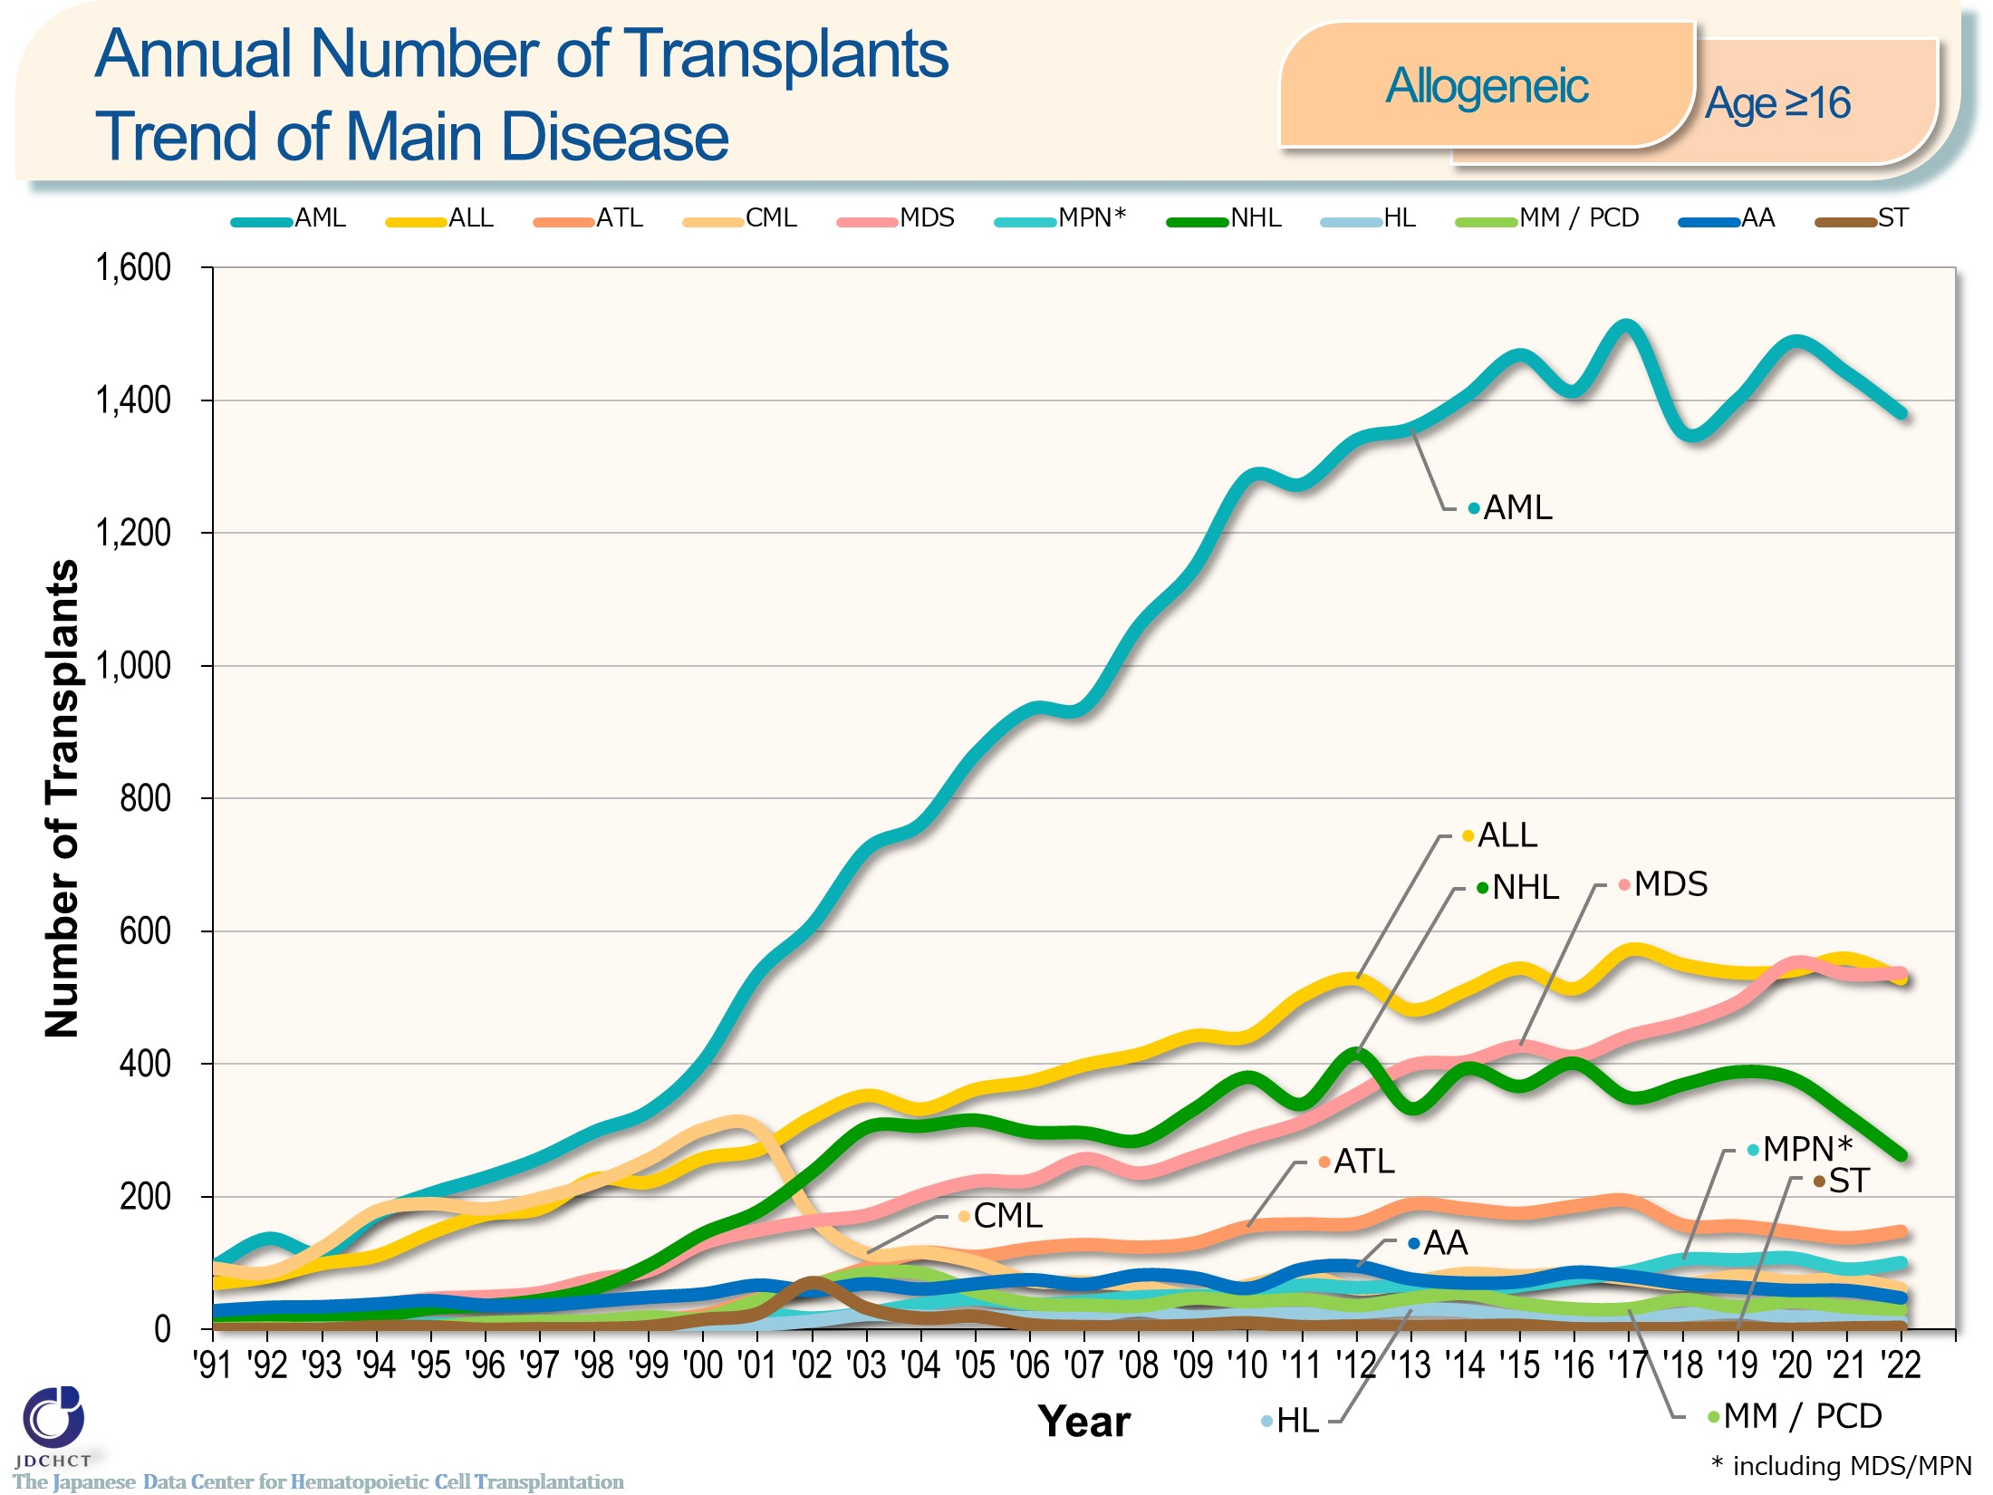
Annual Number of Transplants
Trend of Main Disease <Allogeneic><age≥16>
Notes:
In patients aged 16 years or older, allogeneic transplants are most frequently performed for acute myeloid leukemia, followed by acute lymphoblastic leukemia and myelodysplastic syndrome.
In 2001, imatinib was officially approved in Japan as a molecular targeted therapy for chronic myeloid leukemia were approved. Since then, transplantation for chronic myeloid leukemia has decreased.
The number of allogeneic transplants for malignant lymphoma has shown a tendency to decrease in recent years, possibly due to the introduction of cellular therapy.

Slide 22
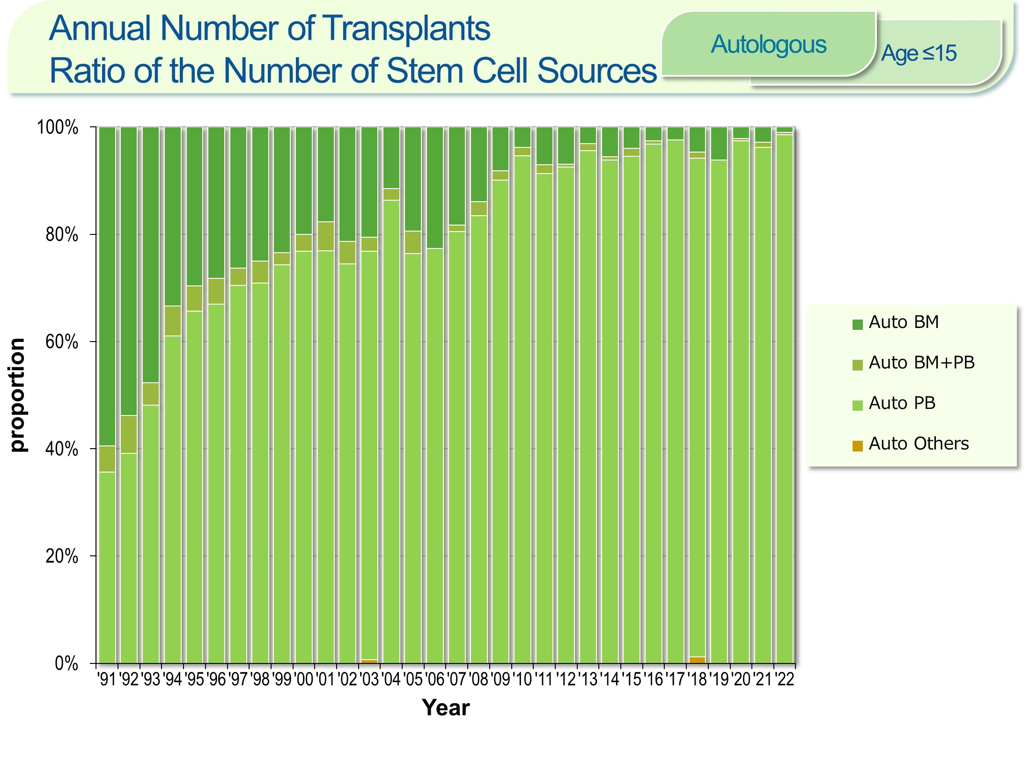
Annual Number of Transplants
Ratio of the Number of Stem Cell Sources <Autologous><age≤15>
Notes:
Recently, peripheral blood stem cell transplantations account for about 95％ of the total cases of autologous transplants in patients aged 0 to 15 years. The process of collecting peripheral blood stem cells poses less burden to patients than the harvesting procedure in bone marrow transplantation. Since 2000, the process of collecting peripheral blood stem cells for transplantation through the use of granulocyte-colony stimulating factor (G-CSF) has been covered by the national health insurance. For these reasons, the number of autologous peripheral blood stem cell transplantation has increased, whereas autologous bone marrow transplants have decreased.

Slide 23
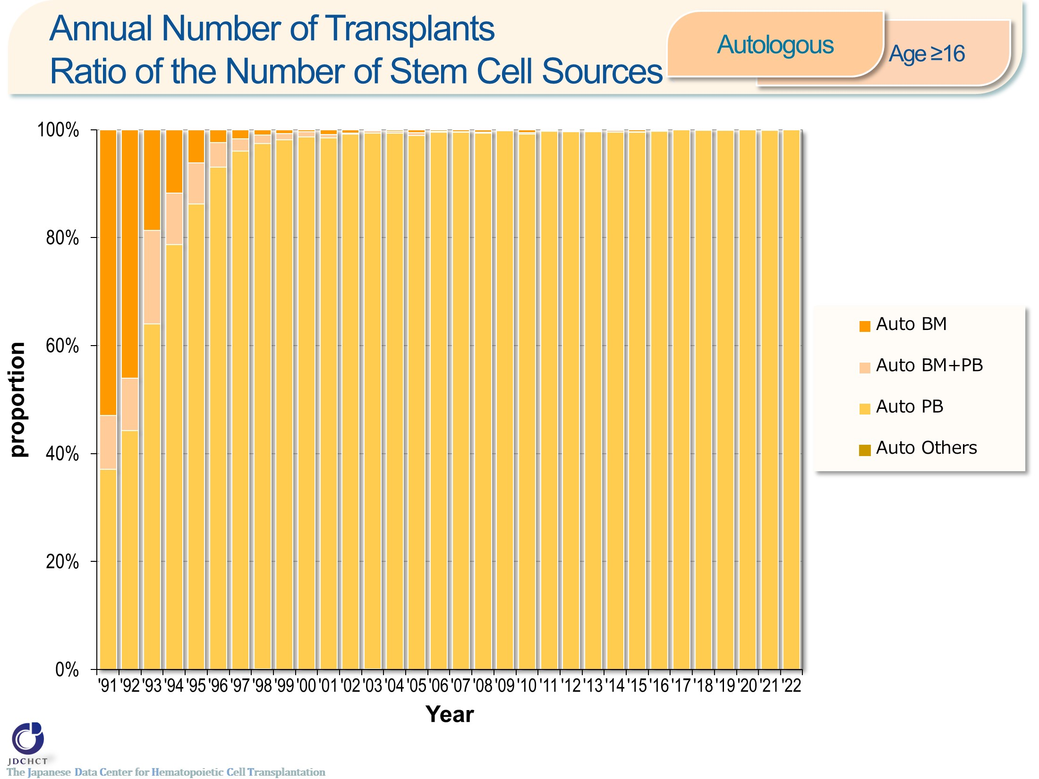
Annual Number of Transplants
Ratio of the Number of Stem Cell Sources <Autologous><age≥16>
Notes:
Recently, peripheral blood stem cell transplantations account for 99％ or more of the total cases of autologous transplants in patients aged 16 years or older. The process of collecting peripheral blood stem cells poses less burden to patients than the harvesting procedure in bone marrow transplantation. Since 2000, the process of collecting peripheral blood stem cells for transplantation through the use of granulocyte-colony stimulating factor (G-CSF) has been covered by the national health insurance. For these reasons, the number of autologous peripheral blood stem cell transplantation has increased, whereas autologous bone marrow transplants have decreased.

Slide 24
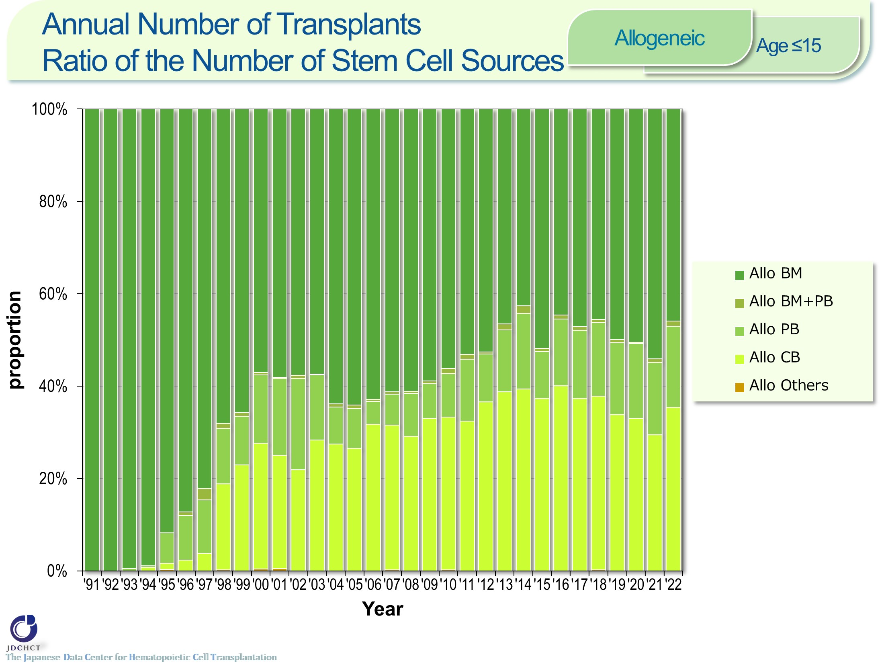
Annual Number of Transplants
Ratio of the Number of Stem Cell Sources <Allogeneic><age≤15>
Notes:
The spread of cord blood transplantation and peripheral blood stem cell transplantation has made the proportion of allogeneic bone marrow transplantation show a tendency to decrease. Bone marrow transplants account for about half of all allogeneic transplants in patients aged 0 to 15 years. In recent years, cord blood transplants account for 30％ or more of the total cases of allogeneic transplantation.

Slide 25
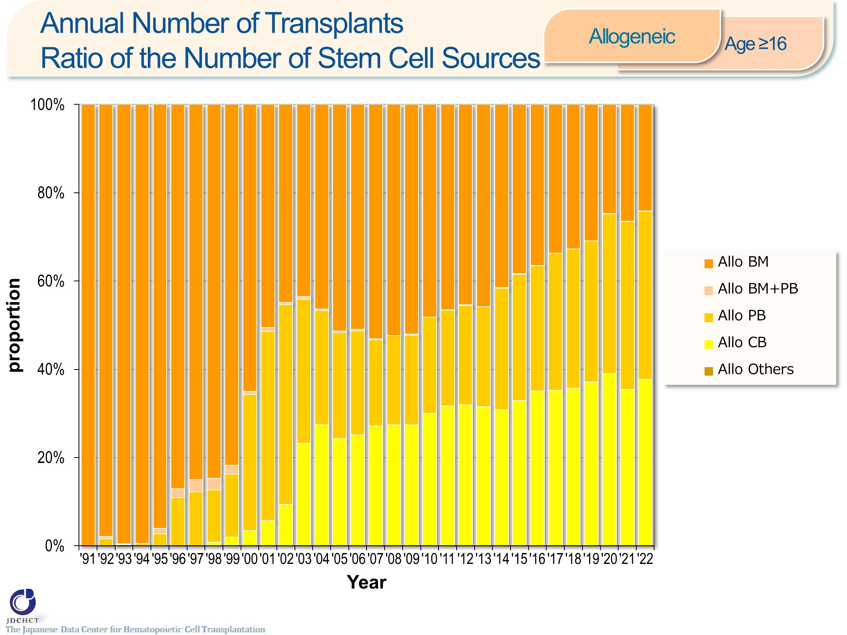
Annual Number of Transplants
Ratio of the Number of Stem Cell Sources <Allogeneic><age≥16>
Notes:
The spread of cord blood transplantation and peripheral blood stem cell transplantation has made the proportion of allogeneic bone marrow transplantation show a tendency to decrease. Peripheral blood stem cell transplants outnumber bone marrow transplants in those aged 16 years or older. In recent years, cord blood transplants account for 30％ or more of the total cases of allogeneic transplantation.

Slide 26
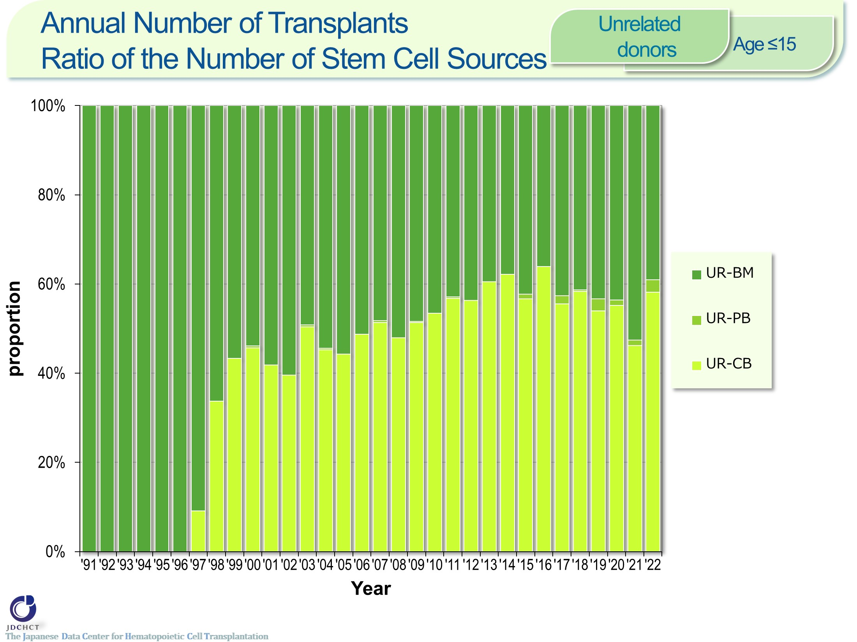
Annual Number of Transplants
Ratio of the Number of Stem Cell Sources <Unrelated donors><age≤15>
Notes:
In transplantation from unrelated donors, the number of cord blood transplants has increased, accounts for about half in recent years.

Slide 27
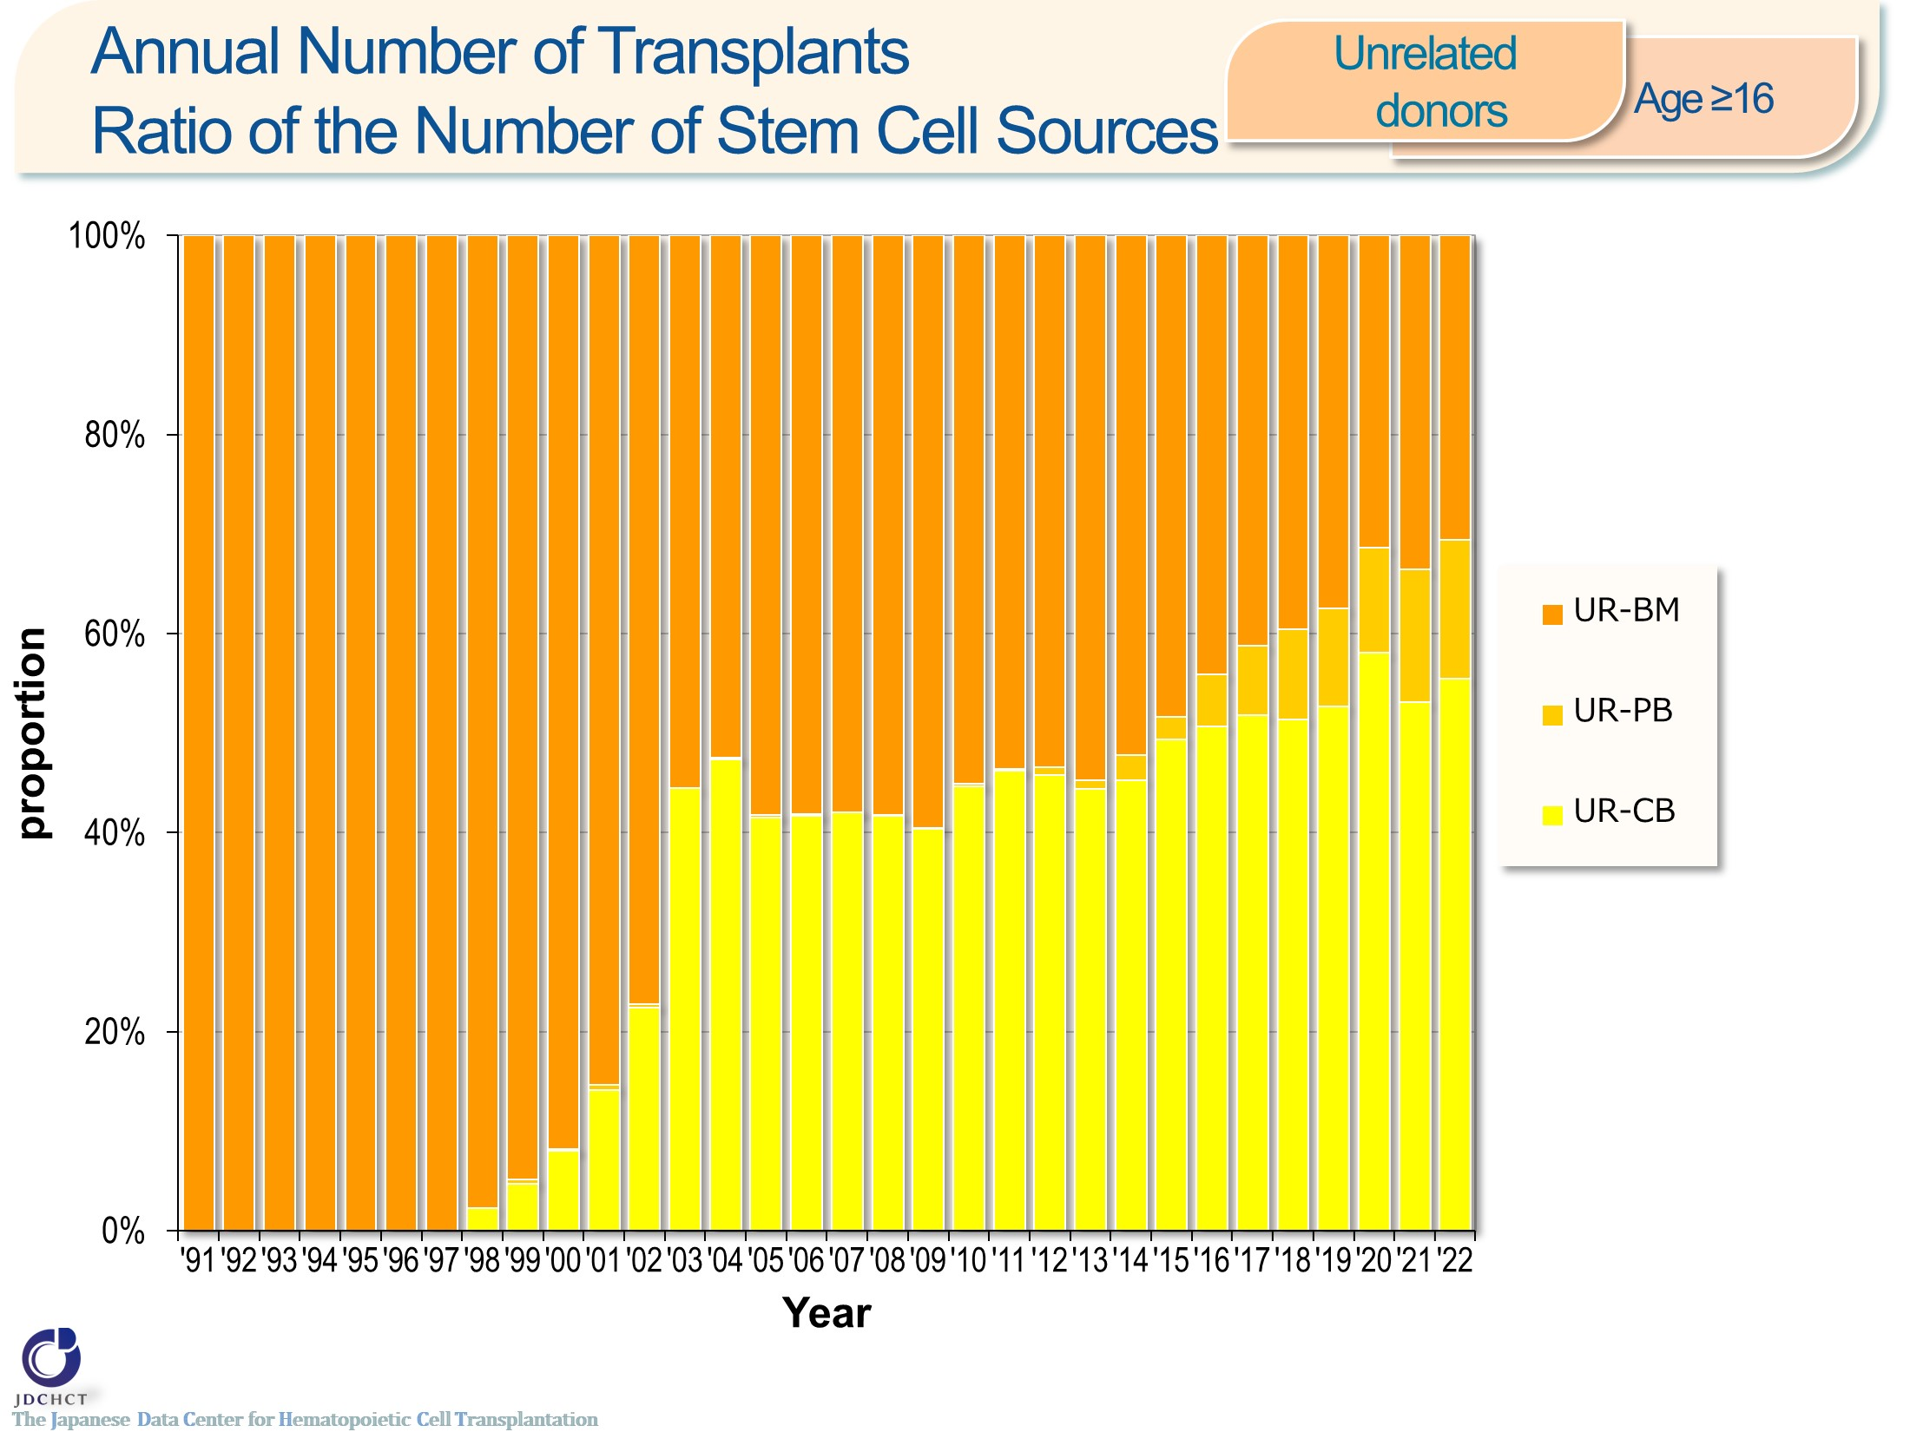
Annual Number of Transplants
Ratio of the Number of Stem Cell Sources <Unrelated donors><age≥16>
Notes:
In transplantation from unrelated donors, the number of cord blood transplants has increased, accounts for about half in recent years.

Slide 28
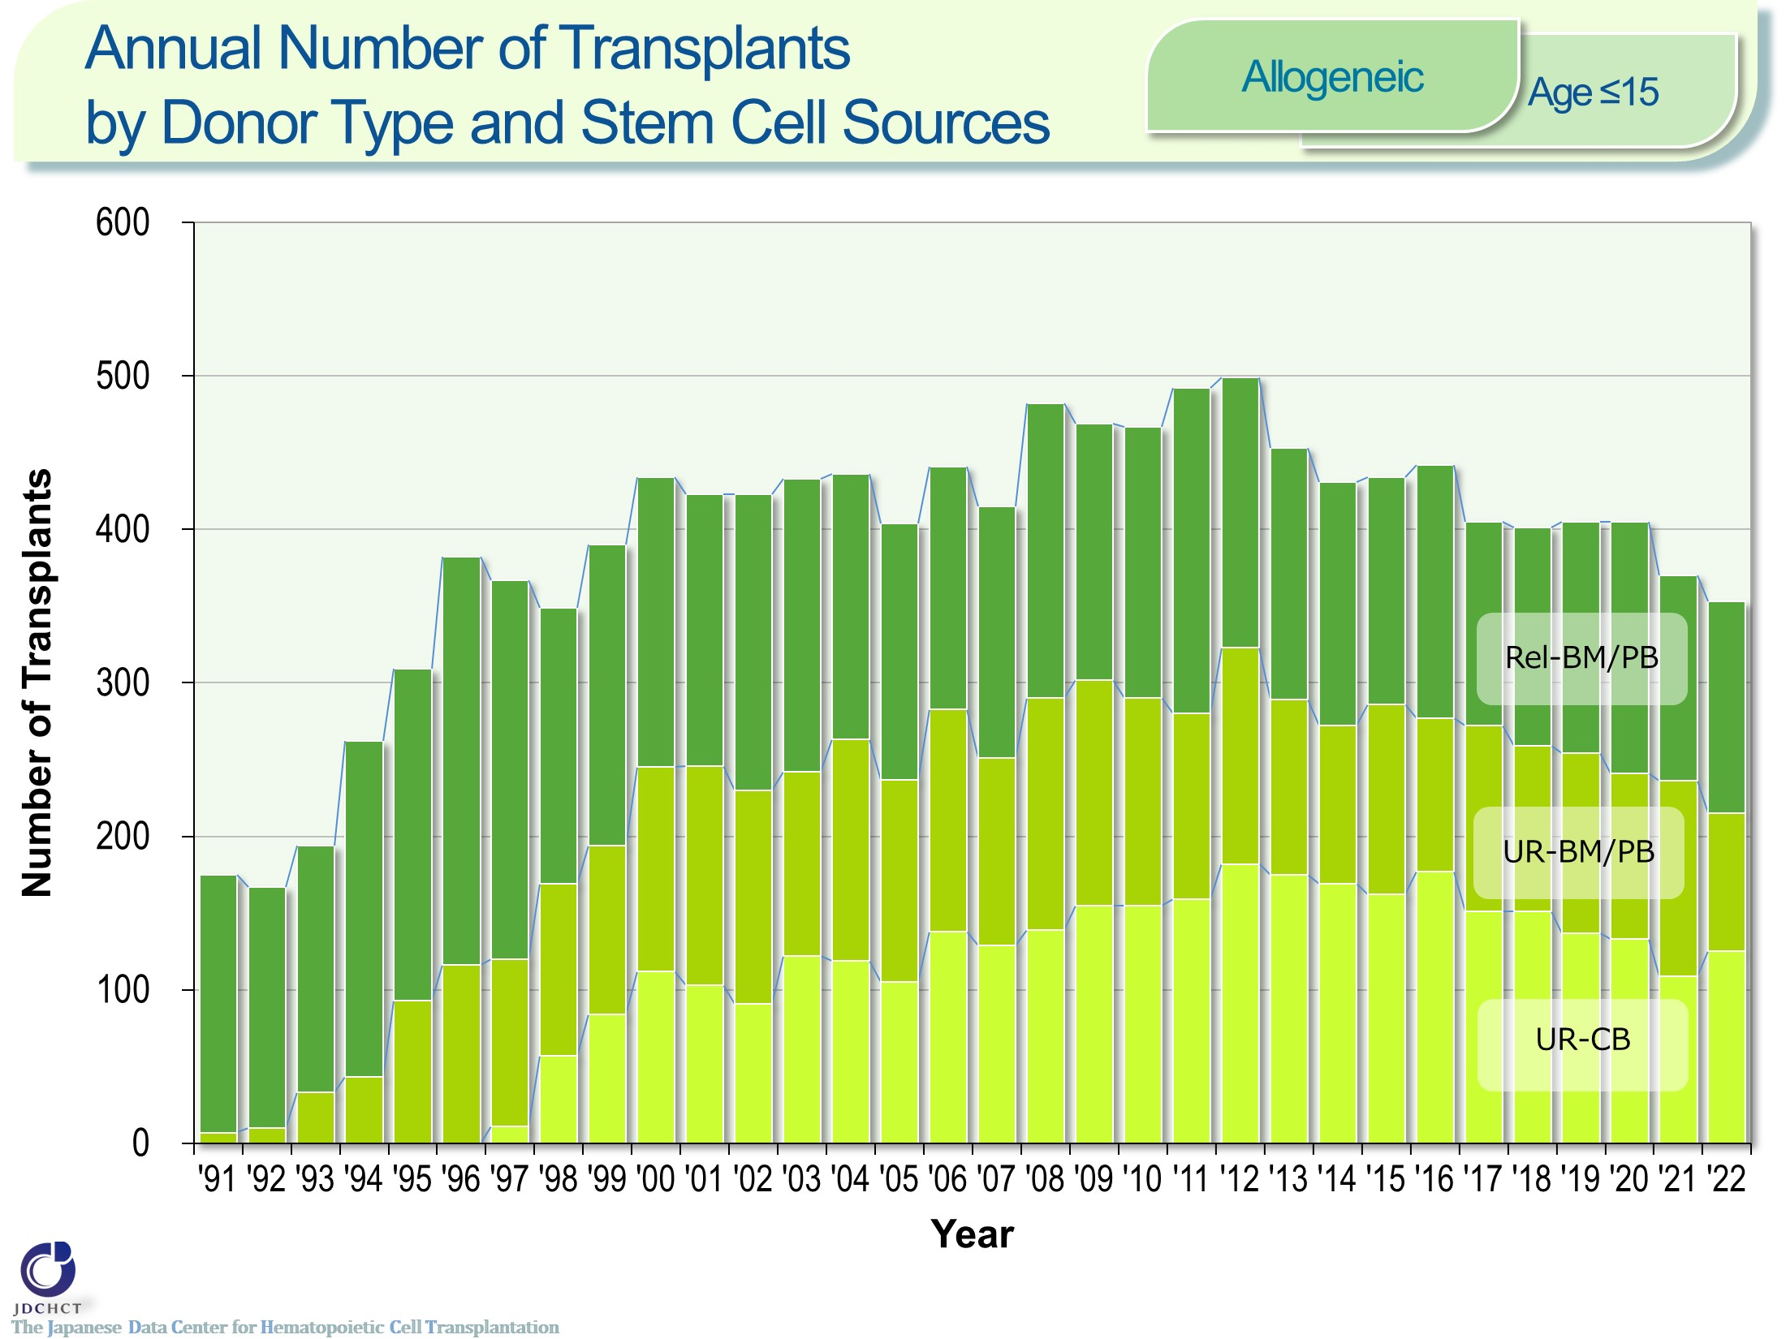
Annual Number of Transplants by Donor Type and Stem Cell Sources <Allogeneic> <age≤15>
Notes:
In recent years, about 350 to 400 allogeneic transplants have been performed annually for patients aged 0 to 15 years. Transplants from unrelated donors account for around 60%.

Slide 29
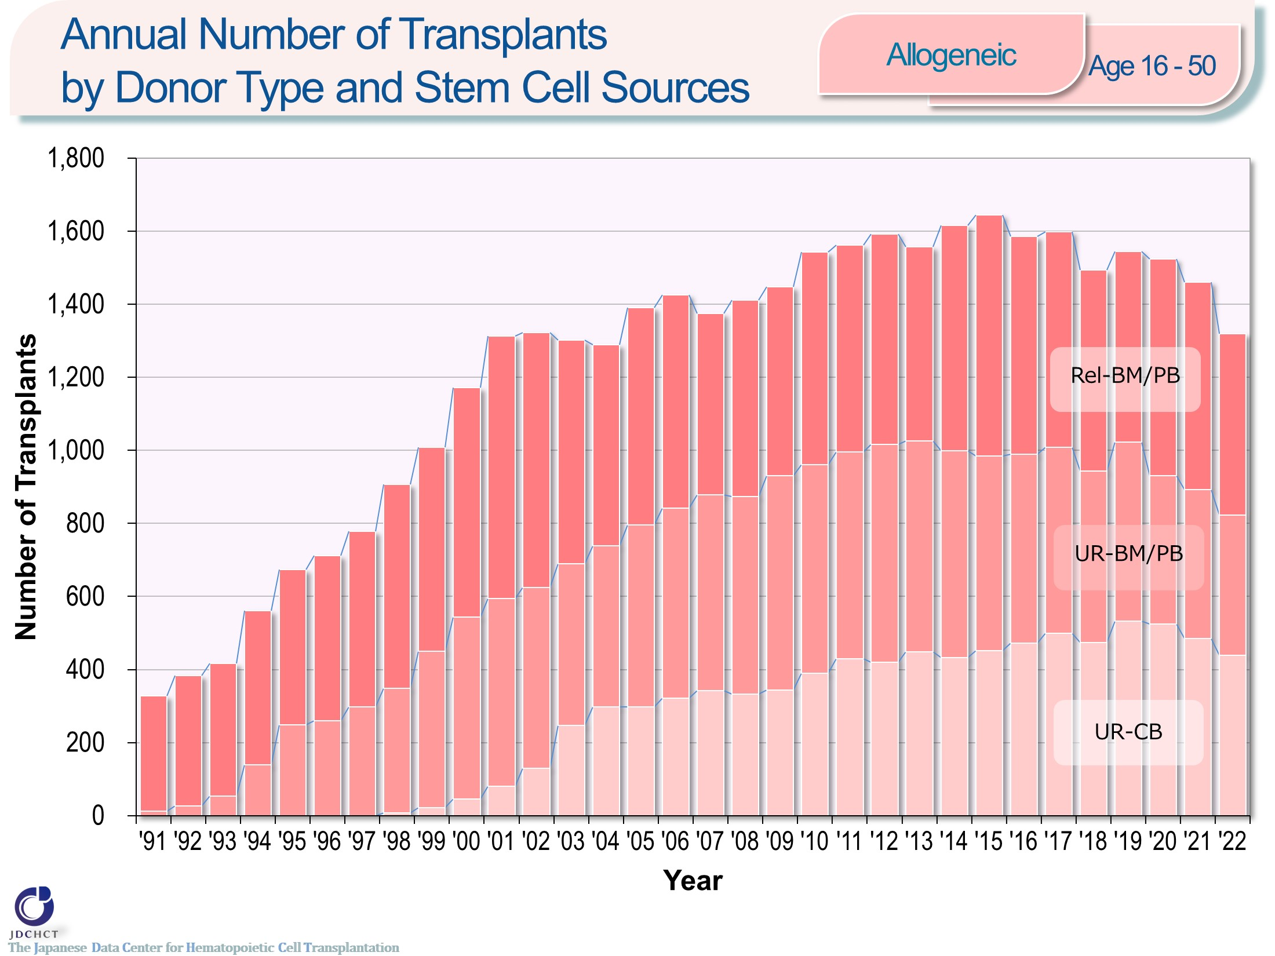
Annual Number of Transplants by Donor Type and Stem Cell Sources <Allogeneic> <age 16-50>
Notes:
In recent years, about 1,300 to 1,500 allogeneic transplants have been performed annually for patients aged 16 to 50 years. The percentage of cord blood transplants from unrelated donors is increasing, accounting for about one-third of all transplants.

Slide 30
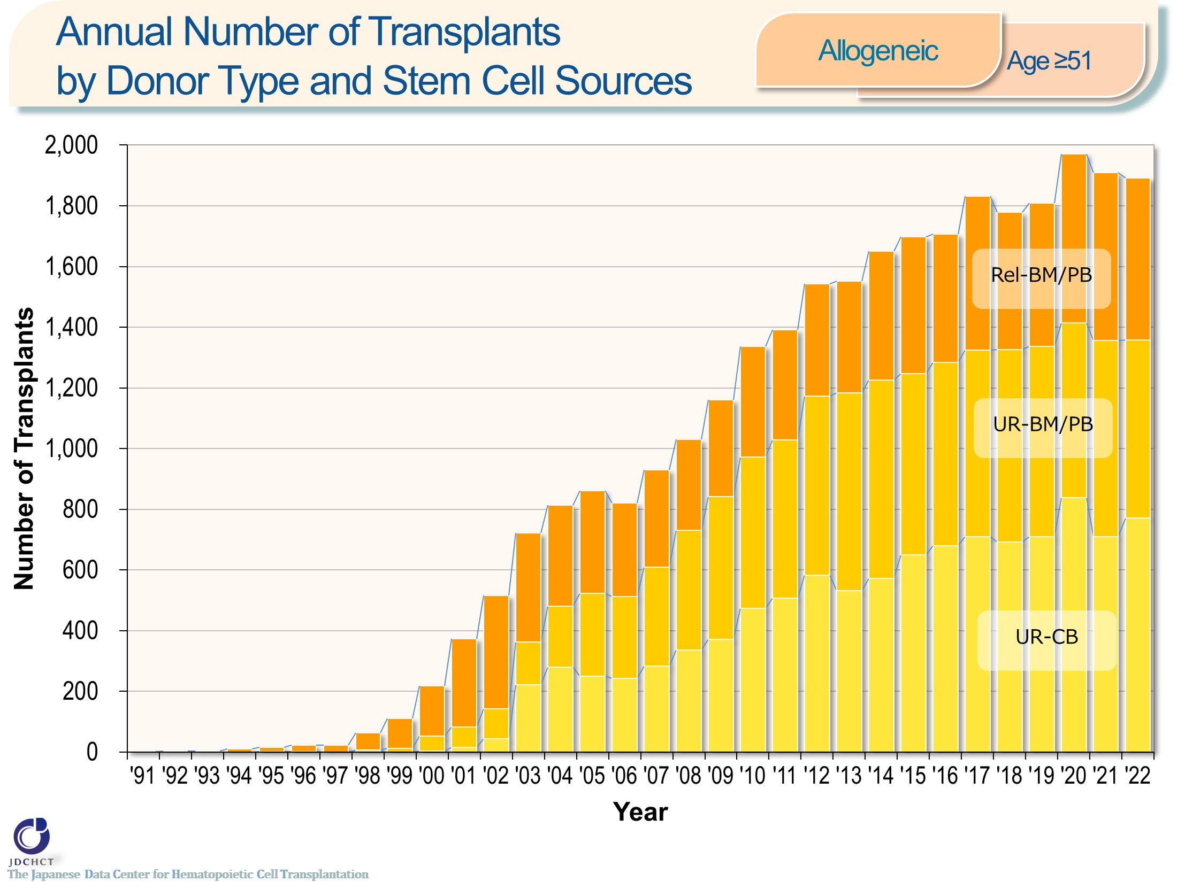
Annual Number of Transplants by Donor Type and Stem Cell Sources <Allogeneic> <age≥51>
Notes:
Due to the spread of transplants with reduced intensity conditioning (RIC), in all types of allogeneic transplants, the number of patients aged 51 years or older has increased. Approximately 1,900 allogeneic transplants have been performed annually for patients aged 51 years or older in recent years. Allogeneic transplants from unrelated donors account for more than 70% of all transplants, with cord blood transplantation being the most commonly used.

Slide 31
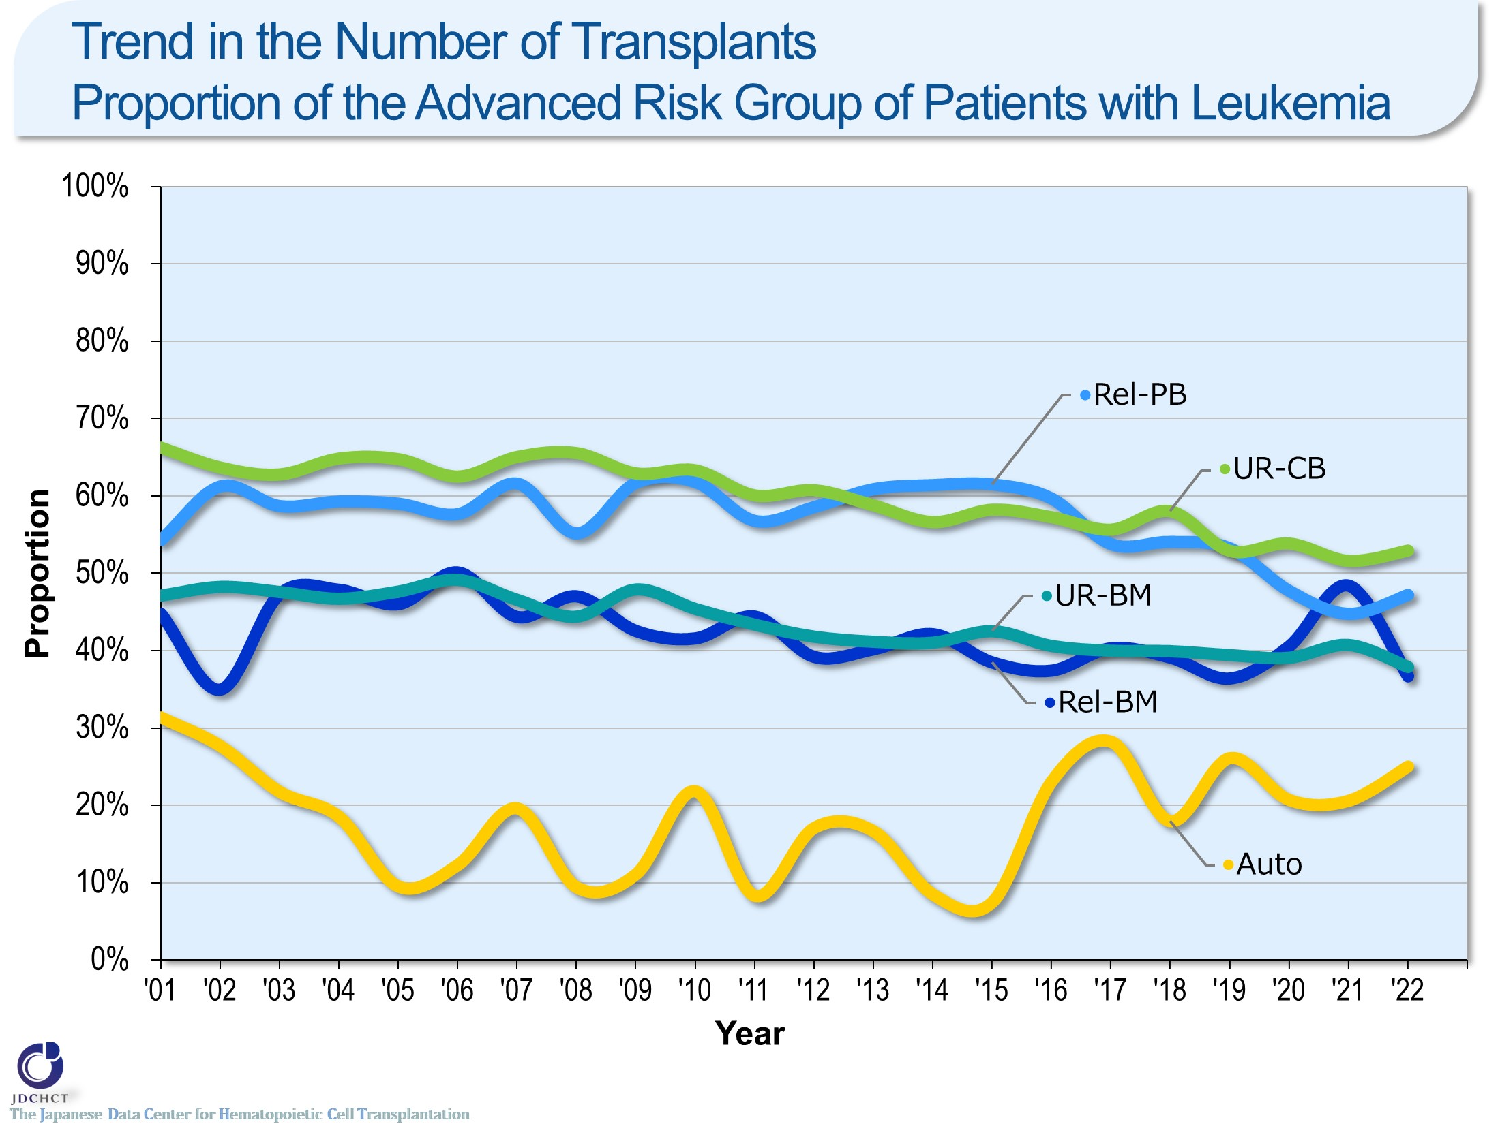
Trend in the Number of Transplants
Proportion of the Advanced Risk Group of Patients with Leukemia
Notes:
The high-risk group for leukemia has recently accounted for about 25% in autologous transplantation and 40 to 55% in allogeneic transplantation.
―≪Disease risk status at transplantation≫―
■Standard Risk Group
・AML (first complete remission[1CR]／second complete remission[2CR])
・ALL (1CR)
・CML (complete hematologic response (CHR) ／first chronic phase[1CP])
・MDS (WHO 2017 classification： MDS with single lineage dysplasia／MDS-RS and single lineage dysplasia
／MDS-RS and multilineage dysplasia
／MDS with multilineage dysplasia
／MDS with isolated del (5q)
／MDS, unclassifiable
／Refractory cytopenia of childhood (provisional entity)
WHO old classification, FAB classification：refractory anemia[RA] ／refractory anemia with ring sideroblasts[RARS]／refractory
cytopenia with multilineage dysplasia[RCMD]／refractory cytopenia with multilineage dysplasia and ringed sideroblasts[RCMD-RS]／myelodysplastic syndrome associated
with isolated del (5q) chromosome abnormality[5q−syndrome])
■Advanced Risk Group
・all other conditions
―――――――――――――――――――――

Slide 32
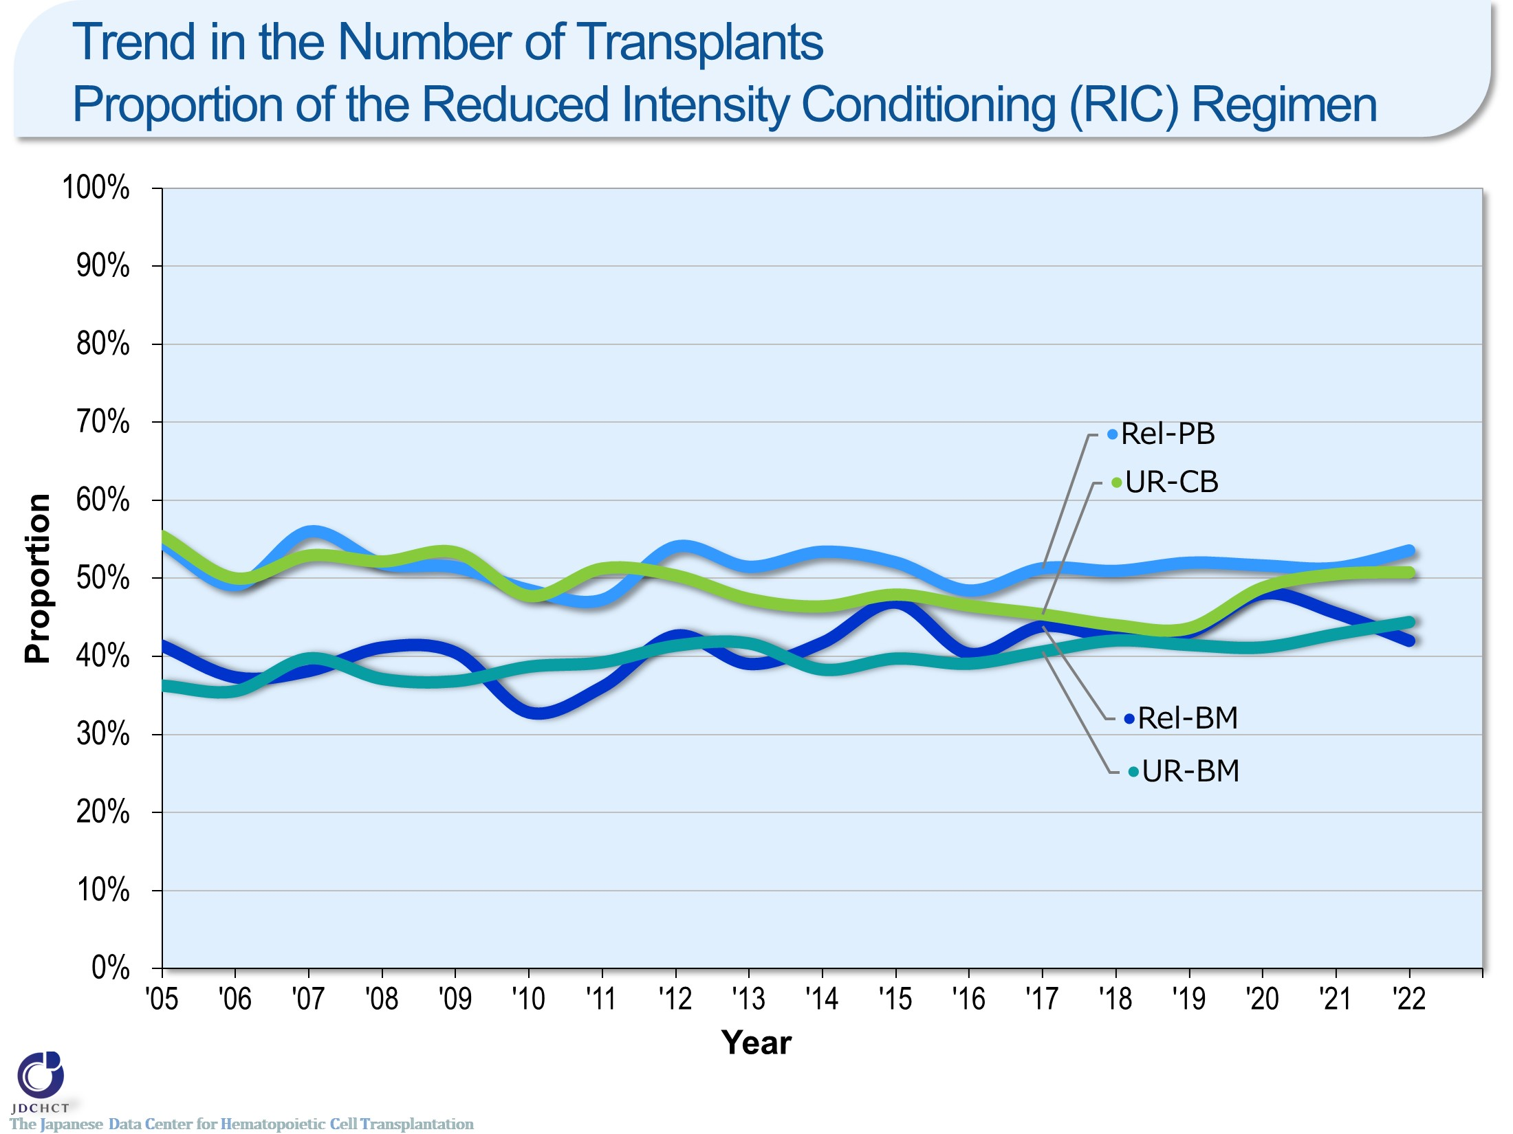
Trend in the Number of Transplants
Proportion of the Reduced Intensity Conditioning (RIC) Regimen
Notes:
The spread of the reduced intensity conditioning (RIC) to reduce toxicity has expanded the scope of indication of transplantation to the older age groups. In all types of allogeneic transplants, the reduced intensity conditioning (RIC) transplant has recently accounted for 40 to 50％.
―≪Conditioning regimen≫――――――
■Myeloablative conditioning (MAC)
Pre-transplantation therapy with the primary purpose of totally destroying cancer cells, together with normal blood cells, in the bone marrow by total body irradiation or high-dose chemotherapy
■Reduced-intensity conditioning (RIC)
Pre-transplantation therapy with the primary purpose of suppressing the patient’s immune system with drugs which do not have strong myelosuppressive effects
―――――――――――――――――――

Slide 33
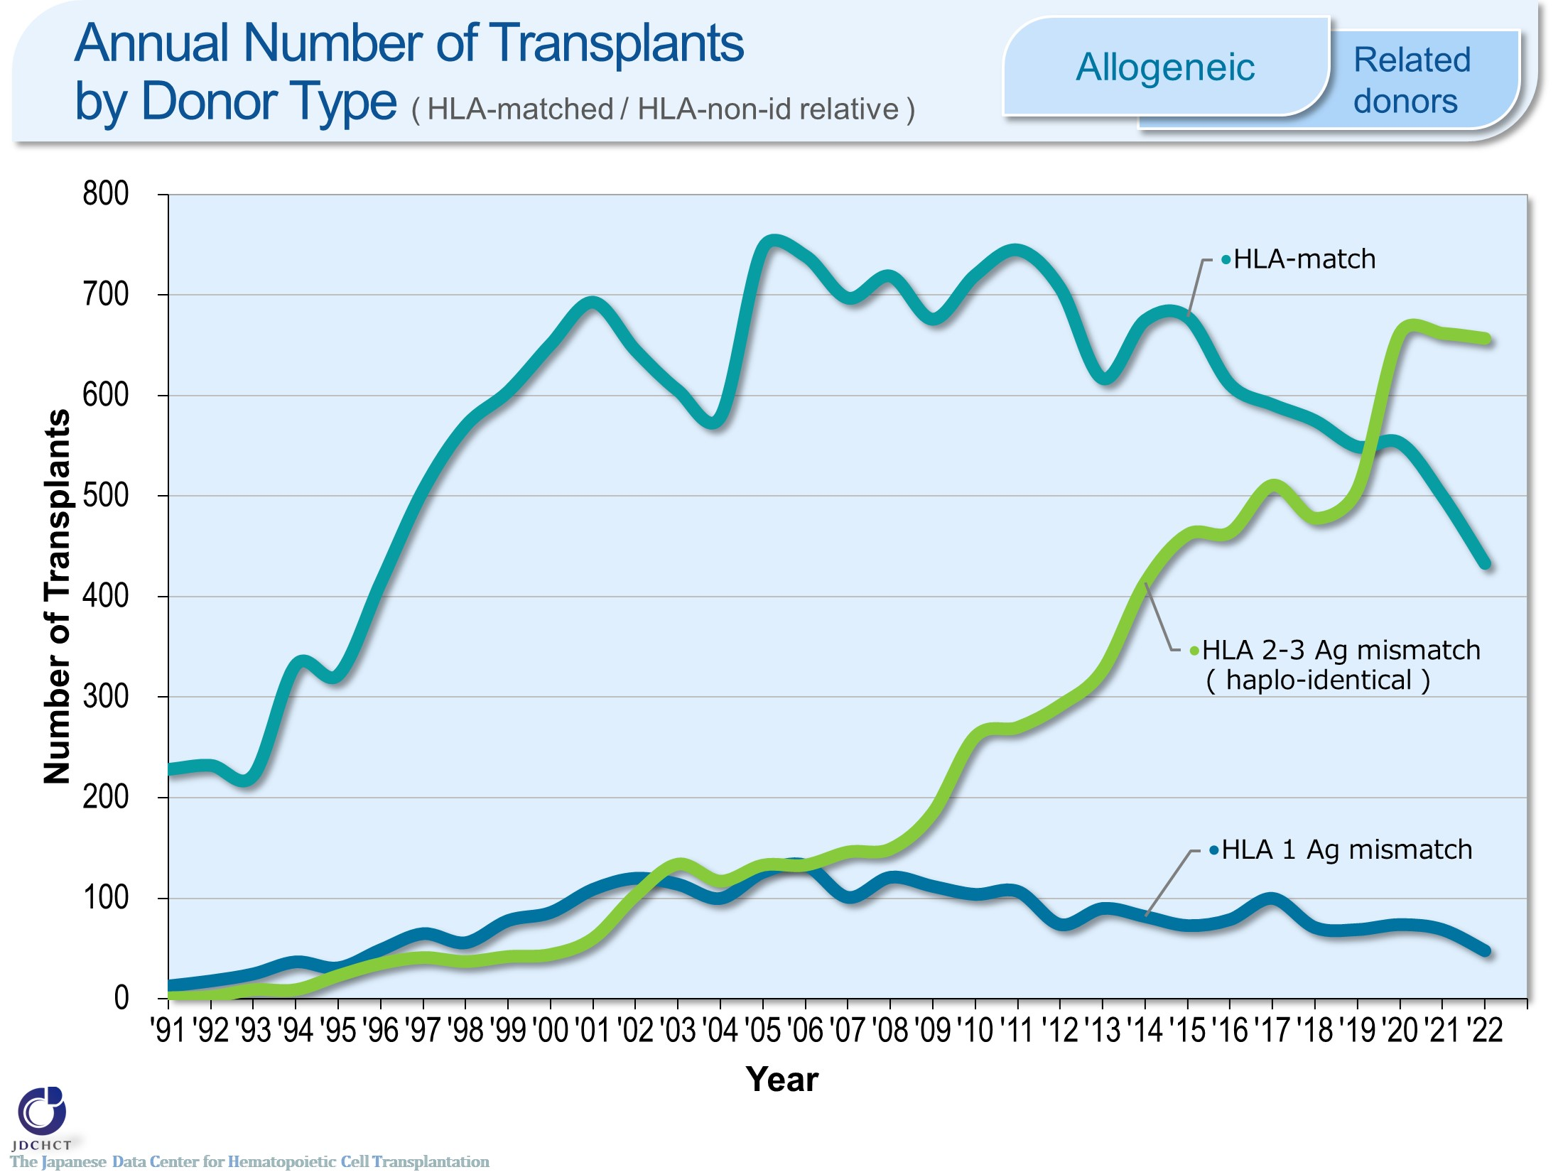
Annual Number of Transplants by Donor Type ( HLA-matched / HLA-non-id relative ) <Allogeneic><Related donors>
Notes:
With the development of GVHD prophylaxis, the number of haplo-identical transplantation increased remarkably since 2010. The annual number of haplo-identical transplants has recently exceeded the annual number of HLA-matched transplants from related donors. The number of haplo-identical transplants registered in 2022 was 657.
※Subjects in this summary table include bone marrow transplantation, peripheral blood stem cell transplantation and bone marrow + peripheral blood stem cell transplantation from related donor.
※GVH-direction is considered for numbers of mismatched HLA loci.

Slide 34
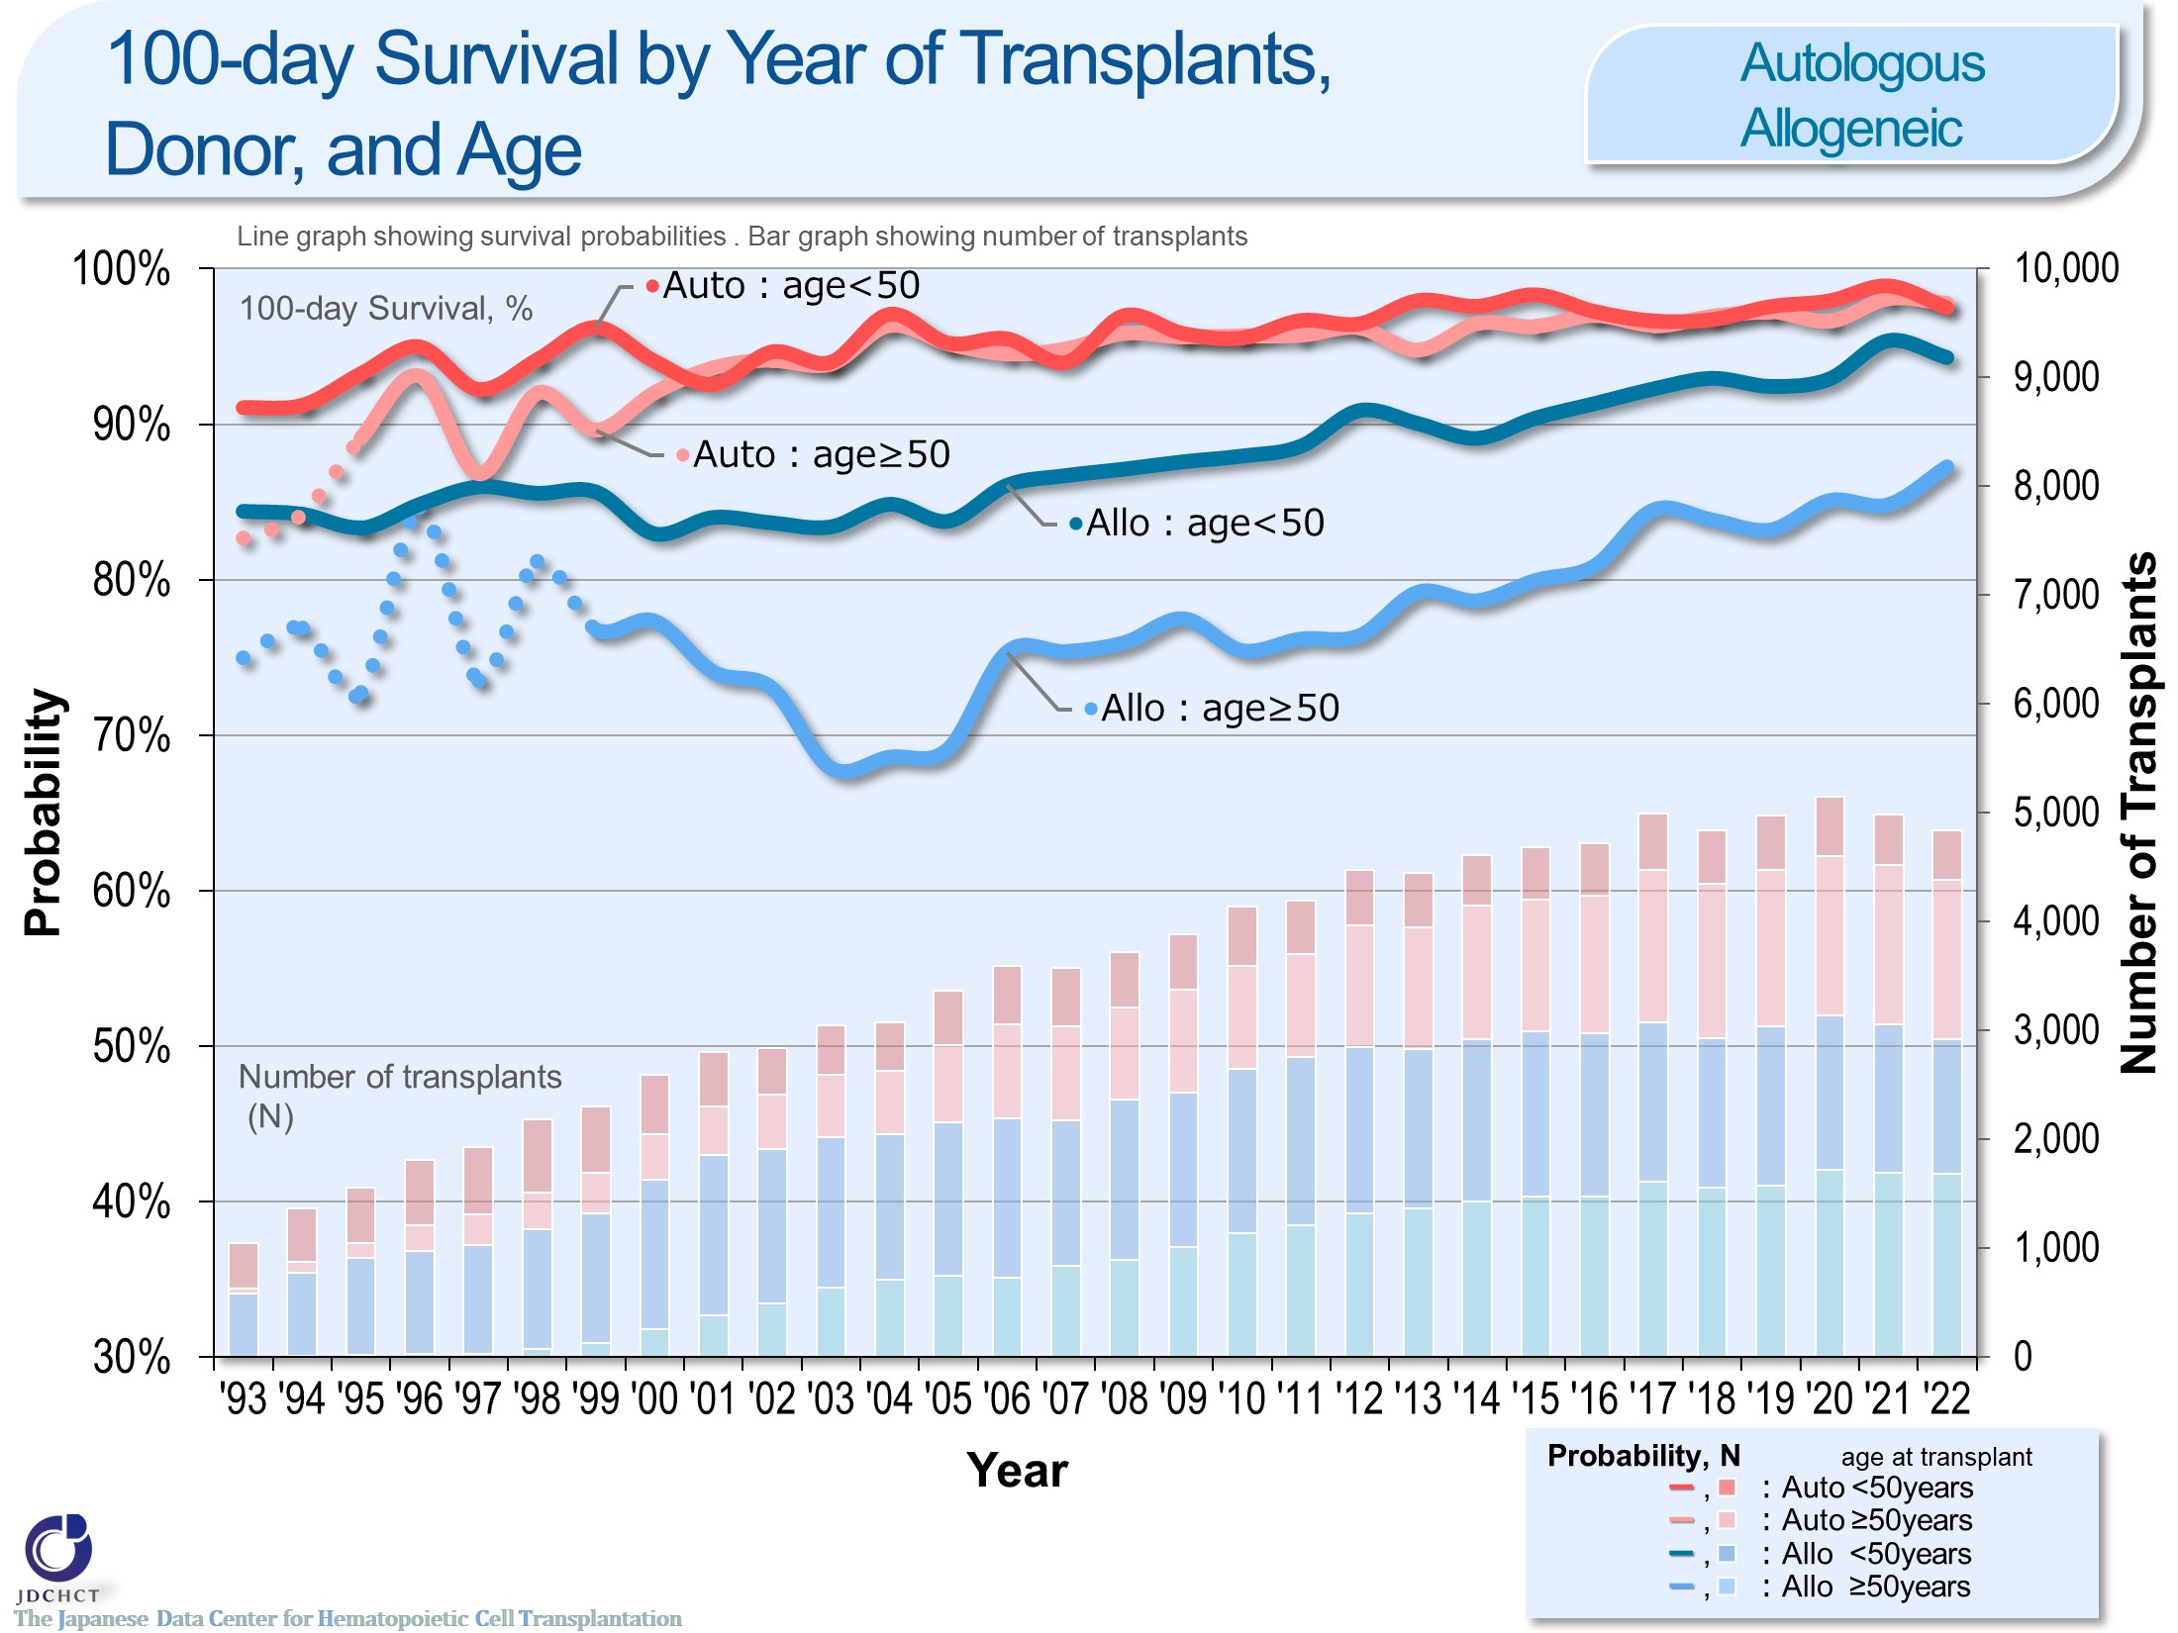
100-day Survival by Year of Transplants,
Donor, and Age <Autologous/Allogeneic>
Notes:
The survival probabilities at 100 days after autologous transplantation are over 95%, with comparable results for those aged 49 years or younger (<50) and those aged 50 years or older (≥50) .
The survival probabilities at 100 days after allogeneic transplantation have shown improving trends over the last decade.
※This table shows the results of analysis performed on patients who received first transplants.
※The dotted lines (…) indicate the survival probabilities calculated when the number of transplants was below 100.

Slide 35
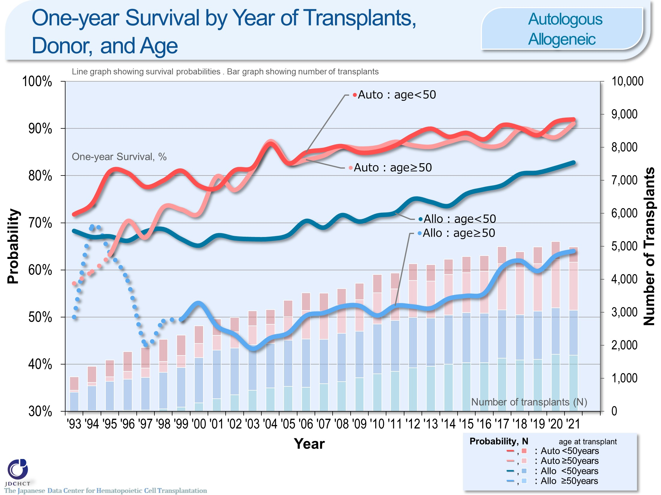
One-year Survival by Year of Transplants,
Donor, and Age <Autologous/Allogeneic>
Notes:
The survival probabilities at 365 days (1 year) after transplantation have shown improving trends over the last decade in both autologous and allogeneic transplant recipients aged 49 years or younger (<50) and 50 years or older (≥50) .
The survival probabilities at 365 days (1 year) after autologous transplantation are similar between those aged 49 years or younger (<50) and those aged 50 years or older (≥50) .
※This table shows the results of analysis performed on patients who received first transplants.
※The dotted lines (…) indicate the survival probabilities calculated when the number of transplants was below 100.

Slide 36
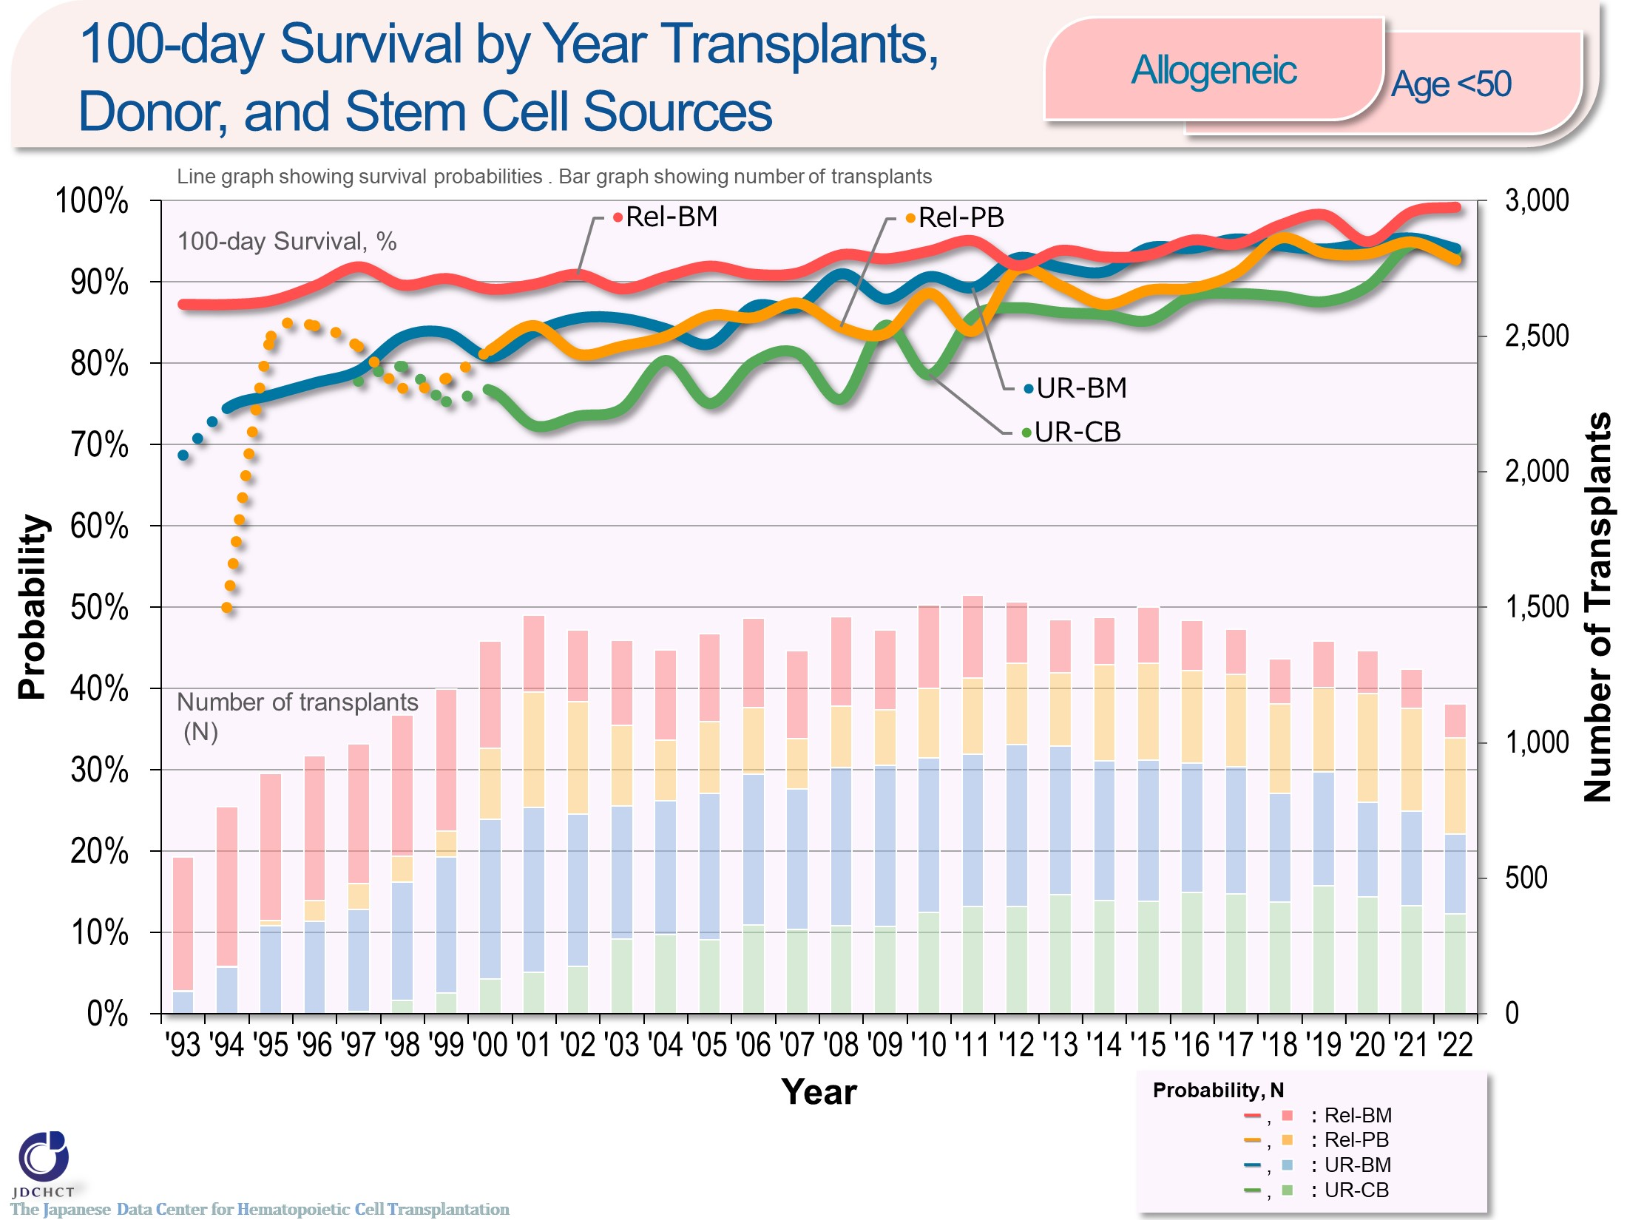
100-day Survival by Year Transplants,
Donor, and Stem Cell Sources <Allogeneic><age<50>
Notes:
In those aged 49 years or younger (<50) , the survival probabilities at 100 days after allogeneic transplantation have shown improving trends over the last decade in both transplantations from related and unrelated donors.
In recent years, there has been improvement in the survival probabilities at 100 days after cord blood transplantation from unrelated donors, comparable to those in other stem cell sources.
※This table shows the results of analysis performed on patients who received first transplants.
※The dotted lines (…) indicate the survival probabilities calculated when the number of transplants was below 100.

Slide 37
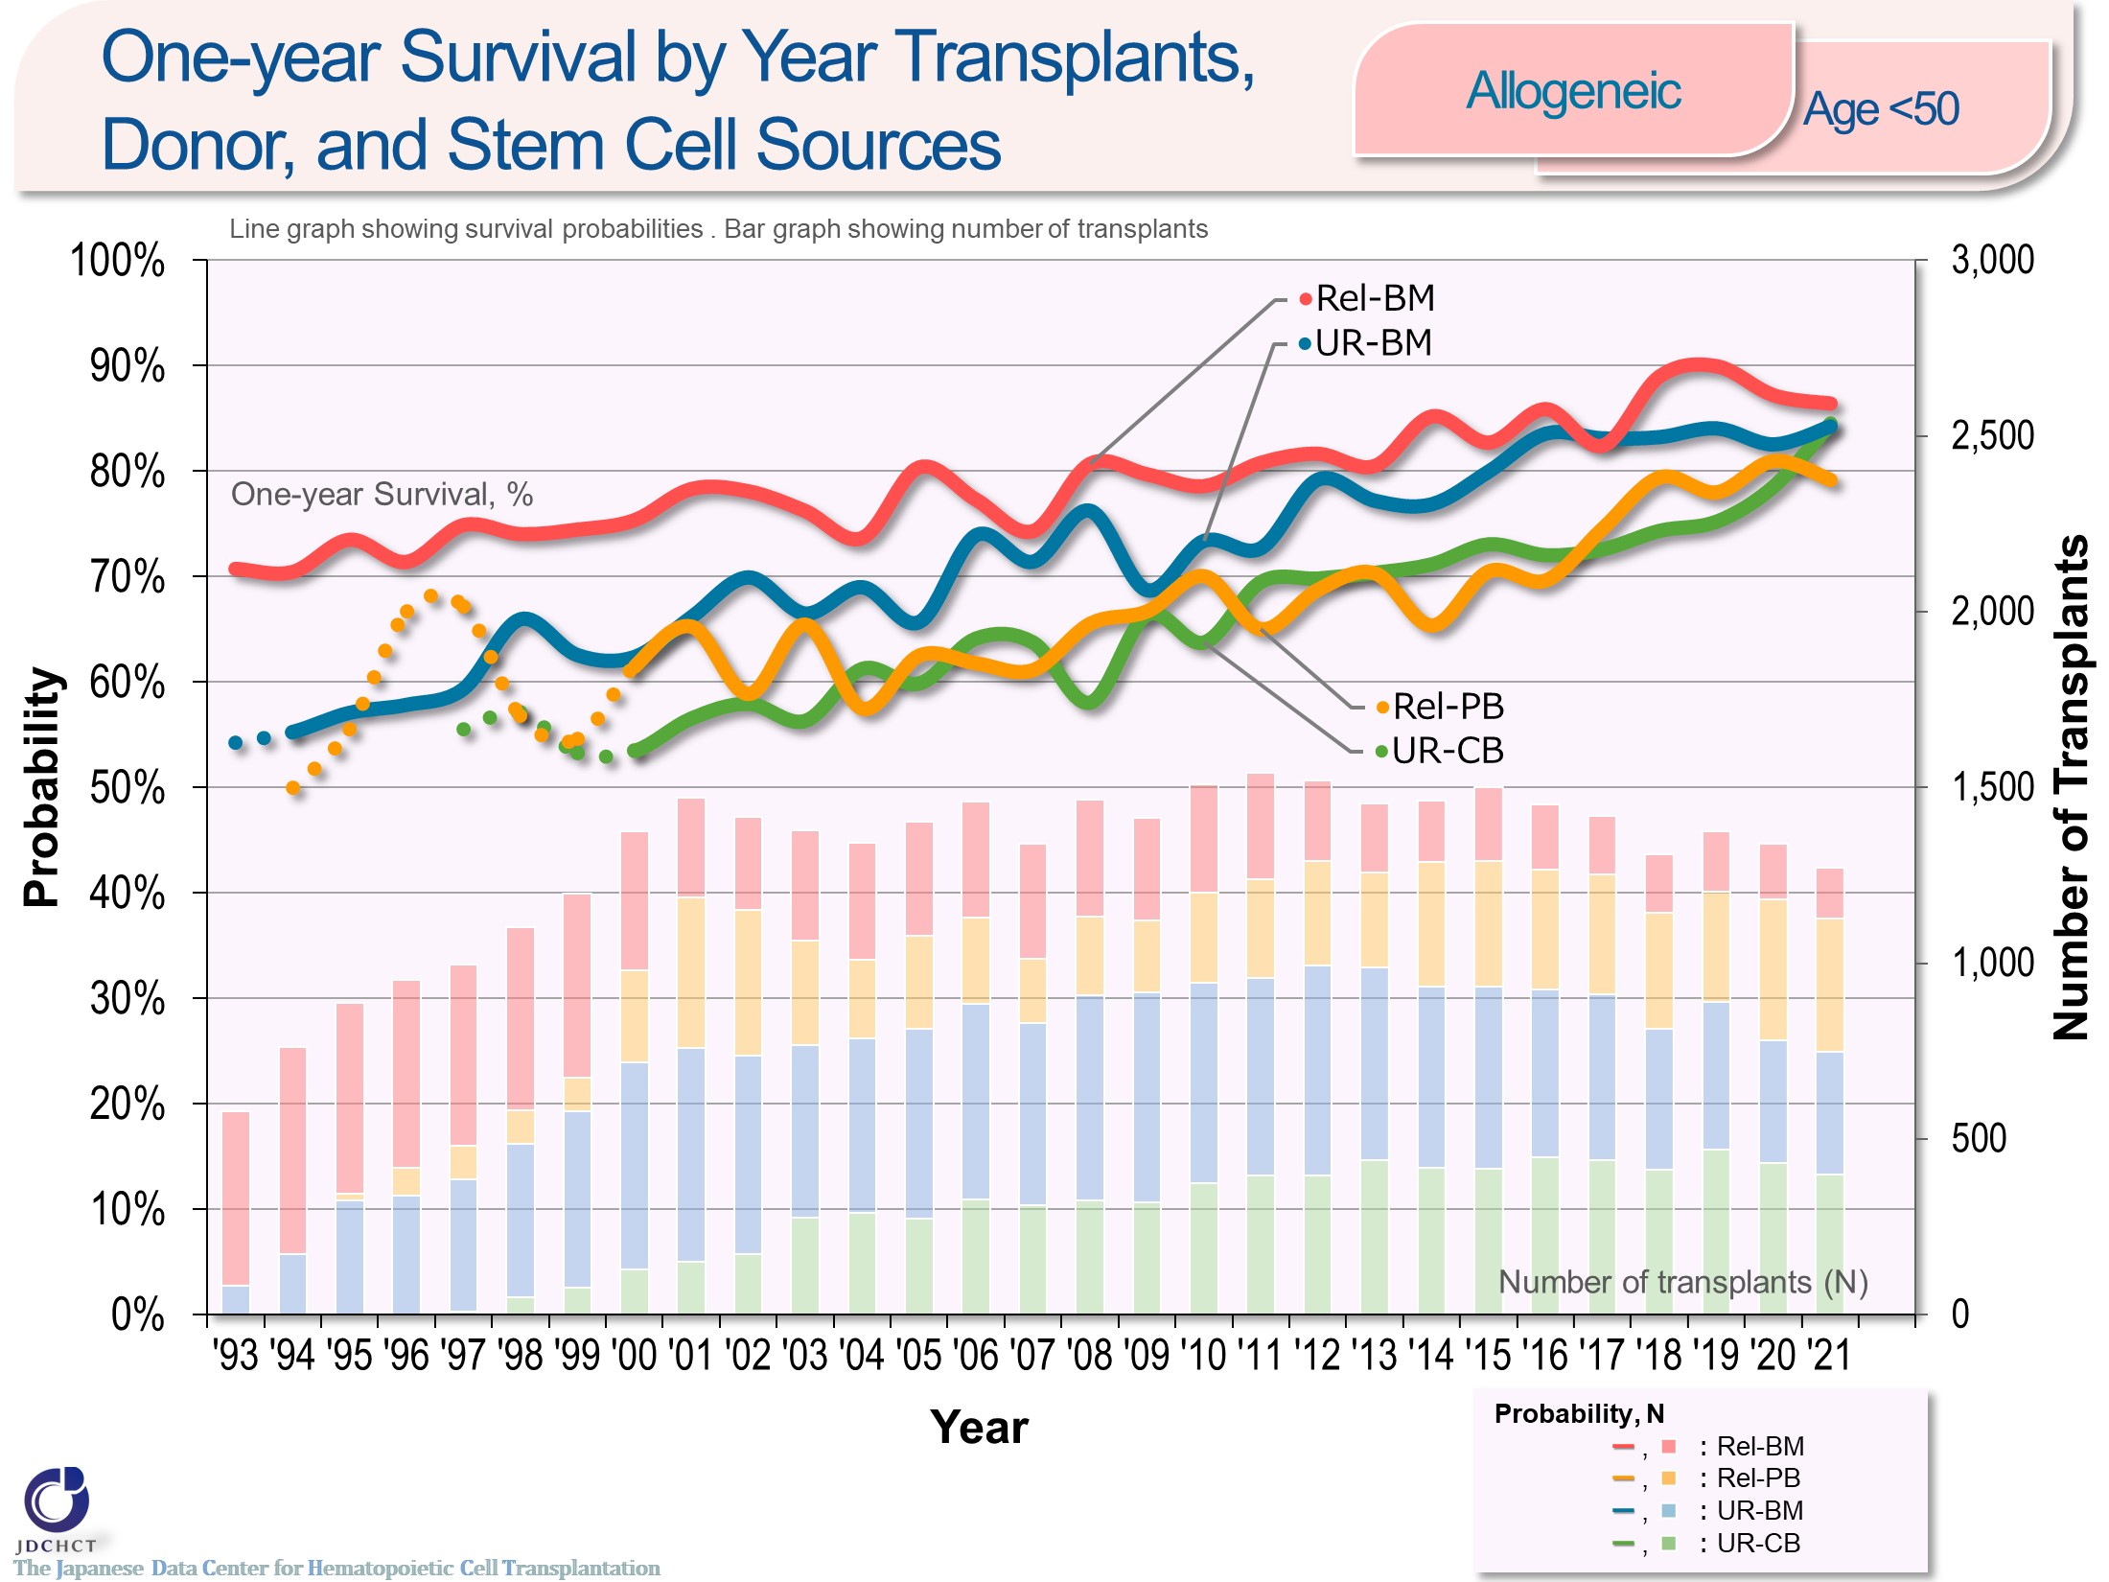
One-year Survival by Year Transplants,
Donor, and Stem Cell Sources <Allogeneic><age<50>
Notes:
In those aged 49 years or younger (<50) , the survival probabilities at 365 days (1 year) after allogeneic transplantation have shown improving trends over the last decade in both transplantations from related and unrelated donors.
The difference in the survival probabilities at 365 days (1 year) after transplantation by donor type and stem cell source is less due to the improvement in survival after peripheral blood stem cell transplantation from related donors and cord blood transplantation from unrelated donors in recent years.
※This table shows the results of analysis performed on patients who received first transplants.
※The dotted lines (…) indicate the survival probabilities calculated when the number of transplants was below 100.

Slide 38
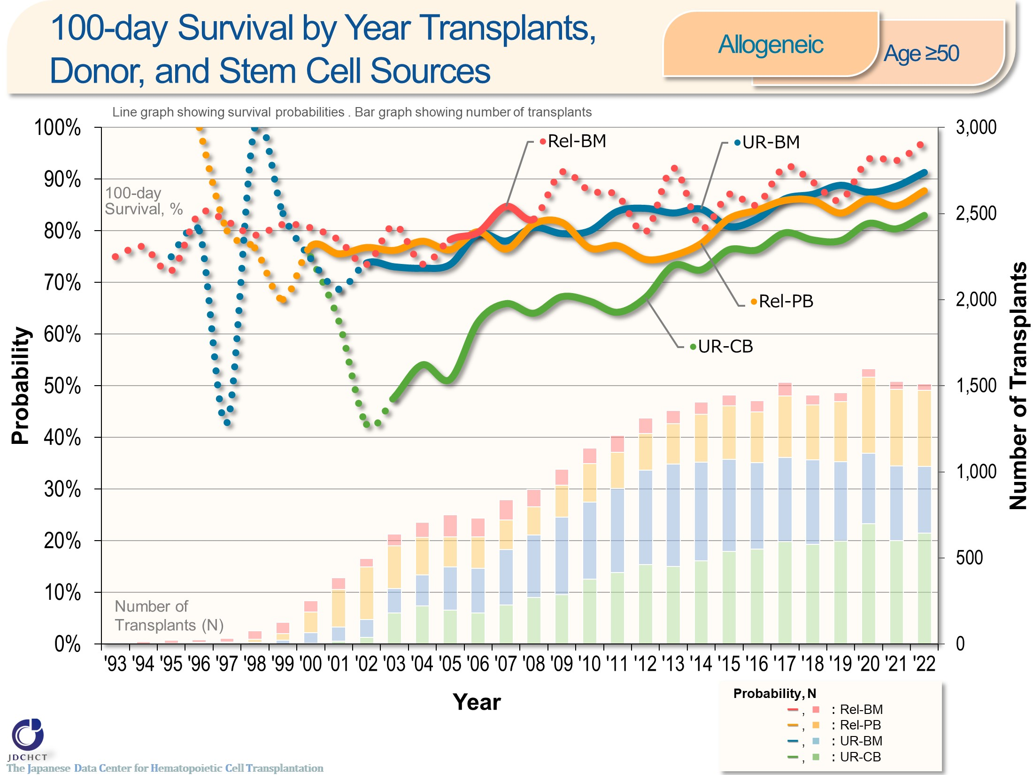
100-day Survival by Year Transplants,
Donor, and Stem Cell Sources <Allogeneic><age≥50>
Notes:
In those aged 50 years or older (≥50) , the survival probabilities at 100 days after allogeneic transplantation from unrelated donors have shown improving trends over the last decade.
※This table shows the results of analysis performed on patients who received first transplants.
※The dotted lines (…) indicate the survival probabilities calculated when the number of transplants was below 100.

Slide 39
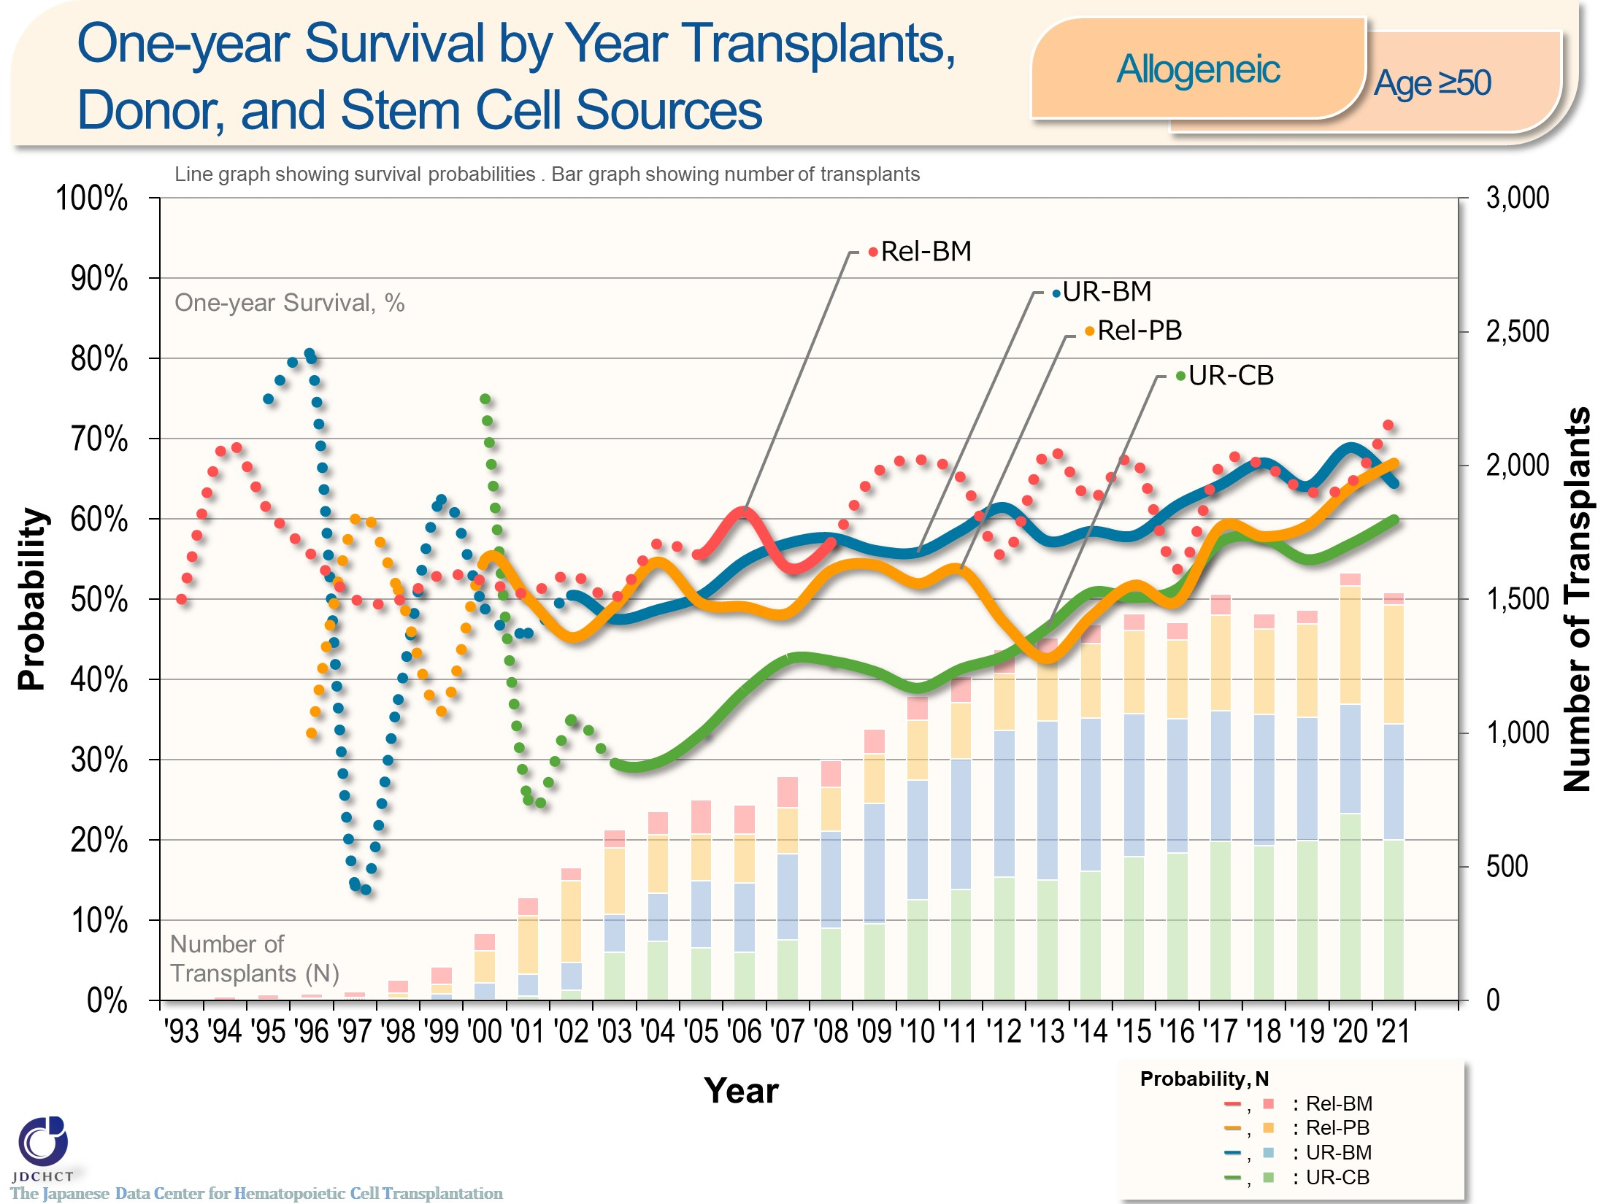
One-year Survival by Year Transplants,
Donor, and Stem Cell Sources <Allogeneic><age≥50>
Notes:
In those aged 50 years or older (≥50) , the survival probabilities at 365 days (1 year) after peripheral blood stem cell transplantation from related donors and allogeneic transplantation from unrelated donors have shown improving trends over the last decade.
The survival probabilities at 365 days (1 year) after peripheral blood stem cell transplantation from related donors and cord blood transplantation from unrelated donors particularly have increased by more than 15% over the last decade.
※This table shows the results of analysis performed on patients who received first transplants.
※The dotted lines (…) indicate the survival probabilities calculated when the number of transplants was below 100.

Slide 40
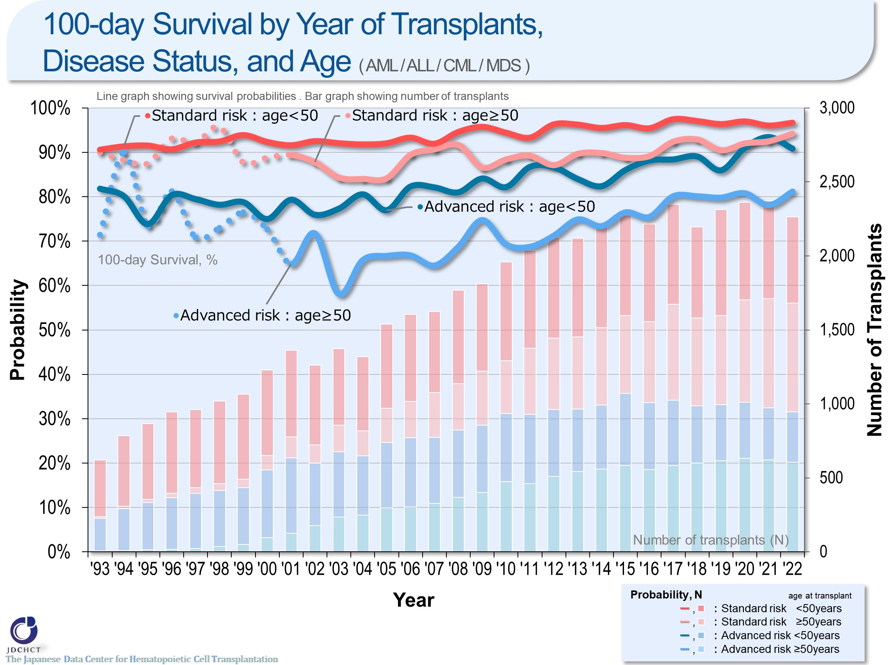
100-day Survival by Year of Transplants,
Disease Status, and Age ( AML / ALL / CML / MDS )
Notes:
The survival probability at 100 days after transplantation in the advanced risk group of patients with leukemia has shown improving trends over the last 10 years in the subgroup of recipients aged 49 years or younger (<50) . In the subgroup of recipients aged 50 years or older (≥50) , the number of transplants increased and the outcome of transplantation improved, when compared with the situation 10 years ago.
※This table shows the results of analysis performed on patients who received first transplants.
※The dotted lines (…) indicate the survival probabilities calculated when the number of transplants was below 100.
―≪Disease risk status at transplantation≫―
■Standard Risk Group
・AML (first complete remission[1CR]／second complete remission[2CR])
・ALL (1CR)
・CML (complete hematologic response (CHR) ／first chronic phase[1CP])
・MDS (WHO 2017 classification： MDS with single lineage dysplasia／MDS-RS and single lineage dysplasia
／MDS-RS and multilineage dysplasia
／MDS with multilineage dysplasia
／MDS with isolated del (5q)
／MDS, unclassifiable
／Refractory cytopenia of childhood (provisional entity)
WHO old classification, FAB classification：refractory anemia[RA] ／refractory anemia with ring sideroblasts[RARS]／refractory
cytopenia with multilineage dysplasia[RCMD]／refractory cytopenia with multilineage dysplasia and ringed sideroblasts[RCMD-RS]／myelodysplastic syndrome associated
with isolated del (5q) chromosome abnormality[5q−syndrome])
■Advanced Risk Group
・all other conditions
―――――――――――――――――――――

Slide 41
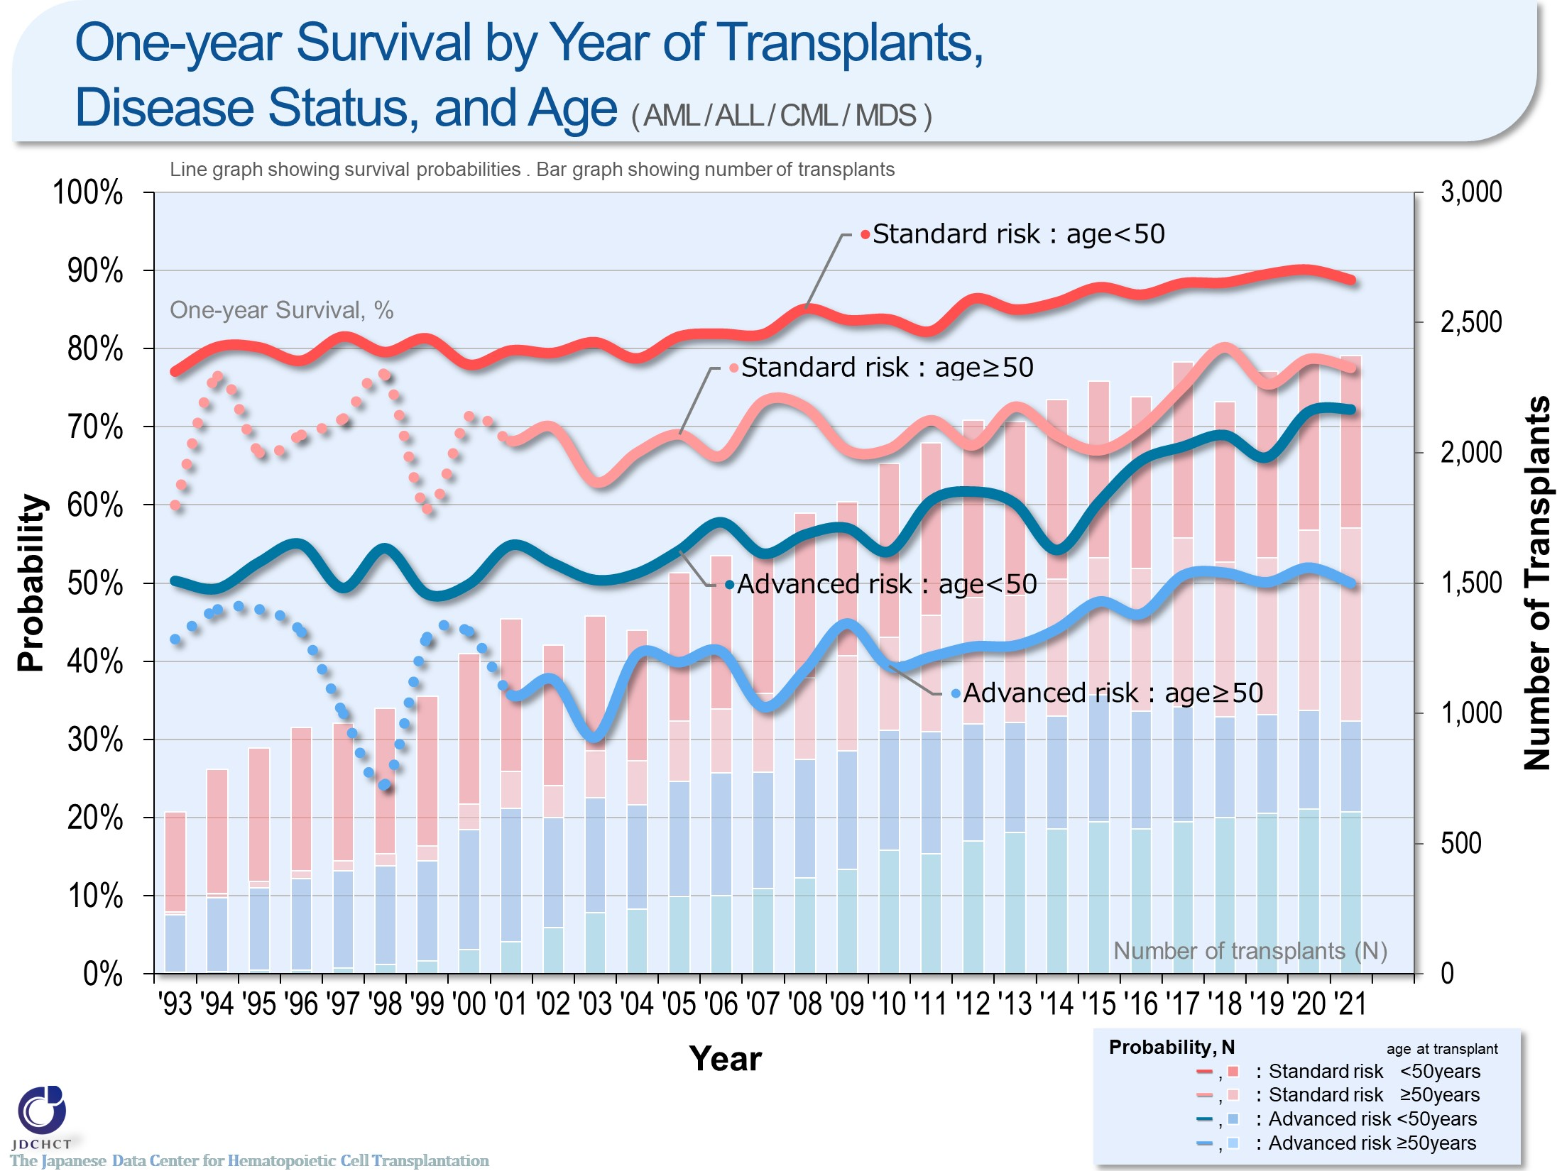
One-year Survival by Year of Transplants,
Disease Status, and Age ( AML / ALL / CML /MDS )
Notes:
The survival probabilities at 365 days (1 year) after transplantation in patients with leukemia have shown improving trends in recent years.
Comparison of the younger patients and the older patients in each risk group has revealed that the outcome of transplantation is better in the younger patient group.
※This table shows the results of analysis performed on patients who received first transplants.
※The dotted lines (…) indicate the survival probabilities calculated when the number of transplants was below 100.
―≪Disease risk status at transplantation≫―
■Standard Risk Group
・AML (first complete remission[1CR]／second complete remission[2CR])
・ALL (1CR)
・CML (complete hematologic response (CHR) ／first chronic phase[1CP])
・MDS (WHO 2017 classification： MDS with single lineage dysplasia／MDS-RS and single lineage dysplasia
／MDS-RS and multilineage dysplasia
／MDS with multilineage dysplasia
／MDS with isolated del (5q)
／MDS, unclassifiable
／Refractory cytopenia of childhood (provisional entity)
WHO old classification, FAB classification：refractory anemia[RA] ／refractory anemia with ring sideroblasts[RARS]／refractory
cytopenia with multilineage dysplasia[RCMD]／refractory cytopenia with multilineage dysplasia and ringed sideroblasts[RCMD-RS]／myelodysplastic syndrome associated
with isolated del (5q) chromosome abnormality[5q−syndrome])
■Advanced Risk Group
・all other conditions
―――――――――――――――――――――

Slide 42
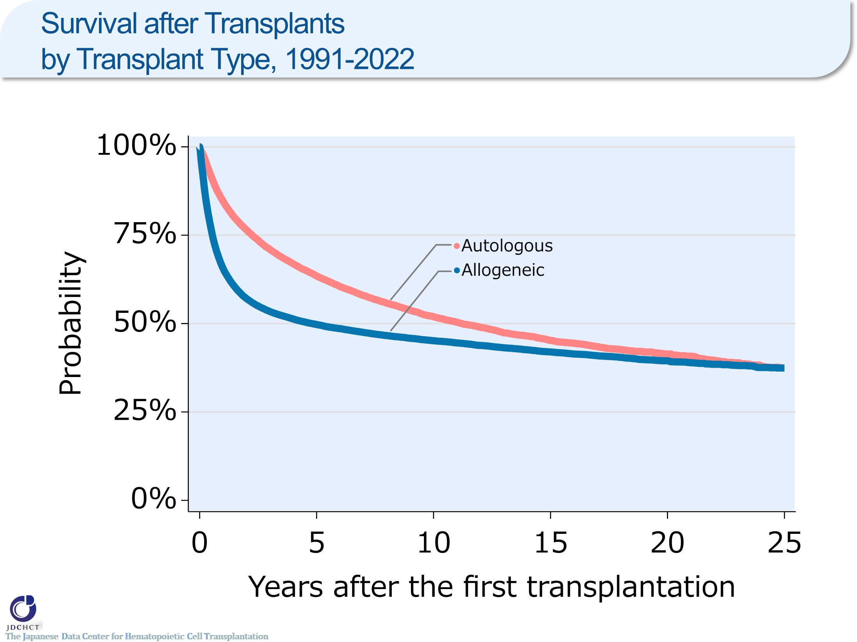
Survival after Transplants by Transplant Type, 1991-2022
Notes:
The number of first autologous transplants registered from 1991 to 2022 is 40,746. Among patients who underwent first autologous transplantation between 1991 and 2022, the 5-year and 10-year probabilities (95%CI) of survival following transplant are 63% (63-64%) and 52% (51-53%), respectively.
The number of first allogeneic transplants registered from 1991 to 2022 is 66,697. Among patients who underwent first allogeneic transplantation between 1991 and 2022, the 5-year and 10-year probabilities (95%CI) of survival following transplant are 50% (49-50%) and 45% (45-46%), respectively.

Slide 43
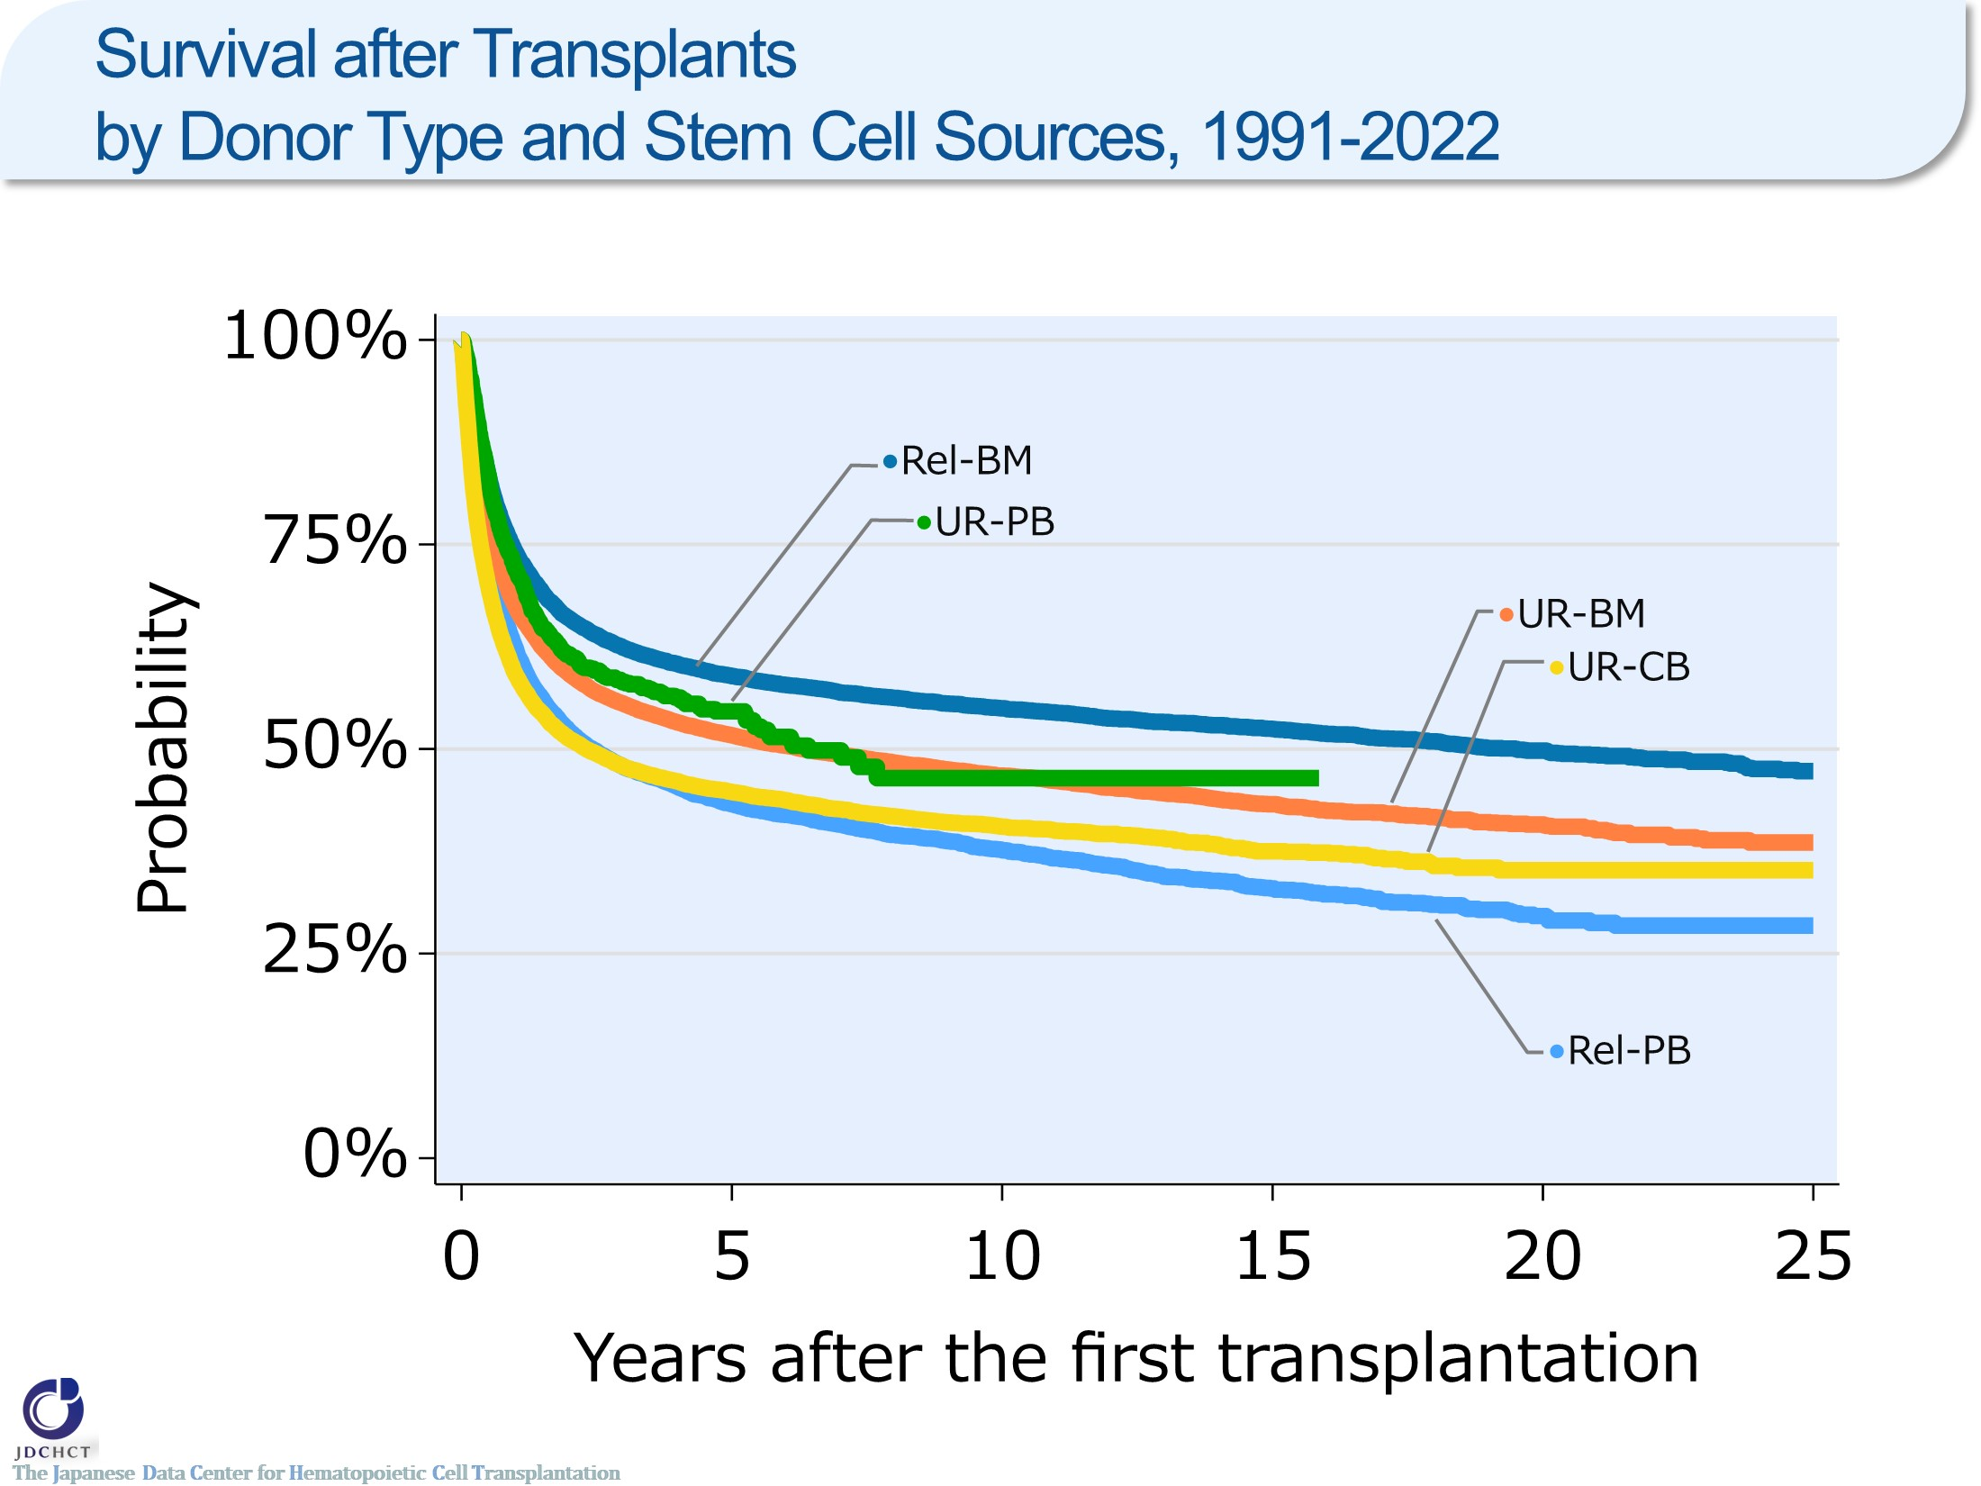
Survival after Transplants by Donor Type and Stem Cell Sources, 1991-2022
Notes:
Among patients who underwent allogeneic transplantation between 1991 and 2022, the 10-year probabilities (95%CI) of survival following transplant according by donor type and stem cell source are:
・Bone marrow transplantation from related donors (N=12,335) 55% (54-56%)
・Peripheral blood stem cell transplantation from related donors (N=13,584) 38% (37-39%)
・Bone marrow transplantation from unrelated donors (N=22,530) 47% (46-47%)
・Peripheral blood stem cell transplantation from unrelated donors (N=1,499) 46% (41-52%)
・Cord blood transplantation from unrelated donors (N=16,749) 41% (40-41%)

Slide 44
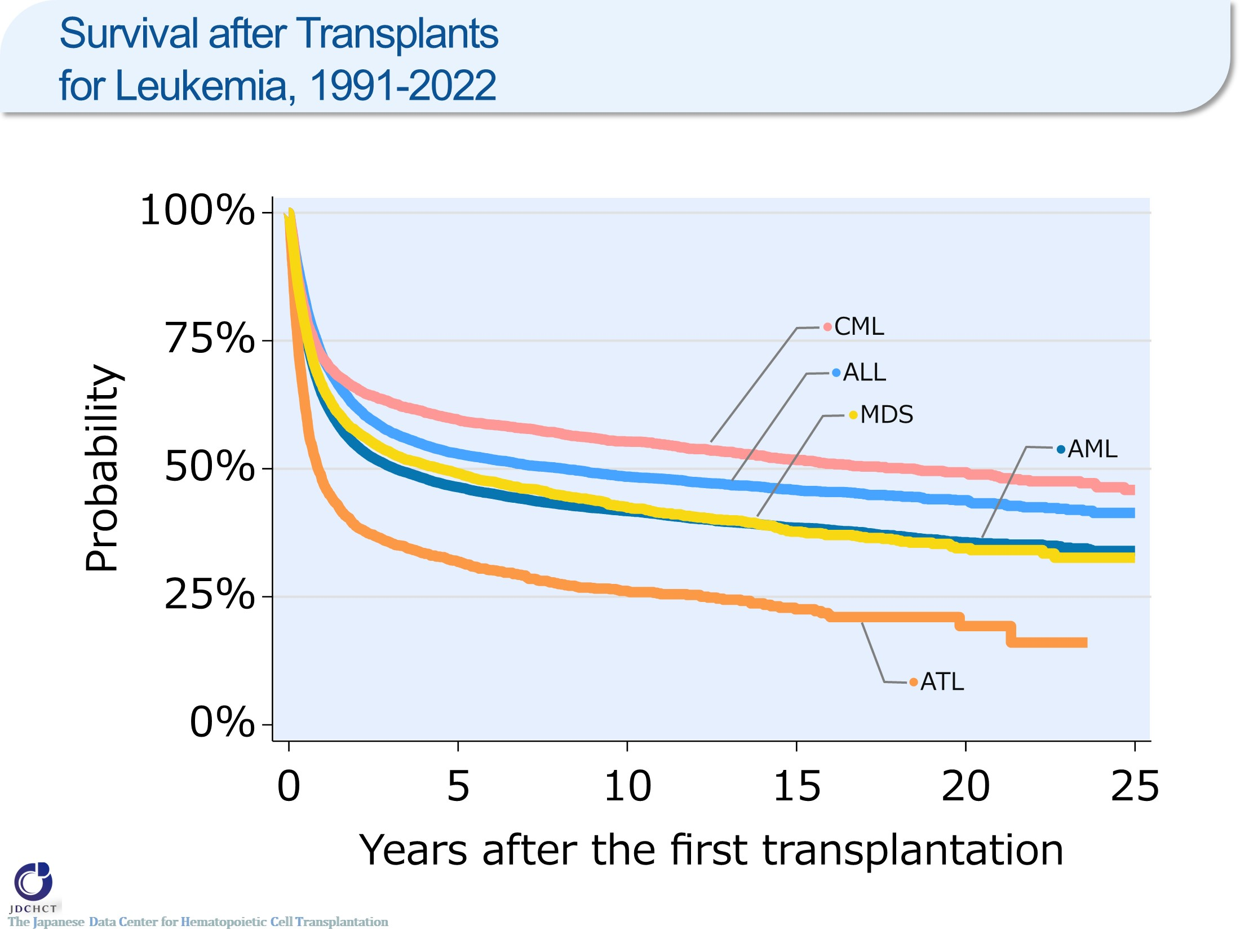
Survival after Transplants for Leukemia, 1991-2022
Notes:
Among patients who underwent autologous or allogeneic transplantation for leukemia between 1991 and 2022, the 10-year probabilities (95%CI) of survival following transplant are:
・Acute myeloid leukemia (N=26,970) 42% (41-42%)
・Acute lymphoblastic leukemia (N=13,942) 48% (48-49%)
・Adult T-cell leukemia (N=2,999) 26% (24-28%)
・Chronic myelogenous leukemia (N=3,855) 55% (54-57%)
・Myelodysplastic syndrome (N=7,560) 42% (41-44%)

Slide 45
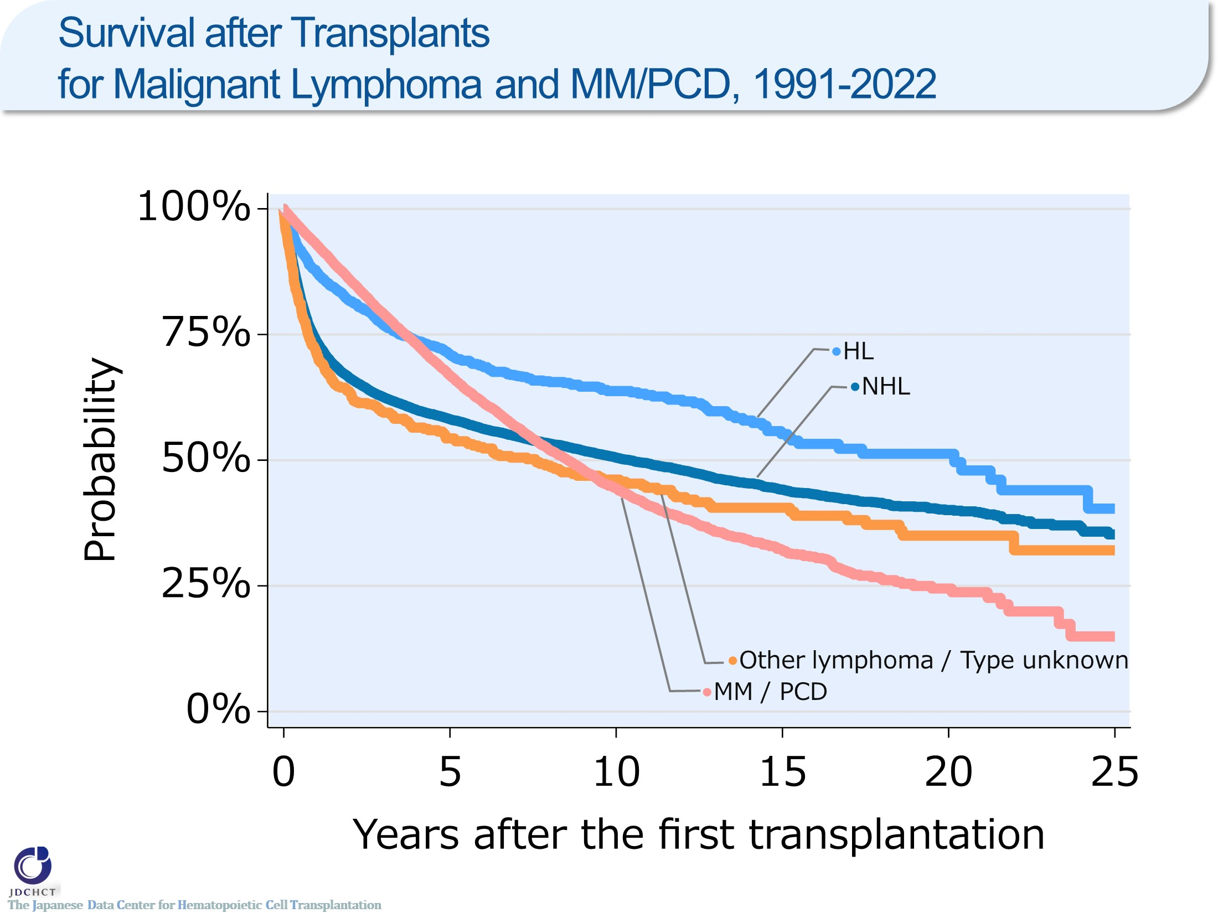
Survival after Transplants for Malignant Lymphoma and MM/PCD, 1991-2022
Notes:
Among patients who underwent autologous or allogeneic transplantation for lymphoma or plasma cell neoplasms including multiple myeloma between 1991 and 2022, the 10-year probabilities (95%CI) of survival following transplant are:
・Non-Hodgkin lymphoma (N=23,243) 51% (50-51%)
・Hodgkin lymphoma (N=1,810) 64% (61-66%)
・Plasma cell neoplasms including multiple myeloma (N=13,097) 44% (43-46%)

Slide 46
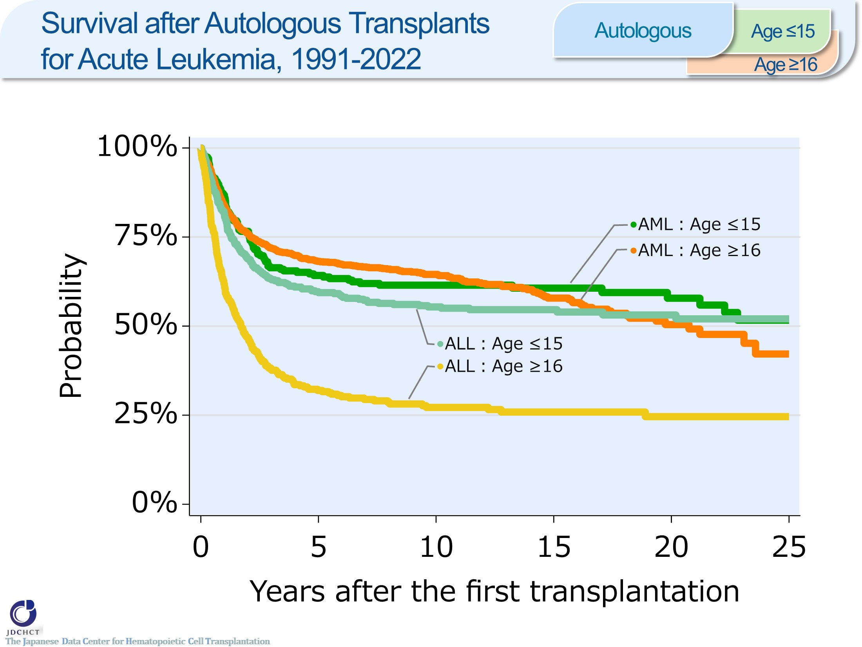
Survival after Autologous Transplants for Acute Leukemia, 1991-2022 <Autologous>
Notes:
Among patients who underwent autologous transplantation for acute myeloid leukemia between 1991 and 2022, the 10-year probabilities (95%CI) of survival following transplant are:
・Those aged 0 to 15 years (N=235) 61% (55-67%)
・Those aged 16 years or older (N=1,546) 65% (62-67%)
Among patients who underwent autologous transplantation for acute lymphoblastic leukemia between 1991 and 2022, the 10-year probabilities (95%CI) of survival following transplant are:
・Those aged 0 to 15 years (N=393) 55% (50-60%)
・Those aged 16 years or older (N=350) 27% (22-32%)

Slide 47
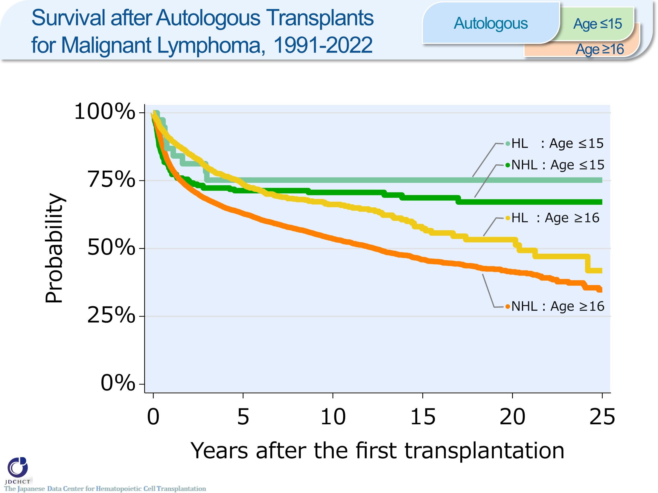
Survival after Autologous Transplants for Malignant Lymphoma, 1991-2022 <Autologous>
Notes:
Among patients who underwent autologous transplantation for non-Hodgkin lymphoma between 1991 and 2022, the 10-year probabilities (95%CI) of survival following transplant are:
・Recipients aged 0 to 15 years (N=226) 71% (64-76%)
・Recipients 16 years or older (N=17,286) 54% (53-55%)
Among patients who underwent autologous transplantation for Hodgkin lymphoma between 1991 and 2022, the 10-year probabilities (95%CI) of survival following transplant are:
・Recipients aged 0 to 15 years (N=38) 75% (58-86%)
・Recipients aged 16 years or older (N=1,599) 66% (63-69%)

Slide 48
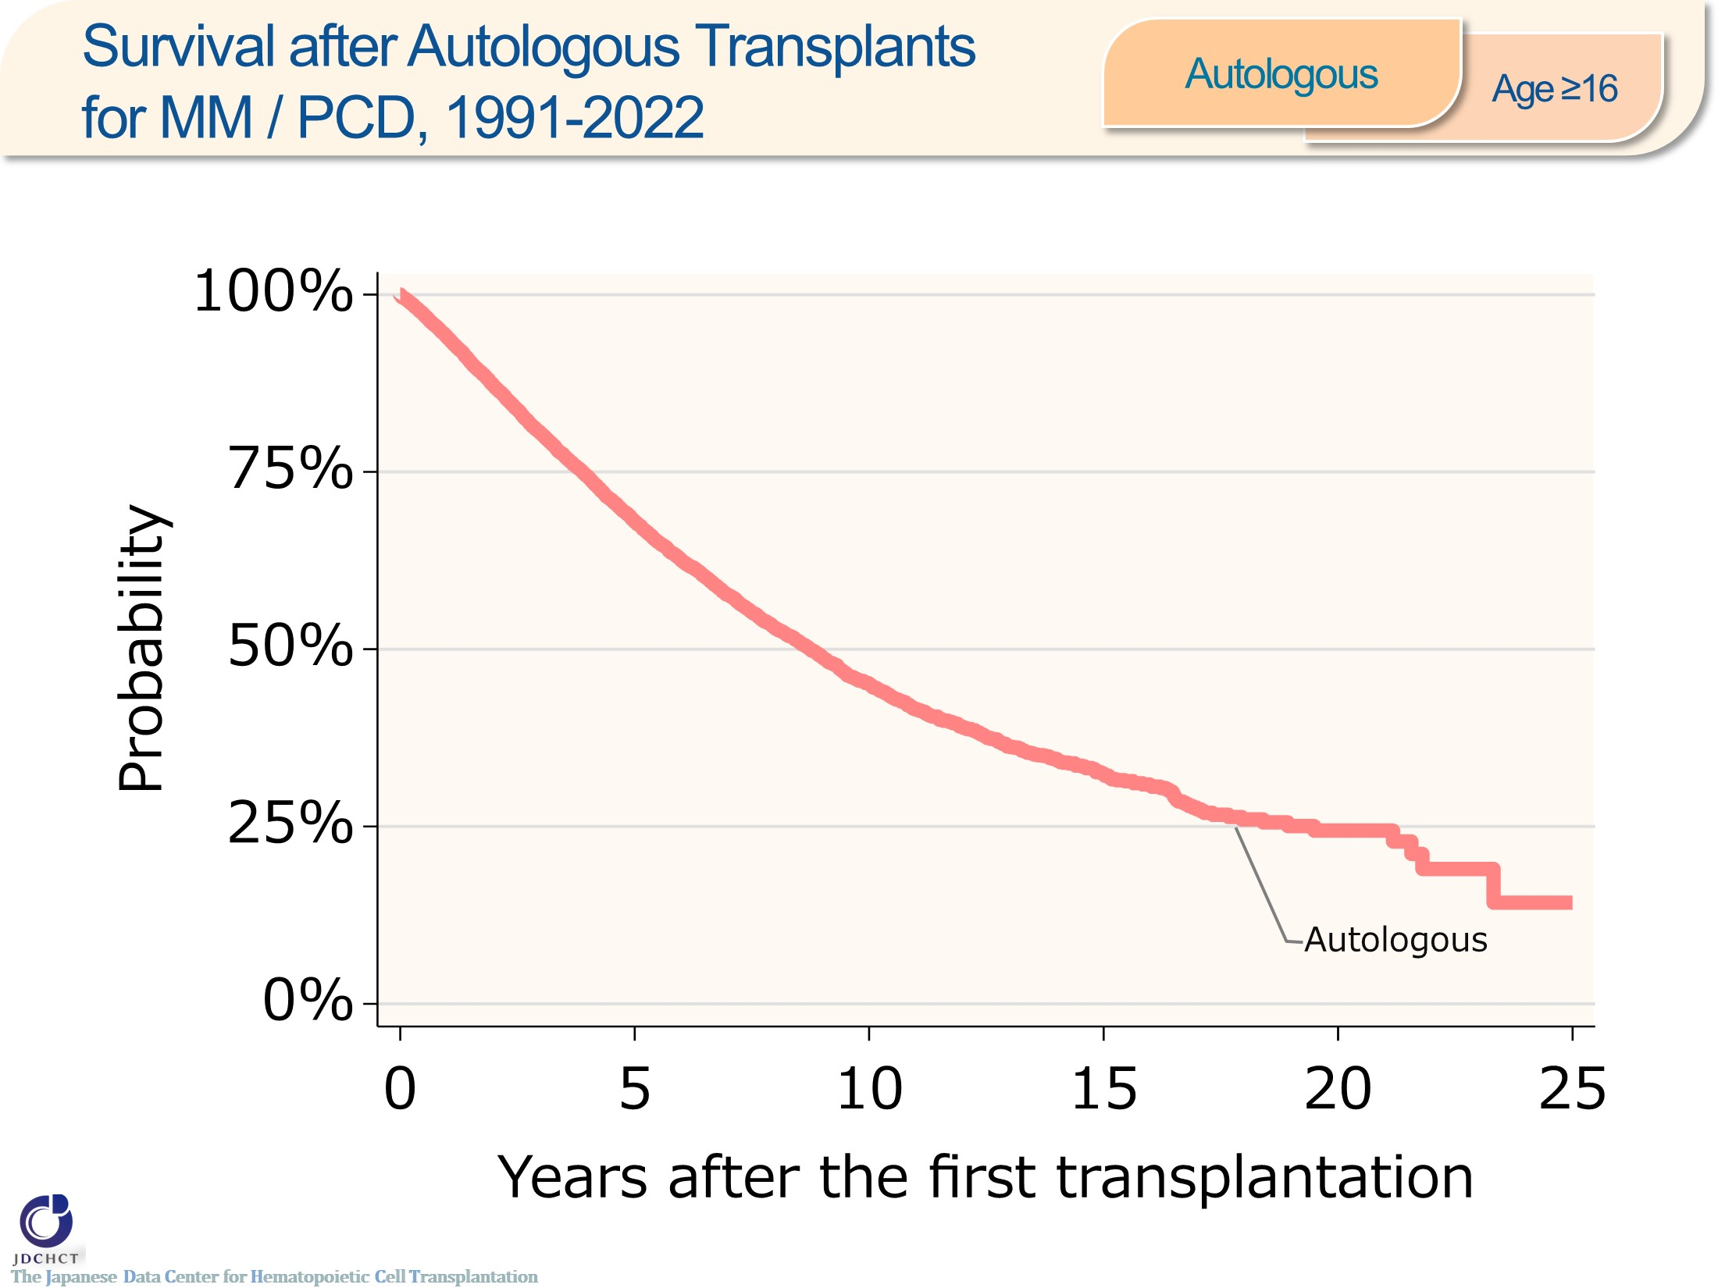
Survival after Autologous Transplants for MM/PCD, 1991-2022 <Autologous><age≥16>
Notes:
In plasma cell neoplasms including multiple myeloma, the number of first autologous transplants registered from 1991 to 2022 is 12,752 in recipients aged 16 years or older. The 5-year and 10-year probabilities (95%CI) of survival following transplant are 68% (67-69%) and 45% (44-46%) , respectively.

Slide 49
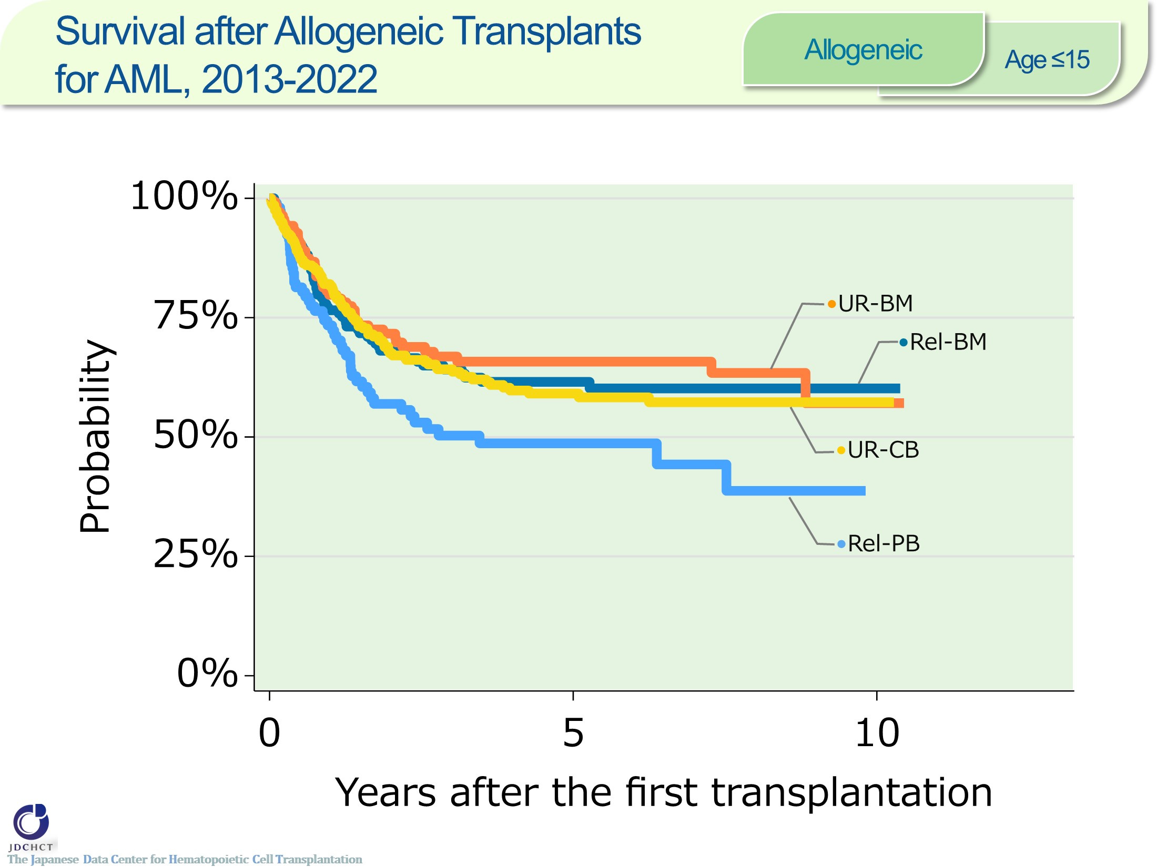
Survival after Allogeneic Transplants for AML, 2013-2022 <Allogeneic><age≤15>
Notes:
Among patients aged 0 to 15 years who underwent allogeneic transplantation for acute myeloid leukemia between 2013 and 2022, the 5-year probabilities (95%CI) of survival following transplant according by donor type and stem cell source are:
・Bone marrow transplantation from related donors (N=161) 62% (53-69%)
・Peripheral blood stem cell transplantation from related donors (N=104) 49% (38-59%)
・Bone marrow transplantation from unrelated donors (N=140) 66% (57-73%)
・Cord blood transplantation from unrelated donors (N=281) 59% (52-65%)

Slide 50
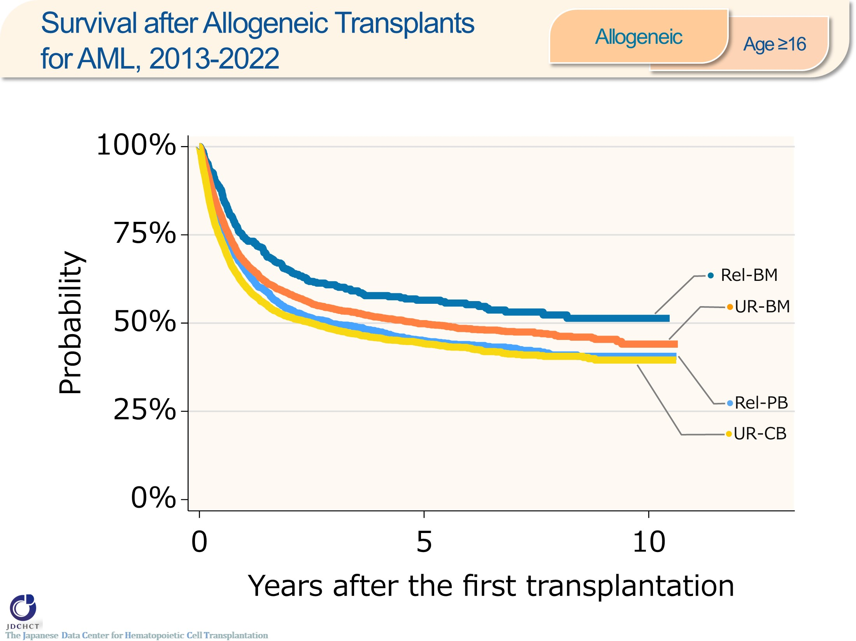
Survival after Allogeneic Transplants for AML, 2013-2022 <Allogeneic><age≥16>
Notes:
Among patients aged 16 years or older who underwent allogeneic transplantation for acute myeloid leukemia between 2013 and 2022, the 5-year probabilities (95%CI) of survival following transplant according by donor type and stem cell source are:
・Bone marrow transplantation from related donors (N=549) 56% (52-61%)
・Peripheral blood stem cell transplantation from related donors (N=2,877) 45% (43-47%)
・Bone marrow transplantation from unrelated donors (N=3,122) 50% (48-52%)
・Cord blood transplantation from unrelated donors (N=4,401) 44% (43-46%)

Slide 51

Survival after Allogeneic Transplants for AML, 2013-2022 <HLA-identical Sibling> <age≤15>
Notes:
Among patients aged 0 to 15 years receiving a HLA-matched sibling donor transplant for acute myeloid leukemia between 2013 and 2022, the 5-year probabilities (95%CI) of survival following transplant according to disease status are:
・Standard risk group (N=63) 73% (59-83%)
・Advanced risk group (N=31) 46% (28-63%)
―≪Disease risk status at transplantation≫―――
■Standard Risk Group : first complete remission [1CR]／second complete remission [2CR]
■Advanced Risk Group：third or more complete remission [≥3CR]／primary induction failure [PIF]／untreated／relapse
―――――――――――――――――――――――

Slide 52

Survival after Allogeneic Transplants for AML, 2013-2022 <HLA-identical Sibling> <age≥16>
Notes:
Among patients aged 16 years or older receiving a HLA-matched sibling donor transplant for acute myeloid leukemia between 2013 and 2022, the 5-year probabilities (95%CI) of survival following transplant according to disease status are:
・Standard risk group (N=1,230) 64% (60-67%)
・Advanced risk group (N=601) 28% (24-32%)
―≪Disease risk status at transplantation≫―――
■Standard Risk Group : first complete remission [1CR]／second complete remission [2CR]
■Advanced Risk Group：third or more complete remission [≥3CR]／primary induction failure [PIF]／untreated／relapse
―――――――――――――――――――――――

Slide 53

Survival after Allogeneic Transplants for AML, 2013-2022 <UR-BM><age≤15>
Notes:
Among patients aged 0 to 15 years receiving a bone marrow transplant from unrelated donors for acute myeloid leukemia between 2013 and 2022, the 5-year probabilities (95%CI) of survival following transplant according to disease status are:
・Standard risk group (N=93) 78% (67-86%)
・Advanced risk group (N=47) 42% (27-57%)
―≪Disease risk status at transplantation≫―――
■Standard Risk Group : first complete remission [1CR]／second complete remission [2CR]
■Advanced Risk Group：third or more complete remission [≥3CR]／primary induction failure [PIF]／untreated／relapse
―――――――――――――――――――――――

Slide 54

Survival after Allogeneic Transplants for AML, 2013-2022 <UR-BM><age≥16>
Notes:
Among patients aged 16 years or older receiving a bone marrow transplant from unrelated donors for acute myeloid leukemia between 2013 and 2022, the 5-year probabilities (95%CI) of survival following transplant according to disease status are:
・Standard risk group (N=2,133) 61% (59-63%)
・Advanced risk group (N=979) 26% (23-29%)
―≪Disease risk status at transplantation≫―――
■Standard Risk Group : first complete remission [1CR]／second complete remission [2CR]
■Advanced Risk Group：third or more complete remission [≥3CR]／primary induction failure [PIF]／untreated／relapse
―――――――――――――――――――――――

Slide 55

Survival after Allogeneic Transplants for AML, 2013-2022 <UR-CB><age≤15>
Notes:
Among patients aged 0 to 15 years receiving a cord blood transplant from unrelated donors for acute myeloid leukemia between 2013 and 2022, the 5-year probabilities (95%CI) of survival following transplant according to disease status are:
・Standard risk group (N=181) 76% (68-82%)
・Advanced risk group (N=98) 27% (18-38%)
―≪Disease risk status at transplantation≫―――
■Standard Risk Group : first complete remission [1CR]／second complete remission [2CR]
■Advanced Risk Group：third or more complete remission [≥3CR]／primary induction failure [PIF]／untreated／relapse
―――――――――――――――――――――――

Slide 56

Survival after Allogeneic Transplants for AML, 2013-2022 <UR-CB><age≥16>
Notes:
Among patients aged 16 years or older receiving a cord blood transplant from unrelated donors for acute myeloid leukemia between 2013 and 2022, the 5-year probabilities (95%CI) of survival following transplant according to disease status are:
・Standard risk group (N=2,164) 61% (59-63%)
・Advanced risk group (N=2,235) 28% (26-31%)
―≪Disease risk status at transplantation≫―――
■Standard Risk Group : first complete remission [1CR]／second complete remission [2CR]
■Advanced Risk Group：third or more complete remission [≥3CR]／primary induction failure [PIF]／untreated／relapse
―――――――――――――――――――――――

Slide 57

Survival after Allogeneic Transplants for ALL, 2013-2022 <Allogeneic><age≤15>
Notes:
Among patients aged 0 to 15 years who underwent allogeneic transplantation for acute lymphoblastic leukemia between 2013 and 2022, the 5-year probabilities (95%CI) of survival following transplant according by donor type and stem cell source are:
・Bone marrow transplantation from related donors (N=202) 70% (62-76%)
・Peripheral blood stem cell transplantation from related donors (N=113) 43% (33-52%)
・Bone marrow transplantation from unrelated donors (N=212) 72% (65-78%)
・Cord blood transplantation from unrelated donors (N=358) 74% (68-78%)

Slide 58

Survival after Allogeneic Transplants for ALL, 2013-2022 <Allogeneic><age≥16>
Notes:
Among patients aged 16 years or older who underwent allogeneic transplantation for acute lymphoblastic leukemia between 2013 and 2022, the 5-year probabilities (95%CI) of survival following transplant according by donor type and stem cell source are:
・Bone marrow transplantation from related donors (N=292) 68% (62-74%)
・Peripheral blood stem cell transplantation from related donors (N=1,108) 59% (55-62%)
・Bone marrow transplantation from unrelated donors (N=1,538) 62% (59-64%)
・Cord blood transplantation from unrelated donors (N=1,267) 58% (55-61%)

Slide 59

Survival after Allogeneic Transplants for ALL, 2013-2022 <HLA-identical Sibling> <age≤15>
Notes:
Among patients aged 0 to 15 years receiving a HLA-matched sibling donor transplant for acute lymphoblastic leukemia between 2013 and 2022, the 5-year probabilities (95%CI) of survival following transplant according to disease status are:
・Standard risk group (N=58) 88% (74-94%)
・Advanced risk group (N=60) 54% (39-67%)
―≪Disease risk status at transplantation≫―――
■Standard Risk Group : first complete remission [1CR]
■Advanced Risk Group : second or more complete remission [≥2CR]／primary induction failure [PIF]／PIF, extramedullary involvement only ／untreated／relapse
――――――――――――――――――――――――

Slide 60

Survival after Allogeneic Transplants for ALL, 2013-2022 <HLA-identical Sibling> <age≥16>
Notes:
Among patients aged 16 years or older receiving a HLA-matched sibling donor transplant for acute lymphoblastic leukemia between 2013 and 2022, the 5-year probabilities (95%CI) of survival following transplant according to disease status are:
・Standard risk group (N=655) 73% (69-77%)
・Advanced risk group (N=179) 41% (32-49%)
―≪Disease risk status at transplantation≫―――
■Standard Risk Group : first complete remission [1CR]
■Advanced Risk Group : second or more complete remission [≥2CR]／primary induction failure [PIF]／PIF, extramedullary involvement only／untreated／relapse
――――――――――――――――――――――――

Slide 61

Survival after Allogeneic Transplants for ALL, 2013-2022 <UR-BM><age≤15>
Notes:
Among patients aged 0 to 15 years receiving a bone marrow transplant from unrelated donors for acute lymphoblastic leukemia between 2013 and 2022, the 5-year probabilities (95%CI) of survival following transplant according to disease status are:
・Standard risk group (N=109) 88% (79-93%)
・Advanced risk group (N=103) 55% (44-66%)
―≪Disease risk status at transplantation≫―――
■Standard Risk Group : first complete remission [1CR]
■Advanced Risk Group : second or more complete remission [≥2CR]／primary induction failure [PIF]／PIF, extramedullary involvement only／untreated／relapse
――――――――――――――――――――――――

Slide 62

Survival after Allogeneic Transplants for ALL, 2013-2022 <UR-BM><age≥16>
Notes:
Among patients aged 16 years or older receiving a bone marrow transplant from unrelated donors for acute lymphoblastic leukemia between 2013 and 2022, the 5-year probabilities (95%CI) of survival following transplant according to disease status are:
・Standard risk group (N=1,196) 69% (65-71%)
・Advanced risk group (N=342) 37% (31-43%)
―≪Disease risk status at transplantation≫―――
■Standard Risk Group : first complete remission [1CR]
■Advanced Risk Group : second or more complete remission [≥2CR]／primary induction failure [PIF]／PIF, extramedullary involvement only／untreated／relapse
――――――――――――――――――――――――

Slide 63

Survival after Allogeneic Transplants for ALL, 2013-2022 <UR-CB><age≤15>
Notes:
Among patients aged 0 to 15 years receiving a cord blood transplant from unrelated donors for acute lymphoblastic leukemia between 2013 and 2022, the 5-year probabilities (95%CI) of survival following transplant according to disease status are:
・Standard risk group (N=163) 84% (76-89%)
・Advanced risk group (N=195) 66% (58-72%)
―≪Disease risk status at transplantation≫―――
■Standard Risk Group : first complete remission [1CR]
■Advanced Risk Group : second or more complete remission [≥2CR]／primary induction failure [PIF]／PIF, extramedullary involvement only／untreated／relapse
――――――――――――――――――――――――

Slide 64

Survival after Allogeneic Transplants for ALL, 2013-2022 <UR-CB><age≥16>
Notes:
Among patients aged 16 years or older receiving a cord blood transplant from unrelated donors for acute lymphoblastic leukemia between 2013 and 2022, the 5-year probabilities (95%CI) of survival following transplant according to disease status are:
・Standard risk group (N=824) 71% (68-75%)
・Advanced risk group (N=442) 33% (28-38%)
―≪Disease risk status at transplantation≫―――
■Standard Risk Group : first complete remission [1CR]
■Advanced Risk Group : second or more complete remission [≥2CR]／primary induction failure [PIF]／PIF, extramedullary involvement only／untreated／relapse
――――――――――――――――――――――――

Slide 65

Survival after Allogeneic Transplants for CML, 2013-2022 <Allogeneic><age≤15>
Notes:
Among patients aged 0 to 15 years who underwent allogeneic transplantation for chronic myelogenous leukemia between 2013 and 2022, the 5-year probabilities (95%CI) of survival following transplant according by donor type and stem cell source are:
・Bone marrow transplantation / peripheral blood stem cell transplantation from related donors (N=14) 79% (47-93%)
・Bone marrow transplantation from unrelated donors (N=12) 75% (41-91%)
・Cord blood transplantation from unrelated donors (N=7) 100%

Slide 66

Survival after Allogeneic Transplants for CML, 2013-2022 <Allogeneic><age≥16>
Notes:
Among patients aged 16 years or older who underwent allogeneic transplantation for chronic myelogenous leukemia between 2013 and 2022, the 5-year probabilities (95%CI) of survival following transplant according by donor type and stem cell source are:
・Bone marrow transplantation from related donors (N=34) 85% (65-94%)
・Peripheral blood stem cell transplantation from related donors (N=174) 63% (54-71%)
・Bone marrow transplantation from unrelated donors (N=229) 70% (62-76%)
・Cord blood transplantation from unrelated donors (N=181) 69% (61-75%)

Slide 67

Survival after Allogeneic Transplants for CML, 2013-2022 <HLA-identical Sibling> <age≥16>
Notes:
Among patients aged 16 years or older receiving a HLA-matched sibling donor transplant for chronic myelogenous leukemia between 2013 and 2022, the 5-year probabilities (95%CI) of survival following transplant according to disease status are:
・Standard risk group (N=46) 85% (66-94%)
・Advanced risk group (N=80) 62% (50-73%)
―≪Disease risk status at transplantation≫―――
■Standard Risk Group : complete hematologic response (CHR) ／first chronic phase[1CP]
■Advanced Risk Group : second or more chronic phase [≥2CP]／accelerated phase [AP]／blast crisis [BC]
―――――――――――――――――――――――

Slide 68

Survival after Allogeneic Transplants for CML, 2013-2022 <UR-BM><age≥16>
Notes:
Among patients aged 16 years or older receiving a bone marrow transplant from unrelated donors for chronic myelogenous leukemia between 2013 and 2022, the 5-year probabilities (95%CI) of survival following transplant according to disease status are:
・Standard risk group (N=94) 78% (67-85%)
・Advanced risk group (N=135) 64% (54-72%)
―≪Disease risk status at transplantation≫―――
■Standard Risk Group : complete hematologic response (CHR) ／first chronic phase[1CP]
■Advanced Risk Group : second or more chronic phase [≥2CP]／accelerated phase [AP]／blast crisis [BC]
―――――――――――――――――――――――

Slide 69

Survival after Allogeneic Transplants for CML, 2013-2022 <UR-CB><age≥16>
Notes:
Among patients aged 16 years or older receiving a cord blood transplant from unrelated donors for chronic myelogenous leukemia between 2013 and 2022, the 5-year probabilities (95%CI) of survival following transplant according to disease status are:
・Standard risk group (N=55) 84% (70-92%)
・Advanced risk group (N=126) 63% (53-71%)
―≪Disease risk status at transplantation≫―――
■Standard Risk Group : complete hematologic response (CHR) ／first chronic phase[1CP]
■Advanced Risk Group : second or more chronic phase [≥2CP]／accelerated phase [AP]／blast crisis [BC]
―――――――――――――――――――――――

Slide 70

Survival after Allogeneic Transplants for MDS, 2013-2022 <Allogeneic><age≤15>
Notes:
Among patients aged 0 to 15 years who underwent allogeneic transplantation for myelodysplastic syndrome between 2013 and 2022, the 5-year probabilities (95%CI) of survival following transplant according by donor type and stem cell source are:
・Bone marrow transplantation from related donors (N=64) 90% (79-95%)
・Peripheral blood stem cell transplantation from related donors (N=14) 76% (43-92%)
・Bone marrow transplantation from unrelated donors (N=115) 80% (70-87%)
・Cord blood transplantation from unrelated donors (N=42) 75% (57-87%)

Slide 71

Survival after Allogeneic Transplants for MDS, 2013-2022 <Allogeneic><age≥16>
Notes:
Among patients aged 16 years or older who underwent allogeneic transplantation for myelodysplastic syndrome between 2013 and 2022, the 5-year probabilities (95%CI) of survival following transplant according by donor type and stem cell source are:
・Bone marrow transplantation from related donors (N=204) 48% (40-55%)
・Peripheral blood stem cell transplantation from related donors (N=821) 49% (45-53%)
・Bone marrow transplantation from unrelated donors (N=1,529) 47% (44-49%)
・Cord blood transplantation from unrelated donors (N=1,158) 46% (43-49%)

Slide 72

Survival after Allogeneic Transplants for MDS, 2013-2022 <HLA-identical Sibling> <age≤15>
Notes:
Among patients aged 0 to 15 years receiving a HLA-matched sibling donor transplant for myelodysplastic syndrome between 2013 and 2022, the 5-year probabilities (95%CI) of survival following transplant according to disease status are:
・Standard risk group (N=40) 92% (78-98%)
・Advanced risk group (N=7) 71% (26-92%)
―≪Disease risk status at transplantation≫―――
■Standard Risk Group
WHO 2017 classification : MDS with single lineage dysplasia／MDS-RS and single lineage dysplasia／MDS-RS and multilineage dysplasia／MDS with multilineage dysplasia／MDS with isolated del (5q) ／MDS, unclassifiable／Refractory cytopenia of childhood (provisional entity)
WHO old classification, FAB classification：RA／RARS／RCMD／RCMD-RS／5q-syndrome
■Advanced Risk Group
WHO 2017 classification : MDS with excess blasts-1 (MDS-EB-1) ／MDS with excess blasts-2 (MDS-EB-2)
WHO old classification, FAB classification : RAEB／RAEBt／RAEB-1／RAEB-2
―――――――――――――――――――――――

Slide 73

Survival after Allogeneic Transplants for MDS, 2013-2022 <HLA-identical Sibling> <age≥16>
Notes:
Among patients aged 16 years or older receiving a HLA-matched sibling donor transplant for myelodysplastic syndrome between 2013 and 2022, the 5-year probabilities (95%CI) of survival following transplant according to disease status are:
・Standard risk group (N=189) 64% (56-71%)
・Advanced risk group (N=334) 46% (40-52%)
―≪Disease risk status at transplantation≫―――
■Standard Risk Group
WHO 2017 classification : MDS with single lineage dysplasia／MDS-RS and single lineage dysplasia／MDS-RS and multilineage dysplasia／MDS with multilineage dysplasia／MDS with isolated del (5q) ／MDS, unclassifiable／Refractory cytopenia of childhood (provisional entity)
WHO old classification, FAB classification：RA／RARS／RCMD／RCMD-RS／5q-syndrome
■Advanced Risk Group
WHO 2017 classification : MDS with excess blasts-1 (MDS-EB-1) ／MDS with excess blasts-2 (MDS-EB-2)
WHO old classification, FAB classification : RAEB／RAEBt／RAEB-1／RAEB-2
―――――――――――――――――――――――

Slide 74

Survival after Allogeneic Transplants for MDS, 2013-2022 <UR-BM><age≤15>
Notes:
Among patients aged 0 to 15 years receiving a bone marrow transplant from unrelated donors for myelodysplastic syndrome between 2013 and 2022, the 5-year probabilities (95%CI) of survival following transplant according to disease status are:
・Standard risk group (N=78) 89% (78-95%)
・Advanced risk group (N=27) 64% (37-82%)
―≪Disease risk status at transplantation≫―――
■Standard Risk Group
WHO 2017 classification : MDS with single lineage dysplasia／MDS-RS and single lineage dysplasia／MDS-RS and multilineage dysplasia／MDS with multilineage dysplasia／MDS with isolated del (5q) ／MDS, unclassifiable／Refractory cytopenia of childhood (provisional entity)
WHO old classification, FAB classification：RA／RARS／RCMD／RCMD-RS／5q-syndrome
■Advanced Risk Group
WHO 2017 classification : MDS with excess blasts-1 (MDS-EB-1) ／MDS with excess blasts-2 (MDS-EB-2)
WHO old classification, FAB classification : RAEB／RAEBt／RAEB-1／RAEB-2
―――――――――――――――――――――――

Slide 75

Survival after Allogeneic Transplants for MDS, 2013-2022 <UR-BM><age≥16>
Notes:
Among patients aged 16 years or older receiving a bone marrow transplant from unrelated donors for myelodysplastic syndrome between 2013 and 2022, the 5-year probabilities (95%CI) of survival following transplant according to disease status are:
・Standard risk group (N=540) 52% (47-57%)
・Advanced risk group (N=943) 43% (40-47%)
―≪Disease risk status at transplantation≫―――
■Standard Risk Group
WHO 2017 classification : MDS with single lineage dysplasia／MDS-RS and single lineage dysplasia／MDS-RS and multilineage dysplasia／MDS with multilineage dysplasia／MDS with isolated del (5q) ／MDS, unclassifiable／Refractory cytopenia of childhood (provisional entity)
WHO old classification, FAB classification：RA／RARS／RCMD／RCMD-RS／5q-syndrome
■Advanced Risk Group
WHO 2017 classification : MDS with excess blasts-1 (MDS-EB-1) ／MDS with excess blasts-2 (MDS-EB-2)
WHO old classification, FAB classification : RAEB／RAEBt／RAEB-1／RAEB-2
―――――――――――――――――――――――

Slide 76

Survival after Allogeneic Transplants for MDS, 2013-2022 <UR-CB><age≤15>
Notes:
Among patients aged 0 to 15 years receiving a cord blood transplant from unrelated donors for myelodysplastic syndrome between 2013 and 2022, the 5-year probabilities (95%CI) of survival following transplant according to disease status are:
・Standard risk group (N=17) 73% (42-89%)
・Advanced risk group (N=20) 72% (45-87%)
―≪Disease risk status at transplantation≫―――
■Standard Risk Group
WHO 2017 classification : MDS with single lineage dysplasia／MDS-RS and single lineage dysplasia／MDS-RS and multilineage dysplasia／MDS with multilineage dysplasia／MDS with isolated del (5q) ／MDS, unclassifiable／Refractory cytopenia of childhood (provisional entity)
WHO old classification, FAB classification：RA／RARS／RCMD／RCMD-RS／5q-syndrome
■Advanced Risk Group
WHO 2017 classification : MDS with excess blasts-1 (MDS-EB-1) ／MDS with excess blasts-2 (MDS-EB-2)
WHO old classification, FAB classification : RAEB／RAEBt／RAEB-1／RAEB-2
―――――――――――――――――――――――

Slide 77

Survival after Allogeneic Transplants for MDS, 2013-2022 <UR-CB><age≥16>
Notes:
Among patients aged 16 years or older receiving a cord blood transplant from unrelated donors for myelodysplastic syndrome between 2013 and 2022, the 5-year probabilities (95%CI) of survival following transplant according to disease status are:
・Standard risk group (N=354) 52% (46-58%)
・Advanced risk group (N=779) 43% (39-47%)
―≪Disease risk status at transplantation≫―――
■Standard Risk Group
WHO 2017 classification : MDS with single lineage dysplasia／MDS-RS and single lineage dysplasia／MDS-RS and multilineage dysplasia／MDS with multilineage dysplasia／MDS with isolated del (5q) ／MDS, unclassifiable／Refractory cytopenia of childhood (provisional entity)
WHO old classification, FAB classification：RA／RARS／RCMD／RCMD-RS／5q-syndrome
■Advanced Risk Group
WHO 2017 classification : MDS with excess blasts-1 (MDS-EB-1) ／MDS with excess blasts-2 (MDS-EB-2)
WHO old classification, FAB classification : RAEB／RAEBt／RAEB-1／RAEB-2
―――――――――――――――――――――――

Slide 78

Survival after Allogeneic Transplants for NHL, 2013-2022 <Allogeneic><age≤15>
Notes:
Among patients aged 0 to 15 years who underwent allogeneic transplantation for non-Hodgkin lymphoma between 2013 and 2022, the 5-year probabilities (95%CI) of survival following transplant according by donor type and stem cell source are:
・Bone marrow transplantation from related donors (N=22) 72% (49-87%)
・Peripheral blood stem cell transplantation from related donors (N=20) 46% (22-67%)
・Bone marrow transplantation from unrelated donors (N=31) 69% (46-84%)
・Cord blood transplantation from unrelated donors (N=42) 73% (57-84%)

Slide 79

Survival after Allogeneic Transplants for NHL, 2013-2022 <Allogeneic><age≥16>
Notes:
Among patients aged 16 years or older who underwent allogeneic transplantation for non-Hodgkin lymphoma between 2013 and 2022, the 5-year probabilities (95%CI) of survival following transplant according by donor type and stem cell source are:
・Bone marrow transplantation from related donors (N=106) 54% (43-63%)
・Peripheral blood stem cell transplantation from related donors (N=787) 41% (37-45%)
・Bone marrow transplantation from unrelated donors (N=547) 50% (46-55%)
・Cord blood transplantation from unrelated donors (N=873) 41% (37-44%)

Slide 80

Survival after Allogeneic Transplants for NHL, 2013-2022 <HLA-identical Sibling> <age≥16>
Notes:
Among patients aged 16 years or older receiving a HLA-matched sibling donor transplant for non-Hodgkin lymphoma between 2013 and 2022, the 5-year probabilities (95%CI) of survival following transplant according to disease status are:
・1CR (N=95) 72% (60-81%)
・2CR (N=40) 85% (69-93%)
・≧3CR (N=17) 81% (51-93%)
・1PR (N=48) 53% (37-67%)
・2PR (N-48) 57% (41-70%)
・Untreated/Primary induction failure (PIF) /Relapse (N=185) 29% (22-36%)

Slide 81

Survival after Allogeneic Transplants for NHL, 2013-2022 <UR-BM><age≤15>
Notes:
Among patients aged 0 to 15 years receiving a bone marrow transplant from unrelated donors for non-Hodgkin lymphoma between 2013 and 2022, the 5-year probabilities (95%CI) of survival following transplant according to disease status are:
・CR/PR (N=17) 59% (30-80%)
・Untreated/Primary induction failure (PIF) /Relapse (N=14) 77% (31-94%)

Slide 82

Survival after Allogeneic Transplants for NHL, 2013-2022 <UR-BM><age≥16>
Notes:
Among patients aged 16 years or older receiving a bone marrow transplant from unrelated donors for non-Hodgkin lymphoma between 2013 and 2022, the 5-year probabilities (95%CI) of survival following transplant according to disease status are:
・1CR (N=128) 63% (54-71%)
・2CR (N=64) 64% (51-75%)
・≧3CR (N=40) 59% (42-72%)
・1PR (N=56) 44% (29-58%)
・2PR (N=66) 54% (40-66%)
・Untreated/Primary induction failure (PIF) /Relapse (N=193) 35% (28-42%)

Slide 83

Survival after Allogeneic Transplants for NHL, 2013-2022 <UR-CB><age≤15>
Notes:
Among patients aged 0 to 15 years receiving a cord blood transplant from unrelated donors for non-Hodgkin lymphoma between 2013 and 2022, the 5-year probabilities (95%CI) of survival following transplant according to disease status are:
・CR/PR (N=26) 84% (63-94%)
・Untreated/Primary induction failure (PIF) /Relapse (N=16) 56% (29-76%)

Slide 84

Survival after Allogeneic Transplants for NHL, 2013-2022 <UR-CB><age≥16>
Notes:
Among patients aged 16 years or older receiving a cord blood transplant from unrelated donors for non-Hodgkin lymphoma between 2013 and 2022, the 5-year probabilities (95%CI) of survival following transplant according to disease status are:
・1CR (N=136) 56% (46-65%)
・2CR (N=91) 59% (48-69%)
・≧3CR (N=23) 72% (47-87%)
・1PR (N=108) 51% (40-60%)
・2PR (N=85) 36% (26-47%)
・Untreated/Primary induction failure (PIF) /Relapse (N=429) 29% (24-34%)

Slide 85

Survival after Autologous Transplants for MM / PCD, 2013-2022 <Autologous><age≥16>
Notes:
In plasma cell neoplasms including multiple myeloma, the number of autologous transplants registered from 2013 to 2022 is 7,790 in recipients aged 16 years or older.
The 5-year probability (95%CI) of survival following transplant is 76% (75-77%) .

Slide 86

Survival after Allogeneic Transplants for MM / PCD, 2013-2022 <Allogeneic><age≥16>
Notes:
Among patients aged 16 years or older who underwent allogeneic transplantation for plasma cell neoplasms including multiple myeloma between 2013 and 2022, the 5-year probabilities (95%CI) of survival following transplant according by donor type and stem cell source are:
・Bone marrow transplantation / peripheral blood stem cell transplantation from related donors (N=29) 31% (15-48%)
・Bone marrow transplantation from unrelated donors (N=21) 29% (11-50%)
・Cord blood transplantation from unrelated donors (N=17) 15% (1-43%)

Slide 87

Survival after Autologous Transplants for MM / PCD, 2013-2022 <Autologous><age≥16>
Notes:
Among patients aged 16 years or older receiving an autologous transplant for plasma cell neoplasms including multiple myeloma between 2013 and 2022, the 5-year probabilities (95%CI) of survival following transplant according to disease status are:
・CR/sCR (N=1,765) 81% (78-83%)
・VGPR (N=2,487) 77% (74-79%)
・PR (N=2,534) 74% (72-76%)
・SD (N=194) 60% (52-68%)
・PD/Relapse (N=153) 35% (26-44%)

Slide 88

Survival after Allogeneic Transplants for MM / PCD, 2013-2022 <Allogeneic><age≥16>
Notes:
Among patients aged 16 years or older receiving an allogeneic transplant for plasma cell neoplasms including multiple myeloma between 2013 and 2022, the 5-year probabilities (95%CI) of survival following transplant according to disease status are:
・CR/sCR/VGPR/PR (N=43) 34% (18-52%)
・SD/PD/Relapse (N=23) 9% (2-24%)

Slide 89

Survival after Allogeneic Transplants for AA, 2013-2022 <Allogeneic><age≤15>
Notes:
Among patients aged 0 to 15 years who underwent allogeneic transplantation for aplastic anemia between 2013 and 2022, the 5-year probabilities (95%CI) of survival following transplant according by donor type and stem cell source are:
・Bone marrow transplantation from related donors (N=121) 96% (91-99%)
・Peripheral blood stem cell transplantation from related donors (N=7) 86% (33-98%)
・Bone marrow transplantation from unrelated donors (N=129) 95% (89-98%)
・Cord blood transplantation from unrelated donors (N=28) 100%

Slide 90

Survival after Allogeneic Transplants for AA, 2013-2022 <Allogeneic><age≥16>
Notes:
Among patients aged 16 years or older who underwent allogeneic transplantation for aplastic anemia between 2013 and 2022, the 5-year probabilities (95%CI) of survival following transplant according by donor type and stem cell source are:
・Bone marrow transplantation from related donors (N=182) 88% (81-92%)
・Peripheral blood stem cell transplantation from related donors (N=86) 70% (58-79%)
・Bone marrow transplantation from unrelated donors (N=229) 74% (68-80%)
・Cord blood transplantation from unrelated donors (N=123) 70% (61-78%)

Slide 91

Survival after Allogeneic Transplants for AA, 2013-2022 <Allogeneic><age≤15>
Notes:
Among patients aged 0 to 15 years who underwent allogeneic transplantation for aplastic anemia between 2013 and 2022, the 5-year probabilities (95%CI) of survival following transplant according by donor type and stem cell source are:
・HLA-matched sibling donor transplantation (N=91) 98% (91-99%)
・Bone marrow transplantation from unrelated donors (N=129) 95% (89-98%)
・Cord blood transplantation from unrelated donors (N=28) 100%

Slide 92

Survival after Allogeneic Transplants for AA, 2013-2022 <Allogeneic><age≥16>
Notes:
Among patients aged 16 years or older who underwent allogeneic transplantation for aplastic anemia between 2013 and 2022, the 5-year probabilities (95%CI) of survival following transplant according by donor type and stem cell source are:
・HLA-matched sibling donor transplantation (N=183) 84% (78-89%)
・Bone marrow transplantation from unrelated donors (N=229) 74% (68-80%)
・Cord blood transplantation from unrelated donors (N=123) 70% (61-78%)

