Slide 1

Cover

Slide 2
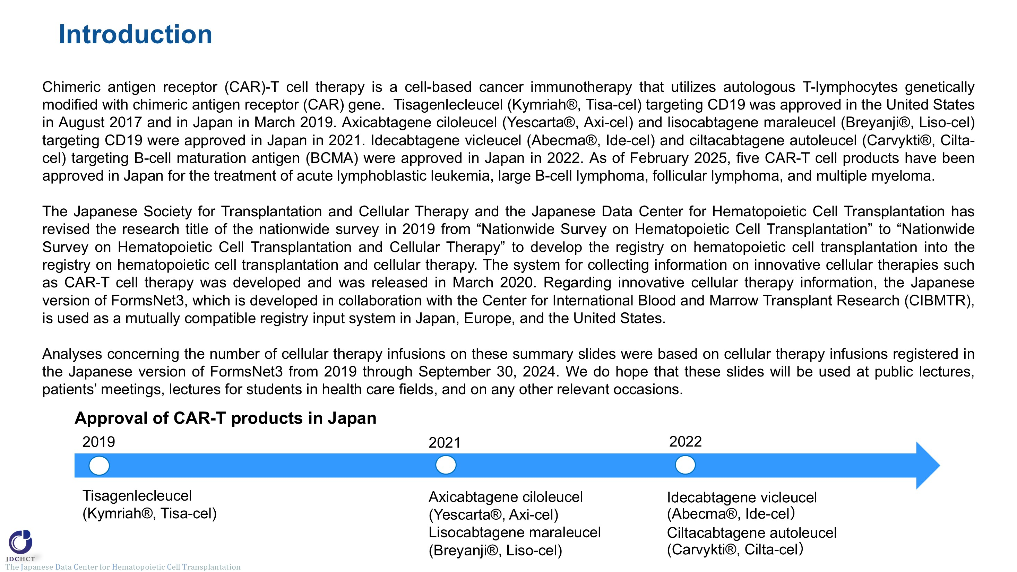
Introduction

Slide 3
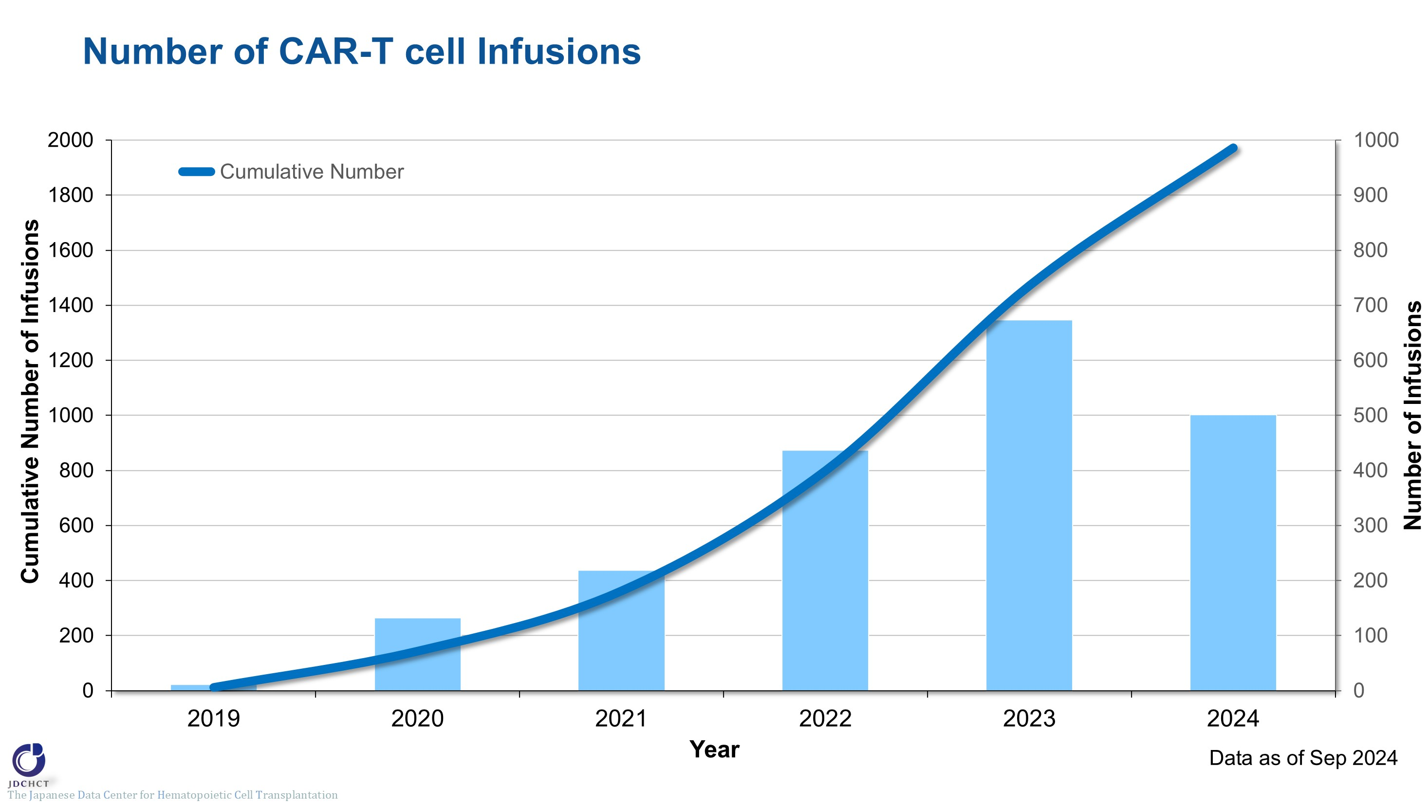
Number of CAR-T cell Infusions
Notes:
The cumulative number of CAR-T cell infusions from 2019 to 2024 was 1,973.
The number of CAR-T cell infusions has increased each year, with 673 infusions in 2023.

Slide 4
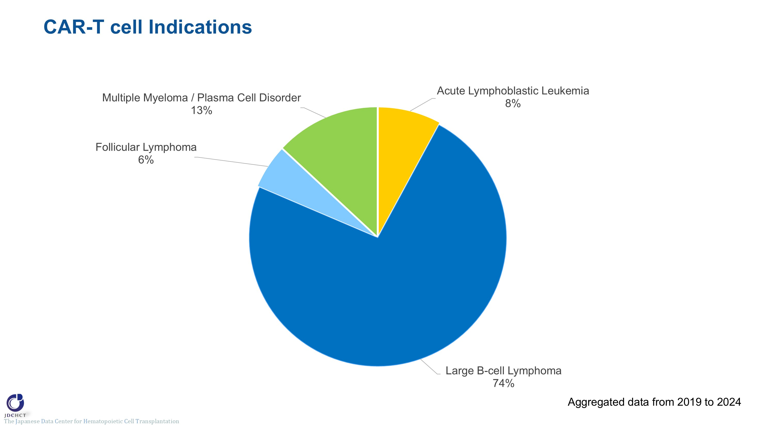
CAR-T cell Indications
Notes:
The most common indication for CAR-T cell therapy at infusion is large B-cell lymphoma, accounting for 74% of all cases. Follicular lymphoma accounts for 6%. Multiple myeloma / plasma cell disorder and acute leukemia account for 13% and 8% respectively.

Slide 5
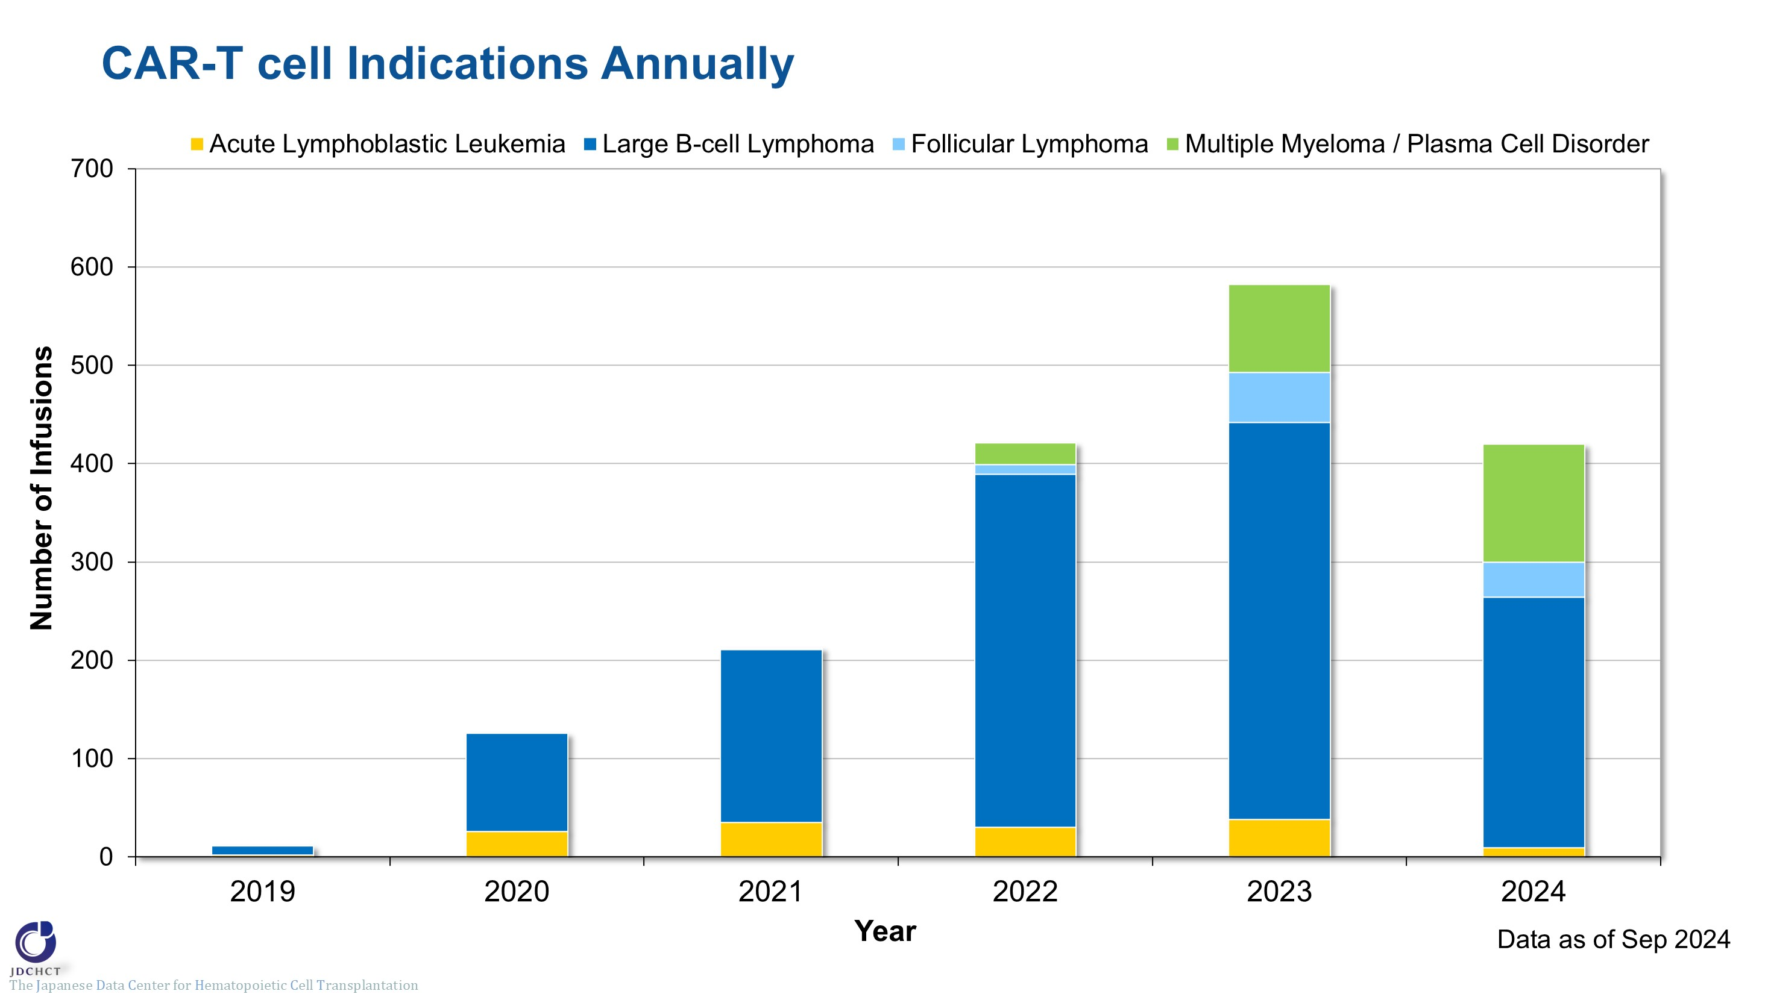
CAR-T cell Indications Annually
Notes:
The number of CAR-T cell infusions for large B-cell lymphoma has increased, with 404 infusions in 2023. The number of CAR-T cell infusions for follicular lymphoma was 51 in 2023.
Approximately 30 CAR-T cell infusions for acute lymphocytic leukemia have been registered annually.
The number of CAR-T cell infusions for multiple myeloma / plasma cell disorder has increased after approval of CAR-T products in 2022.

Slide 6
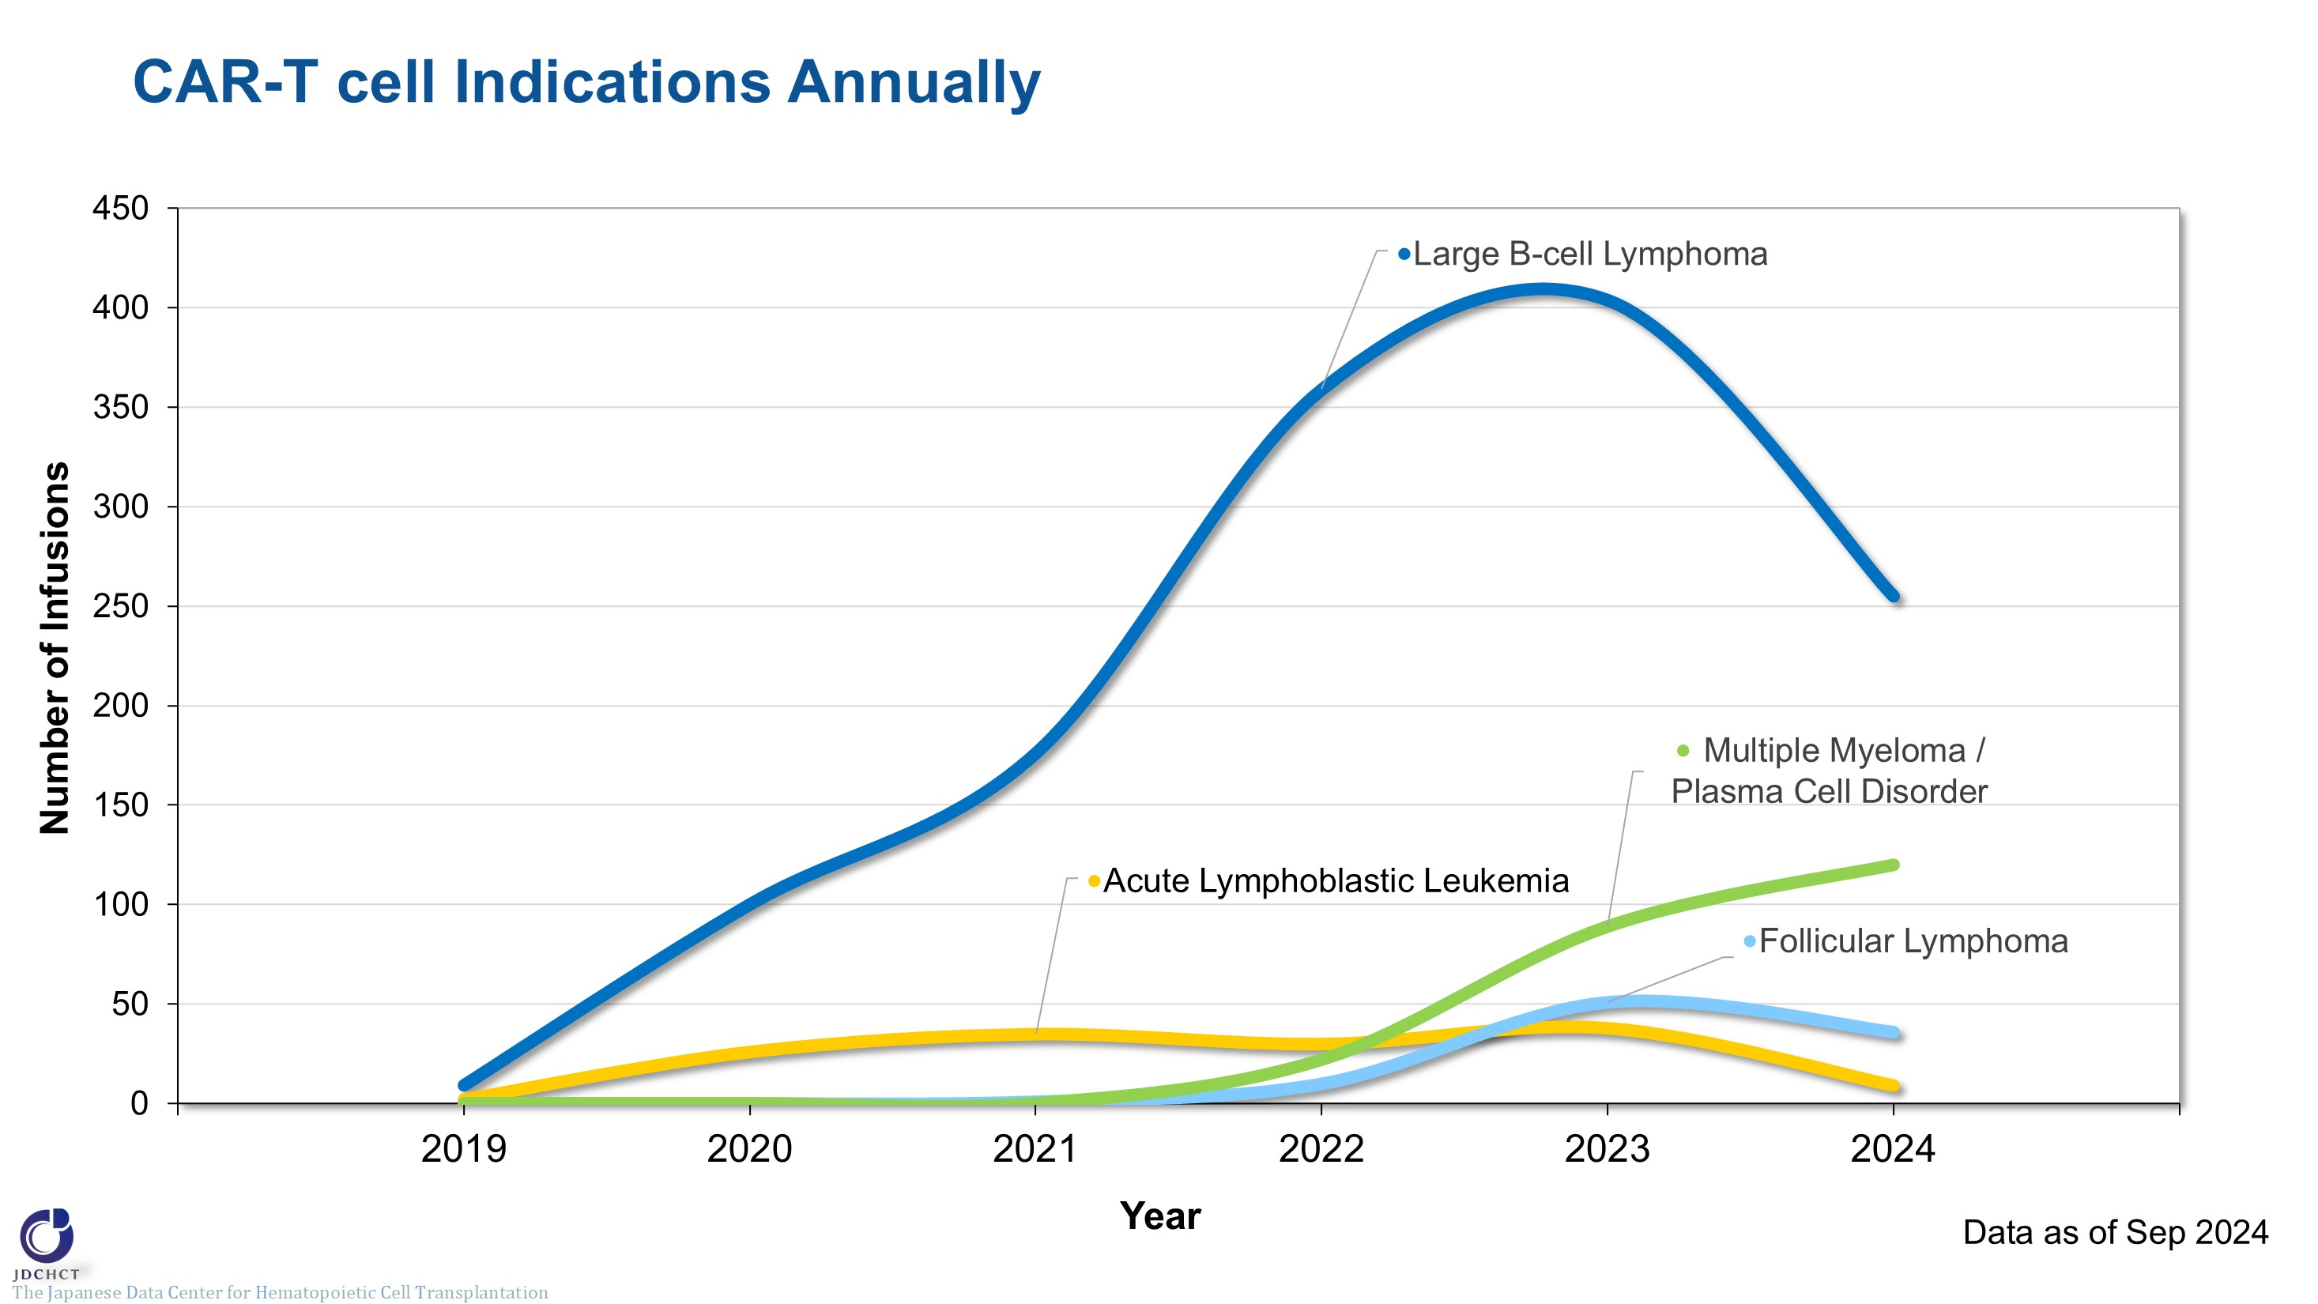
CAR-T cell Indications Annually
Notes:
The number of CAR-T cell infusions for large B-cell lymphoma has increased, with 404 infusions in 2023. The number of CAR-T cell infusions for follicular lymphoma was 51 in 2023.
Approximately 30 CAR-T cell infusions for acute lymphocytic leukemia have been registered annually.
The number of CAR-T cell infusions for multiple myeloma / plasma cell disorder has increased after approval of CAR-T products in 2022.

Slide 7
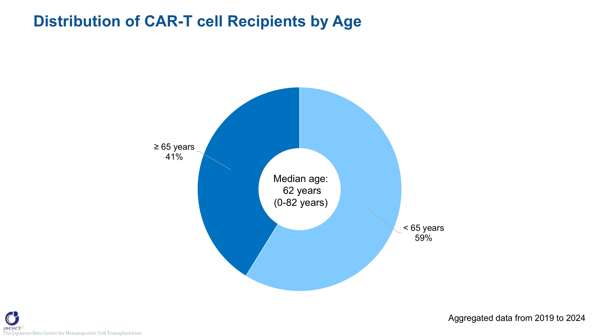
Distribution of CAR-T cell Recipients by Age
Notes:
The median age at the time of CAR-T cell infusion was 62 years (0-82 years). Those aged 65 years or older have recently accounted for 41% of all patients.

Slide 8
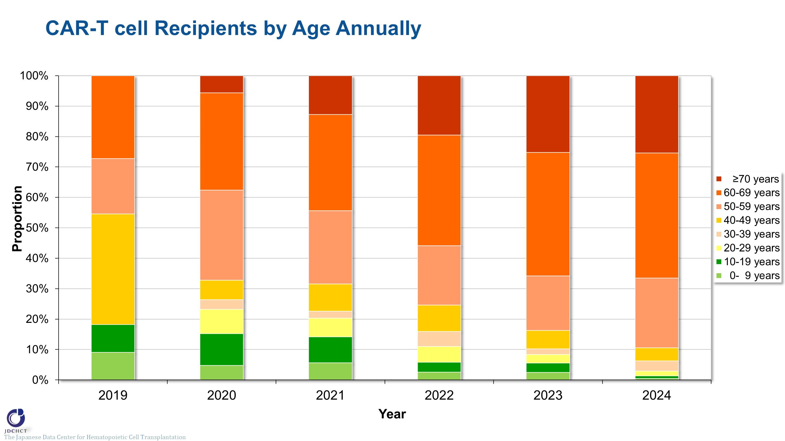
CAR-T cell Recipients by Age Annually
Notes:
The trend of the composition of CAR-T cell infusions by age group demonstrates that the proportion of older patients has increased year by year. Those aged 60 to 69 years accounted for 41% of all patients and those aged 70 years or older accounted for 25% of the total in 2023.

Slide 9
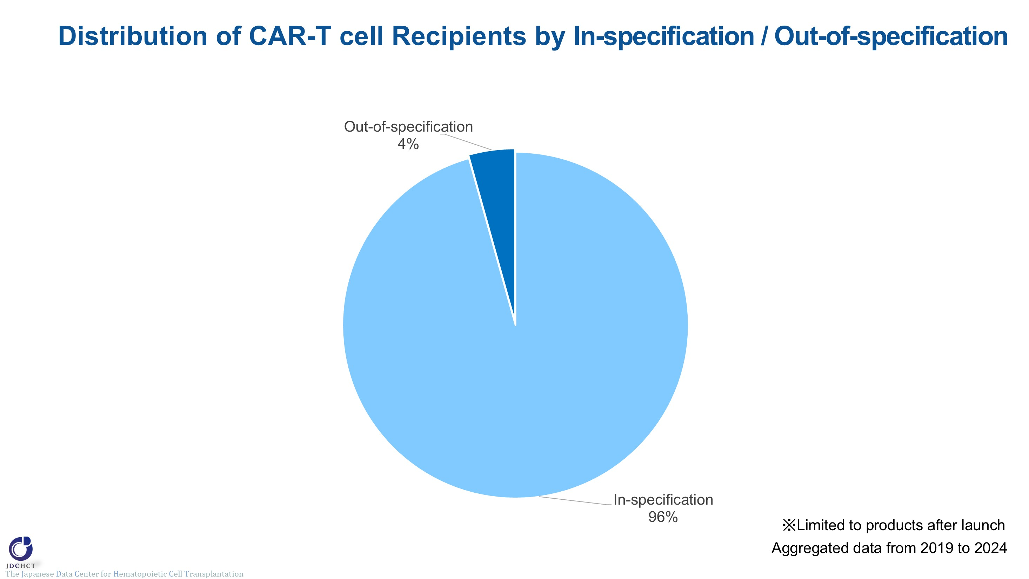
Distribution of CAR-T cell Recipients by In-specification / Out-of-specification
Notes:
It is possible that the final product of CAR-T cells may not meet specifications, termed out of specification (OOS). OOS products may be provided under corporate clinical trials to patients who have no other treatment options. OOS products accounted for 4% of the total CAR-T cell infusions. (Only post-launch products were included for the analysis.)

Slide 10
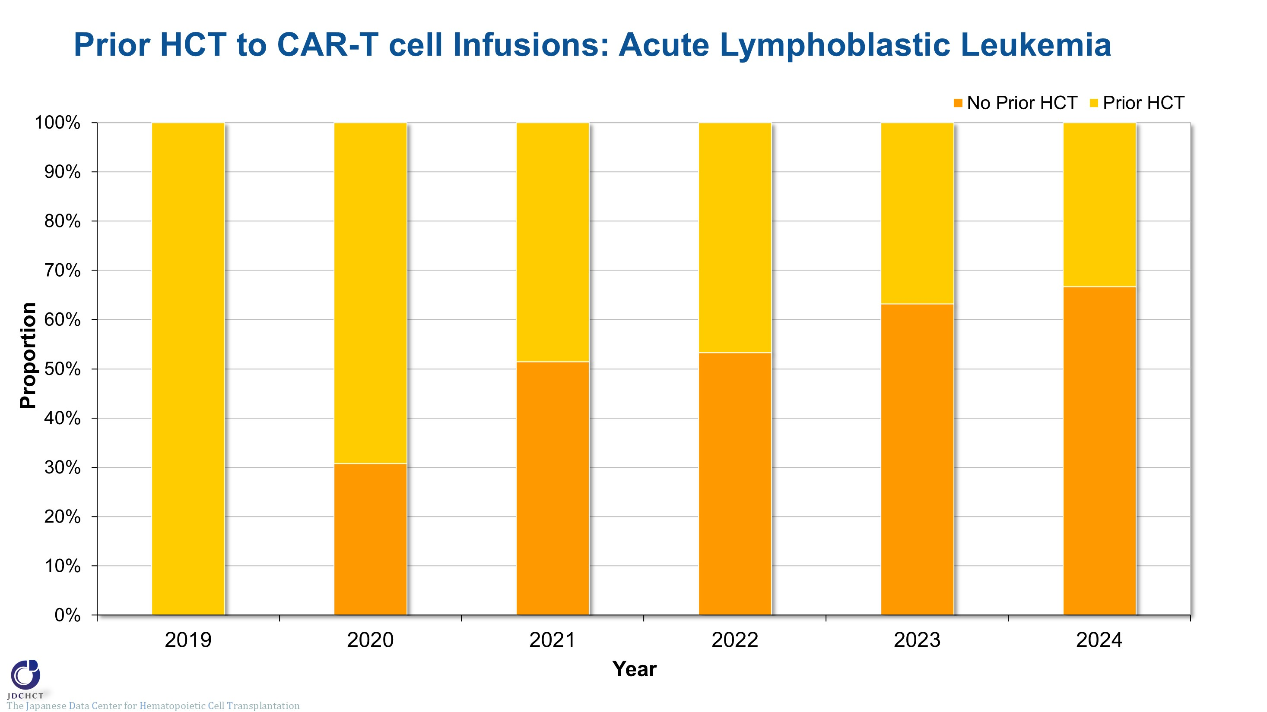
Prior HCT to CAR-T cell Infusions: Acute Lymphoblastic Leukemia
Notes:
This slide illustrates the proportion of patients with acute lymphoblastic leukemia with prior hematopoietic cell transplant. The percentage of patients who did not receive a hematopoietic cell transplant prior to CAR-T cell therapy is increasing, with 63% of patients with acute lymphoblastic leukemia in 2023.

Slide 11
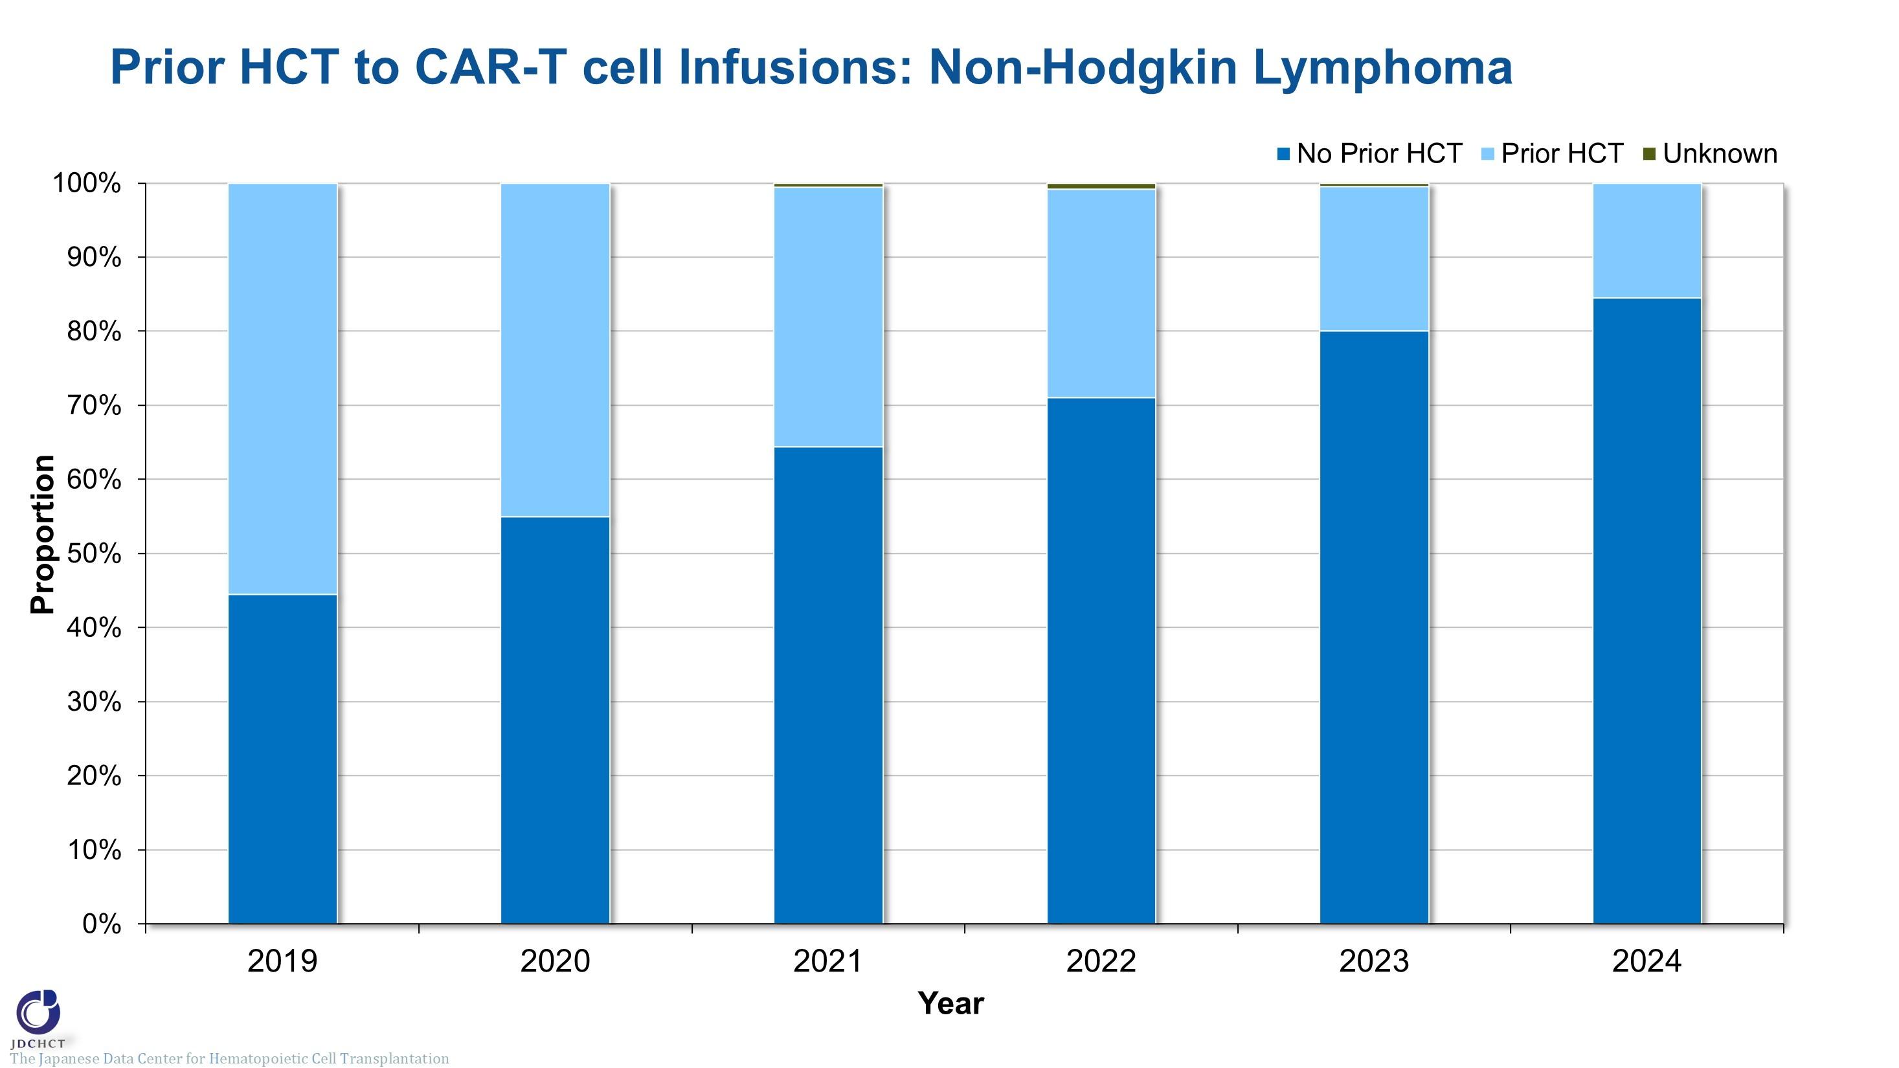
Prior HCT to CAR-T cell Infusions: Non-Hodgkin Lymphoma
Notes:
This slide illustrates the proportion of patients with non-Hodgkin lymphoma with prior hematopoietic cell transplant. The percentage of patients who did not receive a hematopoietic cell transplant prior to CAR-T cell therapy is increasing, with 80% of patients with non-Hodgkin lymphoma in 2023.

