Slide 2
Introduction

Slide 3
Annual Number of Transplant Recipients in the Japan by Transplant Type
Notes:
In Japan, registration for bone marrow transplantation from unrelated donors was started in 1993 and the first case of cord blood transplantation was performed in 1997. Since these times, transplantation from unrelated donors has spread and the total number of allogeneic transplant recipients has increased. Recently, the annual number of autologous and allogeneic transplants registration extends to round 5,400.

Slide 4
Transplant Recipients in the Japan, by Donor Type and Stem Cell Sources (Autologous/Allogeneic)
The Japanese Data Center for Hematopoietic Cell Transplantation
4
Notes:
In Japan, since 1993 in which registration for bone marrow transplantation from unrelated donors was started and since 1997 in which the first case of cord blood transplantation was performed, transplantation from unrelated donors has spread and the total number of transplant recipients has increased. In particular, the increase in cord blood transplants is remarkable. For autologous transplants, the annual number of cases registered has been approximately 1,800 for past several years, for which the stem cell source is peripheral blood in the vast majority of cases.

Slide 5
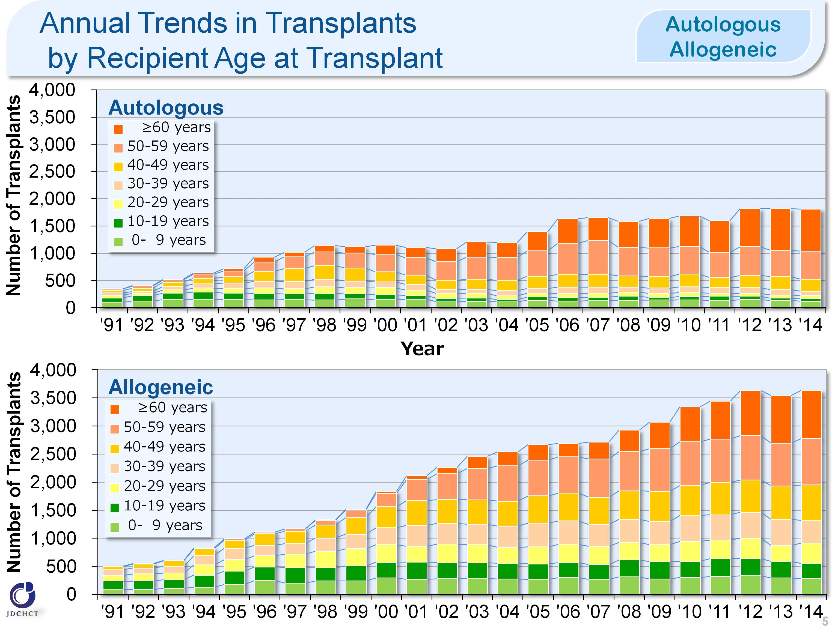
Annual Trends in Transplants by Recipient Age at Transplant (Autologous/Allogeneic)
Notes:
Due to the spread of transplants with reduced intensity conditioning (RIC), the age groups in which transplantation is indicated have expanded, and the number of transplants in older age groups has increased.

Slide 6
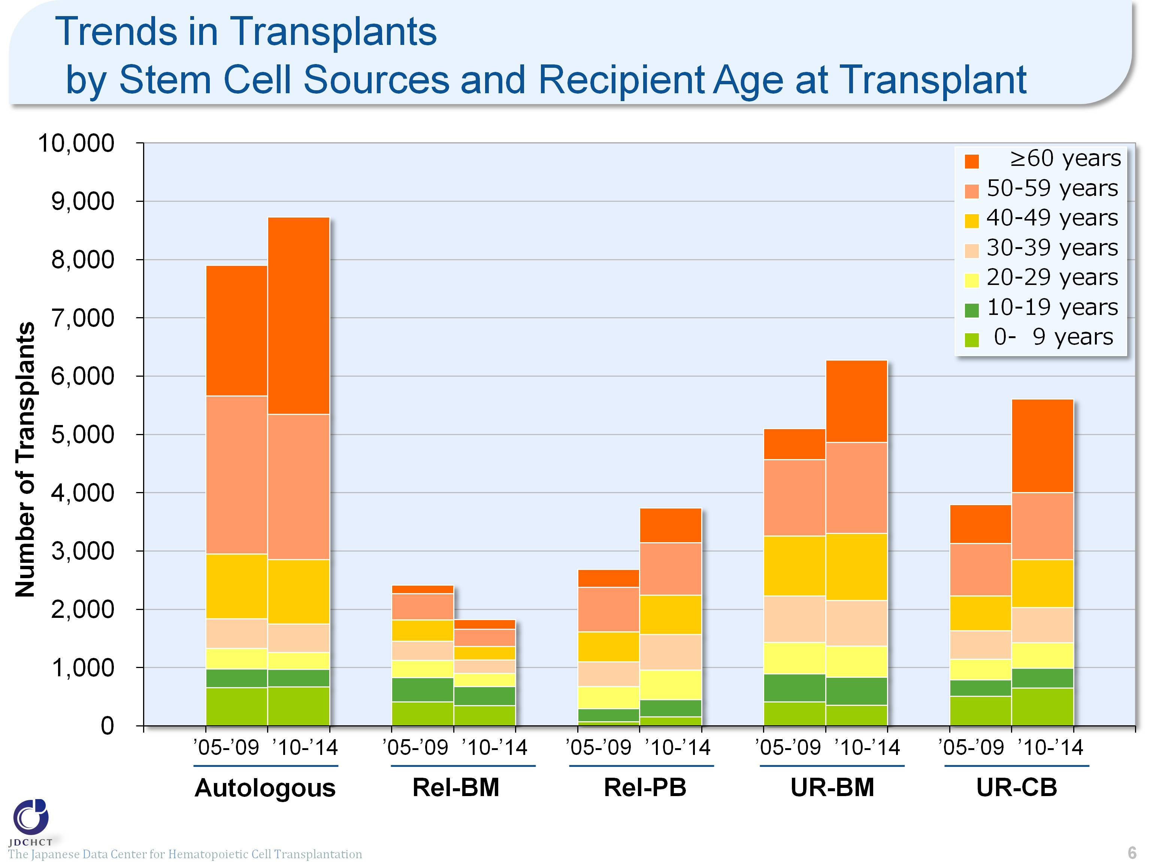
Trends in Transplants by Stem Cell Sources and Recipient Age at Transplant
The Japanese Data Center for Hematopoietic Cell Transplantation
Notes:
The spread of transplants with reduced intensity conditioning (RIC), has expanded the age groups in which transplantation is indicated. The number of transplants from unrelated donors (for bone marrow and cord blood) shows a trend towards an increase in all age groups and in particular, the older age groups.

Slide 7
Trends in Transplants for Leukemia and Malignant Lymphoma by Recipient Age at Transplant
The Japanese Data Center for Hematopoietic Cell Transplantation
Notes:
When compared with the situation 10 years ago, the number of transplants was increased by about 40% for leukemia and by 19% for malignant lymphoma. The increase is specially remarkable in the elderly. (In those aged 50 years or older, the number of transplants was increased by 101% for leukemia and by 31% for malignant lymphoma.) In the period from 2010 to 2014, those aged 50 years or older accounted for 46% of the total cases of leukemia and 61% of the total cases of malignant lymphoma.

Slide 8
Indications for Hematopoietic Stem Cell Transplants in 1991-2014 (Age≤15)
The Japanese Data Center for Hematopoietic Cell Transplantation
Notes:
In pediatric patients, allogeneic transplants are most frequently performed for acute leukemia (acute myeloid leukemia and acute lymphoid leukemia), which accounts for about 56% of the total cases of allogeneic transplantation. Following this, allogeneic transplants are also frequently performed for aplastic anemia. Although aplastic anemia is a rare disease, allogeneic transplantation is the first choice for serious and most serious cases. Accordingly, aplastic anemia accounts for about 10% of the allogeneic transplants in pediatric patients.
For solid tumors in pediatric patients, autologous transplants are performed in order to rescue hematopoietic dysfunction due to high-dose chemotherapy and therefore, autologous transplantation accounts for 87% of the total number of transplants.

Slide 9
Indications for Hematopoietic Stem Cell Transplants in 1991-2014 (Age≥16)
The Japanese Data Center for Hematopoietic Cell Transplantation
Notes:
In patients aged 16 years or older, allogeneic transplants are most frequently performed for acute leukemia (acute myeloid leukemia and acute lymphoid leukemia), which accounts for about 56% of the total cases of allogeneic transplants. Following this, allogeneic transplants are also frequently performed in non-Hodgkin lymphoma, myelodysplastic syndrome and chronic myeloid leukemia.
In 2001, imatinib was officially approved in Japan as a molecular targeted therapy for chronic myeloid leukemia and subsequently, nilotinib and dasatinib were approved. Since then, transplantation for chronic myeloid leukemia has shown a tendency to decrease.
For malignant lymphoma, the number of patients with this disease has increased. However, since rituximab, chemotherapy, and radiotherapy are effective in many cases, allogeneic transplantation is not commonly the first choice.
Multiple myeloma occurs more frequently in the elderly and the number of patients with multiple myeloma has shown a tendency to increase, as in malignant lymphoma. High-dose chemotherapy in combination with autologous transplantation is the established standard therapy for multiple myeloma in patients aged 65 years or younger, and autologous transplants account for about 95% of the first transplantation cases.

Slide 10
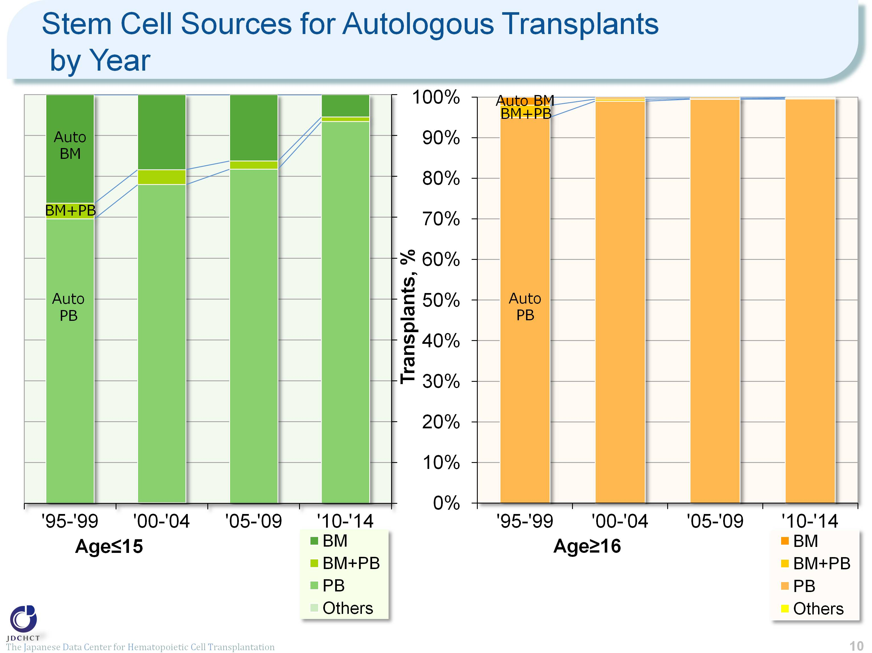
Stem Cell Sources for Autologous Transplants by Year
The Japanese Data Center for Hematopoietic Cell Transplantation
Notes:
In the period from 2010 to 2014, peripheral blood stem cell transplantation accounts for about 93% and 99% of the total cases of autologous transplants in patients aged 0 to 15 years and in those aged 16 years or older, respectively. The process of collecting peripheral blood stem cells poses less burden to patients than the harvesting procedure in bone marrow transplantation. Since 2000, the process of collecting peripheral blood stem cells for transplantation through the use of granulocyte-colony stimulating factor (G-CSF) has been covered by the national health insurance. For these reasons, the number of autologous peripheral blood stem cell transplantation has increased, whereas autologous bone marrow transplants have shown a tendency to decrease.

Slide 11
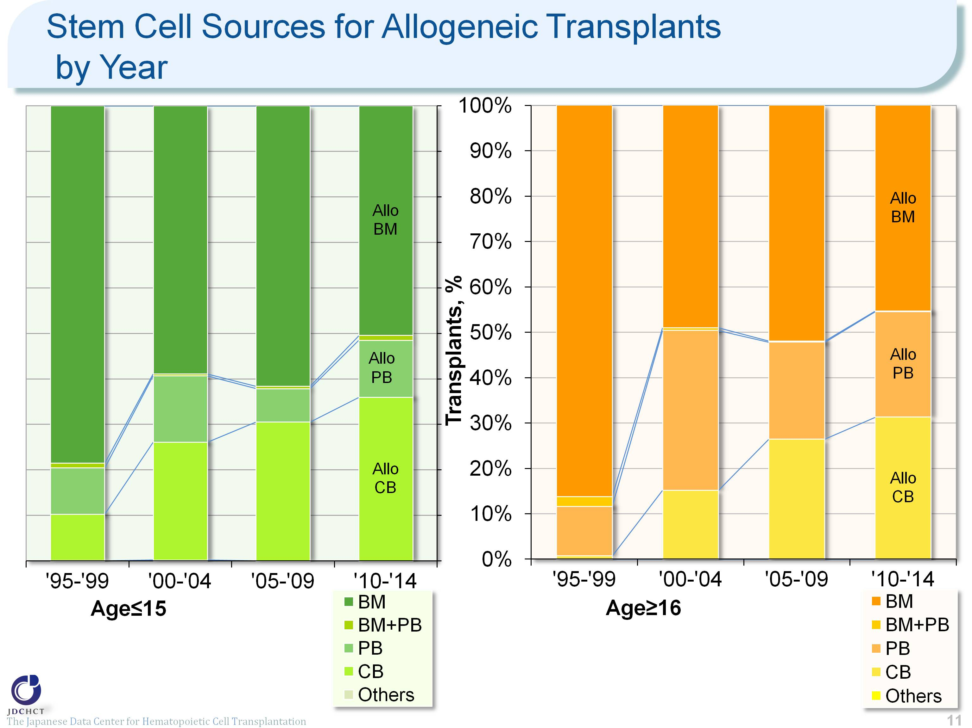
Stem Cell Sources for Allogeneic Transplants by Year
The Japanese Data Center for Hematopoietic Cell Transplantation
Notes:
The spread of cord blood transplantation has made the proportion of allogeneic bone marrow transplantation show a tendency to decrease. However, the number of both bone marrow transplants and cord blood transplants has recently shown a tendency to increase.
In recent years, cord blood transplants account for about 30% of the total cases of allogeneic transplantation.

Slide 12
Stem Cell Sources for Unrelated Donor Transplants by Year
The Japanese Data Center for Hematopoietic Cell Transplantation
Notes:
In transplantation from unrelated donors, the increased number of cord blood transplants has recently resulted in the similar proportion between bone marrow transplants and cord blood transplants.

Slide 13
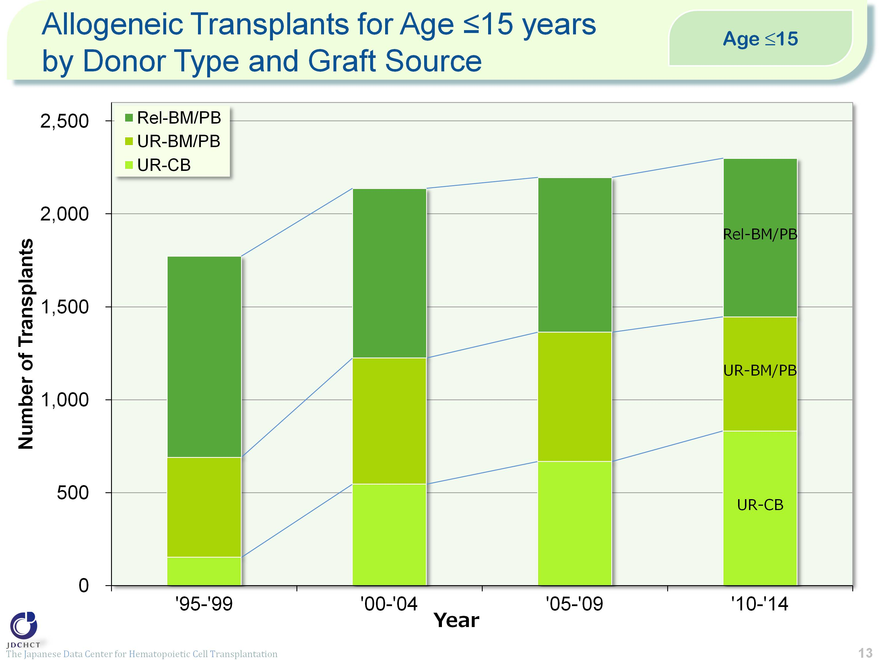
Allogeneic Transplants for Age ≤15 years by Donor Type and Graft Source
Notes:
Transplantation from unrelated donors has increased more markedly than transplantation from related donors. The ratio of transplantation from related donors to that from unrelated donors is 37% to 63%.

Slide 14
Allogeneic Transplants for Age 16 - 50 years by Donor Type and Graft Source
Notes:
Bone marrow transplantation from related donors and peripheral blood stem cell transplantation from related donors have leveled off, whereas the number of bone marrow transplants from unrelated donors and that of cord blood transplants from unrelated donors have shown an increasing trend.

Slide 15
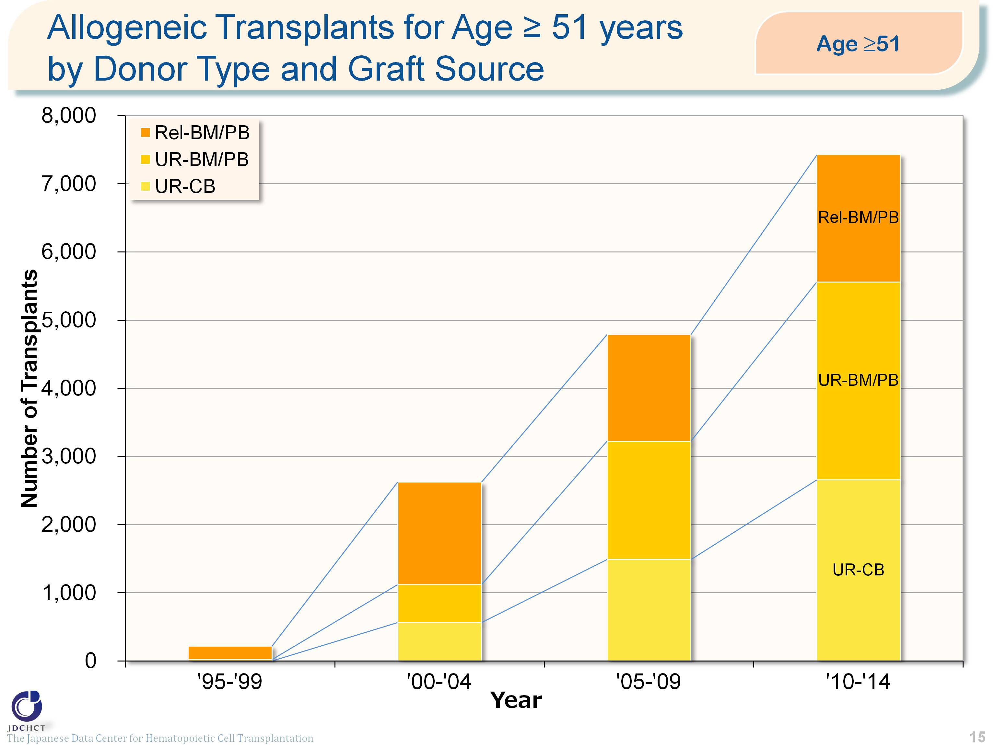
Allogeneic Transplants for Age ≥ 51 years by Donor Type and Graft Source
Notes:
Due to the spread of transplants with reduced intensity conditioning (RIC), in all types of allogeneic transplants, the number has remarkably increased in the elderly.

Slide 16
Trends in Transplants by Disease Status (Risk) at Transplant （AML/ALL/CML/MDS)
The Japanese Data Center for Hematopoietic Cell Transplantation
Notes:
Even in the advanced risk group of patients with leukemia for whom the disease condition is difficult to treat, transplants from unrelated donors (for bone marrow and cord blood) have increased in number.
―≪Disease risk status at transplantation≫―――――――――――――――――
■Standard Risk Group
・AML (first complete remission[1CR]／second complete remission[2CR])
・ALL (1CR)
・CML (1CR)
・MDS (Refractory anemia[RA] ／Refractory anemia with ring sideroblasts[RARS])
■Advanced Risk Group
・all other conditions
________________________________________________________________________________________________________________________

Slide 17
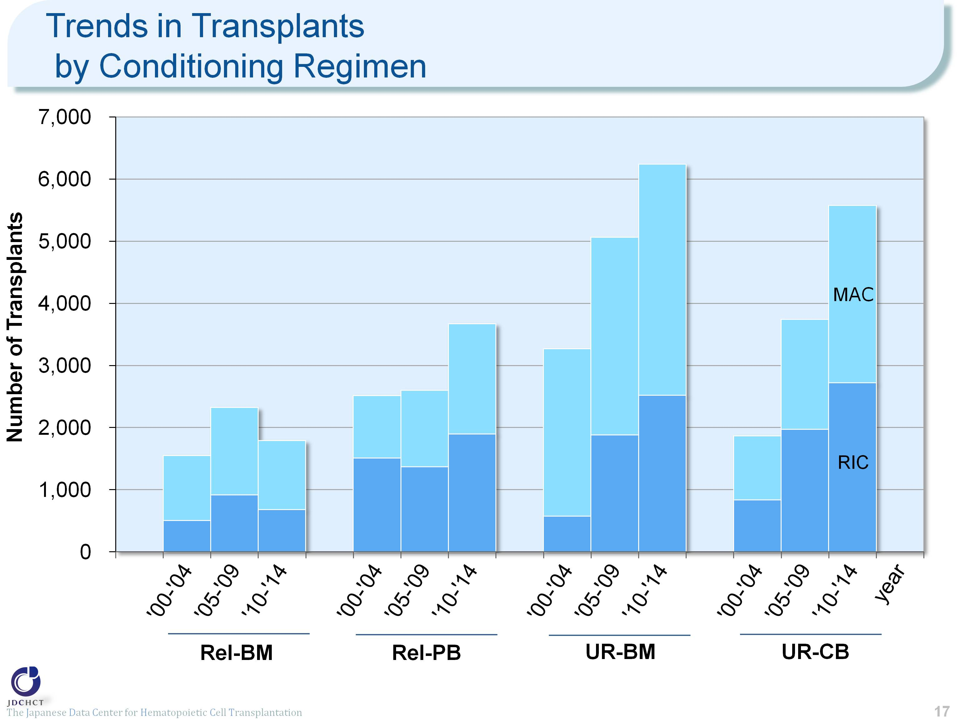
Trends in Transplants by Conditioning Regimen
The Japanese Data Center for Hematopoietic Cell Transplantation
Notes:
The spread of the reduced intensity conditioning (RIC) to reduce toxicity has expanded the scope of indication of transplantation to the elderly, which has greatly contributed to the increased number of overall transplants.
―≪Conditioning regimen≫―――――――――――――――――――――――――――――――――――――――――――――――――――――
■Myeloablative conditioning (MAC)
Pre-transplantation therapy with the primary purpose of totally destroying cancer cells, together with normal blood cells, in the bone marrow by total body irradiation or high-dose chemotherapy
■Reduced-intensity conditioning (RIC)
Pre-transplantation therapy with the primary purpose of suppressing the patient’s immune system with drugs which do not have strong myelosuppressive effects
_______________________________________________________________________________________________________________________________________________________________________________________________________________________

Slide 18
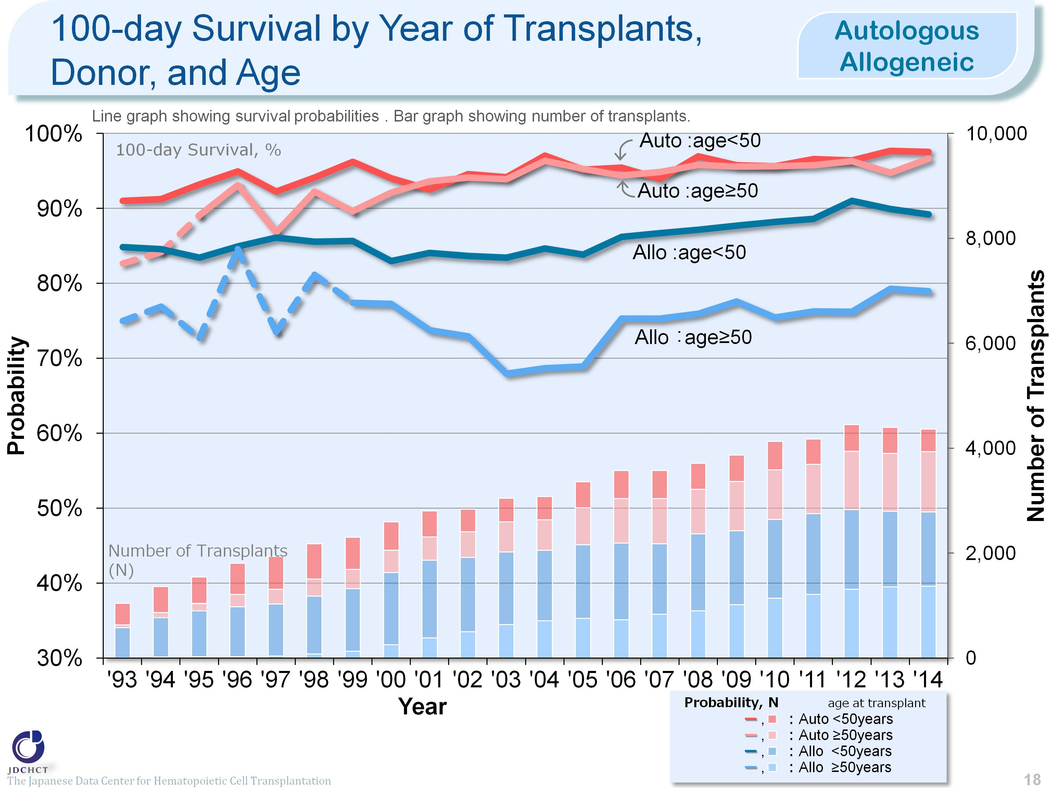
100-day Survival by Year of Transplants, Donor, and Age <Autologous/Allogeneic>
The Japanese Data Center for Hematopoietic Cell Transplantation
Notes:
The survival probabilies 100 days after transplantation have shown slightly increasing trends over the last decade in both autologous and allogeneic transplant recipients.
The survival probabilies 100 days after autologous transplantation are similar between those aged 49 years or younger (<50) and those aged 50 years or older (≥50).
※This table shows the results of analysis performed on patients who received first transplants.
※Cases of peripheral blood stem cell transplantation from unrelated donors are not included in this analysis.
※The dotted lines (---) indicate the survival probabilies calculated when the number of transplants was below 100.

Slide 19
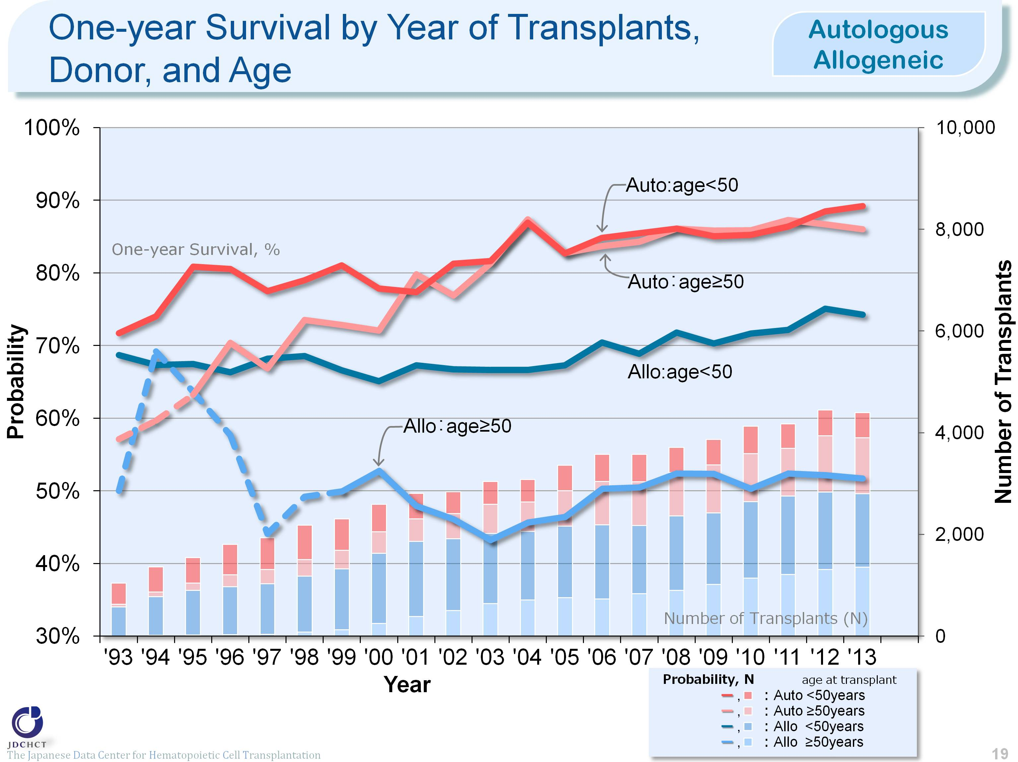
One-year Survival by Year of Transplants, Donor, and Age <Autologous/Allogeneic>
The Japanese Data Center for Hematopoietic Cell Transplantation
Notes:
The survival probabilies 365 days (1 year) after transplantation have shown increasing trends over the last decade in autologous transplant recipients and those aged 49 years or younger (<50) who received allogeneic transplants.
The survival probabilies 365 days after autologous transplantation are similar between those aged 49 years or younger (<50) and those aged 50 years or older (≥50).
※This table shows the results of analysis performed on patients who received first transplants.
※Cases of peripheral blood stem cell transplantation from unrelated donors are not included in this analysis.
※The dotted lines (---) indicate the survival probabilies calculated when the number of transplants was below 100.

Slide 20
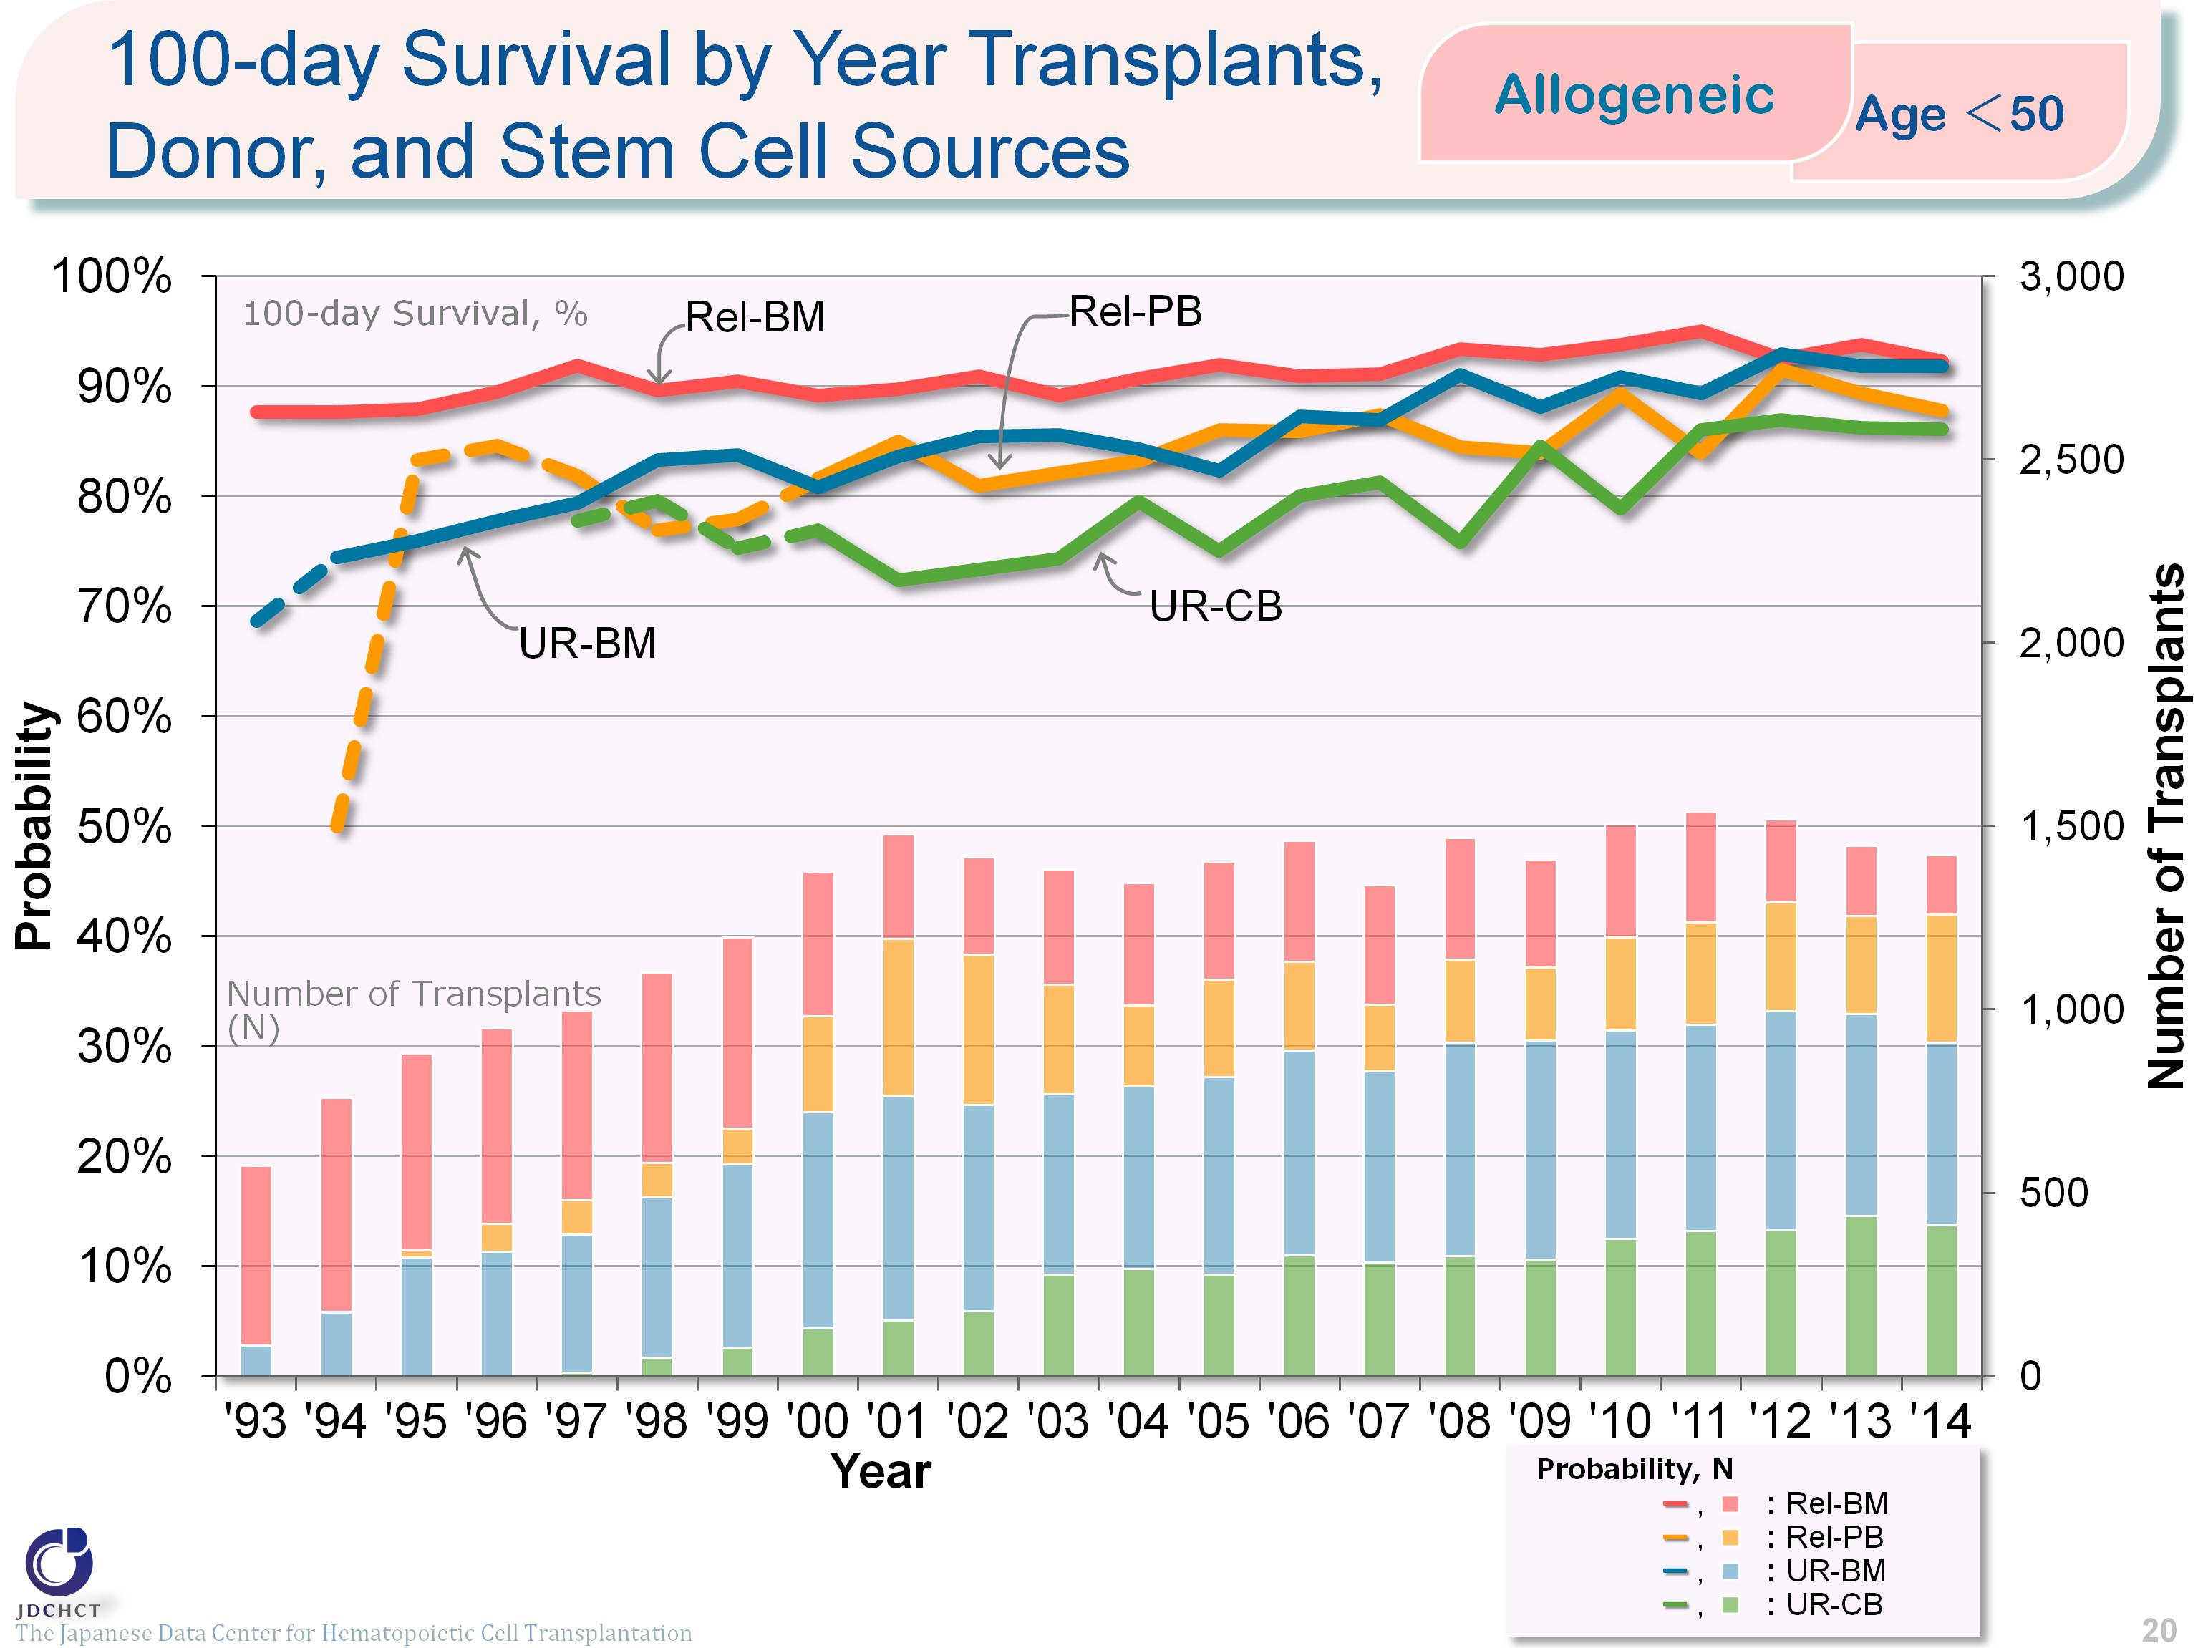
100-day Survival by Year of Allogeneic Transplants, Donor, and Stem Cell Sorce (Age<50)
The Japanese Data Center for Hematopoietic Cell Transplantation
Notes:
In those aged 49 years or younger (<50), the survival probabilies 100 days after transplantation have shown increasing trends over the last decade in both trasnplantation from related and unrelated donors.
Recently, the survival probabilies 100 days after bone marrow transplantation are similar between transplantation from related and unrelated donors.
※This table shows the results of analysis performed on patients who received first transplants.
※Cases of peripheral blood stem cell transplantation from unrelated donors are not included in this analysis.
※The dotted lines (---) indicate the survival probabilies calculated when the number of transplants was below 100.

Slide 21
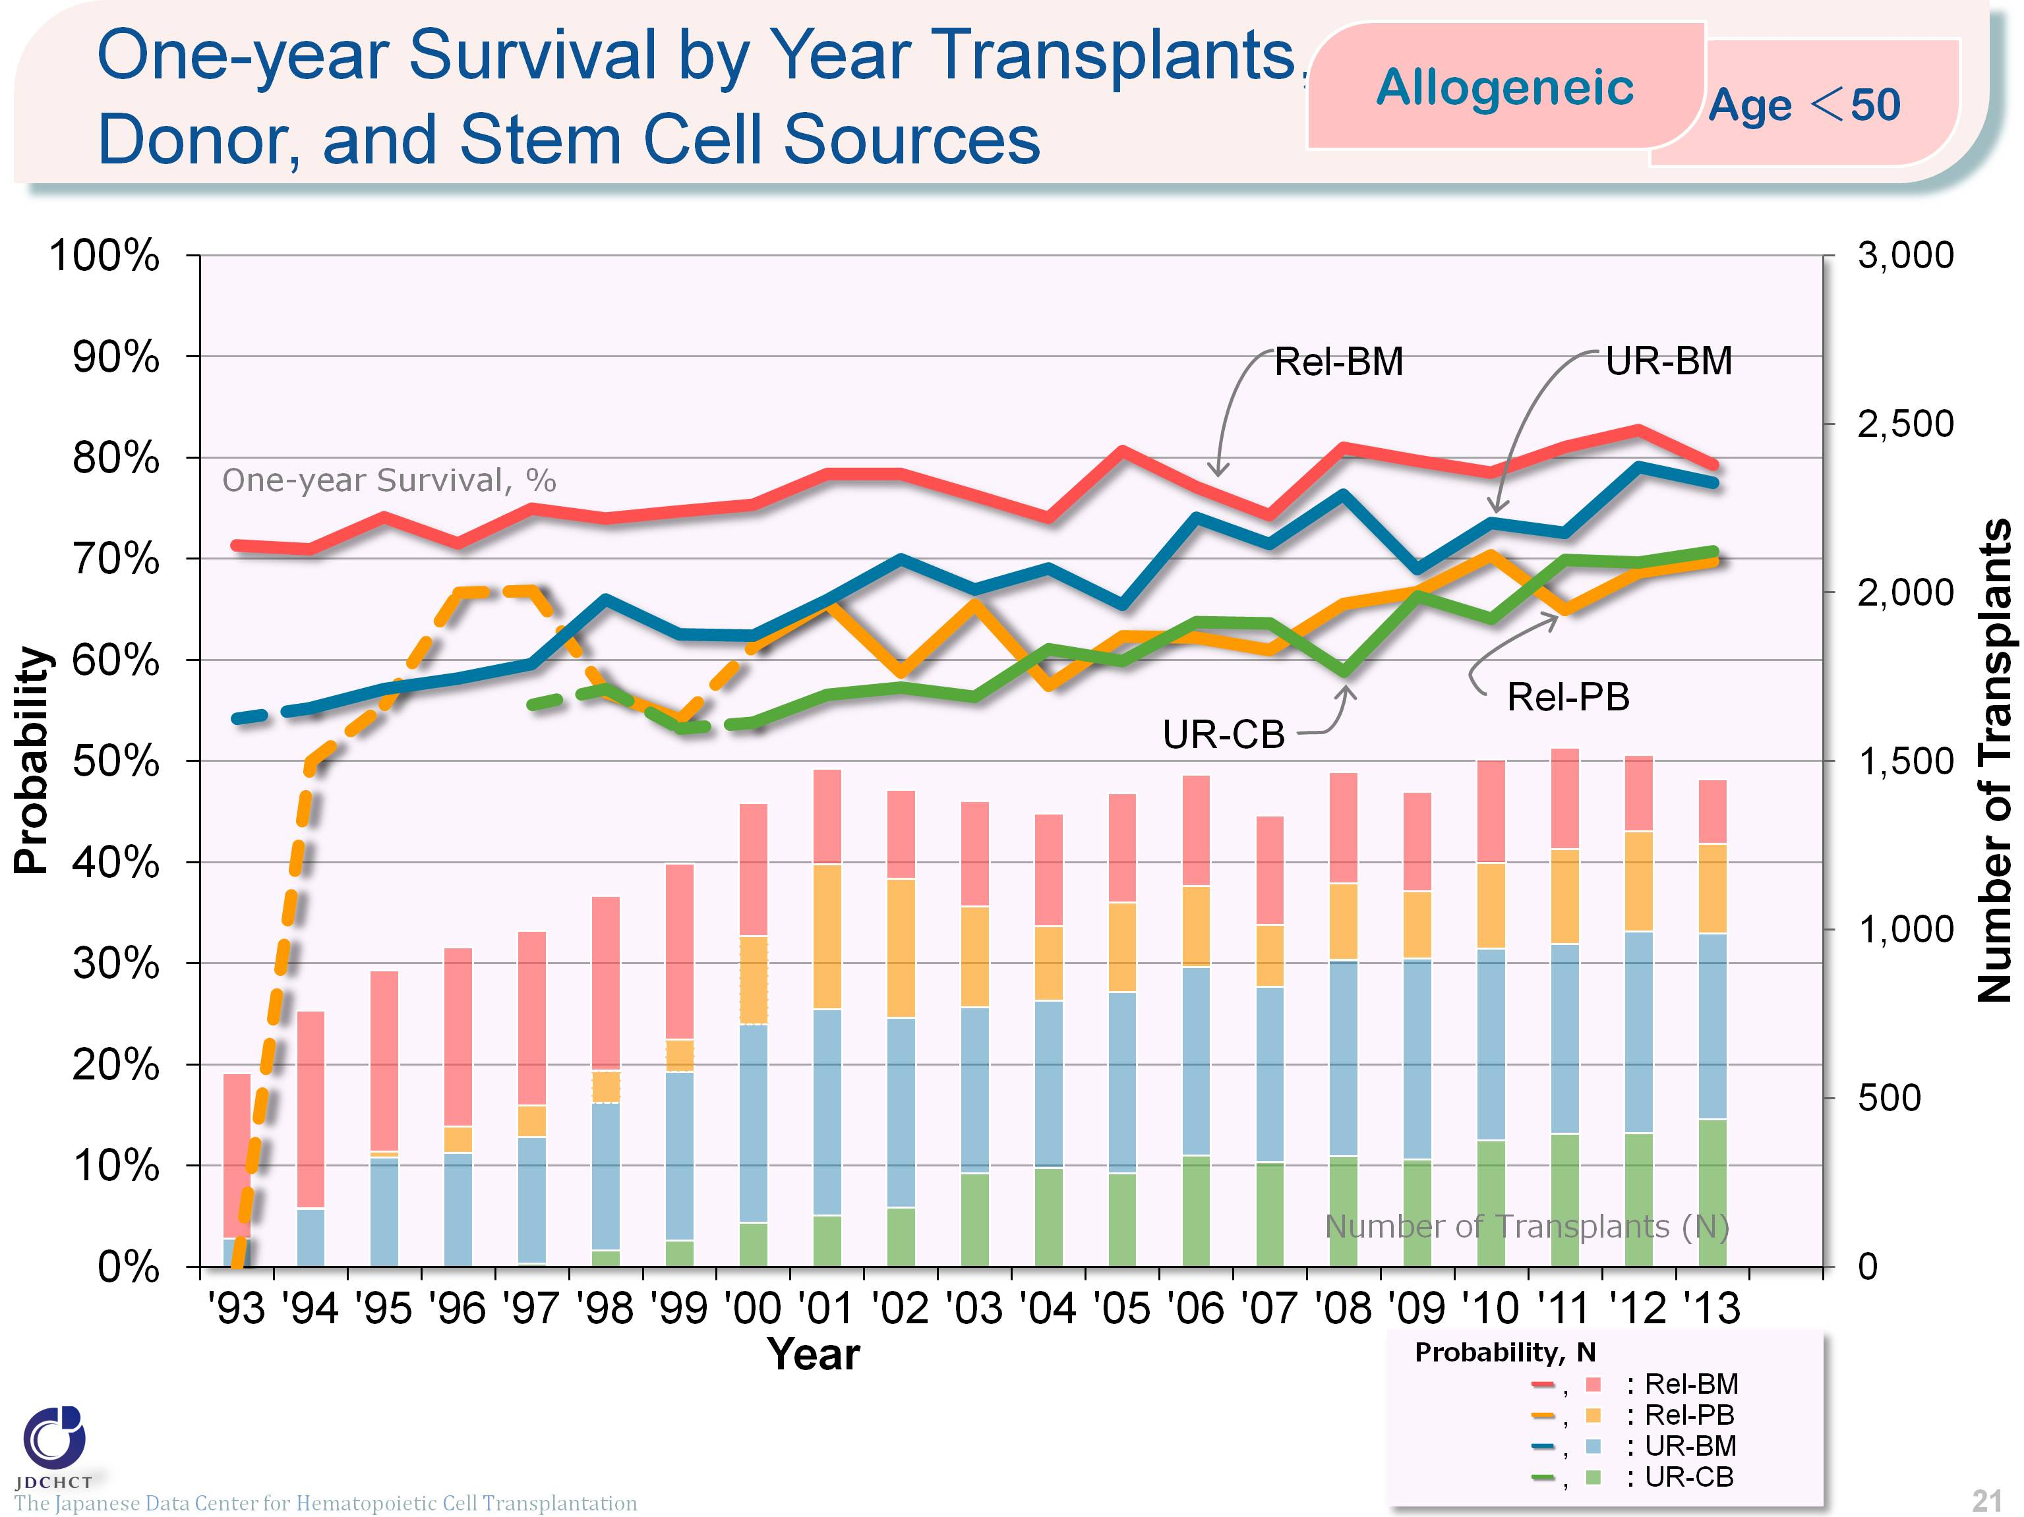
One-year Survival by Year of Allogeneic Transplants, Donor, and Stem Cell Sorce (Age<50)
The Japanese Data Center for Hematopoietic Cell Transplantation
Notes:
In those aged 50 years or younger (<50), the survival probabilies 365 days after transplantation have shown increasing trends over the last decade in both transplantation from related and unrelated donors.
※This table shows the results of analysis performed on patients who received first transplants.
※Cases of peripheral blood stem cell transplantation from unrelated donors are not included in this analysis.
※The dotted lines (---) indicate the survival probabilies calculated when the number of transplants was below 100.

Slide 22
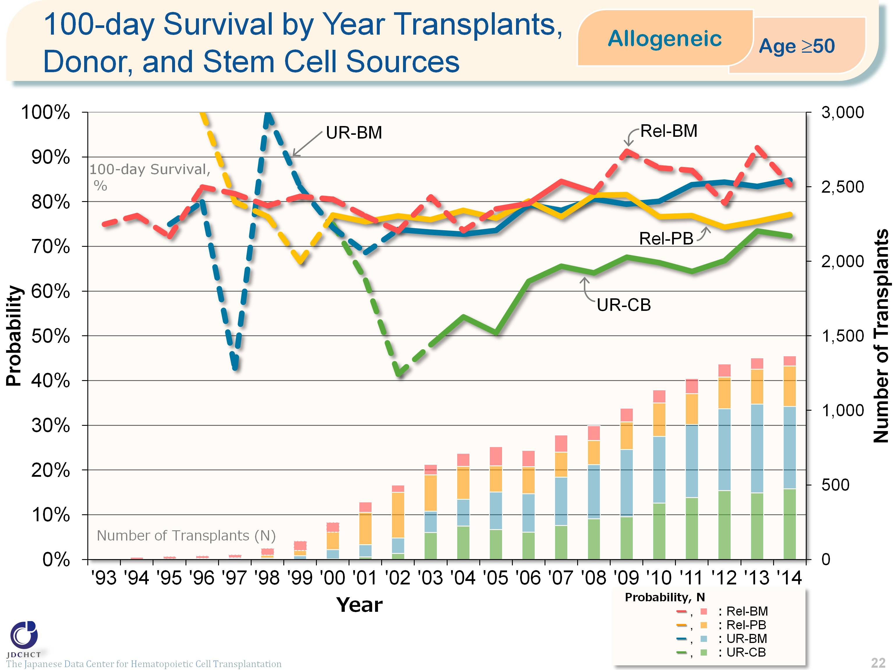
100-day Survival by Year of Allogeneic Transplants, Donor, and Stem Cell Sorce (Age≥50)
The Japanese Data Center for Hematopoietic Cell Transplantation
Notes:
In those aged 50 years or older (≥50), the survival probabilies 100 days after transplantation from unrelated donors have shown increasing trends over the last decade.
※This table shows the results of analysis performed on patients who received first transplants.
※Cases of peripheral blood stem cell transplantation from unrelated donors are not included in this analysis.
※The dotted lines (---) indicate the survival probabilies calculated when the number of transplants was below 100.

Slide 23
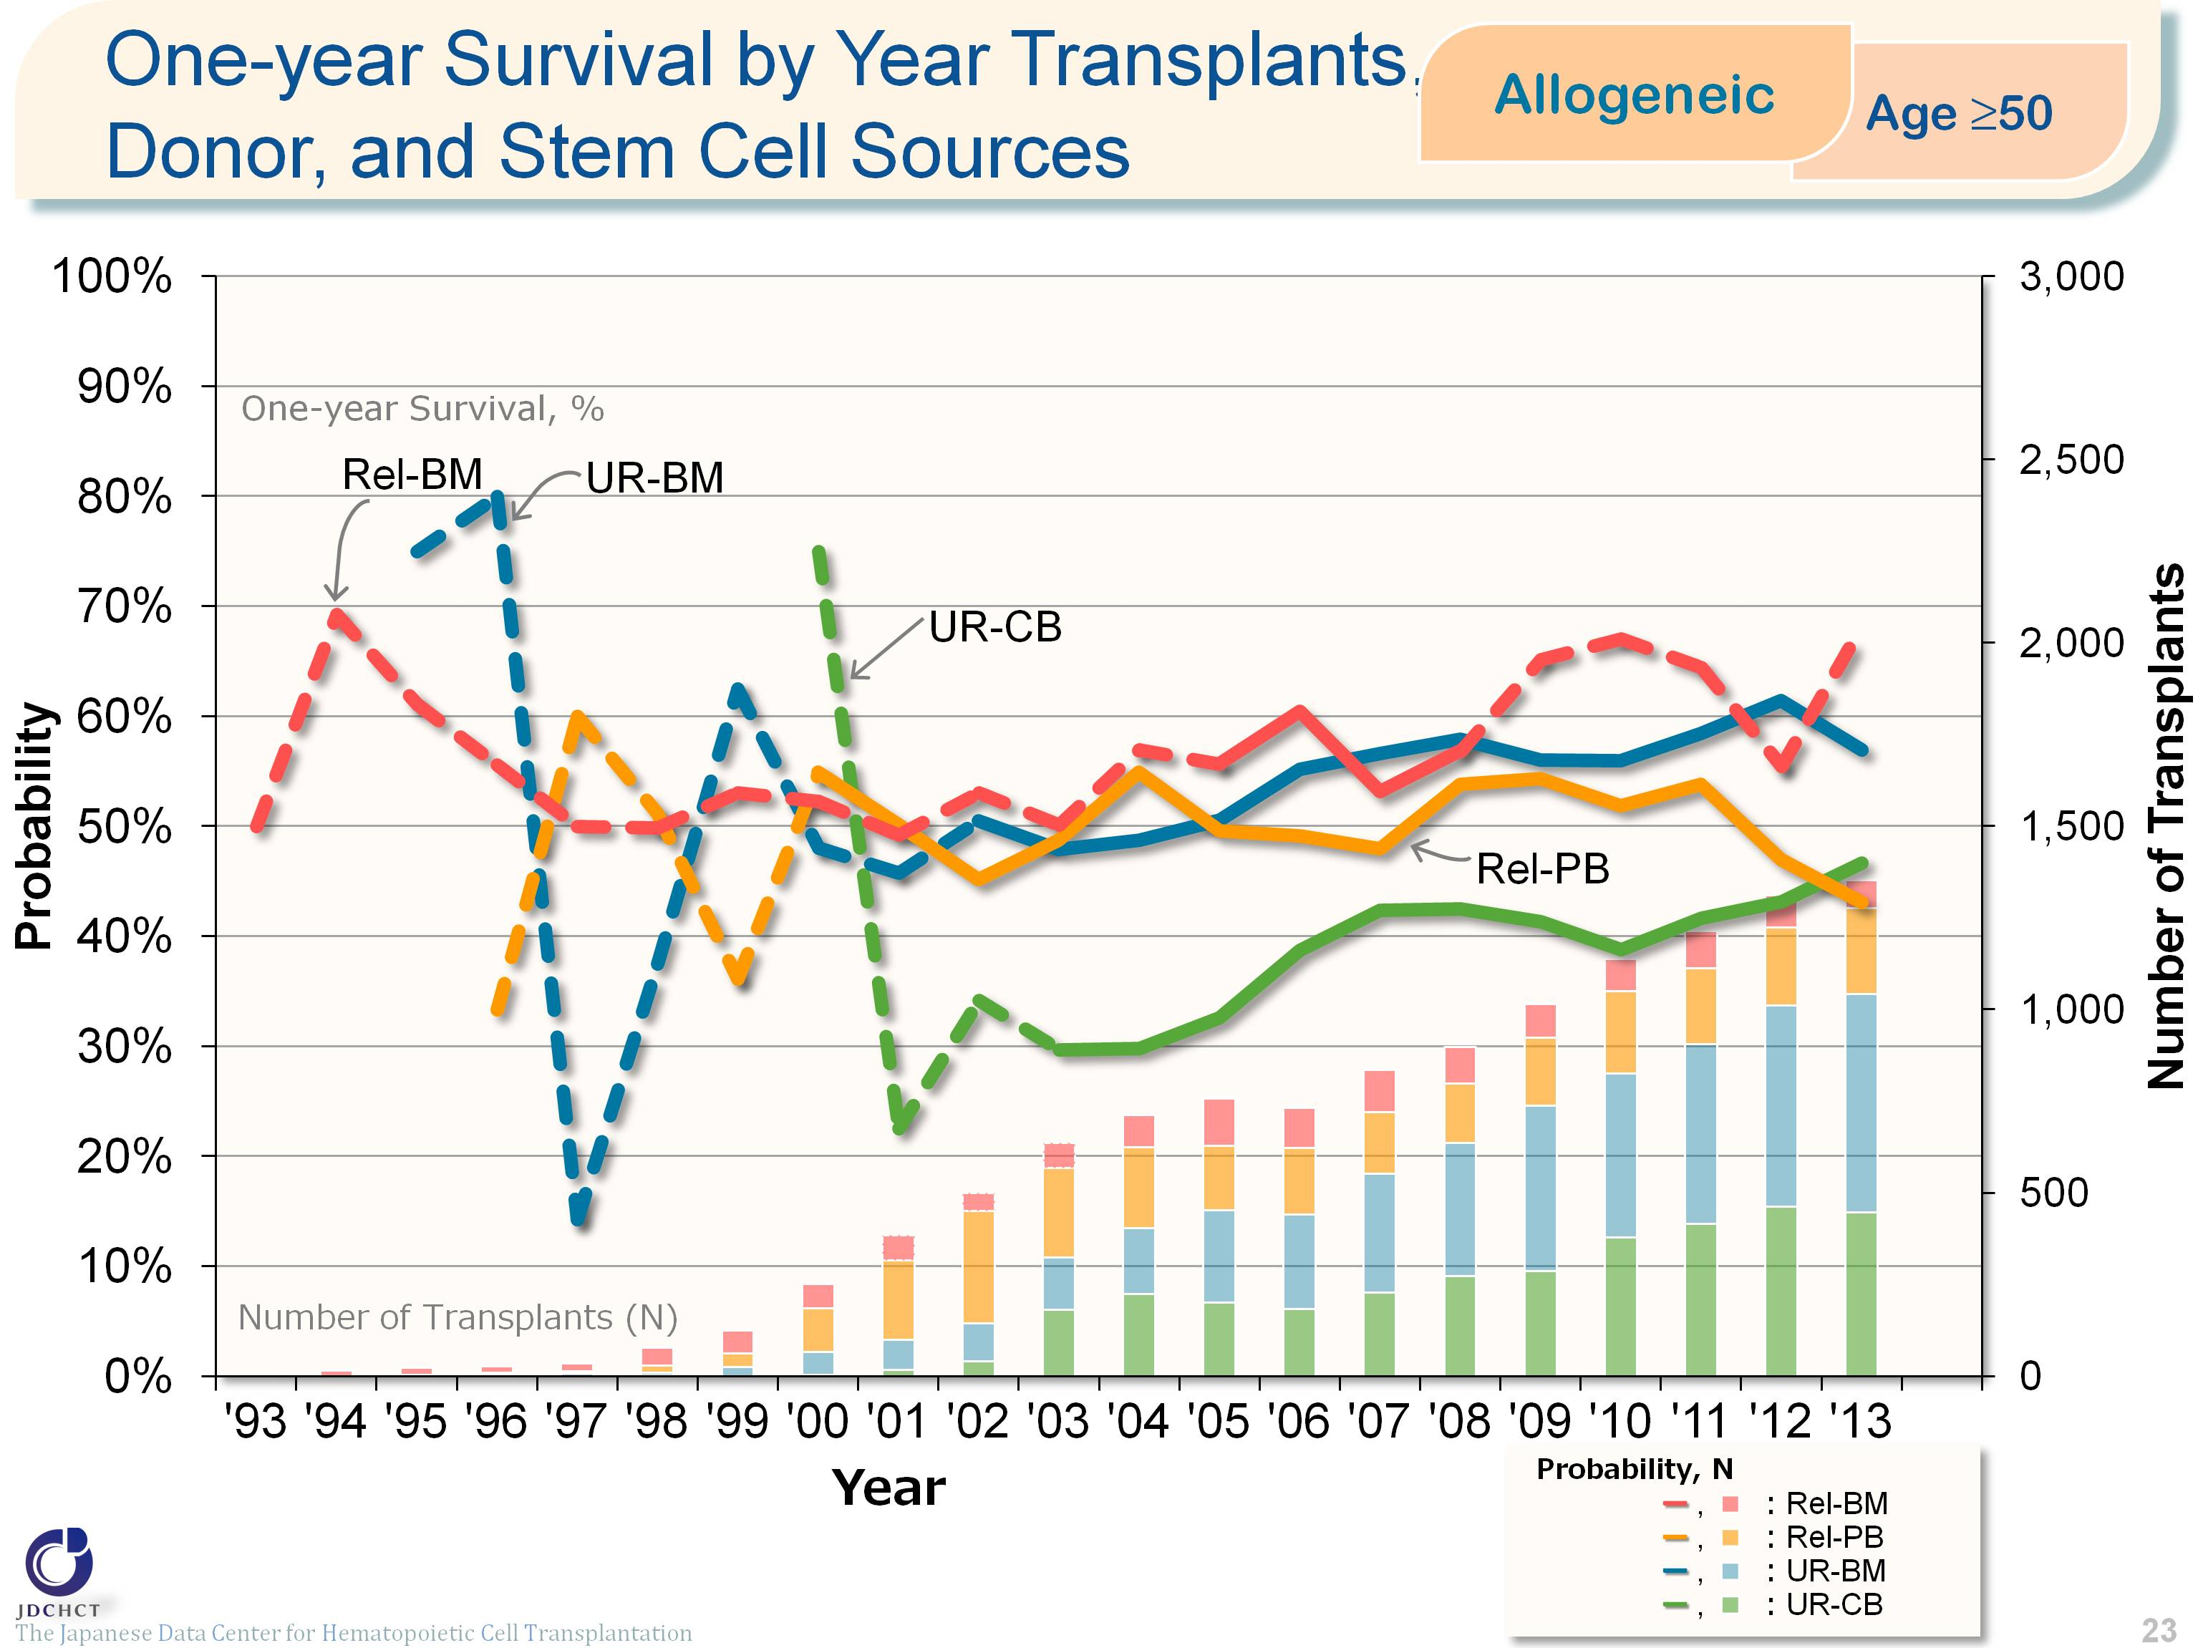
One-year Survival by Year of Allogeneic Transplants, Donor, and Stem Cell Sorce (Age≥50)
The Japanese Data Center for Hematopoietic Cell Transplantation
Notes:
In those aged 50 years or older (≥50), the survival probabilies 365 days after transplantation from unrelated donors have shown increasing trends over the last decade.
※This table shows the results of analysis performed on patients who received first transplants.
※Cases of peripheral blood stem cell transplantation from unrelated donors are not included in this analysis.
※The dotted lines (---) indicate the survival probabilies calculated when the number of transplants was below 100.

Slide 24
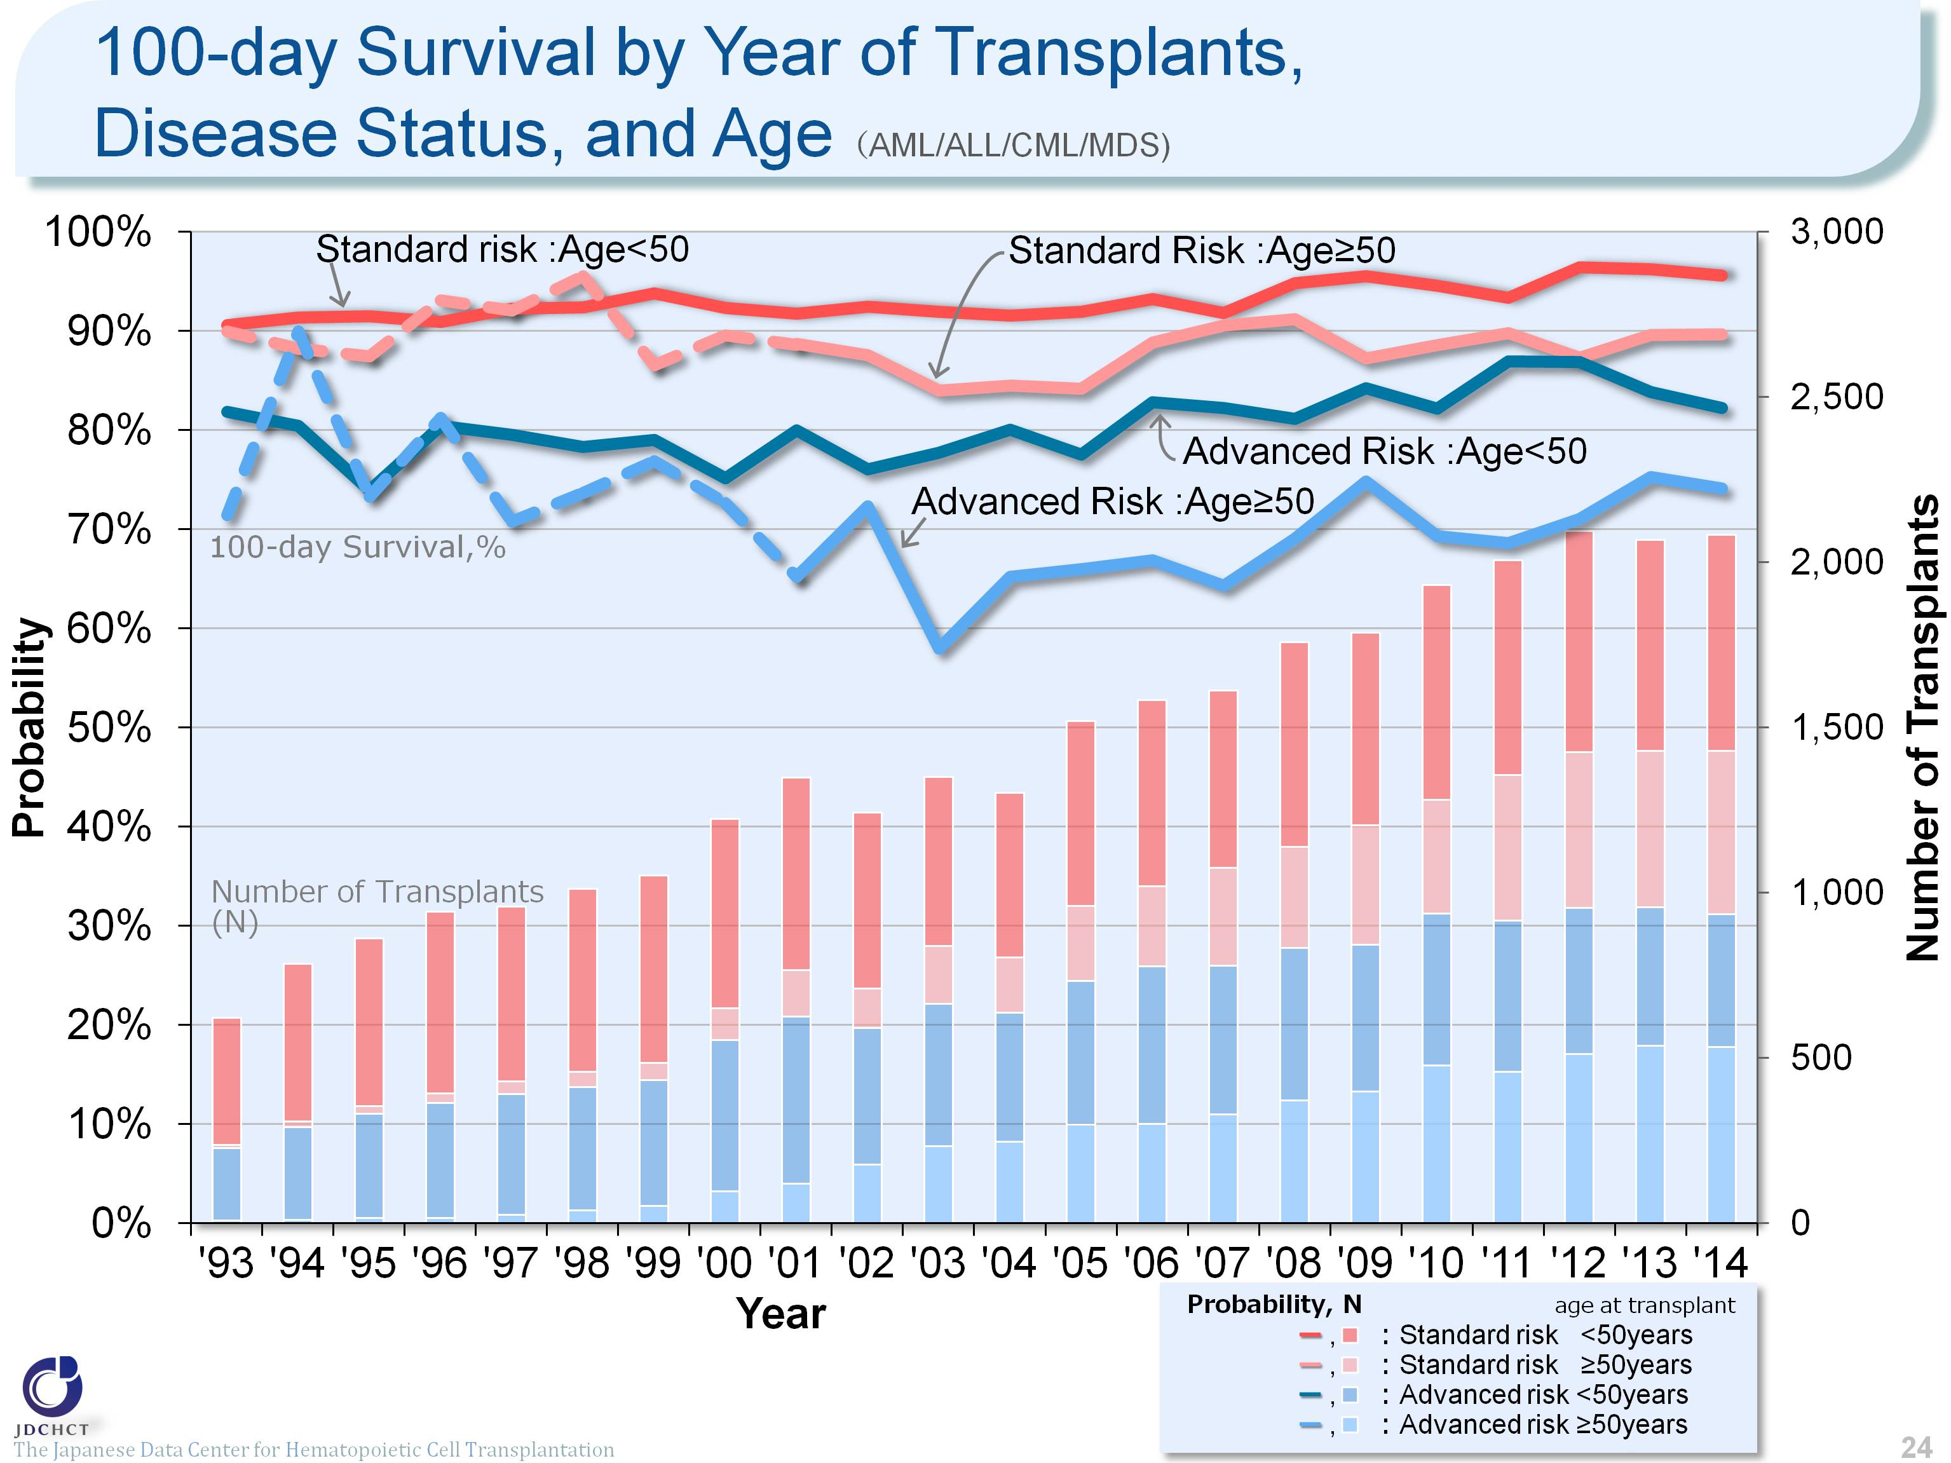
100-day Survival by Year of Transplants, Disease Status, and Age （AML/ALL/CML/MDS)
The Japanese Data Center for Hematopoietic Cell Transplantation
Notes:
The survival probabilies 100 days after transplantation in the advanced risk group of patients with leukemia have shown increasing trends over the last 10 years in the subgroup of recipients aged 49 years or younger (<50). In the subgroup of recipients aged 50 years or older (≥50), the number of transplants increased and the outcome of transplantation improved, when compared with the situation 10 years ago.
※This table shows the results of analysis performed on patients who received first transplants.
※Cases of peripheral blood stem cell transplantation from unrelated donors are not included in this analysis.
※The dotted lines (---) indicate the survival probabilies calculated when the number of transplants was below 100.
―≪Disease risk status at transplantation≫―――――――――――――――――――――――――――――
■Standard Risk Group
・AML (first complete remission[1CR]／second complete remission[2CR])
・ALL (1CR)
・CML (1CR)
・MDS (Refractory anemia[RA] ／Refractory anemia with ring sideroblasts[RARS])
■Advanced Risk Group
・all other conditions
＿＿＿＿ ＿＿＿＿＿＿＿＿＿＿＿＿＿＿ ＿＿＿＿＿＿＿＿＿＿

Slide 25
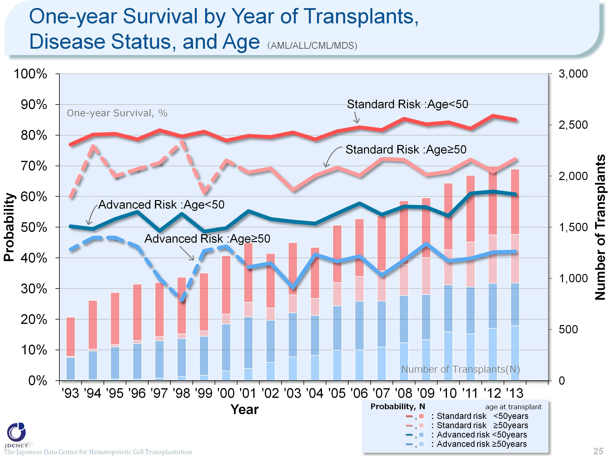
One-year Survival by Year of Transplants, Disease Status, and Age （AML/ALL/CML/MDS)
The Japanese Data Center for Hematopoietic Cell Transplantation
Notes:
The survival probabilities 365 days after transplantation in patients with leukemia have shown slightly increasing trends or have leveled off over the last 10 years. Comparison of the younger patients and the older patients in each risk group has revealed that the outcome of transplantation is slightly better in the younger patient group.
※This table shows the results of analysis performed on patients who received first transplants.
※Cases of peripheral blood stem cell transplantation from unrelated donors are not included in this analysis.
※The dotted lines (---) indicate the survival probabilities calculated when the number of transplants was below 100.
―≪Disease risk status at transplantation≫―――――――――――――――――――――――――――――
■Standard Risk Group
・AML (first complete remission[1CR]／second complete remission[2CR])
・ALL (1CR)
・CML (1CR)
・MDS (Refractory anemia[RA] ／Refractory anemia with ring sideroblasts[RARS])
■Advanced Risk Group
・all other conditions
＿＿＿＿ ＿＿＿＿＿＿＿＿＿＿＿＿＿＿ ＿＿＿＿＿＿＿＿＿＿

Slide 26
Survival after Transplants, by Donor Type and Stem Cell Sources (1991-2014)
Notes:
The survival probability in autologous transplants is 82.0% one year after transplantation, 58.9% five years after transplantation, and slightly lower than 50% ten years after transplantation.
The survival probability in bone marrow transplants from related donors is 57.4% five years after transplantation and 53.6% ten years after transplantation. The survival probability in bone marrow transplants from unrelated donors is 49.5% five years after transplantation and 45.0% ten years after transplantation. In all types of allogeneic transplants analyzed, the survival probabilities from the time of 5 years after transplantation onwards decline only modestly.
≪Probability of survival≫
Years after the first transplantation
N 1year 5years 10years
――――――――――――――――――――――――――――――
Auto 25,469 82.0% 58.9% 49.2%
Rel-BM 10,509 73.0% 57.4% 53.6%
Rel-PB 7,762 57.9% 38.7% 34.0%
UR-BM 15,512 64.9% 49.5% 45.0%
UR-CB 8,551 53.8% 40.1% 36.9%
――――――――――――――――――――――――――――――

Slide 27
Survival after Transplants for Leukemia, 1991-2014
Notes:
In all types of acute leukemia, the survival probabilities are around 45% five years after transplantation and about 40% ten years after transplantation.
In chronic myelogenous leukemia, the spread of therapeutic drugs has reduced the number of transplants, and the survival probabilities both 5 and 10 years after transplantation are above 50%.
In adult T-cell leukemia, the survival probability is 44.0% one year after transplantation and 26.4% ten years after transplantation, both of which are lower than the survival probabilities of the other types of leukemia.
※Cases of peripheral blood stem cell transplantation from unrelated donors are not included in this analysis.
≪Probability of survival≫
Years after the first transplantation
N 1year 5years 10years
――――――――――――――――――――――――――――――
AML 16,570 62.2% 44.4% 40.2%
ALL 9,584 68.0% 48.0% 44.0%
ATL 1,697 44.0% 29.9% 26.4%
CML 3,284 69.9% 57.7% 54.0%
MDS 4,016 64.0% 48.2% 42.6%
――――――――――――――――――――――――――――――

Slide 28
Survival after Transplants for Malignant Lymphoma and MM/PCD, 1991-2014
Notes:
In both non-Hodgkin lymphoma and Hodgkin lymphoma, the survival probabilities are around 60% five years after transplantation and around 50% ten years after transplantation. The survival probability one year after transplantation is slightly higher in Hodgkin lymphoma.
In approximately 96% of first transplants in plasma cell neoplasms including multiple myeloma, autologous transplants are performed. For the total autologous and allogeneic transplants, the survival probability one year after transplantation is as high as 90.2%, whereas the survival probability 10 years after transplantation is 34.0%.
※Cases of peripheral blood stem cell transplantation from unrelated donors were not included in this analysis.
≪Probability of survival≫
Years after the first transplantation
N 1year 5years 10years
――――――――――――――――――――――――――――――
NHL 14,523 72.2% 56.5% 49.2%
HL 1,146 84.4% 65.1% 56.6%
Other lymphoma 654 67.7% 51.5% 43.9%
MM/PCD 6,534 90.2% 57.4% 34.0%
――――――――――――――――――――――――――――――

Slide 29
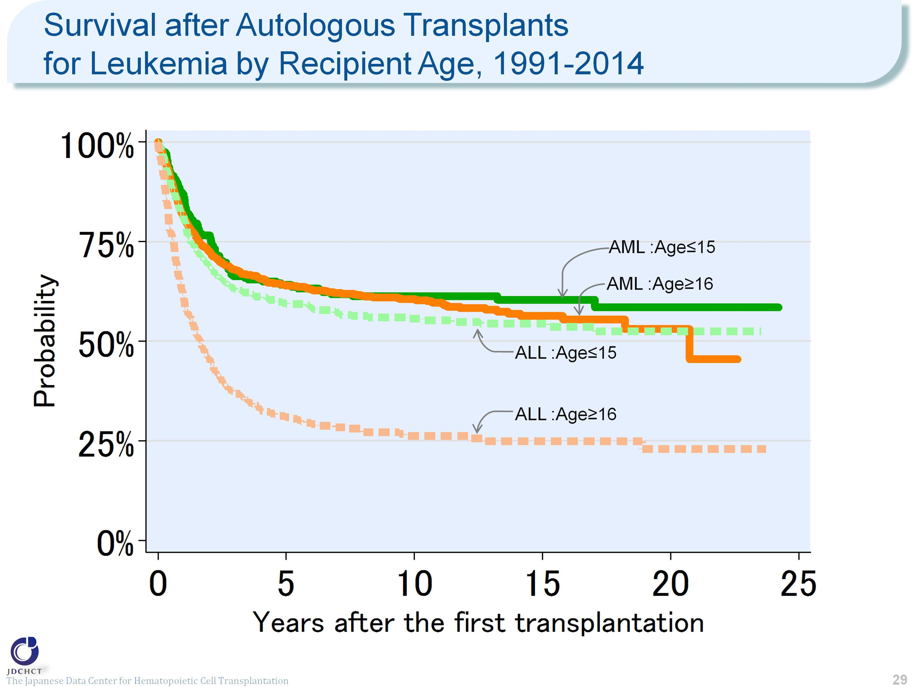
Survival after Autologous Transplants for Leukemia by Recipient Age, 1991-2014
Notes:
In acute myeloid leukemia, the survival probabilities are almost similar between recipients aged 0 to 15 years and those aged 16 years or older (≥16).
In acute lymphoblastic leukemia, the survival probability in those aged 16 years or older (≥16) is 30.9% and 26.2% five and ten years after autologous transplantation, respectively, indicating lower long-term survival probabilities in this age group than in pediatric patients.
≪Probability of survival≫
Years after the first transplantation
N 1year 5years 10years
――――――――――――――――――――――――――――――
AML Age≤15 235 86.8% 64.1% 61.3%
Age≥16 1,270 81.2% 63.9% 60.6%
ALL Age≤15 395 81.3% 59.6% 55.7%
Age≥16 328 61.1% 30.9% 26.2%
――――――――――――――――――――――――――――――

Slide 30
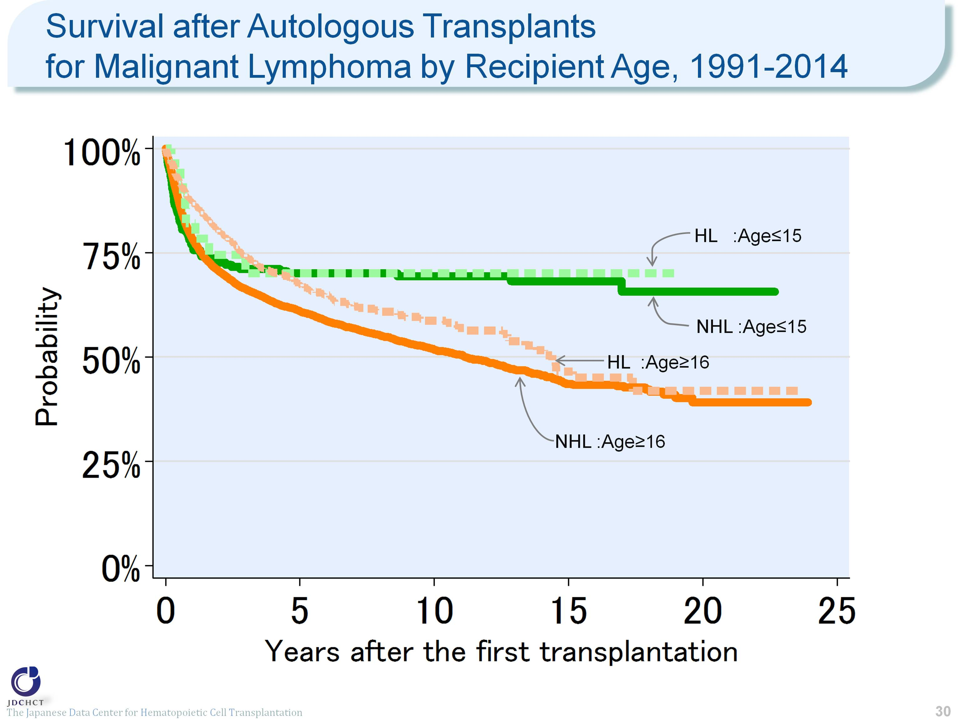
Survival after Autologous Transplants for Malignant Lymphoma by Recipient Age, 1991-2014
Notes:
In malignant lymphoma, non-Hodgkin lymphoma accounts for 90% of the total cases of first transplantation and Hodgkin lymphoma, less than 10%. These proportions are almost the same as those in the incidence rates of malignant lymphoma. The vast majority of transplants are autologous in recipients aged 16 years or older (≥16).
In both non-Hodgkin lymphoma and Hodgkin lymphoma, the survival probabilities 5 years after autologous transplantation are around 70% in recipients aged 0 to 15 years and do not decline subsequently.
The survival probability in autologous transplant recipients aged 16 years or older (≥16) in Hodgkin lymphoma is as high as 87.2% one year after transplantation and is slightly lower than 60% ten years after transplantation.
≪Probability of survival≫
Years after the first transplantation
N 1year 5years 10years
――――――――――――――――――――――――――――――
NHL Age≤15 208 77.1% 70.1% 69.4%
Age≥16 10,694 78.3% 61.0% 51.8%
HL Age≤15 28 82.1% 70.1% 70.1%
Age≥16 1,004 87.2% 67.6% 58.7%
――――――――――――――――――――――――――――――

Slide 31
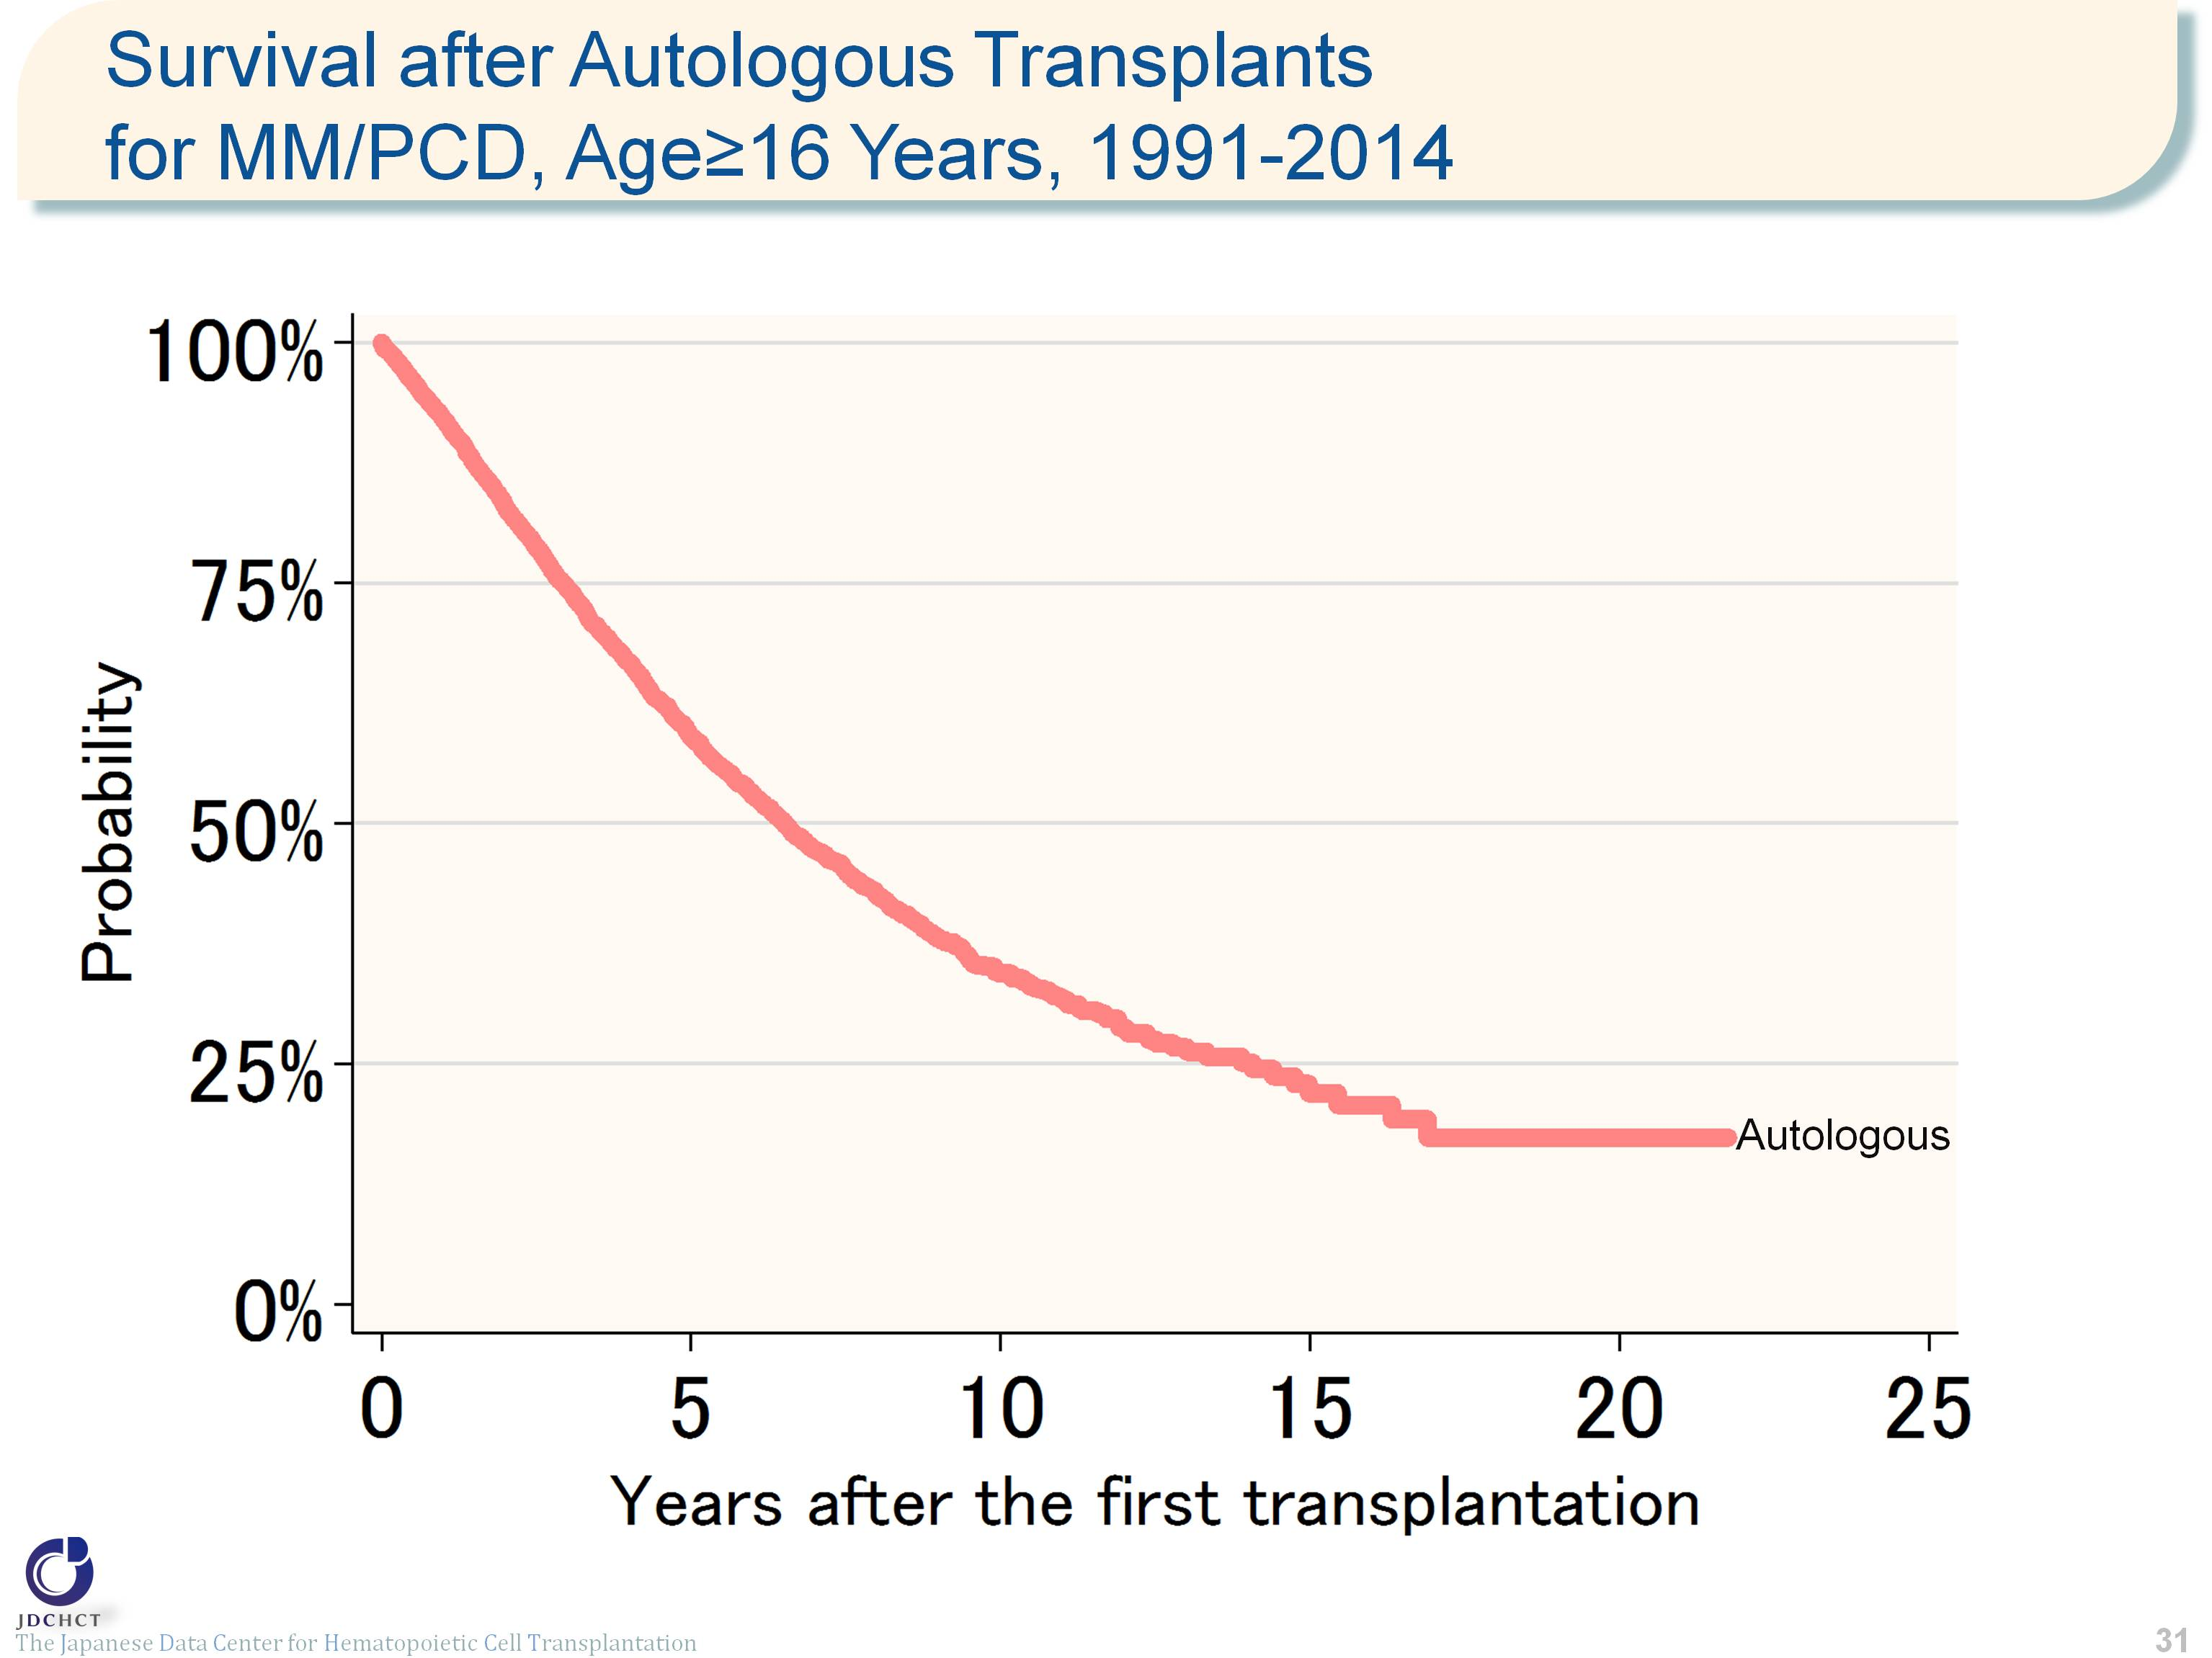
Survival after Autologous Transplants for MM/PCD, Age≥16 Years, 1991-2014
Notes:
Autologous transplants account for approximately 96% of the total cases of transplantation for plasma cell neoplasms including multiple myeloma.
The survival probability is as high as 90% or more one year after transplantation, but decreases to 34% ten years after transplantation.
≪Probability of survival≫
Years after the first transplantation
N 1year 5years 10years
――――――――――――――――――――――――――――――
Auto 6,241 92.0% 59.0% 34.4%
――――――――――――――――――――――――――――――

Slide 32
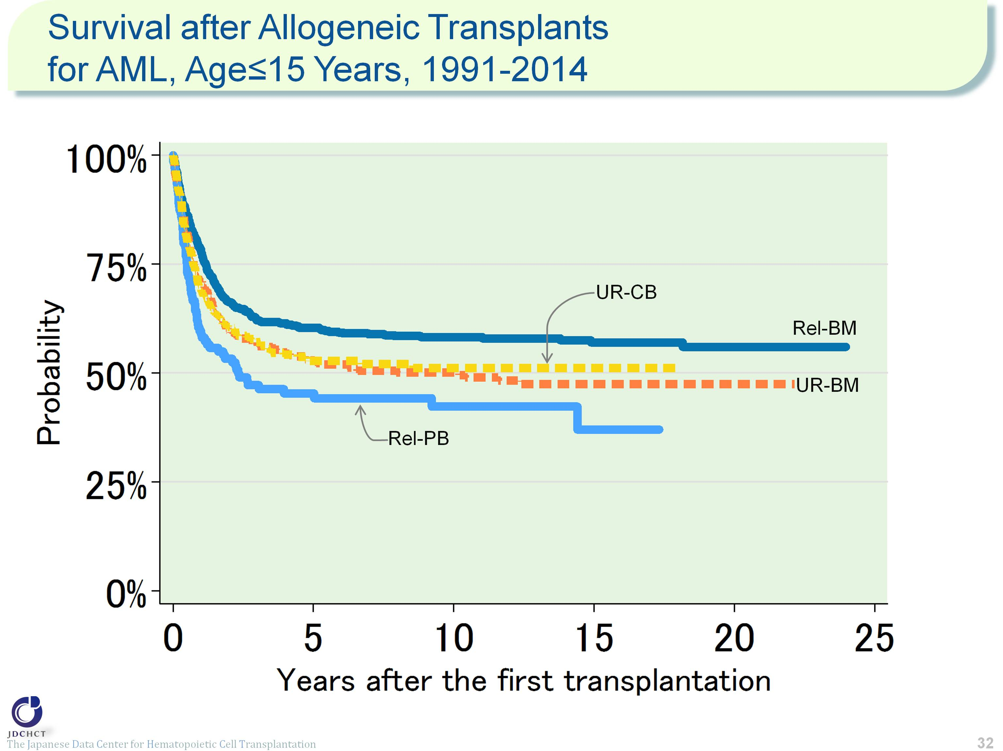
Survival after Allogeneic Transplants for AML, Age≤15 Years, 1991-2014
Notes:
For acute myeloid leukemia , allogeneic transplants account for approximately 90% of the total cases of transplantation, and bone marrow transplants from related donors are frequently performed in patients aged 15 years or younger (≤15). The survival probability 5 years after transplantation in 1,600 registered patients who received first allogeneic transplants in the period between 1991 and 2014 is 60.4% for transplants from related donors and about 50% for transplants from unrelated donors.
≪Probability of survival≫
Years after the first transplantation
N 1year 5years 10years
――――――――――――――――――――――――――――――
Rel-BM 664 78.2% 60.4% 58.2%
Rel-PB 135 58.9% 45.3% 42.3%
UR-BM 420 71.1% 52.9% 50.1%
UR-CB 381 69.2% 52.8% 51.1%
――――――――――――――――――――――――――――――

Slide 33
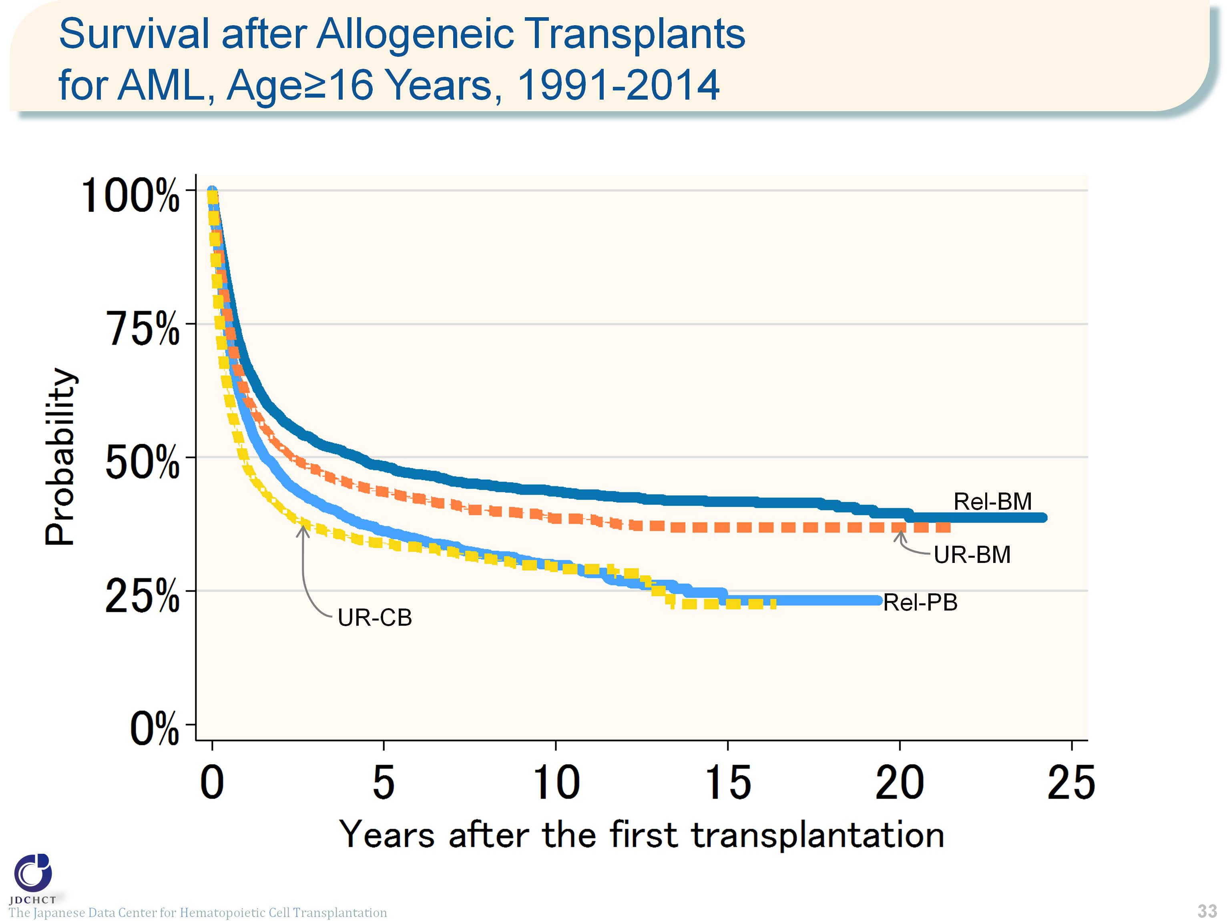
Survival after Allogeneic Transplants for AML, Age≥16 Years, 1991-2014
Notes:
For allogeneic transplants in patients with acute myeloid leukemia aged 16 years or older (≥16), bone marrow transplantation from unrelated donors is frequently performed. The survival probability 5 years after transplantation in 13,462 registered patients who received first allogeneic transplants in the period between 1991 and 2014 ranges from 30% to 50% for both transplants from related and unrelated donors.
≪Probability of survival≫
Years after the first transplantation
N 1year 5years 10years
――――――――――――――――――――――――――――――
Rel-BM 2,526 67.2% 48.3% 43.6%
Rel-PB 2,786 57.8% 36.2% 29.8%
UR-BM 4,954 61.6% 43.6% 38.6%
UR-CB 3,196 48.6% 34.0% 29.5%
――――――――――――――――――――――――――――――

Slide 34
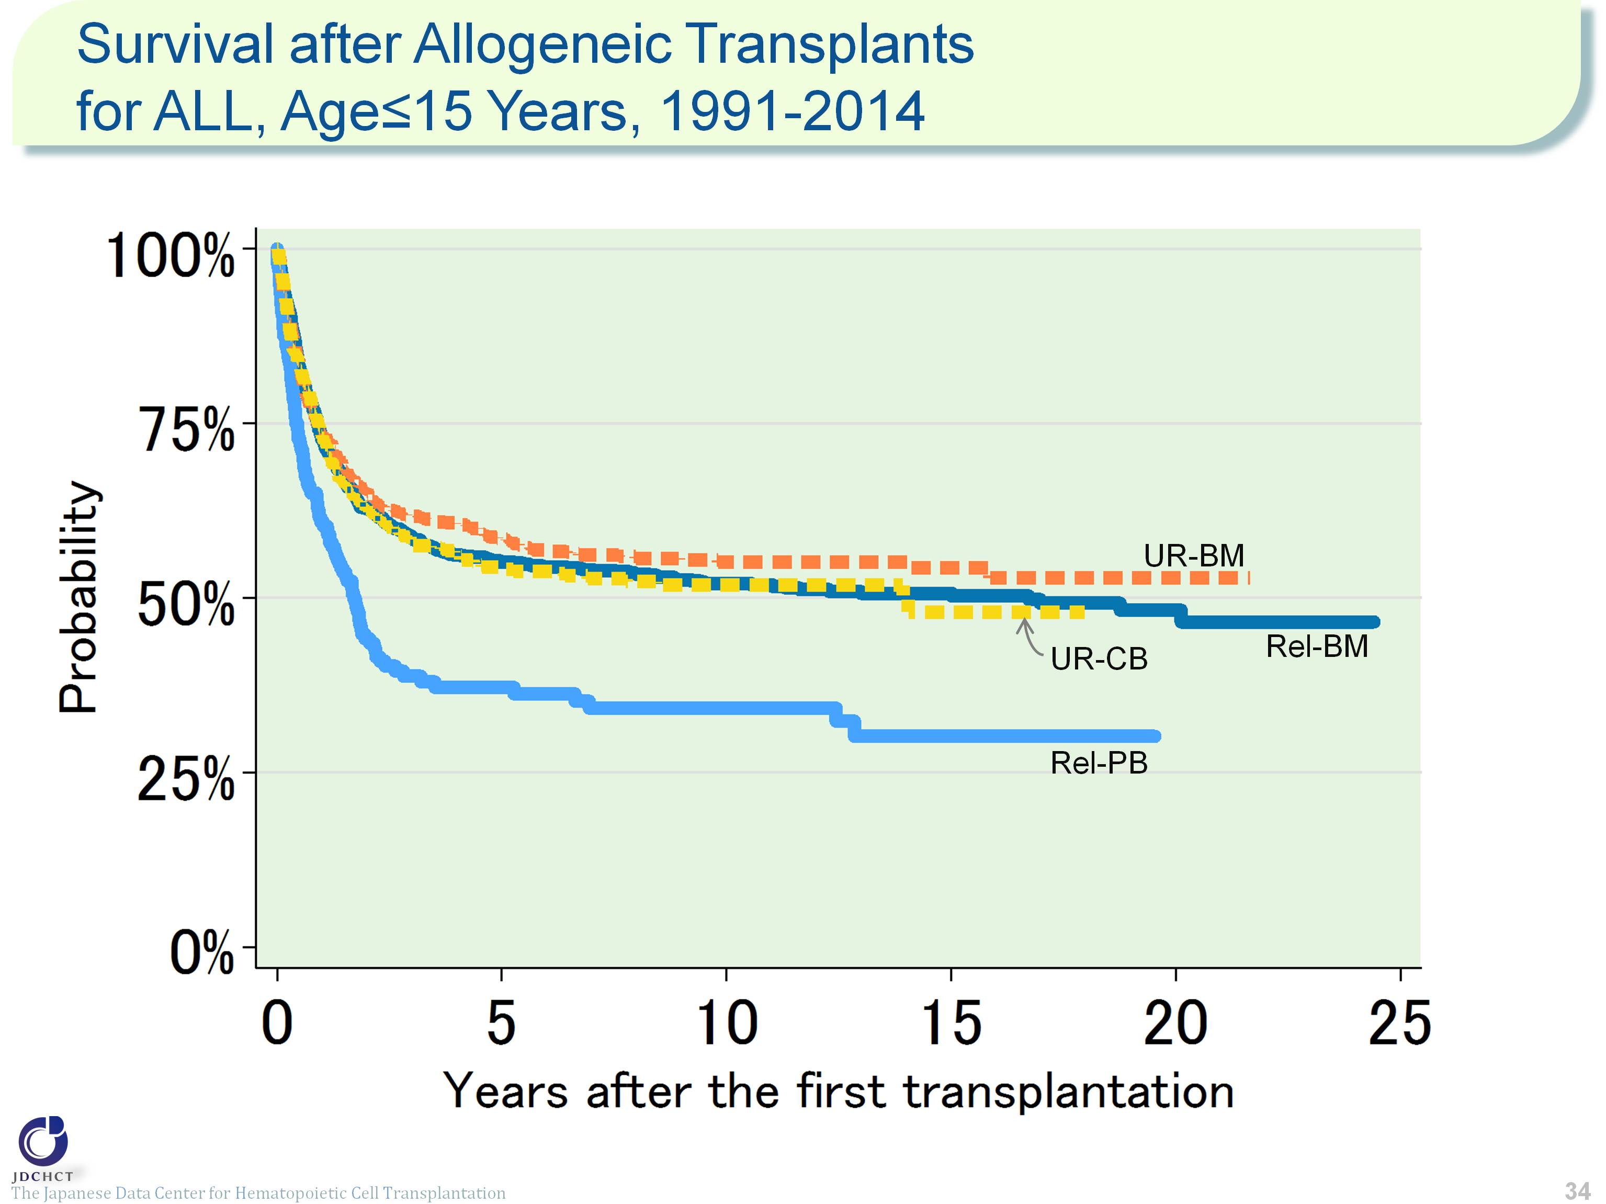
Survival after Allogeneic Transplants for ALL, Age≤15 Years, 1991-2014
Notes:
For acute lymphoblastic leukemia, allogeneic transplants account for approximately 90% of the total cases of transplantation, and bone marrow transplants from related donors are frequently performed in patients aged 15 years or younger (≤15). The survival probability 5 years after transplantation in 2,667 registered patients who received first allogeneic transplants in the period between 1991 and 2014 is around 56% for bone marrow transplants from related donors and those from unrelated donors, and 37.2% for peripheral blood stem cell transplants from related donors. The decline in survival probabilities becomes moderate from the time of 5 years after transplantation onwards, and the survival probabilities 10 years after transplantation are more than 50% for both bone marrow transplants from related and unrelated donors.
≪Probability of survival≫
Years after the first transplantation
N 1year 5years 10years
――――――――――――――――――――――――――――――
Rel-BM 1,037 72.7% 55.1% 52.1%
Rel-PB 185 60.9% 37.2% 34.2%
UR-BM 832 74.1% 58.4% 55.1%
UR-CB 613 73.2% 54.2% 51.8%
――――――――――――――――――――――――――――――

Slide 35
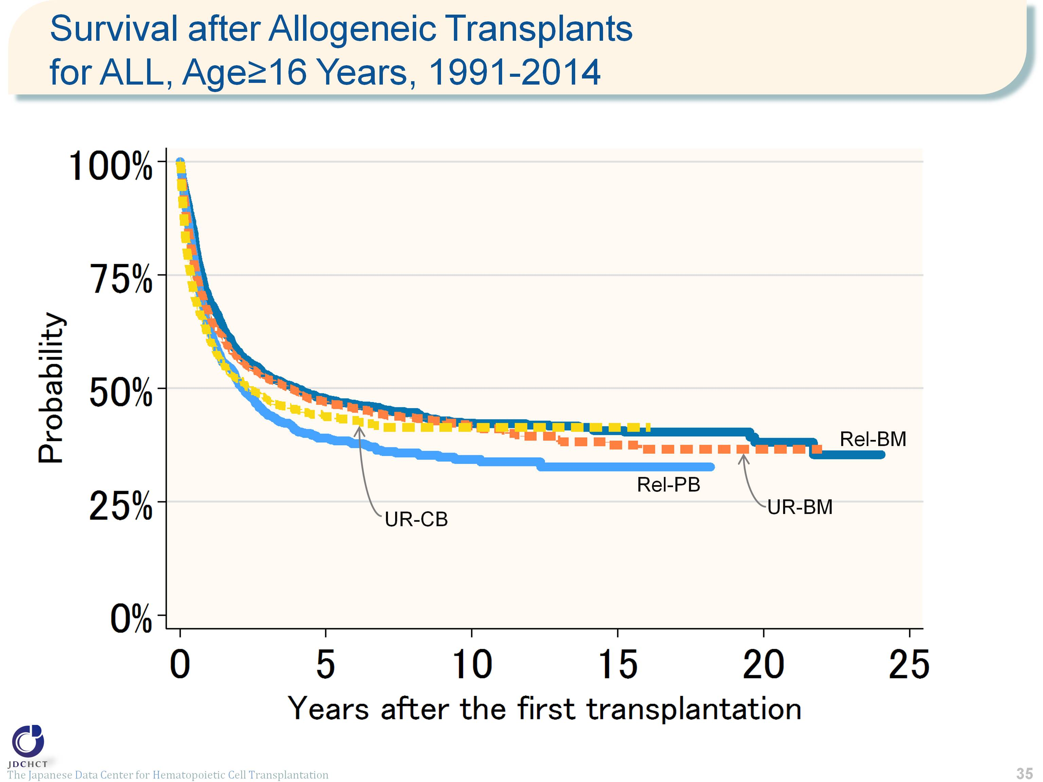
Survival after Allogeneic Transplants for ALL, Age≥16 Years, 1991-2014
Notes:
For allogeneic transplants in patients with acute lymphoblastic leukemia aged 16 years or older (≥16), bone marrow transplantation from unrelated donors is frequently performed. The survival probability 5 years after transplantation in 6,193 registered patients who received first allogeneic transplants in the period between 1991 and 2014 is around 44% for both transplants from related and unrelated donors.
≪Probability of survival≫
Years after the first transplantation
N 1year 5years 10years
――――――――――――――――――――――――――――――
Rel-BM 1,481 69.7% 47.6% 42.4%
Rel-PB 1,097 63.1% 39.0% 34.4%
UR-BM 2,534 66.1% 47.0% 41.8%
UR-CB 1,081 61.0% 43.8% 41.4%
――――――――――――――――――――――――――――――

Slide 36
Survival after Allogeneic Transplants for CML, Age≤15 Years, 1991-2014
Notes:
The number of patients with chronic myeloid leukemia aged 15 years or younger (≤15) is small, for whom bone marrow transplants from related or unrelated donors are frequently performed. The survival probability 5 years after transplantation in 249 registered patients who received first allogeneic transplants in the period between 1991 and 2014 is 75.9% for bone marrow transplants from related donors, 61.1% for peripheral blood stem cell transplants from related donors, and 69.6% for bone marrow transplants from unrelated donors. The decline in survival probabilities becomes moderate from the time of 5 years after transplantation onwards, and the survival probabilities 10 years after transplantation are more than 60% for both transplants from related and unrelated donors.
※Cases of cord blood transplantation (first transplantation) from unrelated donors in patients with chronic myeloid leukemia aged 0 to 15 years are small in number and are not included in this analysis.
≪Probability of survival≫
Years after the first transplantation
N 1year 5years 10years
――――――――――――――――――――――――――――――
Rel-BM 105 83.8% 75.9% 73.6%
Rel-PB 18 77.8% 61.1% 61.1%
UR-BM 113 76.9% 69.6% 68.4%
――――――――――――――――――――――――――――――

Slide 37
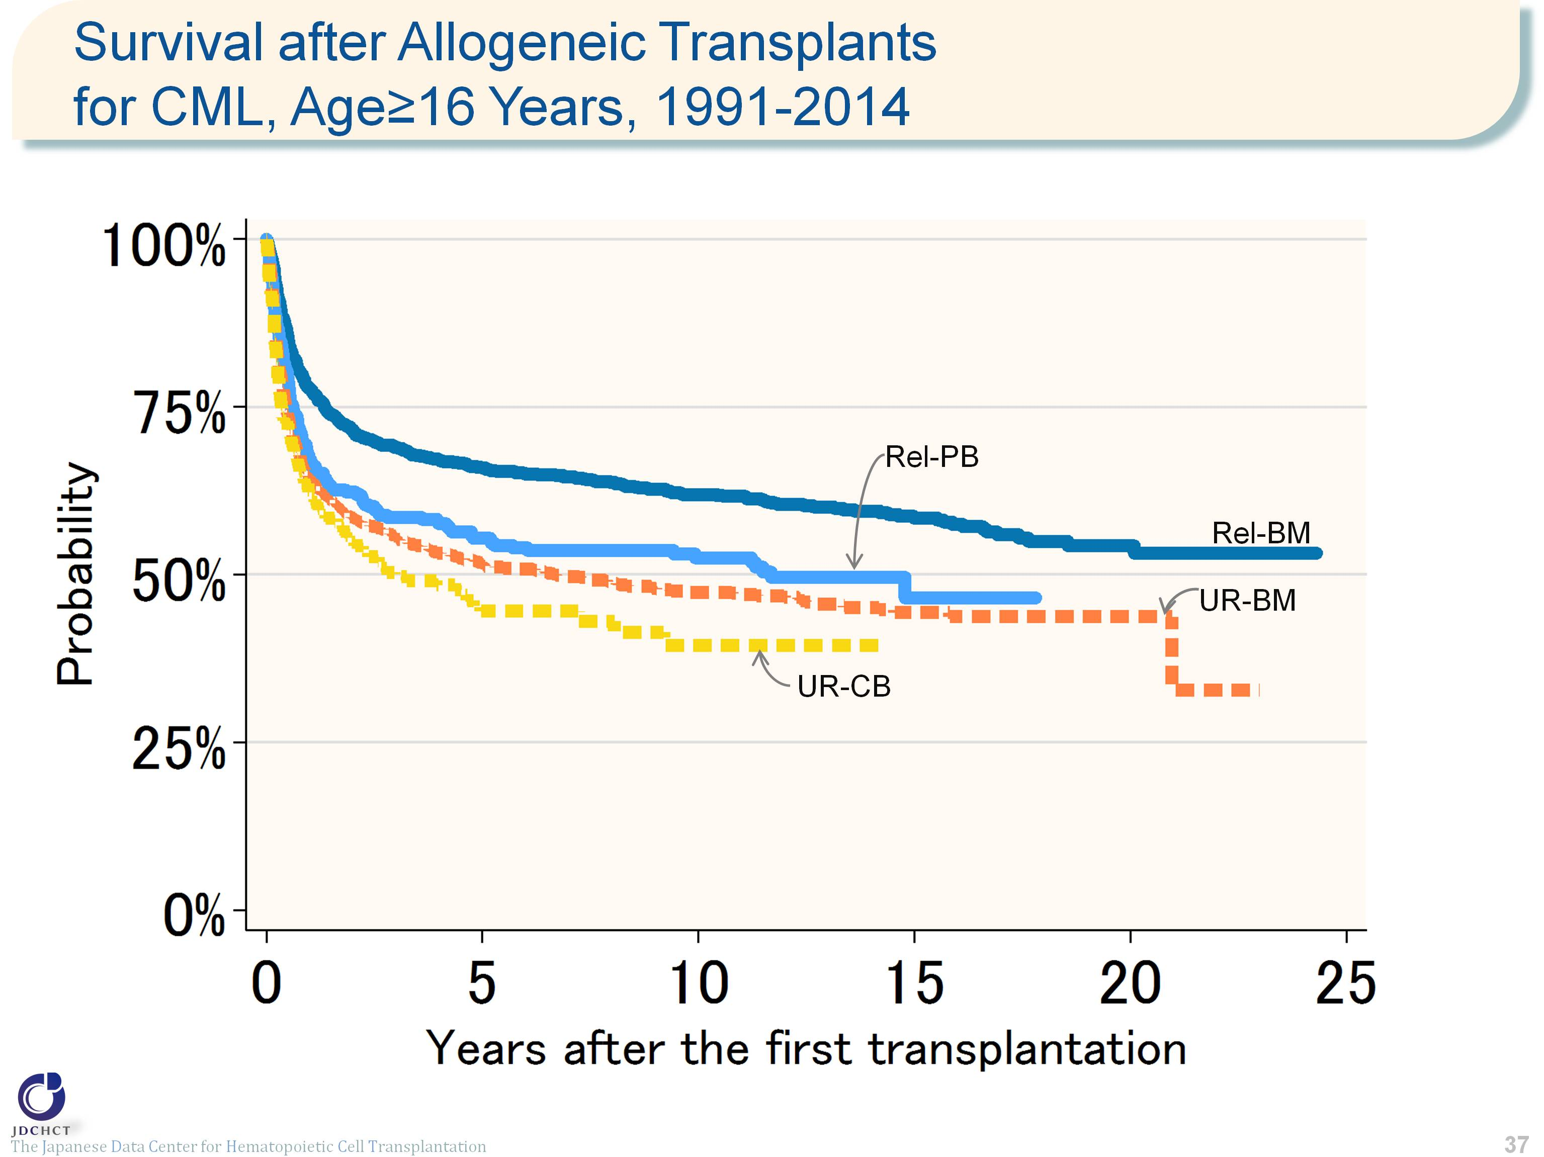
Survival after Allogeneic Transplants for CML, Age≥16 Years, 1991-2014
Notes:
For chronic myeloid leukemia, the vast majority of transplants in patients with the disease are allogeneic and bone marrow transplants from unrelated donors are frequently performed in those aged 16 years or older (≥16). The survival probability 5 years after transplantation in 3,005 registered patients who received first allogeneic transplants in the period between 1991 and 2014 is 65.9% for bone marrow transplants from related donors, 55.4% for peripheral blood stem cell transplants from related donors, 51.7% for bone marrow transplants from unrelated donors, and 44.5% for cord blood transplants from unrelated donors. Ten years after transplantation, the survival probability is below 50% for transplants from unrelated donors.
≪Probability of survival≫
Years after the first transplantation
N 1year 5years 10years
――――――――――――――――――――――――――――――
Rel-BM 1,084 77.8% 65.9% 61.9%
Rel-PB 420 67.1% 55.4% 52.5%
UR-BM 1,258 64.3% 51.7% 47.4%
UR-CB 243 61.7% 44.5% 39.5%
――――――――――――――――――――――――――――――

Slide 38
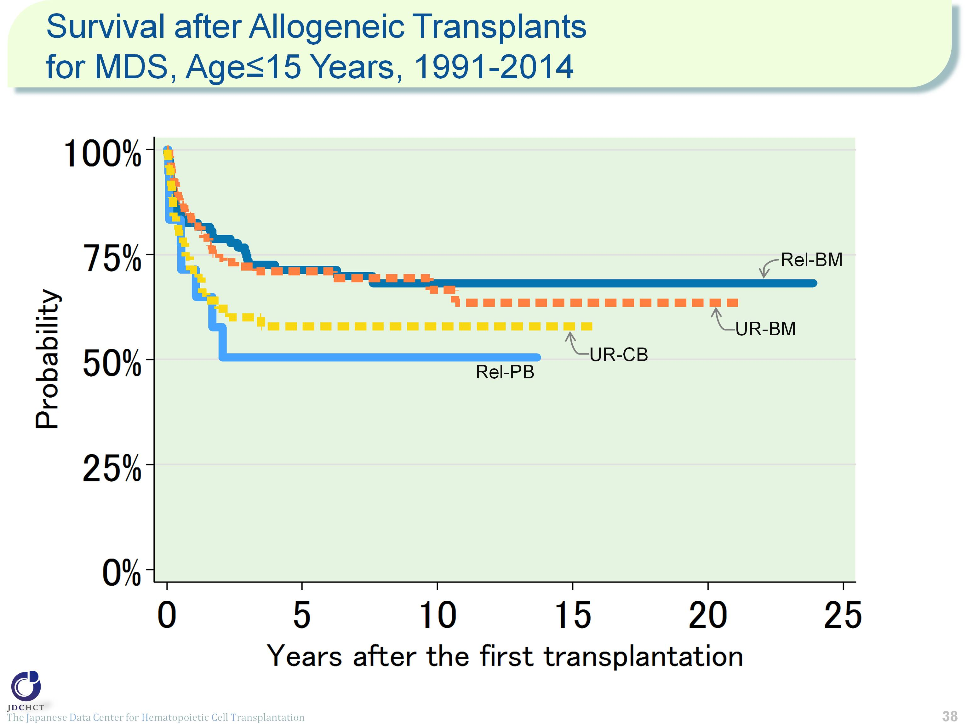
Survival after Allogeneic Transplants for MDS, Age≤15 Years, 1991-2014
Notes:
For myelodysplastic syndrome, the vast majority of transplants in patients with the syndrome are allogeneic and bone marrow transplants from related or unrelated donors are frequently performed in those aged 15 years or younger (≤15). The survival probability 5 years after transplantation in 333 registered patients who received first allogeneic transplants in the period between 1991 and 2014 is 71.3% for bone marrow transplants from related donors, 50.5% for peripheral blood stem cell transplants from related donors, 71.0% for bone marrow transplants from unrelated donors, and 57.9% for cord blood transplants from unrelated donors. The decline in survival probabilities becomes moderate from the time of 5 years after transplantation onwards, and the survival probabilities are more than 50% for both transplants from related and unrelated donors.
≪Probability of survival≫
Years after the first transplantation
N 1year 5years 10years
――――――――――――――――――――――――――――――
Rel-BM 115 82.5% 71.3% 68.2%
Rel-PB 18 71.4% 50.5% 50.5%
UR-BM 130 81.8% 71.0% 66.6%
UR-CB 70 71.3% 57.9% 57.9%
――――――――――――――――――――――――――――――

Slide 39
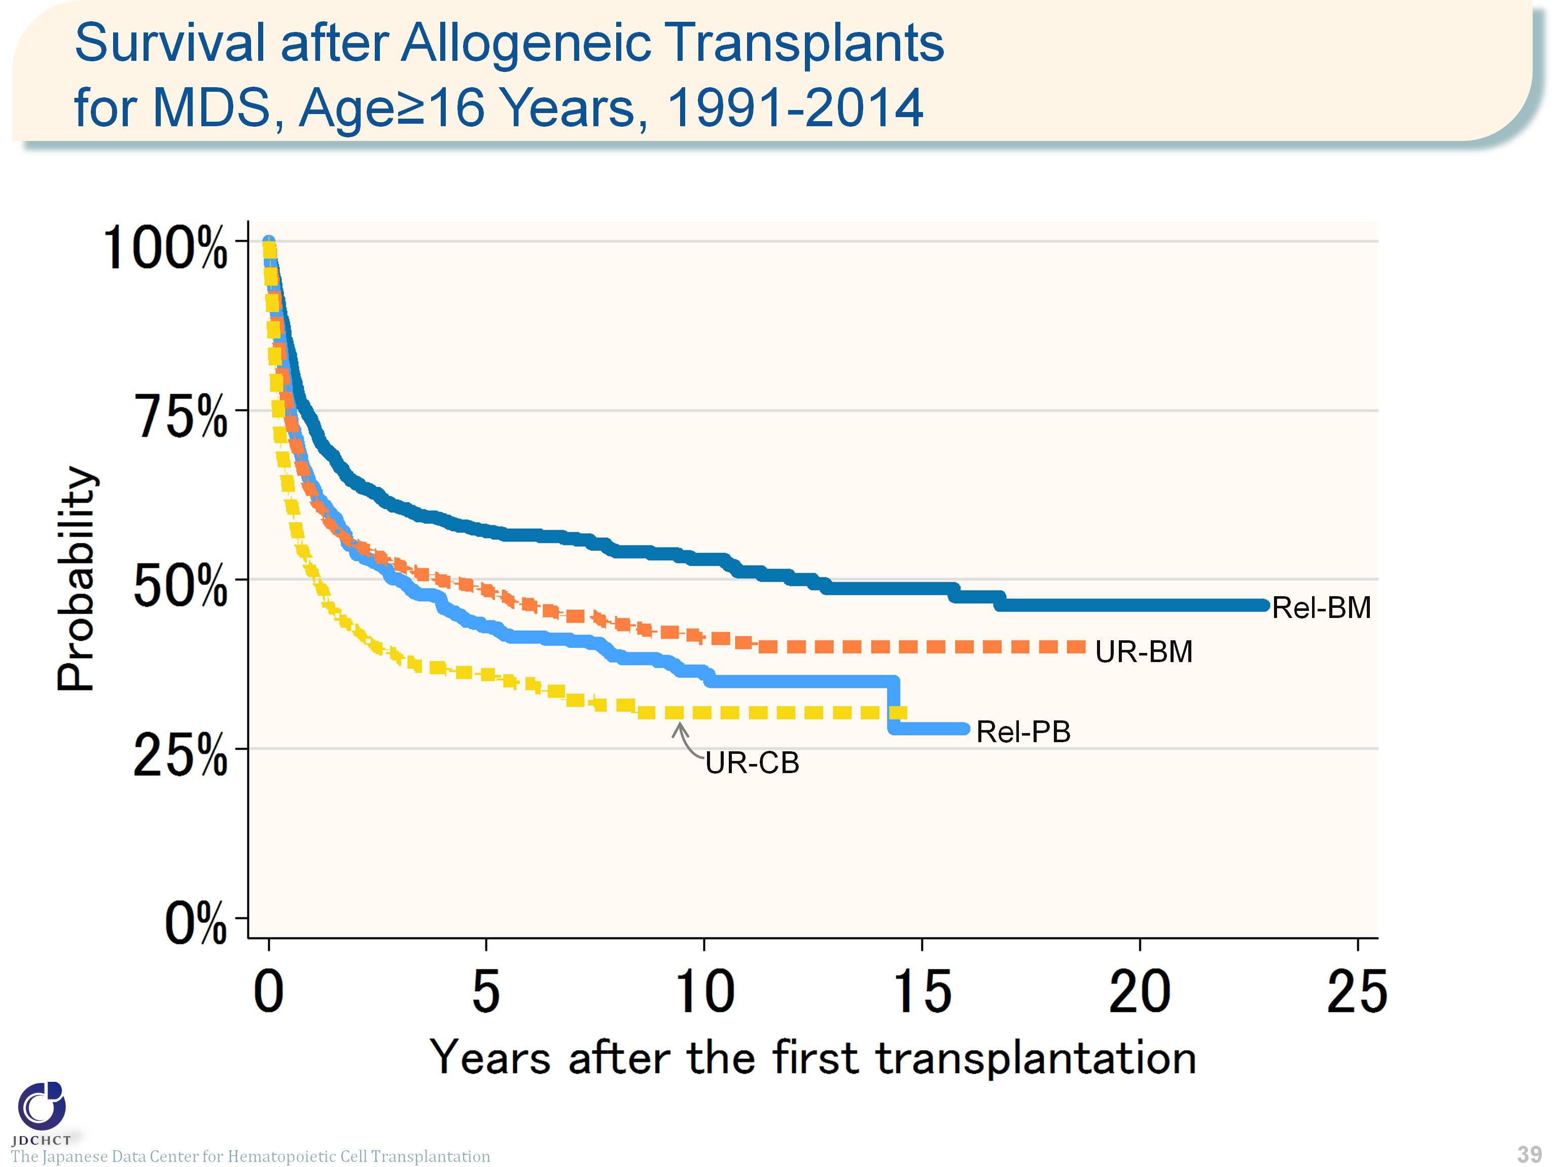
Survival after Allogeneic Transplants for MDS, Age≥16 Years, 1991-2014
Notes:
For allogeneic transplants in patients with myelodysplastic syndrome aged 16 years or older (≥16), bone marrow transplantation from unrelated donors is frequently performed. The survival probability 5 years after transplantation in 3,662 registered patients who received first allogeneic transplants in the period between 1991 and 2014 is 57.1% for bone marrow transplants from related donors and below 50% for both peripheral blood stem cell transplants from related donors and transplants from unrelated donors.
≪Probability of survival≫
Years after the first transplantation
N 1year 5years 10years
――――――――――――――――――――――――――――――
Rel-BM 673 73.4% 57.1% 53.0%
Rel-PB 684 63.8% 43.1% 36.0%
UR-BM 1,582 62.7% 48.4% 41.3%
UR-CB 723 51.2% 35.9% 30.3%
――――――――――――――――――――――――――――――

Slide 40
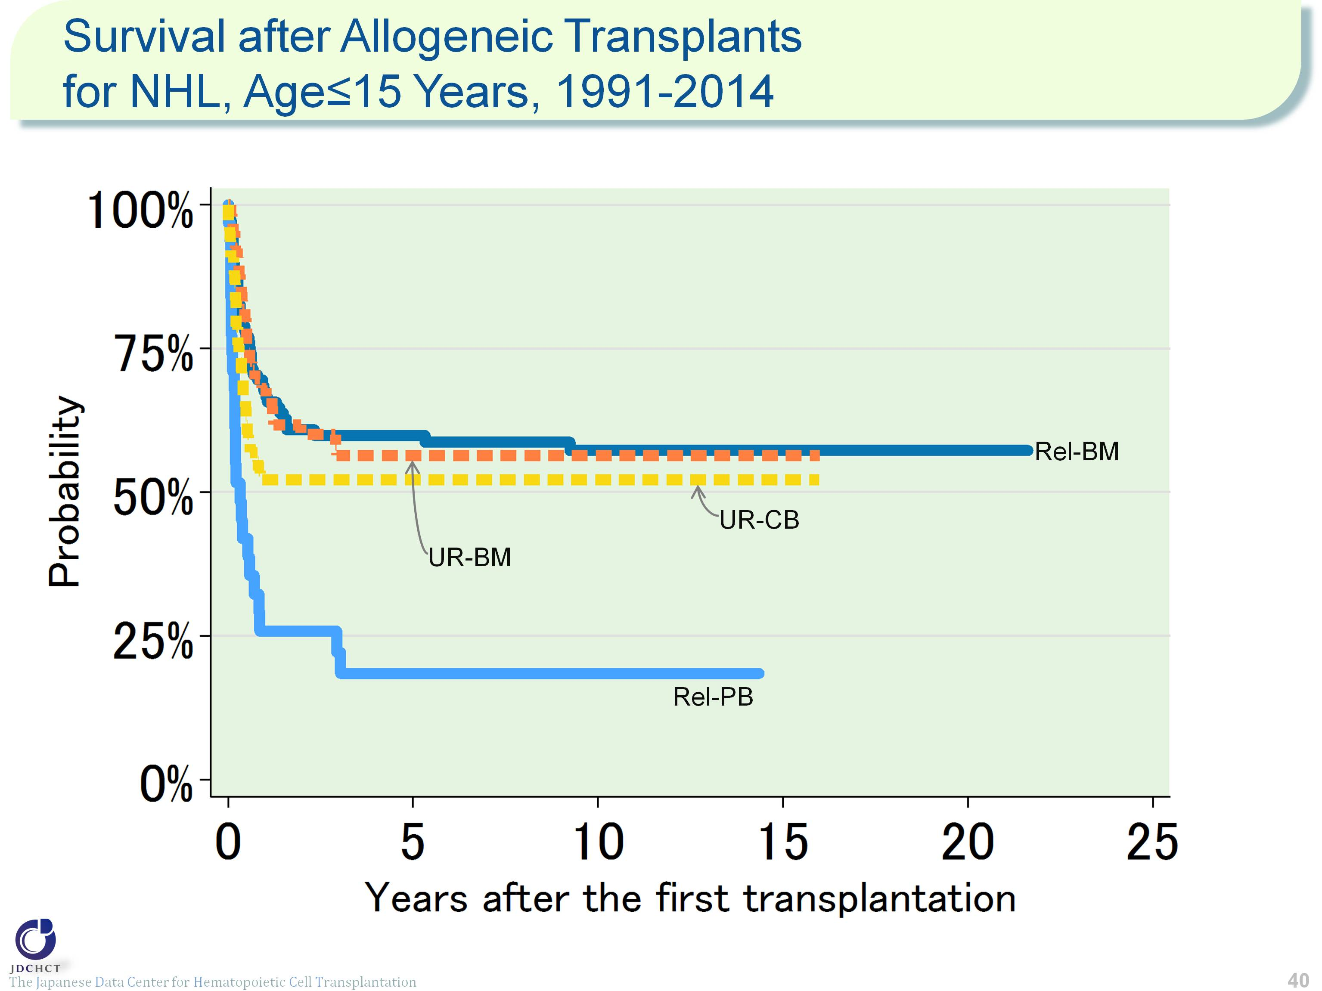
Survival after Allogeneic Transplants for NHL, Age≤15 Years, 1991-2014
Notes:
Approximately half the patients with non-Hodgkin lymphoma aged 15 years or younger (≤15) receive allogeneic transplants, for whom bone marrow transplantation from related donors is frequently performed. The survival probability 5 years after transplantation in 272 registered patients who received first allogeneic transplants in the period between 1991 and 2014 is more than 50% for bone marrow transplants from related donors and for transplants from unrelated donors. From the time of 5 years after transplantation onward, the survival probability remains almost steady.
≪Probability of survival≫
Years after the first transplantation
N 1year 5years 10years
――――――――――――――――――――――――――――――
Rel-BM 109 67.6% 59.9% 57.3%
Rel-PB 31 25.8% 18.4% 18.4%
UR-BM 66 68.1% 56.4% 56.4%
UR-CB 66 52.2% 52.2% 52.2%
――――――――――――――――――――――――――――――

Slide 41
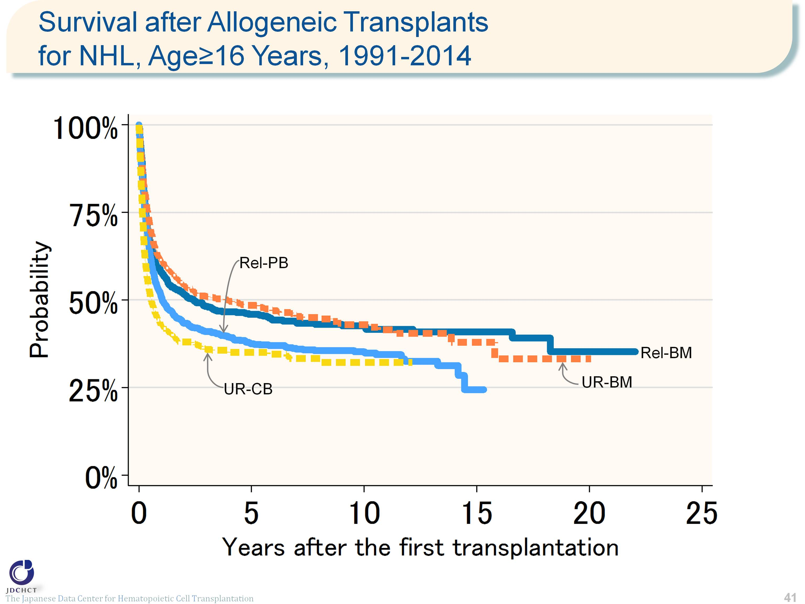
Survival after Allogeneic Transplants for NHL, Age≥16 Years, 1991-2014
Notes:
For allogeneic transplantation in patients with non-Hodgkin lymphoma aged 16 years or older (≥16), peripheral blood stem cell transplantation from related donors and bone marrow transplants from unrelated donors are frequently performed. The survival probability 5 years after transplantation in 3,345 registered patients who received first allogeneic transplants in the period between 1991 and 2014 ranged from 30% to 50% for both transplants from related and unrelated donors.
≪Probability of survival≫
Years after the first transplantation
N 1year 5years 10years
――――――――――――――――――――――――――――――
Rel-BM 539 57.9% 45.9% 42.6%
Rel-PB 1,041 50.8% 37.5% 35.2%
UR-BM 1,020 61.3% 48.5% 42.9%
UR-CB 745 42.7% 35.0% 32.2%
――――――――――――――――――――――――――――――

Slide 42
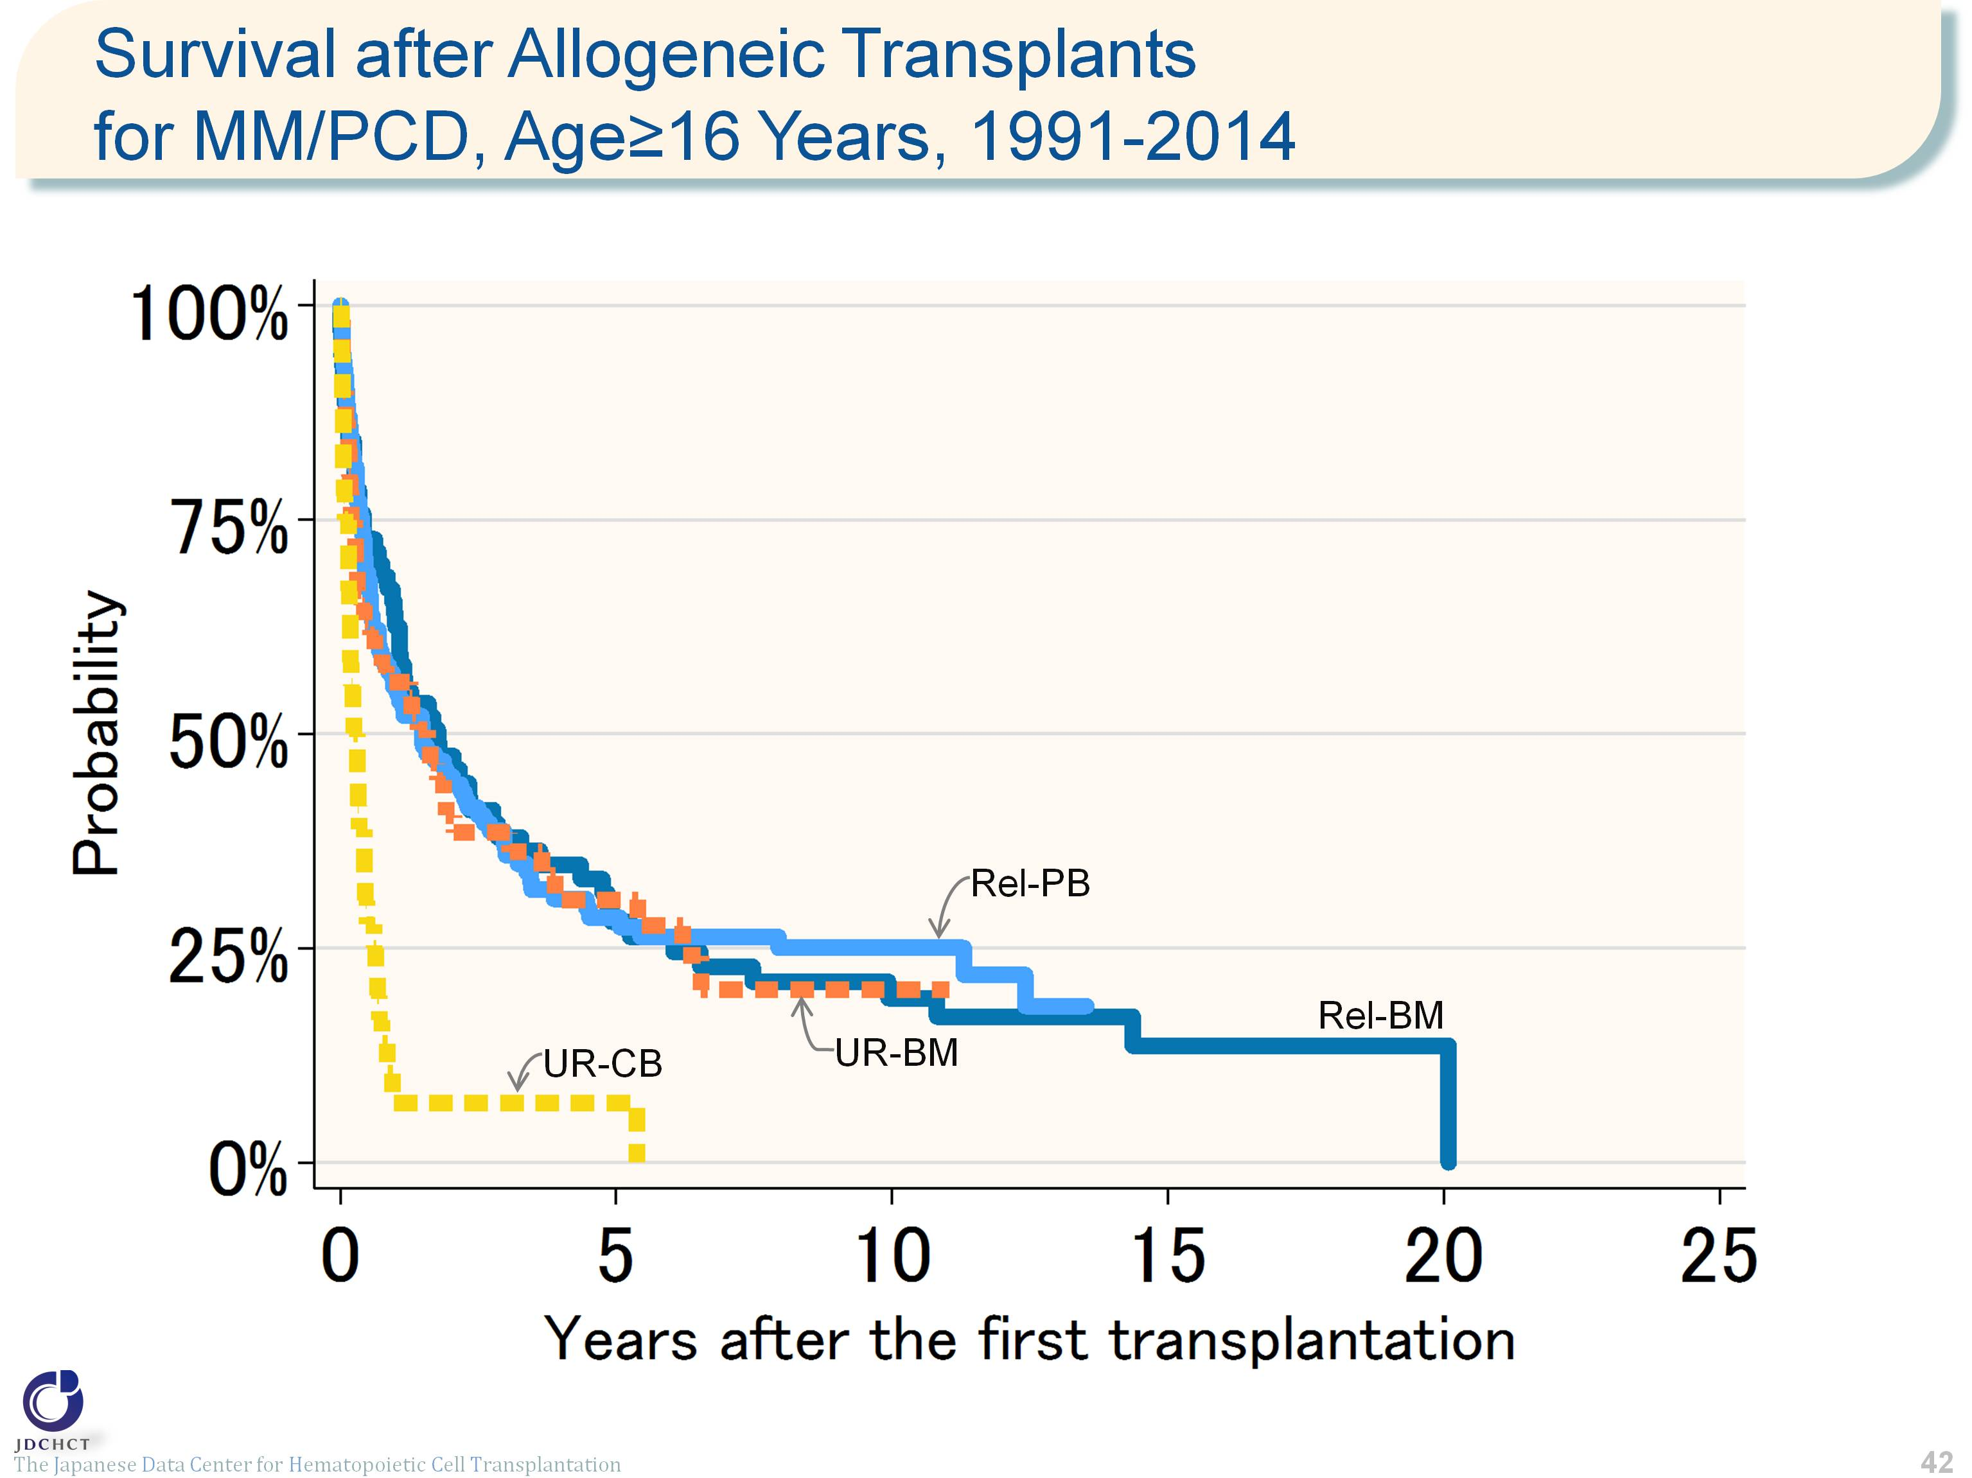
Survival after Allogeneic Transplants for MM/PCD, Age≥16 Years, 1991-2014
Notes:
Multiple myeloma occurs frequently in the elderly. Autologous transplants account for approximately 96% of the total cases of transplants in patients with multiple myeloma aged 16 years or older (≥16). For allogeneic transplants, peripheral blood stem cell transplantation from related donors is frequently performed. The survival probability 5 years after transplantation is below 35% for both transplants from related and unrelated donors, and subsequently, survival probabilities remarkably decline.
≪Probability of survival≫
Years after the first transplantation
N 1year 5years 10years
――――――――――――――――――――――――――――――
Rel-BM 70 64.0% 28.1% 19.2%
Rel-PB 124 55.5% 28.6% 25.0%
UR-BM 60 56.1% 30.7% 20.1%
UR-CB 36 6.9% 6.9% ―
――――――――――――――――――――――――――――――

Slide 43
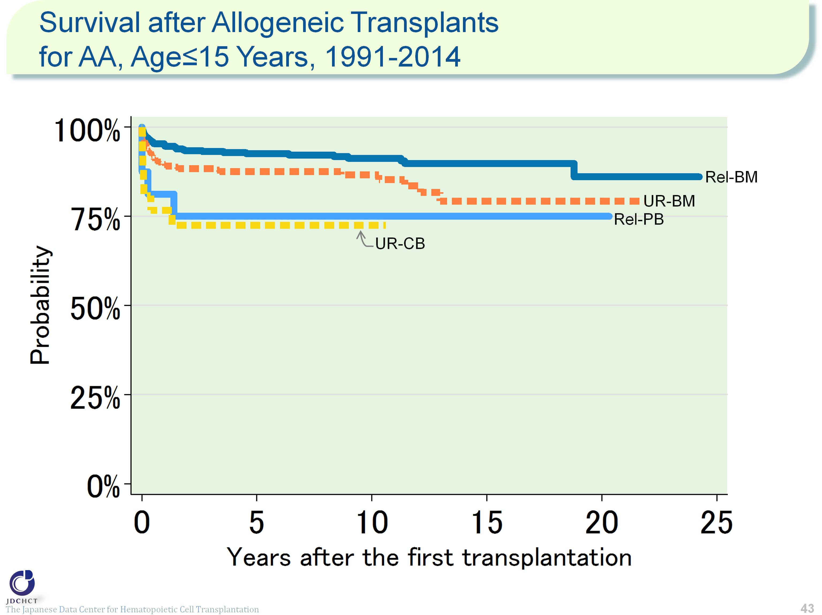
Survival after Allogeneic Transplants for AA, Age≤15 Years, 1991-2014
Notes:
For aplastic anemia, allogeneic transplants are performed and in patients aged 15 years or younger (≤15), bone marrow transplants from related donors are frequently performed. The survival probability 5 years after transplantation is 92.6% for bone marrow transplants from related donors, 75.0% for peripheral blood stem cell transplantation from related donors, 87.5% for bone marrow transplants from unrelated donors, and 72.5% for cord blood transplants from unrelated donors.
≪Probability of survival≫
Years after the first transplantation
N 1year 5years 10years
――――――――――――――――――――――――――――――
Rel-BM 434 94.9% 92.6% 91.3%
Rel-PB 16 81.3% 75.0% 75.0%
UR-BM 298 89.5% 87.5% 86.6%
UR-CB 26 76.7% 72.5% 72.5%
――――――――――――――――――――――――――――――

Slide 44
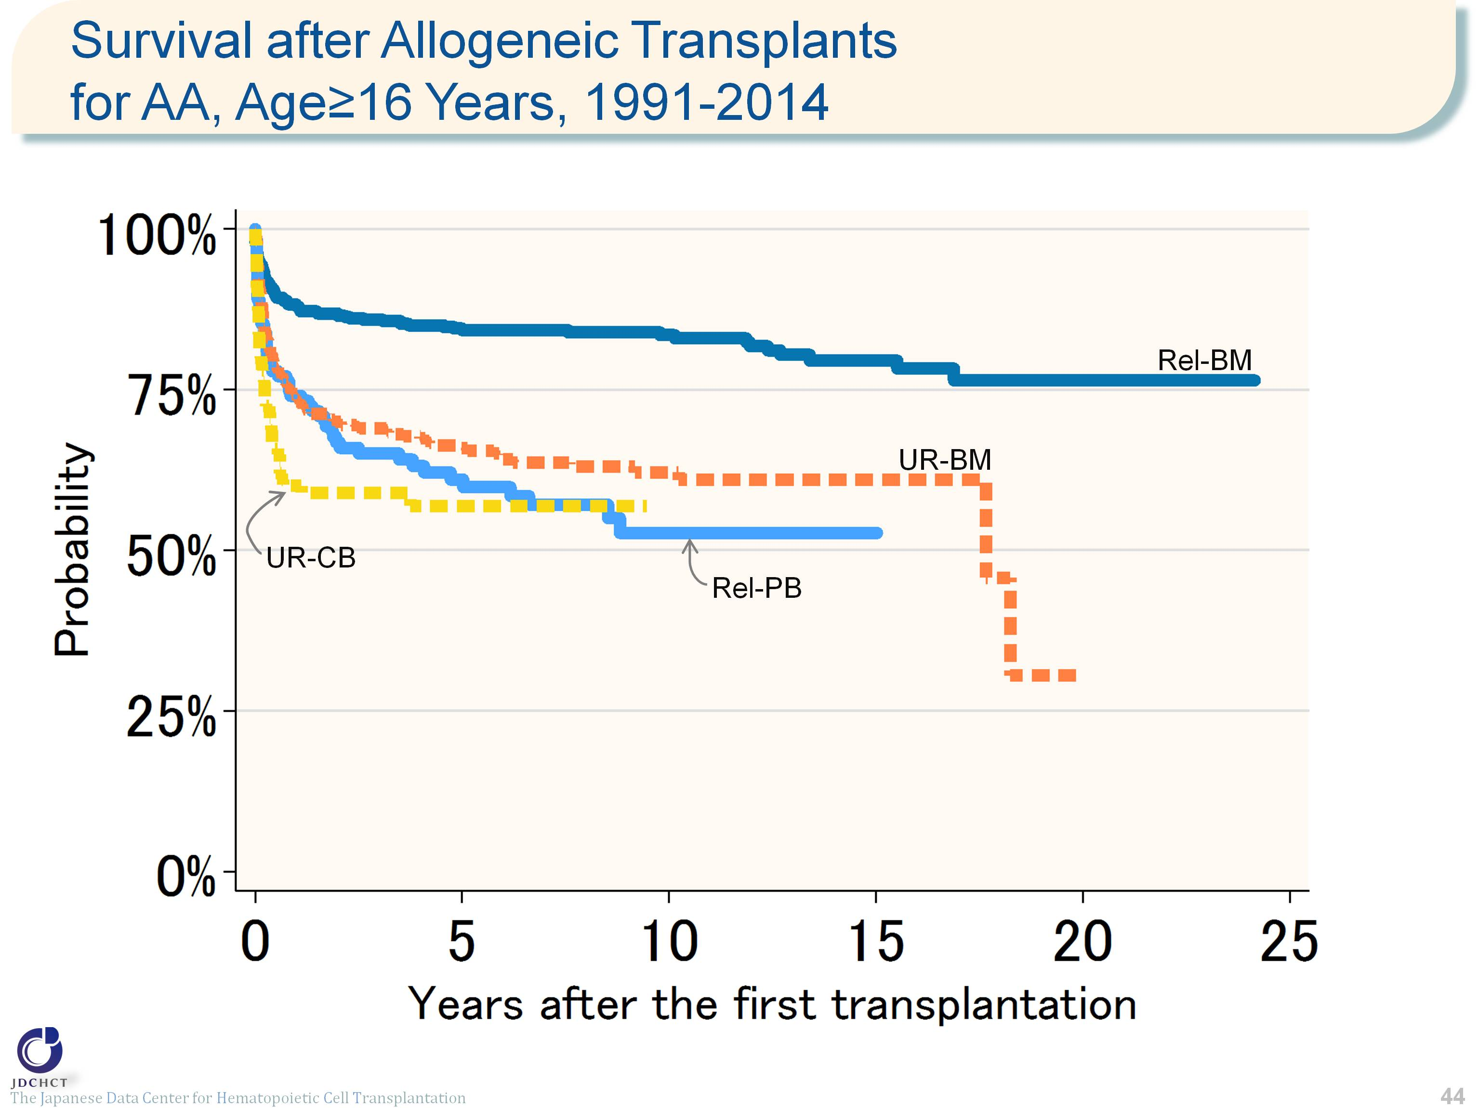
Survival after Allogeneic Transplants for AA, Age≥16 Years, 1991-2014
Notes:
For patients with aplastic anemia aged 16 years or older (≥16), approximately half the allogeneic transplants are bone marrow transplants from related donors. The survival probability 5 years after transplantation is more than 50% for both transplants from related and unrelated donors, and 84.3% for bone marrow transplants from related donors.
≪Probability of survival≫
Years after the first transplantation
N 1year 5years 10years
――――――――――――――――――――――――――――――
Rel-BM 593 88.1% 84.3% 83.5%
Rel-PB 136 74.0% 61.0% 52.7%
UR-BM 462 73.7% 66.0% 62.2%
UR-CB 110 60.0% 56.9% ―
――――――――――――――――――――――――――――――

