Slide 1
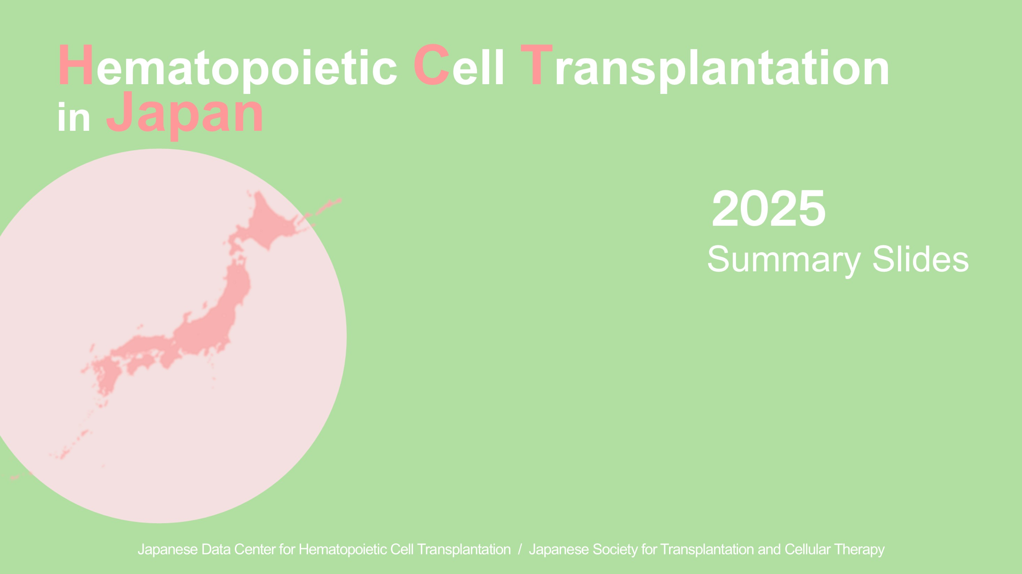
title
Hematopoietic Cell Transplantation
in Japan
２０２５
Summary Slides
Japanese Data Center for Hematopoietic Cell Transplantation / Japanese Society for Transplantation and Cellular Therapy

Slide 2
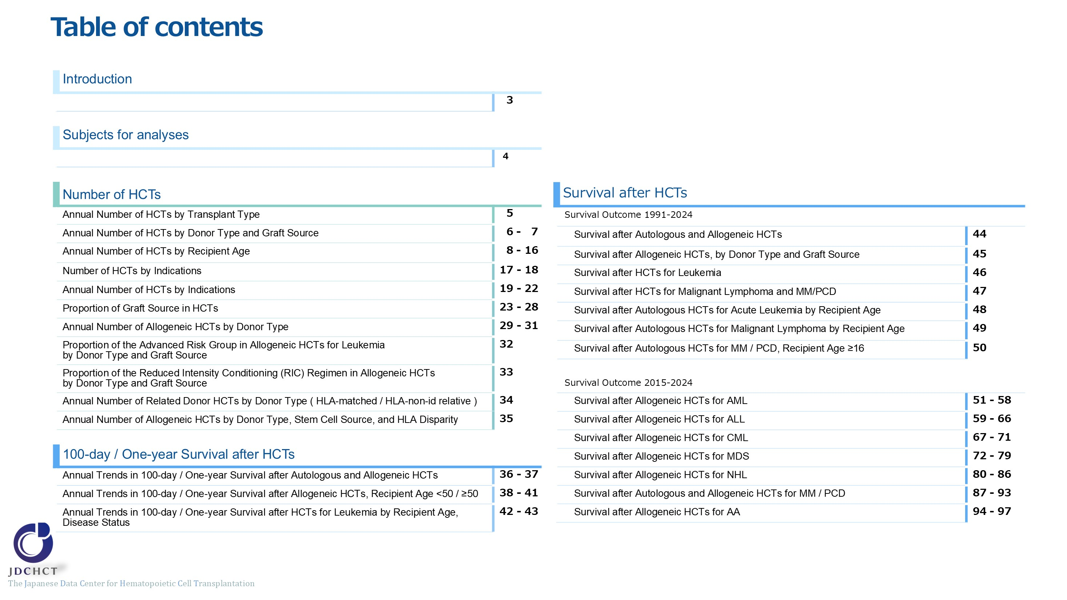
Table of contents

Slide 3
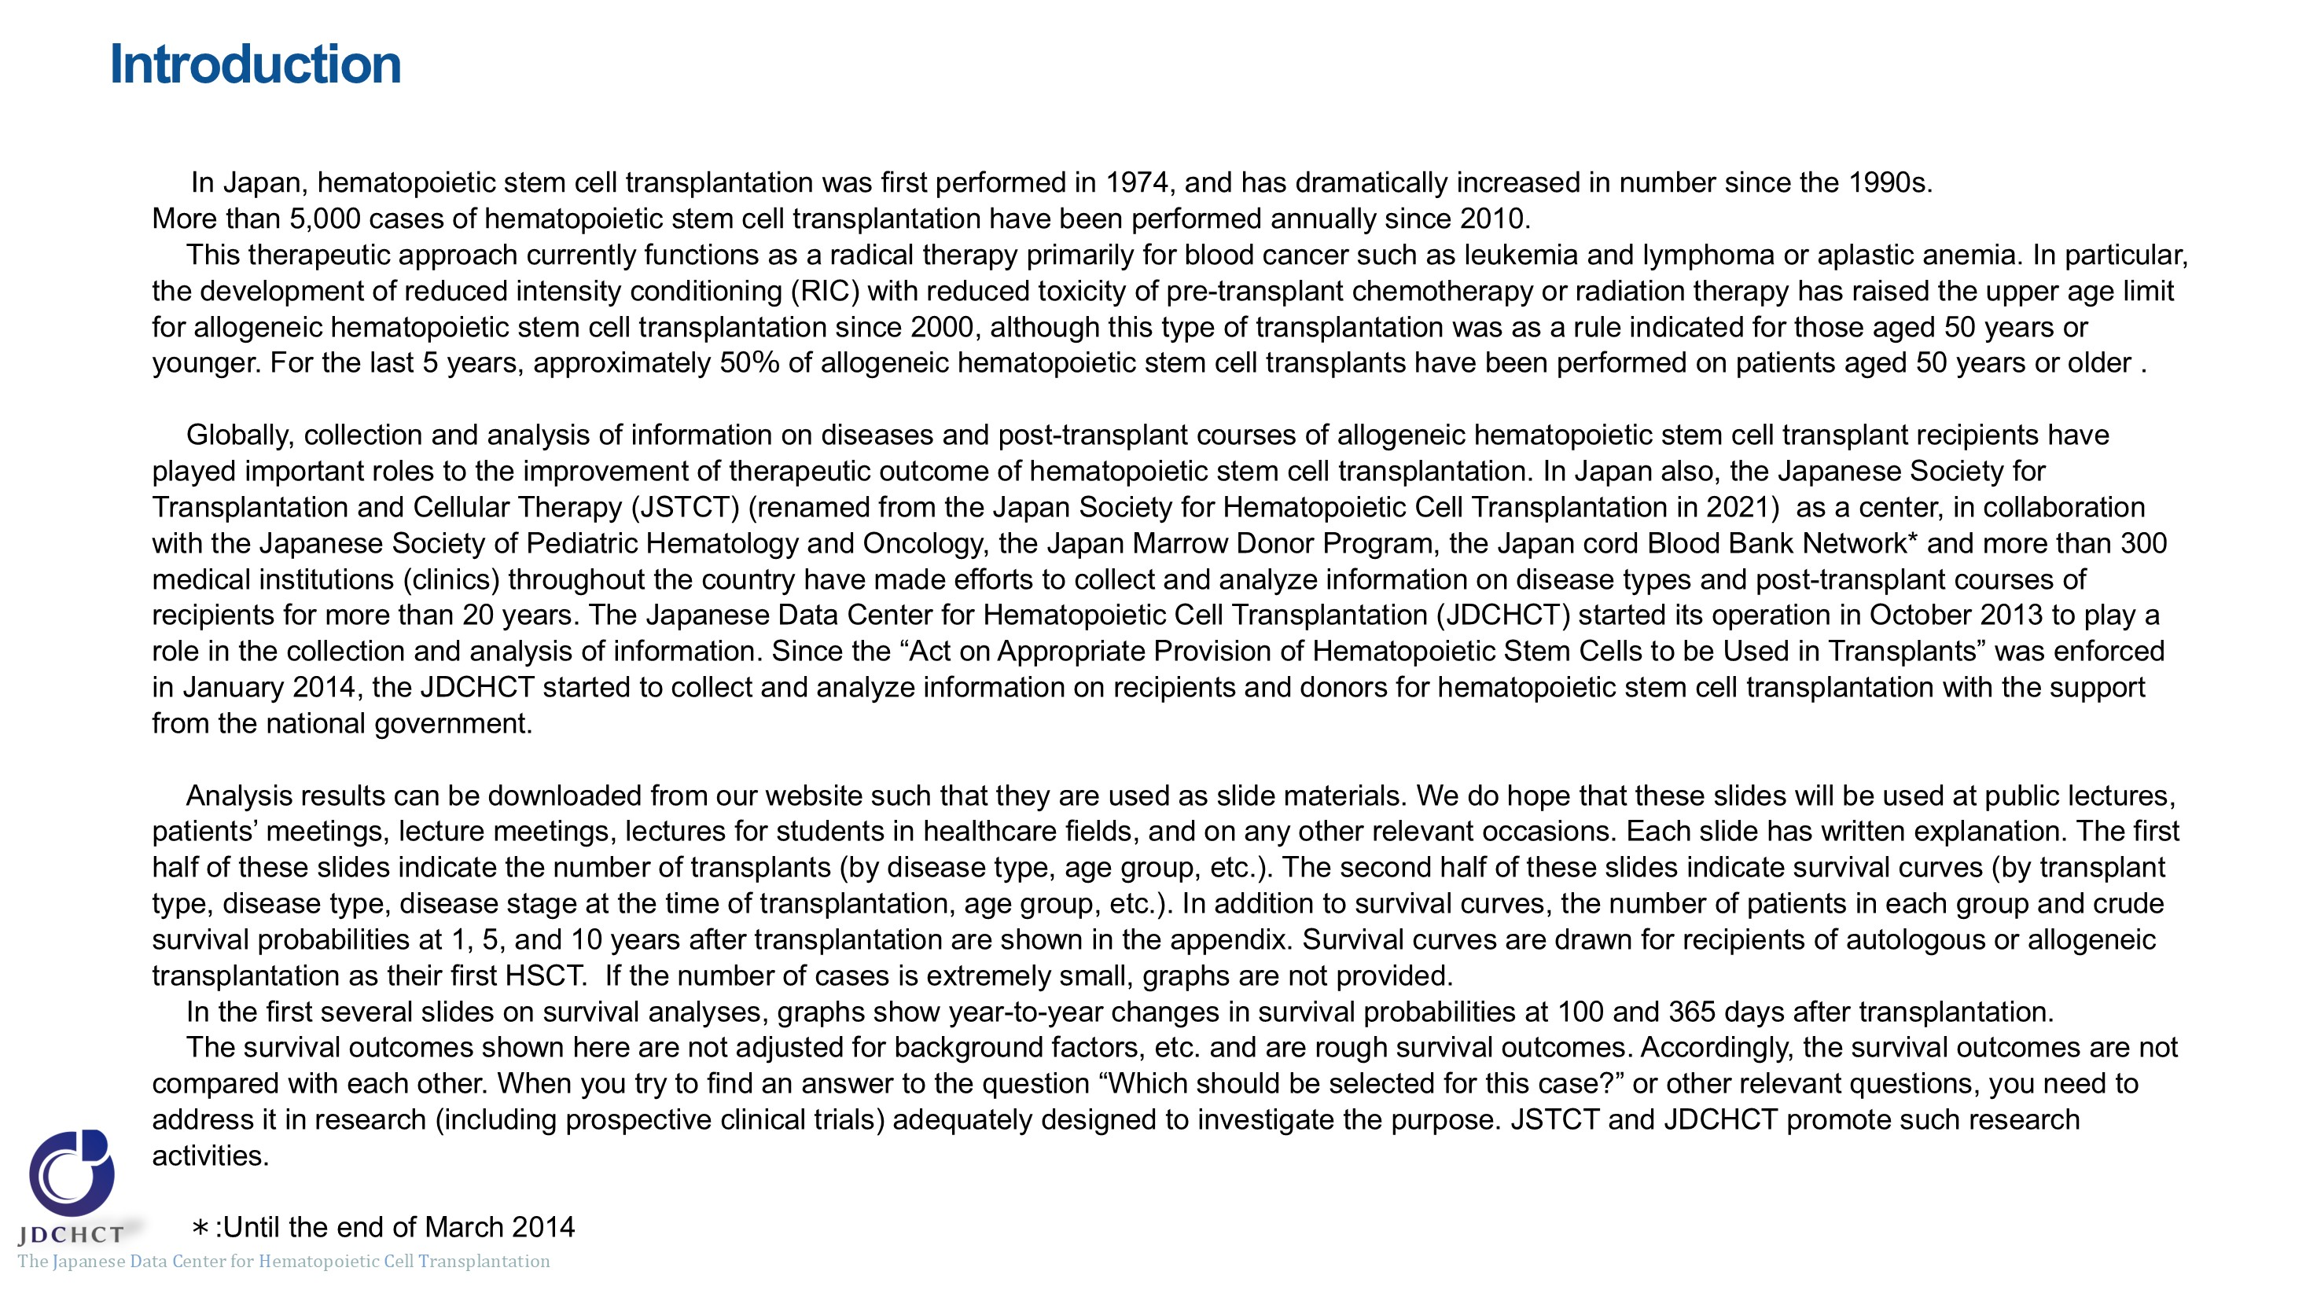
Introduction

Slide 4
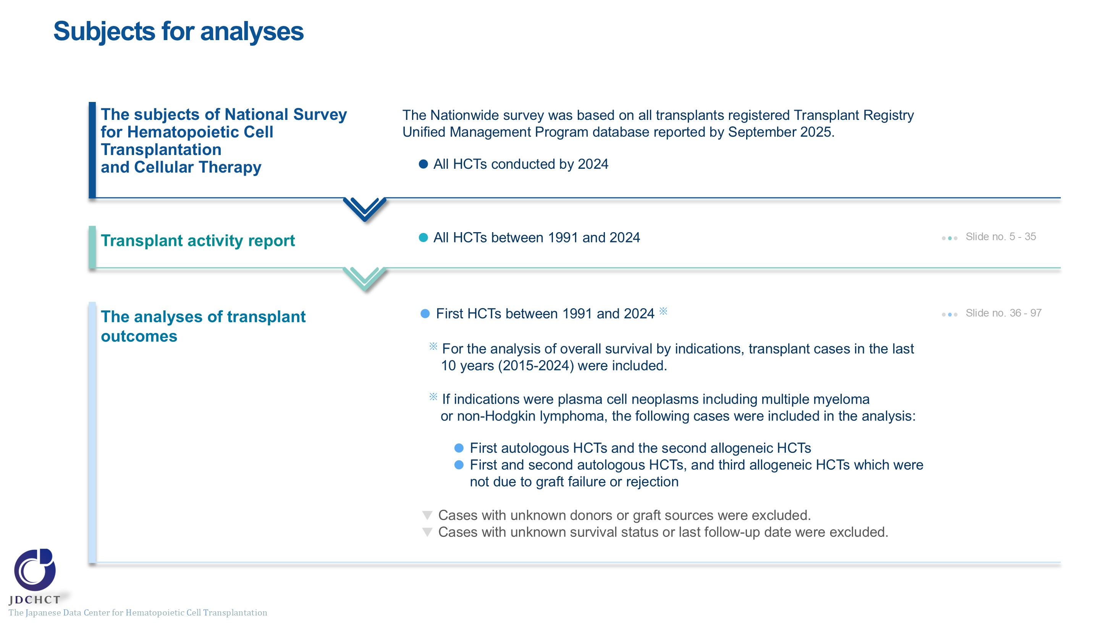
Subjects for analyses

Slide 5
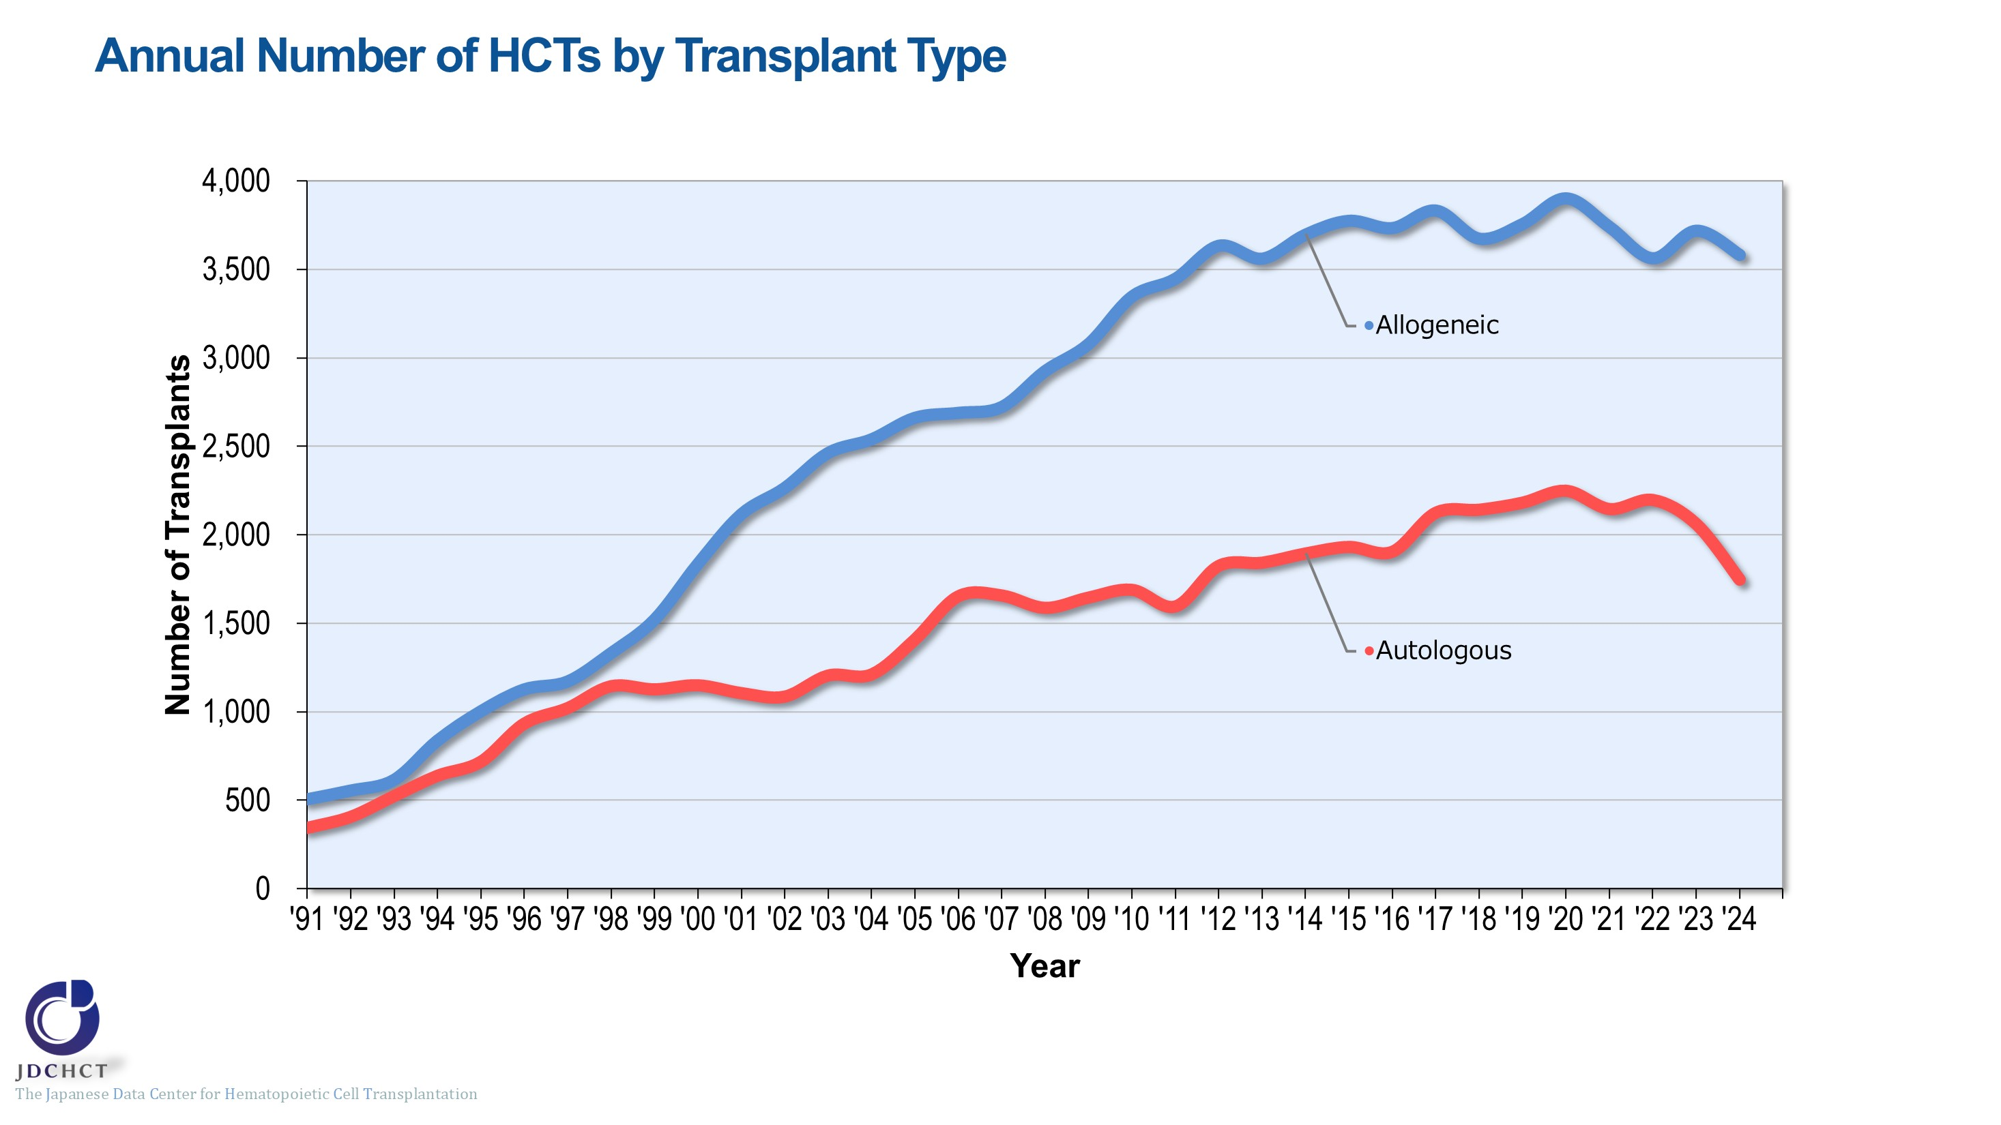
Annual Number of HCTs by Transplant Type
Notes:
In Japan, registration for bone marrow transplantation from unrelated donors was started in 1993 and the first case of cord blood transplantation was performed in 1997. Since these times, transplantation from unrelated donors has spread and the total number of allogeneic transplant recipients has increased. The annual number of registered autologous and allogeneic transplants has exceeded 5,000 since 2010.

Slide 6
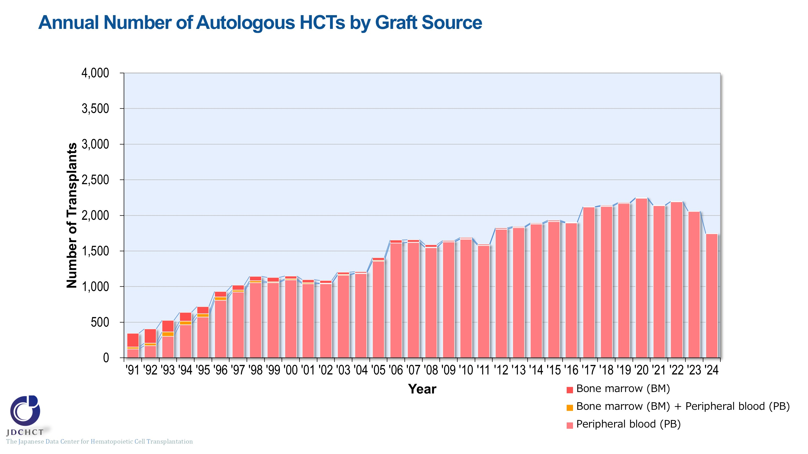
Annual Number of Autologous HCTs by Graft Source
Notes:
For autologous transplants, the annual number of cases registered has exceeded 1,500 since 2006. Recently, peripheral blood stem cell transplants account for 99％ or more of the total cases of autologous transplants.

Slide 7
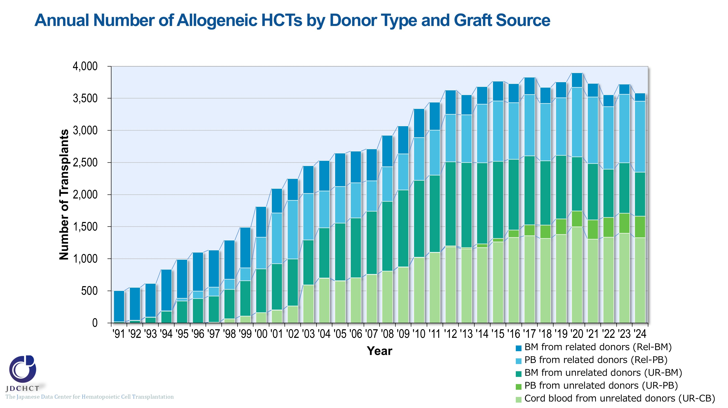
Annual Number of Allogeneic HCTs by Donor Type and Graft Source
Notes:
In Japan, since 1993 when registration for bone marrow transplantation from unrelated donors was started and since 1997 when the first case of cord blood transplantation was performed, transplantation from unrelated donors has spread and the total number of transplant recipients has increased. In particular, the increase in cord blood transplants is remarkable. Additionally, peripheral blood stem cell transplantation from unrelated donors was introduced in 2010 and the number of transplants has been gradually increasing. The number of related peripheral blood stem cell transplants has also increased, as the number of haplo-identical transplants has increased remarkably since 2010. Conversely, bone marrow transplants from both related donors and unrelated donors have gradually decreased in recent years.

Slide 8
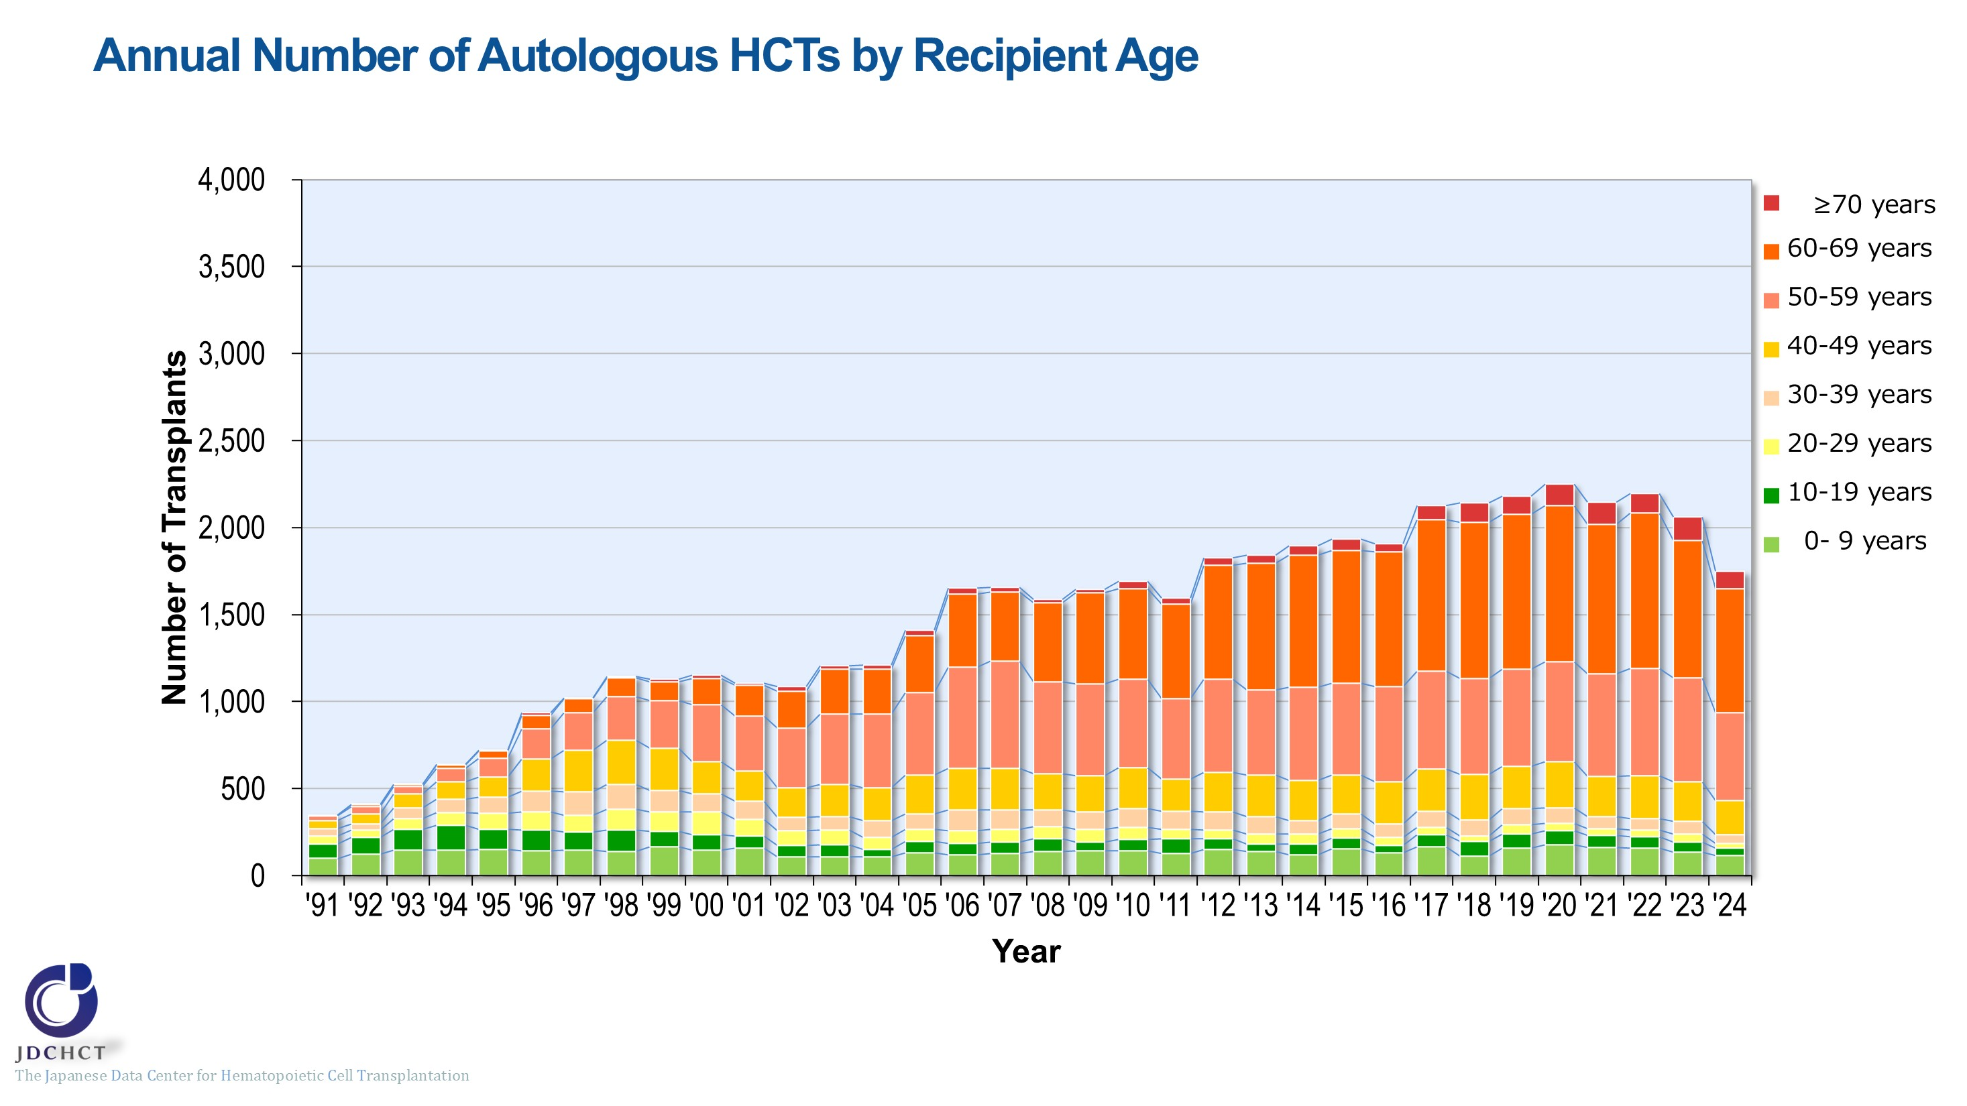
Annual Number of Autologous HCTs by Recipient Age
Notes:
The spread of transplantation with reduced intensity conditioning (RIC) has expanded the age range for transplant eligibility and increased the number of autologous transplants in older age groups; however, this number has been declining slightly since 2023. Those aged 50 years or older have recently accounted for more than 70% of the total cases of autologous transplants.

Slide 9
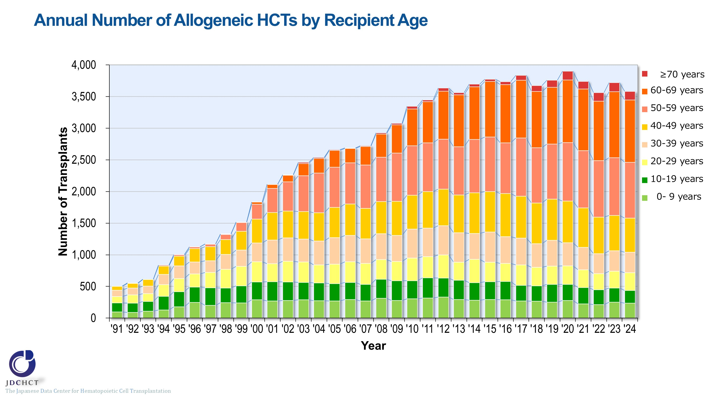
Annual Number of Allogeneic HCTs by Recipient Age
Notes:
The spread of transplantation with reduced intensity conditioning (RIC) has expanded the age range for transplant eligibility and increased the number of allogeneic transplants in older age groups. Those aged 50 years or older have recently accounted for more than 50％ of the total cases of allogeneic transplants.

Slide 10
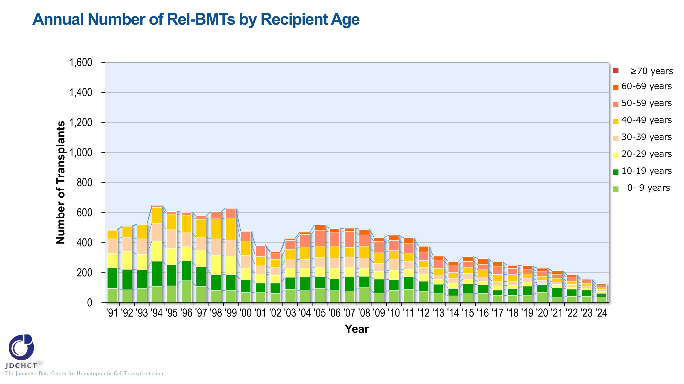
Annual Number of Rel-BMTs by Recipient Age
Notes:
The number of bone marrow transplants from related donors in all age groups is on a decreasing trend.

Slide 11
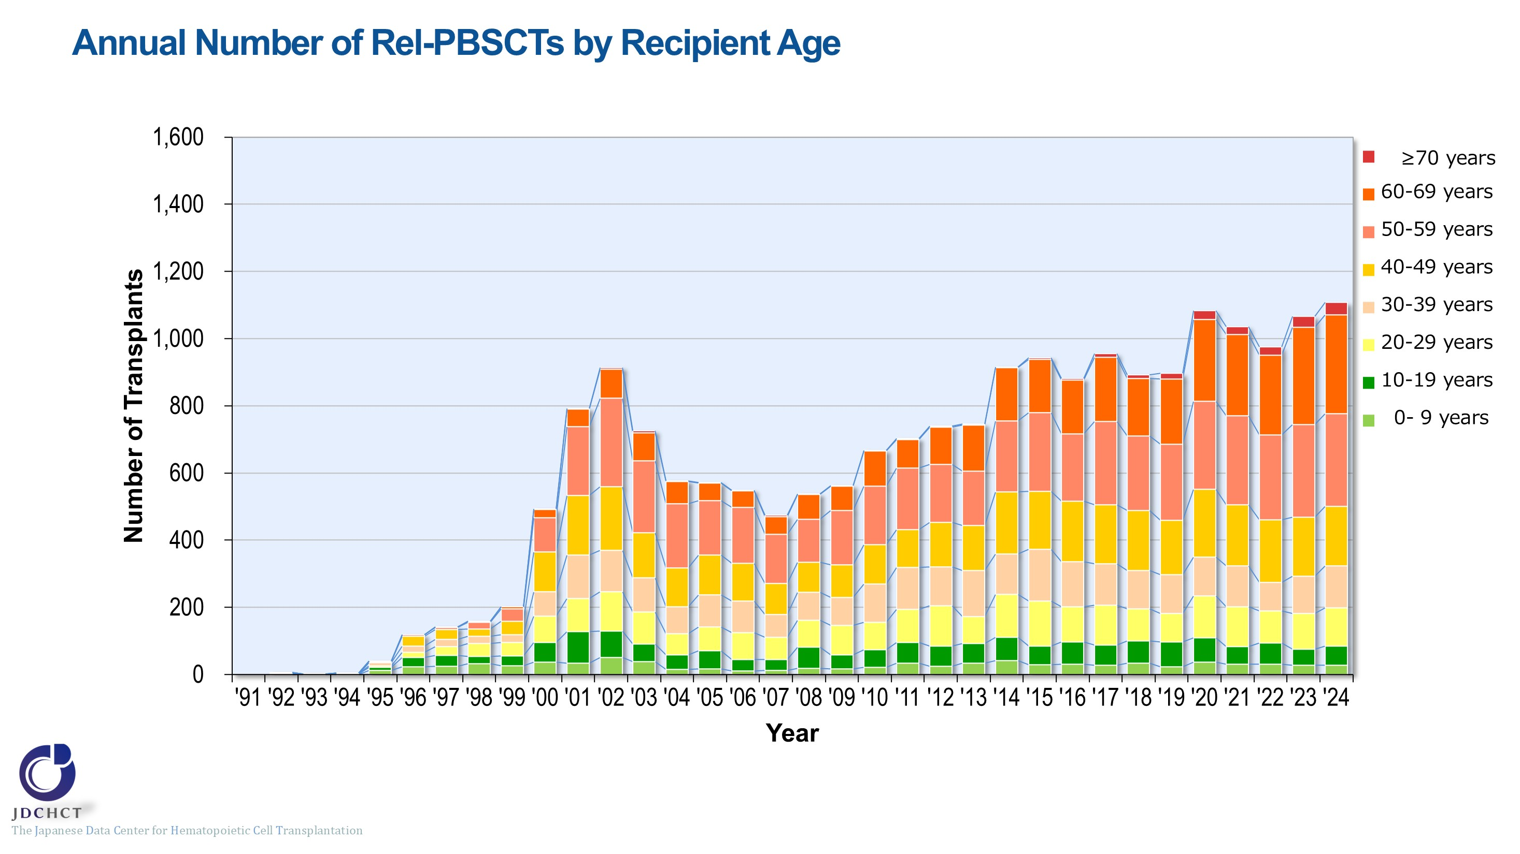
Annual Number of Rel-PBSCTs by Recipient Age
Notes:
The number of peripheral blood stem cell transplants from related donors in older age groups has increased.

Slide 12
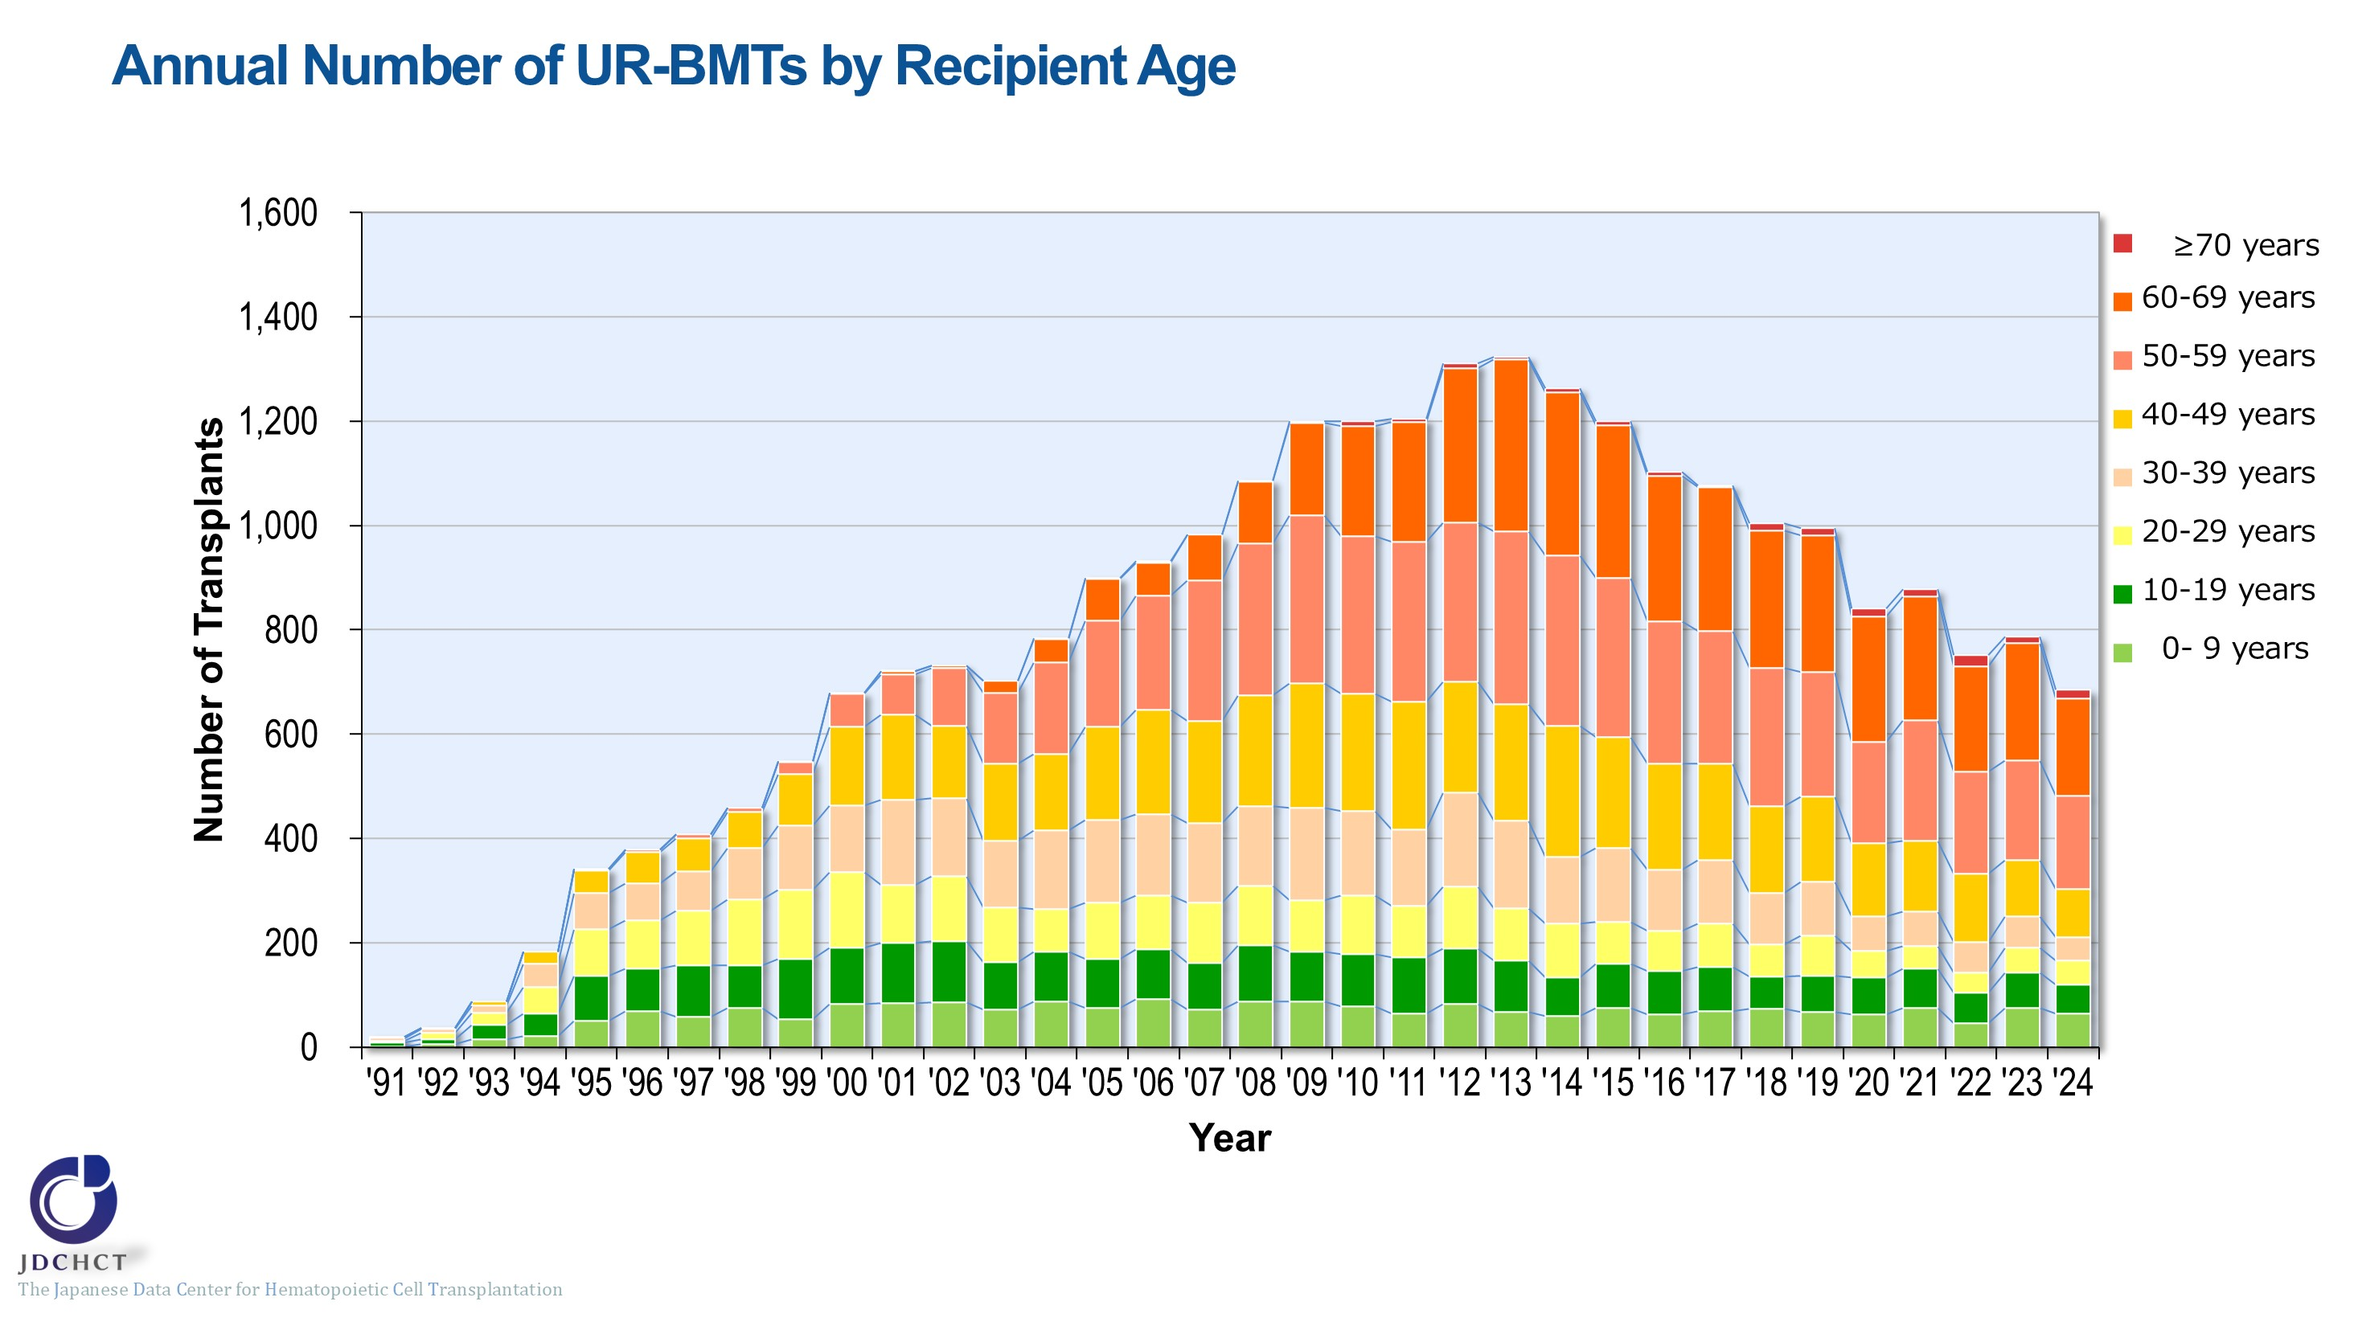
Annual Number of UR-BMTs by Recipient Age
Notes:
With the introduction of peripheral blood stem cell transplantation from unrelated donors, the number of bone marrow transplants from unrelated donors has been declining in adults over the past decade.

Slide 13
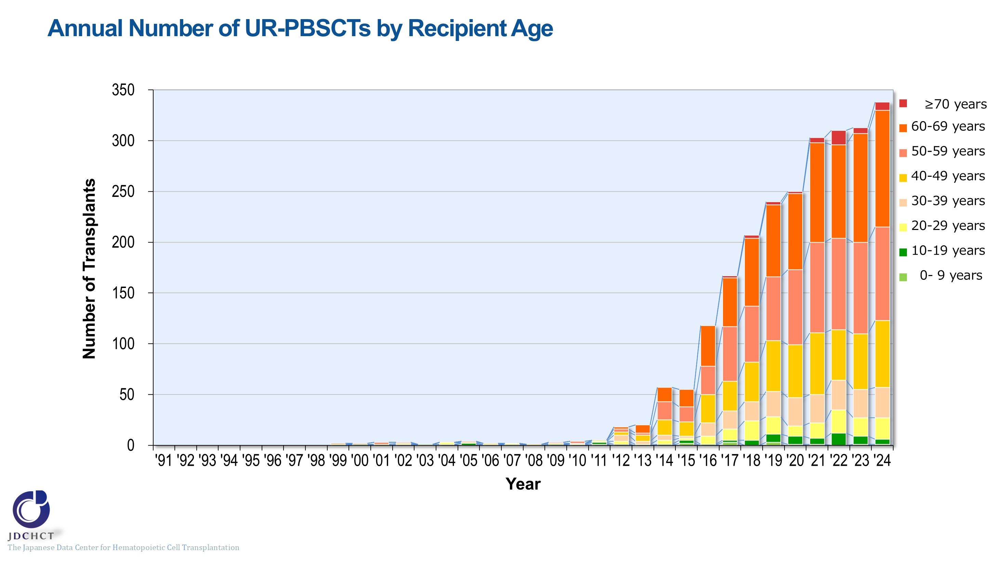
Annual Number of UR-PBSCTs by Recipient Age
Notes:
The number of peripheral blood stem cell transplants from unrelated donors has increased in adults, particularly in older age groups.

Slide 14
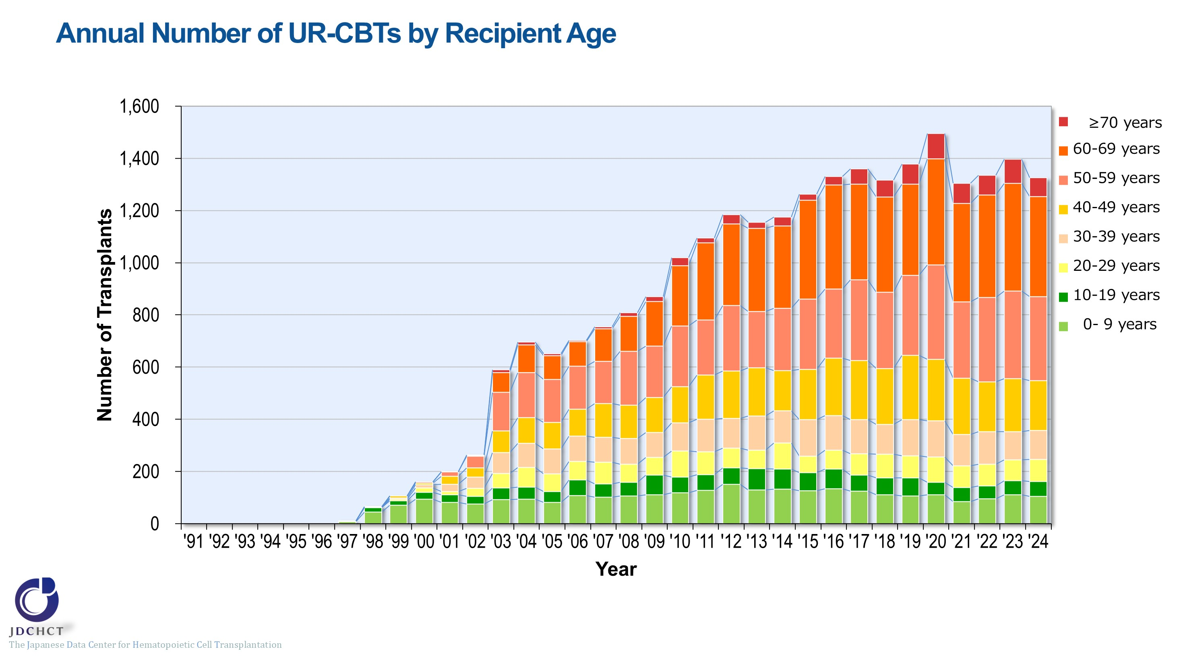
Annual Number of UR-CBTs by Recipient Age
Notes:
In cord blood transplantation from unrelated donors, the number of transplants in older age groups has increased, and those aged 50 years or older accounted for more than 50％.

Slide 15
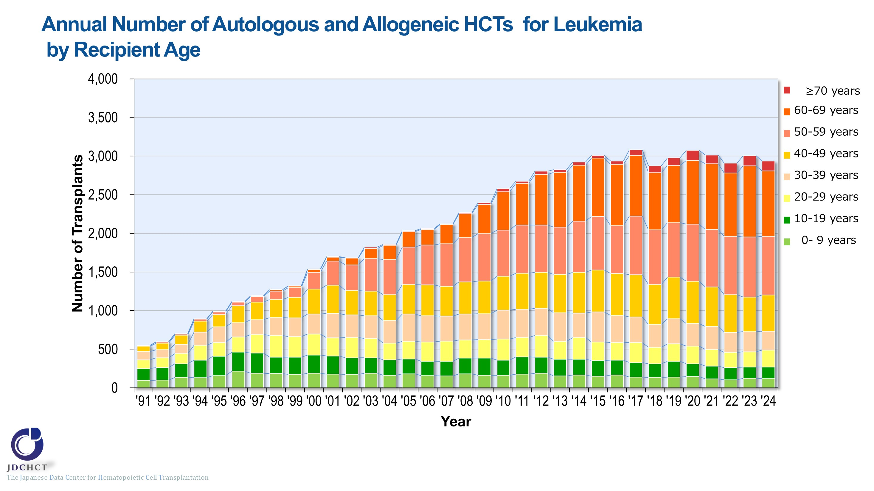
Annual Number of Autologous and Allogeneic HCTs for Leukemia by Recipient Age
Notes:
In leukemia, the number of transplants (autologous and allogeneic transplants) has increased in older age groups. Those aged 50 years or older accounted for approximately 60％ of the total cases of leukemia.

Slide 16
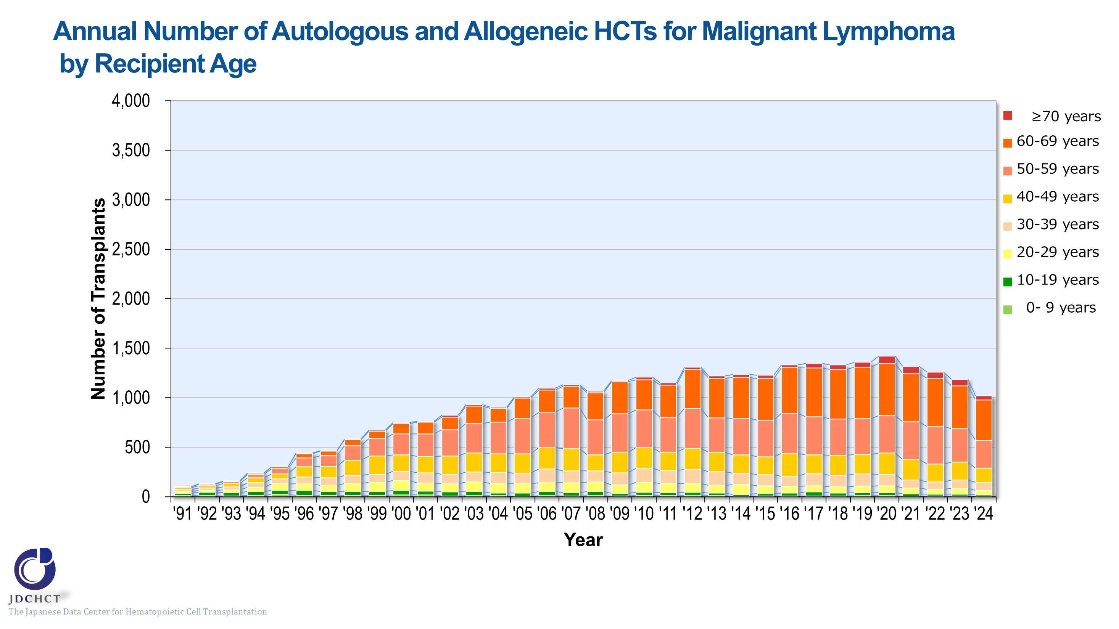
Annual Number of Autologous and Allogeneic HCTs for Malignant Lymphoma by Recipient Age
Notes:
In malignant lymphoma, after the number of transplants (autologous and allogeneic transplants) increased in older age groups, it has slightly decreased across all age groups since 2021. Those aged 50 years or older accounted for approximately 70％ of the total cases of malignant lymphoma.

Slide 17
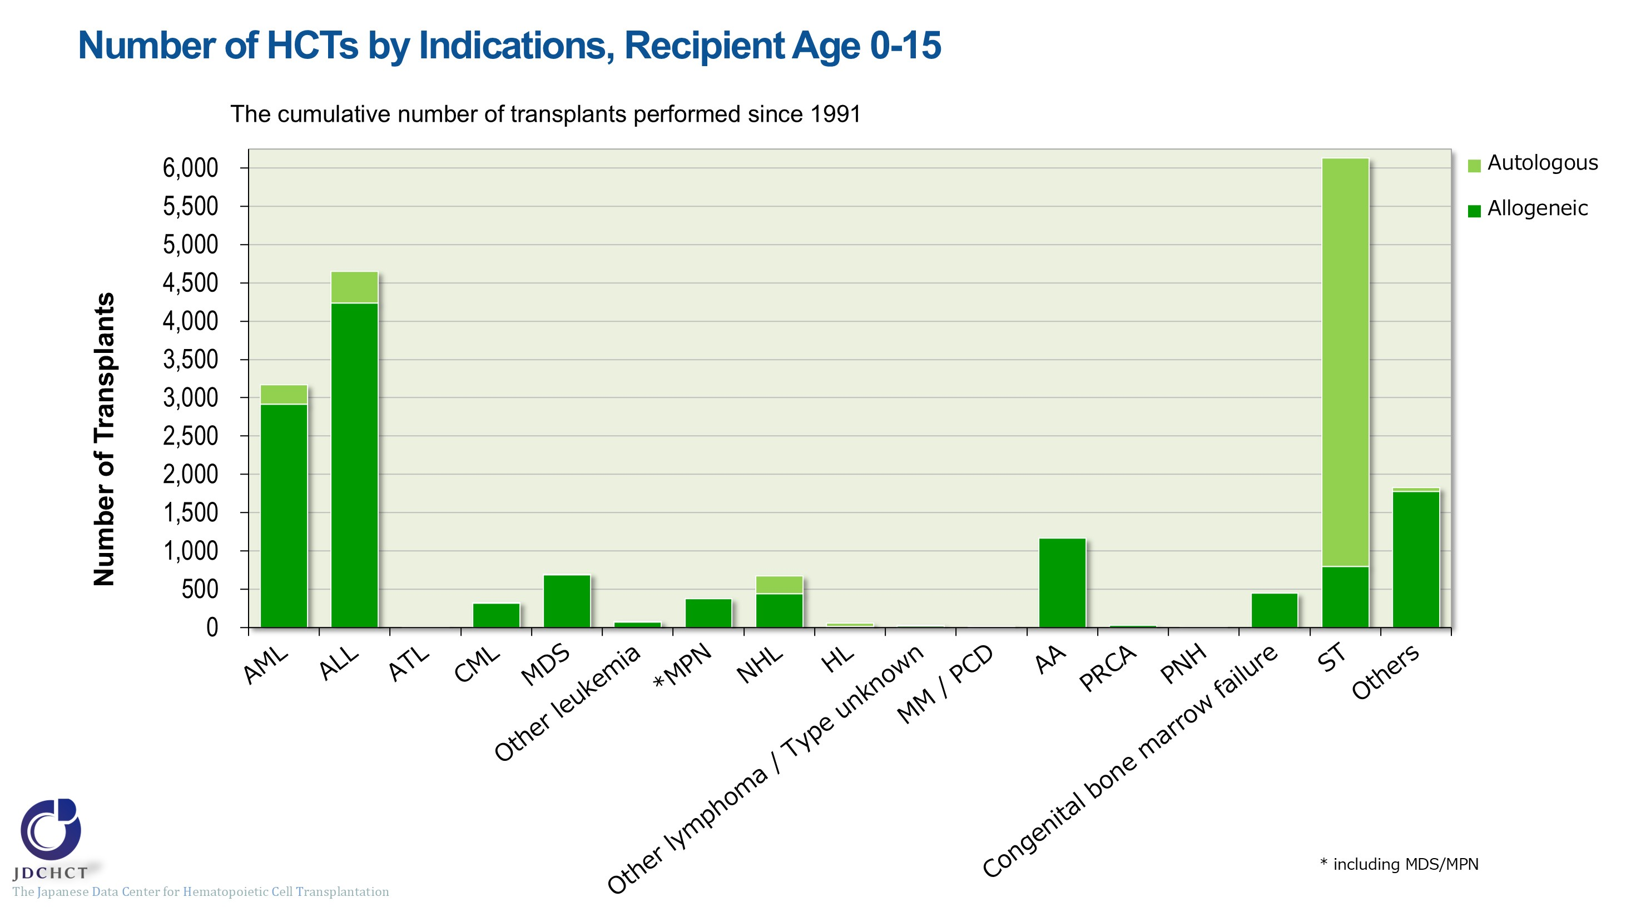
Number of HCTs by Indications, Recipient Age 0-15
Notes:
In pediatric patients, allogeneic transplants are most frequently performed for acute leukemia (acute myeloid leukemia and acute lymphoblastic leukemia) , which accounts for 54％ of the total cases of allogeneic transplantation. Following this, allogeneic transplants are also frequently performed for aplastic anemia. Although aplastic anemia is a rare disease, allogeneic transplantation is the first choice for serious and most serious cases when HLA-matched sibling donors are available. Accordingly, aplastic anemia accounts for 9％ of the allogeneic transplants in pediatric patients.
For solid tumors in pediatric patients, autologous transplants are performed to rescue hematopoietic dysfunction due to high-dose chemotherapy, accounting for 84% of all autologous transplant cases.

Slide 18
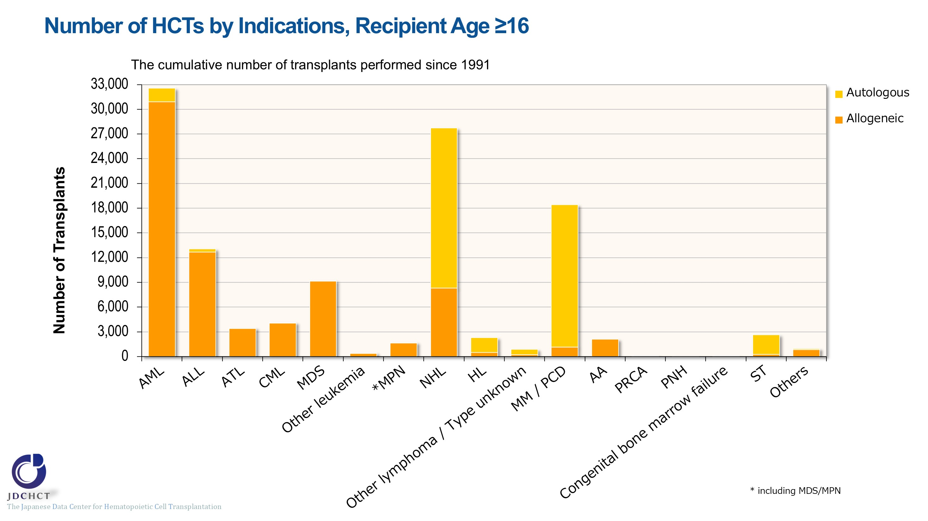
Number of HCTs by Indications, Recipient Age ≥16
Notes:
In patients aged 16 years or older, allogeneic transplants are most frequently performed for acute leukemia (acute myeloid leukemia and acute lymphoblastic leukemia) , which accounts for 58％ of the total cases of allogeneic transplants. Following this, allogeneic transplants are also frequently performed in myelodysplastic syndrome and non-Hodgkin lymphoma. In patients aged 16 years or older, autologous transplants are frequently performed for non-Hodgkin lymphoma and multiple myeloma. High-dose chemotherapy in combination with autologous transplantation is the established standard therapy for multiple myeloma in patients under 65 years of age, and autologous transplants account for 94％.

Slide 19
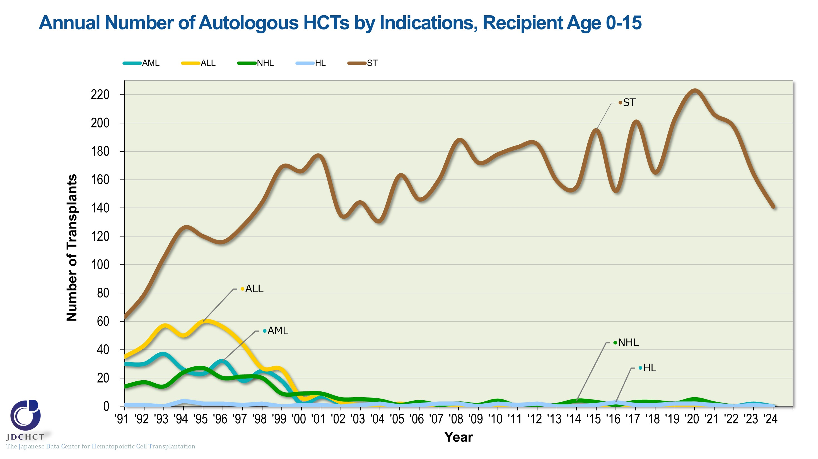
Annual Number of Autologous HCTs by Indications, Recipient Age 0-15
Notes:
For solid tumors in pediatric patients, autologous transplants are performed to rescue hematopoietic dysfunction due to high-dose chemotherapy; consequently, autologous transplantation is most frequently performed.

Slide 20
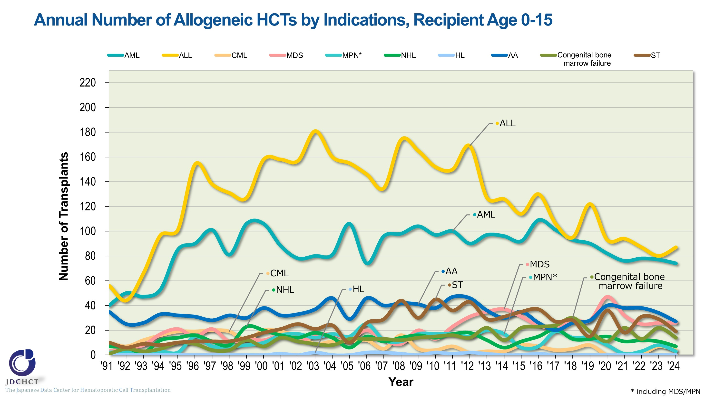
Annual Number of Allogeneic HCTs by Indications, Recipient Age 0-15
Notes:
In pediatric patients, allogeneic transplants are frequently performed for acute lymphoblastic leukemia and acute myeloid leukemia.

Slide 21
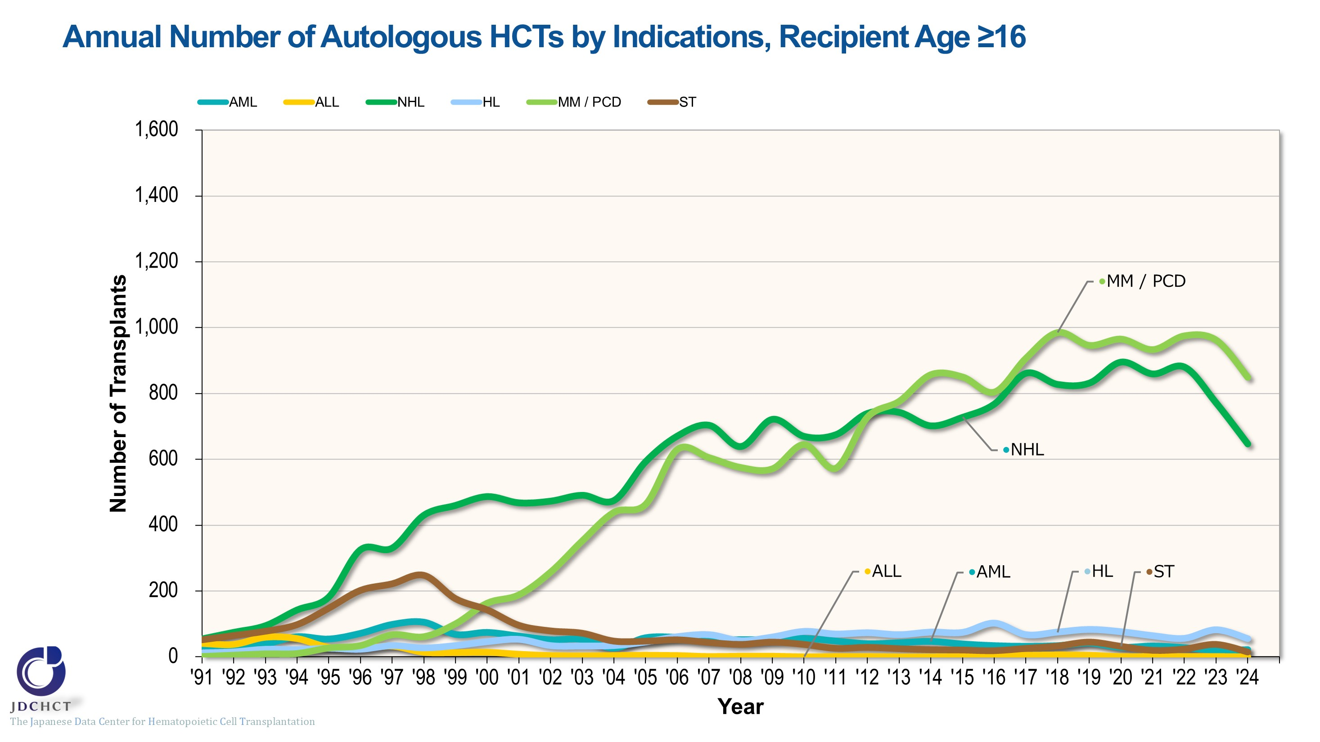
Annual Number of Autologous HCTs by Indications, Recipient Age ≥16
Notes:
Multiple myeloma and malignant lymphoma are the main indications for autologous transplants in patients aged 16 years and older. The number of autologous transplants for malignant lymphoma has been declining slightly since 2023. The number of autologous transplants for multiple myeloma decreased slightly in 2024.

Slide 22
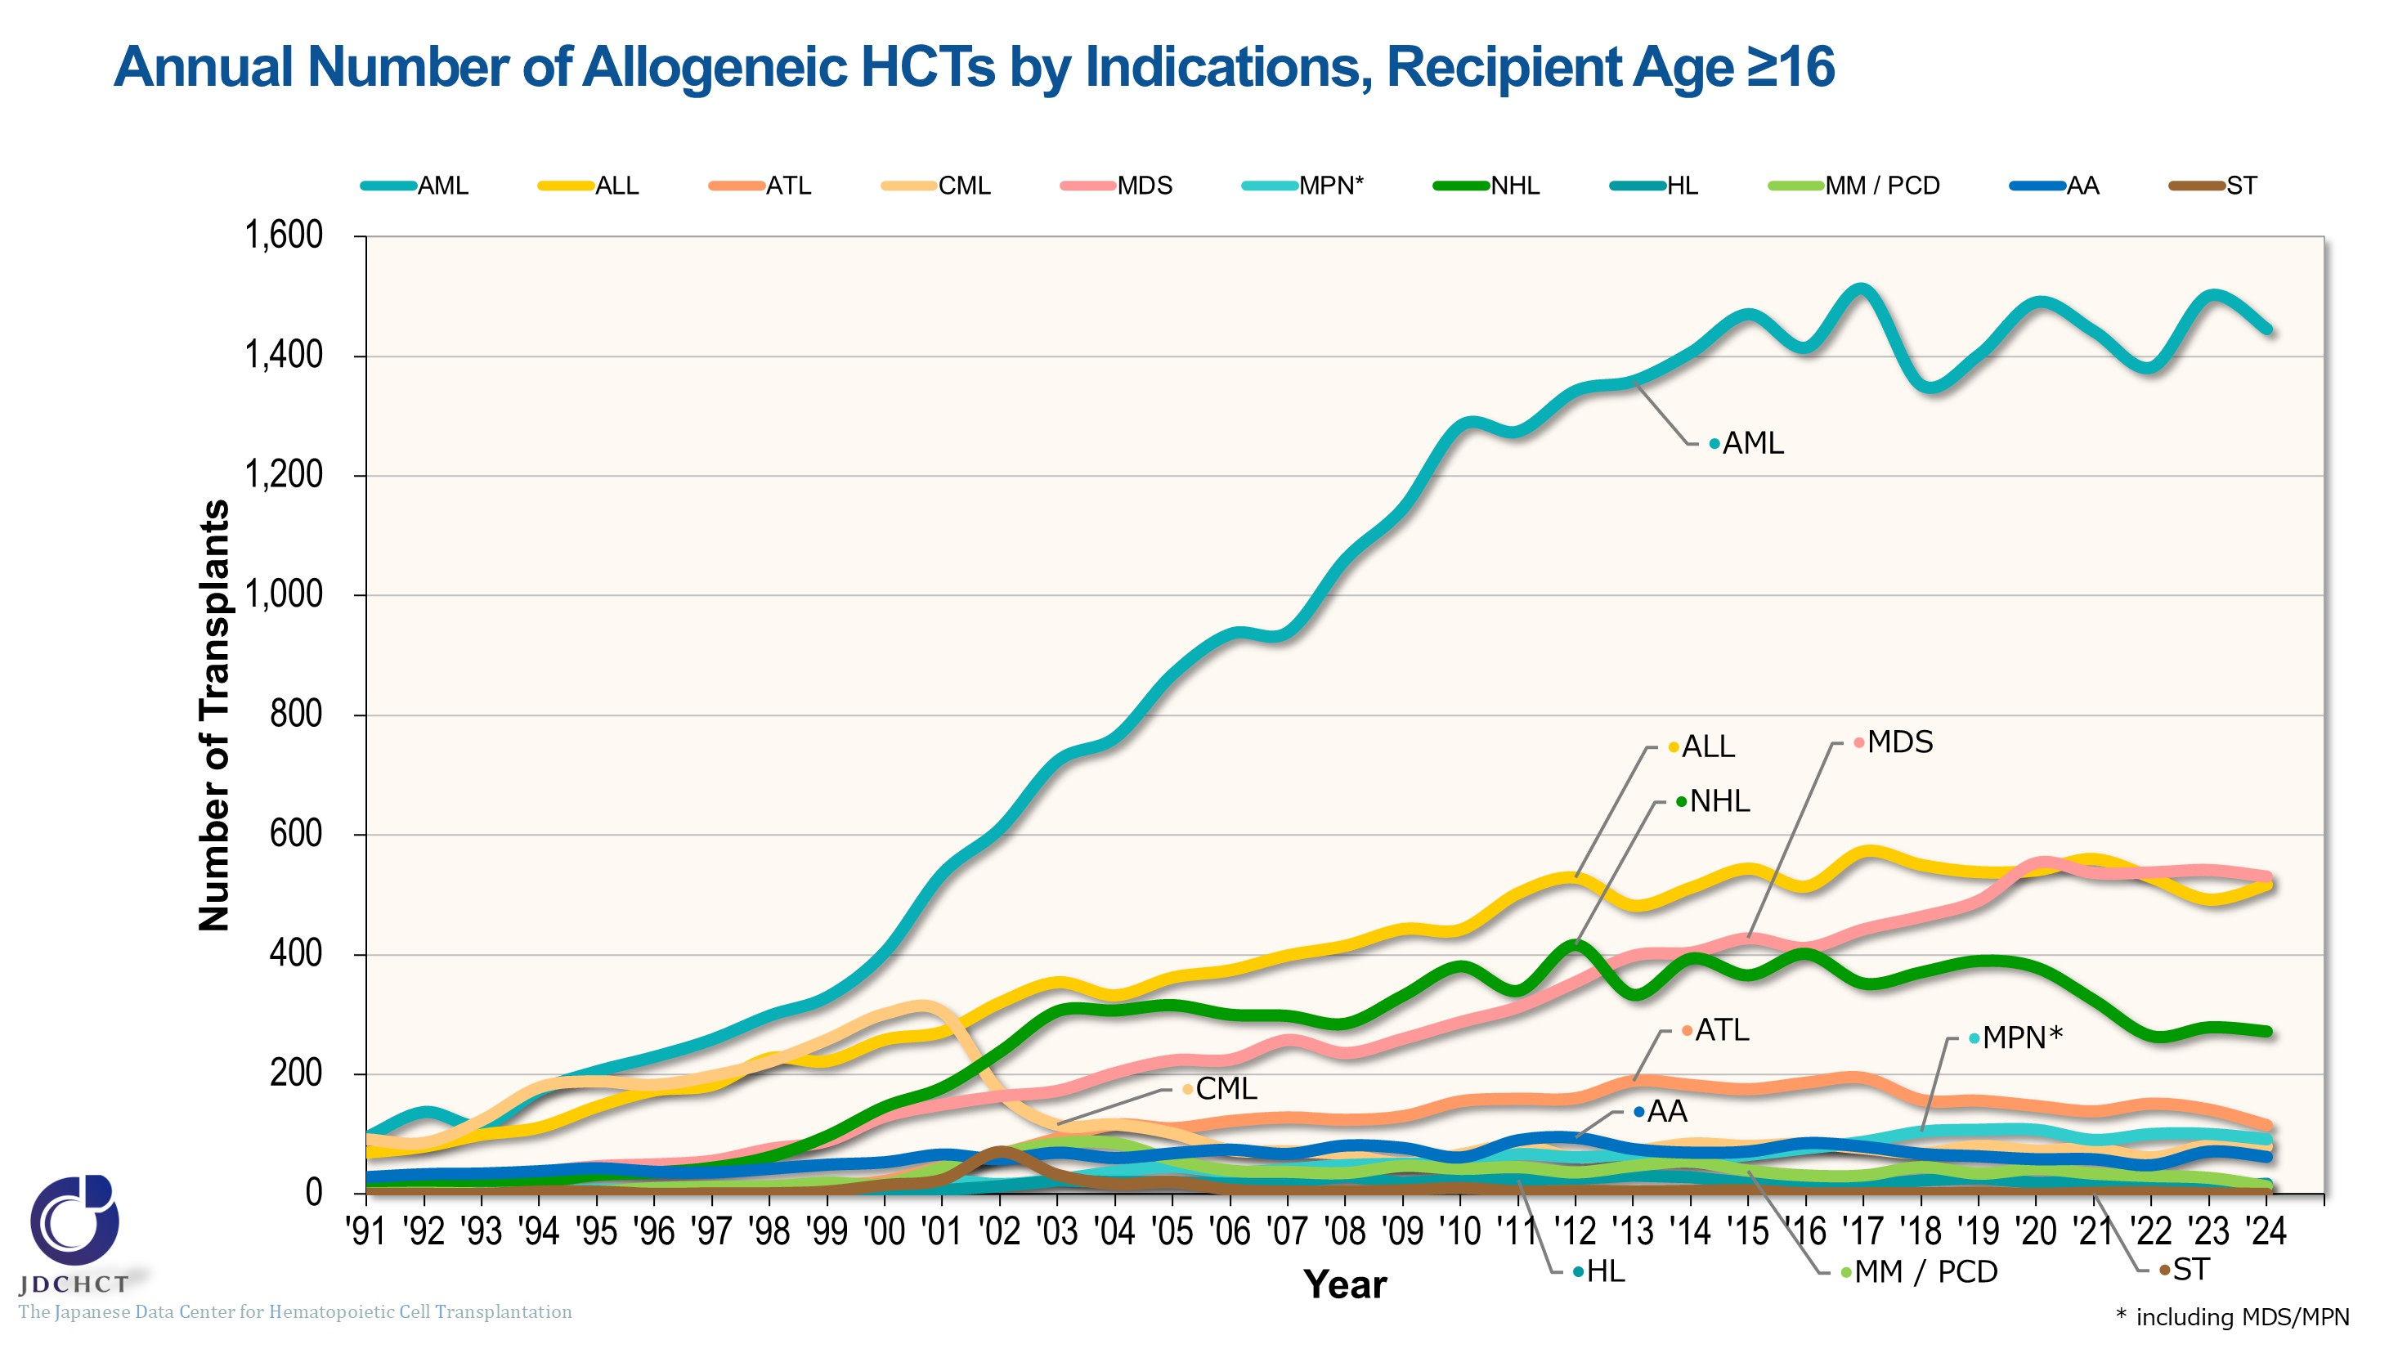
Annual Number of Allogeneic HCTs by Indications, Recipient Age ≥16
Notes:
In patients aged 16 years or older, allogeneic transplants are most frequently performed for acute myeloid leukemia, followed by acute lymphoblastic leukemia and myelodysplastic syndrome.
In 2001, imatinib was officially approved in Japan as a molecular targeted therapy for chronic myeloid leukemia were approved. Since then, transplantation for chronic myeloid leukemia has decreased.
The number of allogeneic transplants for malignant lymphoma has declined slightly since 2021, possibly due to the introduction of cellular therapy.

Slide 23
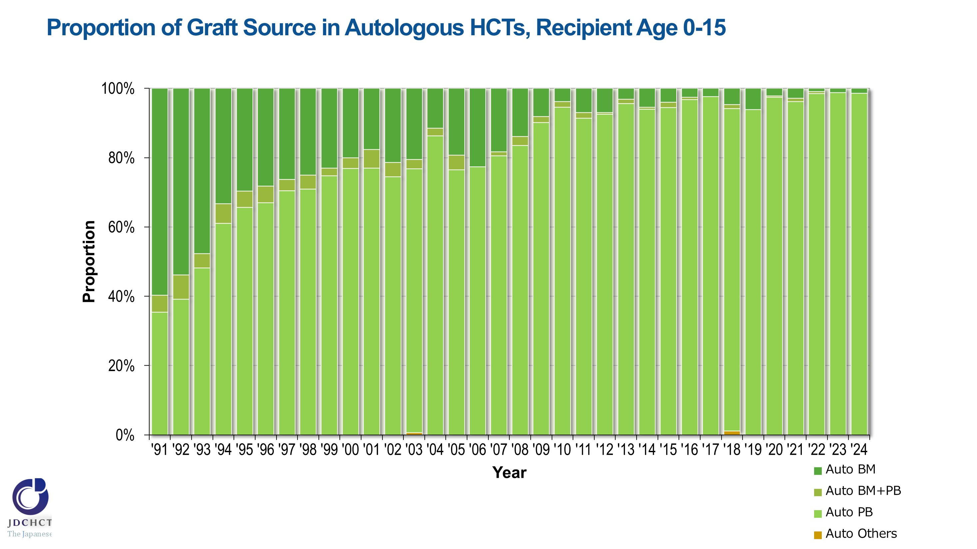
Proportion of Graft Source in Autologous HCTs, Recipient Age 0-15
Notes:
Recently, peripheral blood stem cell transplantations account for 95％ or more of the total cases of autologous transplants in patients aged 0 to 15 years. The process of collecting peripheral blood stem cells poses less burden to patients than the harvesting procedure in bone marrow transplantation. Since 2000, the process of collecting peripheral blood stem cells for transplantation using granulocyte-colony stimulating factor (G-CSF) has been covered by the national health insurance. For these reasons, the number of autologous peripheral blood stem cell transplants has increased, whereas autologous bone marrow transplants have decreased.

Slide 24
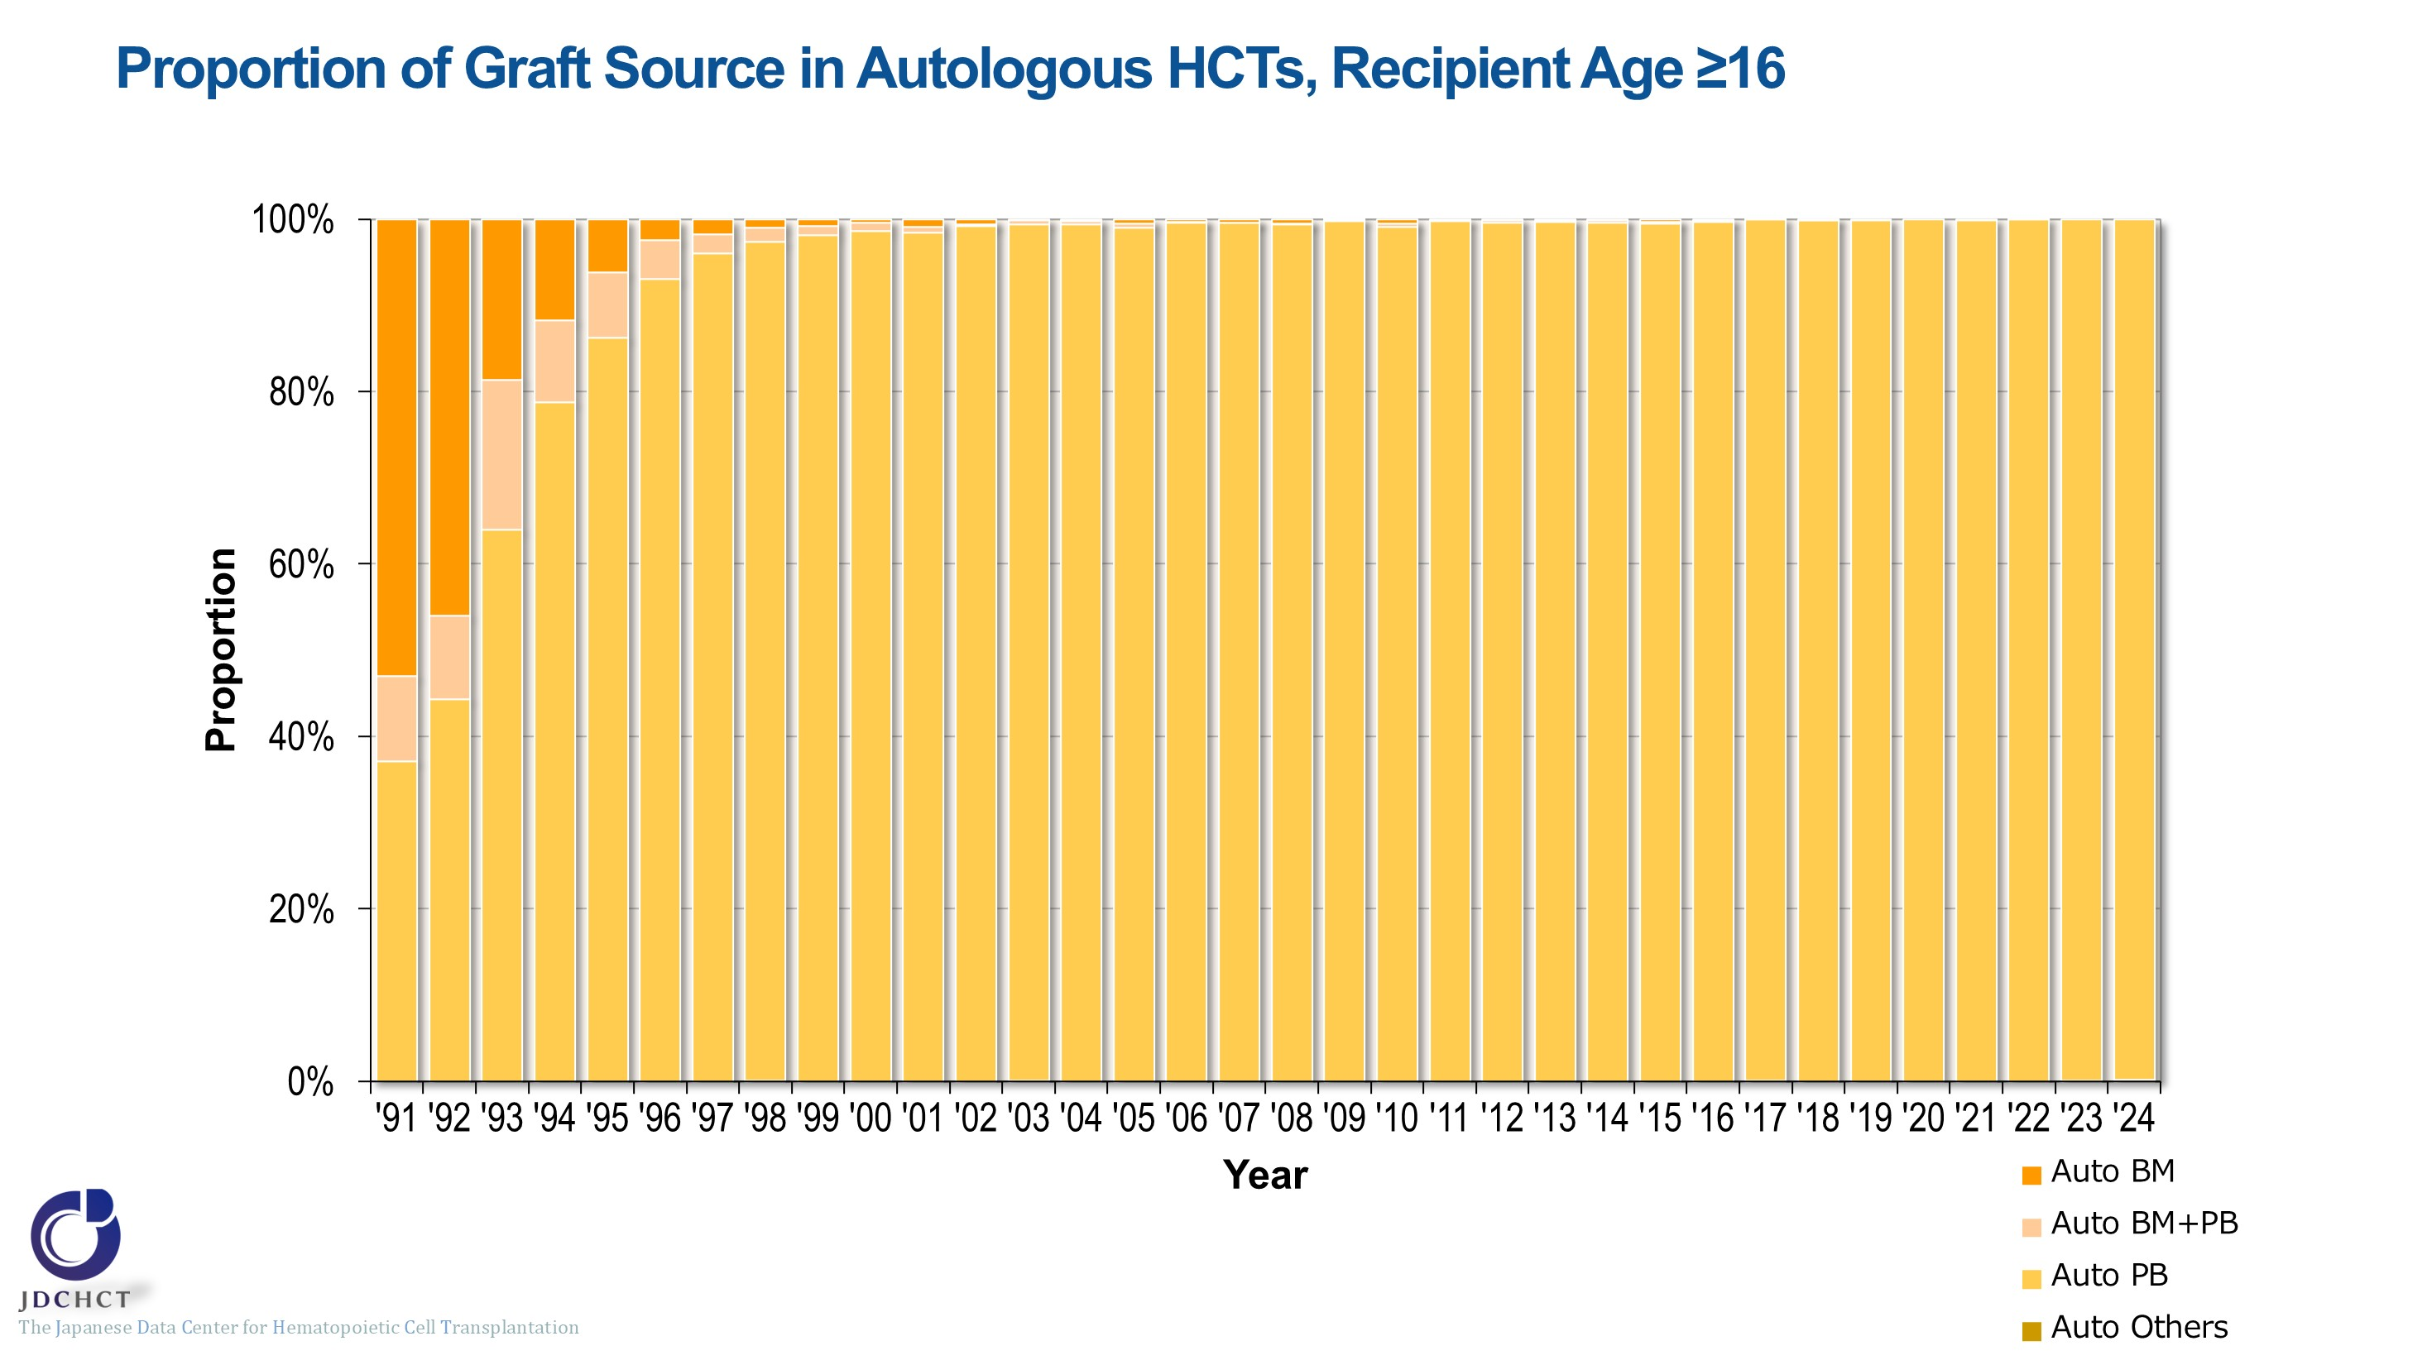
Proportion of Graft Source in Autologous HCTs, Recipient Age ≥16
Notes:
Over the past two decades, peripheral blood stem cell transplants have accounted for 99％ or more of the total cases of autologous transplants in patients aged 16 years or older.

Slide 25
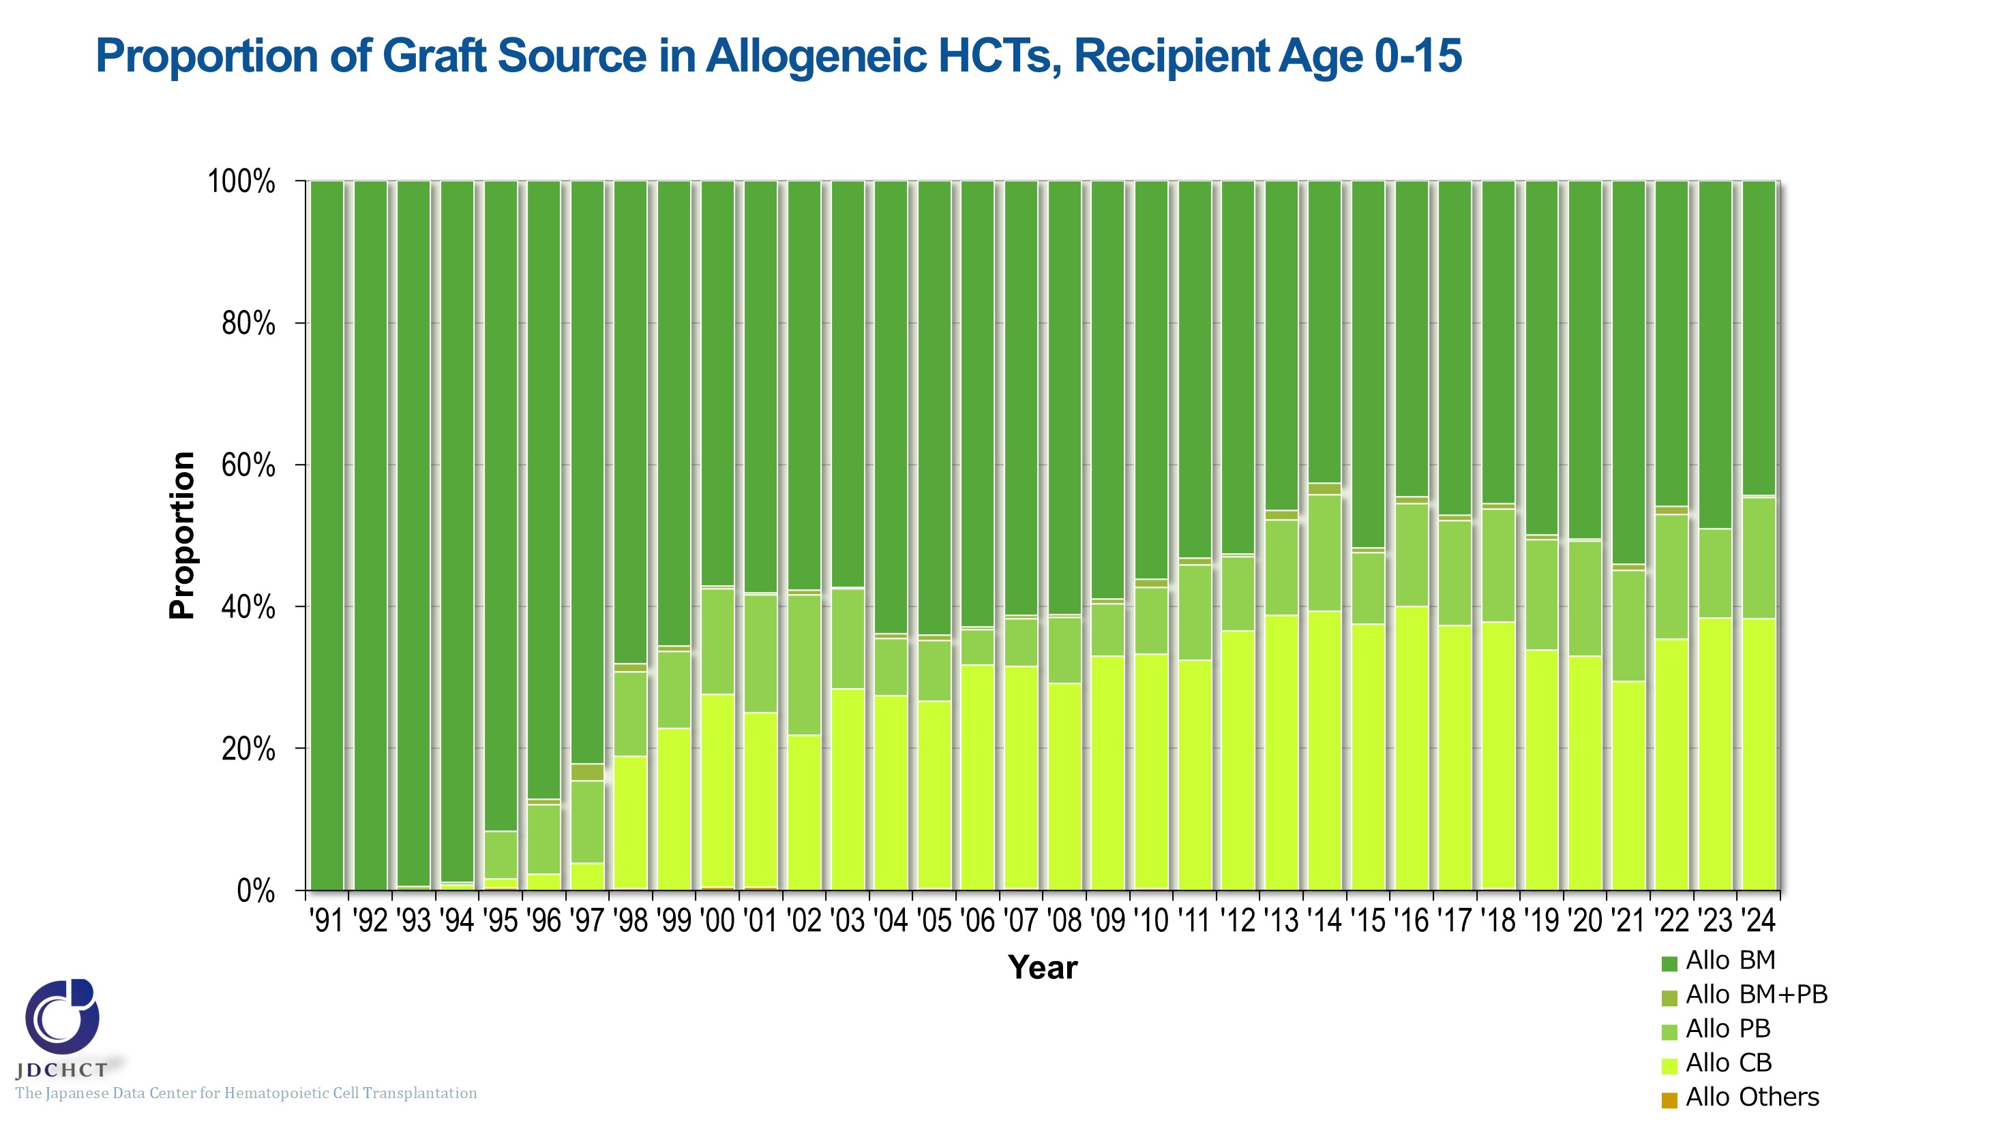
Proportion of Graft Source in Allogeneic HCTs, Recipient Age 0-15
Notes:
In allogeneic transplantation for patients aged 0 to 15 years, the spread of cord blood transplantation and peripheral blood stem cell transplantation has made the proportion of allogeneic bone marrow transplantation show a tendency to decrease. In recent years, bone marrow transplants account for approximately half of all allogeneic transplants, while cord blood transplants account for 30 to 40%.

Slide 26
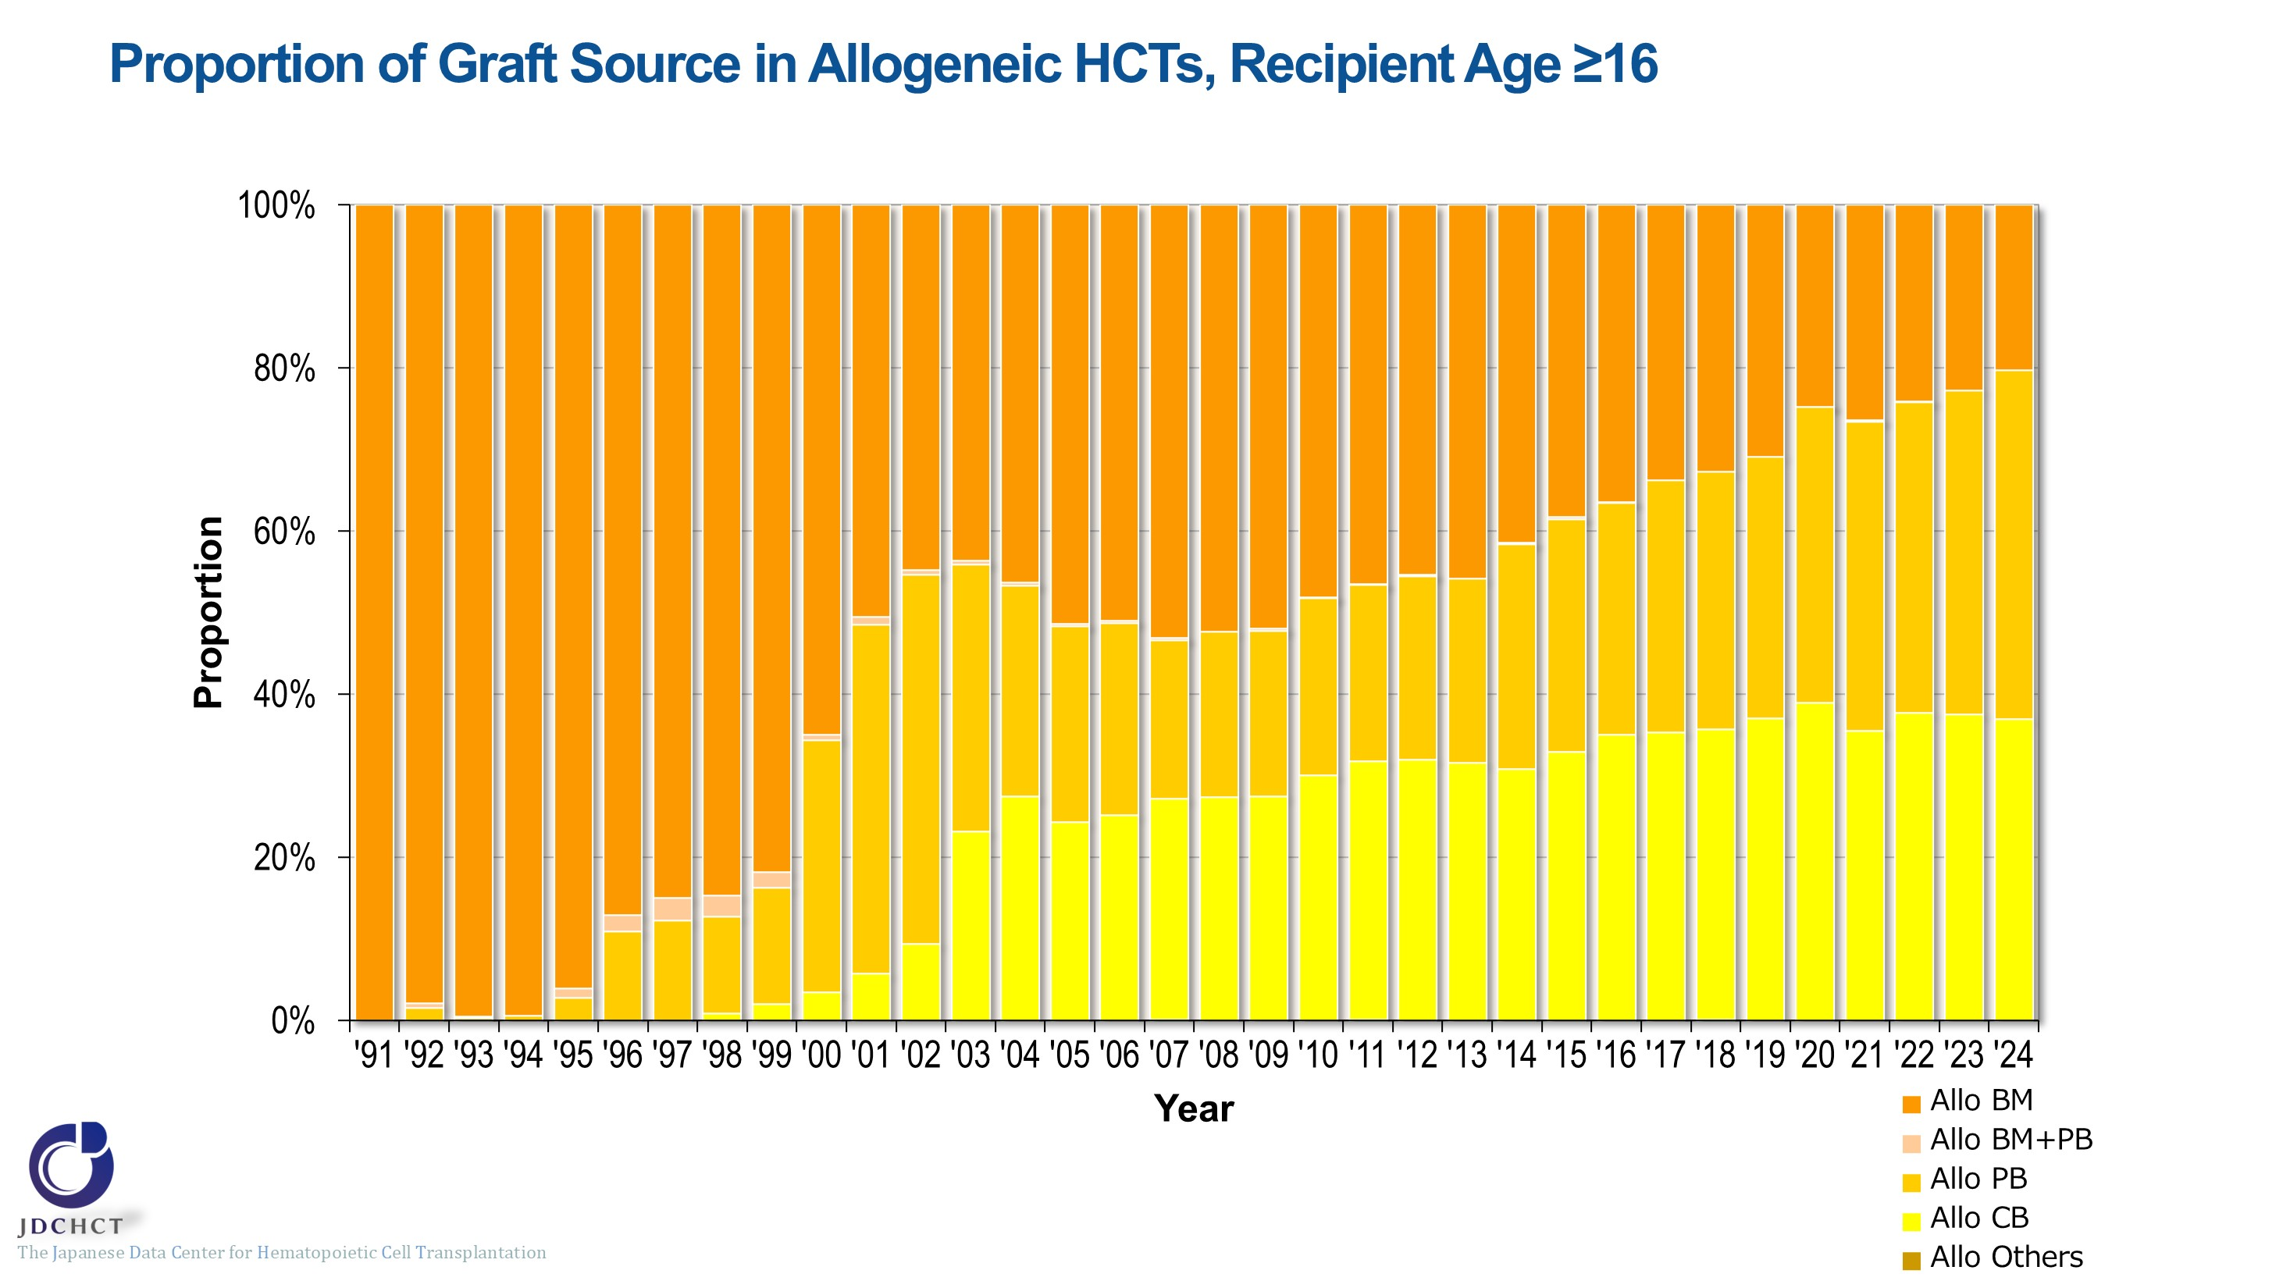
Proportion of Graft Source in Allogeneic HCTs, Recipient Age ≥16
Notes:
In allogeneic transplantation for patients aged 16 years or older, the proportion of cord blood transplants increased during the 2000s, while the proportion of peripheral blood stem cell transplants increased after 2010. Consequently, the proportion of bone marrow transplants has decreased.

Slide 27
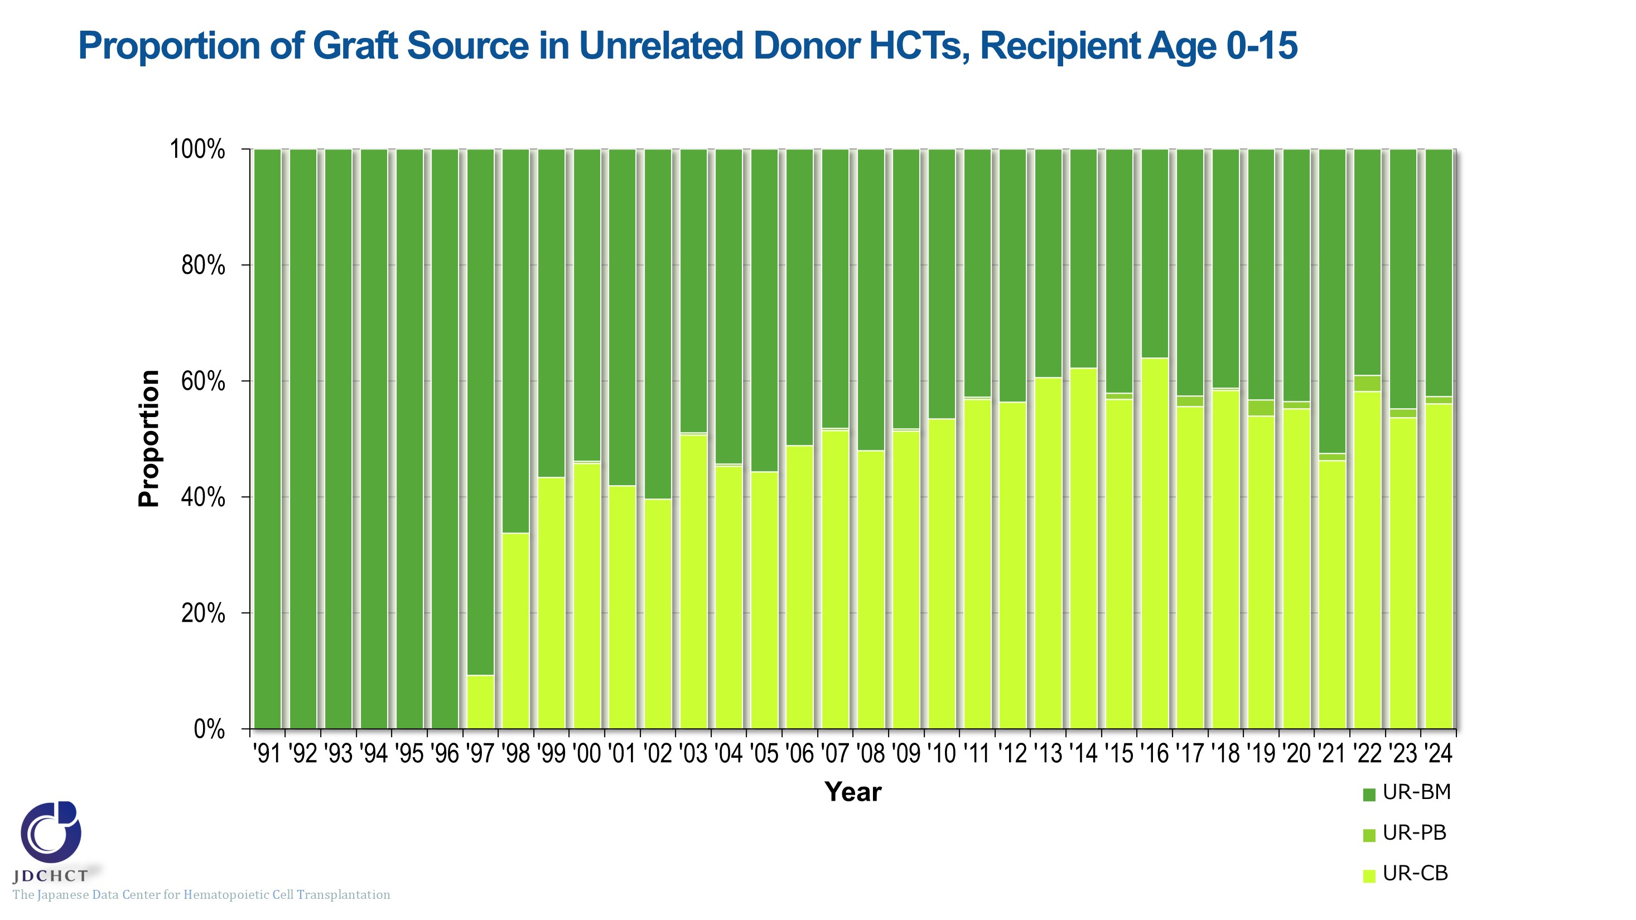
Proportion of Graft Source in Unrelated Donor HCTs, Recipient Age 0-15
Notes:
In transplantation from unrelated donors, the number of cord blood transplants has increased, accounting for approximately half of all transplants from unrelated donors in recent years.

Slide 28
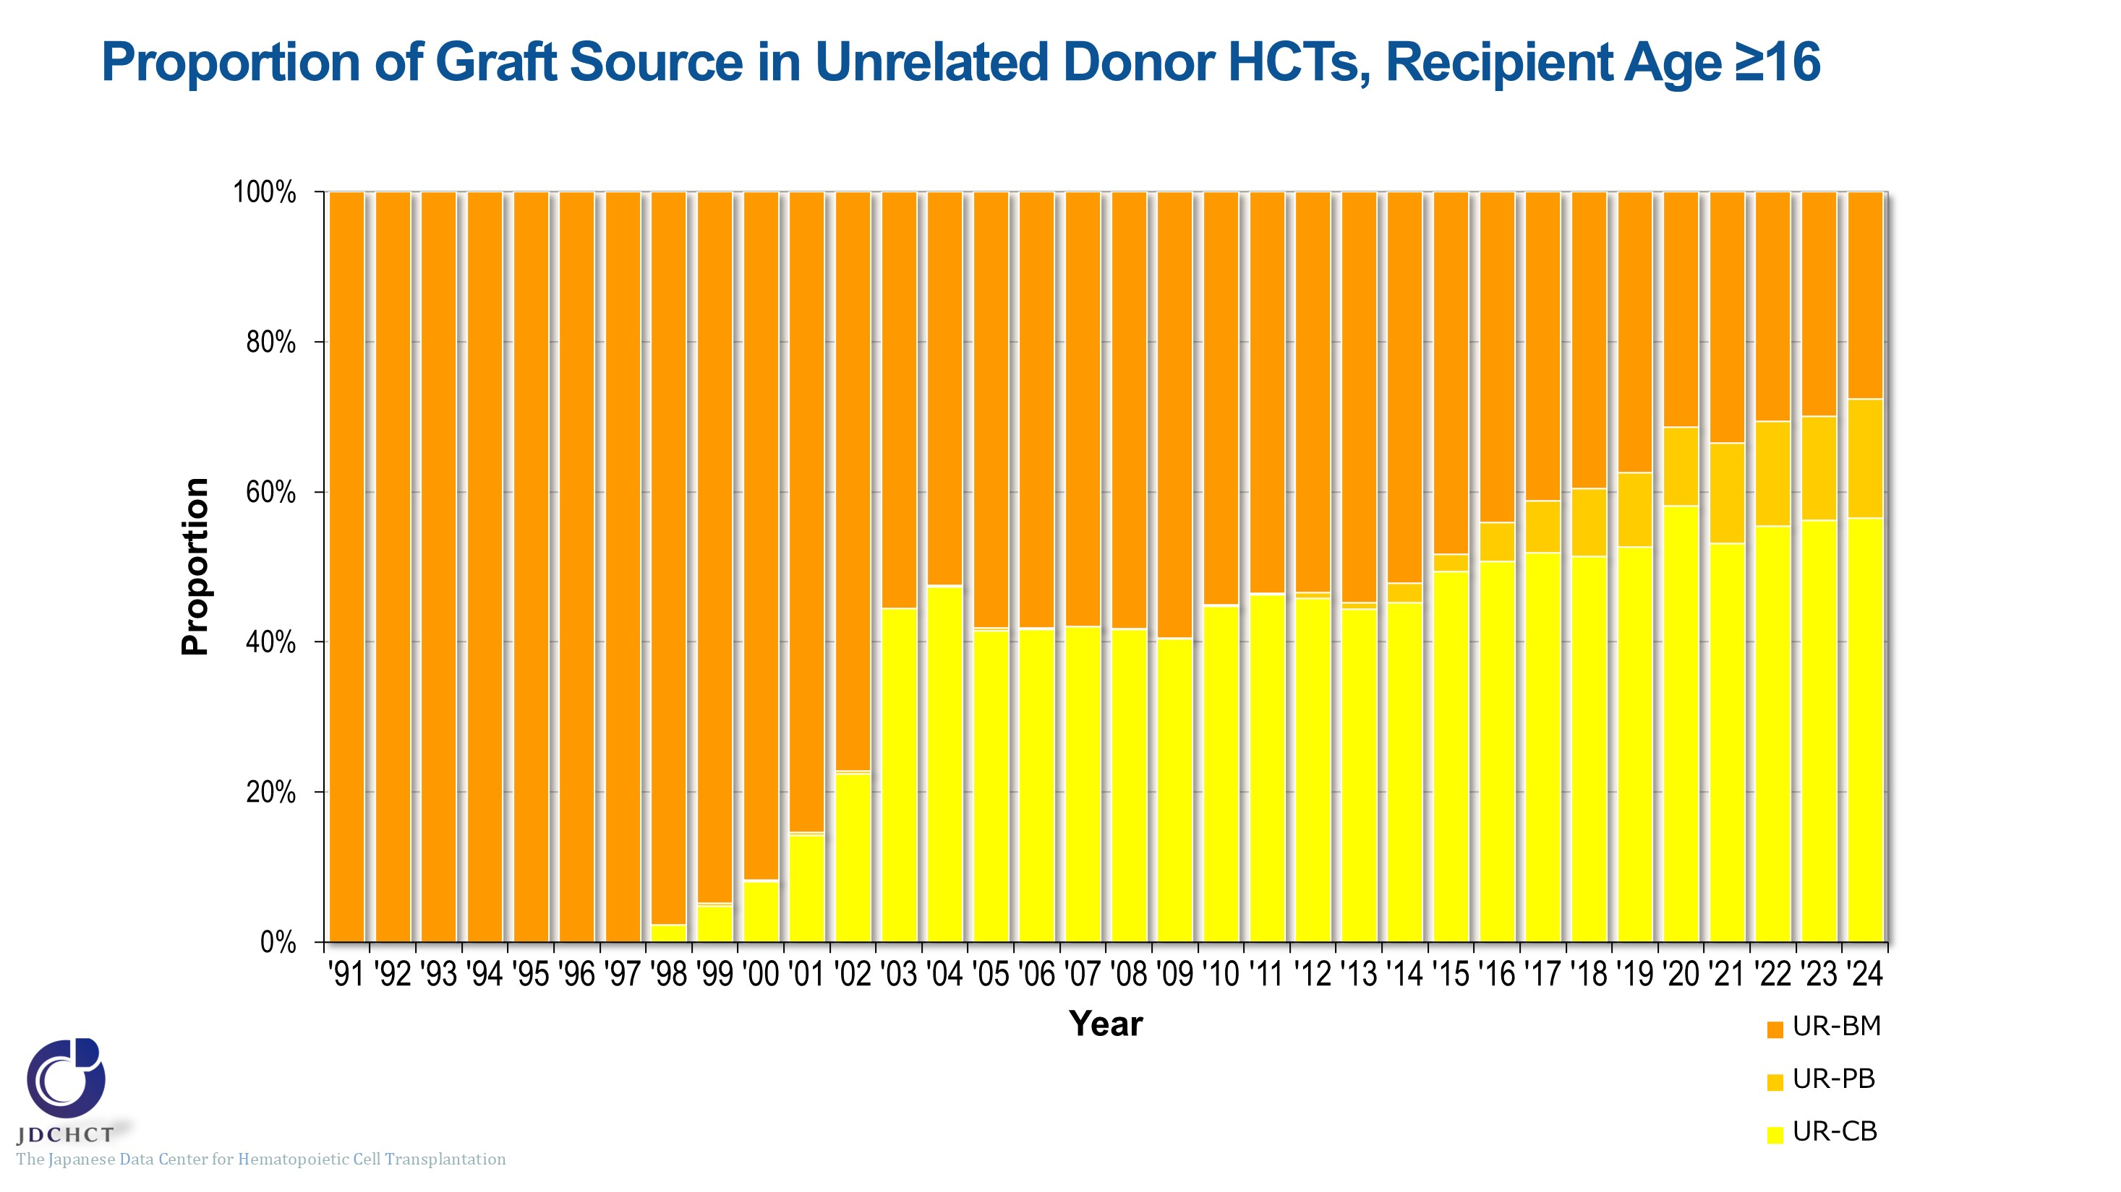
Proportion of Graft Source in Unrelated Donor HCTs, Recipient Age ≥16
Notes:
In transplantation from unrelated donors, the number of cord blood transplants has increased, accounting for approximately half of all transplants from unrelated donors in recent years. There has also been an increase in the proportion of peripheral blood stem cell transplants in recent years.

Slide 29
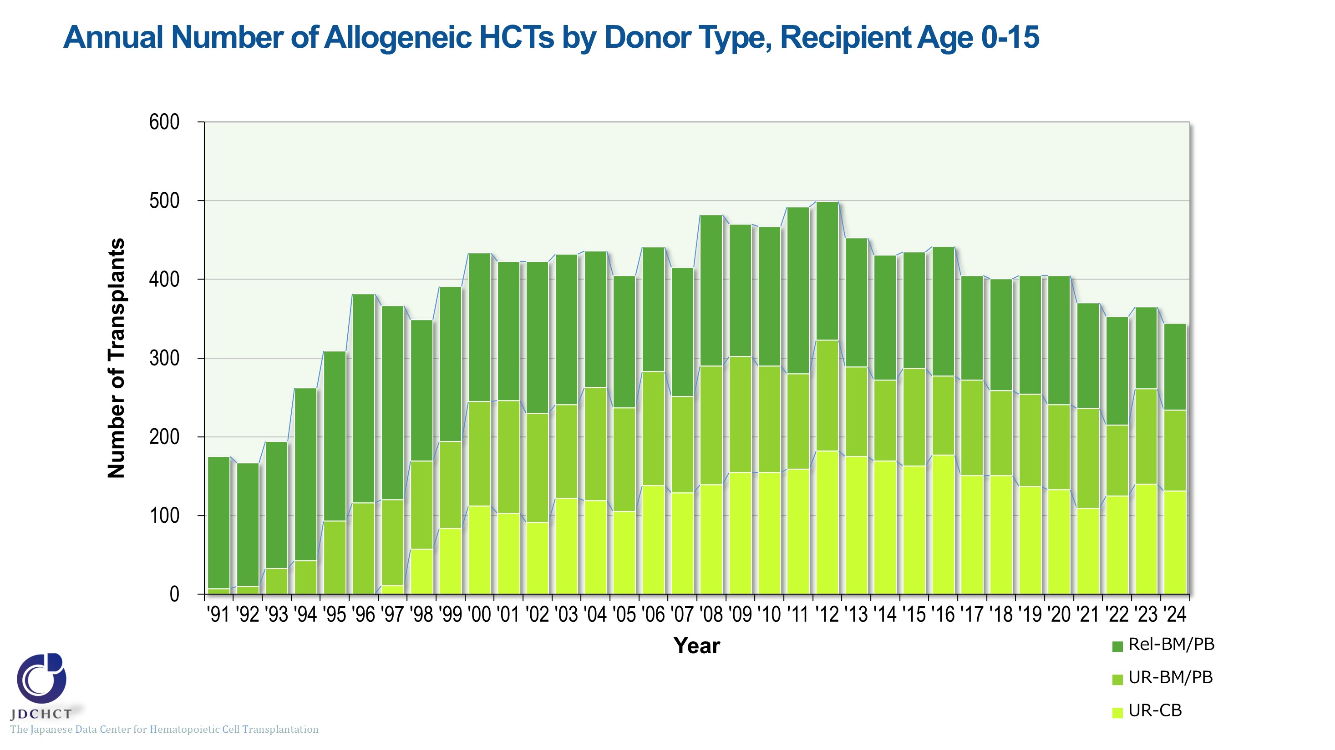
Annual Number of Allogeneic HCTs by Donor Type, Recipient Age 0-15
Notes:
In recent years, approximately 340 to 400 allogeneic transplants have been performed annually for patients aged 0 to 15 years. Transplants from unrelated donors account for 60% to 70%.

Slide 30
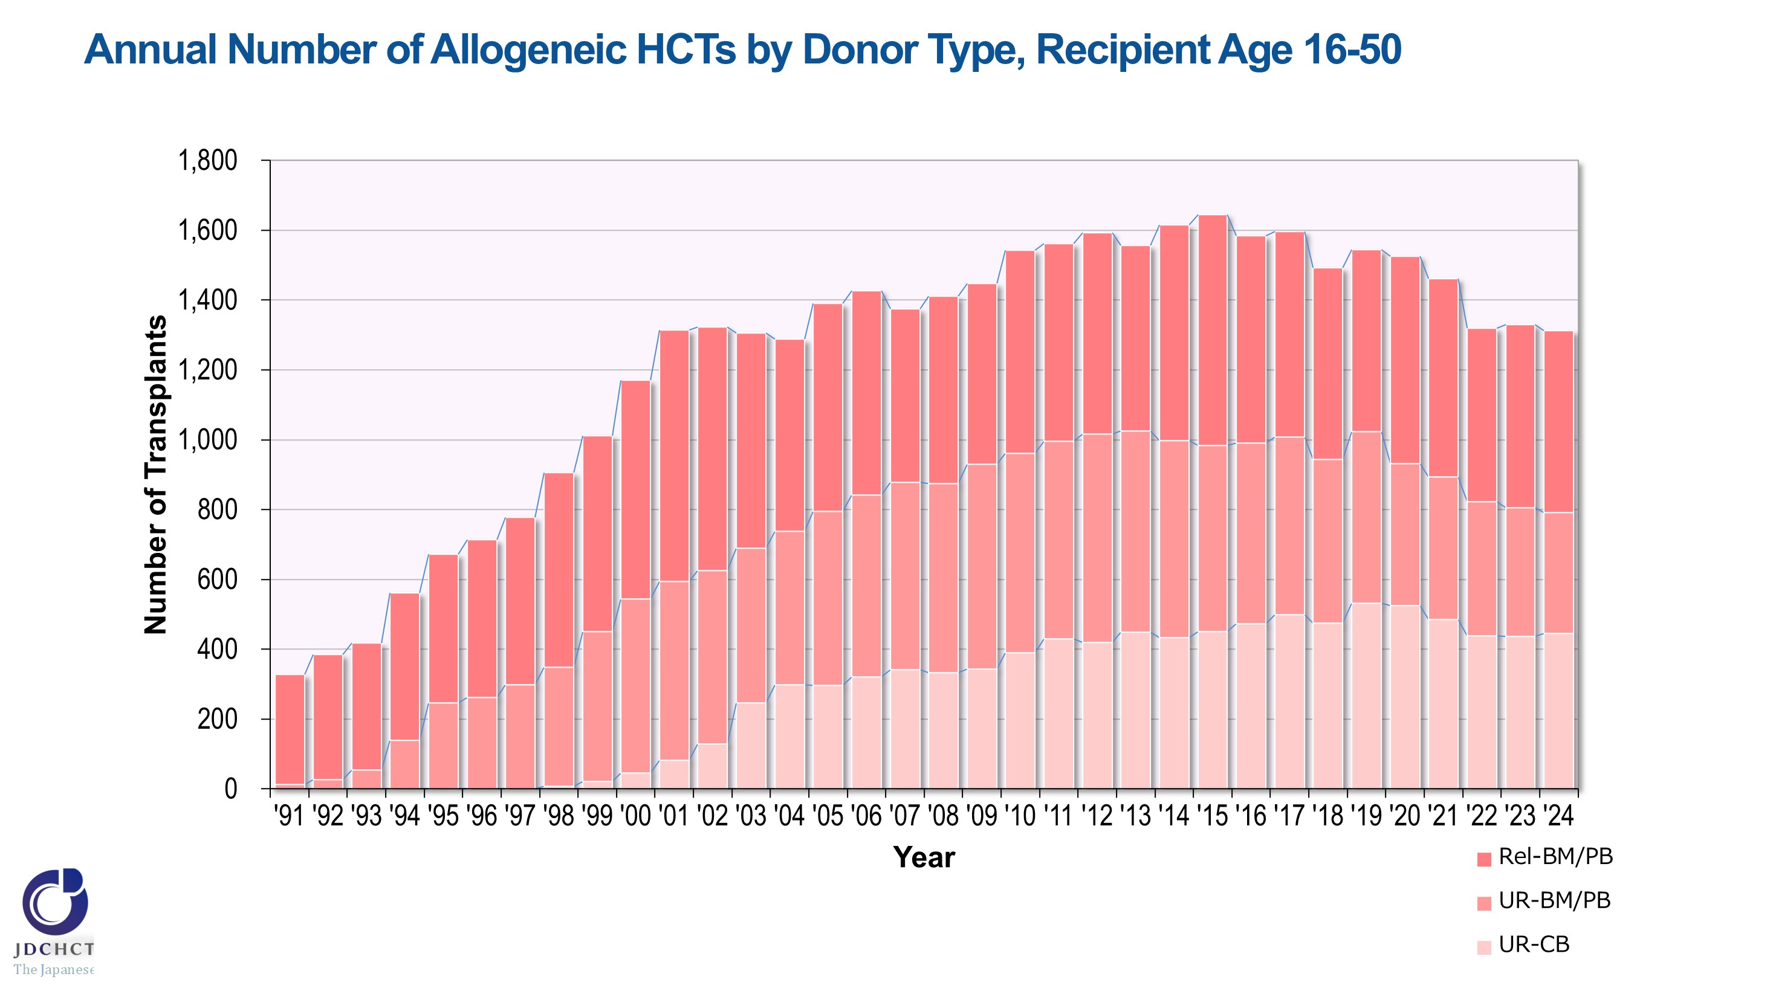
Annual Number of Allogeneic HCTs by Donor Type, Recipient Age 16-50
Notes:
In recent years, approximately 1,300 to 1,500 allogeneic transplants have been performed annually for patients aged 16 to 50 years. The percentage of cord blood transplants from unrelated donors is increasing, accounting for approximately one-third of all transplants.

Slide 31
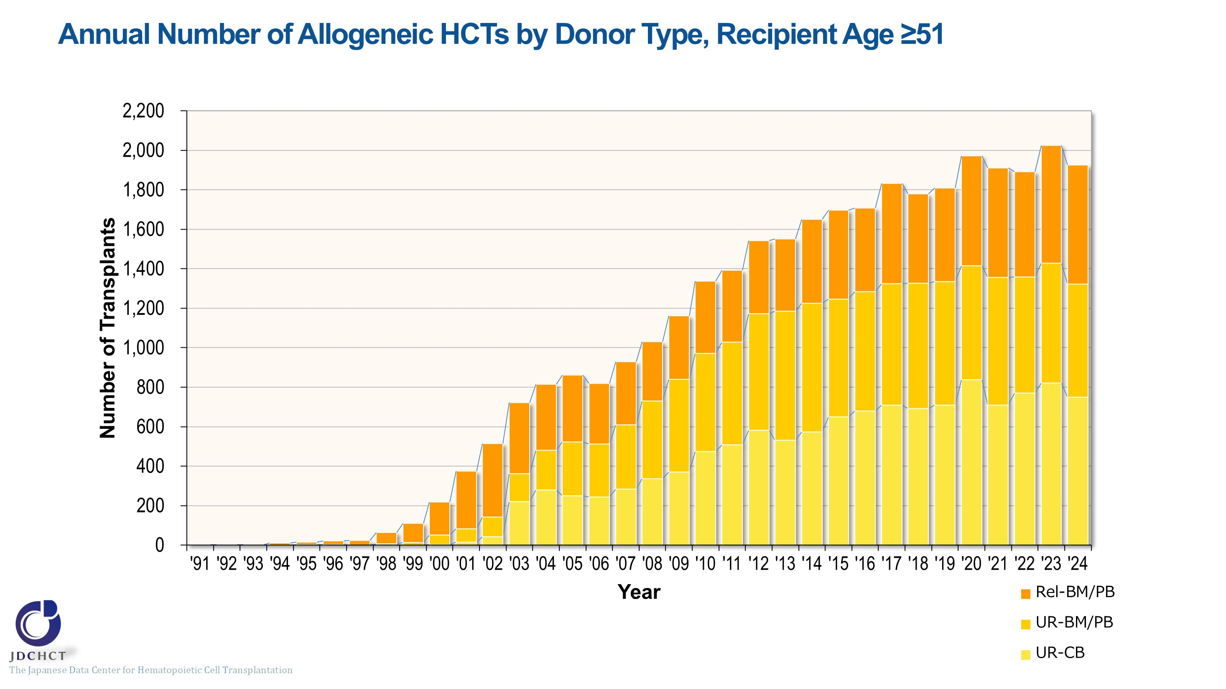
Annual Number of Allogeneic HCTs by Donor Type, Recipient Age ≥51
Notes:
Due to the spread of transplants with reduced intensity conditioning (RIC), in all types of allogeneic transplants, the number of patients aged 51 years or older has increased. Approximately 1,900 allogeneic transplants have been performed annually for patients aged 51 years or older in recent years. Allogeneic transplants from unrelated donors account for more than 70% of all transplants, with cord blood transplantation being the most commonly used.

Slide 32
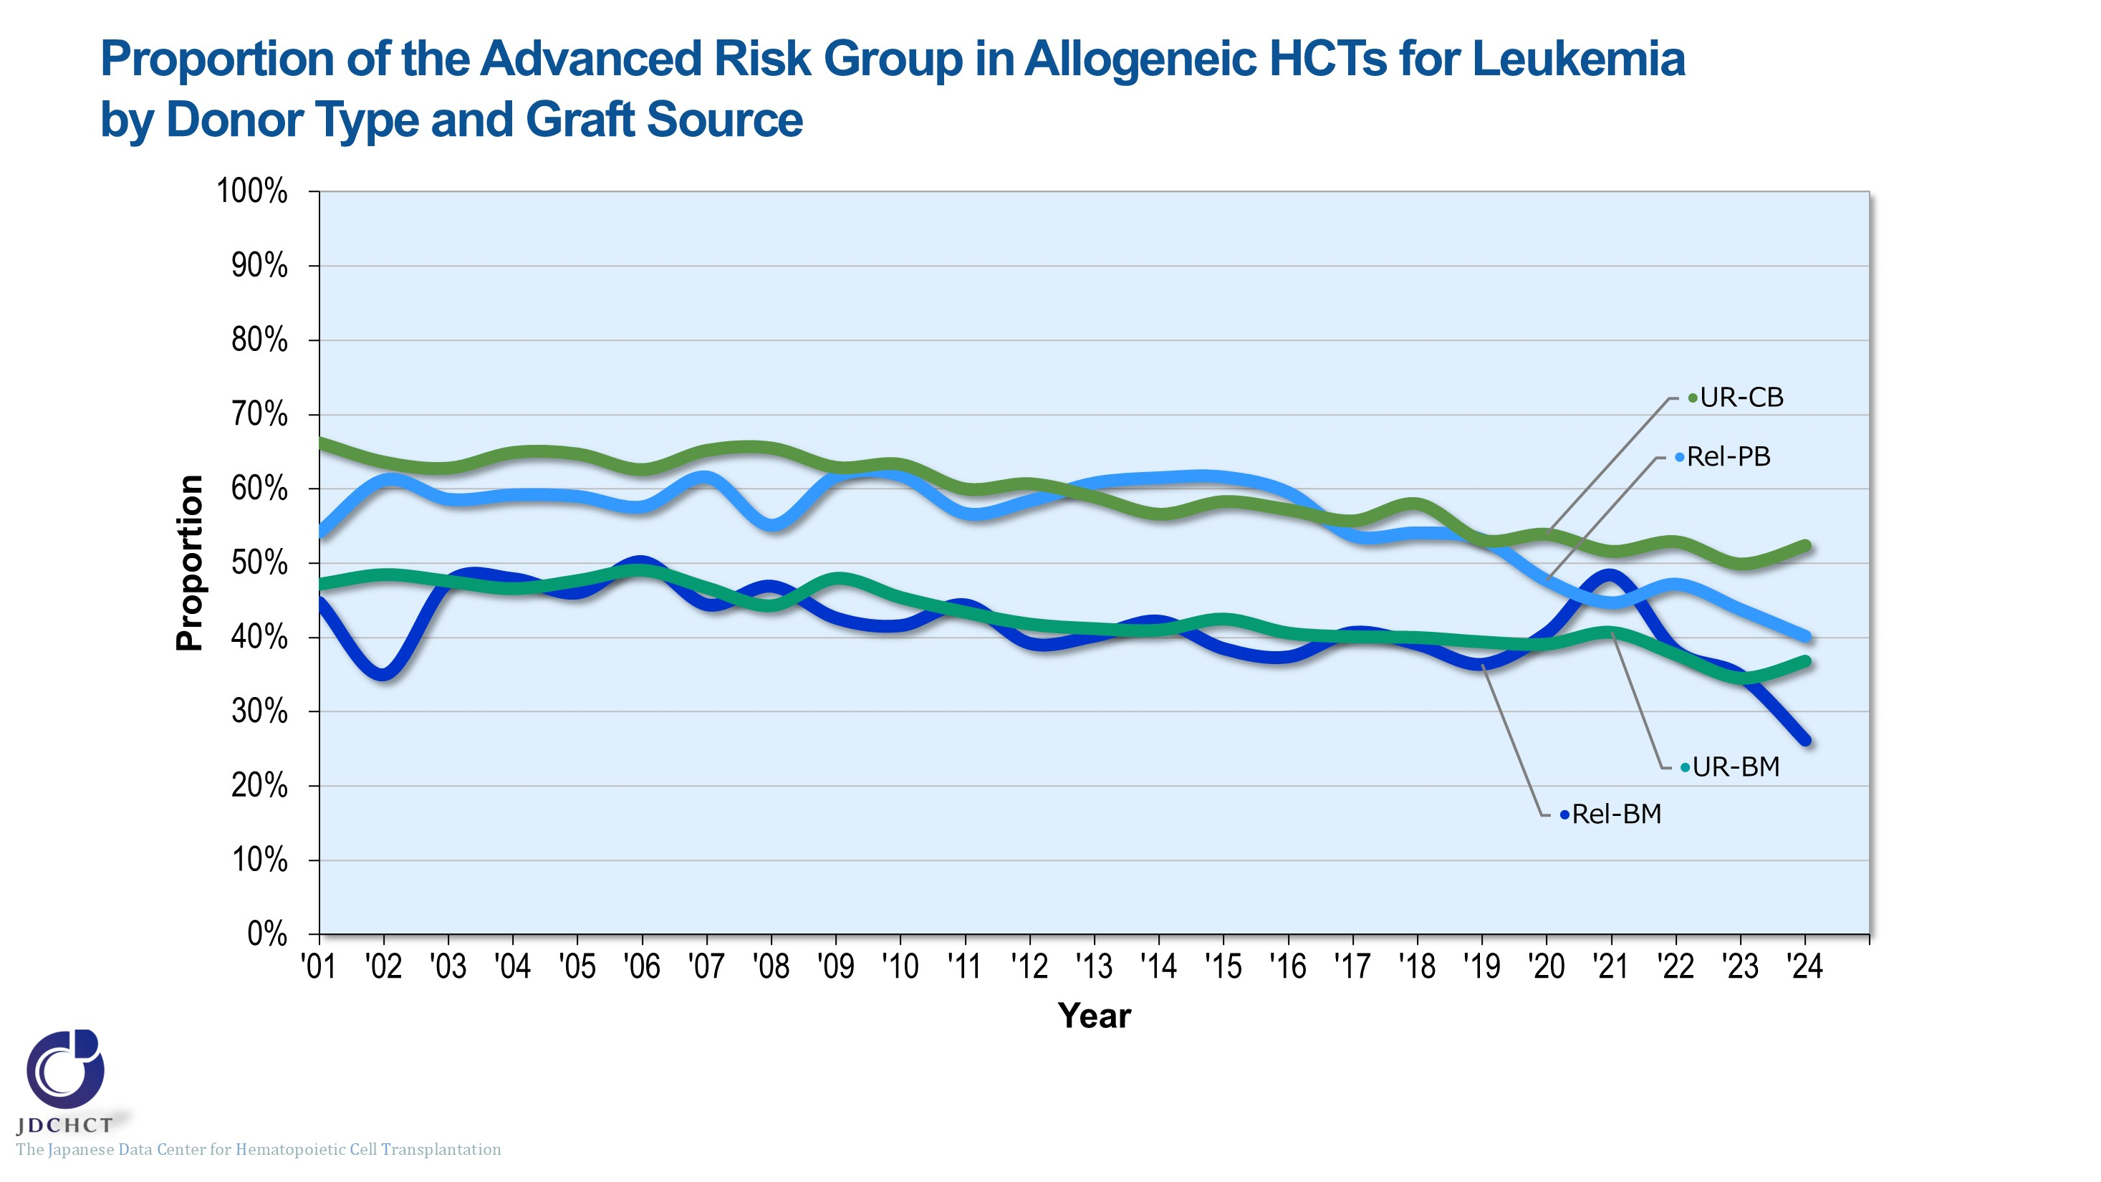
Proportion of the Advanced Risk Group in Allogeneic HCTs for Leukemia by Donor Type and Graft Source
Notes:
The advanced risk group for leukemia has recently accounted for 25 to 55% in allogeneic transplantation, with a gradual declining trend.
―≪Disease risk status at transplantation≫―
■Standard Risk Group
・AML (first complete remission[1CR]／second complete remission[2CR])
・ALL (1CR)
・CML (complete hematologic response (CHR) ／first chronic phase[1CP])
・MDS (WHO 2017 classification： MDS with single lineage dysplasia／MDS-RS and single lineage dysplasia
／MDS-RS and multilineage dysplasia
／MDS with multilineage dysplasia
／MDS with isolated del (5q)
／MDS, unclassifiable
／Refractory cytopenia of childhood (provisional entity)
WHO old classification, FAB classification：refractory anemia[RA] ／refractory anemia with ring sideroblasts[RARS]／refractory
cytopenia with multilineage dysplasia[RCMD]／refractory cytopenia with multilineage dysplasia and ringed sideroblasts[RCMD-RS]／myelodysplastic syndrome associated
with isolated del (5q) chromosome abnormality[5q−syndrome])
■Advanced Risk Group
・all other conditions
―――――――――――――――――――――

Slide 33
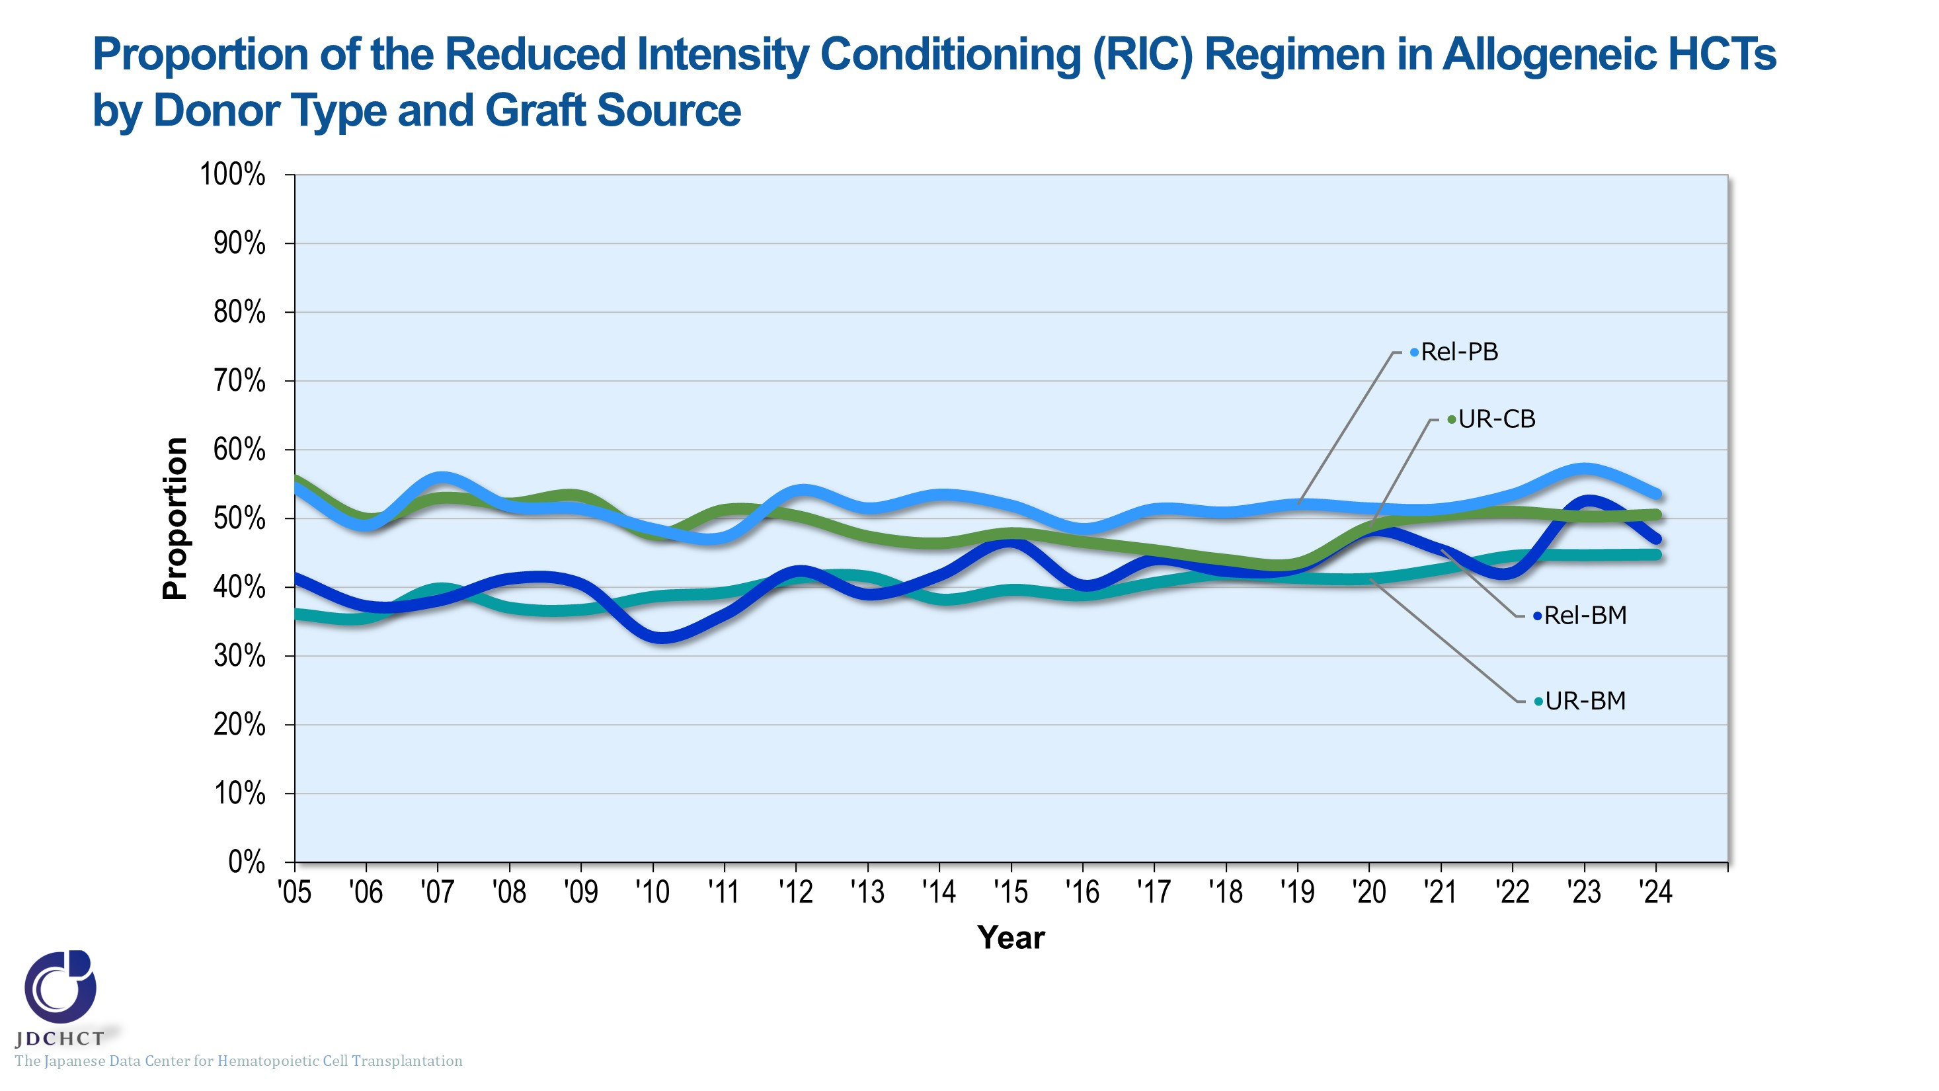
Proportion of the Reduced Intensity Conditioning (RIC) Regimen in Allogeneic HCTs by Donor Type and Graft Source
Notes:
The spread of the reduced intensity conditioning (RIC) to reduce toxicity has expanded the scope of indication of transplantation to the older age groups. In all types of allogeneic transplants, the reduced intensity conditioning (RIC) transplants have recently accounted for 40 to 60％.
―≪Conditioning regimen≫――――――
■Myeloablative conditioning (MAC)
Pre-transplantation therapy with the primary purpose of totally destroying cancer cells, together with normal blood cells, in the bone marrow by total body irradiation or high-dose chemotherapy
■Reduced-intensity conditioning (RIC)
Pre-transplantation therapy with the primary purpose of suppressing the patient’s immune system with drugs which do not have strong myelosuppressive effects
―――――――――――――――――――

Slide 34
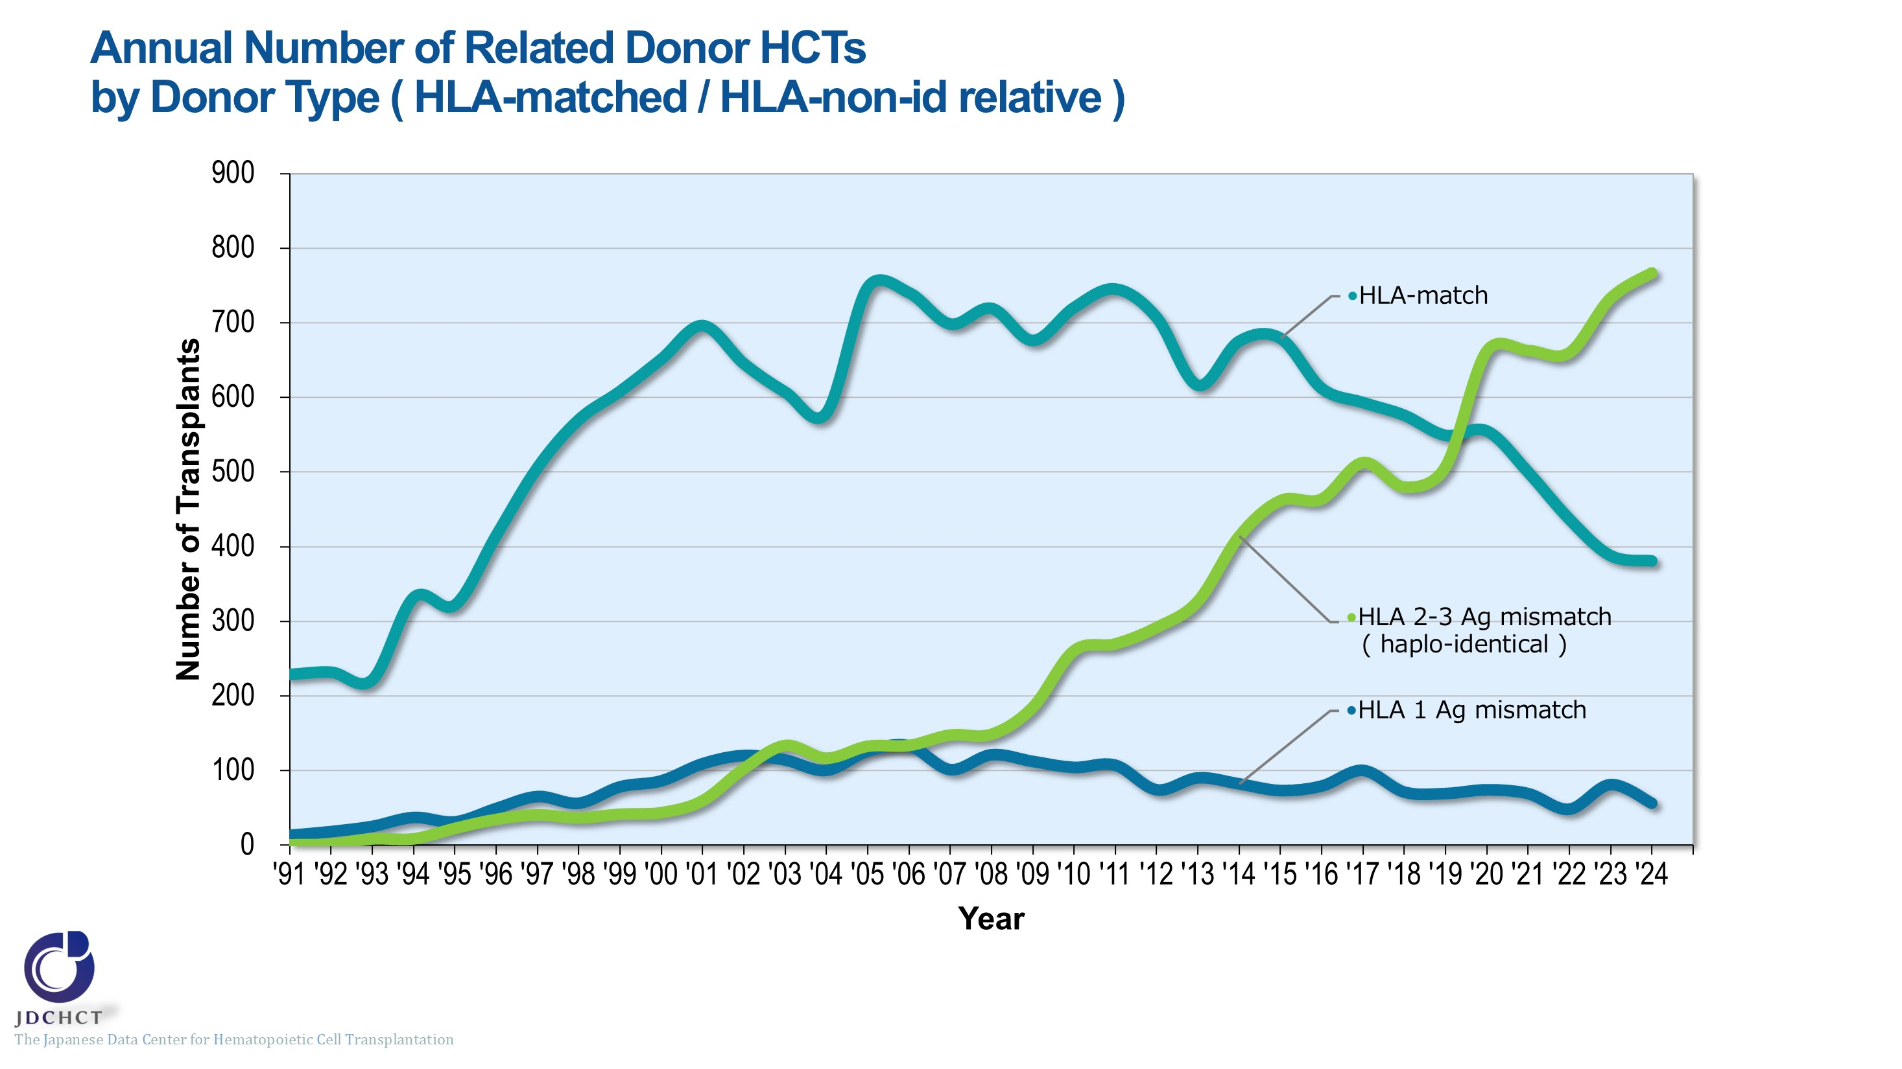
Annual Number of Related Donor HCTs by Donor Type ( HLA-matched / HLA-non-id relative )
Notes:
With the development of GVHD prophylaxis, the number of haplo-identical transplants has increased remarkably since 2010. The number of haplo-identical transplants registered in 2024 was 767. The number of HLA-matched related donor transplants has been on a decreasing trend in recent years.
※Subjects in this summary table include bone marrow transplantation, peripheral blood stem cell transplantation and bone marrow + peripheral blood stem cell transplantation from related donor.
※GVH-direction is considered for numbers of mismatched HLA loci.

Slide 35
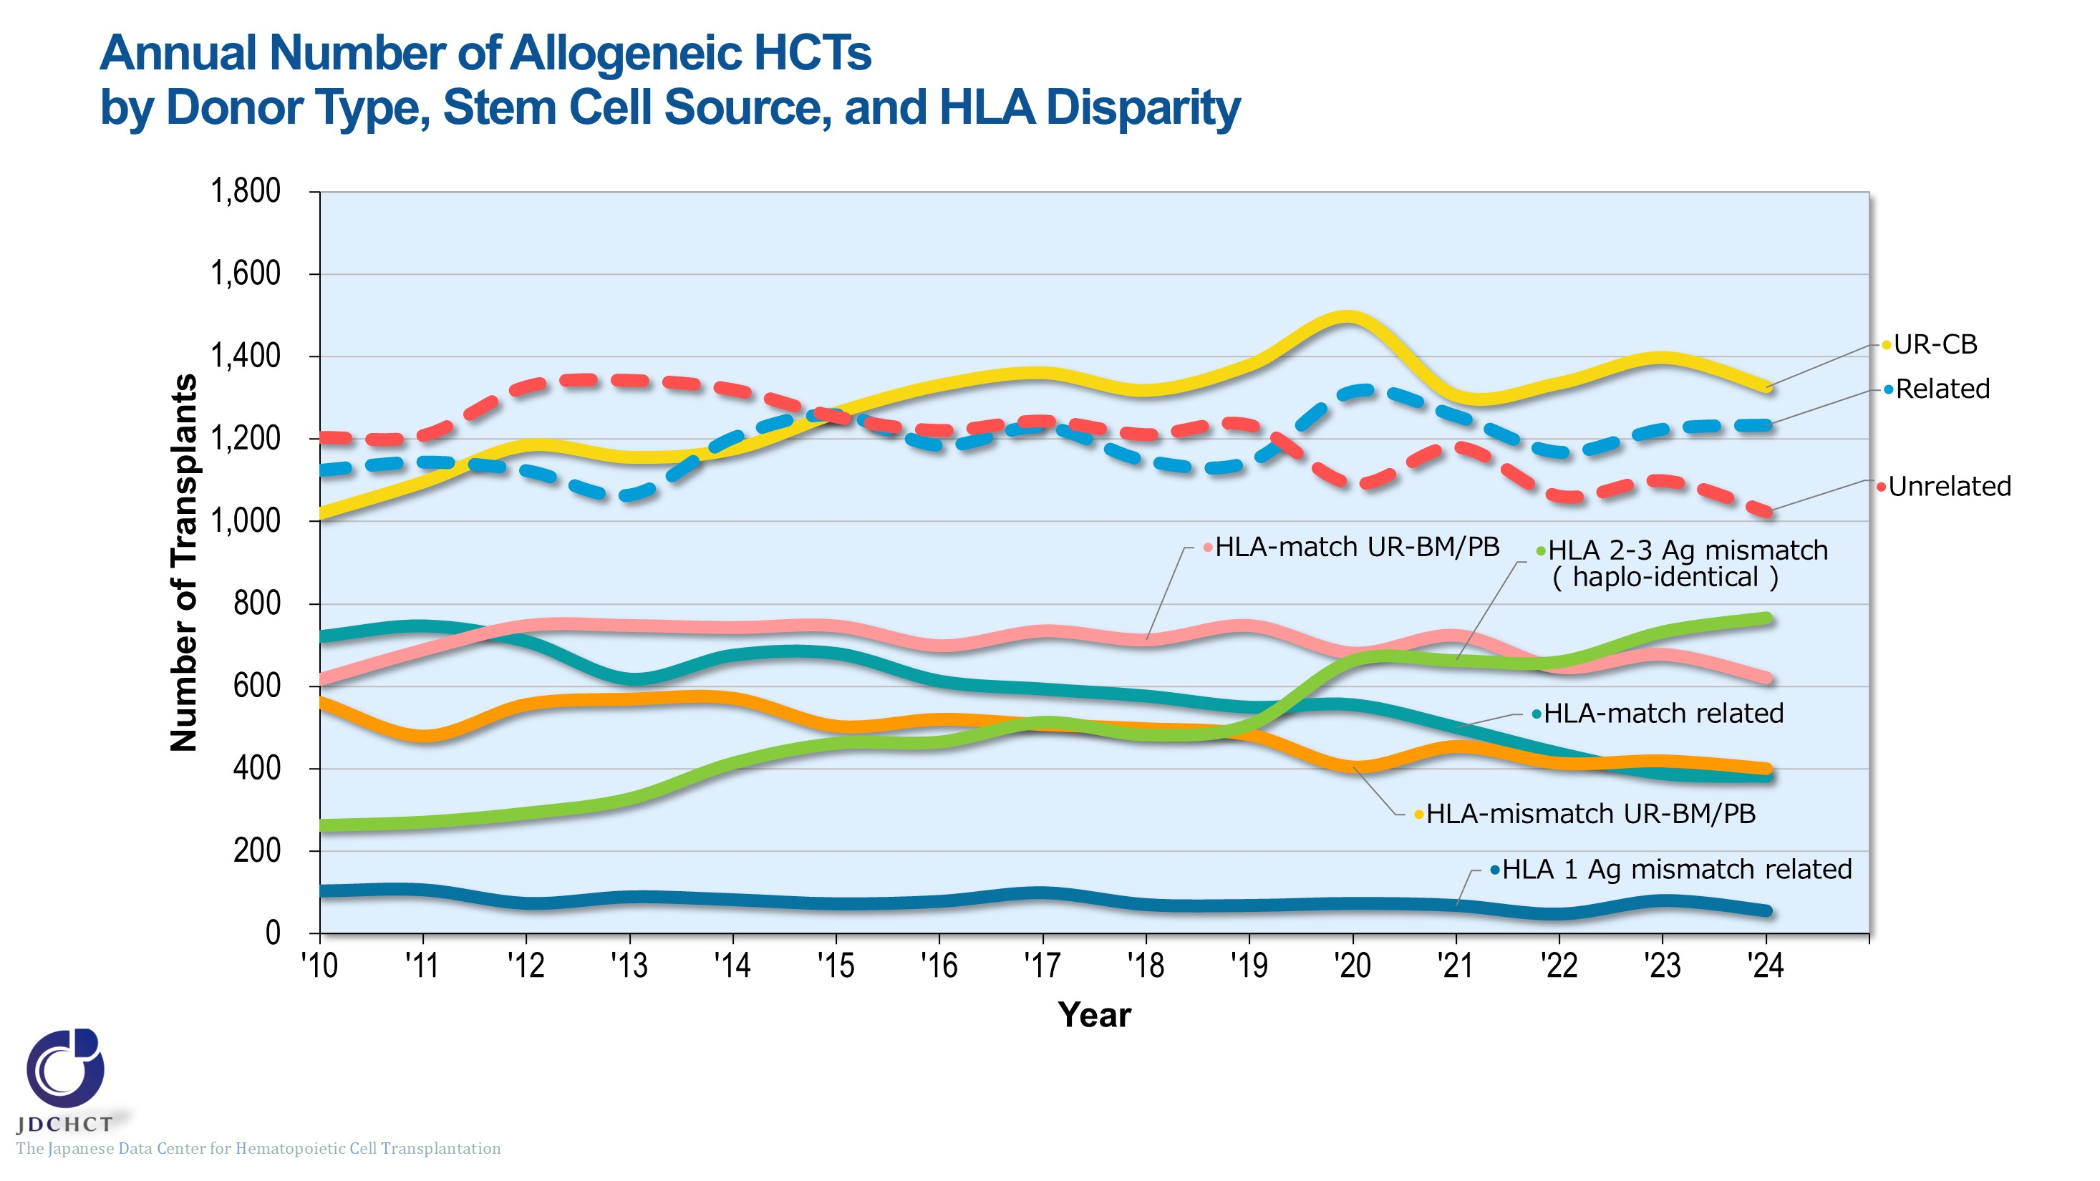
Annual Number of Allogeneic HCTs by Donor Type, Stem Cell Source, and HLA Disparity
Notes:
Since 2010, there has been an increase in cord blood transplants and haplo-identical transplants. Approximately 600 to 750 bone marrow / peripheral blood stem cell transplants from HLA-matched unrelated donors have been performed annually. The number of bone marrow / peripheral blood stem cell transplants from HLA-mismatched unrelated donors has gradually decreased and is approximately 400 per year.

Slide 36
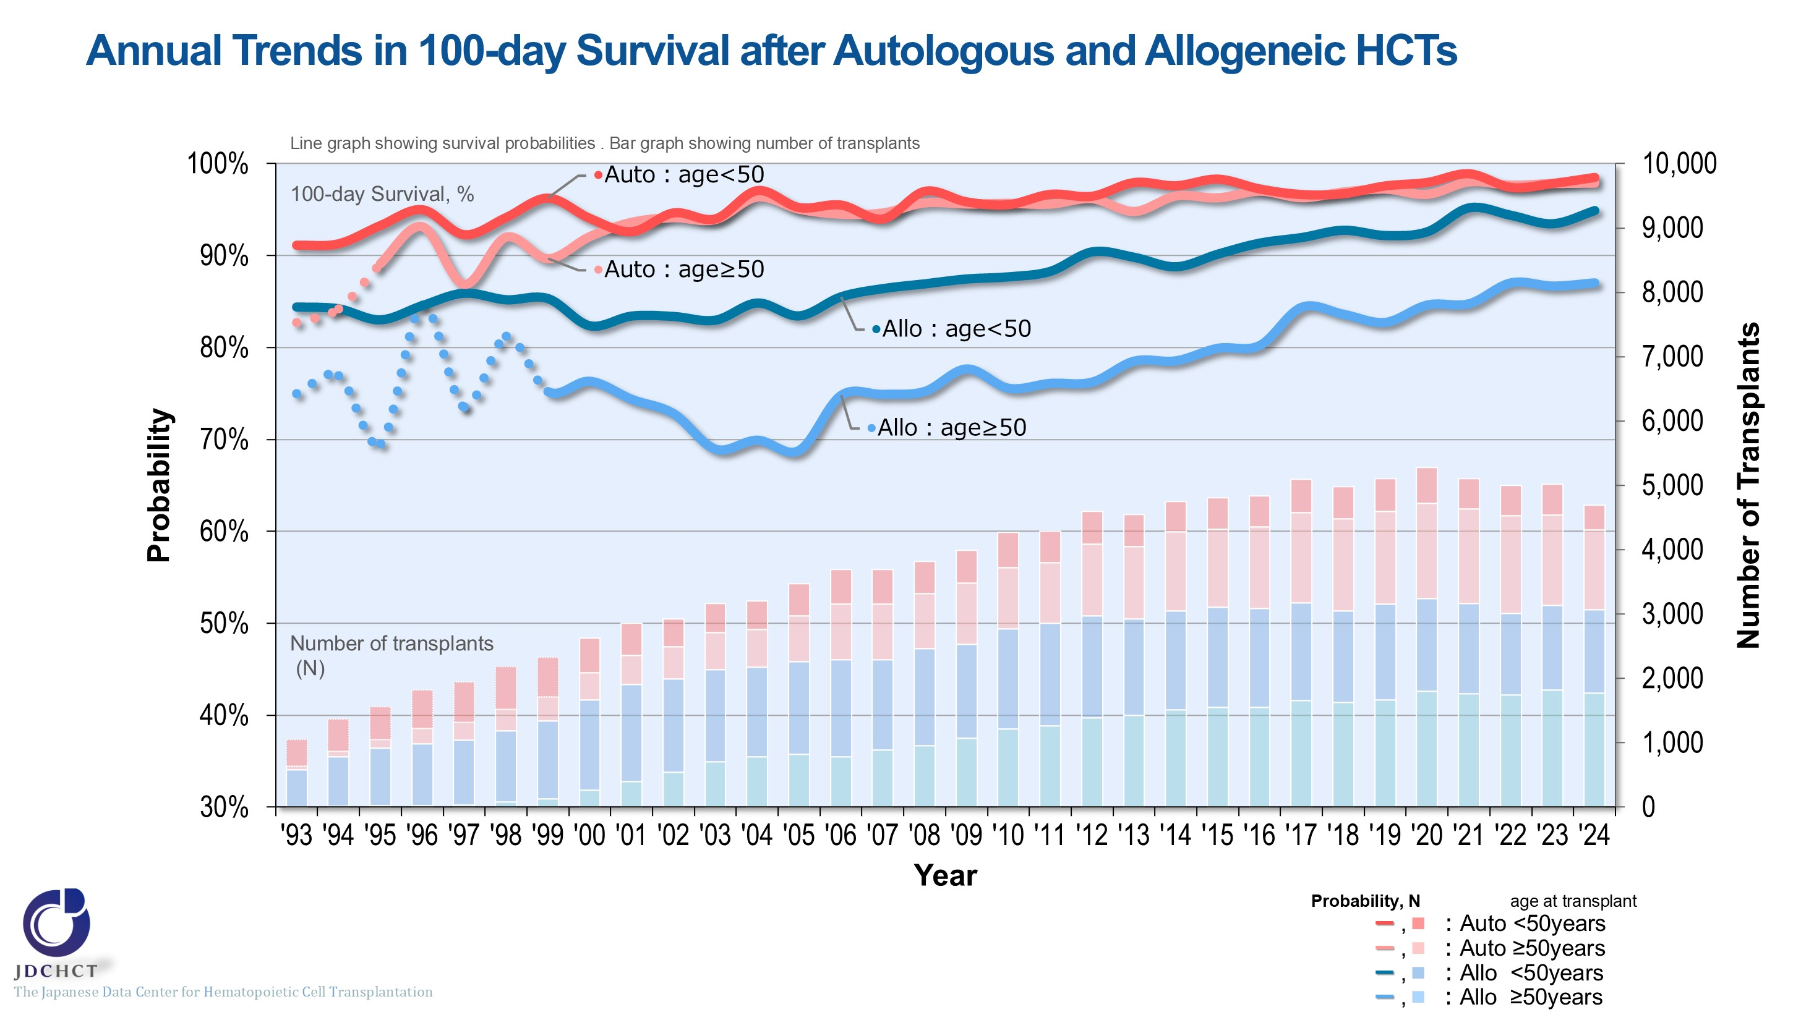
Annual Trends in 100-day Survival after Autologous and Allogeneic HCTs
Notes:
The survival probabilities at 100 days after autologous transplantation are over 95%, with comparable results for those aged 49 years or younger (<50) and those aged 50 years or older (≥50) .
The survival probabilities at 100 days after allogeneic transplantation have shown improving trends over the past two decades.
※This table shows the results of analysis performed on patients who received first transplants.
※The dotted lines (…) indicate the survival probabilities calculated when the number of transplants was below 100.

Slide 37
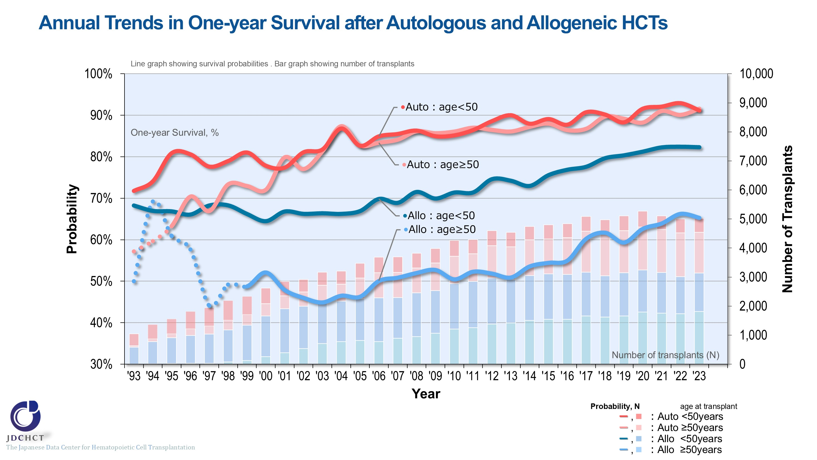
Annual Trends in One-year Survival after Autologous and Allogeneic HCTs
Notes:
The survival probabilities at 365 days (1 year) after transplantation have shown improving trends over the past two decades in both autologous and allogeneic transplant recipients aged 49 years or younger (<50) and 50 years or older (≥50) .
The survival probabilities at 365 days (1 year) after autologous transplantation are similar between those aged 49 years or younger (<50) and those aged 50 years or older (≥50) .
※This table shows the results of analysis performed on patients who received first transplants.
※The dotted lines (…) indicate the survival probabilities calculated when the number of transplants was below 100.

Slide 38
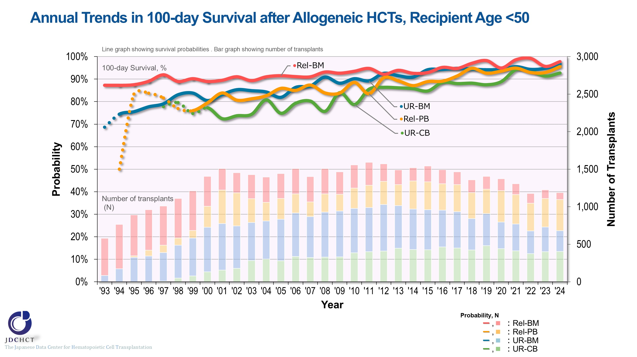
Annual Trends in 100-day Survival after Allogeneic HCTs, Recipient Age <50
Notes:
In those aged 49 years or younger (<50) , the survival probabilities at 100 days after allogeneic transplantation have shown improving trends over the last decade in both transplantations from related and unrelated donors.
In recent years, there has been improvement in the survival probabilities at 100 days after cord blood transplantation from unrelated donors, comparable to those in other stem cell sources.
※This table shows the results of analysis performed on patients who received first transplants.
※The dotted lines (…) indicate the survival probabilities calculated when the number of transplants was below 100.

Slide 39
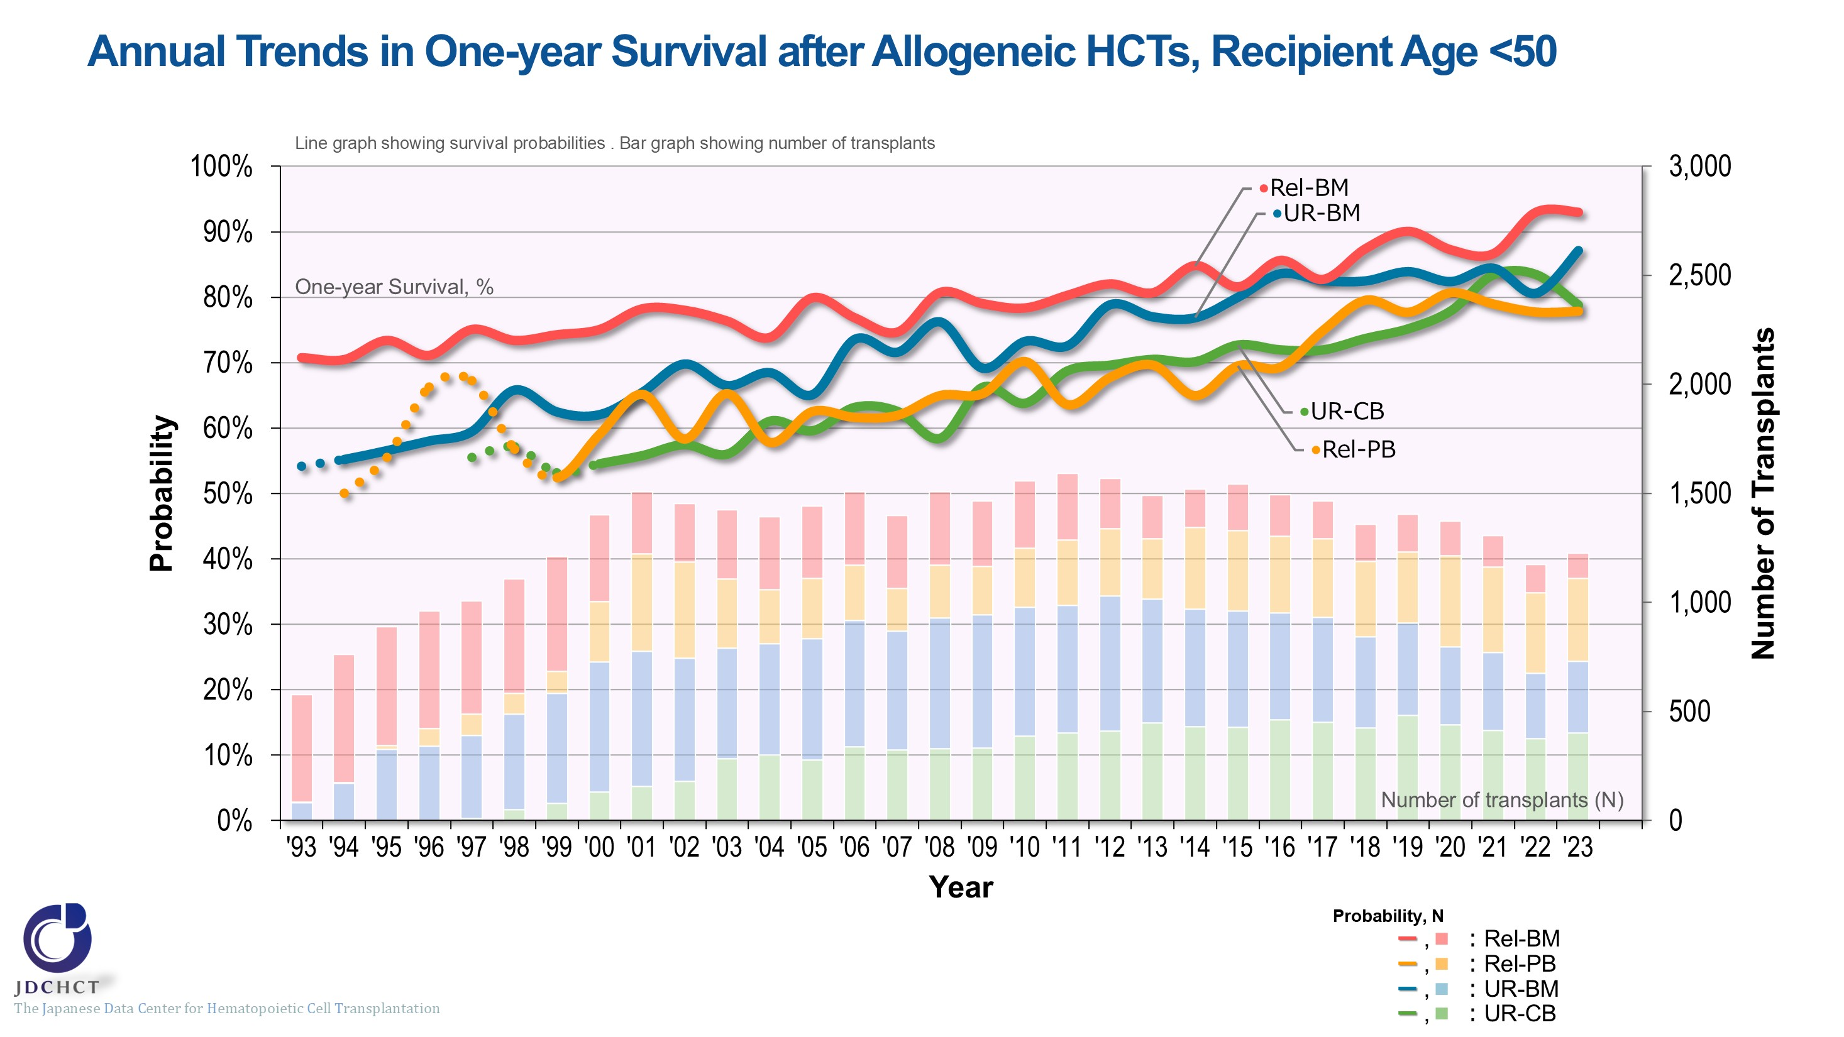
Annual Trends in One-year Survival after Allogeneic HCTs, Recipient Age <50
Notes:
In those aged 49 years or younger (<50) , the survival probabilities at 365 days (1 year) after allogeneic transplantation have shown improving trends over the last decade in both transplantations from related and unrelated donors.
The difference in the survival probabilities at 365 days (1 year) after transplantation by donor type and stem cell source is less due to the improvement in survival after peripheral blood stem cell transplantation from related donors and cord blood transplantation from unrelated donors in recent years.
※This table shows the results of analysis performed on patients who received first transplants.
※The dotted lines (…) indicate the survival probabilities calculated when the number of transplants was below 100.

Slide 40
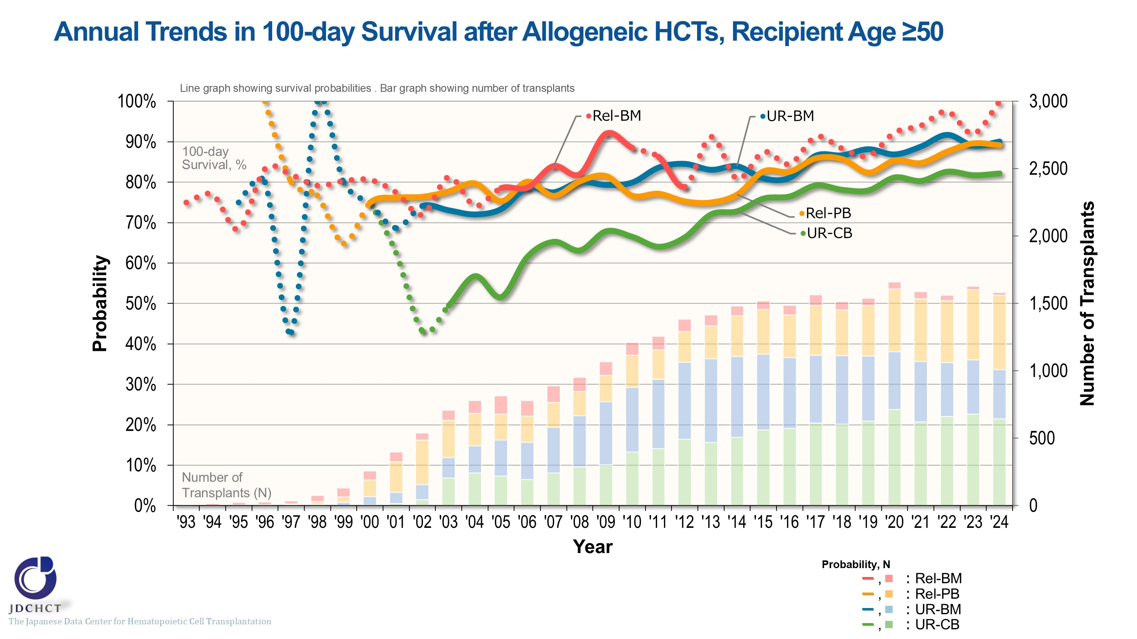
Annual Trends in 100-day Survival after Allogeneic HCTs, Recipient Age ≥50
Notes:
In those aged 50 years or older (≥50) , the survival probabilities at 100 days after peripheral blood stem cell transplantation from related donors and allogeneic transplantation from unrelated donors have shown improving trends over the last decade.
※This table shows the results of analysis performed on patients who received first transplants.
※The dotted lines (…) indicate the survival probabilities calculated when the number of transplants was below 100.

Slide 41
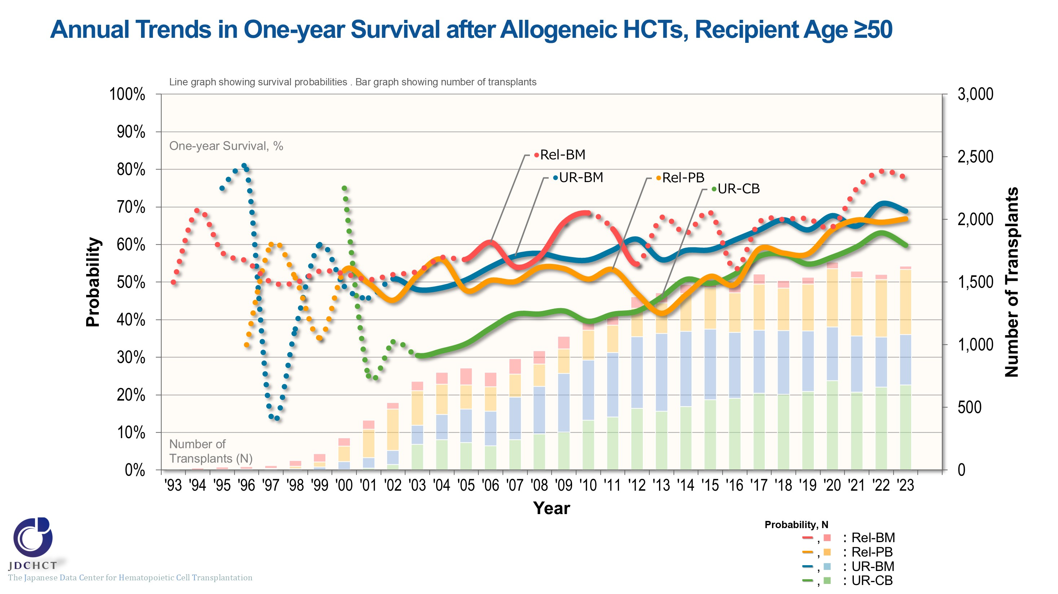
Annual Trends in One-year Survival after Allogeneic HCTs, Recipient Age ≥50
Notes:
In those aged 50 years or older (≥50) , the survival probabilities at 365 days (1 year) after peripheral blood stem cell transplantation from related donors and allogeneic transplantation from unrelated donors have shown improving trends over the last decade.
The survival probabilities at 365 days (1 year) after peripheral blood stem cell transplantation from related donors and cord blood transplantation from unrelated donors particularly have increased by more than 15% since 2010.
※This table shows the results of analysis performed on patients who received first transplants.
※The dotted lines (…) indicate the survival probabilities calculated when the number of transplants was below 100.

Slide 42
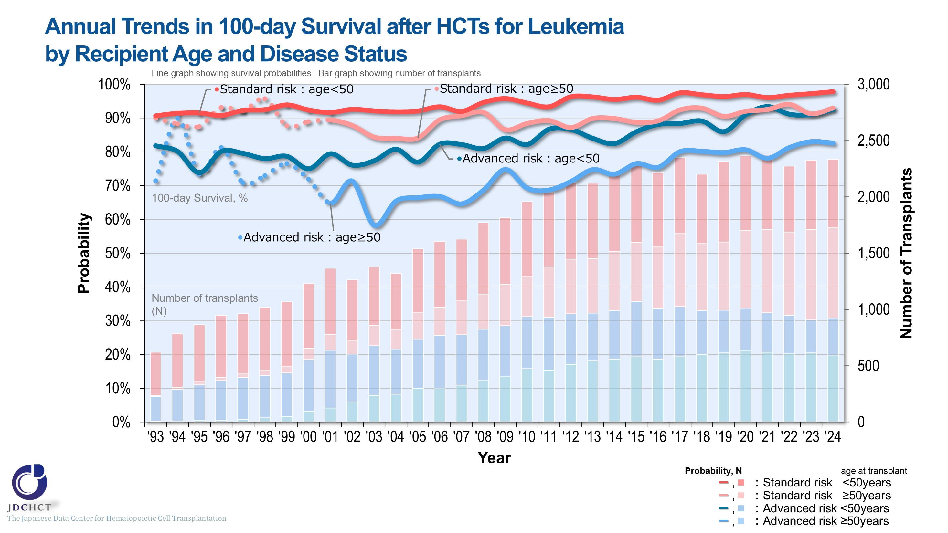
Annual Trends in 100-day Survival after HCTs for Leukemia by Recipient Age and Disease Status
Notes:
The survival probability at 100 days after transplantation in the advanced risk group of patients with leukemia has shown improving trends over the last 10 years in both those aged 49 years or younger (<50) and those aged 50 years or older (≥50) .
※This table shows the results of analysis performed on patients who received first transplants.
※The dotted lines (…) indicate the survival probabilities calculated when the number of transplants was below 100.
―≪Disease risk status at transplantation≫―
■Standard Risk Group
・AML (first complete remission[1CR]／second complete remission[2CR])
・ALL (1CR)
・CML (complete hematologic response (CHR) ／first chronic phase[1CP])
・MDS (WHO 2017 classification： MDS with single lineage dysplasia／MDS-RS and single lineage dysplasia
／MDS-RS and multilineage dysplasia
／MDS with multilineage dysplasia
／MDS with isolated del (5q)
／MDS, unclassifiable
／Refractory cytopenia of childhood (provisional entity)
WHO old classification, FAB classification：refractory anemia[RA] ／refractory anemia with ring sideroblasts[RARS]／refractory
cytopenia with multilineage dysplasia[RCMD]／refractory cytopenia with multilineage dysplasia and ringed sideroblasts[RCMD-RS]／myelodysplastic syndrome associated
with isolated del (5q) chromosome abnormality[5q−syndrome])
■Advanced Risk Group
・all other conditions
―――――――――――――――――――――

Slide 43
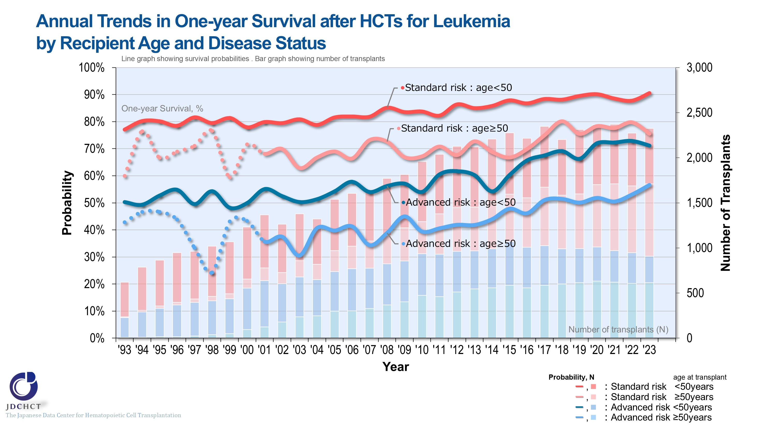
Annual Trends in One-year Survival after HCTs for Leukemia by Recipient Age and Disease Status
Notes:
The survival probabilities at 365 days (1 year) after transplantation in patients with leukemia have shown improving trends in recent years.
Comparison of the younger patients and the older patients in each risk group has revealed that the outcome of transplantation is better in the younger patient group.
※This table shows the results of analysis performed on patients who received first transplants.
※The dotted lines (…) indicate the survival probabilities calculated when the number of transplants was below 100.
―≪Disease risk status at transplantation≫―
■Standard Risk Group
・AML (first complete remission[1CR]／second complete remission[2CR])
・ALL (1CR)
・CML (complete hematologic response (CHR) ／first chronic phase[1CP])
・MDS (WHO 2017 classification： MDS with single lineage dysplasia／MDS-RS and single lineage dysplasia
／MDS-RS and multilineage dysplasia
／MDS with multilineage dysplasia
／MDS with isolated del (5q)
／MDS, unclassifiable
／Refractory cytopenia of childhood (provisional entity)
WHO old classification, FAB classification：refractory anemia[RA] ／refractory anemia with ring sideroblasts[RARS]／refractory
cytopenia with multilineage dysplasia[RCMD]／refractory cytopenia with multilineage dysplasia and ringed sideroblasts[RCMD-RS]／myelodysplastic syndrome associated
with isolated del (5q) chromosome abnormality[5q−syndrome])
■Advanced Risk Group
・all other conditions
―――――――――――――――――――――

Slide 44
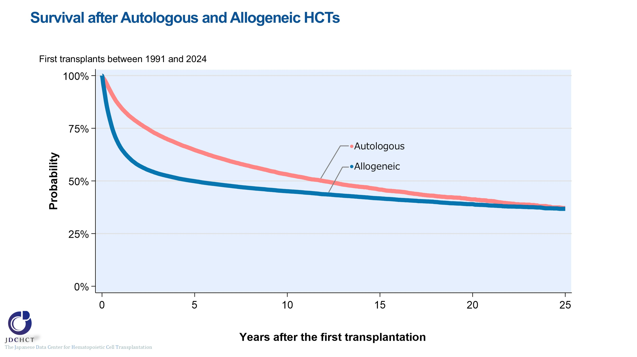
Survival after Autologous and Allogeneic HCTs
Notes:
The number of first autologous transplants registered from 1991 to 2024 is 44,435 . Among patients who underwent first autologous transplantation between 1991 and 2024, the 5-year and 10-year probabilities (95%CI) of survival following transplant are 65% (64-65%) and 53% (52-54%), respectively.
The number of first allogeneic transplants registered from 1991 to 2024 is 75,268 . Among patients who underwent first allogeneic transplantation between 1991 and 2024, the 5-year and 10-year probabilities (95%CI) of survival following transplant are 50% (49.6-50.3%) and 45% (45-46%), respectively.

Slide 45
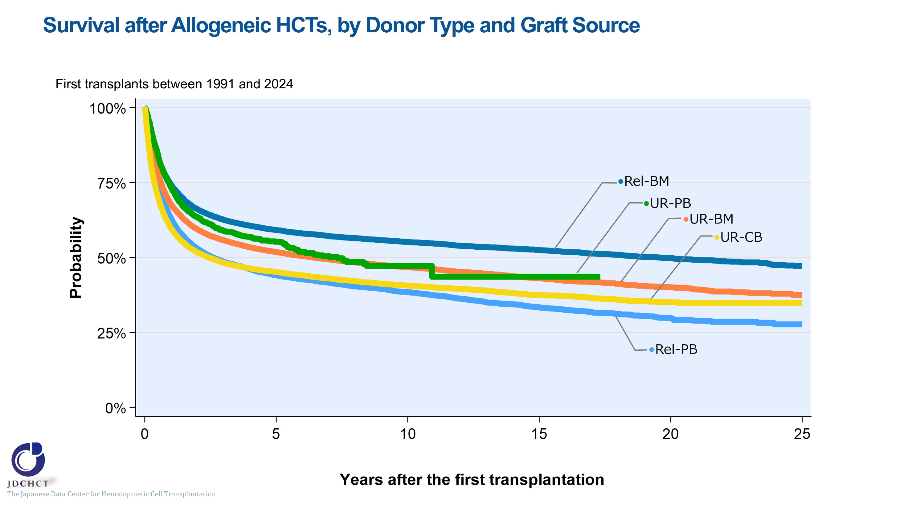
Survival after Allogeneic HCTs, by Donor Type and Graft Source
Notes:
Among patients who underwent allogeneic transplantation between 1991 and 2024, the 10-year probabilities (95%CI) of survival following transplant according by donor type and stem cell source are:
・Bone marrow transplantation from related donors (N=12,765) 55% (54-56%)
・Peripheral blood stem cell transplantation from related donors (N=16,225) 38% (38-39%)
・Bone marrow transplantation from unrelated donors (N=24,653) 47% (46-47%)
・Peripheral blood stem cell transplantation from unrelated donors (N=2,135) 47% (44-51%)
・Cord blood transplantation from unrelated donors (N=19,490) 41% (40-41%)

Slide 46
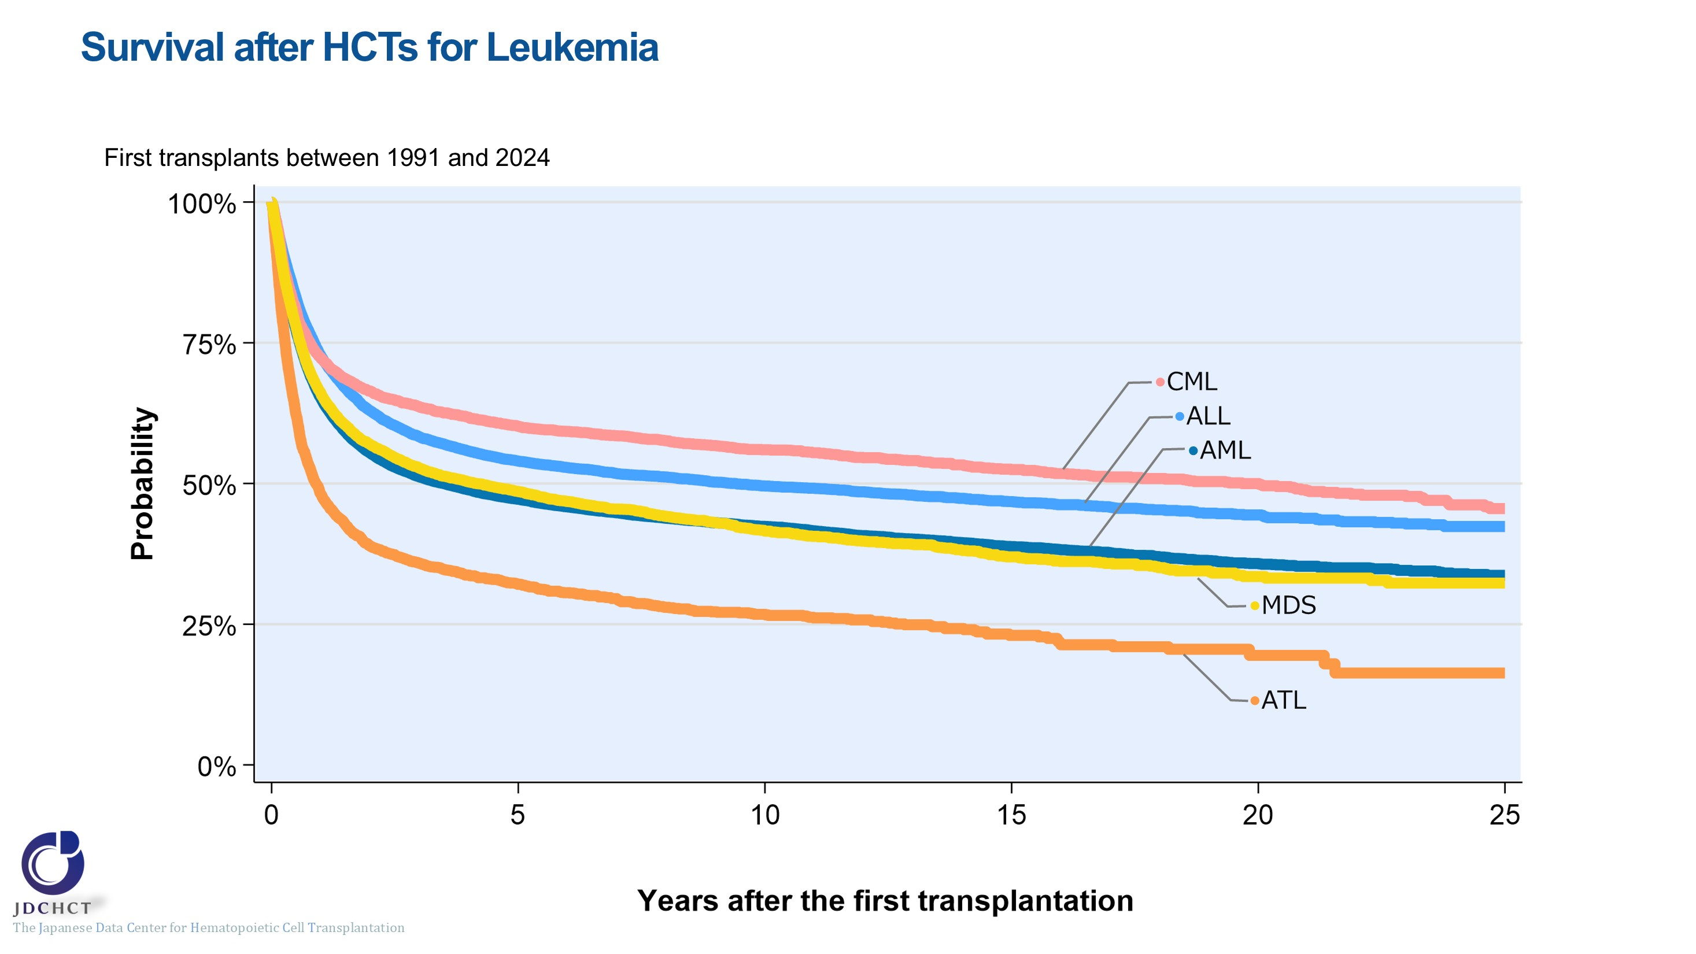
Survival after HCTs for Leukemia
Notes:
Among patients who underwent autologous or allogeneic transplantation for leukemia between 1991 and 2024, the 10-year probabilities (95%CI) of survival following transplant are:
・Acute myeloid leukemia (N=29,581) 42% (42-43%)
・Acute lymphoblastic leukemia (N=14,944) 50% (49-51%)
・Adult T-cell leukemia (N=3,246) 27% (25-29%)
・Chronic myelogenous leukemia (N=4,014) 56% (54-58%)
・Myelodysplastic syndrome (N=8,541) 42% (40-43%)

Slide 47
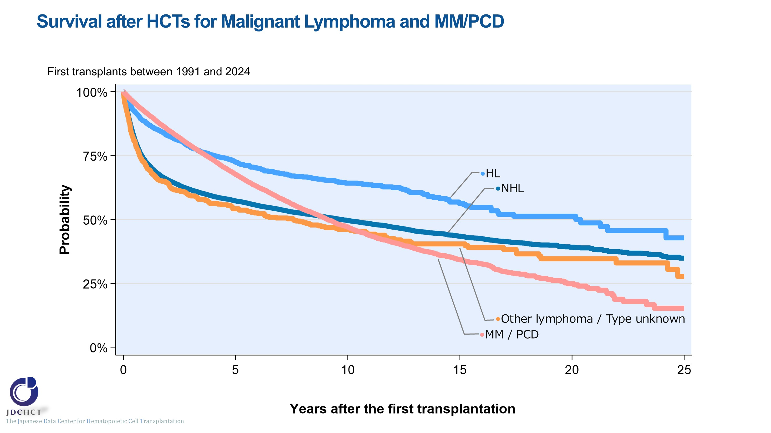
Survival after HCTs for Malignant Lymphoma and MM/PCD
Notes:
Among patients who underwent autologous or allogeneic transplantation for lymphoma or plasma cell neoplasms including multiple myeloma between 1991 and 2024, the 10-year probabilities (95%CI) of survival following transplant are:
・Non-Hodgkin lymphoma (N=26,963) 50% (49-50%)
・Hodgkin lymphoma (N=1,963) 64% (62-67%)
・Plasma cell neoplasms including multiple myeloma (N=15,459) 47% (46-48%)

Slide 48
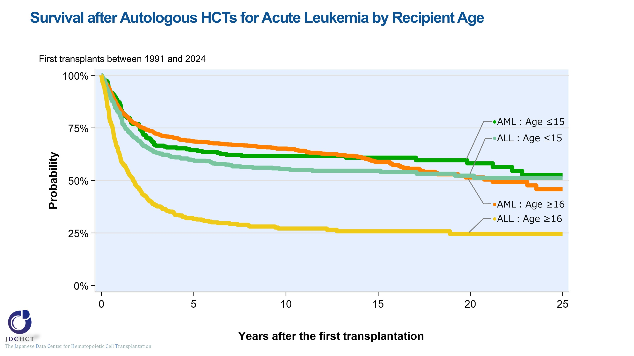
Survival after Autologous HCTs for Acute Leukemia by Recipient Age
Notes:
Among patients who underwent autologous transplantation for acute myeloid leukemia between 1991 and 2024, the 10-year probabilities (95%CI) of survival following transplant are:
・Those aged 0 to 15 years (N=237) 62% (55-68%)
・Those aged 16 years or older (N=1,590) 65% (63-68%)
Among patients who underwent autologous transplantation for acute lymphoblastic leukemia between 1991 and 2024, the 10-year probabilities (95%CI) of survival following transplant are:
・Those aged 0 to 15 years (N=393) 55% (50-60%)
・Those aged 16 years or older (N=351) 27% (22-32%)

Slide 49
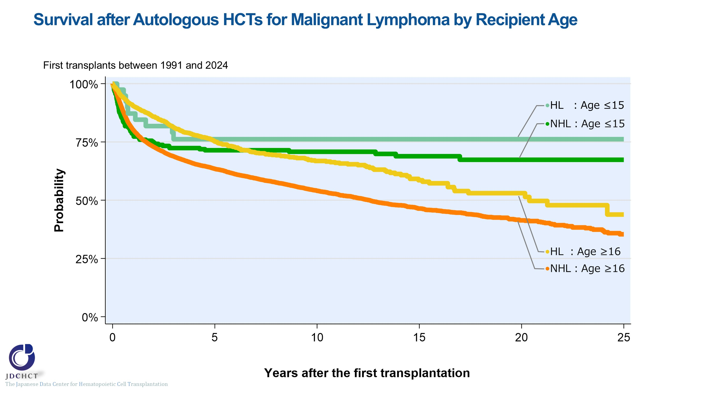
Survival after Autologous HCTs for Malignant Lymphoma by Recipient Age
Notes:
Among patients who underwent autologous transplantation for non-Hodgkin lymphoma between 1991 and 2024, the 10-year probabilities (95%CI) of survival following transplant are:
・Recipients aged 0 to 15 years (N=226) 71% (64-76%)
・Recipients 16 years or older (N=18,766) 54% (53-55%)
Among patients who underwent autologous transplantation for Hodgkin lymphoma between 1991 and 2024, the 10-year probabilities (95%CI) of survival following transplant are:
・Recipients aged 0 to 15 years (N=39) 76% (59-87%)
・Recipients aged 16 years or older (N=1,741) 67% (64-70%)

Slide 50
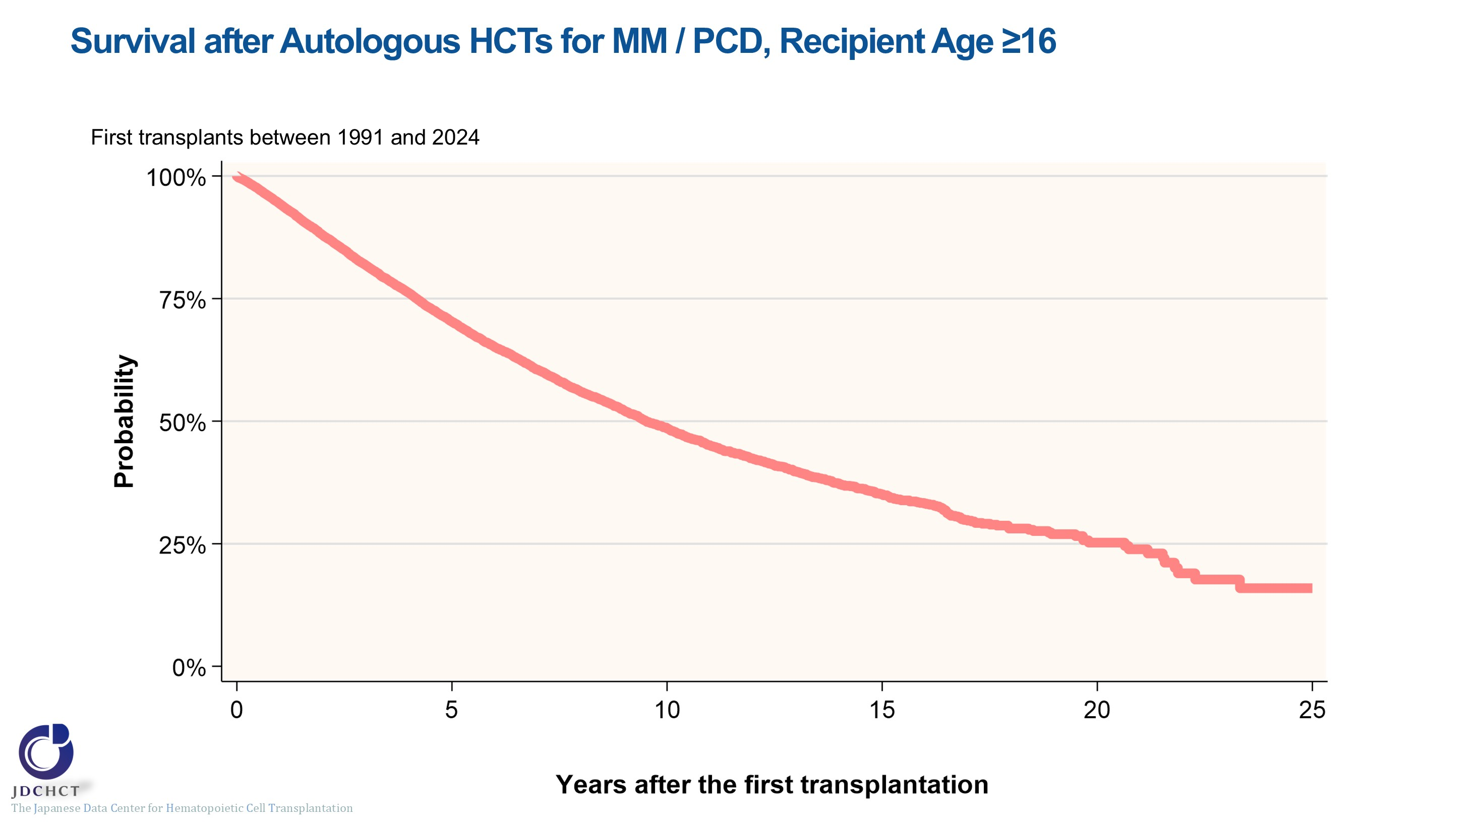
Survival after Autologous HCTs for MM / PCD, Recipient Age ≥16
Notes:
In plasma cell neoplasms including multiple myeloma, the number of first autologous transplants registered from 1991 to 2024 is 14,455 in recipients aged 16 years or older. The 5-year and 10-year probabilities (95%CI) of survival following transplant are 70% (69-71%) and 49% (47-50%) , respectively.

Slide 51

Survival after Allogeneic HCTs for AML by Donor Type and Graft Source,
Recipient Age ≤15
Notes:
Among patients aged 0 to 15 years who underwent allogeneic transplantation for acute myeloid leukemia between 2015 and 2024, the 5-year probabilities (95%CI) of survival following transplant according by donor type and stem cell source are:
・Bone marrow transplantation from related donors (N=150) 62% (54-70%)
・Peripheral blood stem cell transplantation from related donors (N=104) 54% (43-64%)
・Bone marrow transplantation from unrelated donors (N=133) 66% (56-74%)
・Cord blood transplantation from unrelated donors (N=275) 61% (53-67%)

Slide 52

Survival after Allogeneic HCTs for AML by Donor Type and Graft Source,
Recipient Age ≥16
Notes:
Among patients aged 16 years or older who underwent allogeneic transplantation for acute myeloid leukemia between 2015 and 2024, the 5-year probabilities (95%CI) of survival following transplant according by donor type and stem cell source are:
・Bone marrow transplantation from related donors (N=444) 56% (51-61%)
・Peripheral blood stem cell transplantation from related donors (N=3,129) 48% (46-50%)
・Bone marrow transplantation from unrelated donors (N=2,802) 52% (50-54%)
・Cord blood transplantation from unrelated donors (N=4,610) 47% (46-49%)

Slide 53

Survival after HLA-identical Sibling donor HCTs for AML by Disease Status,
Recipient Age ≤15
Notes:
Among patients aged 0 to 15 years receiving a HLA-matched sibling donor transplant for acute myeloid leukemia between 2015 and 2024, the 5-year probabilities (95%CI) of survival following transplant according to disease status are:
・Standard risk group (N=61) 80% (67-88%)
・Advanced risk group (N=28) 43% (25-60%)
―≪Disease risk status at transplantation≫―――
■Standard Risk Group : first complete remission [1CR]／second complete remission [2CR]
■Advanced Risk Group：third or more complete remission [≥3CR]／primary induction failure [PIF]／untreated／relapse
―――――――――――――――――――――――

Slide 54

Survival after HLA-identical Sibling donor HCTs for AML by Disease Status,
Recipient Age ≥16
Notes:
Among patients aged 16 years or older receiving a HLA-matched sibling donor transplant for acute myeloid leukemia between 2015 and 2024, the 5-year probabilities (95%CI) of survival following transplant according to disease status are:
・Standard risk group (N=1,133) 65% (61-68%)
・Advanced risk group (N=518) 31% (27-35%)
―≪Disease risk status at transplantation≫―――
■Standard Risk Group : first complete remission [1CR]／second complete remission [2CR]
■Advanced Risk Group：third or more complete remission [≥3CR]／primary induction failure [PIF]／untreated／relapse
―――――――――――――――――――――――

Slide 55

Survival after UR-BMT for AML by Disease Status,
Recipient Age ≤15
Notes:
Among patients aged 0 to 15 years receiving a bone marrow transplant from unrelated donors for acute myeloid leukemia between 2015 and 2024, the 5-year probabilities (95%CI) of survival following transplant according to disease status are:
・Standard risk group (N=92) 77% (66-84%)
・Advanced risk group (N=41) 42% (26-57%)
―≪Disease risk status at transplantation≫―――
■Standard Risk Group : first complete remission [1CR]／second complete remission [2CR]
■Advanced Risk Group：third or more complete remission [≥3CR]／primary induction failure [PIF]／untreated／relapse
―――――――――――――――――――――――

Slide 56

Survival after UR-BMT for AML by Disease Status,
Recipient Age ≥16
Notes:
Among patients aged 16 years or older receiving a bone marrow transplant from unrelated donors for acute myeloid leukemia between 2015 and 2024, the 5-year probabilities (95%CI) of survival following transplant according to disease status are:
・Standard risk group (N=1,991) 62% (60-64%)
・Advanced risk group (N=806) 27% (24-30%)
―≪Disease risk status at transplantation≫―――
■Standard Risk Group : first complete remission [1CR]／second complete remission [2CR]
■Advanced Risk Group：third or more complete remission [≥3CR]／primary induction failure [PIF]／untreated／relapse
―――――――――――――――――――――――

Slide 57

Survival after UR-CBT for AML by Disease Status,
Recipient Age ≤15
Notes:
Among patients aged 0 to 15 years receiving a cord blood transplant from unrelated donors for acute myeloid leukemia between 2015 and 2024, the 5-year probabilities (95%CI) of survival following transplant according to disease status are:
・Standard risk group (N=192) 74% (66-81%)
・Advanced risk group (N=83) 28% (18-40%)
―≪Disease risk status at transplantation≫―――
■Standard Risk Group : first complete remission [1CR]／second complete remission [2CR]
■Advanced Risk Group：third or more complete remission [≥3CR]／primary induction failure [PIF]／untreated／relapse
―――――――――――――――――――――――

Slide 58

Survival after UR-CBT for AML by Disease Status,
Recipient Age ≥16
Notes:
Among patients aged 16 years or older receiving a cord blood transplant from unrelated donors for acute myeloid leukemia between 2015 and 2024, the 5-year probabilities (95%CI) of survival following transplant according to disease status are:
・Standard risk group (N=2,402) 62% (60-64%)
・Advanced risk group (N=2,207) 31% (29-33%)
―≪Disease risk status at transplantation≫―――
■Standard Risk Group : first complete remission [1CR]／second complete remission [2CR]
■Advanced Risk Group：third or more complete remission [≥3CR]／primary induction failure [PIF]／untreated／relapse
―――――――――――――――――――――――

Slide 59

Survival after Allogeneic HCTs for ALL by Donor Type and Graft Source,
Recipient Age ≤15
Notes:
Among patients aged 0 to 15 years who underwent allogeneic transplantation for acute lymphoblastic leukemia between 2015 and 2024, the 5-year probabilities (95%CI) of survival following transplant according by donor type and stem cell source are:
・Bone marrow transplantation from related donors (N=178) 74% (67-81%)
・Peripheral blood stem cell transplantation from related donors (N=101) 44% (33-55%)
・Bone marrow transplantation from unrelated donors (N=203) 72% (65-79%)
・Cord blood transplantation from unrelated donors (N=349) 78% (73-83%)

Slide 60

Survival after Allogeneic HCTs for ALL by Donor Type and Graft Source,
Recipient Age ≥16
Notes:
Among patients aged 16 years or older who underwent allogeneic transplantation for acute lymphoblastic leukemia between 2015 and 2024, the 5-year probabilities (95%CI) of survival following transplant according by donor type and stem cell source are:
・Bone marrow transplantation from related donors (N=269) 72% (65-77%)
・Peripheral blood stem cell transplantation from related donors (N=1,234) 61% (58-64%)
・Bone marrow transplantation from unrelated donors (N=1,369) 65% (62-67%)
・Cord blood transplantation from unrelated donors (N=1,286) 60% (57-63%)

Slide 61

Survival after HLA-identical Sibling donor HCTs for ALL by Disease risk status,
Recipient Age ≤15
Notes:
Among patients aged 0 to 15 years receiving a HLA-matched sibling donor transplant for acute lymphoblastic leukemia between 2015 and 2024, the 5-year probabilities (95%CI) of survival following transplant according to disease status are:
・Standard risk group (N=49) 84% (70-92%)
・Advanced risk group (N=60) 65% (50-77%)
―≪Disease risk status at transplantation≫―――
■Standard Risk Group : first complete remission [1CR]
■Advanced Risk Group : second or more complete remission [≥2CR]／primary induction failure [PIF]／PIF, extramedullary involvement only ／untreated／relapse
――――――――――――――――――――――――

Slide 62

Survival after HLA-identical Sibling donor HCTs for ALL by Disease Status,
Recipient Age ≥16
Notes:
Among patients aged 16 years or older receiving a HLA-matched sibling donor transplant for acute lymphoblastic leukemia between 2015 and 2024, the 5-year probabilities (95%CI) of survival following transplant according to disease status are:
・Standard risk group (N=637) 74% (70-78%)
・Advanced risk group (N=161) 44% (35-53%)
―≪Disease risk status at transplantation≫―――
■Standard Risk Group : first complete remission [1CR]
■Advanced Risk Group : second or more complete remission [≥2CR]／primary induction failure [PIF]／PIF, extramedullary involvement only／untreated／relapse
――――――――――――――――――――――――

Slide 63

Survival after UR-BMT for ALL by Disease Status,
Recipient Age ≤15
Notes:
Among patients aged 0 to 15 years receiving a bone marrow transplant from unrelated donors for acute lymphoblastic leukemia between 2015 and 2024, the 5-year probabilities (95%CI) of survival following transplant according to disease status are:
・Standard risk group (N=96) 83% (73-90%)
・Advanced risk group (N=107) 62% (50-71%)
―≪Disease risk status at transplantation≫―――
■Standard Risk Group : first complete remission [1CR]
■Advanced Risk Group : second or more complete remission [≥2CR]／primary induction failure [PIF]／PIF, extramedullary involvement only／untreated／relapse
――――――――――――――――――――――――

Slide 64

Survival after UR-BMT for ALL by Disease Status,
Recipient Age ≥16
Notes:
Among patients aged 16 years or older receiving a bone marrow transplant from unrelated donors for acute lymphoblastic leukemia between 2015 and 2024, the 5-year probabilities (95%CI) of survival following transplant according to disease status are:
・Standard risk group (N=1,074) 70% (67-73%)
・Advanced risk group (N=295) 44% (38-51%)
―≪Disease risk status at transplantation≫―――
■Standard Risk Group : first complete remission [1CR]
■Advanced Risk Group : second or more complete remission [≥2CR]／primary induction failure [PIF]／PIF, extramedullary involvement only／untreated／relapse
――――――――――――――――――――――――

Slide 65

Survival after UR-CBT for ALL by Disease Status,
Recipient Age ≤15
Notes:
Among patients aged 0 to 15 years receiving a cord blood transplant from unrelated donors for acute lymphoblastic leukemia between 2015 and 2024, the 5-year probabilities (95%CI) of survival following transplant according to disease status are:
・Standard risk group (N=150) 84% (76-90%)
・Advanced risk group (N=199) 74% (66-80%)
―≪Disease risk status at transplantation≫―――
■Standard Risk Group : first complete remission [1CR]
■Advanced Risk Group : second or more complete remission [≥2CR]／primary induction failure [PIF]／PIF, extramedullary involvement only／untreated／relapse
――――――――――――――――――――――――

Slide 66

Survival after UR-CBT for ALL by Disease Status,
Recipient Age ≥16
Notes:
Among patients aged 16 years or older receiving a cord blood transplant from unrelated donors for acute lymphoblastic leukemia between 2015 and 2024, the 5-year probabilities (95%CI) of survival following transplant according to disease status are:
・Standard risk group (N=839) 74% (70-77%)
・Advanced risk group (N=447) 34% (29-40%)
―≪Disease risk status at transplantation≫―――
■Standard Risk Group : first complete remission [1CR]
■Advanced Risk Group : second or more complete remission [≥2CR]／primary induction failure [PIF]／PIF, extramedullary involvement only／untreated／relapse
――――――――――――――――――――――――

Slide 67

Survival after Allogeneic HCTs for CML by Donor Type and Graft Source,
Recipient Age ≤15
Notes:
Among patients aged 0 to 15 years who underwent allogeneic transplantation for chronic myelogenous leukemia between 2015 and 2024, the 5-year probabilities (95%CI) of survival following transplant according by donor type and stem cell source are:
・Bone marrow transplantation / peripheral blood stem cell transplantation from related donors (N=14) 79% (47-93%)
・Bone marrow transplantation from unrelated donors (N=16) 74% (44-89%)
・Cord blood transplantation from unrelated donors (N=6) 100%

Slide 68

Survival after Allogeneic HCTs for CML by Donor Type and Graft Source,
Recipient Age ≥16
Notes:
Among patients aged 16 years or older who underwent allogeneic transplantation for chronic myelogenous leukemia between 2015 and 2024, the 5-year probabilities (95%CI) of survival following transplant according by donor type and stem cell source are:
・Bone marrow transplantation from related donors (N=25) 92% (71-98%)
・Peripheral blood stem cell transplantation from related donors (N=194) 67% (58-74%)
・Bone marrow transplantation from unrelated donors (N=213) 71% (64-77%)
・Cord blood transplantation from unrelated donors (N=176) 69% (60-75%)

Slide 69

Survival after HLA-identical Sibling donor HCTs for CML by Disease Status,
Recipient Age ≥16
Notes:
Among patients aged 16 years or older receiving a HLA-matched sibling donor transplant for chronic myelogenous leukemia between 2015 and 2024, the 5-year probabilities (95%CI) of survival following transplant according to disease status are:
・Standard risk group (N=50) 87% (67-95%)
・Advanced risk group (N=66) 66% (53-77%)
―≪Disease risk status at transplantation≫―――
■Standard Risk Group : complete hematologic response (CHR) ／first chronic phase[1CP]
■Advanced Risk Group : second or more chronic phase [≥2CP]／accelerated phase [AP]／blast crisis [BC]
―――――――――――――――――――――――

Slide 70

Survival after UR-BMT for CML by Disease Status,
Recipient Age ≥16
Notes:
Among patients aged 16 years or older receiving a bone marrow transplant from unrelated donors for chronic myelogenous leukemia between 2015 and 2024, the 5-year probabilities (95%CI) of survival following transplant according to disease status are:
・Standard risk group (N=95) 74% (63-83%)
・Advanced risk group (N=118) 69% (59-77%)
―≪Disease risk status at transplantation≫―――
■Standard Risk Group : complete hematologic response (CHR) ／first chronic phase[1CP]
■Advanced Risk Group : second or more chronic phase [≥2CP]／accelerated phase [AP]／blast crisis [BC]
―――――――――――――――――――――――

Slide 71

Survival after UR-CBT for CML by Disease Status,
Recipient Age ≥16
Notes:
Among patients aged 16 years or older receiving a cord blood transplant from unrelated donors for chronic myelogenous leukemia between 2015 and 2024, the 5-year probabilities (95%CI) of survival following transplant according to disease status are:
・Standard risk group (N=66) 81% (69-89%)
・Advanced risk group (N=110) 62% (51-71%)
―≪Disease risk status at transplantation≫―――
■Standard Risk Group : complete hematologic response (CHR) ／first chronic phase[1CP]
■Advanced Risk Group : second or more chronic phase [≥2CP]／accelerated phase [AP]／blast crisis [BC]
―――――――――――――――――――――――

Slide 72

Survival after Allogeneic HCTs for MDS by Donor Type and Graft Source,
Recipient Age ≤15
Notes:
Among patients aged 0 to 15 years who underwent allogeneic transplantation for myelodysplastic syndrome between 2015 and 2024, the 5-year probabilities (95%CI) of survival following transplant according by donor type and stem cell source are:
・Bone marrow transplantation from related donors (N=58) 91% (79-96%)
・Peripheral blood stem cell transplantation from related donors (N=12) 82% (45-95%)
・Bone marrow transplantation from unrelated donors (N=116) 76% (66-84%)
・Cord blood transplantation from unrelated donors (N=38) 83% (65-92%)

Slide 73

Survival after Allogeneic HCTs for MDS by Donor Type and Graft Source,
Recipient Age ≥16
Notes:
Among patients aged 16 years or older who underwent allogeneic transplantation for myelodysplastic syndrome between 2015 and 2024, the 5-year probabilities (95%CI) of survival following transplant according by donor type and stem cell source are:
・Bone marrow transplantation from related donors (N=173) 48% (40-56%)
・Peripheral blood stem cell transplantation from related donors (N=981) 47% (43-50%)
・Bone marrow transplantation from unrelated donors (N=1,425) 47% (44-50%)
・Cord blood transplantation from unrelated donors (N=1,294) 45% (42-48%)

Slide 74

Survival after HLA-identical Sibling donor HCTs for MDS by Disease Status,
Recipient Age ≤15
Notes:
Among patients aged 0 to 15 years receiving a HLA-matched sibling donor transplant for myelodysplastic syndrome between 2015 and 2024, the 5-year probabilities (95%CI) of survival following transplant according to disease status are:
・Standard risk group (N=29) 93% (75-98%)
・Advanced risk group (N=6) 67% (20-90%)
―≪Disease risk status at transplantation≫―――
■Standard Risk Group
WHO 2017 classification : MDS with single lineage dysplasia／MDS-RS and single lineage dysplasia／MDS-RS and multilineage dysplasia／MDS with multilineage dysplasia／MDS with isolated del (5q) ／MDS, unclassifiable／Refractory cytopenia of childhood (provisional entity)
WHO old classification, FAB classification：RA／RARS／RCMD／RCMD-RS／5q-syndrome
■Advanced Risk Group
WHO 2017 classification : MDS with excess blasts-1 (MDS-EB-1) ／MDS with excess blasts-2 (MDS-EB-2)
WHO old classification, FAB classification : RAEB／RAEBt／RAEB-1／RAEB-2
―――――――――――――――――――――――

Slide 75

Survival after HLA-identical Sibling donor HCTs for MDS by Disease Status,
Recipient Age ≥16
Notes:
Among patients aged 16 years or older receiving a HLA-matched sibling donor transplant for myelodysplastic syndrome between 2015 and 2024, the 5-year probabilities (95%CI) of survival following transplant according to disease status are:
・Standard risk group (N=174) 60% (52-68%)
・Advanced risk group (N=304) 48% (42-54%)
―≪Disease risk status at transplantation≫―――
■Standard Risk Group
WHO 2017 classification : MDS with single lineage dysplasia／MDS-RS and single lineage dysplasia／MDS-RS and multilineage dysplasia／MDS with multilineage dysplasia／MDS with isolated del (5q) ／MDS, unclassifiable／Refractory cytopenia of childhood (provisional entity)
WHO old classification, FAB classification：RA／RARS／RCMD／RCMD-RS／5q-syndrome
■Advanced Risk Group
WHO 2017 classification : MDS with excess blasts-1 (MDS-EB-1) ／MDS with excess blasts-2 (MDS-EB-2)
WHO old classification, FAB classification : RAEB／RAEBt／RAEB-1／RAEB-2
―――――――――――――――――――――――

Slide 76

Survival after UR-BMT for MDS by Disease Status,
Recipient Age ≤15
Notes:
Among patients aged 0 to 15 years receiving a bone marrow transplant from unrelated donors for myelodysplastic syndrome between 2015 and 2024, the 5-year probabilities (95%CI) of survival following transplant according to disease status are:
・Standard risk group (N=67) 87% (75-94%)
・Advanced risk group (N=32) 56% (31-76%)
―≪Disease risk status at transplantation≫―――
■Standard Risk Group
WHO 2017 classification : MDS with single lineage dysplasia／MDS-RS and single lineage dysplasia／MDS-RS and multilineage dysplasia／MDS with multilineage dysplasia／MDS with isolated del (5q) ／MDS, unclassifiable／Refractory cytopenia of childhood (provisional entity)
WHO old classification, FAB classification：RA／RARS／RCMD／RCMD-RS／5q-syndrome
■Advanced Risk Group
WHO 2017 classification : MDS with excess blasts-1 (MDS-EB-1) ／MDS with excess blasts-2 (MDS-EB-2)
WHO old classification, FAB classification : RAEB／RAEBt／RAEB-1／RAEB-2
―――――――――――――――――――――――

Slide 77

Survival after UR-BMT for MDS by Disease Status,
Recipient Age ≥16
Notes:
Among patients aged 16 years or older receiving a bone marrow transplant from unrelated donors for myelodysplastic syndrome between 2015 and 2024, the 5-year probabilities (95%CI) of survival following transplant according to disease status are:
・Standard risk group (N=482) 52% (47-57%)
・Advanced risk group (N=891) 43% (40-47%)
―≪Disease risk status at transplantation≫―――
■Standard Risk Group
WHO 2017 classification : MDS with single lineage dysplasia／MDS-RS and single lineage dysplasia／MDS-RS and multilineage dysplasia／MDS with multilineage dysplasia／MDS with isolated del (5q) ／MDS, unclassifiable／Refractory cytopenia of childhood (provisional entity)
WHO old classification, FAB classification：RA／RARS／RCMD／RCMD-RS／5q-syndrome
■Advanced Risk Group
WHO 2017 classification : MDS with excess blasts-1 (MDS-EB-1) ／MDS with excess blasts-2 (MDS-EB-2)
WHO old classification, FAB classification : RAEB／RAEBt／RAEB-1／RAEB-2
―――――――――――――――――――――――

Slide 78

Survival after UR-CBT for MDS by Disease Status,
Recipient Age ≤15
Notes:
Among patients aged 0 to 15 years receiving a cord blood transplant from unrelated donors for myelodysplastic syndrome between 2015 and 2024, the 5-year probabilities (95%CI) of survival following transplant according to disease status are:
・Standard risk group (N=14) 84% (50-96%)
・Advanced risk group (N=19) 76% (48-90%)
―≪Disease risk status at transplantation≫―――
■Standard Risk Group
WHO 2017 classification : MDS with single lineage dysplasia／MDS-RS and single lineage dysplasia／MDS-RS and multilineage dysplasia／MDS with multilineage dysplasia／MDS with isolated del (5q) ／MDS, unclassifiable／Refractory cytopenia of childhood (provisional entity)
WHO old classification, FAB classification：RA／RARS／RCMD／RCMD-RS／5q-syndrome
■Advanced Risk Group
WHO 2017 classification : MDS with excess blasts-1 (MDS-EB-1) ／MDS with excess blasts-2 (MDS-EB-2)
WHO old classification, FAB classification : RAEB／RAEBt／RAEB-1／RAEB-2
―――――――――――――――――――――――

Slide 79

Survival after UR-CBT for MDS by Disease Status,
Recipient Age ≥16
Notes:
Among patients aged 16 years or older receiving a cord blood transplant from unrelated donors for myelodysplastic syndrome between 2015 and 2024, the 5-year probabilities (95%CI) of survival following transplant according to disease status are:
・Standard risk group (N=387) 49% (44-55%)
・Advanced risk group (N=867) 43% (39-47%)
―≪Disease risk status at transplantation≫―――
■Standard Risk Group
WHO 2017 classification : MDS with single lineage dysplasia／MDS-RS and single lineage dysplasia／MDS-RS and multilineage dysplasia／MDS with multilineage dysplasia／MDS with isolated del (5q) ／MDS, unclassifiable／Refractory cytopenia of childhood (provisional entity)
WHO old classification, FAB classification：RA／RARS／RCMD／RCMD-RS／5q-syndrome
■Advanced Risk Group
WHO 2017 classification : MDS with excess blasts-1 (MDS-EB-1) ／MDS with excess blasts-2 (MDS-EB-2)
WHO old classification, FAB classification : RAEB／RAEBt／RAEB-1／RAEB-2
―――――――――――――――――――――――

Slide 80

Survival after Allogeneic HCTs for NHL by Donor Type and Graft Source,
Recipient Age ≤15
Notes:
Among patients aged 0 to 15 years who underwent allogeneic transplantation for non-Hodgkin lymphoma between 2015 and 2024, the 5-year probabilities (95%CI) of survival following transplant according by donor type and stem cell source are:
・Bone marrow transplantation from related donors (N=24) 75% (53-88%)
・Peripheral blood stem cell transplantation from related donors (N=22) 48% (25-67%)
・Bone marrow transplantation from unrelated donors (N=31) 69% (48-83%)
・Cord blood transplantation from unrelated donors (N=41) 74% (56-85%)

Slide 81

Survival after Allogeneic HCTs for NHL by Donor Type and Graft Source,
Recipient Age ≥16
Notes:
Among patients aged 16 years or older who underwent allogeneic transplantation for non-Hodgkin lymphoma between 2015 and 2024, the 5-year probabilities (95%CI) of survival following transplant according by donor type and stem cell source are:
・Bone marrow transplantation from related donors (N=118) 53% (43-62%)
・Peripheral blood stem cell transplantation from related donors (N=1,056) 42% (38-45%)
・Bone marrow transplantation from unrelated donors (N=592) 51% (46-55%)
・Cord blood transplantation from unrelated donors (N=1,136) 40% (37-43%)

Slide 82

Survival after HLA-identical Sibling donor HCTs for NHL by Disease Status,
Recipient Age ≥16
Notes:
Among patients aged 16 years or older receiving a HLA-matched sibling donor transplant for non-Hodgkin lymphoma between 2015 and 2024, the 5-year probabilities (95%CI) of survival following transplant according to disease status are:
・CR (N=159) 67% (59-75%)
・PR (N=111) 57% (46-66%)
・Untreated/Primary induction failure (PIF) /Relapse (N=223) 32% (25-38%)

Slide 83

Survival after UR-BMT for NHL by Disease Status,
Recipient Age ≤15
Notes:
Among patients aged 0 to 15 years receiving a bone marrow transplant from unrelated donors for non-Hodgkin lymphoma between 2015 and 2024, the 5-year probabilities (95%CI) of survival following transplant according to disease status are:
・CR/PR (N=18) 65% (37-83%)
・Untreated/Primary induction failure (PIF) /Relapse (N=13) 76% (43-92%)

Slide 84

Survival after UR-BMT for NHL by Disease Status,
Recipient Age ≥16
Notes:
Among patients aged 16 years or older receiving a bone marrow transplant from unrelated donors for non-Hodgkin lymphoma between 2015 and 2024, the 5-year probabilities (95%CI) of survival following transplant according to disease status are:
・CR (N=268) 59% (53-65%)
・PR (N=129) 52% (42-61%)
・Untreated/Primary induction failure (PIF) /Relapse (N=195) 37% (30-45%)

Slide 85

Survival after UR-CBT for NHL by Disease Status,
Recipient Age ≤15
Notes:
Among patients aged 0 to 15 years receiving a cord blood transplant from unrelated donors for non-Hodgkin lymphoma between 2015 and 2024, the 5-year probabilities (95%CI) of survival following transplant according to disease status are:
・CR/PR (N=27) 79% (53-91%)
・Untreated/Primary induction failure (PIF) /Relapse (N=14) 64% (33-83%)

Slide 86

Survival after UR-CBT for NHL by Disease Status,
Recipient Age ≥16
Notes:
Among patients aged 16 years or older receiving a cord blood transplant from unrelated donors for non-Hodgkin lymphoma between 2015 and 2024, the 5-year probabilities (95%CI) of survival following transplant according to disease status are:
・CR (N=328) 57% (51-63%)
・PR (N=254) 44% (37-50%)
・Untreated/Primary induction failure (PIF) /Relapse (N=553) 29% (25-33%)

Slide 87

Survival after Autologous HCTs for MM / PCD,
Recipient Age ≥16
Notes:
In plasma cell neoplasms including multiple myeloma, the number of autologous transplants registered from 2015 to 2024 is 8,109 in recipients aged 16 years or older.
The 5-year probability (95%CI) of survival following transplant is 80% (79-81%) .

Slide 88

Survival after Allogeneic HCTs for MM / PCD by Donor Type and Graft Source,
Recipient Age ≥16
Notes:
Among patients aged 16 years or older who underwent allogeneic transplantation for plasma cell neoplasms including multiple myeloma between 2015 and 2024, the 5-year probabilities (95%CI) of survival following transplant according by donor type and stem cell source are:
・Bone marrow transplantation / peripheral blood stem cell transplantation from related donors (N=88) 34% (23-45%)
・Bone marrow transplantation from unrelated donors (N=98) 47% (37-57%)
・Cord blood transplantation from unrelated donors (N=65) 18% (9-31%)

Slide 89

Survival after Autologous HCTs for MM / PCD by Disease Status,
Recipient Age ≥16
Notes:
Among patients aged 16 years or older receiving an autologous transplant for plasma cell neoplasms including multiple myeloma between 2015 and 2024, the 5-year probabilities (95%CI) of survival following transplant according to disease status are:
・CR/sCR (N=2,067) 84% (82-86%)
・VGPR (N=2,709) 80% (78-82%)
・PR (N=2,361) 77% (75-79%)
・SD (N=163) 68% (59-76%)
・PD/Relapse (N=147) 36% (27-46%)

Slide 90

Survival after Allogeneic HCTs for MM / PCD by Disease Status,
Recipient Age ≥16
Notes:
Among patients aged 16 years or older receiving an allogeneic transplant for plasma cell neoplasms including multiple myeloma between 2015 and 2024, the 5-year probabilities (95%CI) of survival following transplant according to disease status are:
・CR/sCR/VGPR/PR (N=193) 45% (37-52%)
・SD/PD/Relapse (N=73) 11% (5-21%)

Slide 91

Survival after HLA-identical Sibling donor HCTs for MM / PCD by Disease Status, Recipient Age ≥16
Notes:
Among patients aged 16 years or older receiving a HLA-matched sibling donor transplant for plasma cell neoplasms including multiple myeloma between 2015 and 2024, the 5-year probabilities (95%CI) of survival following transplant according to disease status are:
・CR/sCR/VGPR/PR (N=35) 46% (27-62%)

Slide 92

Survival after UR-BMT for MM / PCD by Disease Status,
Recipient Age ≥16
Notes:
Among patients aged 16 years or older receiving a bone marrow transplant from unrelated donors for plasma cell neoplasms including multiple myeloma between 2015 and 2024, the 5-year probabilities (95%CI) of survival following transplant according to disease status are:
・CR/sCR/VGPR/PR (N=71) 59% (46-69%)
・SD/PD/Relapse (N=23) 18% (5-37%)

Slide 93

Survival after UR-CBT for MM / PCD by Disease Status,
Recipient Age ≥16
Notes:
Among patients aged 16 years or older receiving a cord blood transplant from unrelated donors for plasma cell neoplasms including multiple myeloma between 2015 and 2024, the 5-year probabilities (95%CI) of survival following transplant according to disease status are:
・CR/sCR/VGPR/PR (N=36) 29% (13-46%)

Slide 94

Survival after Allogeneic HCTs for AA by Donor Type and Graft Source,
Recipient Age ≤15
Notes:
Among patients aged 0 to 15 years who underwent allogeneic transplantation for aplastic anemia between 2015 and 2024, the 5-year probabilities (95%CI) of survival following transplant according by donor type and stem cell source are:
・Bone marrow transplantation from related donors (N=117) 96% (91-99%)
・Peripheral blood stem cell transplantation from related donors (N=9) 89% (43-98%)
・Bone marrow transplantation from unrelated donors (N=135) 94% (88-97%)
・Cord blood transplantation from unrelated donors (N=31) 100%

Slide 95

Survival after Allogeneic HCTs for AA by Donor Type and Graft Source,
Recipient Age ≥16
Notes:
Among patients aged 16 years or older who underwent allogeneic transplantation for aplastic anemia between 2015 and 2024, the 5-year probabilities (95%CI) of survival following transplant according by donor type and stem cell source are:
・Bone marrow transplantation from related donors (N=176) 86% (79-91%)
・Peripheral blood stem cell transplantation from related donors (N=105) 76% (66-84%)
・Bone marrow transplantation from unrelated donors (N=209) 79% (73-85%)
・Cord blood transplantation from unrelated donors (N=114) 69% (59-77%)

Slide 96

Survival after Allogeneic HCTs for AA by Donor Type and Graft Source,
Recipient Age ≤15
Notes:
Among patients aged 0 to 15 years who underwent allogeneic transplantation for aplastic anemia between 2015 and 2024, the 5-year probabilities (95%CI) of survival following transplant according by donor type and stem cell source are:
・HLA-matched sibling donor transplantation (N=80) 97% (90-99%)
・Bone marrow transplantation from unrelated donors (N=135) 94% (88-97%)
・Cord blood transplantation from unrelated donors (N=31) 100%

Slide 97

Survival after Allogeneic HCTs for AA by Donor Type and Graft Source,
Recipient Age ≥16
Notes:
Among patients aged 16 years or older who underwent allogeneic transplantation for aplastic anemia between 2015 and 2024, the 5-year probabilities (95%CI) of survival following transplant according by donor type and stem cell source are:
・HLA-matched sibling donor transplantation (N=168) 85% (79-90%)
・Bone marrow transplantation from unrelated donors (N=209) 79% (73-85%)
・Cord blood transplantation from unrelated donors (N=114) 69% (59-77%)

